Slide 1
Azure IoT For Smart Bicycle

Slide 2
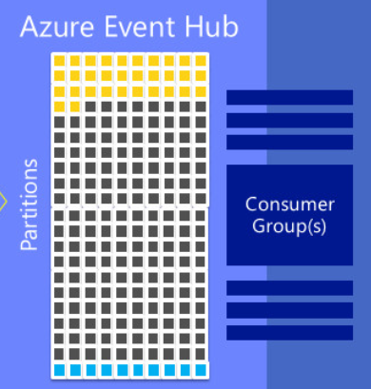
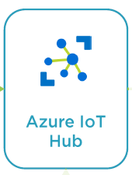


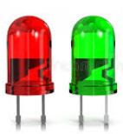
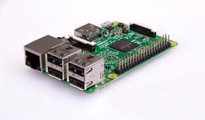
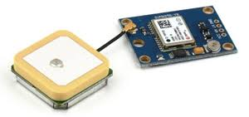
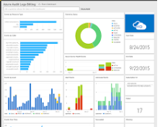

High Level Diagram
Webjob: IoTEventHandler
Storage Container
Device 2 Cloud Message
SmartDeviceAgent
Event Hub
Blob Storage
LED sensor
Cloud 2 Device Message
Rpi-3 with Win 10 IOT Core
gps sensor
Mobile App
Dashboard

Slide 3
Smart Device Agent : Field component
Application is responsible for communication with the IoT Hub
Using Microsoft.Azure.Device.Client library
Connect to the IoT Hub using connection string
Read parameters from the gps sensor through gpio/serial interface - <in a loop with specific frequency/when parameters change>
Convert the parameters into JSON
Send the Device to Cloud messages using SendEvent API
Register a callback for receiving Cloud to Device Messages

Slide 4
IoT Event Handler : Cloud component
This is a Webjob hosted in the cloud, using Azure App service
Responsible for receiving the messages from the device and keep them in cloud storage
  Uses the Azure Event Hub mechanism (Alternate solution: Azure Stream Analytics)
  Event hub internally stores the data in Azure Blob storage
  Events are processed in parallel using partitions
Sends Cloud to Device message as required
  Eg:- messages to unlock the bicycle

Slide 5
Mobile app, Dashboard
Mobile app
  Used to unlock the bicycle after reading a barcode from the bicycle/device
  Capable of doing user management
  Able to make reservation, payment etc
Dashboard
  TBD

Slide 6
Initialization Sequence
Azure SDK
Mobile App
GPS Sensor
Device Agent
Event Handler
CreateFromConnectionString(DeviceConnString)
Open device ()
OpenDevice()
Register for C2D Messages from Cloud
ReadParams()
Create an EventProcessorHost (Params:-ioTHub Conn string, storage conn string,
Storage container name, consumer grp name etc)
Register for D2C messages using IEventProcessor obj
Create an EventHubConfiguration and AddEventProcessorHost to it
Create a jobHostConfiguration and UseEventHub confugration created above
Create a web JobHost object using the JobHostConfiguration and Run it

Slide 7
D2C Sequence – Unlock Bicycle Scenario
Azure SDK
Mobile App
LED Sensor
Device Agent
Event Handler
Unlock Request
Prepare payload & SendMessage
D2C Msg Callback()
Verify Payload(unlock req) & SendCloudToDeviceMessage
C2D Msg Callback()
Unlock (Approved/Rejected)
Write(Green/Red)

Slide 8
Webjob deployment
Deployment of the EventHandler program can be done through Azure App service
  Use Visual Studio to publish the EventHandler program
  Choose an app service hosting plan
  Trigger the service manually once it is published in Azure

Slide 9
Samples
Bandagent – a client side implementation from pluralsight eg
Message processor – Event handler implementation from pluralsight eg.

Slide 10
Thank You

