Slide 1

CS3503 – Machine Learning PBL
Project Review
VAULT-API: Idempotent Payment Infrastructure with Explainable Transaction-Driven Merchant Churn Prediction
Presentation by
PRANAV KUMAR GATTUPALLI (2104251040699)
MONIKA P D (2104251040682)
Dept. of Computer Science and Engineering
Mentor
Dr. THIYAGARAJAN, Ph.D.
Associate Professor
Dept. of Computer Science and Engineering

Slide 2
Problem & Objectives
Problem Statement
Merchants disengage silently — there is no cancellation event, only payment attempts that stop. By the time the drop shows up in a revenue report, the merchant is already gone.
Standard churn models, including our base paper [1], learn from a static customer table: one row per customer, a churn label inherited with the dataset, and a random train/test split. That classifies a state which already exists — it does not forecast, and a random split on temporal data lets the model train on the future and test on the past.
Affected: payment platforms and their retention teams, who need a ranked list of which merchants are leaving — and why — weeks before they go.
Why it matters: only 4.0% of merchant-weeks are churn, so a model that always predicts “active” is 96.0% accurate and completely useless. The problem demands imbalance-aware metrics and per-merchant explanations.
Prerequisite solved first: retried HTTP requests that commit duplicate payment rows inflate the transaction-frequency features the model reads, so the ledger had to be made duplicate-free before any of this was measurable.
Objective
Reformulate churn as a forward-looking task: one row per merchant per week, a 90-day observation window, label = zero payment attempts in the next 60 days.
Engineer 12 leakage-safe RFM and payment-reliability features, and prove the leakage rules with tests rather than assuming them.
Train an XGBoost classifier under 4% class imbalance with scale_pos_weight, on chronological splits separated by purge gaps.
Benchmark against a majority classifier, a recency-only rule and an RFM-only model, so any gain is measured against the simpler explanation.
Explain every prediction with SHAP and serve it through a churn-risk endpoint.
Expected Outcome
A leakage-safe, explainable merchant-churn model that beats a recency-only rule on PR-AUC and F1 under heavy class imbalance.
Achieved — PR-AUC 0.289 and F1 0.346 on a test period scored once, against 0.240 / 0.315 for recency alone and a 0.040 positive-rate floor (7.2× the floor); ROC-AUC 0.895.
A ranked retention list that arrives with its reasons: GET /merchants/{id}/churn-risk returns churn_score, risk band and the top SHAP factors with their direction.
Supporting outcome: 50 concurrent duplicate requests commit exactly one payment row, which is what keeps the frequency features honest.

Slide 3
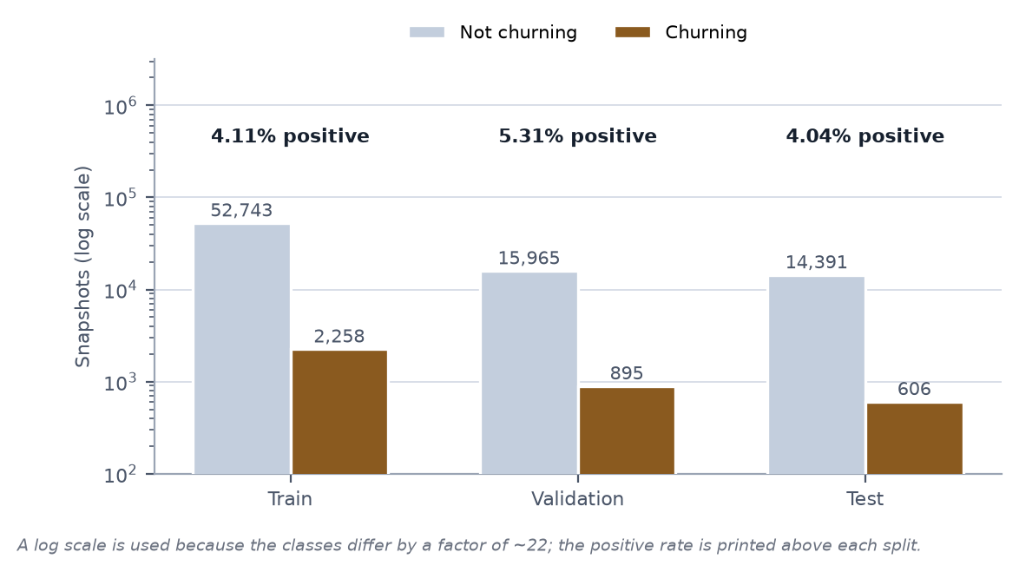
Input, Analysis & Insights
Input / Data Sources
Reproducible synthetic payment ledger — ml/synthetic/generate.py, fixed seed 42; no real merchant ledger was available.
2,000 merchants · 24 months (2024-06-30 → 2026-06-30) · 925,805 logical payments · 39,229 failed attempts (4.24%).
295 merchants (14.8%) churn, through gradual, abrupt and straggler disengagement modes, so the trajectories are not all alike.
Derived input: 116,464 eligible merchant × snapshot rows, 5,283 positive (4.54%); cadence 7 d, window 90 d, horizon 60 d.
12 features, all computed from ledger facts. industry is stored but withheld from the model — the generator assigns it, so it would be a shortcut.
Analysis / Processing
Weekly snapshots: walk each merchant forward in 7-day steps; at snapshot t use only payments with created_at ≤ t over the preceding 90 days, and look into (t, t + 60 d] for the label alone.
Eligibility: tenure ≥ 90 d, a full 60 d of data after t, and ≥ 1 attempt in the prior 60 d — keeping the population to merchants who have not already obviously left. FAILED attempts count as activity, not absence.
Chronological split with 9-week purge gaps — train 55,001 / validation 16,860 / test 14,997 rows — so no training label window overlaps a later decision point. Positive rate stays stable at 4.1% / 5.3% / 4.0%.
Imbalance handled by scale_pos_weight = 23.36 (train negatives ÷ positives) rather than SMOTEENN: reweighting leaves the temporal structure untouched.
Threshold 0.84 chosen on validation for F1, then frozen; the test split was scored exactly once.
Key Insights
Recency alone is a strong baseline — 0.240 PR-AUC against a 0.040 floor. Any model has to beat “hasn’t paid in a while.”
Trajectory earns its place: RFM + tenure lifts PR-AUC to 0.275. frequency_change separates a merchant falling from 30 payments to 8 from one who always made 8 — same recency, different future.
SHAP ranks tx_count_30d above recency_days: the model reads how much activity remains, not merely how long ago the last payment was.
Reliability features add +0.014 PR-AUC, but the merchant-grouped bootstrap CI [−0.002, +0.031] spans zero — reported as unresolved, not as a win.
A leakage test caught recency measured over the uncut frame — a bug that would have improved every metric in the report.
Class balance across the chronological splits — train / validation / test

Slide 4
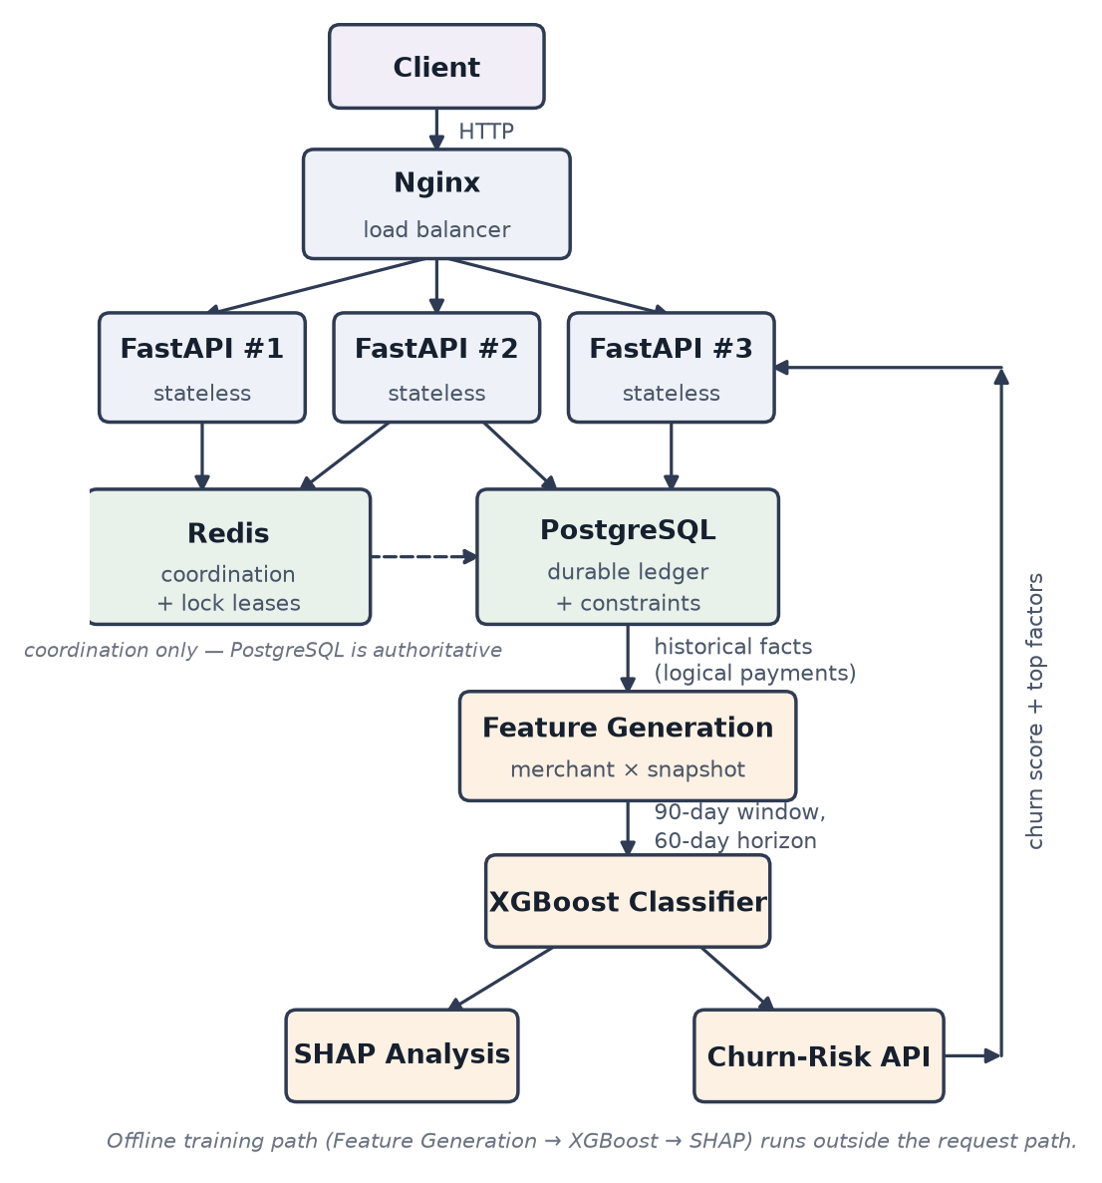
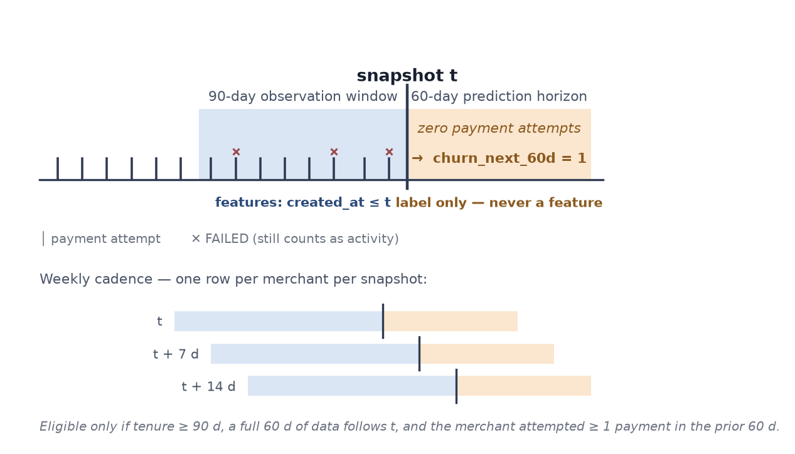
Technical Approach
Architecture
Nginx → 3 stateless FastAPI workers → Redis coordination + PostgreSQL ledger. The offline ML path (feature generation → XGBoost → SHAP) runs outside the request path and feeds the churn-risk API.
ML Methodology and Implementation Process
Pipeline: generate ledger → build merchant × snapshot features → chronological split with purge gaps → train XGBoost (scale_pos_weight 23.36) → freeze the threshold on validation → score the test split once → SHAP → serve GET /merchants/{id}/churn-risk.
Model D (selected): max_depth 3, learning_rate 0.05, n_estimators 300, min_child_weight 1, subsample 0.8, colsample_bytree 0.8, reg_lambda 1, reg_alpha 0.
Leakage control is the method, not a detail: features see created_at ≤ t only; the label alone may read (t, t + 60 d]; five tests enforce it.
Figure 4.1 — Target system architecture of vault-api
Technology Stack
ML: Python 3.12, XGBoost, SHAP, scikit-learn, pandas, NumPy
Serving: FastAPI, Pydantic v2, SQLAlchemy 2.x (async), Uvicorn
Infra: PostgreSQL 16, Redis 7, Nginx, Docker Compose, Alembic
Testing: pytest, pytest-asyncio, httpx; Parquet model artifacts
Figure 4.4 — Temporal formulation on one merchant timeline: 90-day window, 60-day forward label, weekly cadence

Slide 5
Feasibility, Risk and Challenges
Feasibility
No paid API, no cloud account and no dataset-access delay — the whole ledger regenerates from seed 42 in minutes.
116,464 × 12 tabular rows train with XGBoost in minutes on an 8 GB laptop CPU; no GPU is required anywhere in the pipeline.
The full stack — Nginx, three API workers, PostgreSQL and Redis — comes up from one docker-compose.yml on a single machine.
Reproducible by construction: xgboost_model.json plus model_metadata.json pin the feature order, window, horizon and frozen threshold.
Risk and Challenges
Label leakage — the largest ML risk, and one we hit. recency_days was first computed over the merchant’s whole history, so for exactly the merchants about to churn it read the future. It would have raised every score, and no metric would have revealed it.
Severe class imbalance — 4.0% positives, so accuracy is meaningless and ROC-AUC is visually optimistic with 14,391 negatives against 606 positives.
A trivially easy problem — our first generator produced data a recency threshold almost solved; a synthetic world can be accidentally separable.
Temporal structure — a shuffled split would place a merchant’s later snapshots in training and its earlier ones in test.
Unresolved effect size — the +0.014 PR-AUC from reliability features sits inside bootstrap noise at a single generator seed.
Uncalibrated output — churn_score orders merchants; it is not a probability.
Duplicate behavioural events — retried requests inflate transaction counts and corrupt the frequency features at source.
Mitigation
Five leakage tests, including the blunt one that caught the bug: insert a payment strictly after t and assert that no feature value changes.
scale_pos_weight instead of SMOTEENN, PR-AUC as the headline metric, and accuracy not reported at all.
Chronological splits with 9-week purge gaps, threshold frozen on validation, test split scored exactly once.
A four-model ladder (A–D) plus a merchant-grouped bootstrap, so a small gain is published with its confidence interval rather than as a headline.
Duplicates stopped at the database: a unique (merchant_id, idempotency_key) constraint is the authority, with Redis as coordination only.

Slide 6
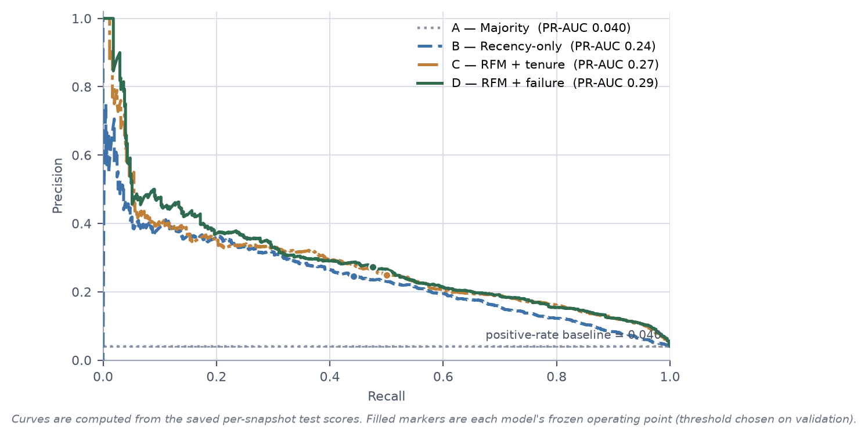
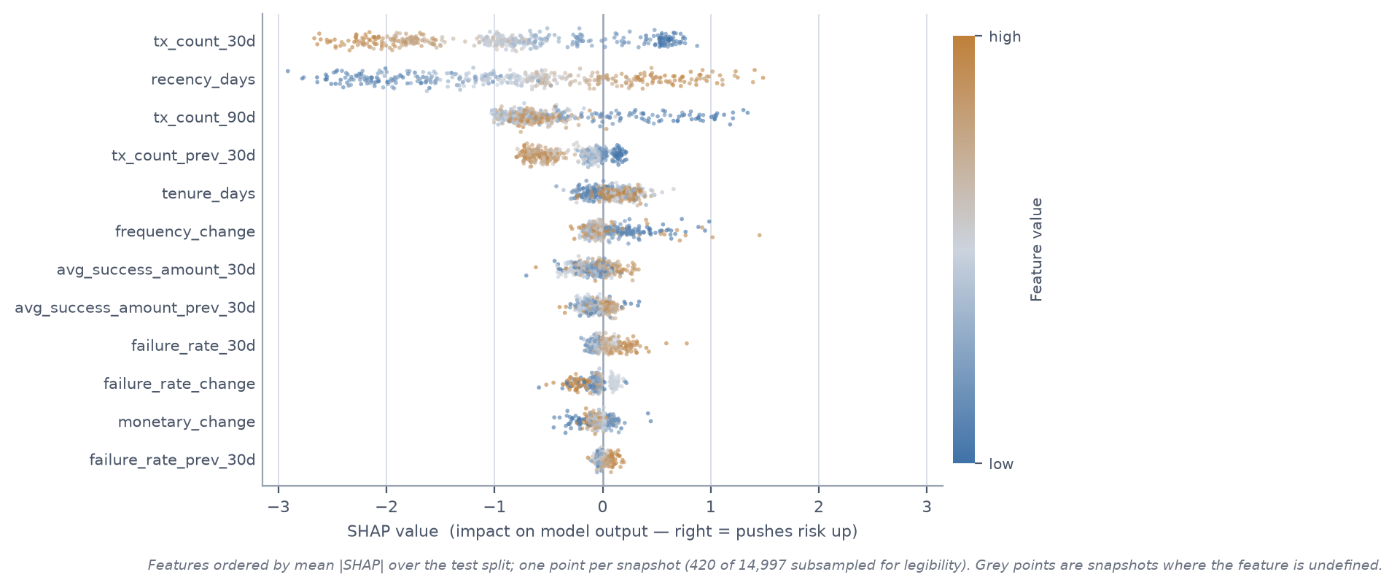
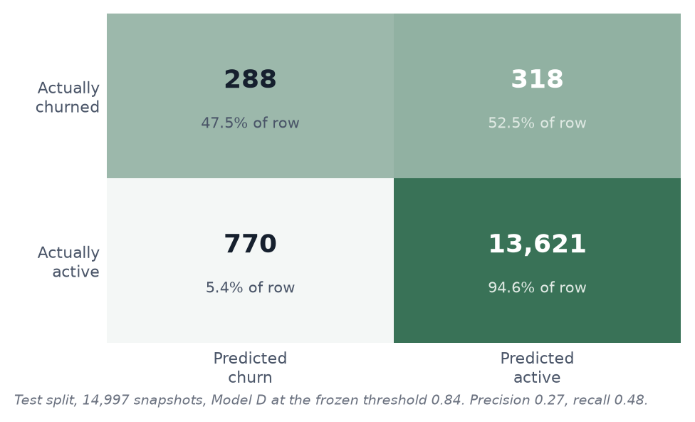
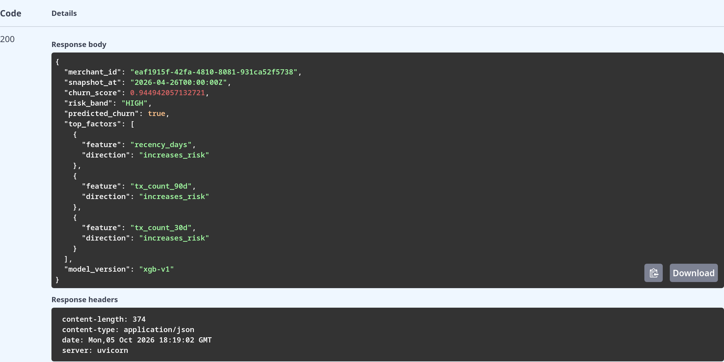
Result and Applications
Project Output
Model D, test period scored once (14,997 snapshots): PR-AUC 0.289 · F1 0.346 · ROC-AUC 0.895 · precision 0.272 · recall 0.475 — recency-only baseline 0.240 / 0.315 · positive-rate floor 0.040.
Precision–recall curves for Models A–D with their frozen operating points
SHAP summary for Model D — tx_count_30d outranks recency_days
Confusion matrix at the frozen threshold 0.84 (288 TP / 770 FP / 318 FN / 13,621 TN)
GET /merchants/{id}/churn-risk — score, risk band and top SHAP factors
Applications
Retention targeting — rank merchants weekly and route the HIGH band to account managers with the contributing factors already attached.
Churn-cause diagnostics (failure-driven vs. engagement-driven decline) · revenue-at-risk forecasting · onboarding-cohort health monitoring · targeted pricing and incentive experiments · support triage for merchants whose payment-failure rate is rising.

Slide 7
Conclusion, Limitations & Future Scope
Conclusion
We reformulated merchant churn from a static flag into 116,464 forward-looking merchant × weekly snapshot observations, each summarising a 90-day window and labelled by whether the merchant makes zero payment attempts in the following 60 days.
An XGBoost classifier over 12 leakage-safe RFM and payment-reliability features, trained with scale_pos_weight 23.36 on chronological splits with 9-week purge gaps, reached 0.289 PR-AUC and 0.346 F1 on a test period scored once — against 0.240 and 0.315 for a recency-only rule and a 0.040 floor.
SHAP ranks tx_count_30d above recency_days and supplies the per-merchant factors returned by the churn-risk endpoint, so every score arrives with its reasons.
The most useful outcome was not a score: it was the recency leak the tests caught — a defect that would have improved every metric in this report and been invisible in all of them.
Limitations
Synthetic data. The generator was written to be difficult, but we wrote it: the result is evidence about the method, not about real merchants.
A single generator seed — no confidence interval should be inferred for differences of a point or two of PR-AUC.
The +0.014 PR-AUC from reliability features is statistically unresolved (bootstrap CI [−0.002, +0.031]).
Uncalibrated: a churn_score of 0.84 is a rank, not an 84% probability; no reliability curve was fitted and the reweighting distorts the output by design.
Precision 0.272 — a retention list of 1,058 merchants contains 288 real leavers; cost-sensitive thresholding is untouched.
Future Scope
Survival analysis in place of a fixed 60-day flag — estimate time-to-churn and compare 30, 60 and 90-day horizons directly.
Repeat across many generator seeds and report confidence intervals, so small PR-AUC differences can be quoted responsibly.
Calibrate with isotonic or Platt scaling so churn_score becomes a probability and the threshold can be chosen on cost.
Reproduce the base paper’s SMOTEENN resampling and GA-tuned XGBoost on our chronological splits, for a like-for-like comparison.
Validate on real merchant transaction data; stream events through Kafka for incremental features and online retraining under drift.

Slide 8



Project Video Link
<paste the demo video link here>
GitHub Repository Link
github.com/prxnav007/Vaultlock-API
PRANAV KUMAR GATTUPALLI, MONIKA P D
Dept. of Computer Science and Engineering
GitHub Repository

