Slide 1
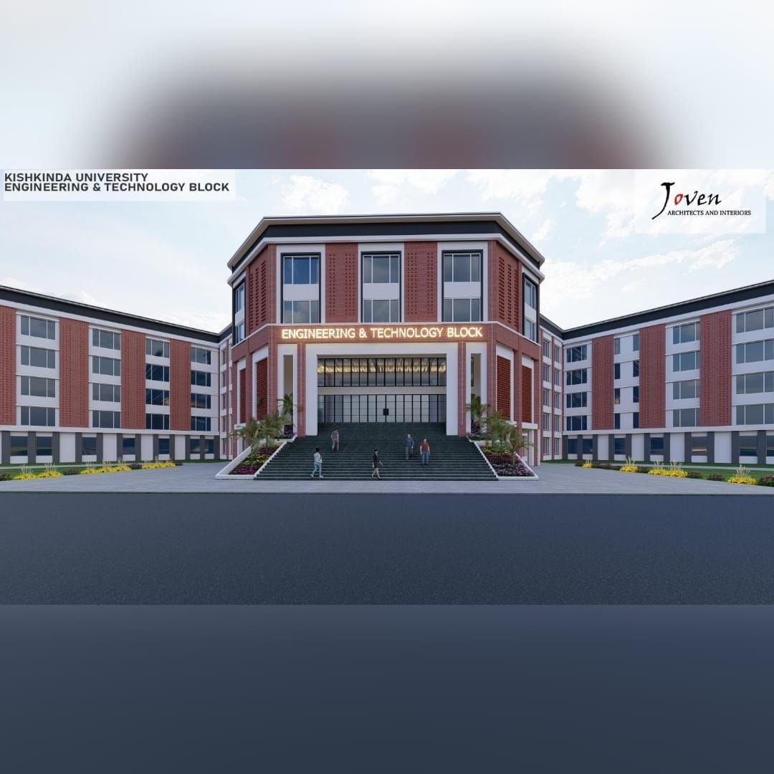

KISHKINDA UNIVERSITY
5W38+WVG, Siruguppa Rd, Ashok Nagar, Rajeshwari nagar, Ballari, Karnataka 5832753
Department of CSE
Project Presentation on
“ ATHLETE HEALTH TRACKING
AND APPOINTMENT SCHEDULER ”
Project Team Members
Sai Pawan
Vijayashree K
Meghana G
Tejeshwar M
Nagaraj Y Patil
KUB23CSE121
KUB23CSE157
KUB23CSE083
KUB23CSE148
KUB23CSE090
Internal Guide:
- Sukumar T

Slide 2



Introduction
In today’s world of competitive sports, athletes require optimal physical health and personalized care to maintain peak performance. Athlete Health Tracking and Appointment Scheduling Systems have become integral tools in managing an athlete’s overall well-being. These systems not only help in monitoring an athlete's physical condition but also streamline appointments with medical professionals, physiotherapists, and trainers.

Slide 3


Introducing the Sports Clinic Appointment Schedule
Objective: Design a system to manage clinic appointments for athletes, including scheduling, tracking medical appointments, and monitoring health progress.
2. Data Models and Functionalities: Utilize models for Athlete, Appointment, and Clinic to support CRUD operations, manage appointments by athlete ID, and track health and recovery progress.

Slide 4
Objective
This Project has been developed for Athletes
To appointment for a clinic
Efficient Management:
Develop a system to efficiently manage clinic appointments, including scheduling and tracking medical appointments for athletes.
Health Monitoring:
Implement features to monitor and track the health and recovery progress of athletes

Slide 5


Existing System :
Manual Scheduling: Currently, clinic appointments for athletes are often managed manually, leading to inefficiencies, scheduling conflicts, and potential errors in tracking appointments and health records.
Limited Health Tracking: There is a lack of systematic tracking for athletes health and recovery progress, making it difficult to monitor their medical history and recovery milestones effectively.

Slide 6
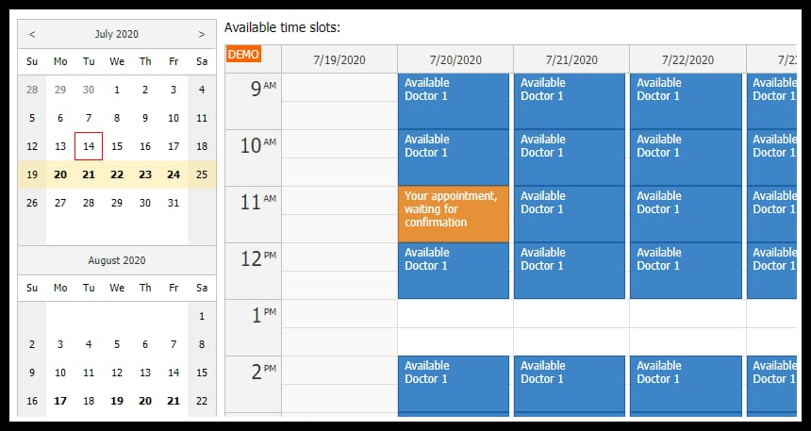

Proposed System:
Automated Scheduling:
Implement an automated system for managing clinic appointments, reducing errors and improving efficiency in scheduling and tracking medical appointments for athletes.
2. Comprehensive Health Tracking: Develop features to systematically monitor and record athletes health and recovery progress, providing a detailed and accessible medical history.

Slide 7
Vision
The vision for this project is to create a streamlined and efficient system for managing clinic appointments and tracking athletes health. By automating scheduling and providing comprehensive health tracking, the system aims to reduce administrative burdens and enhance the quality of care athletes receive, ensuring timely and effective medical attention.

Slide 8

Project Architecture Diagram :
Athlete
- athlete_id
- name
- age
- sport
- health_progress
----------------------------------
add_health_progress()
view_health_progress()
----------------------------------
Appointment
-------------------------
- appointment_id
- athlete_id
- date
- time
- reason
-------------------------
Clinic
--------------------------------------
- athletes
-appointments
---------------------------------------
- add_athlete()
- create_appointment()
- read_appointment()
- update_appointment()
- delete_appointment()
- manage_medical_appointment()
- track_health_progress()
- get_athlete()
----------------------------------
User Interaction
----------------------------
- Command Loop
- Menu Options
- Input Prompts
----------------------------

Slide 9
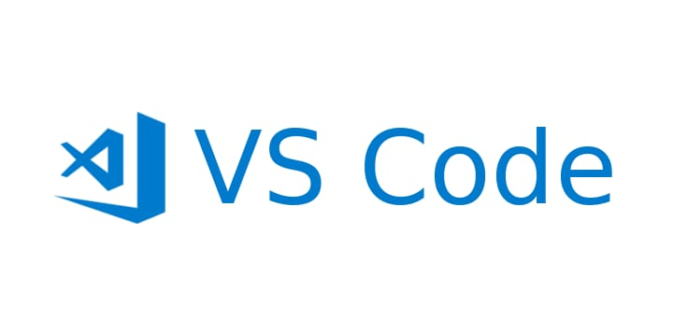

Software Requirements :
Python 3.12.6 (64-bits)
Visual Studio Code
Hardware Requirements :
Processor : Intel i5 12th Gen
Ram : 8 GB
Hard Drive : 512 GB SSD

Slide 10
Advantages :
Modularity: Each class (Athlete, Appointment, Clinic) is self-contained, making it easier to manage.
OOP Design: Object-Oriented Programming (OOP) ensures better code reusability and scalability.
Readability: Easy to read and maintain due to clear separation of concerns.
Extensibility: New features like appointment reminders or notifications can be added without affecting the core logic.

Slide 11
Disadvantages :
Limited Error Handling: Current design has basic error handling. This could lead to issues in real-world scenarios.
No Database: Uses in-memory data structures, so data is lost when the program terminates. Using a persistent database would be more suitable for larger applications.
Scalability: Managing large numbers of athletes and appointments with dictionaries can become inefficient over time; a database would handle larger datasets better.

Slide 12
Conclusion :
In this Sports Clinic Appointment Scheduler , we have outlined a structured approach to manage clinic appointments, specifically tailored for athletes. The key modules include:
CRUD Operations for Clinic Appointments: Efficiently handle the creation, reading, updating, and deletion of appointments.
Manage Medical Appointments for Athletes: Provide a focused interface to manage medical appointments using athlete IDs.
Track Health and Recovery Progress: Monitor and report on the health and recovery progress of athletes.
By following an object-oriented approach and utilizing Python’s built-in data structures, we ensure that the system is modular, maintainable, and scalable. Proper documentation and testing further enhance the reliability and usability of the system.

Slide 13

Future Enhancements :
AI and Machine Learning: Utilizing AI to analyze performance data can help in identifying patterns, predicting injuries, and customizing training plans based on individual needs and historical performance.
Telehealth Services: Expand access to sports health professionals through virtual appointments for consultations, injury assessments, and follow-ups.
Holistic Health Integration : Mental Health Support Include psychological assessments and mental wellness programs, recognizing the importance of mental health in sports performance.
Enhanced Scheduling Features : Smart Scheduling Algorithms: Develop intelligent scheduling systems that consider athlete preferences, training loads, and recovery needs to optimize appointment times.
Data Privacy Enhancements : Robust Security Protocols: Ensure top-tier security measures to protect sensitive athlete data, building trust and compliance with regulations.

Slide 14

References :
Books :
"Wearable Technology in Sports: Principles and Practices" by Anupama S. Chaudhary
"Sports Analytics: A Guide for Coaches, Managers, and Other Decision Makers" by Benjamin Alamar
Online Resources:
American College of Sports Medicine (ACSM)
ACSM Position Stands: Offers guidelines and research on exercise science and sports health.
2. The Sports Medicine Journal
Sports Medicine Journal: Publishes research on various aspects of sports health and performance.

Slide 15


