Slide 1
Machine Learning: An Exploration into Lunchbox ML for Grasshopper
Preston Pape

Slide 2
Type of Machine Learning
Supervised Learning
Unsupervised Learning
Goal: predict outcomes
Types: classification, regression
Goal: discover insights
Types: clustering, association
Identification vs Organization

Slide 3
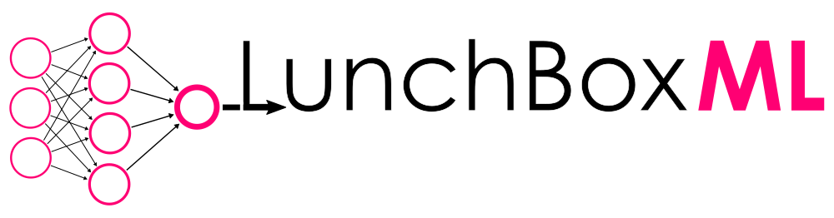


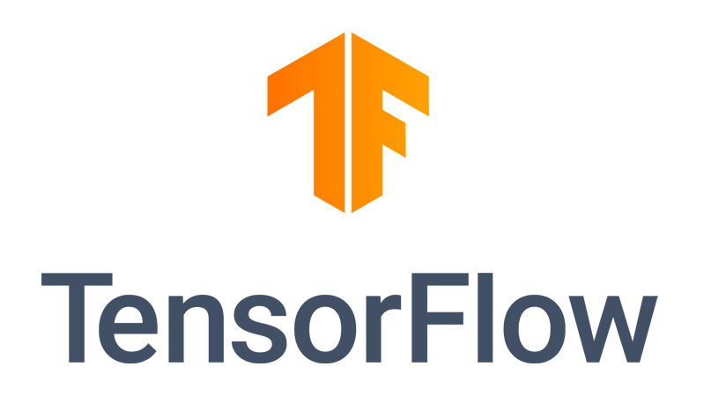


Slide 4
Notes:
Seperating these tools out, from least useful to most useful to architects, we have yellow indicating pure programming language-based implementations
Red showing ML toolkits and libraries
Blue being a grasshopper plugin

Slide 5
Lunchbox ML
Grasshopper plugin
Data IO, ML, complex geometry, panelization tools, etc.
ML components = ‘black box’
Relatively simple

Slide 6
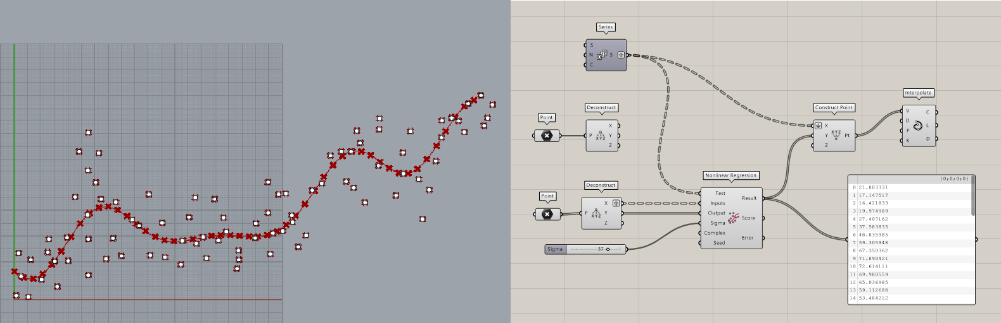
Non-linear Regression
Best fit line
Not necessarily points as input
Use case?

Slide 7
Non-linear Regression (cont.)

Slide 8
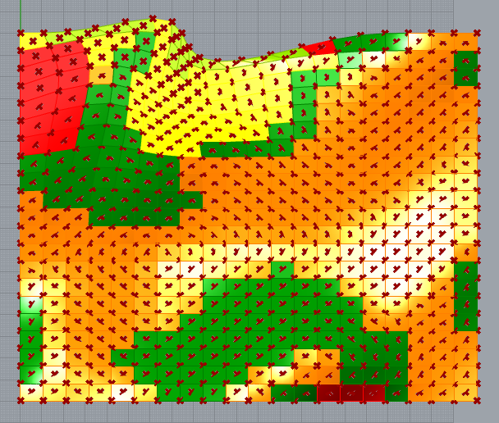
Gaussian Mix Solver
Clustering type
Groups data according to number of clusters
Panels by area/perimeter

Slide 9
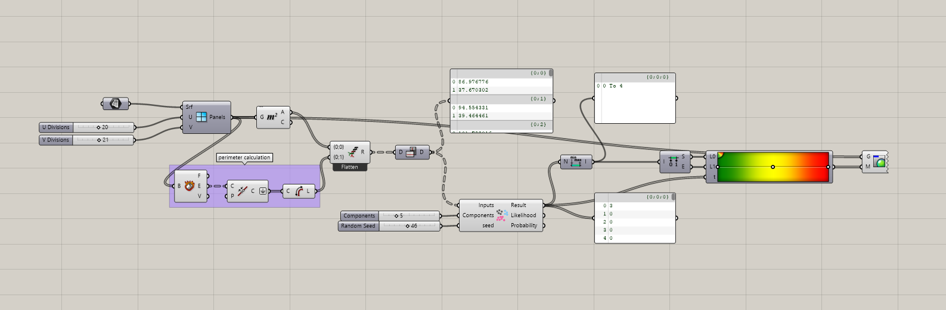
Gaussian Mix Solver (cont.)

Slide 10
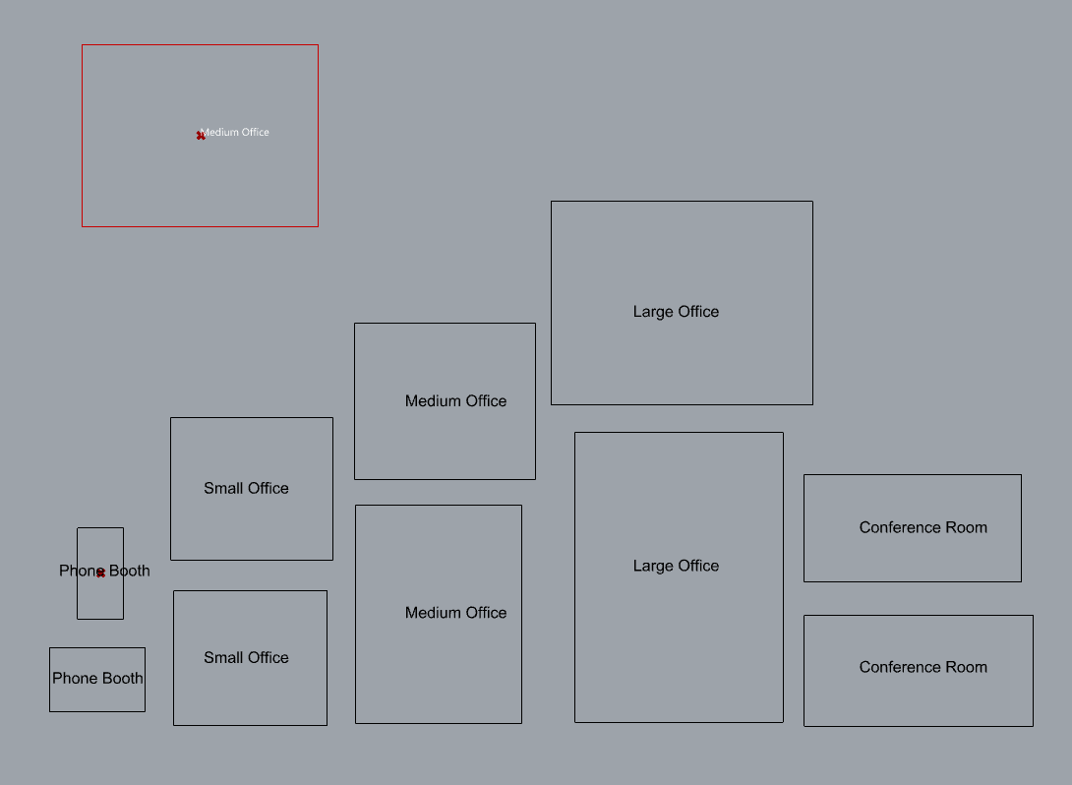
Neural Network
Room areas, dimensions
Labeled data; supervised
Accuracy scales with training set size

Slide 11
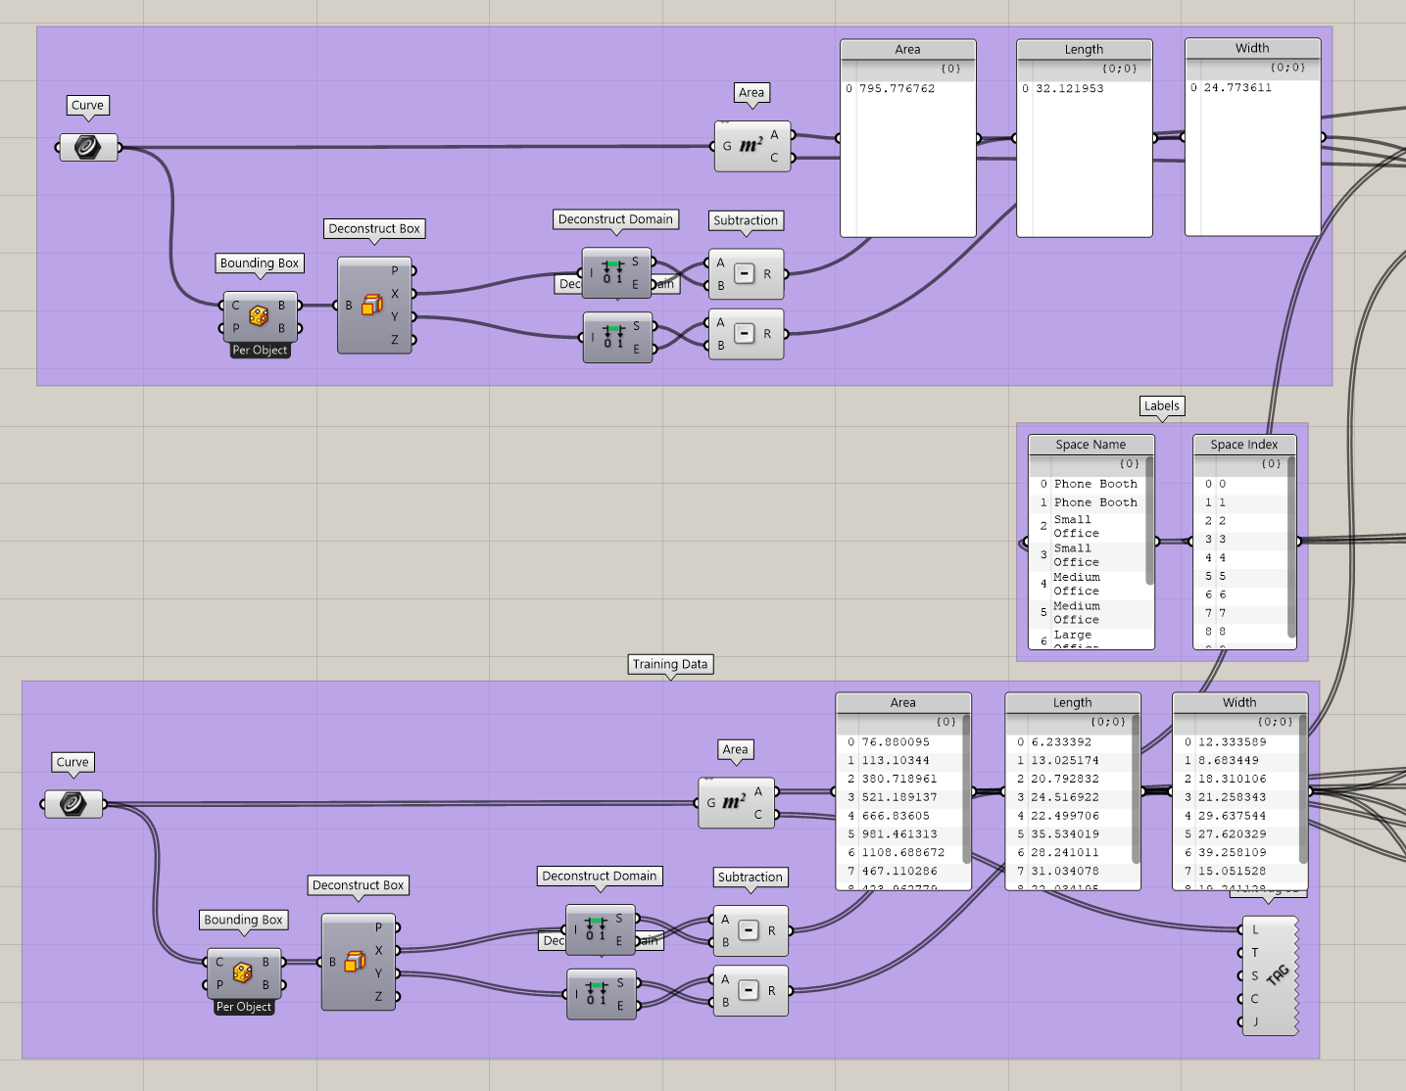
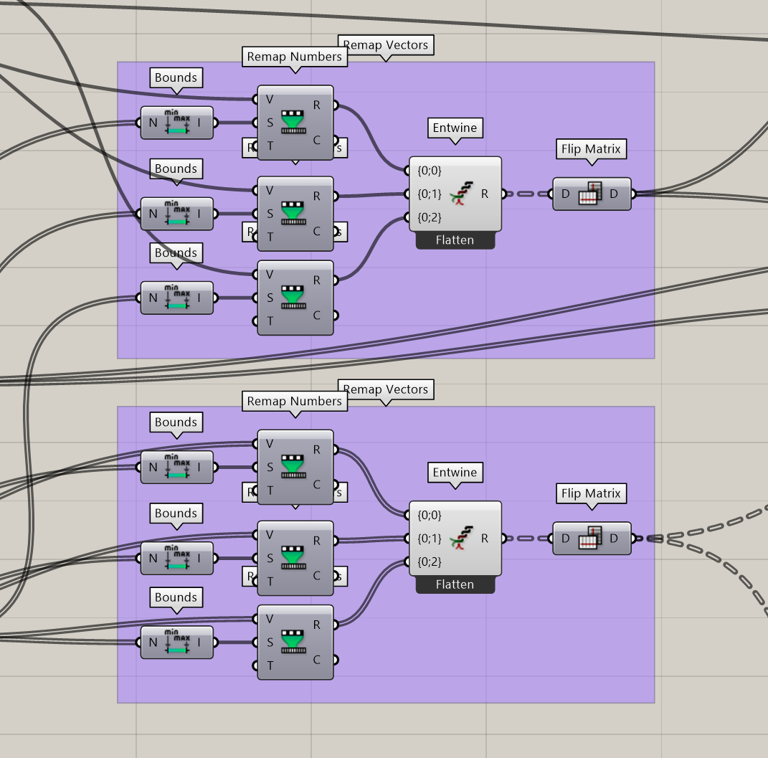
Neural Network (cont.)

Slide 12
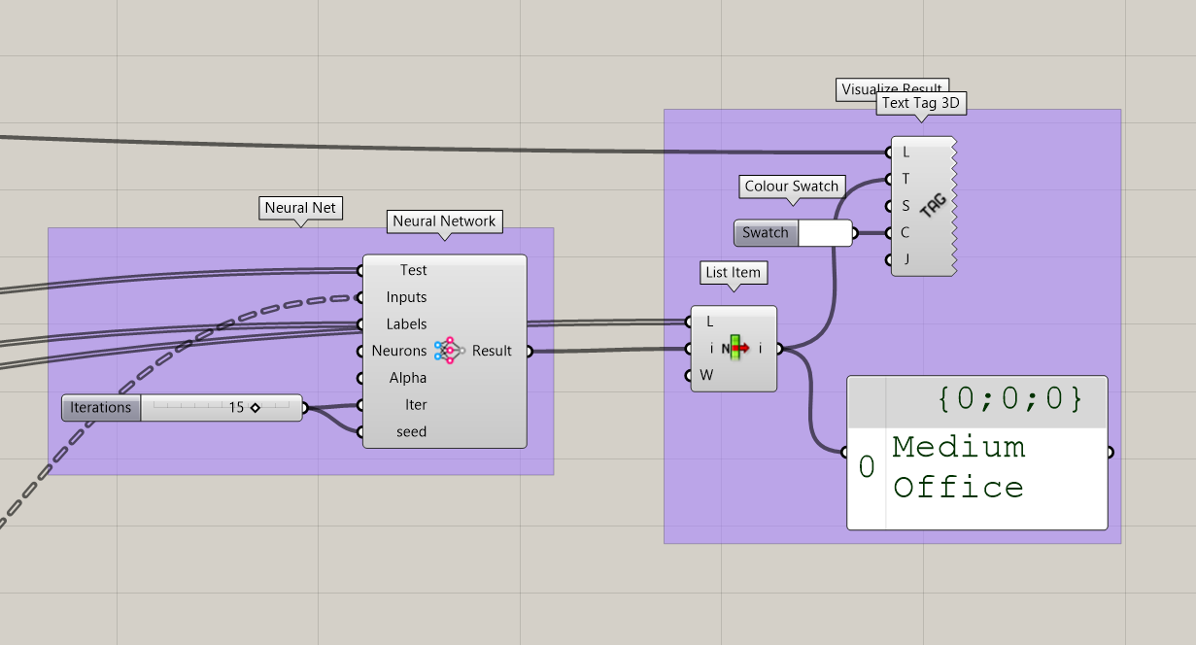
Neural Network (cont.)

Slide 14
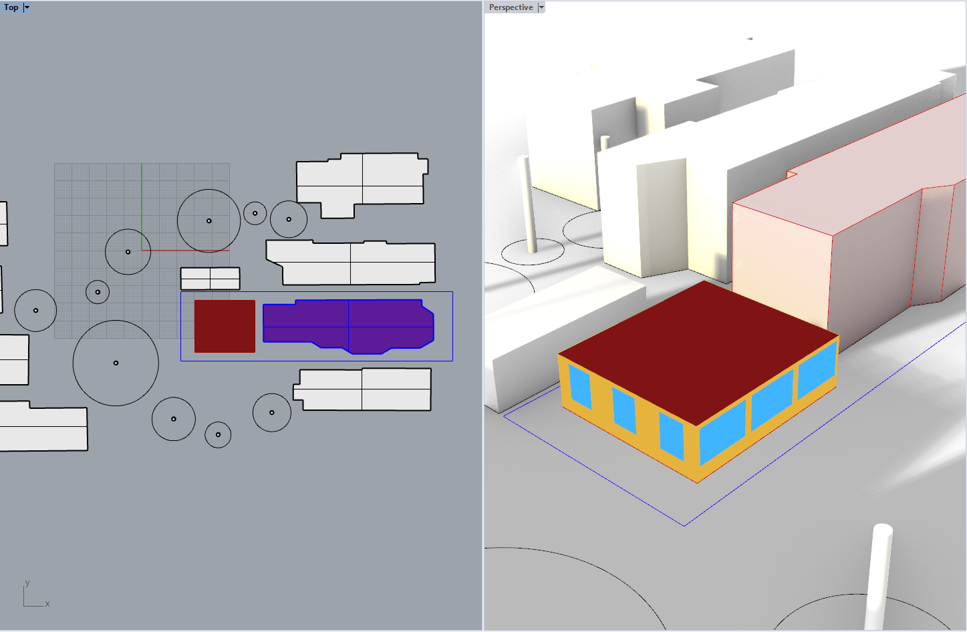
Current work
EUI optimization of ADUs based on WWR, orientation, etc.
Grasshopper implementation
Requires many tools:
Rhino
Grasshopper
Galapagos
Ladybug
Honeybee
Etc.

Slide 15
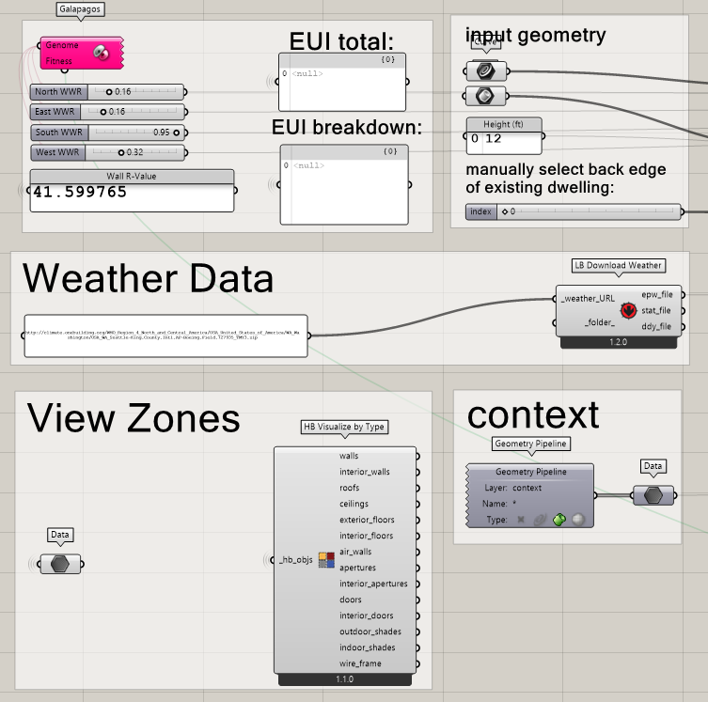
Future work
EUI prediction of ADUs based on WWR, orientation, etc.
“Surrogate modeling”
EnergyPlus simulation data as training set
Grasshopper -> Python
Only one required software/tool/programming language

Slide 16
In Review
Nearly endless applications
Difficult to wrap design problems into dataset
Unique niche within architecture

