Slide 1
Machine Learning: Methods & Current Landscape within Architectural Practice
Preston Pape

Slide 2
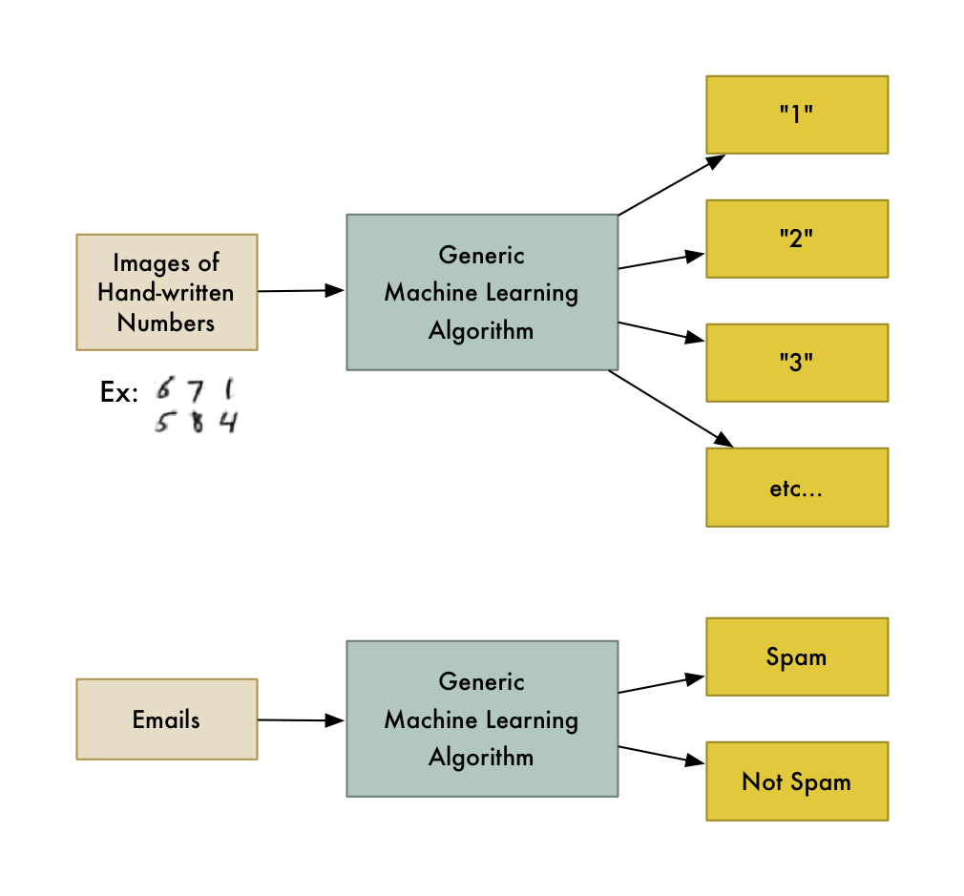
Machine Learning?
Trained algorithm
Pro: typically simple I/O
y=x
Con: require large training datasets
AEC data relatively lacking
https://medium.com/@ageitgey/machine-learning-is-fun-80ea3ec3c471

Slide 3
Type of Machine Learning
Supervised Learning
Unsupervised Learning
Labeled data
Predicts output
Goal: predict outcomes
Types: classification, regression
Unlabeled data
Finds hidden patterns
Goal: discover insights
Types: clustering, association
Identification vs Organization

Slide 4
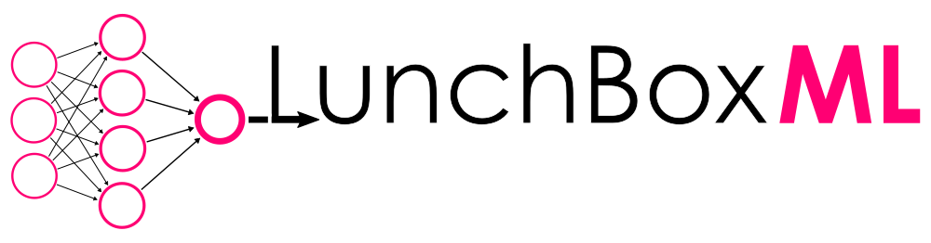





Slide 5
Notes:
Seperating these tools out, from least useful to most useful to architects, we have yellow indicating pure programming language-based implementations
Red showing ML toolkits and libraries
Blue being a grasshopper plugin

Slide 6
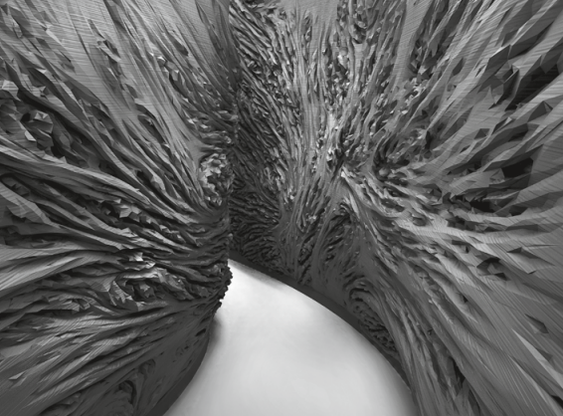
Wonderlab - Morphocyte
2015
Cellular division algorithm
‘counter-intuitive aesthetics’
Designer points out expected instances
ML algo finds similar, unexpected designs
Supervised learning
Andrasek, Alisa. “In Search of the Unseen: Towards Superhuman Intuition.” Architectural Design 89, no. 5 (2019): 112–19.

Slide 7
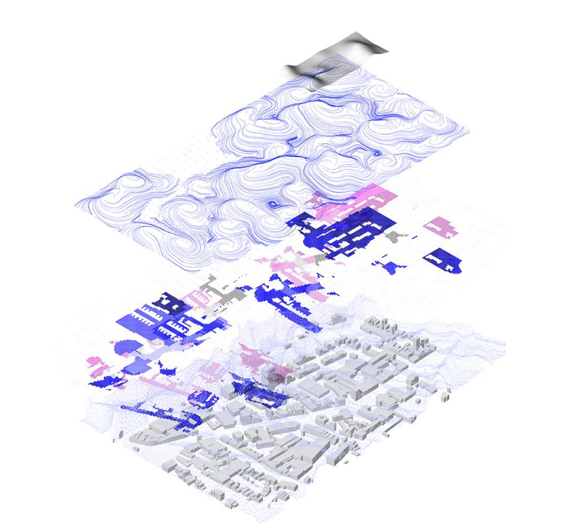
Alisa Andrasek - Fissures
2012
Locating humanly-indistinguishable patterns
Parsing LA GIS data
Unsupervised learning
Clustering relevant data by layer
Bottazzi, Roberto. “Learning Algorithms, Design, and Computed Space.” Enquiry The ARCC Journal for Architectural Research 16, no. 2 (2019): 6–17.

Slide 8
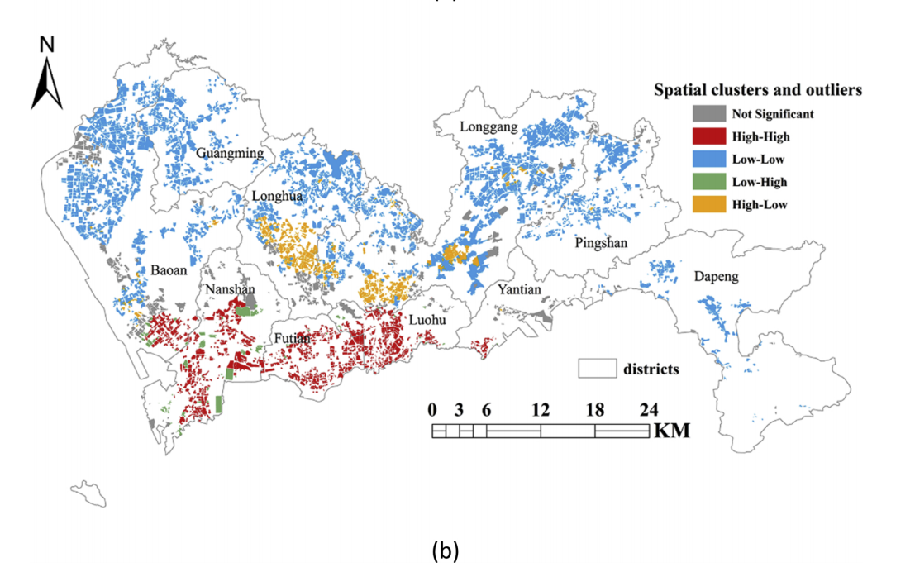
Case study- Housing
2019
Training set: OHRWs,
Zillow equivalent
Most pay extra for walkable location
Shenzhen implementation
Effective to inform equitable housing policy
Hu, Lirong, Shenjing He, Zixuan Han, He Xiao, Shiliang Su, Min Weng, and Zhongliang Cai. “Monitoring Housing Rental Prices Based on Social Media:An Integrated Approach of Machine-Learning Algorithms and Hedonic Modeling to Inform Equitable Housing Policies.” Land Use Policy 82 (2019): 657–73. https://doi.org/10.1016/j.landusepol.2018.12.030.

Slide 9
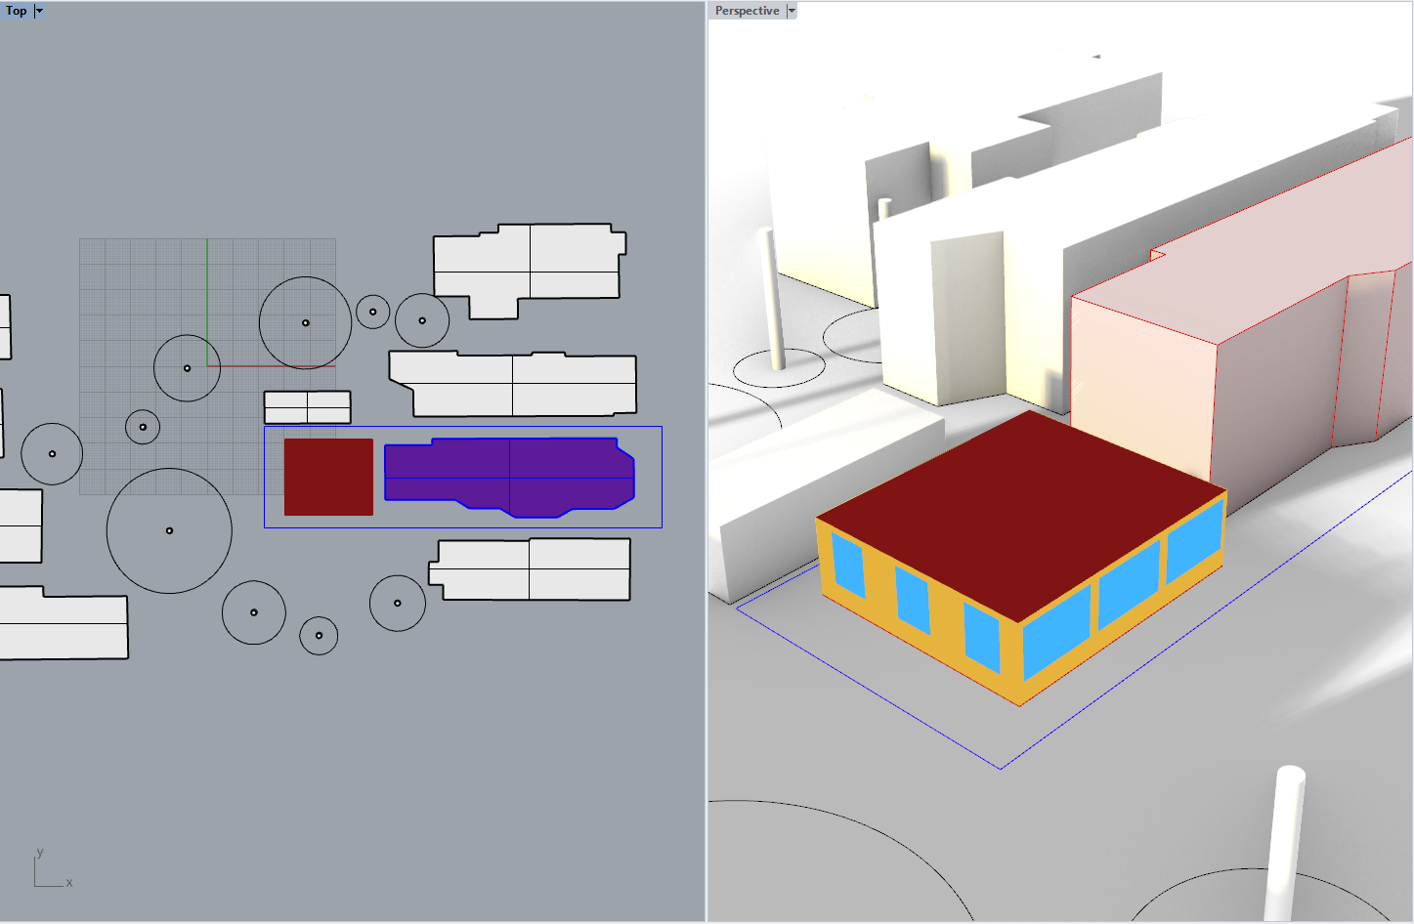
Current work
EUI optimization of ADUs based on WWR, orientation, etc.
Grasshopper implementation
Requires many tools:
Rhino
Grasshopper
Galapagos
Ladybug
Honeybee
Etc.

Slide 10
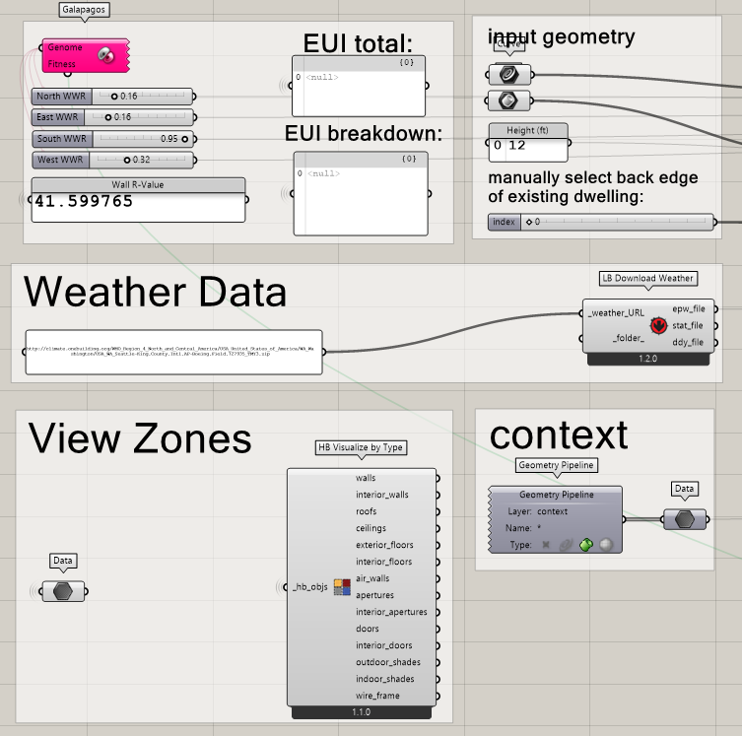
Future work
EUI prediction of ADUs based on WWR, orientation, etc.
“Surrogate modeling”
EnergyPlus simulation data as training set
Grasshopper -> Python
Only one required software/tool/programming language

