Slide 1
Machine Learning: Methods & Current Landscape within Architectural Practice
Preston Pape

Slide 2
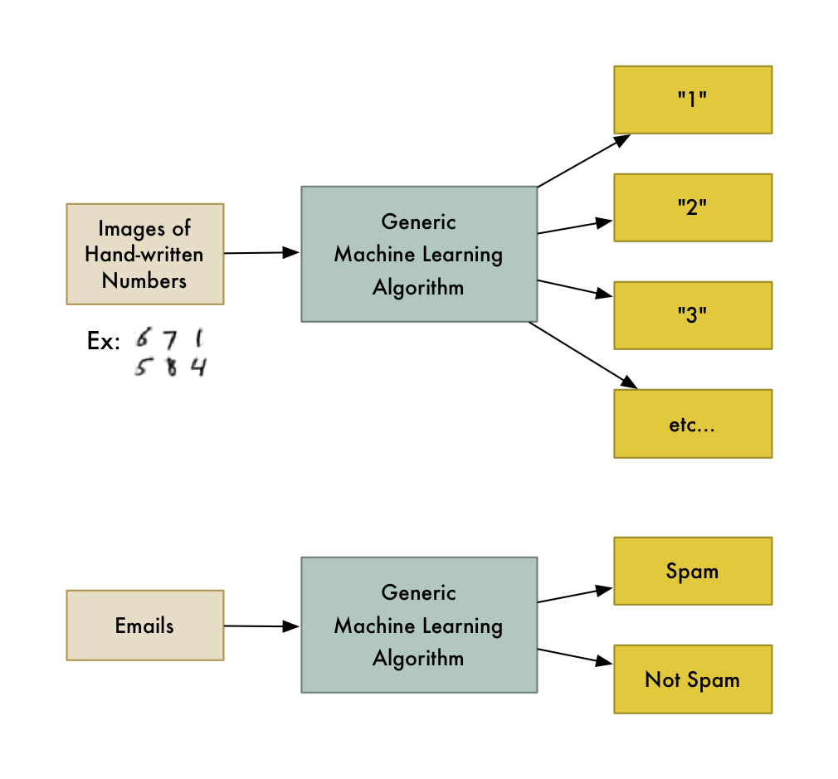
Machine Learning?
Trained algorithm
Typically simple I/O
Require large training datasets
https://medium.com/@ageitgey/machine-learning-is-fun-80ea3ec3c471

Slide 3
Type of Machine Learning
Supervised Learning
Unsupervised Learning
Labeled data
Predicts output
Goal: predict outcomes
Types: classification, regression
Unlabeled data
Finds hidden patterns
Goal: discover insights
Types: clustering, association
Identification vs Organization

Slide 4
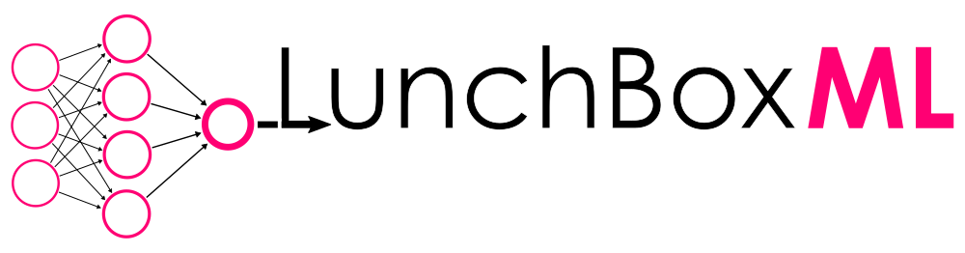





Slide 5
Notes:
Seperating these tools out, from least useful to most useful to architects, we have yellow indicating pure programming language-based implementations
Red showing ML toolkits and libraries
Blue being a grasshopper plugin

Slide 6
Lunchbox ML
Grasshopper plugin
Data IO, ML, complex geometry, panelization tools, etc.
ML components = ‘black box’
Relatively simple

Slide 7
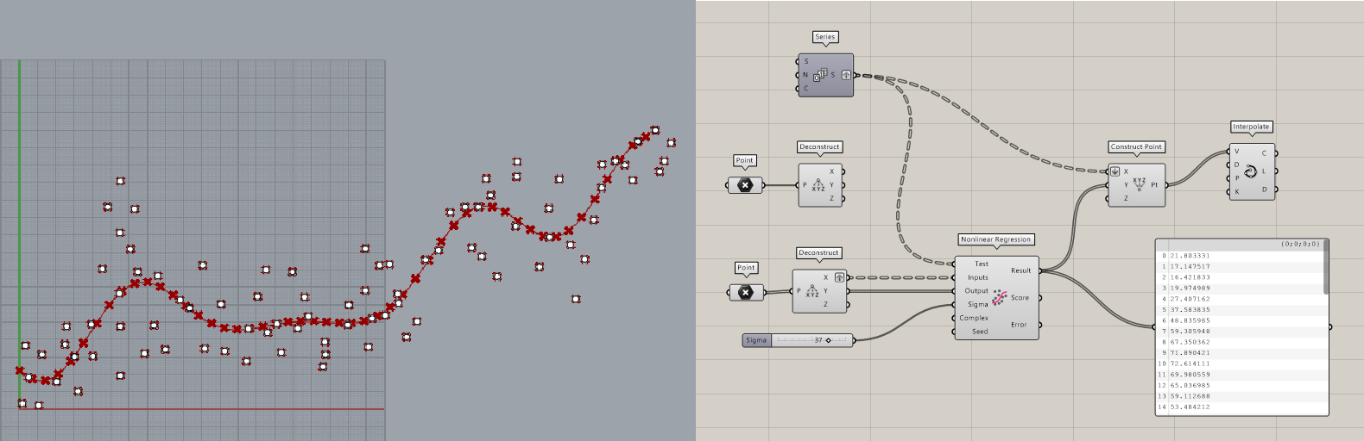
Non-linear Regression
Best fit line
Not necessarily points as input
Use case?

Slide 8
Non-linear Regression (cont.)

Slide 9
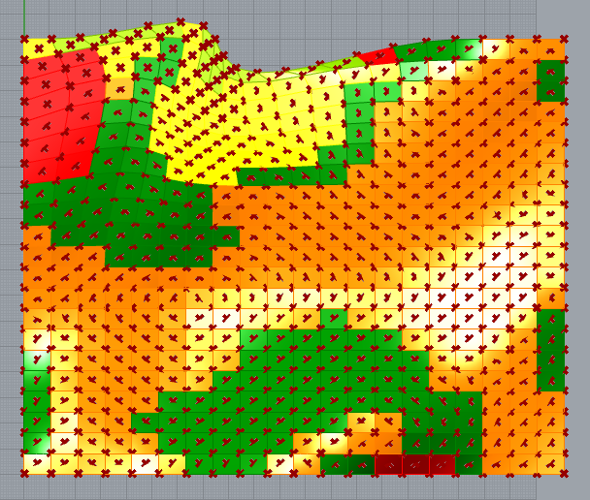
Gaussian Mix Solver
Clustering type
Groups data according to number of clusters
Panels by area/perimeter

Slide 10
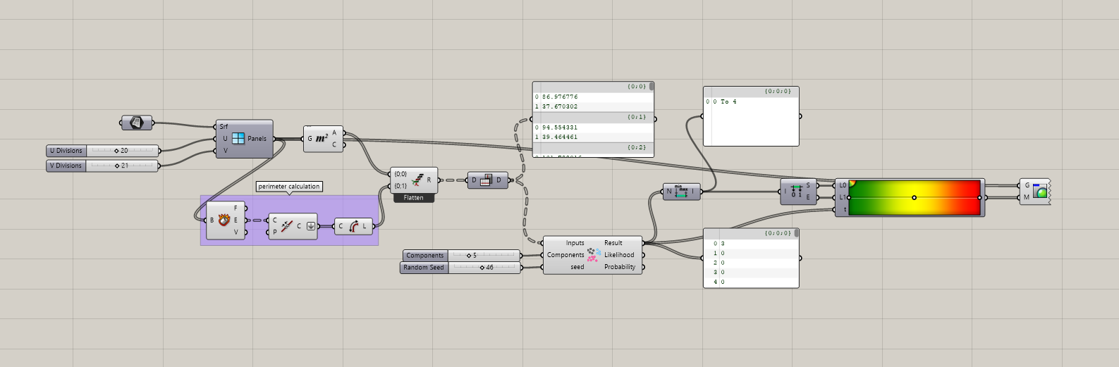
Gaussian Mix Solver (cont.)

Slide 11
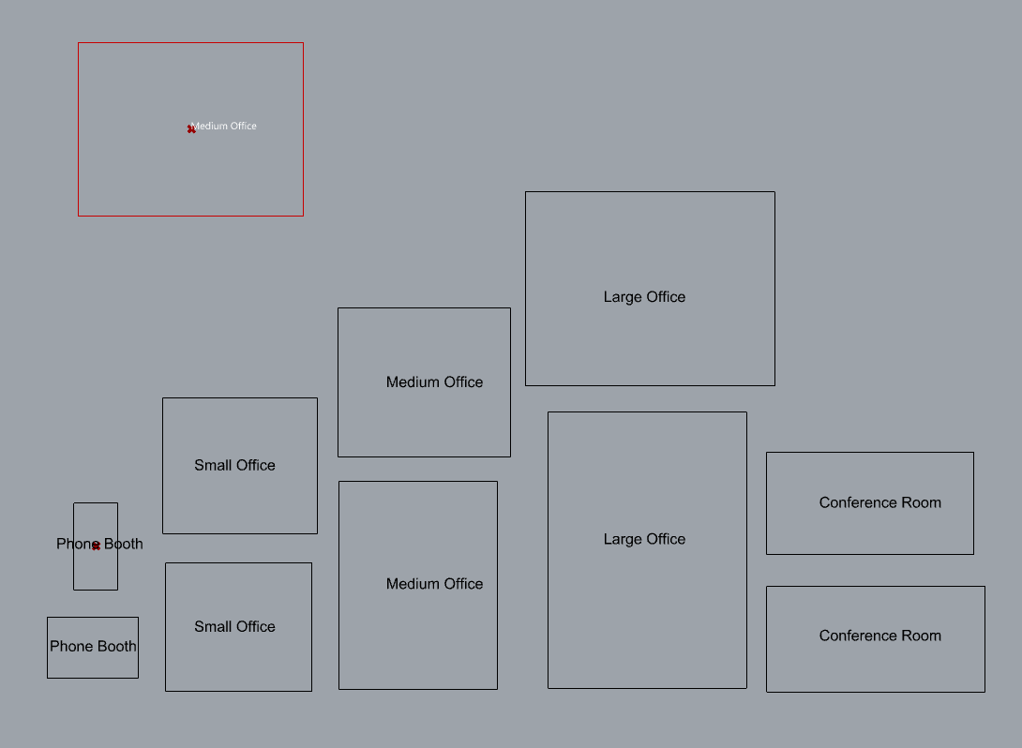
Neural Network
Room areas, dimensions
Labeled data; supervised
Accuracy scales with training set size

Slide 12
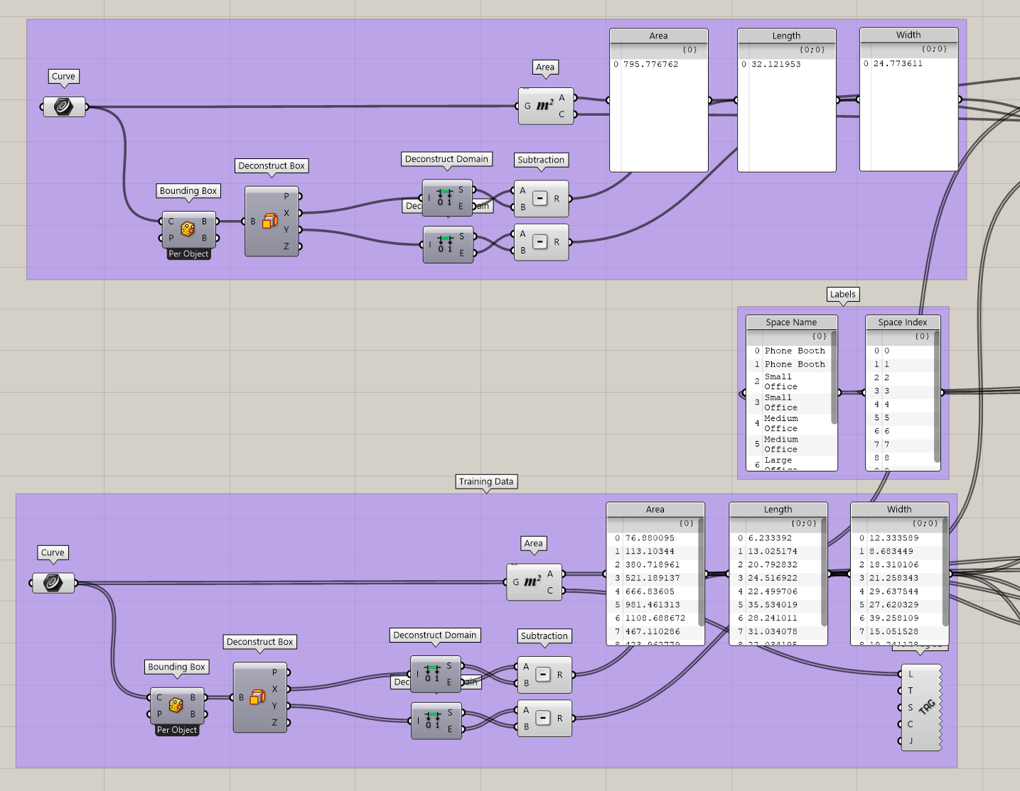
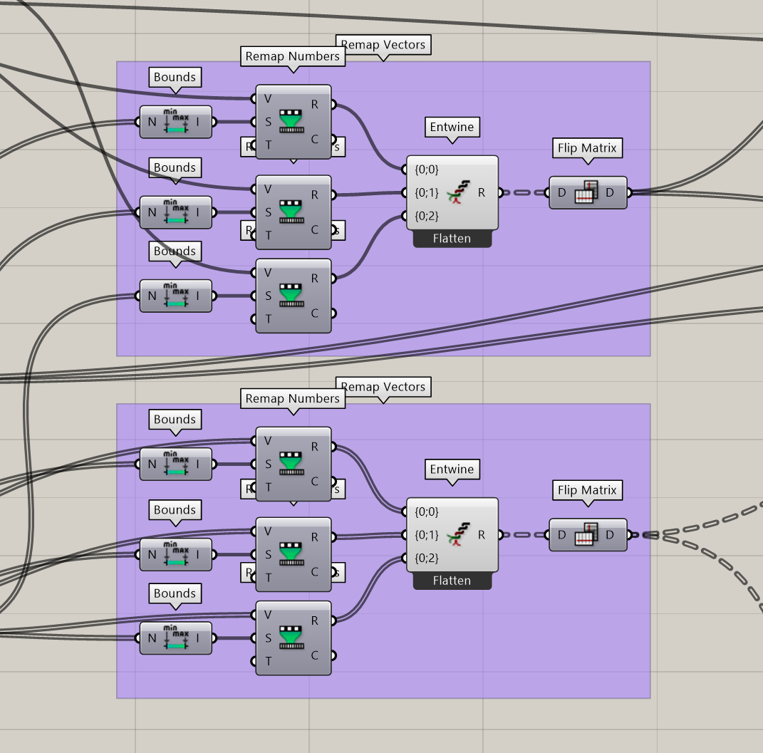
Neural Network (cont.)

Slide 13
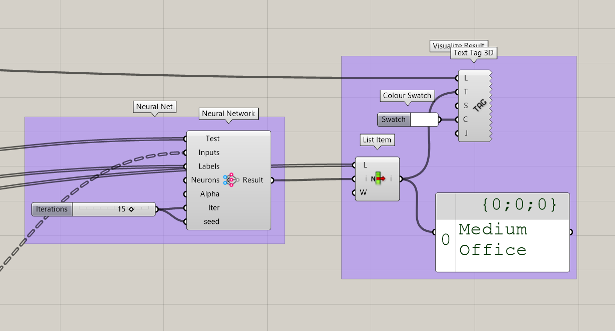
Neural Network (cont.)

Slide 15
In Review
Nearly endless applications
Difficult to wrap design problems into dataset
Unique niche within architecture

Slide 16
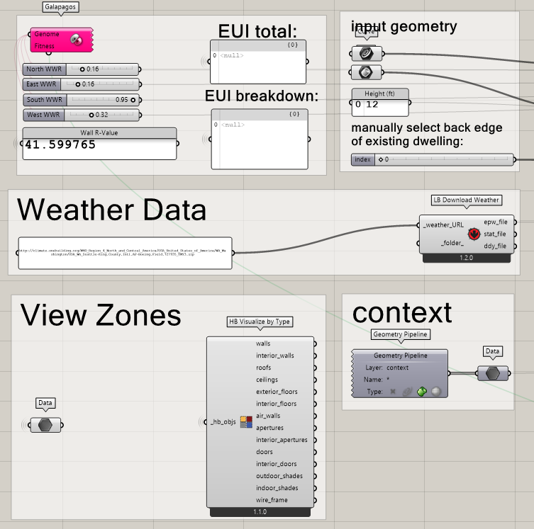
Future work
EUI prediction of ADUs based on WWR, orientation, etc.
“Surrogate modeling”
EnergyPlus simulation data as training set
Grasshopper -> Python

