Slide 1
Surrogate Energy Modeling Tool for Accessory Dwelling Units and Potential Policy Implications
committee:
rick mohler (chair)
tomás méndez echenagucia
preston pape

Slide 2
STATISTICS
44 million renters in united states
more than 47% of these are rent-burdened (household spending >30% of gross income on rent and utilities, as defined by HUD)
since 1961, median home prices have increased by 121%, whereas median household income has only increased by 29%
those with <80% median area income spend average of 7.2%-25% on energy utility costs
seattle: ECB = 2% (~$1700)
https://kinder.rice.edu/urbanedge/2019/07/25/gap-between-income-growth-and-housing-cost-increases-continues-grow
Notes:
https://kinder.rice.edu/urbanedge/2019/07/25/gap-between-income-growth-and-housing-cost-increases-continues-grow

Slide 3
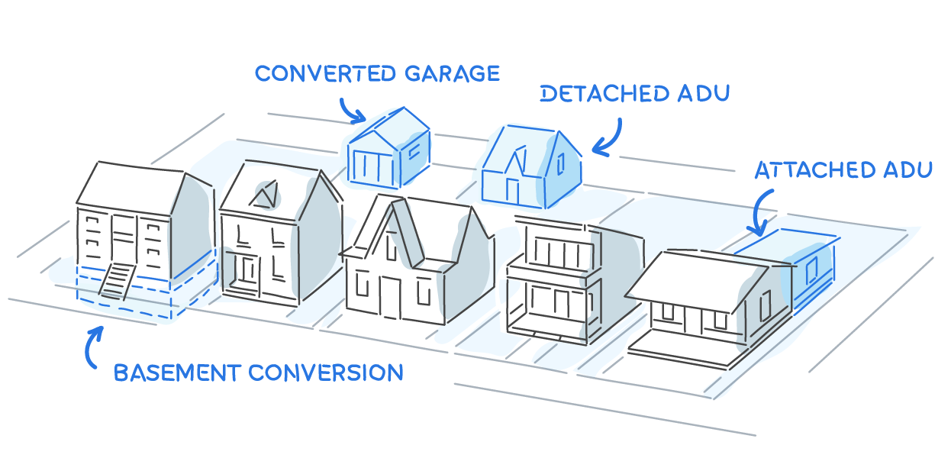
https://www.housable.com/city/sacramento-ca-179074

Slide 4

ADU BENEFITS:
reduced space occupied per person for healthy living
increased home value to property owner
enables affordable inclusion for low-income residents
offers proximity to better public schools
increased walkability (15 min. city)
helps to stabilize rental prices by increasing supply without sprawl
enables the elderly to remain independent
https://aduniverse-seattlecitygis.hub.arcgis.com/pages/gallery

Slide 5
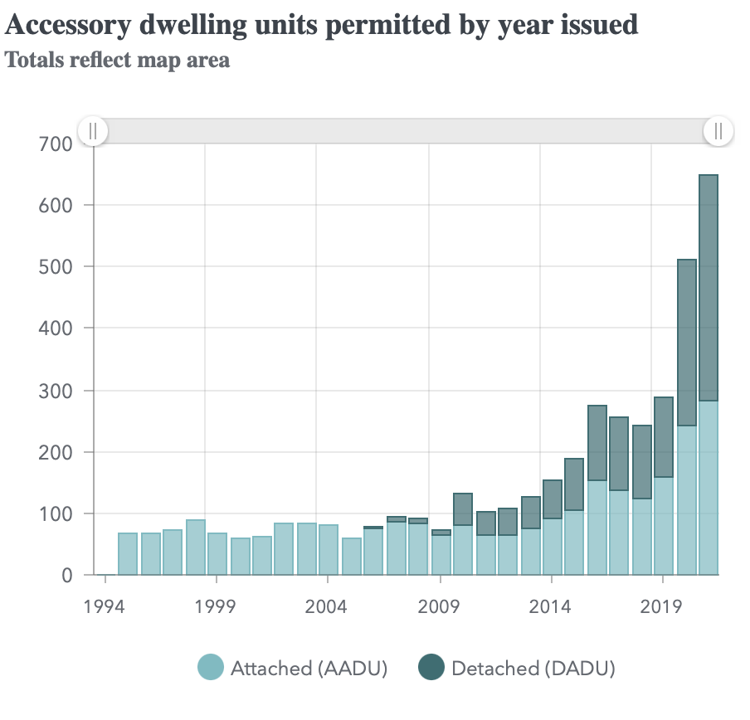
STATE OF ADUS IN SEATTLE
pre-approved DADU designs via city
large uptick in construction
housing goals still not met:
nearly 1.8 million new residents by 2050
however:
many are low-performance
~260 new DADUs in 2020, when 100,000 properties eligible
https://aduniverse-seattlecitygis.hub.arcgis.com/pages/data

Slide 6
RESEARCH QUESTIONS
can a machine learning powered design tool reduce carbon and energy use while increasing production of DADUs in seattle?
what is the effect of empowering potential owners to see energy quantities beforehand?
which design constraints impact DADU energy use greatest?
how does the energy performance of the 10 pre-approved designs compare to a site-specific DADU design?
can results generated by tool verify city planning policy initiatives?

Slide 7

COMPARATIVE ANALYSIS: pre-approved DADU plans
simulation of ten existing DADU designs (pre-approved for permitting)
analyze and compare energy/carbon
compare to site-designed DADU using tool once complete
give feedback to city regarding results
https://aduniverse-seattlecitygis.hub.arcgis.com/pages/gallery

Slide 8


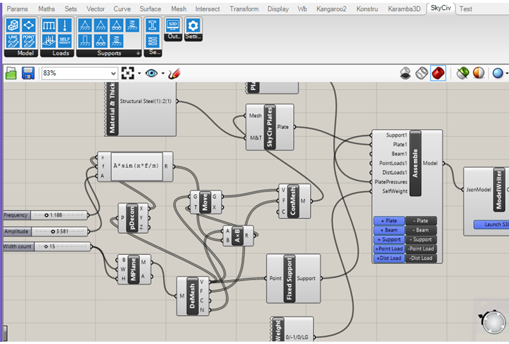
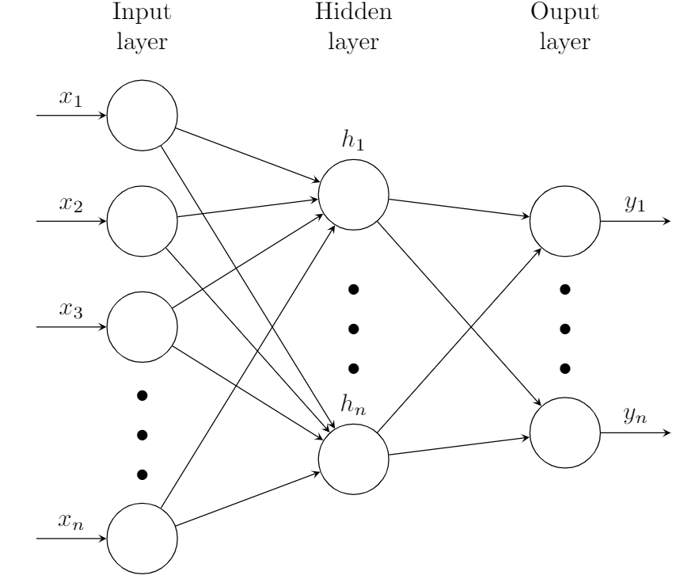
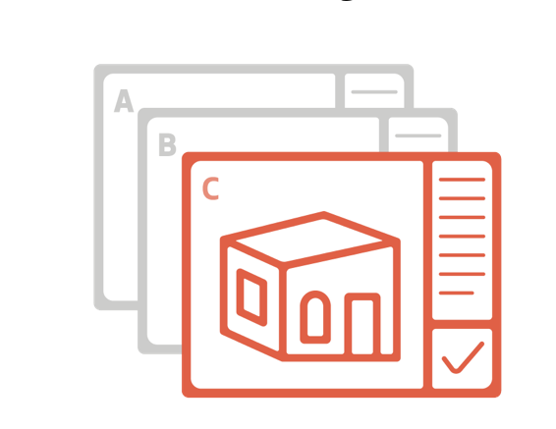
DEVELOPMENT PIPELINE
https://tex.stackexchange.com/questions/497859/neural-network-diagram
mass simulation of design inputs using energyplus via grasshopper
polynomial regression
random forest
neural network
web-based, real-time
EUI + carbon design tool
https://aduniverse-seattlecitygis.hub.arcgis.com/pages/gallery

Slide 9
SIMULATION DESIGN SPACE (inputs)
CURRENT
POTENTIAL
location: seattle EPW (1)
lot type: infill vs. corner (2)
lot access: alley vs. no alley (2)
# of ADUs: 1-2; 1-5 (2) or (5)
WWR: low vs. medium vs. high (3)
insulation mat (2-3)
facade mat (2-4)
etc..
site: retain trees vs. cut (2)
sqft. variance (FAR) (?)
setbacks: existing vs. reduced (2)
total simulations: 172800+
target run time/simulation: ~8s
total time: 2 days

Slide 10
SIMULATION DESIGN SPACE (outputs)
PRIMARY
SECONDARY
energy use intensity (EUI)
embodied carbon
operational carbon
total carbon
POTENTIAL
results archived as JSON files
-> converted to .csv
-> read into either scikit-learn- or pytorch-based learning model
EUI/capita
total carbon/capita
other created metrics

Slide 11

UTILIZATION PIPELINE
insights drawn from results to backup key planning policy initiatives
(seattle office of planning and community development)
optimization of model via usage of tool

Slide 12
THANK YOU

