Slide 1
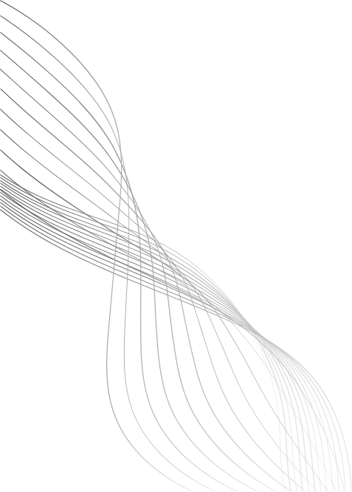
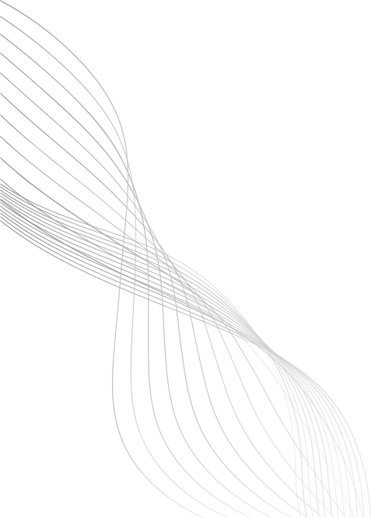
INTRODUCTION -
BEYOND RANDOM GROWTH
While the Random Growth model shows how networks can form, many real-world networks have a more ordered structure.
The Small-World Model asks a different question: How does a network evolve to be both highly ordered locally and easily navigable globally?
Key Concepts for Structural Analysis:
High Clustering Coefficient: "My friends all know each other." This creates tight-knit local communities, a feature often missing in purely random graphs.
Low Average Path Length: "Six Degrees of Separation." The ability to get from anyone to anyone else in a few steps.
The Small-World model provides a bridge between perfectly ordered networks and purely random ones.
09
PRIYANSH
205124071
SMALL WORLD MODEL

Slide 2
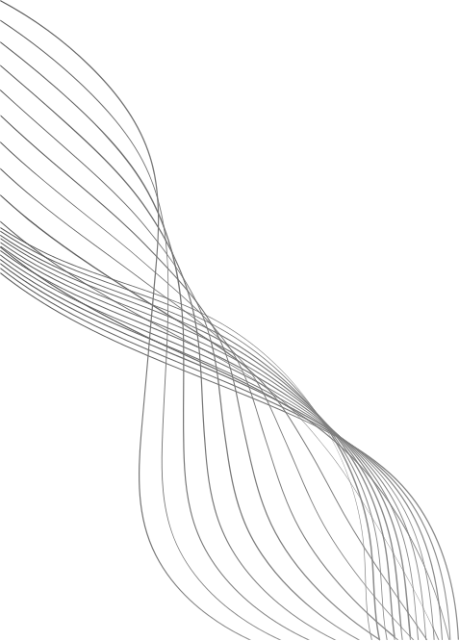
THE WATTS-STROGATZ MODEL:
AN EVOLUTIONARY PROCESS
This model doesn't focus on adding new nodes, but on how the connections within a network evolve. It's a process of structural transformation.
Algorithm Steps:
START (Ordered Network): Begin with a static, regular ring lattice. Every node is connected only to its immediate k neighbors.
Characteristic: High clustering, but very high average path length.
EVOLVE (Introduce Shortcuts): Iterate through each edge. With a small probability p, "rewire" one end of the edge to connect to a random node anywhere in the network.
This dynamic process creates long-range shortcuts.
The probability p controls how much the network evolves from order (p=0) to chaos (p=1).
RESULT (Small-World Network): A few random shortcuts are enough to drastically lower the average path length, while keeping the high local clustering intact.
10

Slide 3
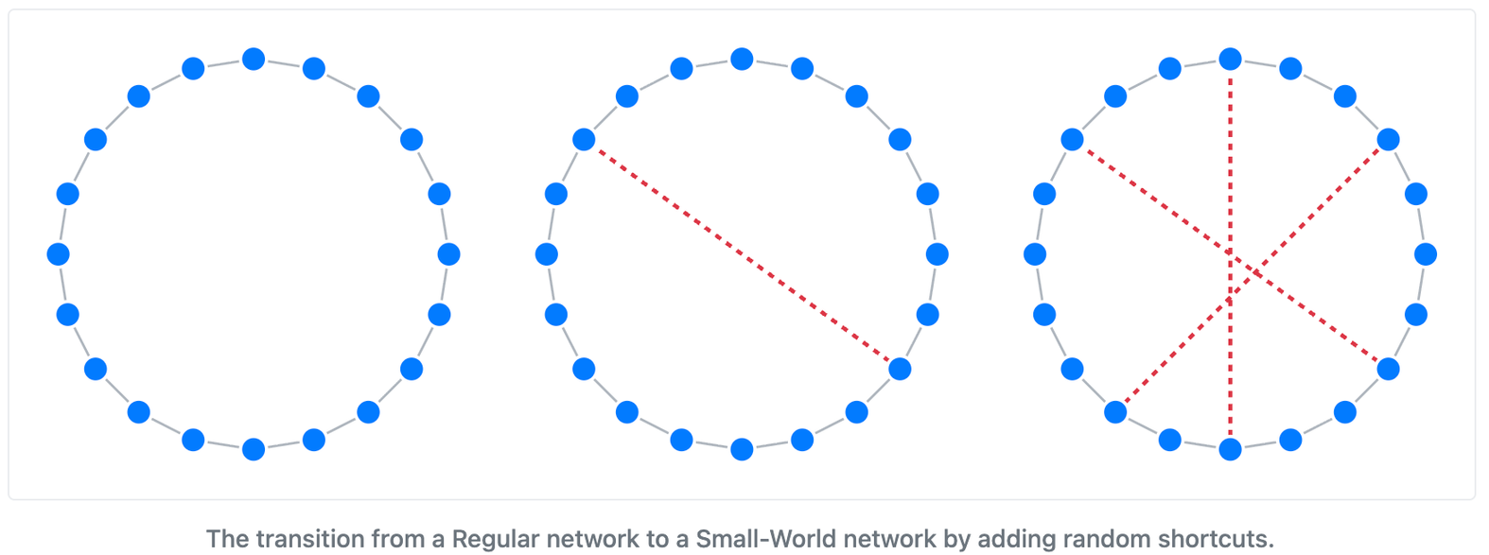
GRAPH -
A DYNAMIC REWIRING PROCESS
P=0
P is small
P is larger
This visual shows the algorithm in action. We start with a perfectly ordered ring and introduce random shortcuts, transforming the network's structure.
11

Slide 4
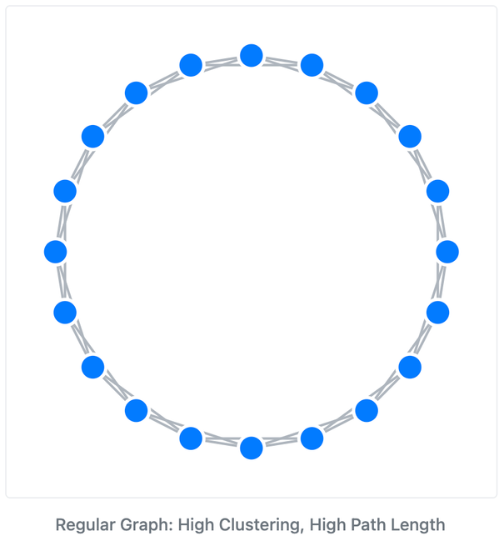
GRAPH -
VISUALIZING THE EXTREMES
A Perfectly Ordered Network (p=0)
Represents a static, non-evolved social structure.
High Clustering: Very strong, dense local communities are visible.
High Path Length: Information or influence spreads very slowly across the network.
12

Slide 5
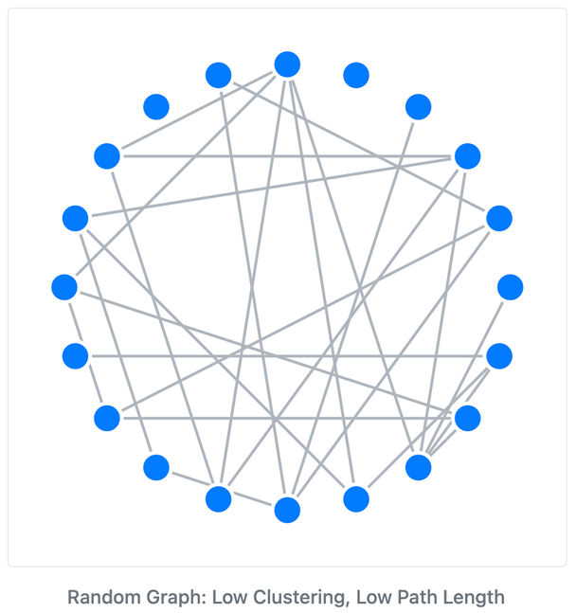
GRAPH -
VISUALIZING THE EXTREMES
A Fully Random Network (p=1)
Shows what happens when all structure is random.
Low Clustering: Local communities are destroyed.
Low Path Length: Information spreads quickly, but there's no local cohesion.
13

Slide 6
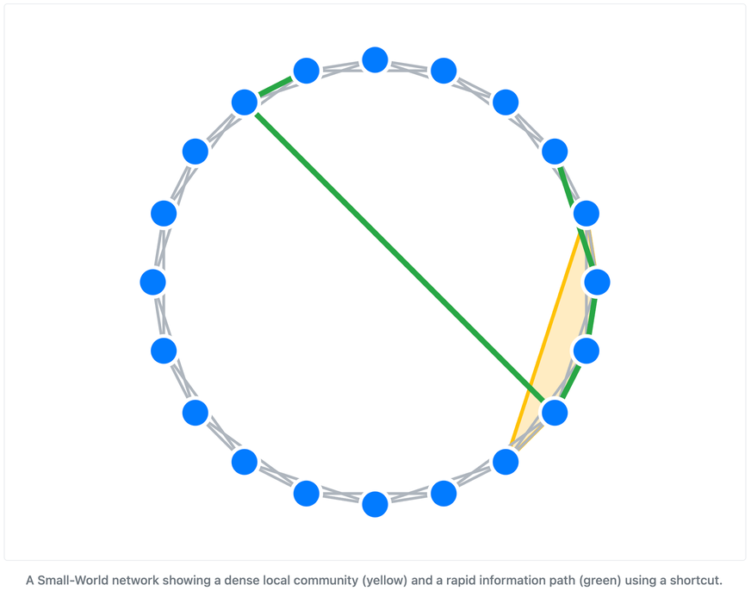
GRAPH -
"SMALL-WORLD" SWEET SPOT
This graph illustrates the result of the evolutionary rewiring process.
The Evolved Small-World Structure (small p)
Community Structure is Preserved: The high clustering (yellow area) from the original ordered network remains. This explains why we have distinct groups of friends or colleagues.
Global Connection is Achieved: The few rewired "shortcuts" (red edge) create superhighways for information. The green path shows how a message can now jump across the network in a few steps, explaining rapid information diffusion.
14

Slide 7
ROLE IN NETWORK GROWTH & LIMITATIONS
Applications (Why it's a key model):
Information Diffusion: Explains viral trends and how ideas jump between communities.
Social Network Structure: Models how we can have tight friend groups but still feel connected to a larger global community.
Biological Networks: Found in brain neuron connections and gene networks.
Limitations (Connecting to the next speaker):
It's NOT a True Growth Model: The key limitation in our context is that the Watts-Strogatz model does not add new nodes. It starts with a fixed number of members and only evolves the links between them.
No "Hubs" (Scale-Free Property): It doesn't explain why some nodes (like celebrities or major websites) have vastly more connections than others.
This sets the stage for other models, like Preferential Attachment, which are true growth models that explain the emergence of these popular hubs.
15

Slide 8
THANK YOU
16

