Slide 1
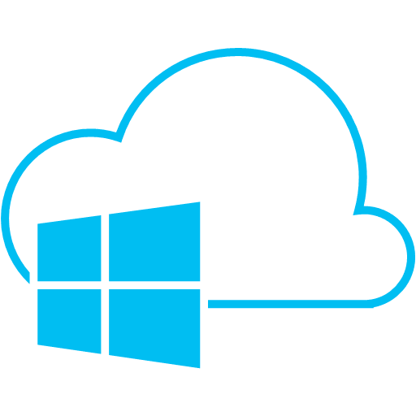
Microsoft Azure
Brief Overview and Creation of Test Website
Notes:
Introduction
Сленг:
Вижла, засекьюрить, Services

Slide 2

What is Microsoft Azure?

Slide 3
From Official Website
“Azure is Microsoft’s cloud computing platform, a growing collection of integrated services - analytics, computing, database, mobile, networking, storage, and web - for moving faster, achieving more, and saving money.”
http://azure.microsoft.com/
Notes:
Which Cloud Architecture?
The canonical benefit of cloud computing is the business agility fueled by the IT scalability enabled by the massive computing resources made available to the application developers. Businesses will no longer be bogged down by the IT resource issues as they now can easily create new solutions to help existing customers, venture into new business domains and enter new markets unhindered. While the business and IT agility characteristics are common to both PaaS and IaaS, some nuanced differences in the context of an application will make one of them more suitable for adoption.

Slide 4
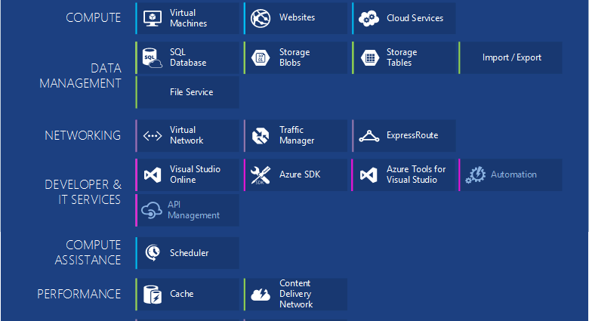
Azure Components
Notes:
https://azure.microsoft.com/en-us/documentation/articles/fundamentals-introduction-to-azure/
Icons:
https://www.amido.com/azure-icons-for-lucidchart/

Slide 5
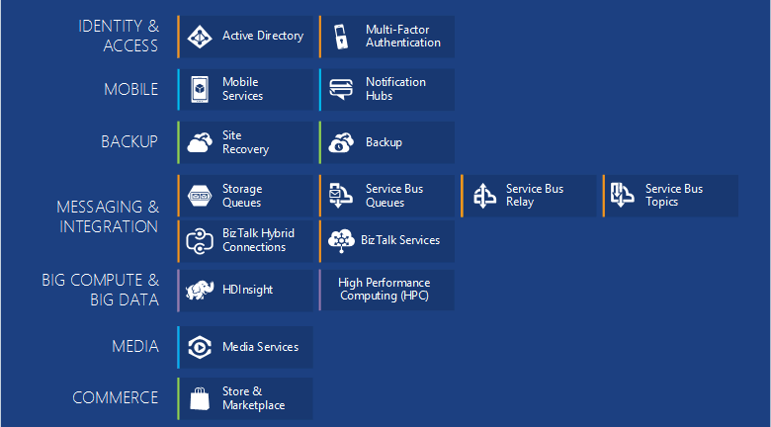
More Azure Components
Notes:
https://azure.microsoft.com/en-us/documentation/articles/fundamentals-introduction-to-azure/

Slide 6

Azure Geography
Azure operates out of 17 regions around the world
Notes:
http://azure.microsoft.co
AZURE REGION LOCATION
Central US Iowa
East US Virginia
East US 2 Virginia
US Gov Iowa Iowa
US Gov Virginia Virginia
North Central US Illinois
South Central US Texas
West US California
North Europe Ireland
West Europe Netherlands
East Asia Hong Kong
Southeast Asia Singapore
Japan East Tokyo, Saitama
Japan West Osaka
Brazil South Sao Paulo State
Australia East New South Wales
Australia Southeast Victoriam/en-us/regions/

Slide 7
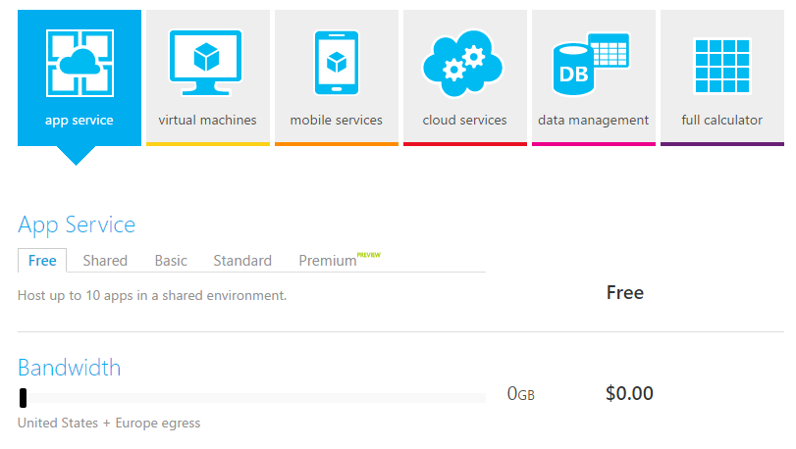
Pricing Calculator
Screenshot
Notes:
http://azure.microsoft.com/en-us/pricing/calculator/?scenario=appservice

Slide 8

alternatives

Slide 9
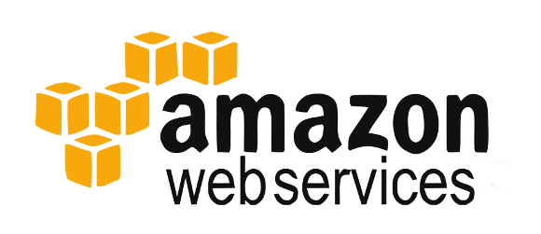

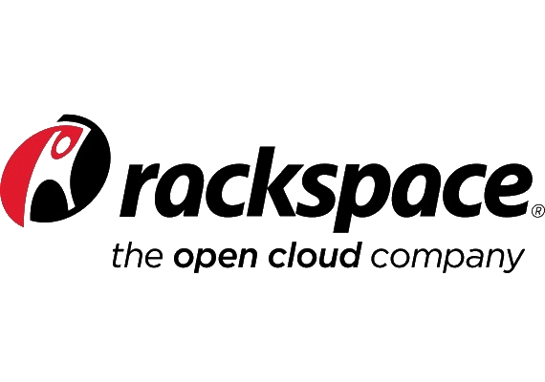
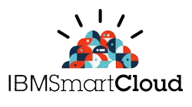

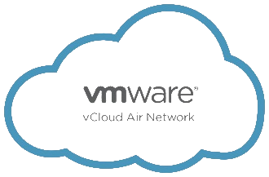
Cloud Solutions
War of Attrition
Notes:
Slides “Windows Azure vs. Amazon AWS”:
http://www.slideshare.net/tekcraft/azure-vsamazon?related=1
https://image.slidesharecdn.com/warofattritioninfographicv1-150103195155-conversion-gate02/95/war-of-attrition-aws-vs-google-ibm-and-microsoft-azure-1-638.jpg?cb=1424632280

Slide 10
Public Cloud Usage 2015
Notes:
Information from:
http://assets.rightscale.com/uploads/pdfs/RightScale-2015-State-of-the-Cloud-Report.pdf
http://www.rightscale.com/blog/cloud-industry-insights/cloud-computing-trends-2015-state-cloud-survey
In private cloud leading VMware
In January 2015, RightScale conducted its fourth annual State of the Cloud Survey of the latest cloud computing trends, with a focus on infrastructure-as-a-service. The survey asked 930 IT professionals about their adoption of cloud infrastructure and related technologies. The respondents ranged from technical executives to managers and practitioners and represented organizations of varying sizes across many industries. The margin of error is 3.2 percent.
Крупнее

Slide 11
Public Cloud Usage 2015 vs. 2014
Notes:
In private cloud leading VMware

Slide 12
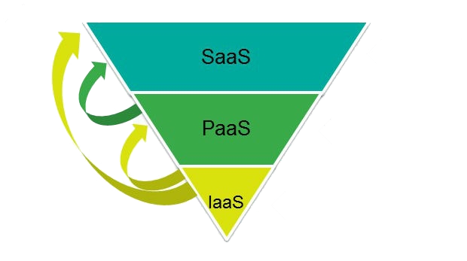
Cloud Service Models

Slide 13
Cloud Service Models
Managed by Customer
Managed by Vendor
Private
(On-Premises)
Infrastructure
(as a Service)
Platform
(as a Service)
Software
(as a Service)
Applications
Applications
Applications
Applications
Data
Data
Data
Data
Runtime
Runtime
Runtime
Runtime
Middleware
Middleware
Middleware
Middleware
O/S
O/S
O/S
O/S
Virtualization
Virtualization
Virtualization
Virtualization
Server
Server
Server
Server
Storage
Storage
Storage
Storage
Networking
Networking
Networking
Networking
Notes:
Windows Azure IaaS vs. PaaS vs. SaaS
http://robertgreiner.com/2014/03/windows-azure-iaas-paas-saas-overview/
Which Windows Azure Cloud Architecture? PaaS or IaaS ?
http://blogs.msdn.com/b/hanuk/archive/2013/12/03/which-windows-azure-cloud-architecture-paas-or-iaas.aspx
Platform as a Service - PaaS
PaaS is the self-service enabled compute service that provisions computing resources in terms of CPU, memory and volatile disk storage through resource descriptors provided at the deployment time. The unit of deployment in PaaS is an application package and its associated data. PaaS is characterized by the stateless compute nodes which will be complimented by a collection of managed services for accelerating the application delivery to the market. These managed services shown in the picture below are not unique to PaaS as the same can be consumed inside an IaaS hosted application.
Windows Azure PaaS is available to application developers as Web Role and Worker Role abstractions deployed into a resource container titled Cloud Service. The role abstractions encapsulate a programming model and a deployment model aided by a resource descriptor which when combined provides complete metadata for design time deployment as well as run time operations. The Web Role presents ASP.NET programming model that is meant to be used as a template for spawning individual node instances of a web farm as dictated by the accompanying XML resource descriptor.
The Worker Role exposes a background processing programming model for implementing batch processing farms with the necessary resources described in the accompanying XML resource descriptor.
There are several variations of the above roles resulting from the customizations for meeting specific platform needs. Examples are: ASP.NET MVC4 Web Role, WCF Service Web Role, Cache Worker Role and Worker Role with Service Bus Queue. These custom roles at provisioning time will invariably be mapped to either a Web Role or a Worker Role.
Web Role, Worker Role and Cloud Service collectively presents a design time sand box which by default constrains developers from taking hard dependencies on the underlying OS environment. Because of the low surface area between the deployed application and the OS, system software upgrades and security patches by Windows Azure is totally opaque to the application. Automated server maintenance presents a tangible opex savings relative to its IaaS counterpart. The complete list of positive and negative aspects of PaaS are listed below:
Advantages of PaaS
Business: Low Total Cost of Ownership
Automated server maintenance and auto scaling of compute resources for meeting temporal resource demands are the two significant contributors towards lowering the cost of operations. Optimizing operational cost is a key requirement for services operated by cost centers like corporate IT shops which services internal employees. Profitability of certain types of services targeting external customers is sensitive to the operational cost profiles especially the services that are commodity in nature. Commodity services tend to have a lot of competition both from the open source as well as the proprietary providers; the resulting price pressure will make PaaS a suitable hosting platform. Examples of such commodity services include content management, collaboration, storage and other horizontal services.
Certain intellectual property oriented cloud services in the vertical domains like airline revenue management with proprietary algorithms, reservoir simulation in upstream oil & gas operations, seismic interpretation applications for oil & gas exploration, real-time billing for telecom providers, etc. may not have as much price pressure as the commodity services. Providers of these services can afford to extract much larger per-seat licensing fee and hence their motivation towards a cloud architecture selection is not driven by the cost but by the flexibility of the architecture to realize the implementation. Since these vertical applications often require complete control of the OS due to the variety of factors including the usage of low level OS APIs and the 3rdparty libraries that may not be compatible with the PaaS sandbox, they may favor IaaS.
Business: Accelerates Innovation
Azure team tests the latest OS and application platforms and makes them available for developers to use in their applications. Due to the surface area between the application and the underlying platform is optimal in PaaS, developers will be able to move to new releases easily and build innovative solutions to meet the market demands. With IaaS, applications tend to be sticky to the underlying platform due to the tight coupling resulting from the complete control developers have on the OS and application platform stack. Migrating to newer releases of the infrastructure is much harder in IaaS resulting in applications getting stuck in the older platforms there by hampering innovation.
Technology: Better Development Operations
Windows Azure PaaS is characterized by the REST interfaces for a fine grained interaction with the deployment artifacts. These interfaces are wrapped with developer friendly PowerShell commandlets for easy deployment of applications. Developers are no longer needed to work at the levels that require deep understanding of the OS and the networking infrastructure. OS patch management and upgrades are no longer needed to be part of the runbook for operating PaaS hosted applications.
Adding a new network interface, public or private, is merely a data entry job; the developer is no longer need to be aware of the network adapters, binding IP addresses and entering port number exceptions in the server firewall or setting up routing tables. PaaS makes all of this very simple by allowing a developer to add network endpoints with public and private port mapping through intuitive commands or UI. Developers can also specify system diagnostics like performance monitor counters and application specific events from within the deployment descriptor without ever knowing the arcane aspects of Windows Server performance monitor event configuration. Essentially developers will work with applications and data which they are very familiar with. The data may include deployment metadata as well as line of business data.
Technology: Mitigates Vulnerability Risks
Maintaining physical and/or virtual servers is a laborious process as it involves downloading of the patches, testing them on a representative sample of servers, verify application compatibility, distribute patches and perform rolling upgrades so as to not to impact the availability of the mission critical apps. In spite of the advances in automation, it still requires significant effort on the part of the IT Pros to keep the infrastructure healthy. Azure PaaS team takes care of the infrastructure health by keeping the infrastructure updated against all the known vulnerabilities for which fixes have been distributed. Since this process is opaque to the developers and is automatic, the risk of information breach resulting from the known vulnerabilities is significantly reduced
Disadvantages of PaaS
Harder Transition to Cloud
Leveraging the intellectual property embedded in existing applications is relatively harder with PaaS given the extent of rework necessary for certain types of applications due to the PaaS sandbox restrictions. Applications that rely on local file system, expect locally stored data to be persistent between restarts, applications that rely on dynamic TCP and UDP ports, applications that rely on MAC address for licensing, and applications that require reboots during installation (e.g. installation of a driver) are some examples that require rework if at all if they can be migrated to Azure PaaS without sacrificing the core functionality. Applications with dependencies on 3rd party SDKs and servers which may not have been certified to run inside the PaaS sandbox will also run into cloud migration issues. Due these reasons a service provider can’t transform their business through cloud adoption at the pace the market demands.
Technology: Application Portability Issues
Due to the run time environment differences between Azure PaaS and the on-premise setup, applications have to be modified to be more transparent in terms of the telemetry they generate so that IT Professional can gain more insights into the operations and proactively mitigate the availability and scalability risks. Rewiring the diagnostics, accommodating resource governance in a multi-tenant setting, local file system access and implementing software metering are a few PaaS specific work items that will impact time-to-market and application portability. Due to these PaaS specific changes to the application, it is not easy to take the same application and run it on-premise.
Technology: PaaS ISV Ecosystem is not as mature as IaaS
PaaS ISV ecosystem is not as mature as its IaaS counterpart yet. If an app requires a specific RMS implementation, management & monitoring product or a specific license enforcement product, the chances are that these may not be available on Azure PaaS yet. IaaS will be a good cloud path for such applications due to the immediate portability of these 3rd party solutions. Of course one has to work with the respective ISVs for supportability of these products before making plans for cloud hosting.
Technology: Different Codebases for Cloud and Premise
Many cloud providers require the same code base for cloud hosting as well as for deploying on-premise at their customers. Due to the irreversible chances one has to make for PaaS deployment, ISVs will have to maintain two different build scripts and two sets of libraries that will adapt the build to multiple deployment and run time environments. This requires deliberate architecture effort that separates core libraries from the environment specific libraries and combine them at build time or inject them at run time into the execution context. This requires skilled architects and software designers to build systems for polymorphic deployments.
Infrastructure as a Service - IaaS
IaaS is a managed compute service that gives complete control of the OS and the application platform stack to the application developers and IT Professional which is analogous to Hyper-V and other virtualization platforms. The unit of deployment is at the granularity of a virtual machine. Developers with the help of IT Professionals deploy virtual machines, application bits and the associated data to the target compute infrastructure. Even though developers get complete control of the stack at the design time, the deployment still needs to consider the systemic qualities of the application influenced by the storage, virtual networking and the managed services ecosystem that surrounds it. While IaaS gives design time portability, in due course the application may take advantage of the managed services (e.g. Azure Storage, cache) that will impact its overall portability. Similar to the analysis of PaaS, we will take look at the advantages and disadvantages of IaaS from both business and technology angles.
Advantages of IaaS
Business: Quick transition to Cloud
Due to the excellent portability enabled by IaaS, ISVs now can easily start offering cloud hosted services to their customers with minimal effort. This will help business expansion through upselling within the current customer base as well as into new markets (e.g. small and medium businesses who don’t have much infrastructure) and new geographies. The quick time-to-market aspects of IaaS helps ISVs in establishing their leadership in their respective domains through the agility of technology adaption towards new inflexions in computing.
Technology: Mature ISV Ecosystem
Mature ISV ecosystem readily offers various solution and operational components that are popular in an on-premise setting. A DRM component for protected content, a special encryption component for compliance, or a domain specific search service for information discovery within your app, anything and everything that is required by your application can be found compatible for running on IaaS. From the operations perspective, leveraging 3rd party components for integrating with the enterprise helpdesk, trouble ticket systems and management and monitoring infrastructure is pretty easy in IaaS relative to PaaS.
Technology: Complete Control
Applications that require complete control (e.g. Disaster Recovery services that need to clone the drive by capturing disk IO at the driver level, software licensing service based on the virtual MAC address) can be built on IaaS. The developers and IT professionals have access to the complete app platform stack, user mode subsystems and kernel level control so that the VM can be customized to the needs of the business domains they serve. Some business domains like telecom and financial services require security hardened OS distributions that can only be satisfied by IaaS.
Technology: Solution Portability
IaaS allows excellent design time portability of the application assets as the granularity of the deployment is a Virtual Hard Drive (VHD) containing both OS and application bits. Application owners can easily migrate their Windows as well as Linux application and system code to Windows Azure without any rework. This assumes that all the system dependencies including database servers (e.g. Oracle, SQL Server, MySQL) and 3rd party components (e.g. Redis, RabitMQ, Cassandra) are also portable along with the application bits. ISVs often thrive to maximize the value of their investment by reusing the existing software assets in the cloud and IaaS is a perfect vehicle for accomplishing that.
Disadvantages of IaaS
Business: Expensive to Operate
Expensive to operate as the solutions have to factor in the higher server maintenance for software patching and upgrades. IaaS generally tend to operate its own database servers and other supporting application infrastructure (e.g. Active Directory) which also adds to the cost of operations relative to PaaS. PaaS is more conducive to the usage of cloud provider’s managed services (e.g. Azure Storage, Azure SQL Database, Azure AD) there by making it a better opex friendly compared to IaaS.
Business: Slows Down Innovation
The complete control on the OS and application server stack encourages developers to take dependencies on specific versions of the OS and app server. As a result, application migration to future versions of the OS and app server ecosystem becomes progressively harder and harder. This will not only slow down innovation but also becomes harder to find developers to maintain the existing system.
Business: Security Risks from Unpatched Servers
Many companies have well defined processes for testing and updating on-premise severs for security vulnerabilities. These processes need to be extended to the cloud hosted IaaS VMs to mitigate hacking risks. An unpatched server hosting sensitive data and processing logic can pose a huge PR risk for the company. There are no such problems with PaaS as server patching is automatically taken care of.
Technology: Difficult to Maintain Legacy Apps
Can be stuck with the older version of the operating systems and application stacks. This can result in applications that are difficult to maintain and add new functionality over the period of time. This often will result in massive reengineering efforts that are very risky. For example, companies stuck with VB6, VC++ and MFC find very difficult to find programmers to maintain the systems let alone program new systems. Some point in time they have to start massive fundamental architecture work to mitigate the legacy issues.
Technology: Requires Rigorous Processes for Enabling DevOps
IaaS based applications suffer from the same DevOps issues that plague on-premise deployments. It requires rigorous processes to bring developers and IT Pros together to build operations’ friendly applications. One of the important tools of enabling DevOps is the deployment automation and the application instrumentation; given that these two aspects are not as fundamental to IT shops as they are to a PaaS service provider, IaaS requires rigorous processes to build operations friendly cloud services.
Technology: Requires Rigorous Server Maintenance Processes
Diligent processes are required for server patching and upgrades; this is more so for smaller companies than larger companies with mature server maintenance practices. Customers have to set up patch testing environment either in the cloud or an on-premise representative app environment so that every patch that is applied to the servers will not impact production applications. IT Pros in conjunction with developers need to build smoke test scripts and run them to ensure that the patches won’t take down the mission critical systems. There is no need of patching the PaaS compute infrastructure due to the cloud provider taking care of it.
Conclusion
PaaS and IaaS are part of the larger cloud ecosystem where managed services add a lot of value to the deployment in terms of the accelerated solution development. While these two cloud architectures have their respective benefits as outlined in this document, focusing on either PaaS or IaaS alone only sheds light on a smaller part of the overall application run time environment that is compute. PaaS has a definite economic advantage for operations over IaaS for commodity applications where cost of operations breaks the business model. On the other hand, IaaS gives complete control of the OS and application platform stack which is a requirement for certain class of applications.

Slide 14
Infrastructure (as a Service)
IaaS is a managed compute service that gives complete control of the OS and the application platform stack to the IT Professional. The unit of deployment is at the granularity of a virtual machine.
Advantages
Quick transition to Cloud
Disadvantages
Solution Portability
Expensive to Operate
Slows Down Innovation
Security Risks from Unpatched Servers
Requires Server Maintenance Processes
Complete Control

Slide 15
Platform (as a Service)
“PaaS is the self-service enabled compute service that provisions computing resources in terms of CPU, memory and disk storage. The unit of deployment is an application package and its associated data.”
Advantages
Low Total Cost of Ownership
Disadvantages
Accelerates Innovation
Better Development Operations
Harder Transition to Cloud
Different Codebases for Cloud and Premise
PaaS Ecosystem is not as mature as IaaS
Mitigates Security Risks
Notes:
Harder Transition to Cloud
Move
Different Codebases for Cloud and Premise
Configure
Take Advantage of PaaS Where You Can
Many Applications could benefit from migrating to a mixed deployment. Migrating to web/worker roles or taking advantage of other Windows Azure services (storage, cache etc..)
Benefits of Web and Worker Roles
Simplified Deployment and Configuration
Health Model
Easy High Availability
Instance Scalability
OS Patching
Automatic Firewall Configuration
Simple Certificate Deployment
Many others

Slide 16








Cloud Service Models and Azure
IaaS
Virtual Machines
PaaS
SaaS
App Services
Cloud Services
WordPress
Django
Joomla
New Relic
Check Azure Market
Notes:
Windows Azure IaaS vs. PaaS vs. SaaS
http://robertgreiner.com/2014/03/windows-azure-iaas-paas-saas-overview/
IaaS: VM
PaaS: CloudServices, WebSites, SQL Azure
SaaS: WebSites (Drupal, Jumla), SharePoint,
Icons:
https://www.amido.com/azure-icons-for-lucidchart/

Slide 17
Azure IaaS vs PaaS Statistics

Slide 18

From Words to Deeds
Notes:
https://portal.azure.com
https://manage.windowsazure.com

Slide 19
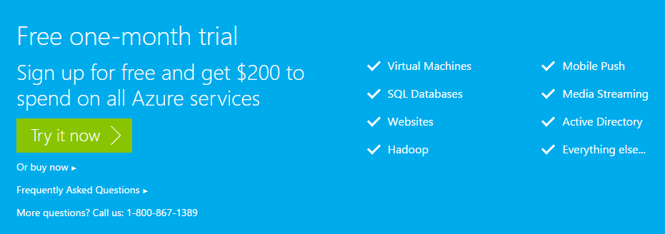
How to Try (Free Trial)
Screenshot
Notes:
Cost 1$
Free one-month trial
http://azure.microsoft.com/en-us/pricing/free-trial/

Slide 20
How to Manage
From Visual Studio with Azure SDK
From Management Portals:
https://manage.windowsazure.com
https://portal.azure.com (beta)
Using PowerShell Console
Notes:
How to install and configure Azure PowerShell:
https://azure.microsoft.com/en-us/documentation/articles/powershell-install-configure/

Slide 21
Azure SDK and Command-line Tools
The Azure SDK for .NET is the core building block that helps developers author Cloud Services using Azure Service Runtime Programming model, debug using emulators on the local machine, and deploy to Azure data centers in the cloud.
The Azure SDK Policy covers Azure SDK Authoring Tools, Command line utilities, Compute & Storage Emulators, and Azure Tools for Microsoft Visual Studio.
Notes:
Downloads:
http://azure.microsoft.com/en-us/downloads/
Main data from:
https://msdn.microsoft.com/en-us/library/azure/dn479282.aspx
How to install and configure Azure PowerShell
https://azure.microsoft.com/en-us/documentation/articles/powershell-install-configure/

Slide 22

App Service (Web App)
Notes:
Link to Icon:
https://github.com/amido/azure-vector-icons/blob/master/icons/Web%20Sites.svg

Slide 23
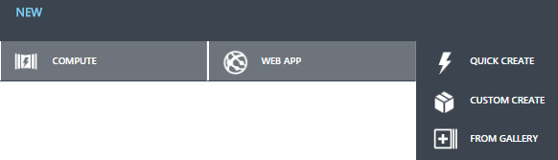

Create App Service
Screenshot
From Management Portals
From Visual Studio Interface
Using PowerShell Console
Screenshot
Notes:
How could be created?

Slide 24
Create App Service from PowerShell
Code Snippet
$AzureSubscriptionId = "Some_Azure_Subscription_Id"
Import-AzurePublishSettingsFile “**\*.publishsettings"
Set-AzureSubscription –SubscriptionId $ AzureSubscriptionId
$AzureTestWebSite = "workshop-created-from-ps"
New-AzureWebsite $ AzureTestWebSite
Get-AzureWebsite -Name $ AzureTestWebSite
Stop-AzureWebsite -Name $ AzureTestWebSite
Get-AzureWebsite -Name $ AzureTestWebSite
Remove-AzureWebsite -Name $ AzureTestWebSite
Get-AzureWebsite
CreateWebSite.ps1
Notes:
How to install and configure Azure PowerShell
https://azure.microsoft.com/en-us/documentation/articles/powershell-install-configure/
Clear-AzureProfile before the Add-AzureAccount
http://blogs.msdn.com/b/devfish/archive/2015/02/12/get-azurevm-your-azure-credentials-have-not-been-set-up-or-have-expired-please-run-add-azureaccount-to-set-up-your-azure-credentials.aspx
Add-AzureAccount
https://msdn.microsoft.com/en-us/library/dn495128.aspx
New-AzureWebsite
https://msdn.microsoft.com/en-us/library/azure/dn495157.aspx

Slide 25
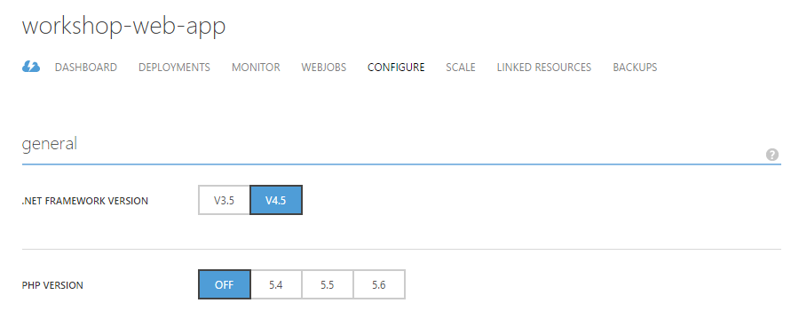
Check Web App Configuration
Screenshot

Slide 26
Deploy a Web App
Deploy from a cloud-hosted source control system
Deploying from an IDE
Deploy using an FTP utility
Deploying from an on-premises source control system
Deploy using command-line tools and the Azure REST management API
Octopus Deploy
Notes:
Deploy a web app in Azure App Service
https://azure.microsoft.com/en-us/documentation/articles/web-sites-deploy/

Slide 27

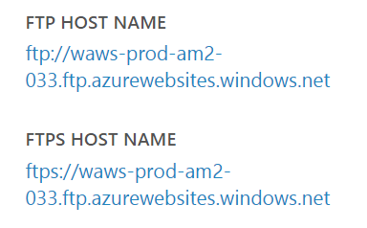
FTP Access
Just create FTP credentials and use provided on Management Portal access points
Screenshots

Slide 28
Secure a Web App in Azure App Service
Secure communications (HTTPS)
Secure development
Publishing profiles and publish settings
Configuration settings, and connection strings
SFTP
Notes:
Show on Azure Portal
Secure a web app in Azure App Service
https://azure.microsoft.com/en-us/documentation/articles/web-sites-security/
Secure communications
If you use the .azurewebsites.net domain name created for your web app, you can immediately use HTTPS, as an SSL certificate is provided for all **.azurewebsites.net** domain names. If your site uses a custom domain name, you can upload an SSL certificate to enable HTTPS for the custom domain.
Publishing profiles and publish settings
When developing applications, performing management tasks, or automating tasks using utilities such as Visual Studio, Web Matrix, Azure PowerShell or the Azure Command-Line Interface (Azure CLI), you can use either a publish settings file or a publishing profile. Both authenticate you to Azure, and should be secured to prevent unauthorized access.
Configuration settings, and connection strings
It's common practice to store connection strings, authentication credentials, and other sensitive information in configuration files. Unfortunately, these files may be exposed on your website, or checked into a public repository, exposing this information.

Slide 29
Web Jobs
WebJobs is a feature of Azure App Service that enables developers to run a program or script in the same context as a web app. The purpose of the WebJobs SDK is to simplify the task of writing code that runs as a WebJob and works with Azure Storage queues, blobs, and tables, and Service Bus queues.
On Demand
Continuous
Schedule
Notes:
Definition from here:
https://azure.microsoft.com/en-us/documentation/articles/websites-dotnet-webjobs-sdk/
Introducing Windows Azure WebJobs
http://www.hanselman.com/blog/IntroducingWindowsAzureWebJobs.aspx

Slide 30

Traffic Manager

Slide 31
Traffic Manager (Overview)
“Microsoft Azure Traffic Manager allows to control the distribution of user traffic to specified endpoints, which can include Azure cloud services, websites, and other endpoints.”
“Traffic Manager works by applying an intelligent policy engine to Domain Name System (DNS) queries for the domain names of Internet resources.”
Notes:
Traffic Manager Overview
https://azure.microsoft.com/en-us/documentation/articles/traffic-manager-overview/

Slide 32
Service Level Agreements (SLA)
99.95%
“We [Microsoft Azure Team] guarantee that Web Apps, Mobile Apps, Logic Apps, and API Apps running in a customer subscription will be available 99.9% of the time, with a 99.95% SLA provided when multiple instances and traffic manager are used. No SLA is provided for Apps or sites under either the Free or Shared tiers.”

Slide 33
How Traffic Manager Works
a.root-servers.net
…
k.root-servers.net
ns1.workshop.info
ns2.workshop.info
3
Q: What is www.workshop.info?
A: CNAME to workshop-web-app.trafficmgr.com
1
Q: What is www.workshop.info?
A: Ask ns1/2.workshop.info
4
2
5
Q: What is workshop-web-app.trafficmgr.com?
6
Which deployments are up?
9
A: 11.22.33.44
Users’ LDNS IP=99.88.77.66
DNS Server
Policy Engine
7
What are the regions for deployments A and B?
8
What is the network distance between IP 99.88.77.66 and
the US North and West Europe regions?
20ms
80ms
IP=11.22.33.44
IP=33.44.55.66
IP=22.33.44.55
“choose the best performing deployment” between:
Deployment A
Deployment B
Deployment C
workshop-web-app policy
Traffic Manager
Deployment A
US North
Deployment C (Down)
Deployment B
West Europe

Slide 34
Traffic Manager Benefits
Improve availability of critical applications;
Improve responsiveness for high performing applications;
Upgrade and perform service maintenance without downtime;
Traffic distribution for large, complex deployments.
Notes:
Improve availability of critical applications – Traffic Manager allows you to improve the availability of your critical applications by monitoring your endpoints in Azure and providing automatic failover capabilities when an Azure cloud service, Azure website, or other location goes down.
Improve responsiveness for high performing applications – Azure allows you to run cloud services or websites in datacenters located around the world. Traffic Manager can improve the responsiveness of your applications and content delivery times by directing end-users to the endpoint with the lowest network latency from the client.
Upgrade and perform service maintenance without downtime – Traffic Manager supports extended scenarios for hybrid cloud and on-premises deployments including the “burst-to-cloud,” “migrate-to-cloud,” and “failover-to-cloud” scenarios. For planned maintenance, you disable the endpoint in Traffic Manager and then wait for the endpoint to complete the servicing of existing connections. When there is no more traffic to the endpoint, you update the service on that endpoint and test it, then re-enable it in Traffic Manager. This helps you to maintain and upgrade your services without downtime for clients.
Traffic distribution for large, complex deployments – With nested Traffic Manager profiles, in which a Traffic Manager profile can have another Traffic Manager profile as an endpoint, you can create configurations to optimize performance and distribution for larger, more complex deployments. For more information, see Nested profiles.

Slide 35
Traffic Manager Load Balancing Methods
Failover: Select Failover when endpoints in the same or different Azure datacenters (regions in the Management Portal) and is going to use a primary endpoint for all traffic, but provide backups in case the primary or the backup endpoints are unavailable;
Round Robin: Select Round Robin when traffic need to be distributed across a set of endpoints in the same datacenter or across different datacenters;
Performance: Select Performance when endpoints in different geographic locations and requesting clients to use the "closest" endpoint in terms of the lowest latency.
Notes:
About Traffic Manager Load Balancing Methods
https://azure.microsoft.com/en-us/documentation/articles/traffic-manager-load-balancing-methods/

Slide 36


