Slide 1
Presentation
By Priyankar Bhattacharjee
Based on learning between 14th – 25th November

Slide 2
What is RTaaS?
RTaaS is abbreviation of Routing and Telephone as a Service
RTaaS consists of the following components –
MWI – Message waiting indicator
NCT – Nuisance call treatment
UCID- Universal Caller ID
STIR/Shaken

Slide 3
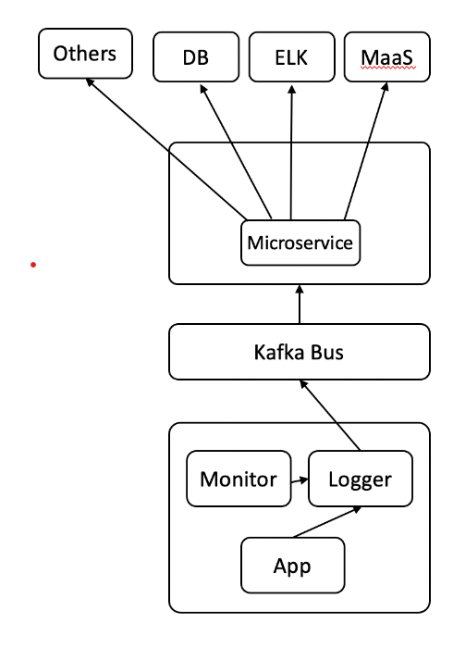
RTaaS Applications’ Architecture
Source: ICE Wiki

Slide 4
What is RTaaS _UCID?
UCID is an RTaaS application.
It is short for Universal Caller ID.
UCID is used for displaying calling id on TVs and mobile phones.

Slide 5
Basic working of UCID
1) CSCF sends INVITE request.
If Extracted details from INVITE indicate Comcast domain, UCID sends INVITE to Video Application Server. UCID also sends a POST request with XML data to TVNS.
CSCF sends invite request. If Extracted details from INVITE indicate Cox, UCID sends a POST request with JSON data to Cox Http server.
2) UCID also writes to Kafka,
3) GEM collects information from Kafka. This information is utilized by applications like ELK, MaaS, Promethius etc.

Slide 6
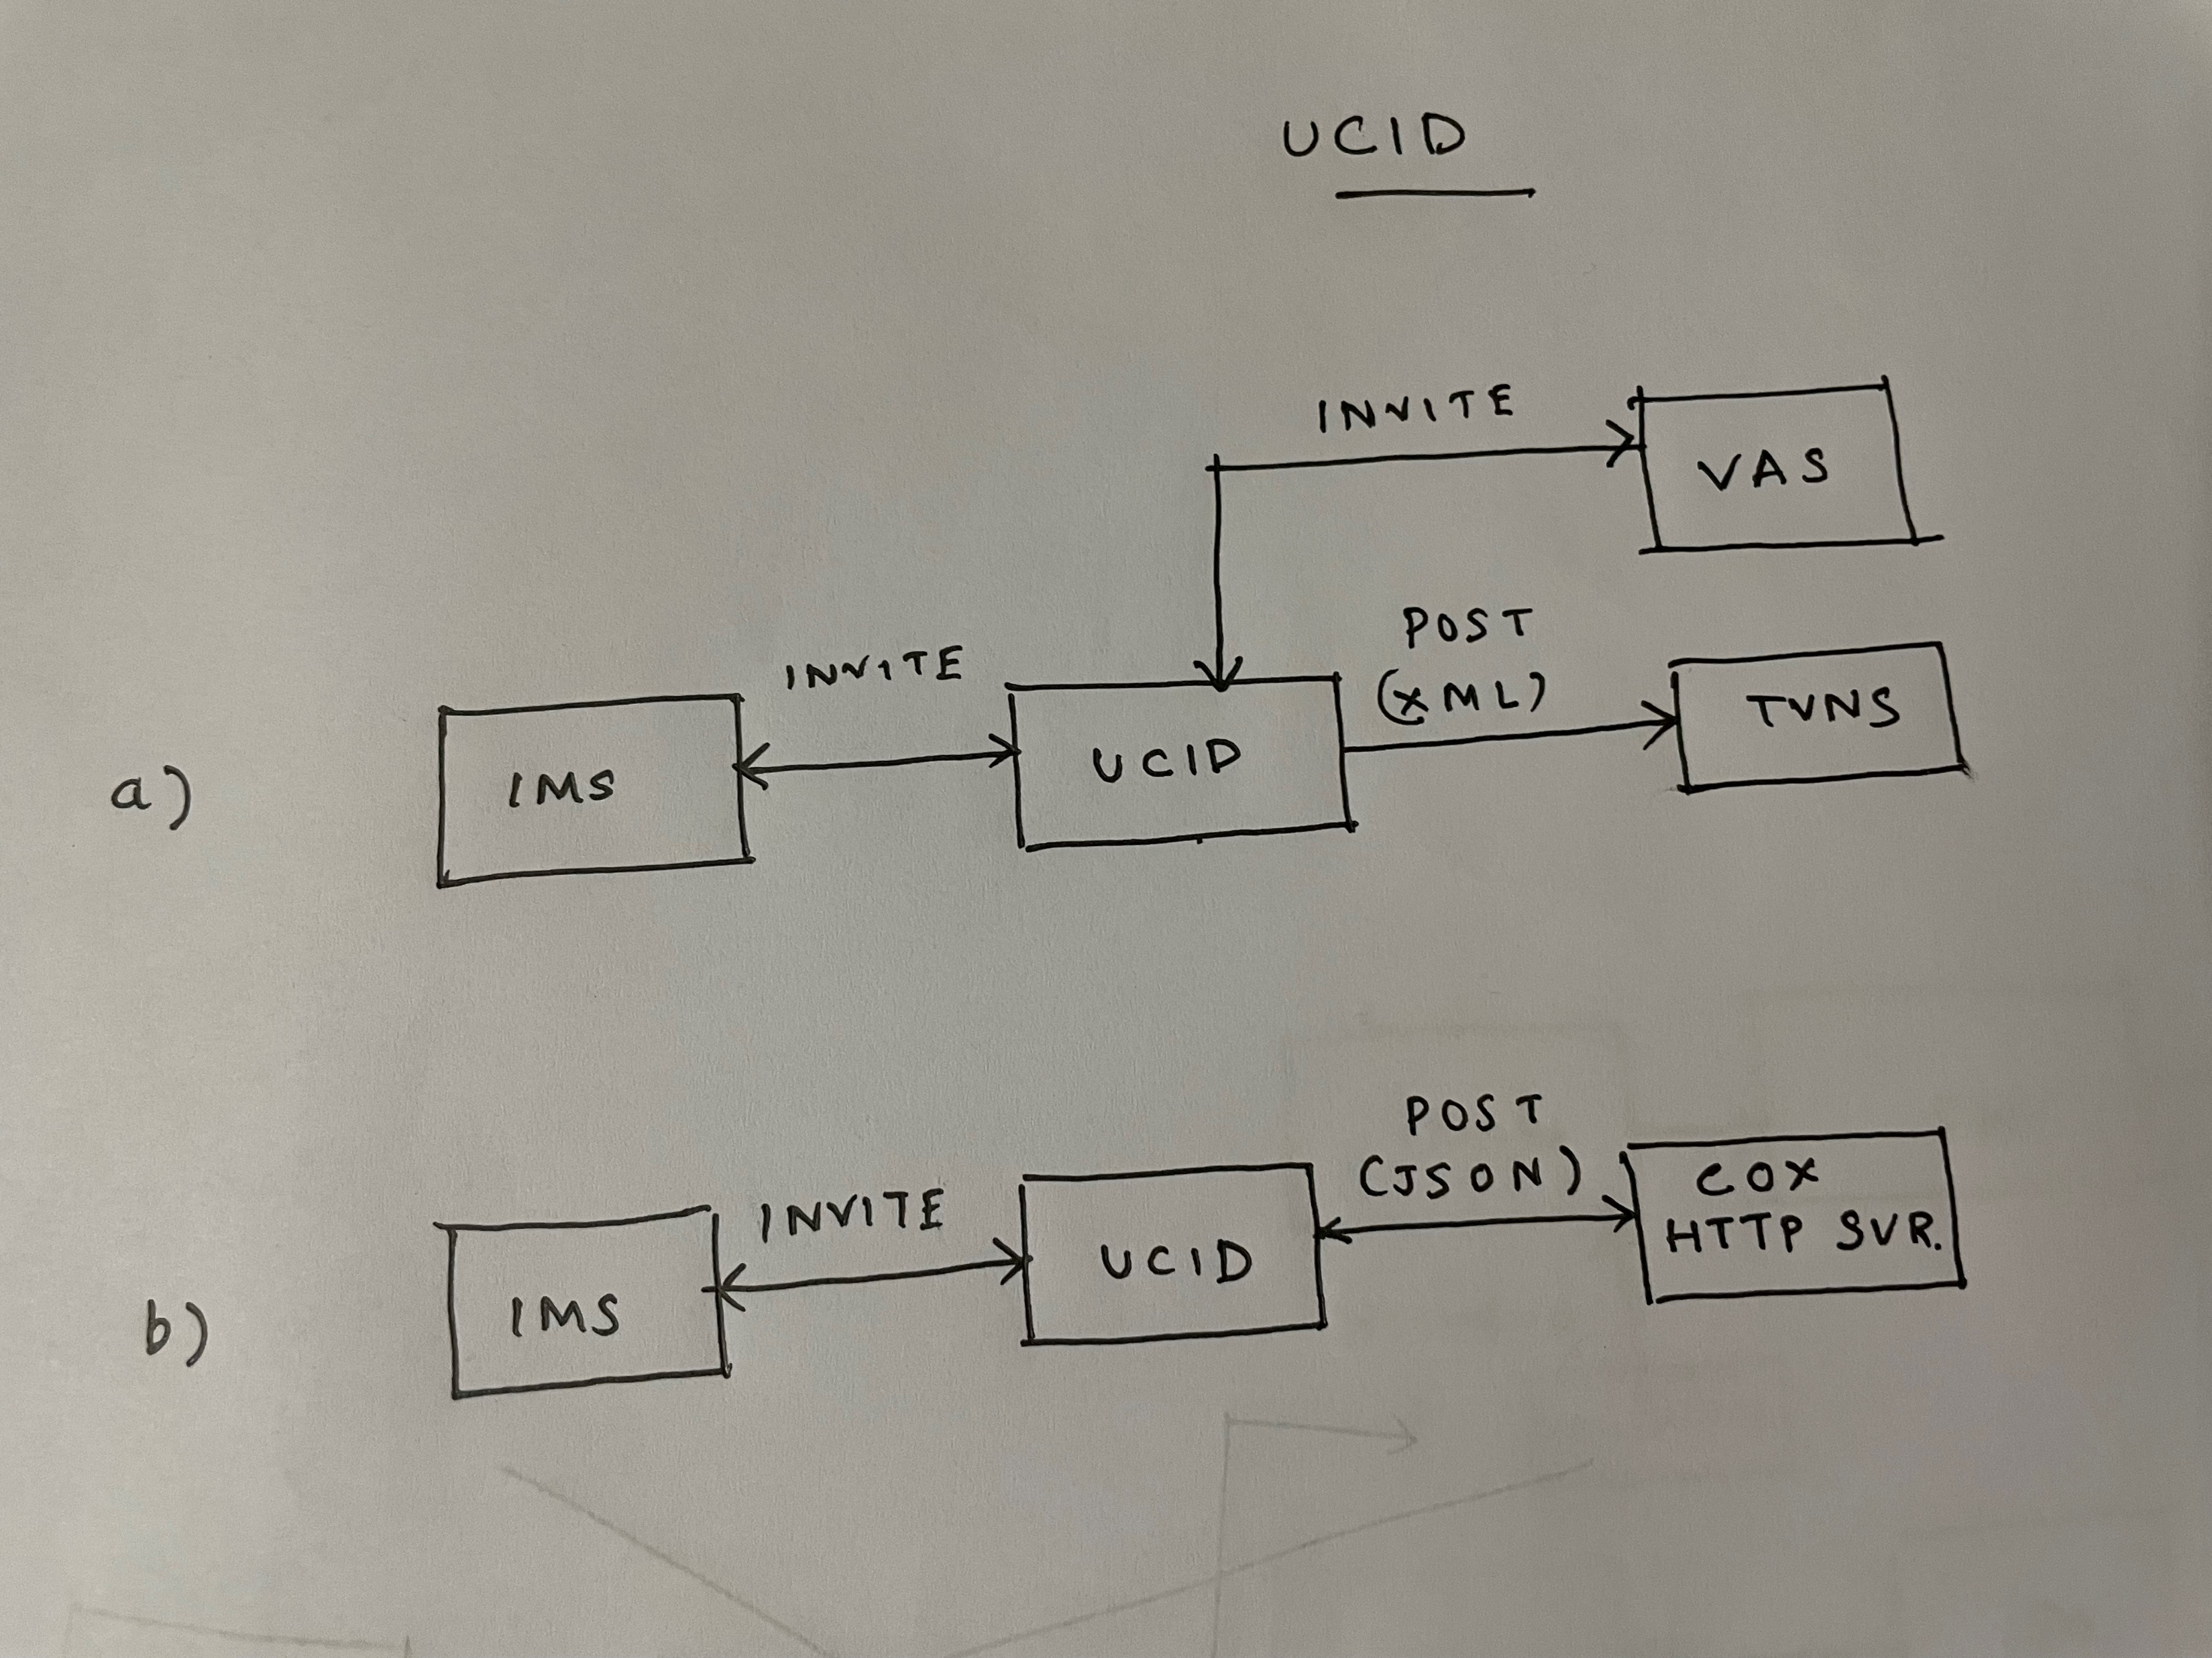

Slide 7
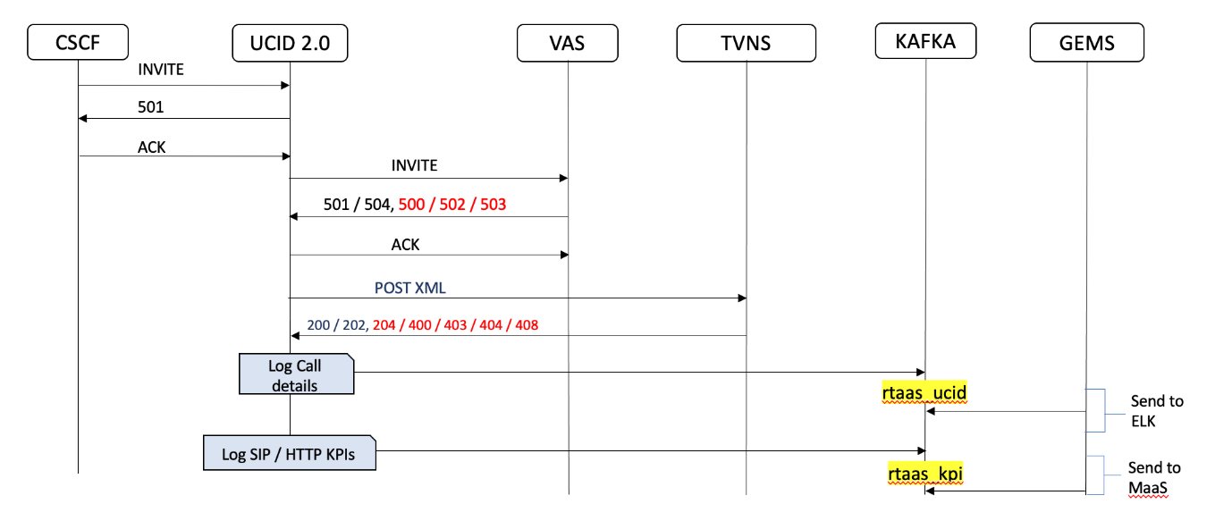
UCID Call Flow (Comcast)
Source: ICE Wiki

Slide 8
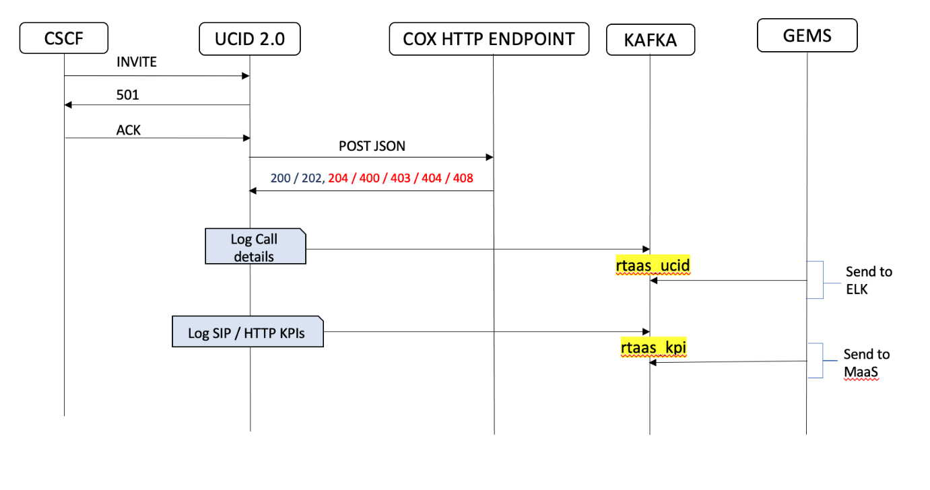
UCID Call Flow (Cox)
Source: ICE Wiki

Slide 9
Message Waiting Indicator (MWI)
MWI acts as a broker between the eDVA and Voicemail server.
Functions
Receives Publish from NEXT VM/Cox SBC.
Sends 200 response.
Reports logs.
Adds/updates data to the database.

Slide 10
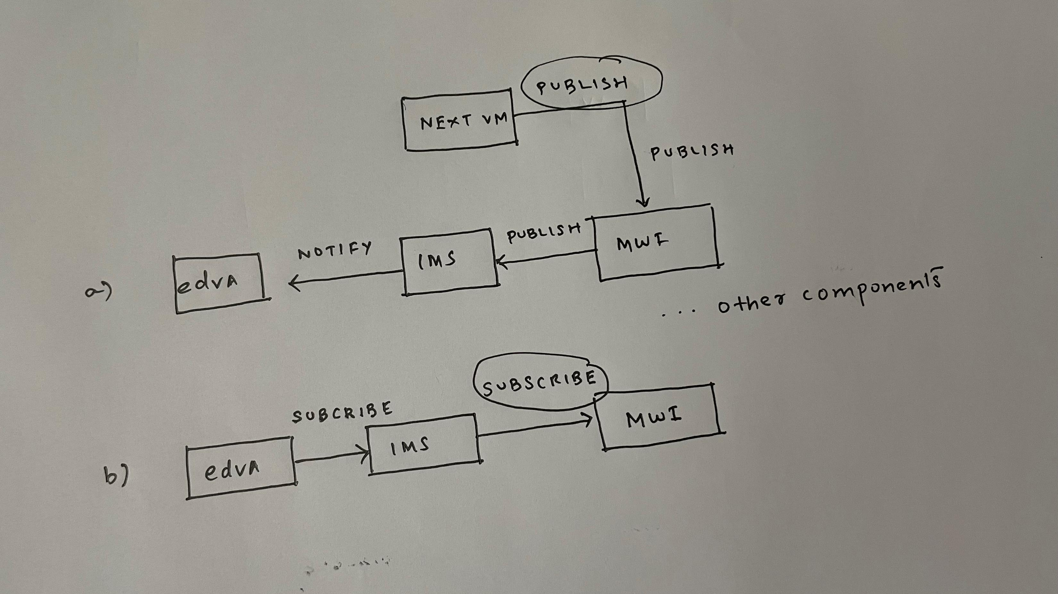
Broker

Slide 11
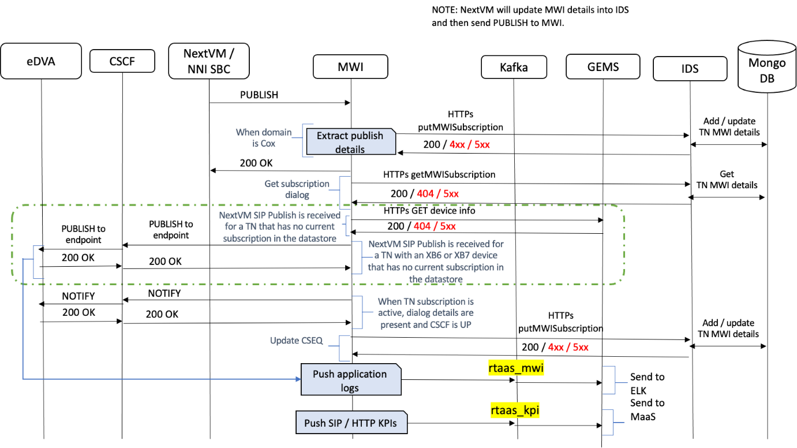
Publish Call Flow
Source: ICE Wiki

Slide 12
Niffler
Automation tool for regression sanity tests.
Input files
XML file contains SIPP call flow.
CSV file for test cases.
Yet to see it in action ..

Slide 13
In progress
Reading through UCID & MWI strategy documents.
Studying SMB MWI IRIS traces in TestRail.

Slide 14
Thanks
Questions?

