Slide 1
OBJECT ORIENTED PROGRAMMING Multithreading
Prepared by
Dr. Abinash Tripathy
School of Computer Application
KIIT Deemed to be University, Bhubaneswar

Slide 2
Multithreading in Java
Multithreading in java is a process of executing multiple threads simultaneously.
A thread is a lightweight sub-process, the smallest unit of processing.
Multiprocessing and multithreading, both are used to achieve multitasking.
However, we use multithreading than multiprocessing because threads use a shared memory area. They don't allocate separate memory area so saves memory, and context-switching between the threads takes less time than process.

Slide 3
Advantage of Java Multithreading
It doesn't block the user because threads are independent and you can perform multiple operations at the same time.
You can perform many operations together, so it saves time.
Threads are independent, so it doesn't affect other threads if an exception occurs in a single thread.

Slide 4
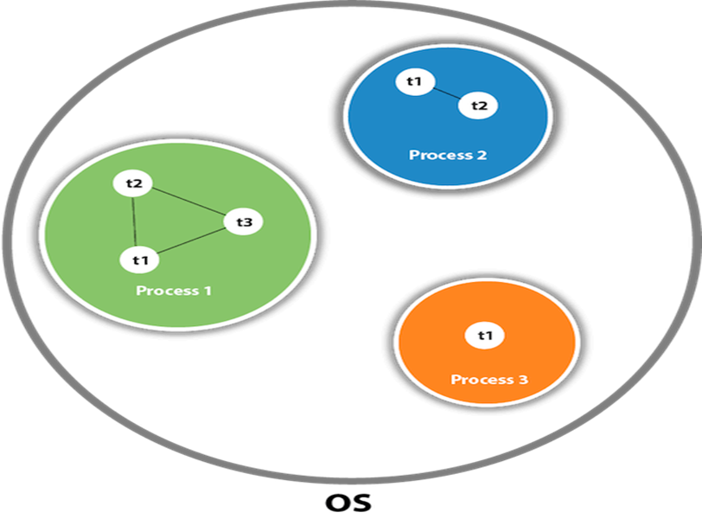
Thread in Java
A thread is a lightweight subprocess, the smallest unit of processing. It is a separate path of execution.
Threads are independent. If there occurs exception in one thread, it doesn't affect other threads. It uses a shared memory area.
As shown in the figure, a thread is executed inside the process.
There is context-switching between the threads. There can be multiple processes inside the OS, and one process can have multiple threads.

Slide 5
Life cycle of Thread
The Life Cycle of a Thread in Java refers to the state transformations of a thread that begins with its birth and ends with its death.
When a thread instance is generated and executed by calling the start() method of the Thread class, the thread enters the runnable state.
When the sleep() or wait() methods of the Thread class are called, the thread enters a non-runnable mode.
Thread returns from non-runnable state to runnable state and starts statement execution.
The thread dies when it exits the run() process. In Java, these thread state transformations are referred to as the Thread life cycle.

Slide 6
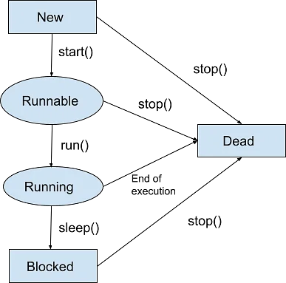
Life cycle of Thread

Slide 7
Life cycle of Thread
New State: As we use the Thread class to construct a thread entity, the thread is born and is defined as being in the New state. That is, when a thread is created, it enters a new state, but the start() method on the instance has not yet been invoked.
Runnable State: A thread in the runnable state is prepared to execute the code. When a new thread's start() function is called, it enters a runnable state.
In the runnable environment, the thread is ready for execution and is awaiting the processor's availability (CPU time). That is, the thread has entered the queue (line) of threads waiting for execution.
Running State: Running implies that the processor (CPU) has assigned a time slot to the thread for execution. When a thread from the runnable state is chosen for execution by the thread scheduler, it joins the running state.
In the running state, the processor allots time to the thread for execution and runs its run procedure. This is the state in which the thread directly executes its operations. Only from the runnable state will a thread enter the running state.
Blocked State : When the thread is alive, i.e., the thread class object persists, but it cannot be selected for execution by the scheduler. It is now inactive.
Dead State : When a thread's run() function ends the execution of sentences, it automatically dies or enters the dead state. That is, when a thread exits the run() process, it is terminated or killed. When the stop() function is invoked, a thread will also go dead.

Slide 8
How to create Thread in Java
There are two ways to create a thread:
By extending Thread class
By implementing Runnable interface.

Slide 9
Thread Class
Thread class provide constructors and methods to create and perform operations on a thread.
Thread class extends Object class and implements Runnable interface.
Commonly used Constructors of Thread class:
Thread()
Thread(String name)
Thread(Runnable r)
Thread(Runnable r, String name)

Slide 10
Create thread using Thread()
The default Thread() constructor is used to create a new Thread class.
public class ThreadExample extends Thread
{
public static void main (String args[])
{
Thread t1 = new Thread();
t1.start();
System.out.println("Thread has been created with name " +t1.getName());
}
}
C:\java\lab>java ThreadExample.java
Thread has been created with name Thread-0

Slide 11
Create thread using Thread(String str)
A thread object is created and a name is provided to the same.
public class ThreadExample1 extends Thread
{
public static void main (String args[])
{
Thread t1 = new Thread("java thread");
t1.start();
System.out.println("Thread has been created with name " +t1.getName());
}
}
C:\java\lab>java ThreadExample1
Thread has been created with name java thread

Slide 12
Create thread using Thread (Runnable R)
Runnable reference is passed and a new Thread object is created.
class Testing implements Runnable
{
public void run()
{
System.out.println("Do something");
}
}
class ThreadExample2 extends Thread
{
public static void main (String args[])
{
Thread t1 = new Thread (new Testing());
t1.start();
System.out.println(" Thread has been created with name " + t1.getName());
}
}
C:\java\lab> java ThreadExample2
Do something
Thread has been created with name Thread-0

Slide 13
Create thread using Thread (Runnable r, String r)
A new Thread object by passing a Runnable reference as the first parameter and also providing a name for the newly generated thread.
class Book implements Runnable
{
public void run()
{
System.out.println("Do A task");
}
}
public class ThreadExample3 extends Thread
{
public static void main (String args[])
{
Thread t1 = new Thread (new Book(), "Book Thread");
t1.start();
System.out.println("Thread has been created with name " +t1.getName());
}
}
C:\java\lab> java ThreadExample3
Do A task
Thread has been created with name Book Thread

Slide 14
Multithreading in Java
In Java, multithreading is the method of running two or more threads at the same time to maximize CPU utilization.
As a result, it is often referred to as Concurrency in Java. Each thread runs in parallel with the others.
Since several threads do not assign different memory areas, they conserve memory. Furthermore, switching between threads takes less time.
In Java, multithreading enhances program structure by making it simpler and easier to navigate.
These generalized threads can be used in high-server media applications to easily change or enhance the configuration of these complex structures.

Slide 15
public class ExampleMT implements Runnable
{
public static void main ( String args[])
{
Thread E = new Thread ("demo1");
Thread E1 = new Thread ("demo2");
E.start();
E1.start();
System.out.println("Thread names are following");
System.out.println(E.getName());
System.out.println(E1.getName());
}
public void run()
{
}
}
C:\java\lab>java ExampleMT
Thread names are following
demo1
demo2

Slide 16
Thread Priority in java
The number of services assigned to a given thread is referred to as its priority. Any thread generated in the JVM is given a priority. The priority scale runs from 1 to 10.
In most cases, thread schedular schedules the threads according to their priority (known as preemptive scheduling).
1 is considered as lowest priority
5 is considered as standard priority
10 is considered as highest level of priority
The main thread's priority is set to 5 by default, and each child thread will have the same priority as its parent thread. We have the ability to adjust the priority of any thread, whether it is the main thread or a user-defined thread.
It is advised to adjust the priority using the Thread class's constants, which are as follows:
Thread.MIN_PRIORITY;
Thread.NORM_PRIORITY;
Thread.MAX_PRIORITY;

Slide 17
import java.lang.*;
class ThreadPriority extends Thread
{
public void run()
{
System.out.println("Inside run method");
}
public static void main ( String args[])
{
ThreadPriority t1 = new ThreadPriority();
ThreadPriority t2 = new ThreadPriority();
ThreadPriority t3 = new ThreadPriority();
System.out.println ("t1 thread priority :" +t1.getPriority());
System.out.println ("t2 thread priority :" +t2.getPriority());
System.out.println ("t3 thread priority :" +t3.getPriority());
t1.setPriority(2);
t2.setPriority(5);
t3.setPriority(8);
System.out.println ("t1 thread priority :" +t1.getPriority());
System.out.println ("t2 thread priority :" +t2.getPriority());
System.out.println ("t3 thread priority :" +t3.getPriority());
System.out.println("Currently Executing Thread : " + Thread.currentThread().getName());
System.out.println("Main thread priority : " + Thread.currentThread().getPriority());
Thread.currentThread().setPriority(10);
System.out.println("Main thread priority : " + Thread.currentThread().getPriority());
}
}
C:\java\lab>java ThreadPriority
t1 thread priority :5
t2 thread priority :5
t3 thread priority :5
t1 thread priority :2
t2 thread priority :5
t3 thread priority :8
Currently Executing Thread : main
Main thread priority : 5
Main thread priority : 10

Slide 18
Thread Synchronization
When more than one thread has to use a shared resource, Java finds a way of ensuring that only one thread uses the resources at one point of time; this is called Synchronization.
The key concept of synchronization is the monitor. The monitor holds the exclusive lock that can be hold by only one object at a time. The monitor allows only one thread to execute a synchronized method on the object at one time.
When the execution of the synchronized method is complete, the lock on the object is opened and monitor allow the highest priority runnable thread attempting to invoke a synchronized method to proceed.
A thread executing in a synchronized method may determine that it can not proceed, so, it voluntarily calls wait().
The notify() method acts as a signal to the waiting thread that the condition satisfied for the waiting threads.
The notifyAll() method acts as a signal to all the waiting threads that condition is satisfied but it can get the access based on the thread priority.
The keyword synchronized is used to synchronize the thread and there are two way to do this: by using synchronized methods and using a synchronized statement

Slide 19
Synchronized methods
If two or more threads modify an object, that methods that carry the modifications are declared synchronized.
Constructors need not be synchronized because a new object is created in only one thread.
The general method for declaring a method synchronized is the following:
Modifier synchronized <return_type> <method_name> (parameters)

Slide 20
class ThreadSM implements Runnable
{
ClassA ob1;
Thread t;
ThreadSM(ClassA c)
{
this.ob1 = c;
t = new Thread(this);
}
public void run()
{
ob1.printvalue();
}
public static void main (String args[])
{
ClassA ca = new ClassA();
ThreadSM one = new ThreadSM(ca);
one.t.start();
ThreadSM two = new ThreadSM(ca);
two.t.start();
ThreadSM three = new ThreadSM(ca);
three.t.start();
}
}
import java.io.*;
class ClassA
{
synchronized void printvalue ()
{
try
{
for(int i=0;i<=5;i++)
{
System.out.print(i + " ");
Thread.sleep(1000);
}
}
catch (InterruptedException e)
{
}
}
}
C:\java\lab>javac ThreadSM.java
C:\java\lab>java ThreadSM
0 1 2 3 4 5 0 1 2 3 4 5 0 1 2 3 4 5

Slide 21
Synchronized statements
As an alternative to declaring a method synchronized, Java shows flexibility.
The programmer can declare a part of the code as synchronized using synchronized statement.
The general syntax of declaring a set of statements synchronized is as follows:
synchronized <object> <statement>;
In the case of synchronized statements, we need to specify an object to act as a monitor for this object.
Each java object can act as a monitor and hence java object can be specified synchronized.

Slide 22
import java.io.*;
class ClassA
{
synchronized void printvalue ()
{
try
{
for(int i=0;i<=5;i++)
{
System.out.print(i + " ");
Thread.sleep((int)Math.random()*1000);
}
}
catch (InterruptedException e)
{
}
}
}
class ThreadSS implements Runnable
{
ClassA ob1;
Thread t;
ThreadSS(ClassA c)
{
this.ob1 = c;
t = new Thread(this);
}
public void run()
{
synchronized(ob1)
{
ob1.printvalue();
}
}
public static void main (String args[])
{
ClassA ca = new ClassA();
ThreadSS one = new ThreadSS(ca);
one.t.start();
ThreadSS two = new ThreadSS(ca);
two.t.start();
ThreadSS three = new ThreadSS(ca);
three.t.start();
}
}
C:\java\lab>javac ThreadSS.java
C:\java\lab>java ThreadSS
0 1 2 3 4 5 0 1 2 3 4 5 0 1 2 3 4 5

