Slide 1
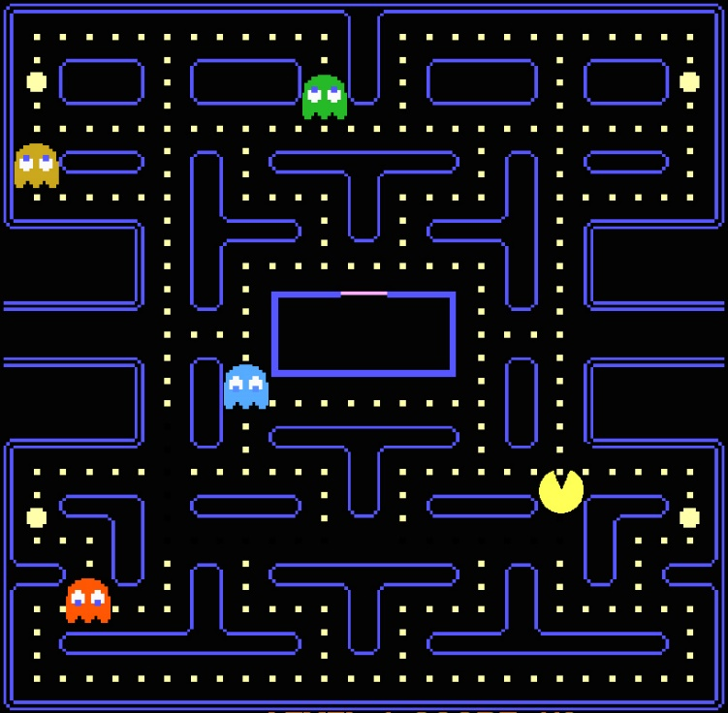

Player1
Player2
Score
1500
355
Lives
High Score
Player2
25894

Slide 2
Leaderboard
Player1
256452
Host
Player2
200002
Join
Server name
Player3
145005
Nickname
Player4
132546
clicked
Player5
115648
Player6
99450
Show leaderboard

