Slide 1

Energy is what makes the world go 'round
Przemek Klosowski

Slide 2
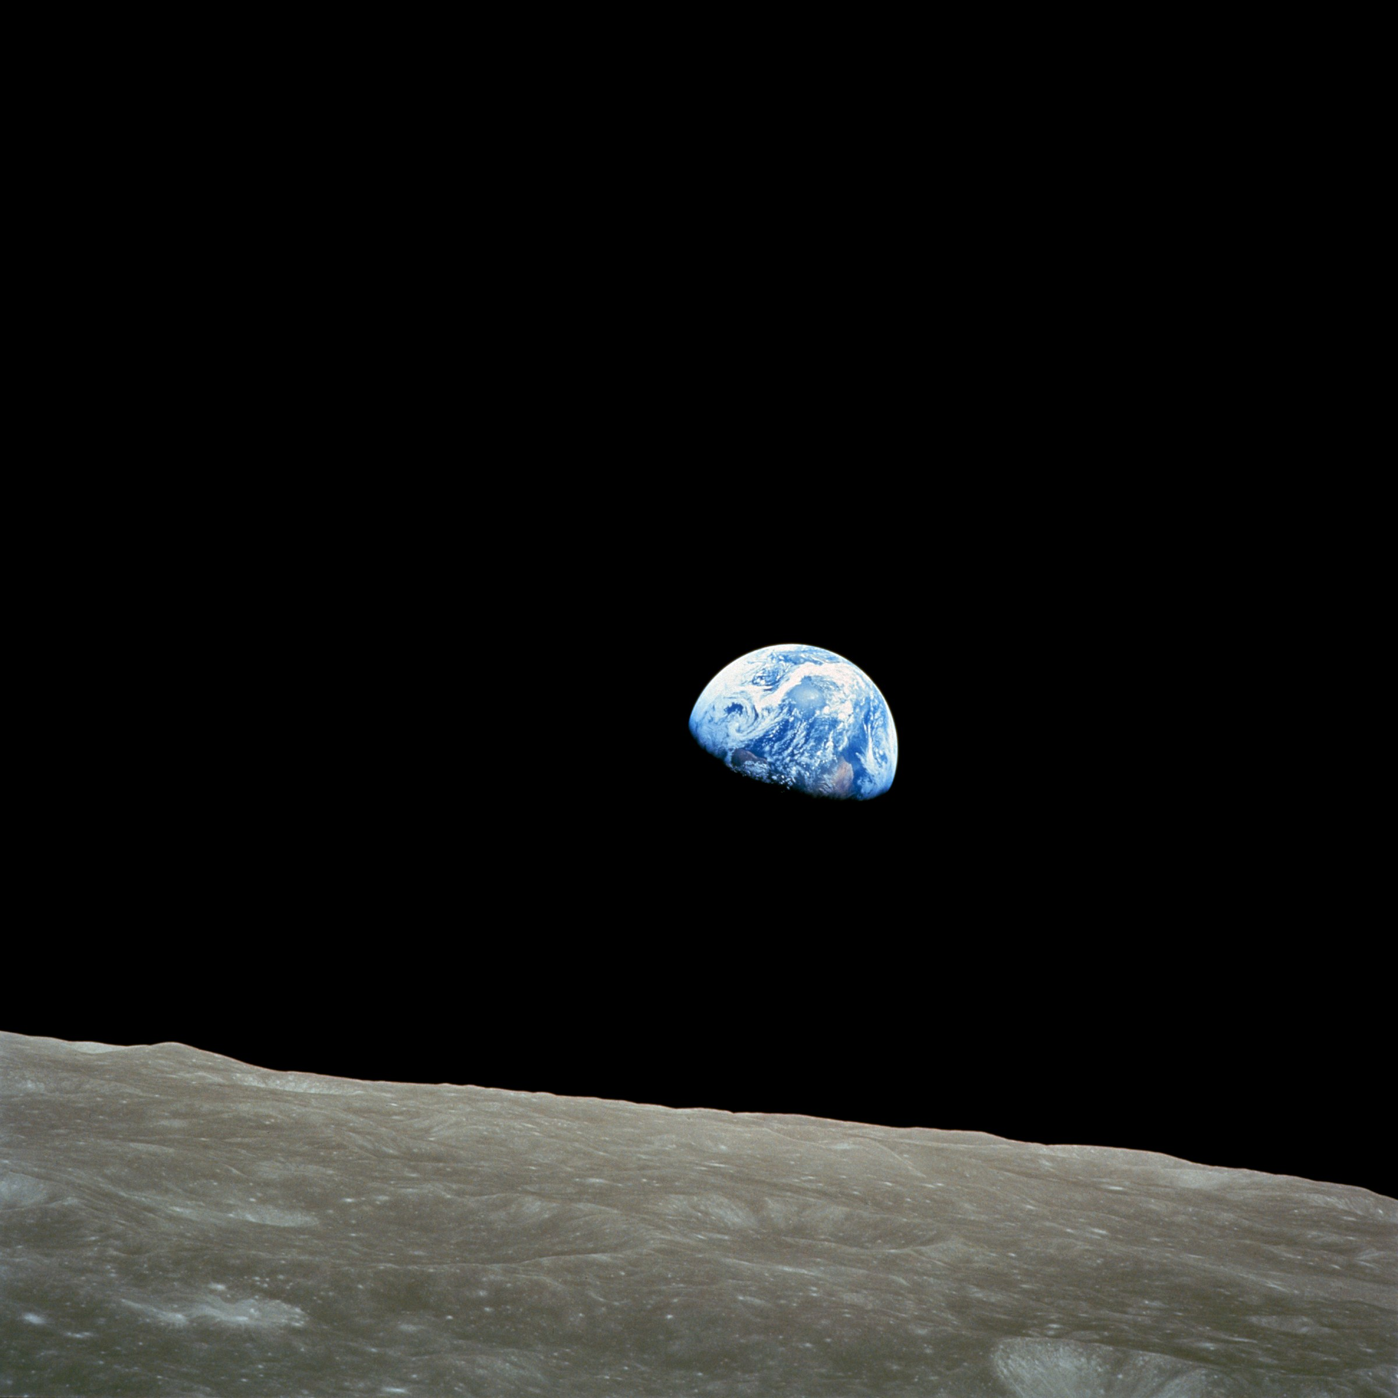
The world

Slide 3
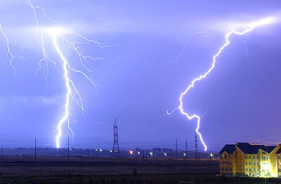
What is Energy?
from the Greek ἐνέργεια , "activity, operation"
Work, movement
Stored potential
State of agitation
  Temperature

Slide 4
Energy: can't live without it
Potential energy: bottled up
  Gravitational
  Chemical
  Nuclear
  Elastic
Kinetic energy: in motion
  Mechanical
  Radiation
  Thermal

Slide 5
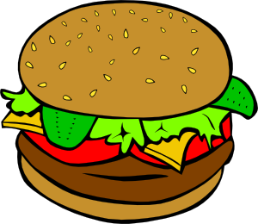
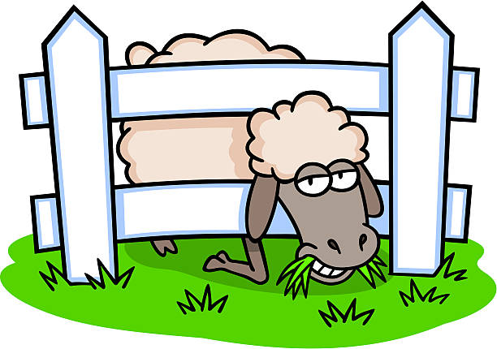

We need Energy to Live
We get it from food
Food gets it from plants
Plants get it from the Sun
Sun gets it from burning nuclear fuel

Slide 6
We need Energy to Live
We get it from food
Food gets it from plants
Plants get it from the Sun
Sun gets it from burning nuclear fuel
WHAT IF IT RUNS OUT?!?!?

Slide 7


Slide 8
Will Sun “run out of gas”?
Yes it will
Fortunately it'll take 1.5 billion years
Hopefully we'll figure something out in the meantime...
... but you need to get busy studying science because it's your job to start looking for the solution!

Slide 9
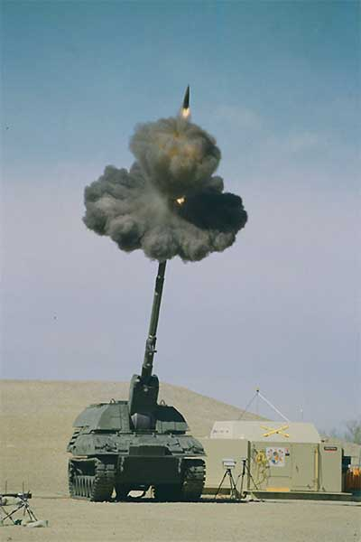
Energy Is Conserved
All the forms of energy are equivalent
They can convert into each other
Pendulum
  Kinetic ⇔ potential
Firing a gun
  Chemical ⇒ kinetic ⇒ potential
Sun
  Nuclear ⇒ radiation ⇒ thermal ⇒ chemical

Slide 10
Energy
Is
Conserved

Slide 11
Conservation of Energy
A fundamental law of physics
  You can't lose OR gain the energy
Other laws can be derived from it
  Advanced mechanics
    Hamiltonian (total energy)
  Quantum mechanics
  I'd love to explain this but it's a little too long

Slide 12
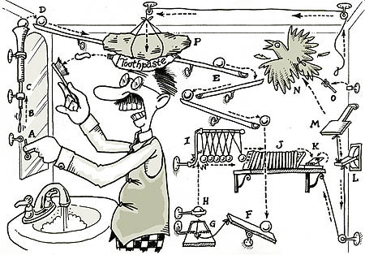

Slide 13
Conservation of Energy
Perpetuum Mobile
  IMPOSSIBLE :(
Great life-guiding principle
Conserve your energy for worthy things

Slide 14
Energy and Power
Energy and work are equivalent
  Similar to money
Power is the capacity to do work
  Would you like a hundred dollars?

Slide 15
Energy and Power
Energy and work are equivalent
  Similar to money
Power is the capacity to do work
  Would you like a hundred dollars?
  What if I gave it to you over 100 years
Power = Energy / Time
  More examples:
    Distance and speed
    Flow of anything
    Even velocity of money i.e. cash flow

Slide 16
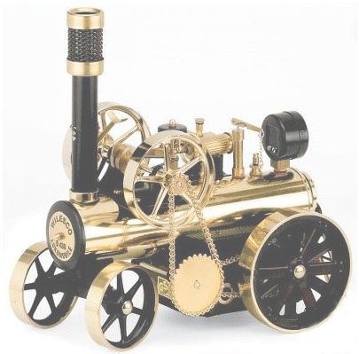
How do we measure Energy
Joule: basic unit of work, named after James Prescott Joule
1 Joule : effort to push against 1 Newton of force for 1 meter
  Example
  Lifting a pack of cheese from the floor to the table

Slide 17
Useful fact about electricity
When you buy electricity, you buy energy
Electricity costs about 15 cents per kWhr
kWhr: kilo=1000, Watt=Joule/second, hour
1 year has about 31 million seconds
1 Watt costs about 1 $ per year
  Turn off those lights!!

Slide 18
Various energies: Food
1 calorie is the amount of thermal energy needed to heat 1cm³ of water by 1 deg C
1 food Calorie = 1000 calories
1 hamburger is around 400 Calories
Which is 1.7 million Joules, enough to
accelerate 4000 lb SUVs to 65 mph, twice
So, driving wastes a lot of hamburgers :)

Slide 19
The ice-cream diet mistake
Eat a cup (250 grams) of ice cream
  300 Calories
your body has to heat it up by 30 deg C
  7500 calories!!
Can you lose weight by eating ice cream?
NO! you are off by a factor of 1000
  300 Calories is 300,000 calories

Slide 20
Various energies: electrical
Heating 1 liter (1000 ccm) of water, from room temperature (around 20C) to boiling (100C)
80,000 calories or 300,000 Joules
Water boiler is typically 1000 Watts
so it takes 300 seconds or about 5 minutes

Slide 21
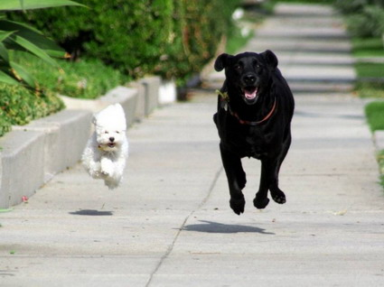
Spot the Energy

Slide 22
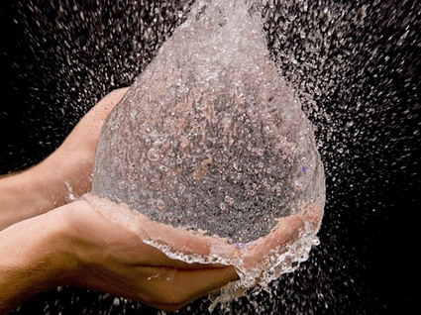
Spot the Energy

Slide 23
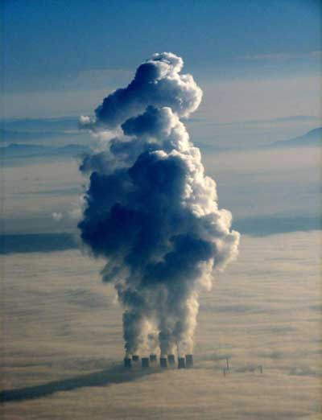
Spot the Energy

Slide 24
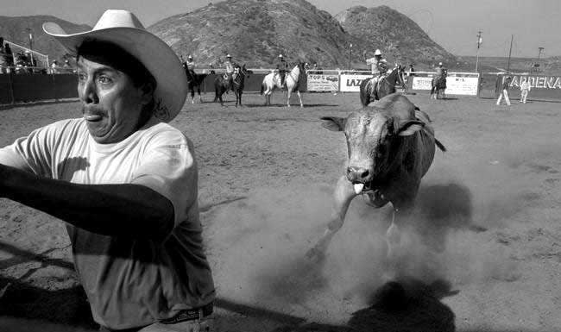
Spot the Energy

Slide 25
But First Let's Talk About Units
Units are about agreeing on how you measure properties of things
  Length, Area, Volume, Mass, time, electric charge, current, speed, energy, ...
Units let you compare things
  Which rope is longer?
  How long are they?
Similar things share the same unit
Everything has units

Slide 26
Measuring with Units
Length: inches (meters, feet, miles)
  Area,
  Volume
Mass: Kilogram (pound)
Time: secod (hour, month, day)
Electric current: Ampere
Unit of light: Candela

Slide 27
Basic and derived units
Five basic units are enough
  SI or international units
    MKSA: meter, kilogram, second, Ampere
  Imperial or British/US units
    inch, pound, second, mile
  Other units: furlong per fortnight, etc
Only used in US and Burma;
British gave up in the 70s

Slide 28
Basic and derived units
Combine basic units for derived units:
    speed = distance / time
      meter/second
    lollipops per afternoon
    Easter Chocolate eggs per square yard
    Cars per traffic lane per second

Slide 29
Tricks with Units
Check your work: units have to agree.
Example: what is the mass of a gallon of milk? We know that
  milk density is 1.02 g/cm³
  a gallon is 3.78 liters
Do we multiply or divide by density?
  Divide? Liter / (g/cm³)  cm⁶/g
NOPE

Slide 30
Tricks with Units
Check your work: units have to agree.
Example: what is the mass of a gallon of milk? We know that
  milk density is 1.02 g/cm³
  a gallon is 3.78 liters
Do we multiply or divide by density?
  Divide? Liter / (g/cm³)  cm⁶/g
  Multiply? Liter * g/cm³  g
NOPE
YES

