Slide 1
Action Research in companies: experiences and reflections
10.05.2023
Adam Przybyłek
Gdansk University of Technology
Poland

Slide 2
Research methodology
research methods
  survey
  controlled experiment
  case study
  action research
  design science research
data collection techniques:
  interview
  questionnaire
  focus group
  participant observation
  analysis of work artifacts
  metrics

Slide 3
Case Study
investigates a contemporary phenomenon within its real-life context, especially when the boundaries between phenomenon and context are not clearly evident;
relies on multiple sources of evidence (e.g. documents, archival records, interviews, participant observation, physical artefacts, metrics);
the researcher is observing and commenting on a situation without improving it

Slide 4
Action Research
an emergent inquiry process in which scientific knowledge is integrated with existing organizational practices and applied to solve real organizational problems;
needs an industrial context where the work is embedded
  a precondition for AR is to have a problem owner willing to collaborate to both identify a problem, and engage in an effort to solve it;
a method for co-development of research results, where academia and industry can work together
  through this co-development, the researchers and practitioners learn from each other, and thus they develop research results which contribute to both the industrial practice and academic theories, tools, methods, and knowledge development

Slide 5
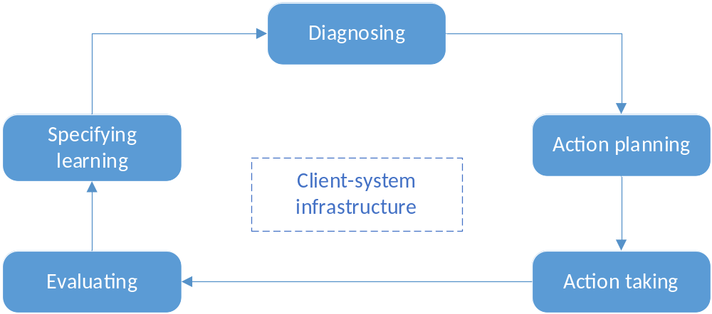
Canonical Action Research cycle

Slide 6
Initiation of AR projects
problem-driven initiation
  practitioners are confronted by a seemingly invincible problem and looking for help from academics
    SAFe transformation (Nordea)
    Scaling Scrum with Nexus (Intel)
    Overcoming challenges of virtual Scrum teams (Lufthansa)
research-driven initiation
  researchers are in possession of ideas or general theoretical approaches to addressing problem situations
    Game-based Sprint retrospectives (OKE Poland, Dynatrace, SentiOne)
    Game-based requirements engineering (Staples, Intel)

Slide 7
SAFe transformation in Nordea:
Research context
project: Core Banking Platform
  5-year project
  10 teams
  100+ developers
  highly regulated environment
problematic situations:
  Scrum of Scrums did not work well, so it was replaced by SAFe
  SAFe mitigated some inter-team coordination problems, but many other problems remained unresolved, and new problems appeared

Slide 8
SAFe transformation in Nordea:
Examples of the diagnosed problems
Confusion regarding who (Product Manager, Solution Manager, Epic Owner, PO, Business Analyst, etc.) should manage which type of backlog items (epic, feature, capability, story)
Disputes over which train/team should develop what scope of the product.
A lot of bugs in the production environment
Instability of testing environments
adopting pair programming to implement unit tests; unifying the implementation of unit tests; automating GUI testing
creating an isolated container-based testing enviroment for each team

Slide 9
SAFe transformation in Nordea:
Lessons Learned
Implementing SAFe is only the first step towards a successful transformation, followed by a process of stepwise refinement.
Involving employees in problem-solving processes enhances their support and acceptance for the transformation.
The staff have knowledge about how to improve their work practices, but they require a trigger as well as facilitation to take actions.

Slide 10
Scaling Scrum with Nexus in Intel:
Research context
project: Big data integration platform (TAP)
  6 teams
  60+ developers
organizational problem:
  none of the existing scaling agile frameworks entirely fitted the organizational structure, corporate governance, and project characteristics;
  the department was not able to implement any framework in a one-time shift
constrains:
  continue the scaling agile process started by Intel instead of starting from scratch
  the organizational structure and corporate governance cannot be modified
  do not disturb the daily work performed by the teams

Slide 11
Scaling Scrum with Nexus in Intel:
Lessons Learned
fixing the Scrum process resolves a lot of problems even though the scaling process was only underway;
a successful large-scale agile transformation is possible without the adoption of an agile mindset at the organizational level and with the old bureaucracy as well as the Taylor-devised management system in place;
portraying SAFe as the most suitable framework for working in regulated, large organizations may be an oversimplification;

Slide 12
Game-based Sprint Retrospectives
host organizations:
  OKE Poland, Dynatrace, SentiOne
organizational problem:
  inefficient Sprint Retrospective meetings
practical objectives:
  to audit and revise the work practices related to the Sprint Retrospective;
  to enhance participants' competencies;
research objectives:
  to find out whether the adoption of collaborative games mitigate common retrospective problems;
  to find out what are the advantages and disadvantages of different collaborative games;

Slide 13
AR: Diagnosing (1)
Interviews:
  to determine the current adoption of Scrum practices in the participating teams;
  to identify retrospective problems;
Key findings:
  Only one out of 6 teams strictly adhered to Scrum;
  Retrospectives were implemented improperly and compromised when the team worked under time pressure;
  all teams encountered most of the common retrospective problems;

Slide 14
AR: Diagnosing (2)
Retrospective problem | OKE_A | OKE_B | Dyna_A | Dyna_B | Senti_A | Senti_B
little added value | ++ | + | +++ | ++ | + | n/a
too repetitive | +++ | ++ | + | +++ | +++ | n/a
lack of structure / preparation | + | + |  | + | +++ | n/a
unequal participation | ++ | +++ | ++ | + |  | n/a
too many complaints |  | + | ++ | + | ++ | n/a
+ fewer than 1/3 team members noticed the problem (but at least one)
++ between 1/3 to 2/3 team members noticed the problem
+++ more than 2/3 team members noticed the problem

Slide 15
AR: Action planning
Starfish
Sailboat
Mad/Sad/Glad
Mood++
5L's
360° Appreciation

Slide 16
Takeaway
When you go back to your workplace, look around and think if there is something that can be improved.
If so, employ Action Research and do research.
Good luck!

Slide 17
Questions?
adam.przybylek@gmail.com

