Slide 1

Track on
Lean and Agile Software Development https://lasd.pl
SAC 2023

Slide 2
History, presence and future
FedCSIS:
  LASD’17 (Prague)
  LASD’18 (Poznań)
Standalone conference:
  LASD’21 (Online)
ACM SAC:
  LASD’23 (Tallinn)
  LASD’24 (Ávila) ???
ISD:
  LASD’24 (Sopot/Gdańsk) ???
  LASD’19 (Leipzig)
  LASD’20 (Online)
  LASD’22 (Online)

Slide 3
Track details
25 submissions
100 PC members from 36 countries
#accepted papers:
  5 full papers
  2 short papers (posters)
    14:30-16:30, room A046
  1 student research competition paper
    16:00–18:00, room A346
collaboration with JCR journals:
  Computer Science and Information Systems (ComSIS, IF: 1.17)
  Journal of Computer Languages (Cola, IF: 1.78)

Slide 4
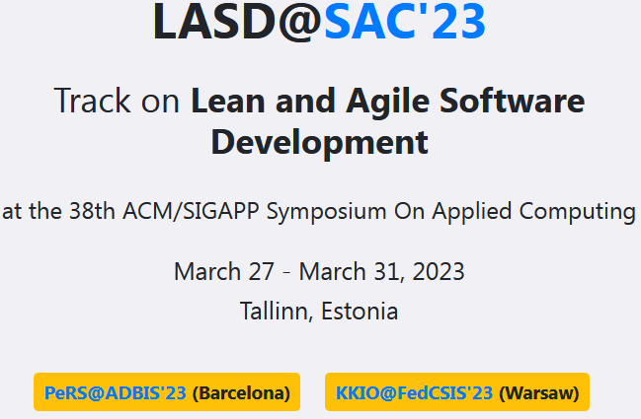
Other research events in 2023
KKIO@FedCSIS’23 (Warsaw)
  24th Conference on Practical Aspects of and Solutions for Software Engineering
  https://kkio.lasd.pl
PeRS@ADBIS’23 (Barcelona)
  2nd Workshop on Personalization and Recommender Systems
  https://pers.lasd.pl

