Slide 1
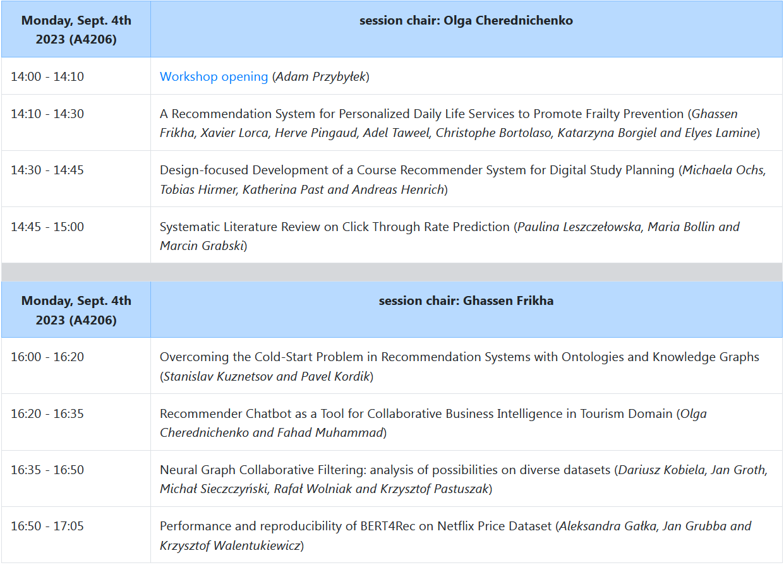
2nd Workshop on Personalization and Recommender Systems

Slide 2
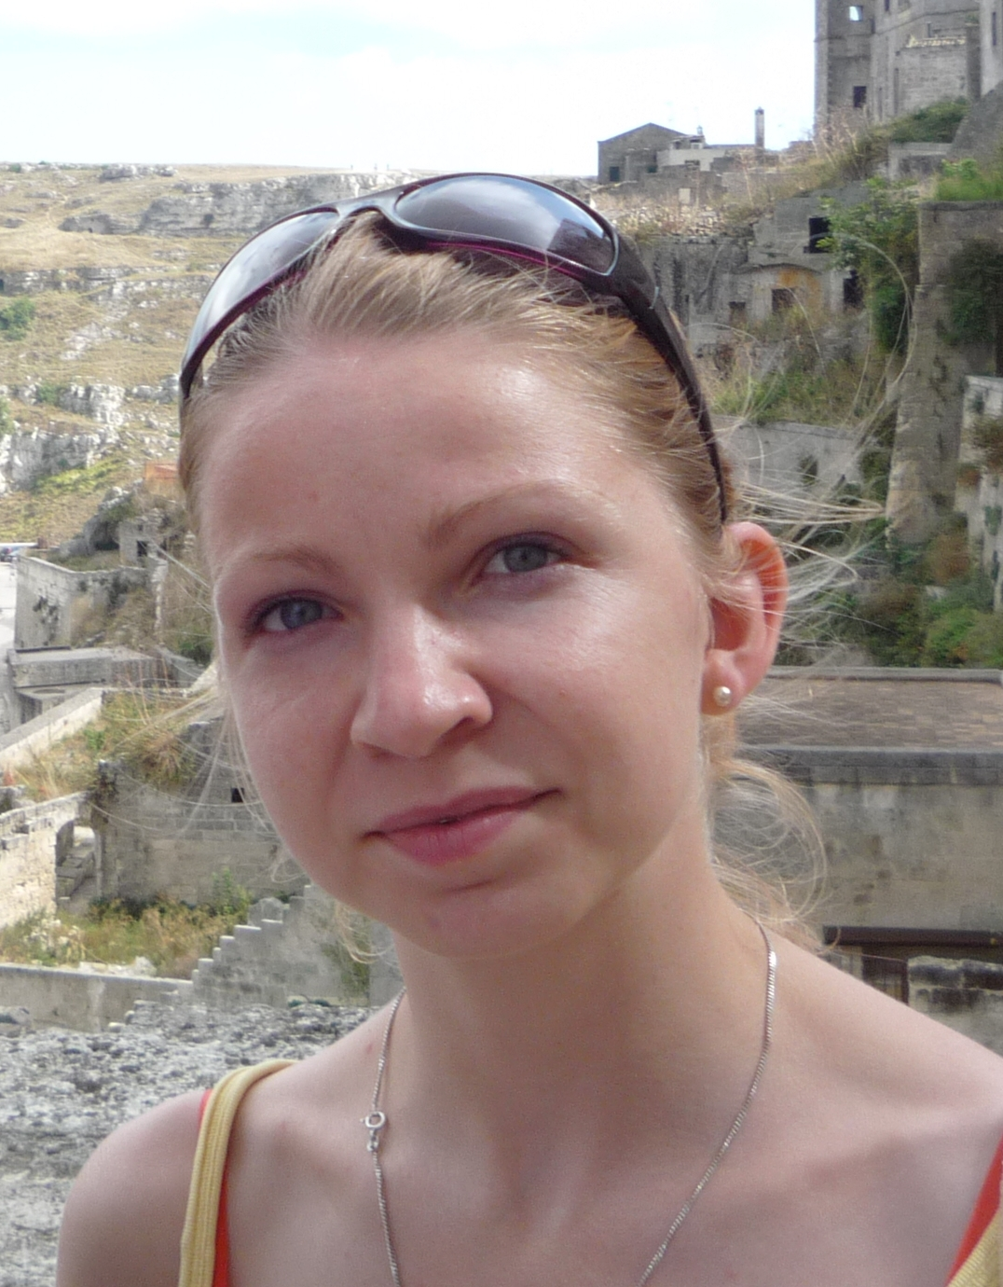
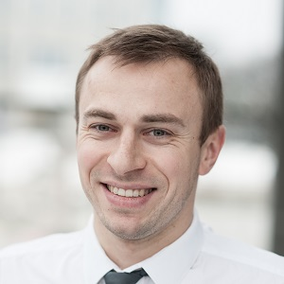
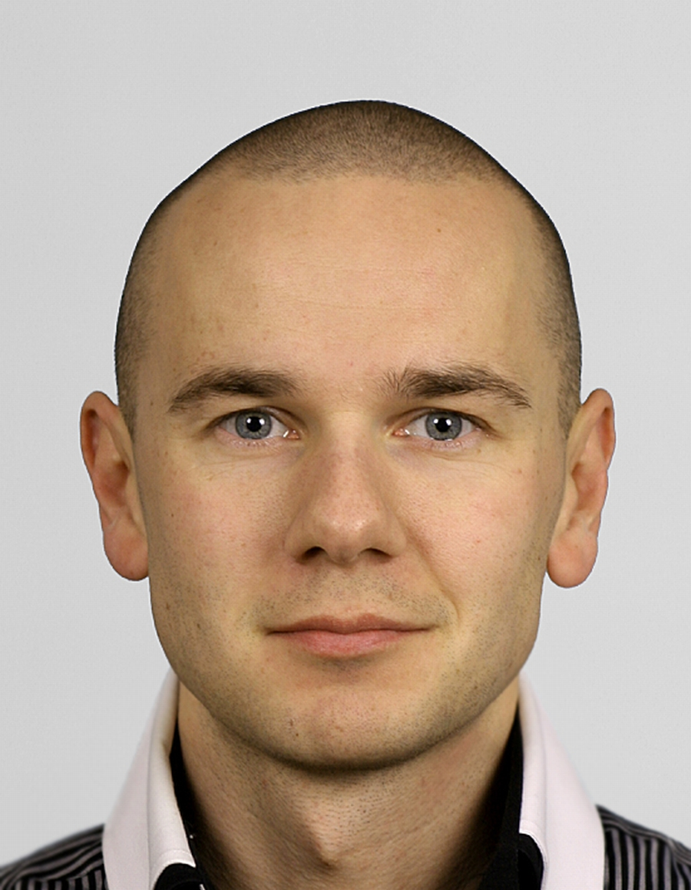
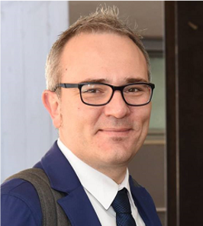
PeRS’24 Co-chairs
Aleksandra Karpus
Gdańsk University of Technology, Poland
Marek Grzegorowski
University
of Warsaw,
Poland
Adam Przybyłek
Gdańsk University of Technology, Poland
Tommaso di Noia
Politecnico di Bari, Italy

Slide 3
Special thanks
PeRS authors
PeRS PC members
PeRS session chairs:
  Olga Cherednichenko, Ghassen Frikha
General ADBIS chairs:
  Robert Wrembel, Oscar Romero
General ADBIS workshop chairs:
  Francesca Bugiotti, Johann Gamper
Piotr Szczuko

Slide 4
PeRS’24 Details
14 submissions
35 PC members from 19 countries
#accepted papers:
  2 full papers
  5 short papers

Slide 5
Research events in 2024
ACM SAC’24 (Avila, Spain)
  39th ACM/SIGAPP Symposium On Applied Computing (April 8 – 12, 2024)
  https://sac.lasd.pl
ISD’24 (Sopot/Gdańsk, Poland)
  32nd International Conference on Information Systems Development (August 30 – Sep. 1, 2024)
  https://isd.lasd.pl
PeRS’24 (???)
  ADBIS vs FedCSIS vs ???
  https://pers.lasd.pl

