Slide 1
CS 331 -COMPUTER NETWORKS
Prof. SAMEER G.KULKARNI
SMART GUARD
(Centralized IoT Environmental Monitoring System)
Chepuri Venkata Naga Thrisha (23110079)
Katta Revathi (23110159)
Pappala Sai Keerthana (23110229)
Thoutam Dhruthika (23110340)
1

Slide 2

PROBLEM STATEMENT
Manual monitoring of classroom and lab environments is time-consuming and lacks real-time updates. Issues like high CO₂ levels may go unnoticed, and managing multiple rooms is challenging due to the scattered and uncentralized nature of data.
This project addresses these challenges by developing a centralized monitoring system that efficiently collects and visualizes data from multiple simulated sensors using Mininet, providing real-time insights and efficiently managing multiple spaces from a single interface.
2

Slide 3

OBJECTIVES
Develop a centralized system to collect real-time temperature, humidity, light, and CO₂ data from classrooms and labs.
1
5
Implement threshold-based alerting to detect environmental hazards like overheating or poor air quality.
Simulate a scalable 100-node
sensor network using Mininet to represent virtual IoT clients.
Establish automated pipelines to continuously collect temperature, humidity, CO₂, and light intensity data
2
6
Implement asynchronous data
transmission between sensors and the server using the MQTT protocol.
3
Build comprehensive Grafana dashboards featuring heatmaps, graphs, and alert panels for intuitive data exploration.
7
Store collected sensor data efficiently
in an InfluxDB time-series database
for historical analysis.
4
3

Slide 4

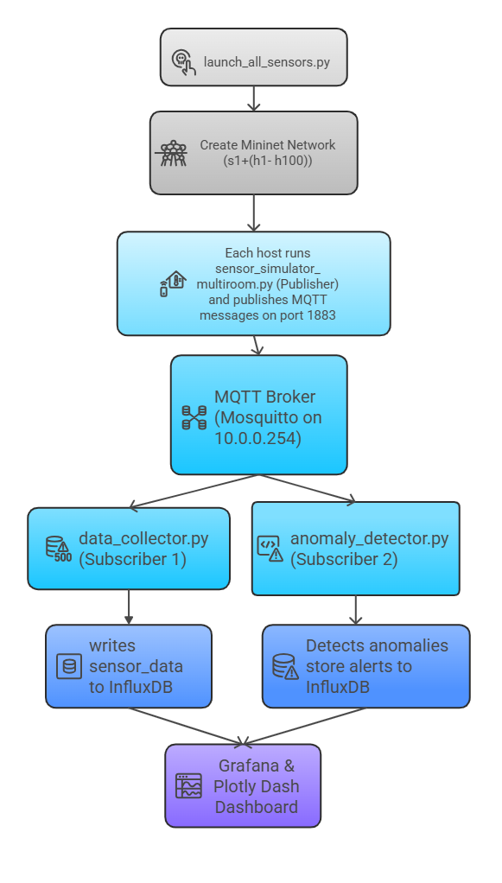
SYSTEM ARCHITECTURE
Simulation Layer:
  Implemented using Mininet
  Each host acts as a simulated IoT sensor node
  Generates data (Temperature, Humidity, Light, Air Quality)
  Publish readings via MQTT topics (e.g., sensors/temperature/CR101/h1)
Communication Layer:
  Mosquitto MQTT Broker routes messages between publishers and subscribers
  Enables lightweight, real-time data transfer
Processing Layer:
  Data Collector Service: Stores sensor data into InfluxDB (time-series DB)
  Anomaly Detector Service: Detects abnormal readings and logs alerts
Visualization Layer:
  Grafana Dashboard displays real-time and historical trends
  Also accessible via a web browser for centralized room monitoring
4

Slide 5


WHAT IS MQTT?
WHY IS IT USED?
MQTT (Message Queuing Telemetry Transport)
  A lightweight publish–subscribe protocol designed for IoT and sensor networks.
  Works through a broker that routes messages between publishers (senders) and subscribers (receivers).
  Operates over TCP/IP and uses minimal bandwidth.
  Ideal for real-time, low-power, and high-latency environments
  Lightweight and efficient for large numbers of IoT sensors.
  Reliable data delivery with low network overhead.
  Supports topic-based filtering for flexible data routing.
  Easy to integrate with Python, InfluxDB, and Grafana.
Alternative Protocols (Not Used):
  HTTP/REST: Heavyweight; adds overhead due to frequent connection setup.
  CoAP (Constrained Application Protocol): Lightweight but limited broker support and a less mature ecosystem.
  AMQP (Advanced Message Queuing Protocol): More complex, designed for enterprise messaging rather than IoT.
  WebSockets: Real-time, but lacks built-in topic-based message management.
5

Slide 6
METHODOLOGY
1
6
Anomaly Detection (server/anomaly_detector.py)
Network Interfaces and IPs in VM
2
Network Setup Script ( setup_network.sh)
7
Visualization with Grafana Dashboard
3
Network Simulation using Mininet (launch_all_sensors.py)
8
REST API Backend (web_dashboard.py)
4
Sensor Data Simulation (sensors/sensor_simulator_multiroom.py) and MQTT Communication
9
Custom Web Dashboard Frontend (app.py)
5
Data Collection (server/data_collector.py)
and Storage in InfluxDB
6

Slide 7
2
Network Setup Script ( setup_network.sh):
  We configure IP forwarding and NAT using a Bash script to enable Mininet hosts (in the 10.0.0.0/8 network) to access external networks.
  This setup routes traffic through the host machine’s IP, enabling full internet connectivity for simulated nodes.
3
Network Simulation using Mininet (launch_all_sensors.py):
  Sets up a virtual network with 1 switch (s1) and 100 hosts (h1–h100), each host representing a unique room and IoT sensor.
  Each host runs a sensor script that sends real-time environmental data to the MQTT Broker (10.0.0.254:1883).
4
Sensor Data Simulation (sensors/sensor_simulator_multiroom.py) and MQTT Communication:
  Each Mininet host simulates temperature, humidity, light, and CO₂ readings every 5 seconds with realistic randomness.
  Publishes values via plain MQTT (no auth/TLS) to Mosquitto broker at 10.0.0.254:1883.
  Data sent to topic: sensors/<metric>/<room>/<sensor_id> using paho-mqtt library.
5
Data Collection (server/data_collector.py)
and Storage in InfluxDB:
  Subscribes to all sensor topics on MQTT broker (10.0.0.254:1883) using paho-mqtt.
  Parses JSON data to extract room, sensor ID, metric, and timestamp.
  Stores readings in InfluxDB for fast ingestion and easy historical analytics, enabling later filtering and visualization.
7

Slide 8

6
7
Visualization with Grafana Dashboard:
  Visualization with Grafana Dashboard
  Connects to InfluxDB to display real-time graphs, heatmaps, and alert panels.
  Visualizes temperature, humidity, light, and CO₂ across rooms.
  Accessible via browser at http://192.168.56.103:3000.
  Supports centralized, data-driven monitoring and decision-making.
Anomaly Detection (server/anomaly_detector.py):
  Subscribes to MQTT sensor data stream.
  Checks readings against thresholds (e.g., CO₂ > 1000 ppm, light < 300 lux).
  On anomaly: prints real-time alerts and logs them to InfluxDB for later analysis.
8
Backend – REST API (web_dashboard.py):
  Flask-based service exposing sensor and alert data from InfluxDB (port 8086).
  Endpoints for registering sensors, listing rooms, getting latest/historic readings, and thresholds/alerts.
  Runs on port 5000, serving HTTP data for web dashboards and other applications.
9
Frontend – Custom Web Dashboard (app.py):
  Built with Dash (Plotly) for interactive, real-time visualization.
  Fetches sensor and alert data from Flask API (port 5000).
  Displays metrics, heatmaps, alerts; supports room filtering and history.
  Runs on port 8050, accessible in any web browser.
8

Slide 9
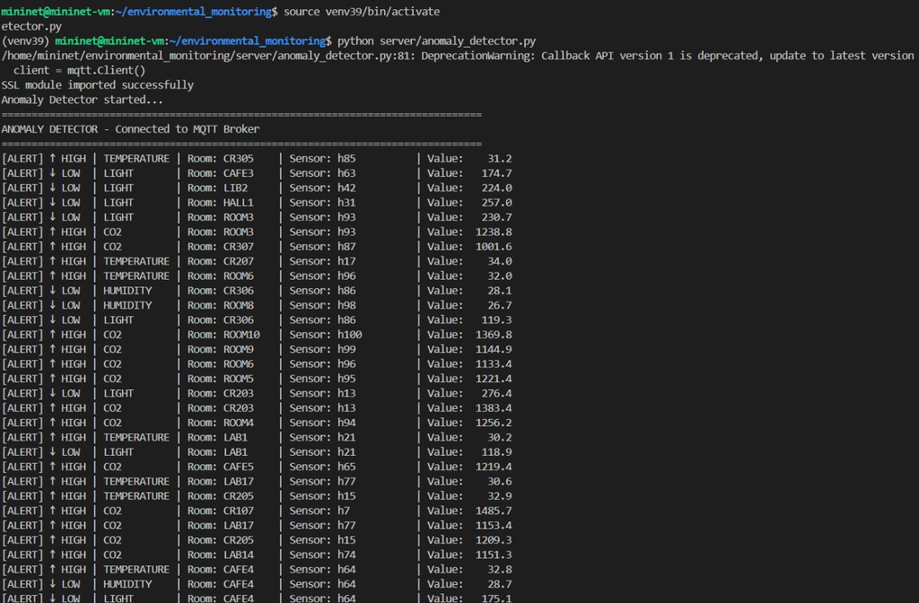
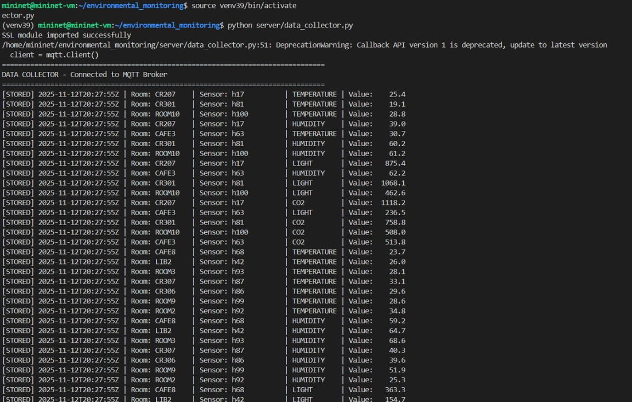
OBJECTIVES ACHIEVED
The terminal output below shows real-time sensor data being collected and logged via MQTT, confirming successful data ingestion by the collector for dashboard analysis.
The terminal output below confirms that the anomaly detector is issuing real-time alerts for abnormal environmental values across monitored rooms.
9

Slide 10
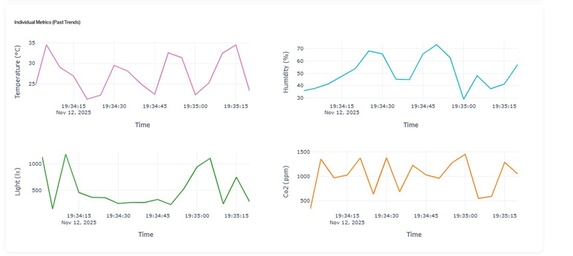
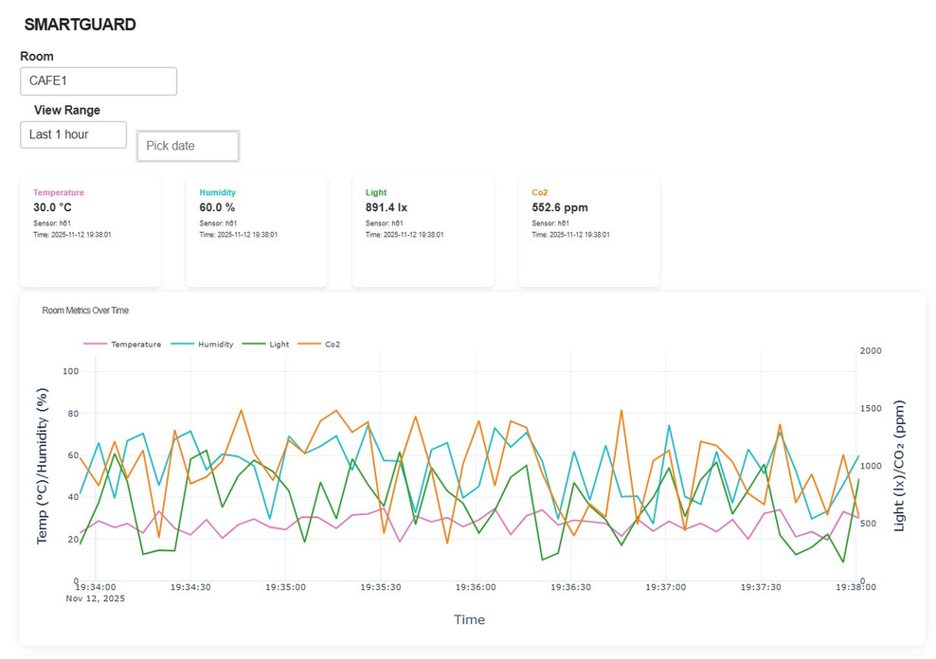
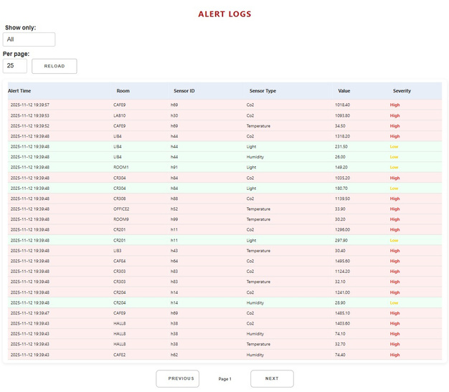
OBJECTIVES ACHIEVED
The plotly dashboard below displays real-time and historical environmental data (temperature, humidity, light, and CO₂) for a selected room, allowing users to monitor and analyze room conditions over a chosen time range.
The plotly dashboard below visualizes past trends of individual environmental metrics temperature, humidity, light intensity, and CO₂ levels over time, helping to monitor and analyze variations in room conditions.
The plotly dashboard beside displays alert logs generated by sensor readings, showing the time, room, sensor type, value, and severity (high or low) to help identify abnormal environmental conditions in real-time.
10

Slide 11
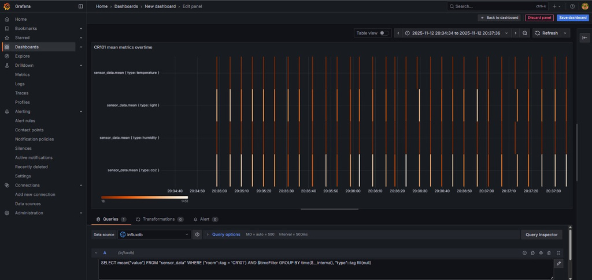
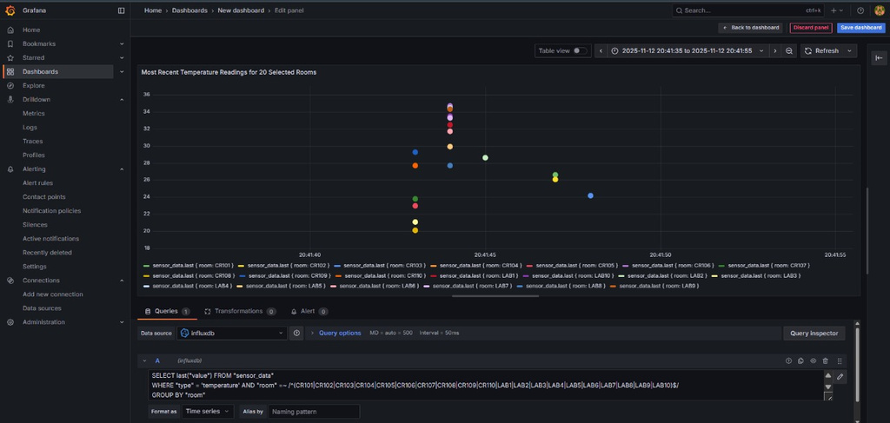
OBJECTIVES ACHIEVED
The Grafana panel below displays the most recent temperature readings from 20 selected rooms, allowing for a quick comparison of environmental conditions across multiple locations using data retrieved from InfluxDB.
The Grafana dashboard below visualizes real-time mean sensor metrics (temperature, humidity, light, and CO₂) for room CR101 over time, utilizing data queried from InfluxDB to monitor environmental conditions dynamically.
11

Slide 12
FUTURE PROSPECTS
1
Real Sensor Deployment: Replace simulated data with real-time IoT sensor readings (ESP32, DHT22, BH1750, MQ-135) sent via MQTT.
3
Enhanced Security: Utilize secure MQTT with TLS encryption and user authentication for secure data access and control.
2
Machine Learning Integration: Use collected data to predict temperature trends and detect anomalies for proactive monitoring.
4
User Authentication System: Implement role-based login (e.g., OAuth 2.0) to provide personalized and secure access to the dashboard.
12

Slide 13
REFERENCES
[1]Lantz, B., Heller, B., and McKeown, N. "A network in a laptop: Rapid prototyping for Software-Defined Networks." Proceedings of the 9th ACM SIGCOMM Workshop on Hot Topics in Networks (HotNets), Monterey, CA, USA, October 2010. (The foundational paper for Mininet, which you used for network simulation.)
[2]Banks, A., and Gupta, R. "MQTT Version 3.1.1." OASIS Standard. October 2014. [Online]. Available: http://docs.oasis-open.org/mqtt/mqtt/v3.1.1/os/mqtt-v3.1.1-os.html (The official specification for the MQTT protocol you implemented.)
[3]S. H. L., T. K. L., and C. F. L. "Design and Implementation of an IoT-Based Environmental Monitoring System with MQTT, InfluxDB, and Grafana," 2021 International Conference on Computer and Information Sciences (ICCOINS), 2021, pp. 1-6. (A paper with an almost identical technology stack, ideal for citing as related work.)
[4]InfluxData. "InfluxDB Technical Documentation." [Online]. Available: https://docs.influxdata.com/influxdb/ (The official documentation for the time-series database you used.)
[5]Grafana Labs. "Grafana Documentation." [Online]. Available: https://grafana.com/docs/grafana/latest/ (The official documentation for the Grafana visualization platform.)
[6]“Dash Documentation & User Guide | Plotly,” dash.plotly.com. https://dash.plotly.com
[7]Flask, “Welcome to Flask — Flask Documentation (1.1.x),” flask.palletsprojects.com. https://flask.palletsprojects.com/
‌[8]L. Gupta, “What is REST – Learn to create timeless REST APIs,” Restfulapi.net, Jun. 13, 2019. https://restfulapi.net/
13

Slide 14

THANK YOU
14

