Slide 1
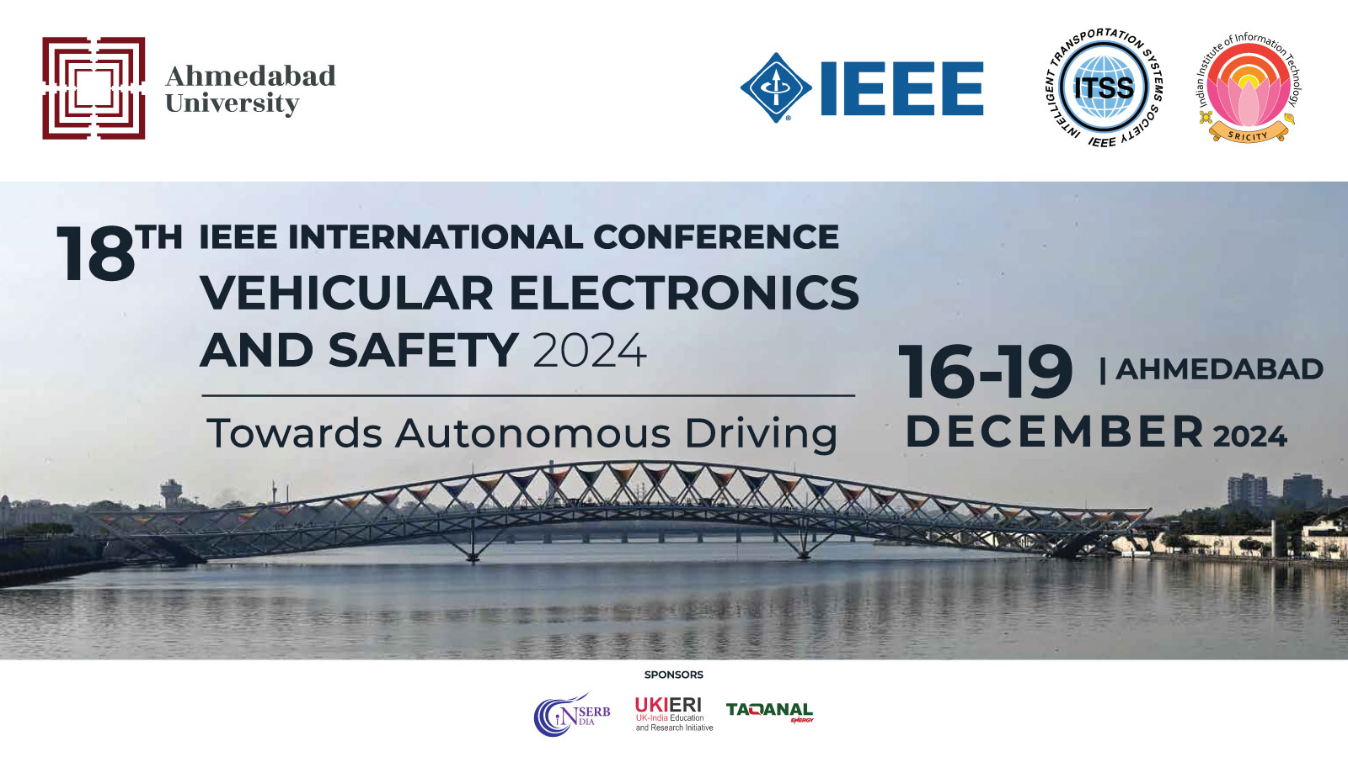
18th IEEE International Conference on Vehicular Electronics and Safety 2024
Optimizing IoT Workloads for Minimal Time and
Energy with UAV Networks using Deep Q Network
Priyansh Singhal
Dr. Piyush Joshi
Dept. Of Computer Science & Engineering,
Indian Institute Of Information Technology, Sri City
Dept. Of Computer Science & Engineering,
Indian Institute Of Information Technology, Sri City

Slide 2
Table Of Content
01
02
03
04
05
Introduction
Challenges & Contributions System Model
Proposed Method
Results & Conclusion

Slide 3
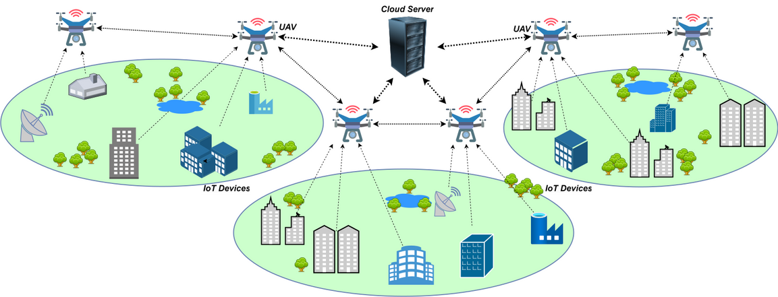
01
Introduction
1. IoTs in Various Sectors & Challenges
Widely used in smart cities, healthcare, and industry, where it enables efficient, data-driven operations [1].
Challenges associated with IoTs:
Processing power and battery constraints [2].
Delays and battery depletion during tasks [2].
2. UAV Network for Task Offloading
Powerful Processors: Handle intensive computations.
Larger Batteries: Extend operational life.
Mobility: Enable dynamic positioning in high-demand areas.

Slide 4
01
Introduction
3. Objective & Proposed Solution
Objective: To minimize task delays and energy use in IoT-UAV networks.
Solution:
Offload tasks to UAV network with greater battery and computing power, as well as cloud servers for load balancing.
Utilize Deep Q Network (DQN) reinforcement learning to dynamically manage task distribution, optimizing the balance between IoT devices, UAVs, and cloud servers.

Slide 5
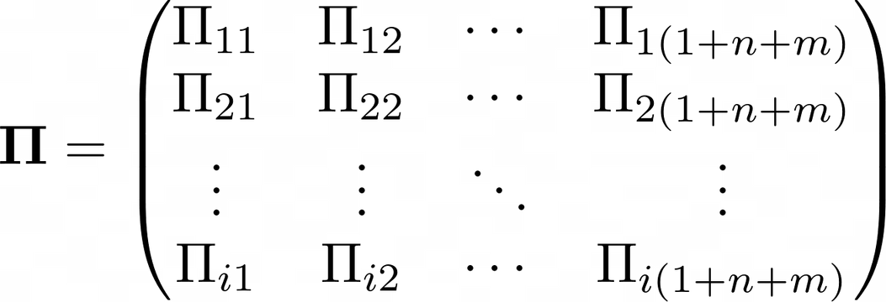
01
Challenges & Contributions
Challenge
Task Partitioning Calculation: Determining the fraction of each IoT device’s task to be offloaded.
Contribution
Sub-task Deployment Matrix: Calculating and tracking task partitioning fractions for each IoT device in the UAV cloud network.

Slide 6
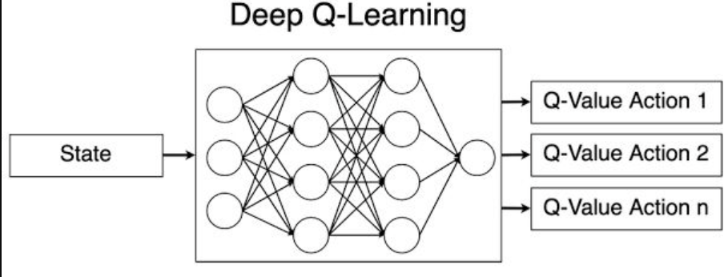
01
Challenges & Contributions
Challenge
Minimizing Delay and Energy Consumption: Optimizing the offloading process.
Contribution
Deep Q Networks for Task Offloading: Using DQN [7] to minimize time delay and energy consumption

Slide 7
04
System Model
1. System Components
IoT Devices: Limited in power and computation; initiate tasks.
UAVs: Serve as task offloading agents, with higher processing power and mobility.
Cloud Server: Acts as a backup resource for UAVs to prevent network overload.
2. Task Deployment Matrix
It is a matrix which defines how each task is split across IoT devices, UAVs, and cloud servers.
Ensures task distribution fractions sum to 1 for each IoT device.
Each element represents the fraction of ith task allocated to jth device.

Slide 8
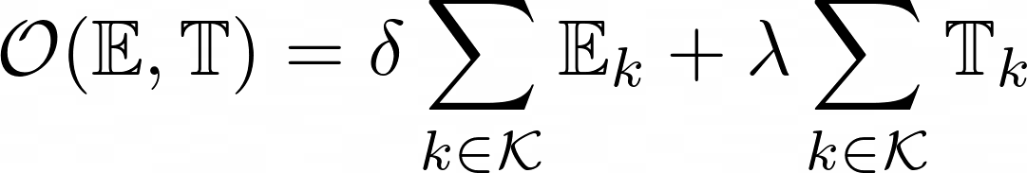
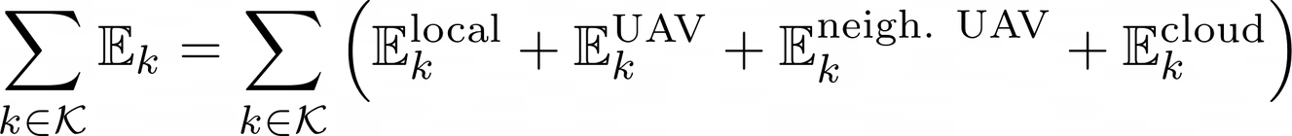
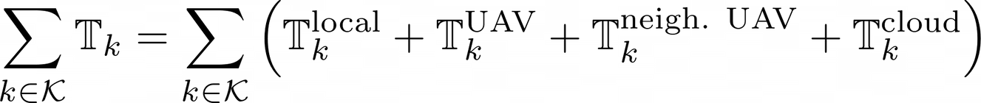
04
System Model (Contd.)
5. Objective Function
Goal: Minimize total delay and energy consumption.
Objective function balances delay and energy, controlled by hyperparameters (δ and λ).
Components of energy (E) and delay (T) cover execution on IoT devices, UAVs, neighboring UAVs, and cloud servers.
The System Model used for Time and Energy calculation has been referenced from [6]

Slide 9
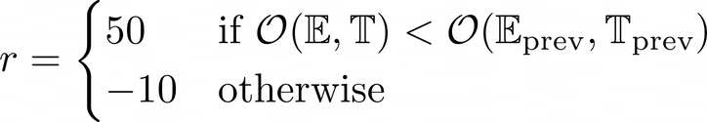
03
Proposed Method
1. Environment Design
State Representation
Modelled on subtask deployment matrices representing task distributions across IoT devices, UAVs, and cloud servers.
Action Space
Each action modifies the task allocation for a specific IoT device, choosing between self-processing, UAV, or cloud offloading.
Each action specifies:
Index of IoT Device whose task distribution is to be modified
Index of the offloading option to which task fraction will be assigned
Reward Function
Rewards are based on the reduction in delay and energy consumption:
Penalty applied if total delay or energy exceeds preset constraints:

Slide 10
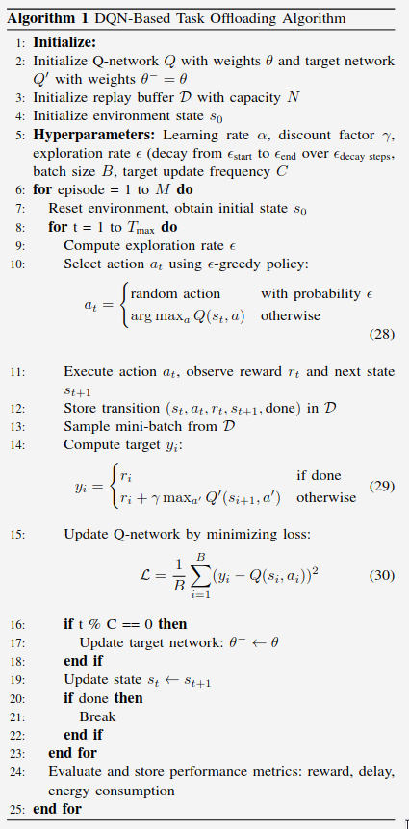
03
Proposed Method
2. DQN-Based Task Offloading Algorithm
Deep Q Network (DQN) Process: Initializes Q-network to predict optimal actions based on state transitions.
Learning Process: Q-network updated through experience replay, minimizing a loss function to achieve the best action selection over time.
.....
.....

Slide 11
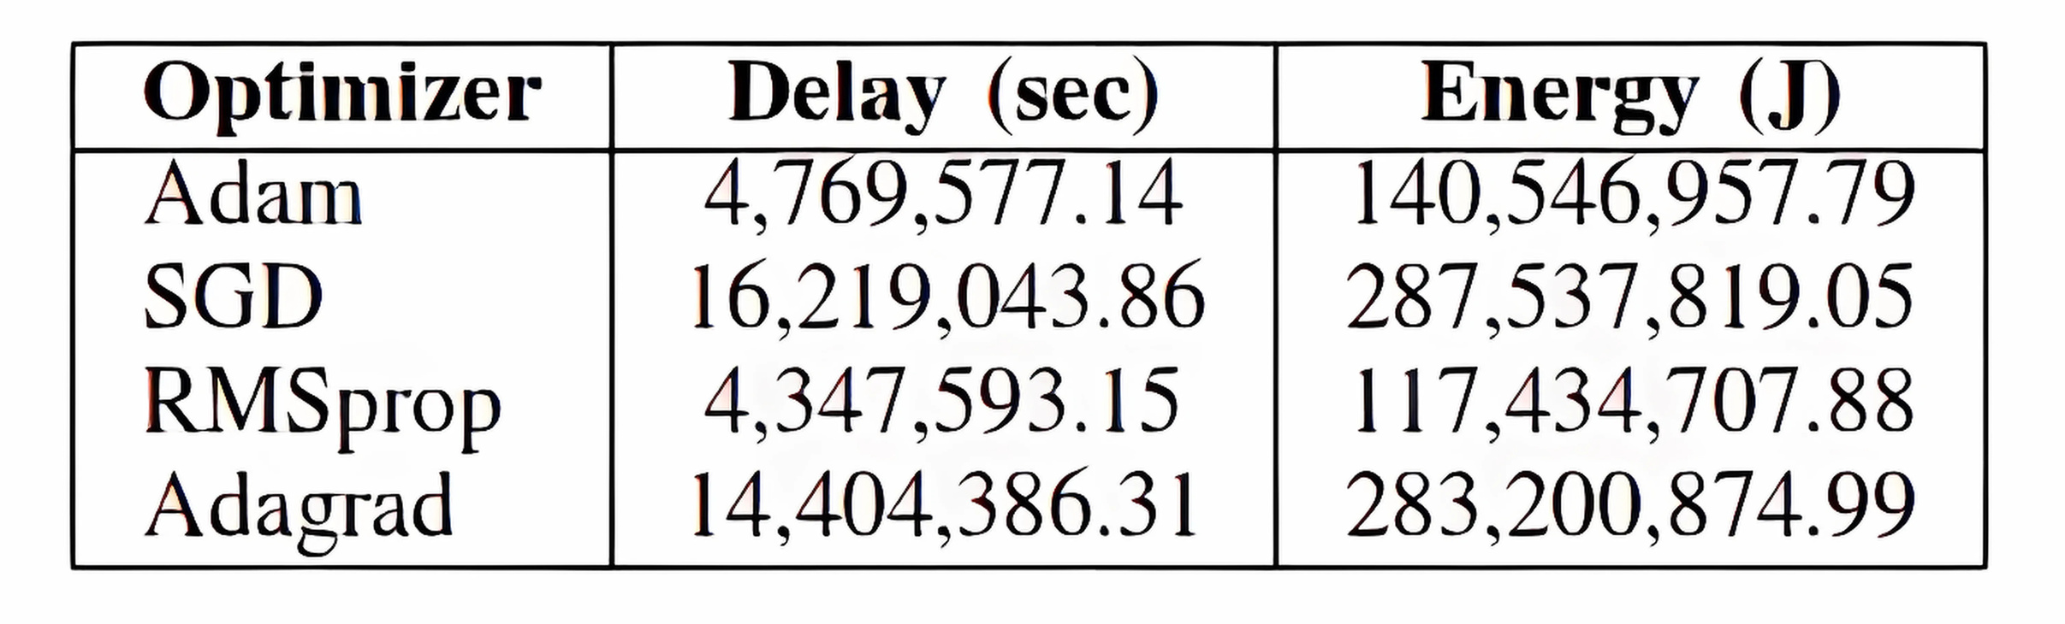
05
Results & Conclusion
Simulation Setup
Configured network with 12 IoT devices, 3 UAVs, and 1 cloud server to test the DQN-based task offloading.
Optimizers Tested
Compared Adam, SGD, RMSprop, and Adagrad optimizers to evaluate delay and energy efficiency.
The final readings are in the following table.

Slide 12
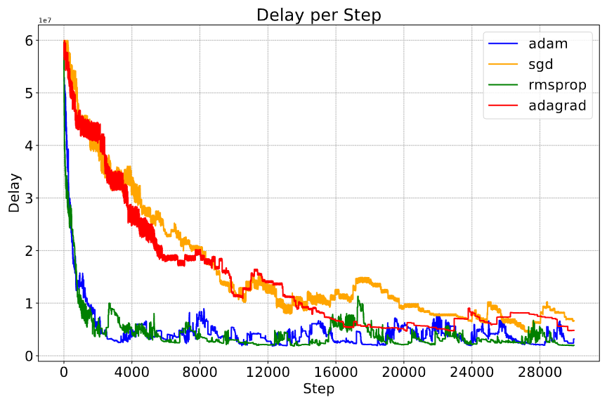
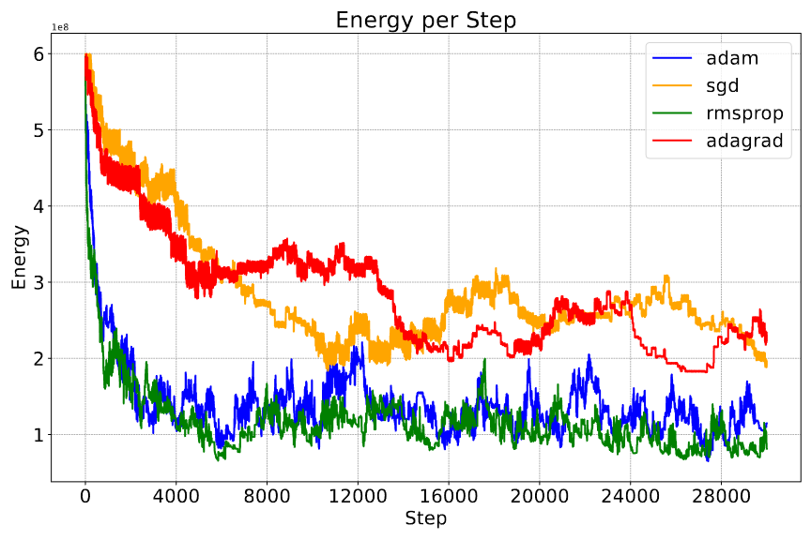
05
Results & Conclusion (Contd.)
Delay Reduction
Adam and RMSprop achieved the best results, reducing delays by over 92% from the initial values.
These optimizers demonstrated faster convergence to minimal delay values.
Energy Efficiency
RMSprop led in energy efficiency with an 80% reduction in energy usage, followed closely by Adam with a 76% reduction.
Both optimizers effectively balanced the trade-off between delay and energy.

Slide 13
References
[1] Z. Lv, B. Hu, and H. Lv, “Infrastructure monitoring and operation for smart cities based on iot system,” IEEE Transactions on Industrial Informatics, vol. 16, 2020.
[2] S. Selvaraj and S. Sundaravaradhan, “Challenges and opportunities in iot healthcare systems: a systematic review,” SN Applied Sciences, vol. 2, 2020.
[3] N. N. Misra, Y. Dixit et al., “Iot, big data, and artificial intelligence in agriculture and food industry,” IEEE Internet of Things Journal, vol. 9, 2022.
[4] J. C. Cano, V. Berrios et al., “Evolution of iot: An industry perspective,” IEEE Internet of Things Magazine, vol. 1, 2018.
[5] H. W. Choi, D. Shin et al., “Smart textile lighting/display system with multifunctional fibre devices for large scale smart home and iot applications,” Nature communications, vol. 13, 2022.
[6] H. Xiao, C. Xu et al., “Edge intelligence: A computational task offloading scheme for dependent iot application,” IEEE Transactions on Wireless Communications, vol. 21, 2022.
[7] J. Xu, D. Li et al., “Uav-assisted task offloading for iot in smart buildings and environment via deep reinforcement learning,” Building and Environment, vol. 222, 2022.
[8] A. Hazra, P. Maurya et al., “Cognitive computing and machine intelligence in fog-cloud infrastructure for industry 5.0,” IEEE Consumer Electronics Magazine, 2024.
[9] S. C. Mukhopadhyay, S. K. S. Tyagi et al., “Artificial intelligence-based sensors for next generation iot applications: A review,” IEEE Sensors Journal, vol. 21, 2021.
[10] A. Hazra, A. Kalita, and M. Gurusamy, “Meeting the requirements of internet of things: The promise of edge computing,” IEEE Internet of Things Journal, vol. 11, 2024. [Online]. Available:
[11] A. Hazra, M. Adhikari et al., “Intelligent service deployment policy for next-generation industrial edge networks,” IEEE Transactions on Network Science and Engineering, vol. 9, 2022.
[12]A. Hazra, M. Adhikari et al. , “Dynamic service deployment strategy using reinforcement learning in edge networks,” in 2022 International Conference on Computing, Communication, Security and Intelligent Systems (IC3SIS), 2022.
[13] A. Hazra, M. Adhikari et al., “Fair scheduling and computation co-offloading for industrial applications in fog networks,” IEEE Transactions on Network and Service Management, vol. 21, pp. 1867–1876, 2024.
[14] A. Hazra, M. A. et al., “Fog computing for energy efficient data offloading of iot applications in industrial sensor networks,” IEEE Sensors Journal, vol. 22, 2022.
[15] N. Agarwal and S. Joshi, “Federated learning-based task offloading in a uav-aided cloud computing mobile network,” IEEE Transactions on Vehicular Technology, pp. 1–6, 2024.
[16] A. Hazra, M. Adhikari et al., “Collaborative aienabled intelligent partial service provisioning in green industrial fog networks,” IEEE Internet of Things Journal, vol. 10, 2023.

