Slide 1
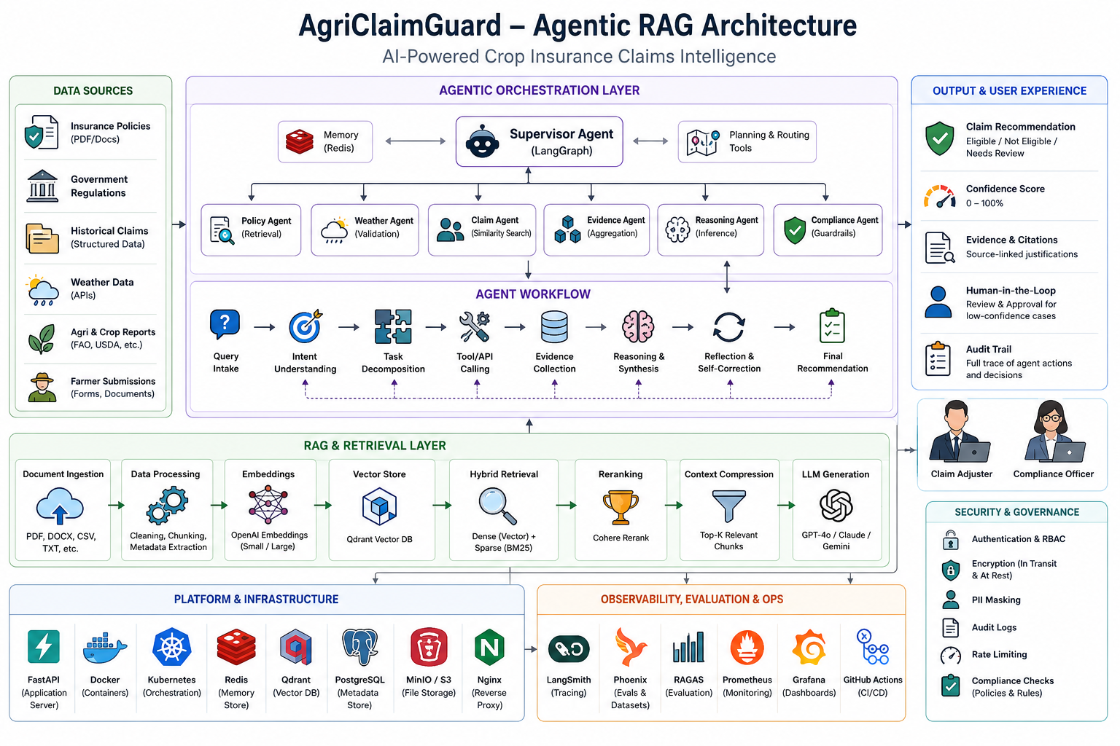
AgriClaimGuard
Agentic RAG for Crop Insurance Claims Intelligence
Competition Pitch
Built With
Enterprise AI platform that retrieves policy clauses, validates evidence, reasons over claims, and produces citation-backed recommendations.
LangGraph, LangChain, NVIDIA AI endpoints, Chroma vector store, BM25, and Python.
Outcome
Faster, more consistent crop insurance decisions with human oversight and auditable evidence.

Slide 2
The Problem
Crop insurance claim assessment is slow, document-heavy, and difficult to audit.
Manual review across policies, regulations, claim forms, and evidence reports.
Weather validation and eligibility checks consume analyst time.
Inconsistent decisions create settlement risk and customer dissatisfaction.
Limited citation trails make compliance audits difficult.
Why It Matters
During peak seasons, insurers may need to process thousands of claims. A slow review cycle delays farmer support and increases operating cost.
< 2 min
100%
Target time
Citation coverage
AgriClaimGuard

Slide 3
The Solution
An Agentic RAG platform that retrieves, reasons, validates, and escalates when needed.
Retrieve
Reason
Govern
Find relevant clauses, documents, weather evidence, and similar claims using hybrid search.
Agents synthesize evidence, compare policy conditions, and form a claim recommendation.
Compliance checks, citations, audit trails, and human review for low-confidence cases.
Designed to reduce assessment time by 70%, improve consistency, and provide explainable recommendations.
Human-in-the-loop review remains central for contradictory evidence, compliance concerns, or confidence below threshold.
AgriClaimGuard

Slide 4
Product Scope
From project PRD: enterprise-grade claim intelligence with explainability and oversight.
MVP Capabilities
Target Users
Data Sources
Submit claim queries Retrieve relevant documents Run multi-agent workflow Return recommendation, confidence, evidence, and citations Support human review
Claim adjusters Insurance analysts Compliance officers Supervisors reviewing low-confidence decisions
Insurance policies Government regulations Weather APIs and reports Historical claims Farmer submissions
AgriClaimGuard

Slide 5
Reference Architecture
Full Agentic RAG architecture from the project assets.
AgriClaimGuard

Slide 6
Current Repository Implementation
The codebase implements the ingestion and hybrid retrieval core of the platform.
LangGraph State
Document Pipeline
Retrieval Pipeline
Rag_State tracks query, document paths, loaded documents, chunks, vector store, BM25 index, and retriever outputs.
safe_file_renamer -> PyMuPDFLoader -> RecursiveCharacterTextSplitter with 1000 chunk size and 300 overlap.
Chroma semantic retriever and BM25 sparse retriever are combined through EnsembleRetriever.
Current query example: What is the eligibility for drought compensation?
Vector storage persists to ./chroma_db and BM25 chunks persist to ./storage/chunks.pkl.
NVIDIA endpoints provide embeddings and chat model configuration through environment variables.
AgriClaimGuard

Slide 7
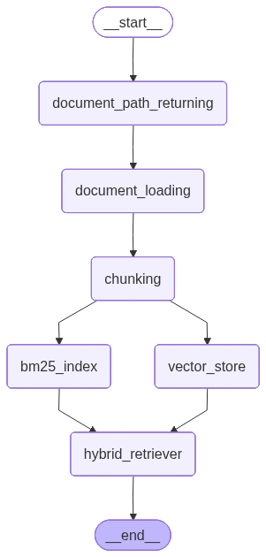
LangGraph Workflow
The ingestion graph generated by the application.
1. Normalize & Load
Rename unsafe files, discover documents, and load PDFs into LangChain Document objects.
2. Chunk Once
Split long policy documents into overlapping chunks for retrievable context.
3. Index in Parallel
Build semantic vectors and BM25 keyword index, then combine results through hybrid retrieval.
AgriClaimGuard

Slide 8
Hybrid Retrieval Strategy
Dense semantic search plus sparse keyword search improves policy lookup reliability.
70%
30%
5
Semantic weight
BM25 weight
Top-k each
Dense Retrieval
Sparse Retrieval
Ensemble Result
Captures meaning: drought compensation, eligibility criteria, claim terms, and similar clauses even when wording differs.
Captures exact terms: policy IDs, clause numbers, crop names, districts, and regulation keywords.
Combines both retrievers to return stronger evidence for downstream claim reasoning.
AgriClaimGuard

Slide 9
Agentic Claim Workflow
How the complete PRD vision extends the current RAG core.
Query intake
Intent understanding
Task decomposition
Tool/API calls
Evidence collection
Reasoning
Reflection
Recommendation
Supervisor agent plans which specialist agents are required.
Policy, weather, historical claim, reasoning, and compliance agents each contribute evidence.
Reflection cycles re-query when context is missing or contradictory.
AgriClaimGuard

Slide 10
Explainability & Governance
Designed for regulated insurance decisions where traceability matters.
Recommendation Package
Human Oversight
Audit Readiness
Decision: Eligible, Not Eligible, or Needs Review Confidence score Supporting evidence Source-linked citations
Escalate when confidence is below 75%, evidence conflicts, or compliance violations are detected.
Log user query, agent actions, retrieved documents, final decisions, and review outcomes.
AgriClaimGuard

Slide 11
Example Claim Scenario
A simple competition demo path for drought compensation eligibility.
Input
System Checks
Output
Farmer: Ram District: Anantapur Crop: Groundnut Loss reason: Drought Policy: PMFBY-2025
Retrieve policy clauses Search drought conditions Compare weather evidence Find similar claims Run compliance validation
Recommendation: Eligible / Needs Review Confidence: 0-100% Citations: policy clauses and evidence reports Audit trail: stored
AgriClaimGuard

Slide 12
Success Metrics
Competition-ready targets from the PRD.
< 2 min
> 90%
100%
< 5%
Claim processing
Retrieval accuracy
Citation coverage
Hallucination rate
> 0.85
< 15 sec
> 99%
< 20%
RAG faithfulness
API response
Availability
Human review
Evaluation layer proposed: RAGAS and DeepEval, with LangSmith/Phoenix traces for agent quality and debugging.
AgriClaimGuard

Slide 13
Risks & Mitigations
The platform is designed around the highest-risk failure modes in AI-assisted claims.
Hallucination
Poor Retrieval
Low Confidence
Mitigation: retrieval-grounded responses, citations, guardrails, and compliance agent review.
Mitigation: hybrid dense + sparse search, re-ranking, context compression, and evaluation metrics.
Mitigation: human-in-the-loop review, audit trail, and reflection/self-correction cycles.
AgriClaimGuard

Slide 14
Roadmap
Path from current RAG core to a full enterprise Agentic AI product.
Phase 1: MVP
Phase 2: Agents
Phase 3: Scale
Ingestion pipeline Hybrid retrieval Claim Q&A Citation-backed evidence Basic demo workflow
Supervisor planning Weather and claims tools Reasoning agent Compliance agent Human review UI
API deployment Monitoring and evaluation Fraud detection Voice and multilingual support Satellite image analysis
AgriClaimGuard turns policy documents and external evidence into faster, auditable, human-supervised crop insurance decisions.
AgriClaimGuard

