Slide 1
Page 31
Percent idio for prior week
Not there at weekly level
Count of positions <$x million on a daily basis for prior week
Not there currently
Page 32
We have top 10 P&L winners but not in the format they need
Rest of the tables - none
Page 33
Performance by market cap table only P&L- yes using group by
Performance by position size only P&L- yes using group by
Performance by industry yes, not at industry X stock
Page 34
P&L Hit rate and slugging planned but blocked on time series metrics
Attribution and factor return (Planned) using group by
Exposure as a chart yes but they have table format

Slide 2
Slide 32: Initiations % GMV
Single Stock Breakdown
Ticker | Total Dollar Vol ($M) | % Idio Variance | % Factor Variance | % Total Variance | % Weight of Gross
Total | 68 | 88% | 12% | 100% | 21%
AAPL | 61.8 | 58.5% | 11.1% | 69.6% | 35.8%
MSFT | 36.6 | 17.1% | -2.0% | 15.1% | -24.9%
TSLA | 27.9 | 9.4% | -2.7% | 6.8% | -7.8%
BBWI | 5.5 | 0.4% | 1.0% | 1.4% | 1.9%
OLLI | 4.9 | 0.4% | 0.6% | 1.0% | 1.9%
DLTR | 4.5 | 0.3% | 0.4% | 0.8% | 1.9%
ULTA | 4.4 | 0.3% | 0.7% | 1.0% | 1.9%
TPR | 4.6 | 0.3% | 0.8% | 1.1% | 1.9%
LW | 4.0 | 0.3% | 0.4% | 0.7% | 1.9%
BURL | 4.2 | 0.3% | 0.7% | 1.0% | 1.9%

Slide 3
Slide 32: P&L Winners
Top 10 Winners
Ticker | 1D Return (%) | 1D P&L ($M) | % Weight of Gross
AAPL | 1.9% | 4.01 | 35.8%
MSFT | -0.9% | 1.29 | -24.9%
TSLA | -1.7% | 0.56 | -7.8%
DLTR | 3.2% | 0.39 | 1.9%
OLLI | 2.8% | 0.36 | 1.9%
TJX | 3.0% | 0.36 | 1.9%
ULTA | 2.0% | 0.20 | 1.9%
DOV | 0.6% | 0.07 | 1.9%
TPR | 0.2% | 0.03 | 1.9%
BURL | 0.3% | 0.03 | 1.9%

Slide 4
Slide 33: P&L Winners
Performance Breakdown
 | 1W Return (%) | MTD Return (%) | YTD Return (%) | 1W P&L ($M)
Total | 0.71% | -2.59% | -1.51% | 4.18
Mega Cap >$200B | 0.51% | -3.42% | -0.41% | 2.13
Large Cap $10B-$200B | 0.43% | -5.33% | -4.36% | 0.34
Nano Cap <$50M | 0.86% | 4.57% | 3.23% | 0.57
Mid Cap $2B-$10B | 3.47% | -0.53% | -6.09% | 1.13
SPY | -1.48% | -6.48% | -5.19%
IWM | -1.64% | -6.62% | -9.28%

Slide 5
Slide 33: Last week performance by position size
Performance Breakdown by Gross Invested
 | 1W Return (%) | MTD Return (%) | YTD Return (%) | 1W P&L ($M)
Total | 0.71% | -2.59% | -1.51% | 4.18
>$100M | 1.23% | -4.33% | -3.69% | 4.35
$10 to 25M | 0.86% | -3.66% | -4.58% | 1.28
$25 to 50M | -2.46% | 6.61% | 21.27% | -1.31
$1M to 10M | -5.67% | 5.58% | -3.07% | -0.15
SPY | -1.48% | -6.48% | -5.19%
IWM | -1.64% | -6.62% | -9.28%

Slide 6
Slide 33: Last week performance by Industry.
Performance Breakdown by Industry
 | 1W Return (%) | MTD Return (%) | YTD Return (%) | 1W P&L ($M) | Ending Gross ($M) | Ending Net ($M)
Total | 0.71% | -2.59% | -1.51% | 4.18 | 574.6 | 146.3
Computer Electronics | -0.17% | -9.90% | -12.89% | -0.35 | 206.7 | 206.7
Software | 3.17% | 4.25% | 9.34% | 4.71 | 143.0 | -143.0
Index | 1.41% | 6.56% | 3.88% | 0.56 | 37.7 | -37.7
Automobiles & Components | -7.49% | 3.61% | 33.99% | -1.88 | 33.4 | -33.4
Forex | 0.04% | 1.55% | 2.01% | 0.01 | 27.0 | 27.0
Distributors & Multiline Retail | 2.37% | 0.26% | -2.60% | 0.54 | 23.4 | 23.4
Apparel Retail | 1.70% | -4.99% | -9.29% | 0.36 | 21.7 | 21.7
Specialty Stores | 2.38% | -8.58% | -14.31% | 0.48 | 20.5 | 20.5
Leisure Products, Luxury Goods & Apparel | -3.93% | -17.40% | 5.07% | -0.50 | 12.4 | 12.4
Airlines | -3.56% | 8.79% | 2.02% | -0.46 | 12.3 | 12.3
Food & Staples Retailing | 8.99% | -0.15% | -0.21% | 1.00 | 12.1 | 12.1
Industrial Machinery | -2.78% | -12.13% | -4.65% | -0.32 | 11.2 | 11.2
Food Products | 1.75% | 4.13% | -10.53% | 0.18 | 10.7 | 10.7
Media & Entertainment | -6.13% | -9.28% | -19.12% | -0.16 | 2.4 | 2.4
SPY | -1.48% | -6.48% | -5.19%
IWM | -1.64% | -6.62% | -9.28%

Slide 7
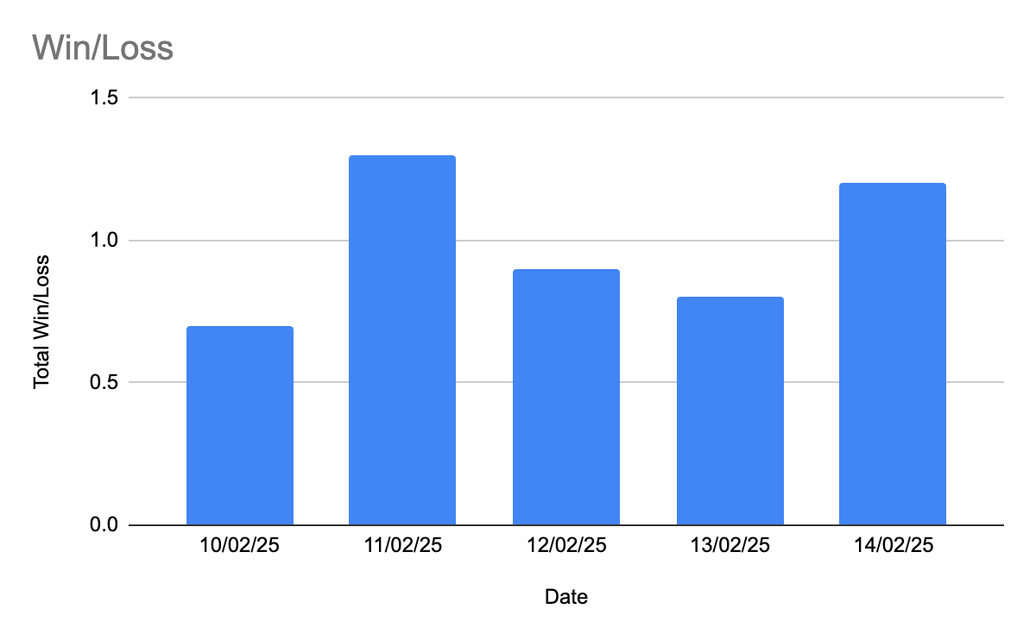
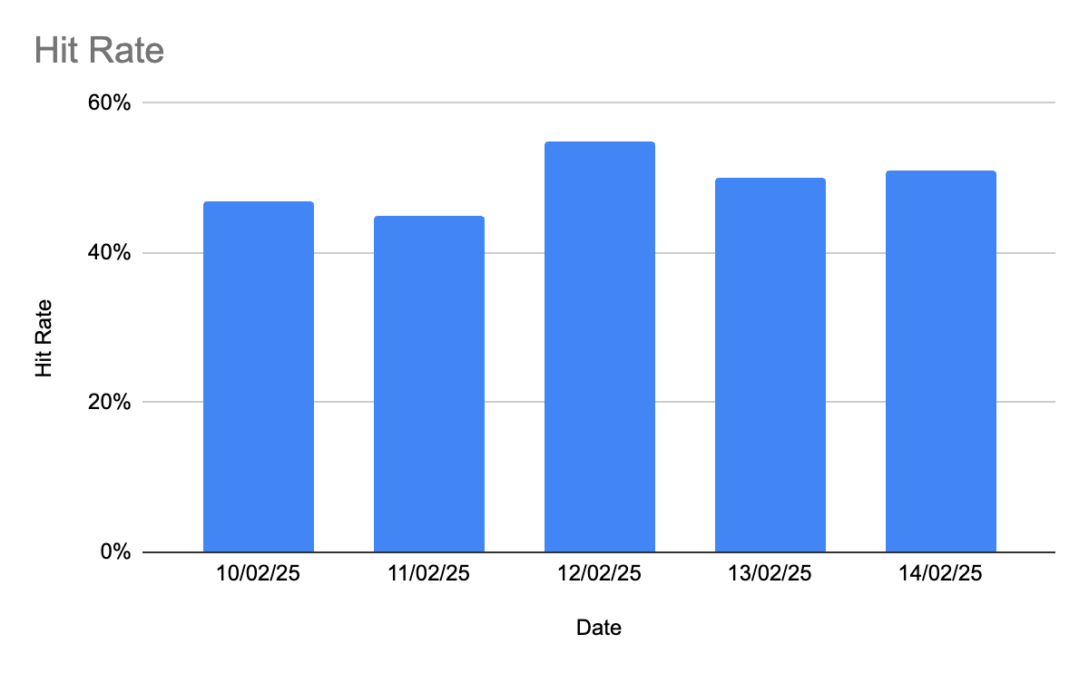
Slide 33: Period wise win/ loss and slugging

