Slide 1

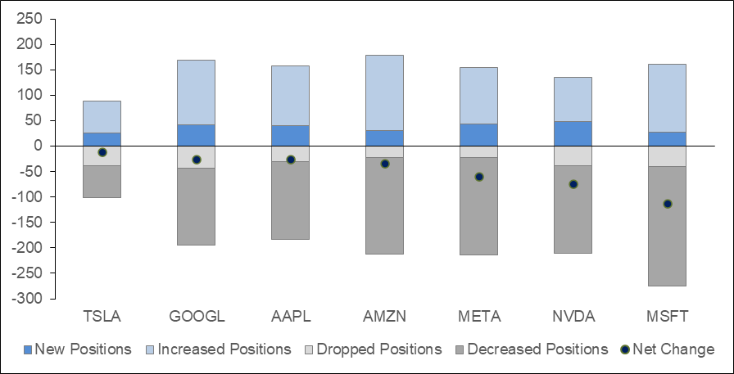
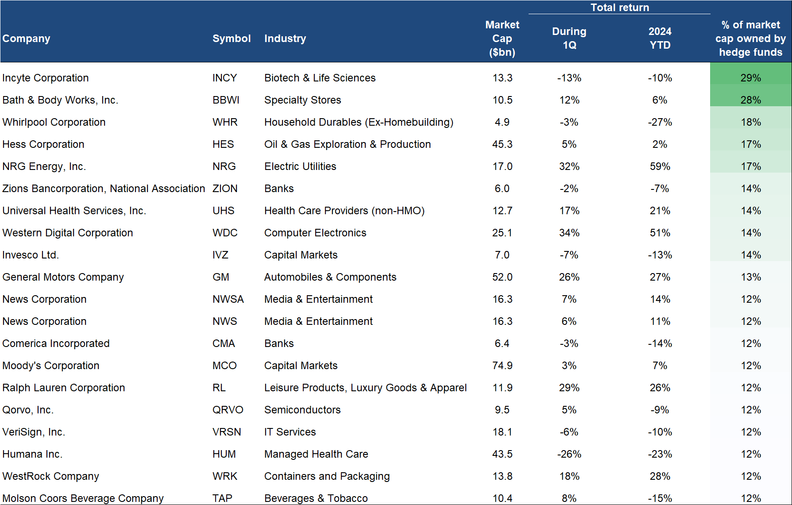
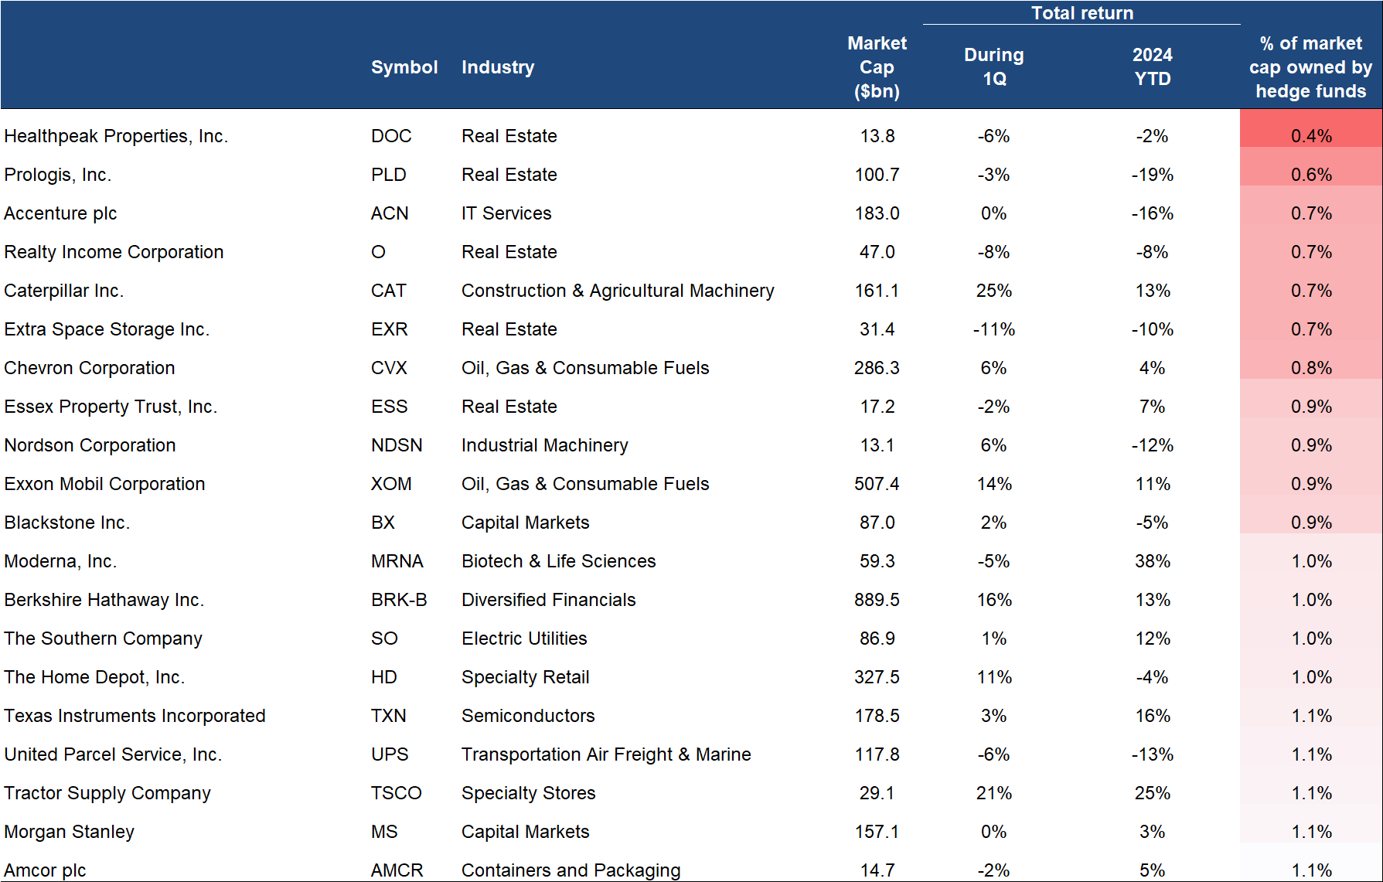
Hedge funds ownership update during Q1’24
Exhibit 22: HFs trimmed positions on net in the Magnificent 7
While new positions outweighed dropped positions, hedge funds trimmed their overall positions on average in the Magnificent 7
Exhibit 23: 25 MOST and LEAST CONCENTRATED hedge fund holdings
Incyte, Bath & Body Works, Whirlpool hedge fund hotels
Healthpeak, Prologis, Accenture less loved
Source: Arcana Terminal,13F data
Ownership represents positions of a stock held as a % of its market cap

