Slide 1

Class Project : MSCA 31006
Praneet Shaw

Slide 2
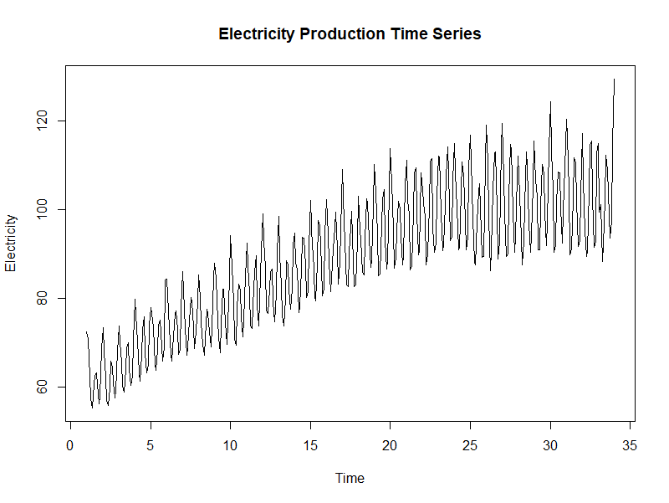
Problem Statement
The data is comprised of 397 months of Electricity Production data in downloaded from Kaggle.
Training set is the first 300 months and Testing is the remaining 97.
The goal is to come up with a model that can predict the time series and explain the sources of variation in terms of lagged variables.

Slide 3
Assumptions
Electricity production is not dependent on any other exogenous factor.
It is seasonal in nature and depends closely on the near past
Past pattern is production is expected in future with no predictable shocks.

Slide 4
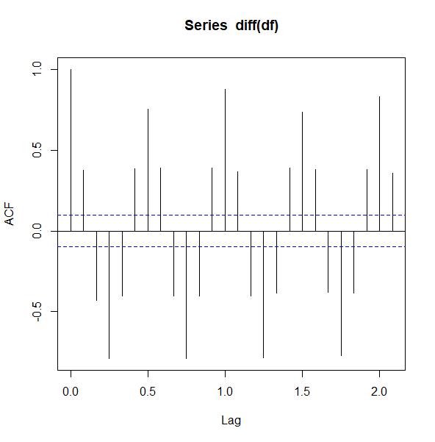
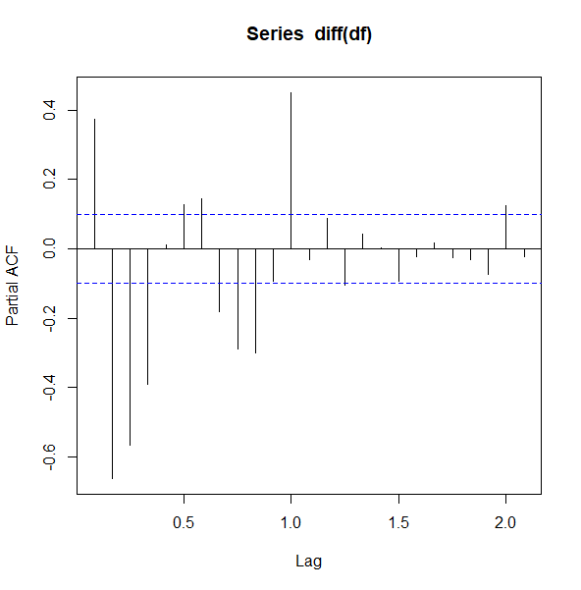
Data Properties
The TS is visibly non stationary. Furthermore, the p-value (<0.05) of the KPSS test confirms the hypothesis.
The ACF and PACF plots of the differenced time series show long tailed periodic correlations, signalling seasonal components at play (lag*12 = monthly lag)

Slide 5
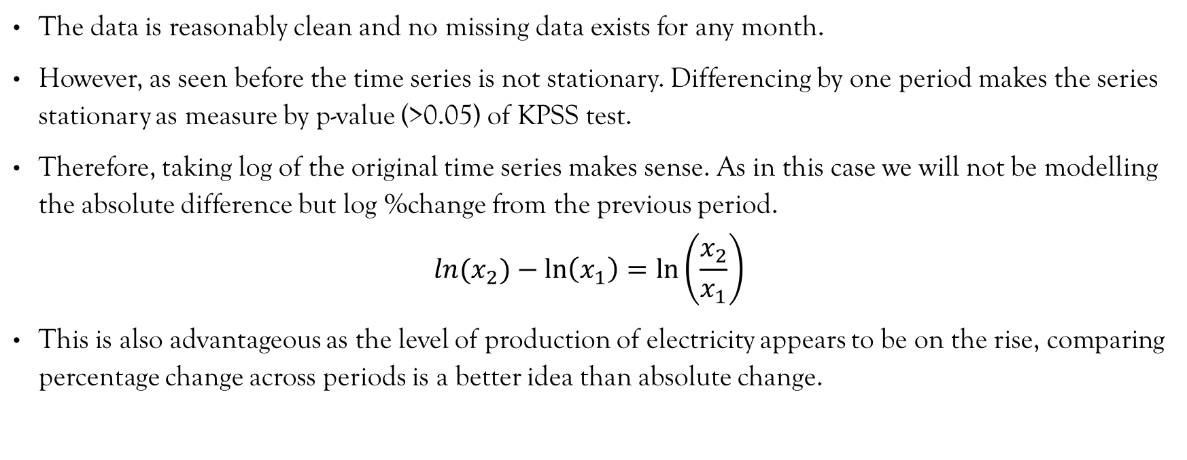
Data Processing & Feature Engg.
The data is reasonably clean and no missing data exists for any month.
However, as seen before the time series is not stationary. Differencing by one period makes the series stationary as measure by p-value (>0.05) of KPSS test.
Therefore, taking log of the original time series makes sense. As in this case we will not be modelling the absolute difference but log %change from the previous period.
$$ln{(x}_{2})−\ln\left(x_{1}\right)=\ln\left(\frac{x_{2}}{x_{1}}\right)$$
This is also advantageous as the level of production of electricity appears to be on the rise, comparing percentage change across periods is a better idea than absolute change.

Slide 6
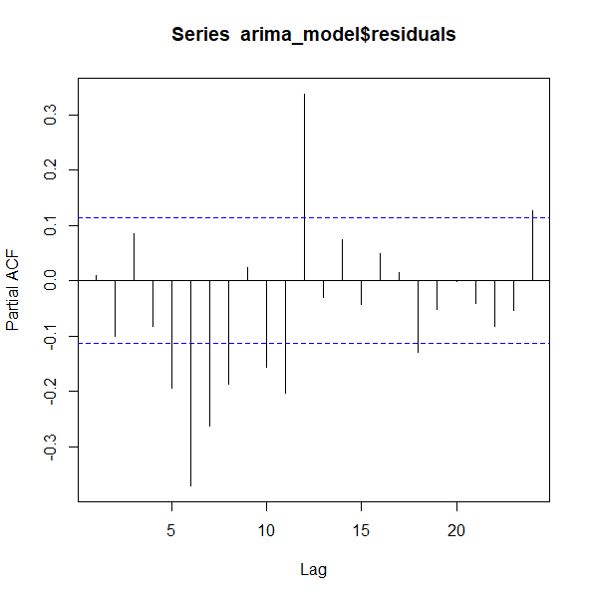
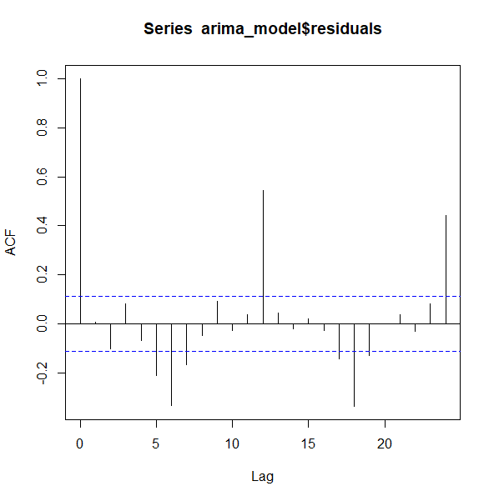
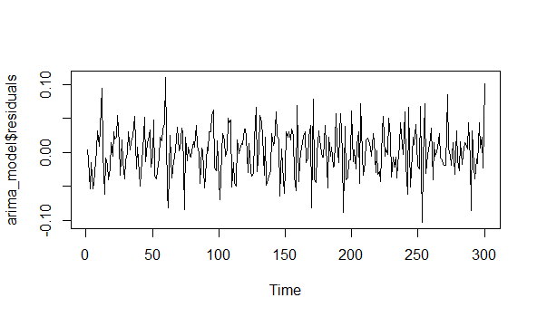
Proposed model : ARIMA
Although we expect the TS to be seasonal, auto-arima fails to detect seasonal components in the training set.
The model suggested is a (2,1,2) model. Running a few iterations yields the lowest AICC for a (2,1,3) model.
These plots shows the ACF, PACF & time-series plot of the model residuals in the training set.
There is clearly a 6, 12 or a 24 period seasonality that auto-arima does not capture.
However, the residuals expectedly pass the KPSS test.

Slide 7
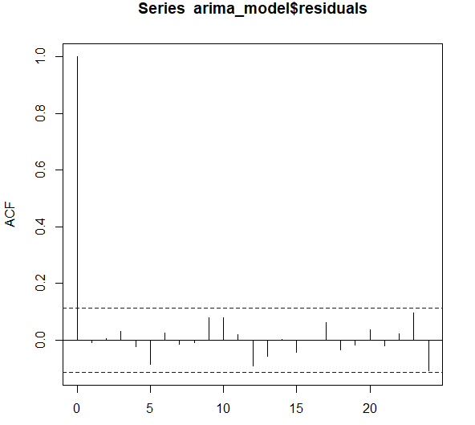
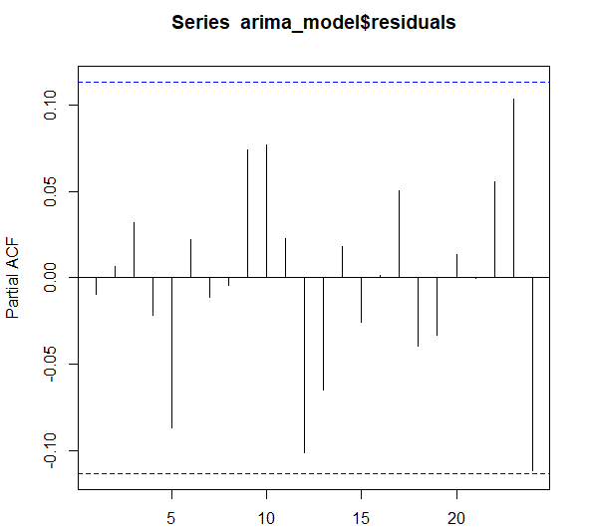
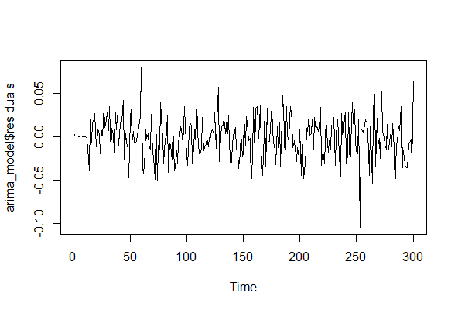
Proposed model : SARIMA
Through repeated iterations, the optimal SARIMA model by AICC turns out to be a multiplicative (2,1,3)(2,1,0)[12].
A seasonal differencing of 12 months and a 12 and 24 month seasonal AR reduces the training residuals to white noise.
ACF, PACF, and residual plots for SARIMA shows the same. The residual also pass the KPSS test.

Slide 8
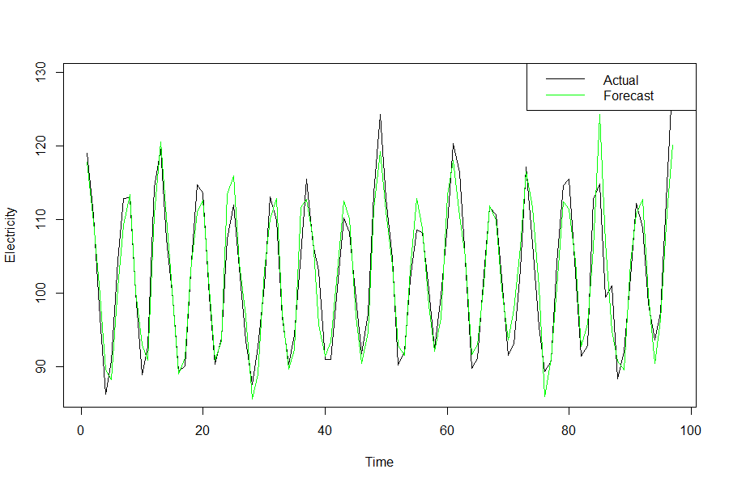
Results (1/2)
The method of testing chosen is a direct-recursion and 97 models were therefore fitted.
After reverse-feature engineering, performance in the testing set is judge by MAPE of 2.47%.
The Out-Of-Sample residual plots (acf, pacf, and line-plots) also exhibit the performance of the model
The seasonal AR as well as the non-seasonal MA terms appear to be very significant, thus supporting the initial hypothesis.

Slide 9
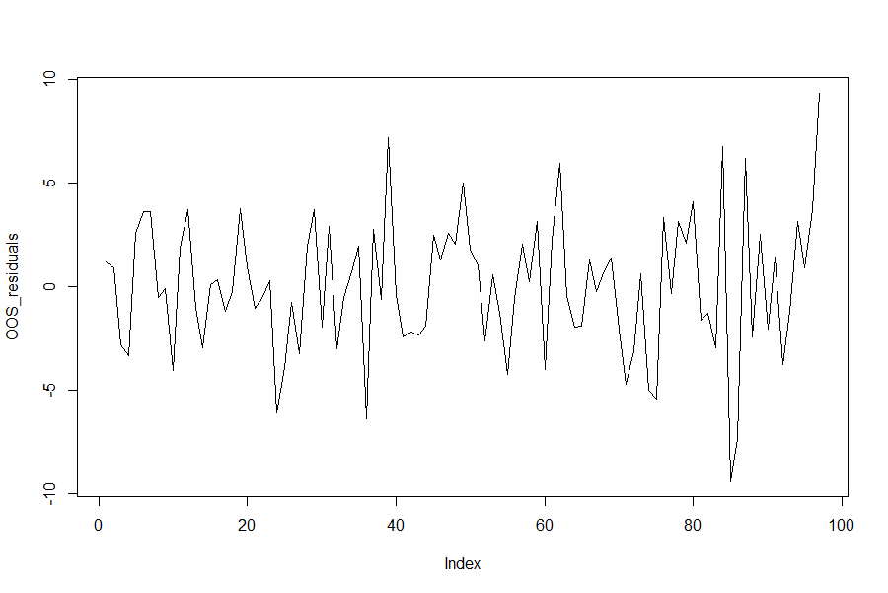
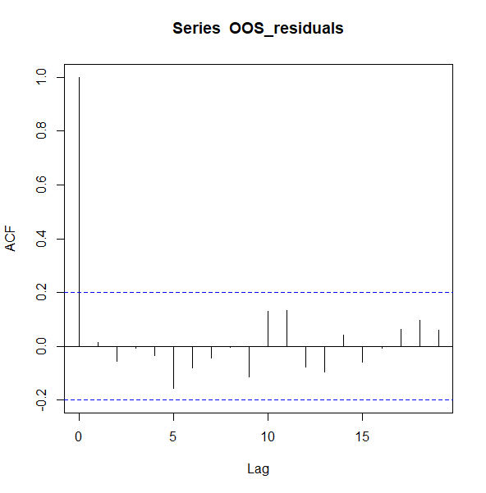
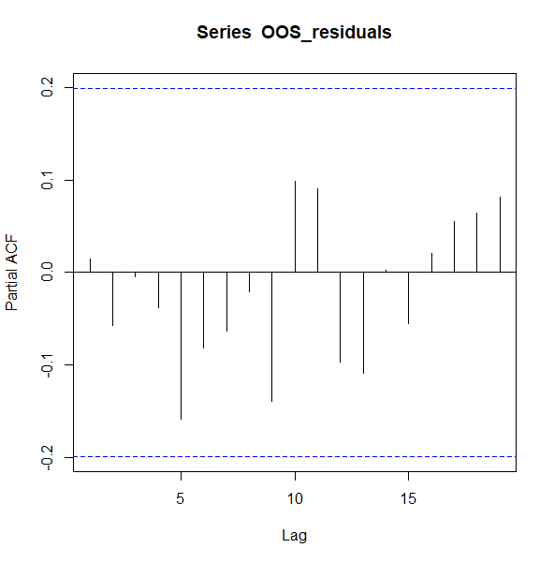
Results (2/2)
The fitted are coefficients are:
 | ar1 | ar2 | ma1 | ma2 | ma3 | sar1 | sar2
Coefficients | 0.2515 | 0.2102 | -0.6452 | -0.4436 | 0.129 | -0.503 | -0.3802
Standard Errors | 0.3649 | 0.1676 | 0.3628 | 0.2878 | 0.1057 | 0.0505 | 0.0508

Slide 10
Future Work
The assumptions of no exogenous variable might not be applicable as electricity production does depend on many external factors such as growing population and industry.
The data can be collected for these exogenous variables and a dynamic regression can be performed for a better model and prediction.
Another approach can be tracking the sale of new refrigerators, A/Cs and other appliances that might be consuming significant amounts of power.

