Slide 1
HAXXORING R2!!1!
HELLO from
@CaptnBanana
@blenk92

Slide 2
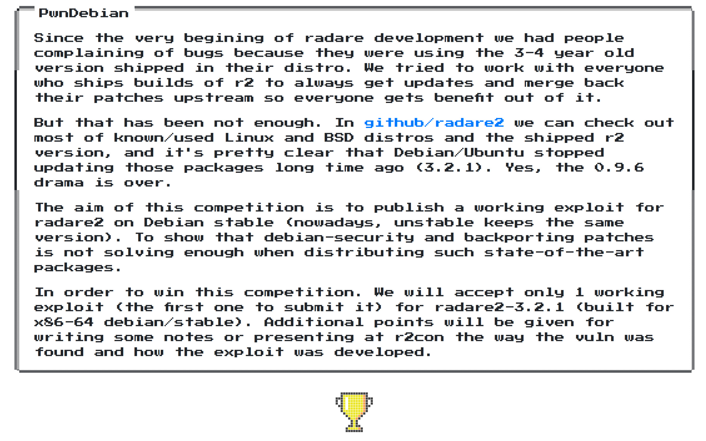

Slide 3
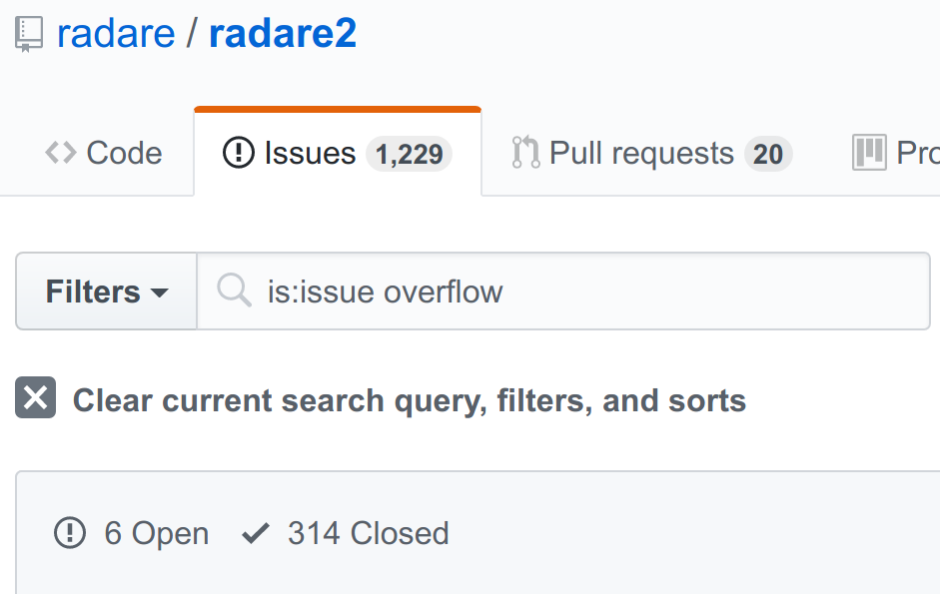
Memory Corruption?
Too Hard!

Slide 4
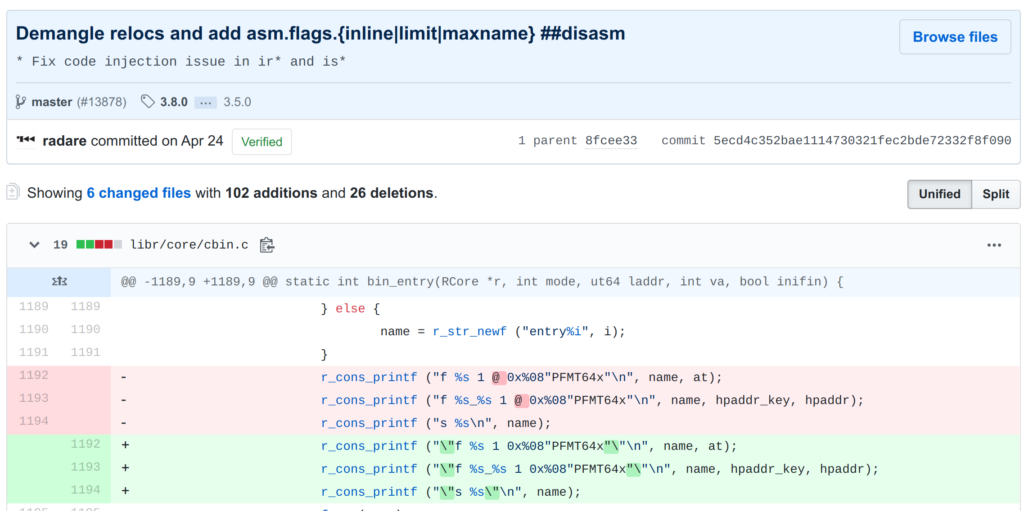
Command Injection Issues

Slide 5
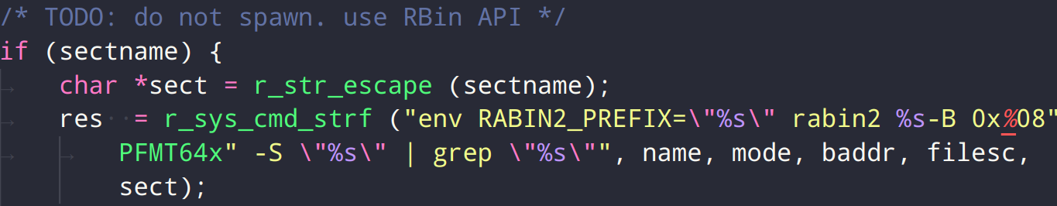
dmS Command Injection
Issue was here,
Fixed now

Slide 6
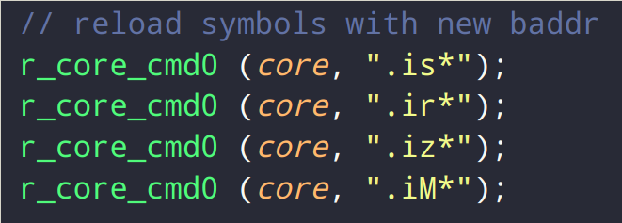
r_core_file_reopen_debug()
ood

Slide 7
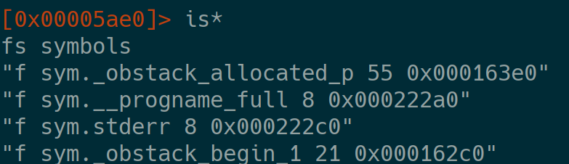
is*
Attacker controlled?

Slide 8
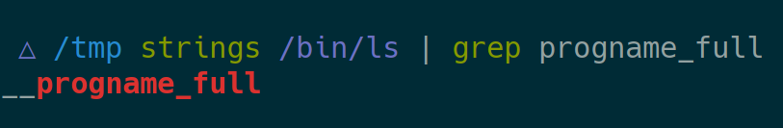
is*
yes

Slide 9
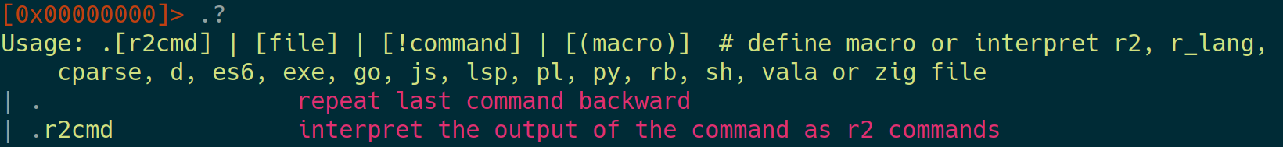
The . operator

Slide 10
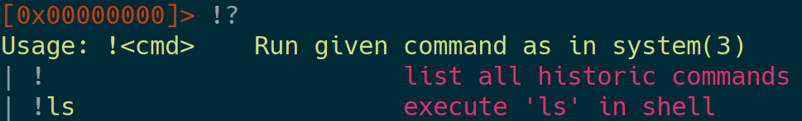
The ! operator

Slide 11
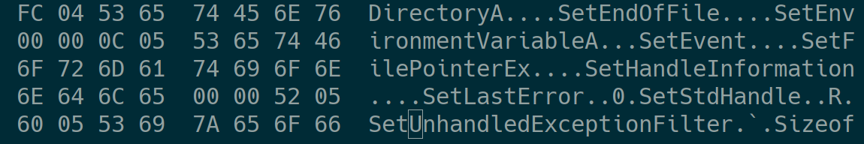
Crafting A Binary

Slide 12
MUCHOS DEMOS
hopefully

Slide 13
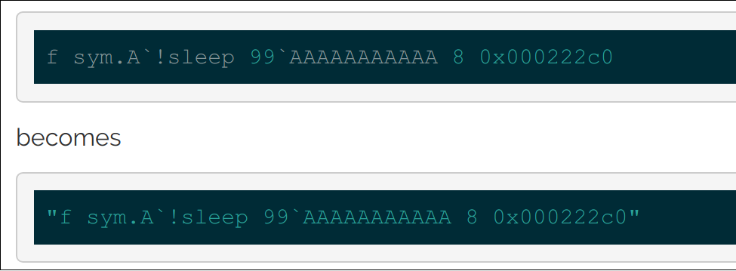
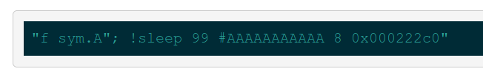
Hot !Fix

Slide 14
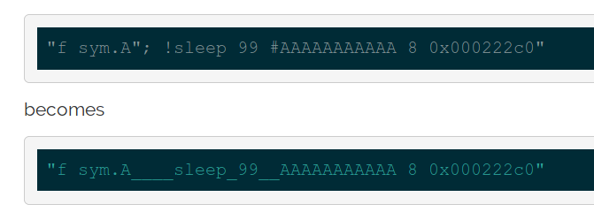
Next Try...
from @thestr4ng3r
What about PE Binaries?

Slide 15
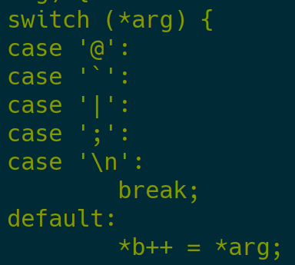
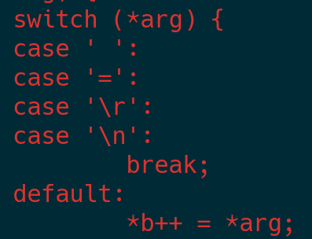
Let pancake do it…
Some more filtering

Slide 16
Surprise Time!

Slide 17
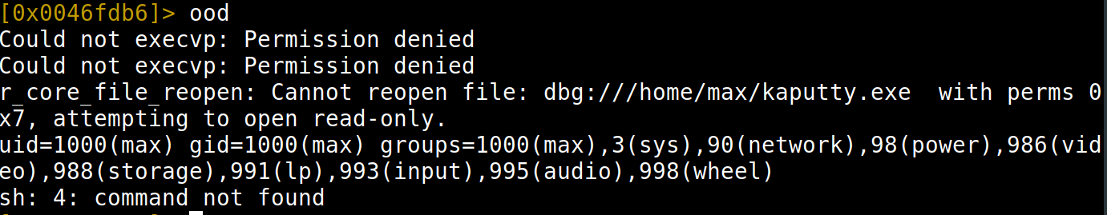

Mad 0-Day
What about ...?
Good News: ood seems currently broken (for ELFs)

Slide 18
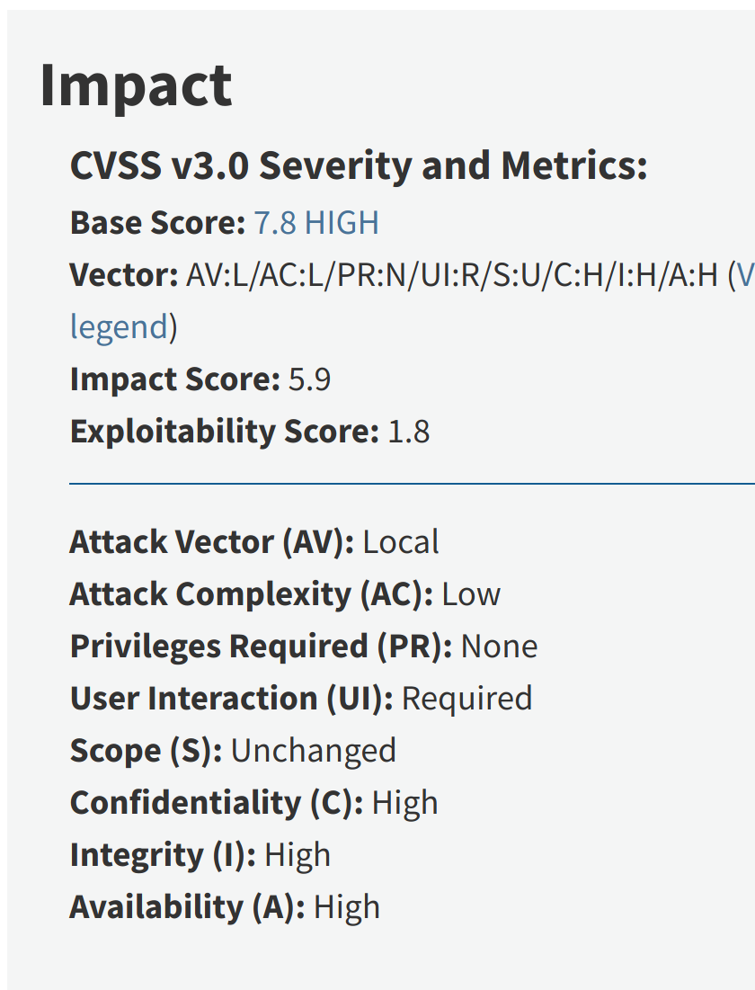
CVEzZZ!!1!
CVE-2019-14745

Slide 19
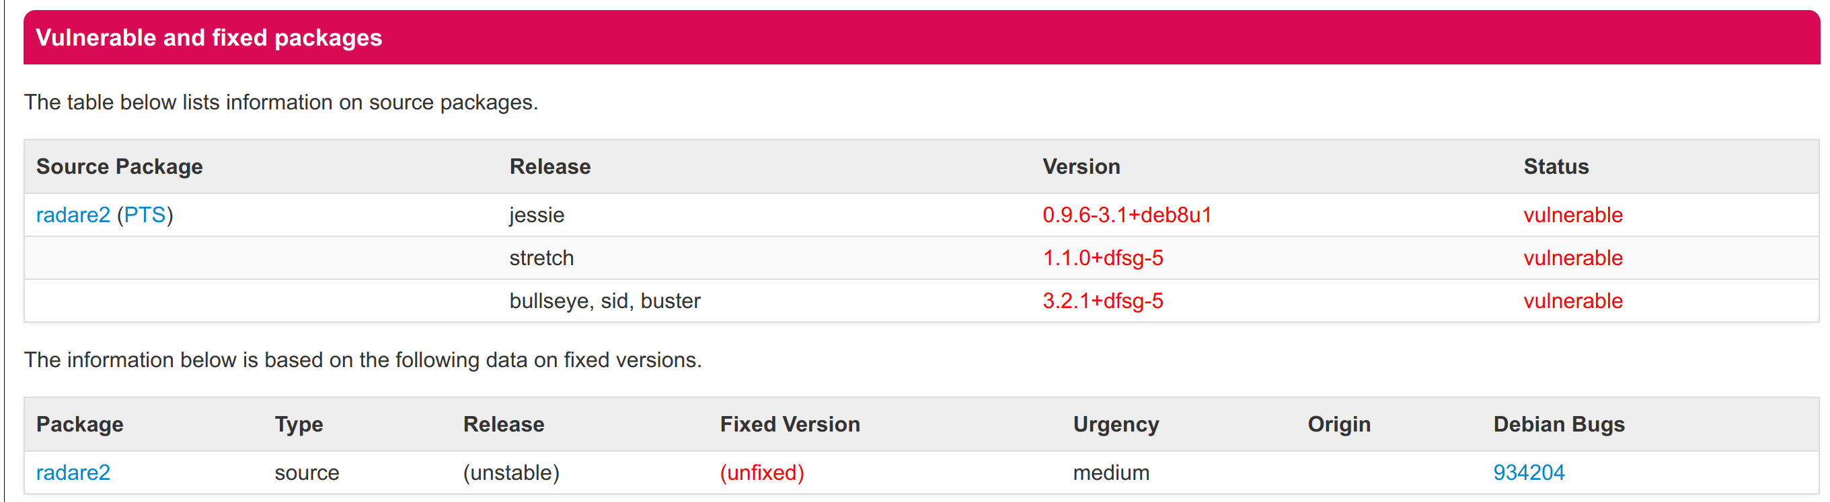
Go And Pwn Yo Friends

Slide 20
Lessons learned
- Don’t derive commands from untrusted input
- Don’t use user commands internally
- Breaking things is easy, fixing is hard...

