Slide 1
Rainfall Impact Intelligence System
RIIS
From a district forecast to the street outside your door
Live weather
Real terrain
8 trained models
Safe routes
Tamil Nadu · October 2026
Notes:
Open with the one-line thesis: rainfall is forecast by district, but damage happens by street. RIIS closes that gap.

Slide 2
The warning came. The impact intelligence did not
20 cm
95 cm
29,000
0
forecast
fell in 24 hours
cusecs for 21 hours
public warnings
Kayalpattinam, Thoothukudi, 17 to 18 Dec 2023
Chembarambakkam release, Chennai, 1 Dec 2015
Red alert issued the morning after rain began
750 tank breaches across two districts
38 dead, 10,000 evacuated by boat and helicopter
CAG audit: a man-made disaster
No real-time flood forecasting at the reservoir
Operating rules unrevised for 23 years
23 lakh homes submerged
Sources: IMD Chennai RMC, Tamil Nadu Chief Secretary briefing Dec 2023, CAG Report 4 of 2017
Notes:
Both events had rainfall warnings in some form. What was missing was the translation into local impact and the time to act on it.

Slide 3
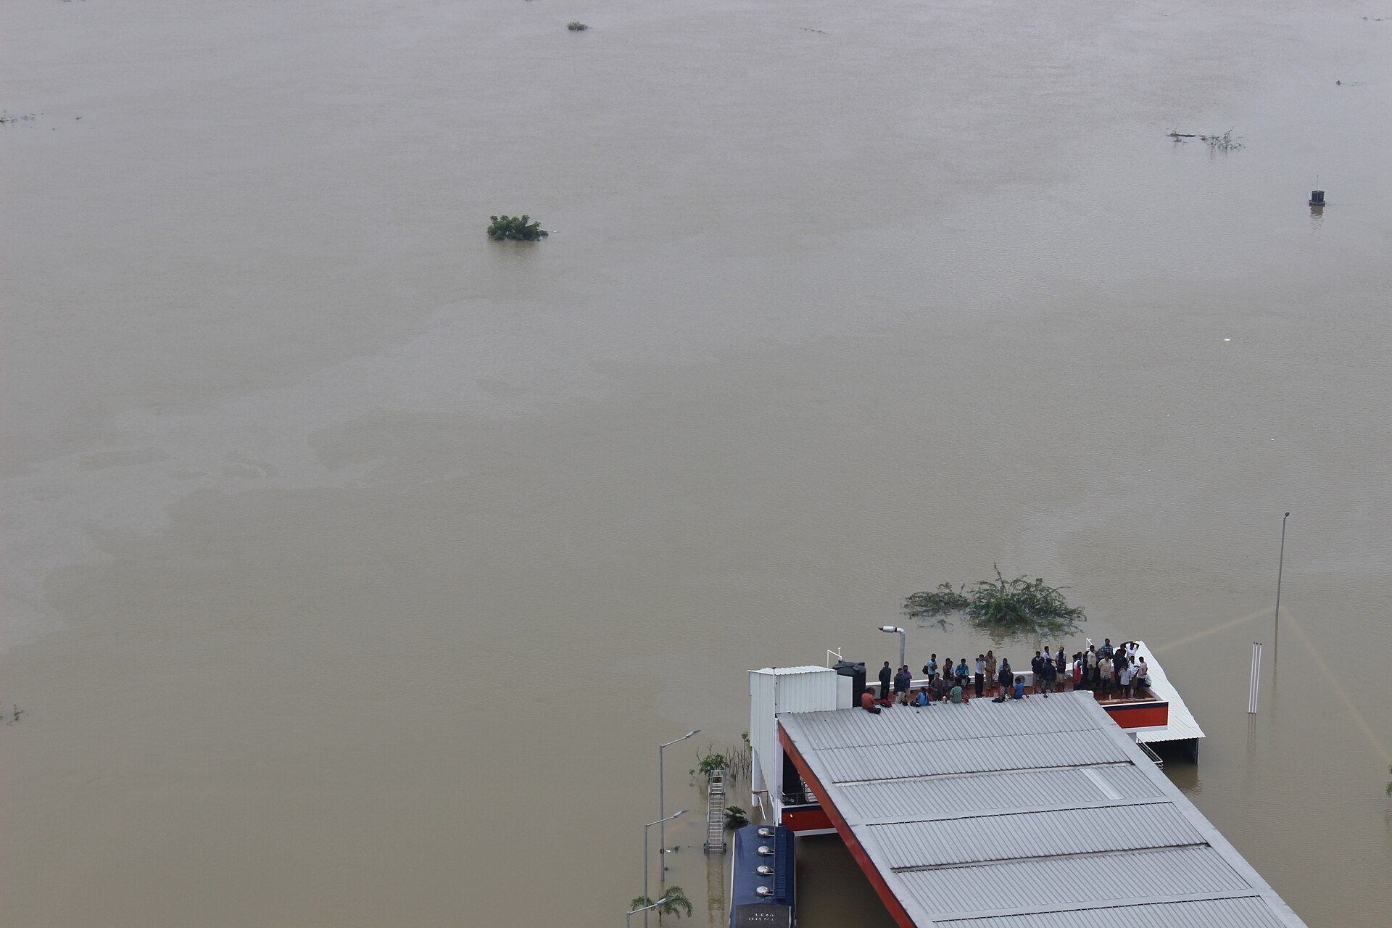
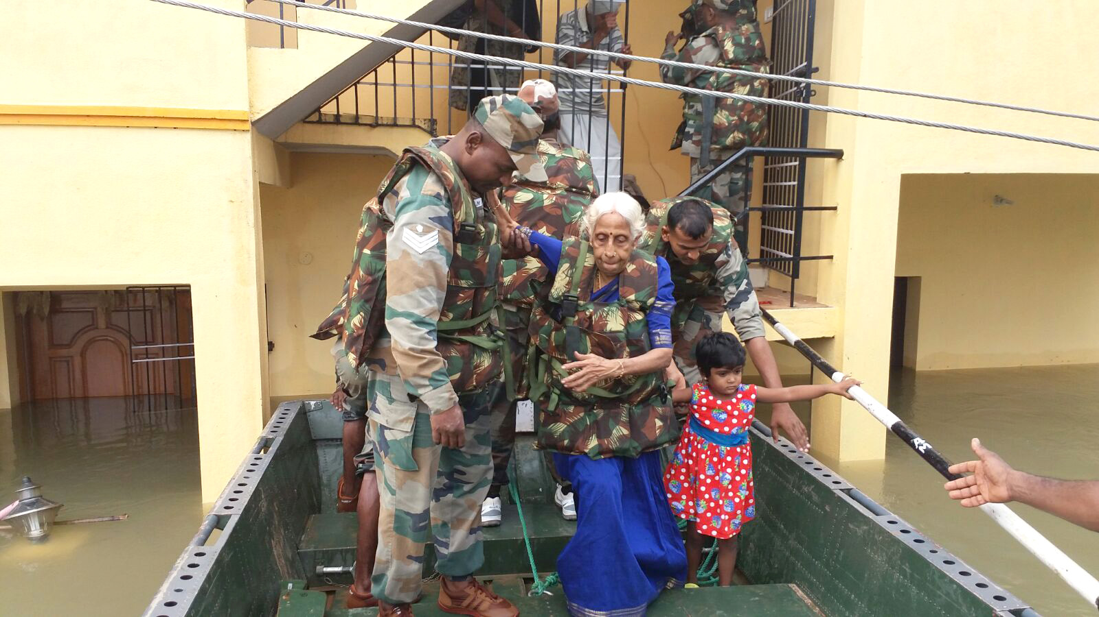
Chennai, December 2015
Adyar in spate after the Chembarambakkam release
23 lakh homes submerged, 470 dead by the state count
Airport closed, power cut citywide for days
Photos: Indian Air Force aerial survey, 2 December 2015, and Indian Army relief, 17 November 2015. Government Open Data License India, via Wikimedia Commons.
Notes:
Let the picture sit for a few seconds before speaking. This is the Adyar corridor from the air on the morning after the release.

Slide 4
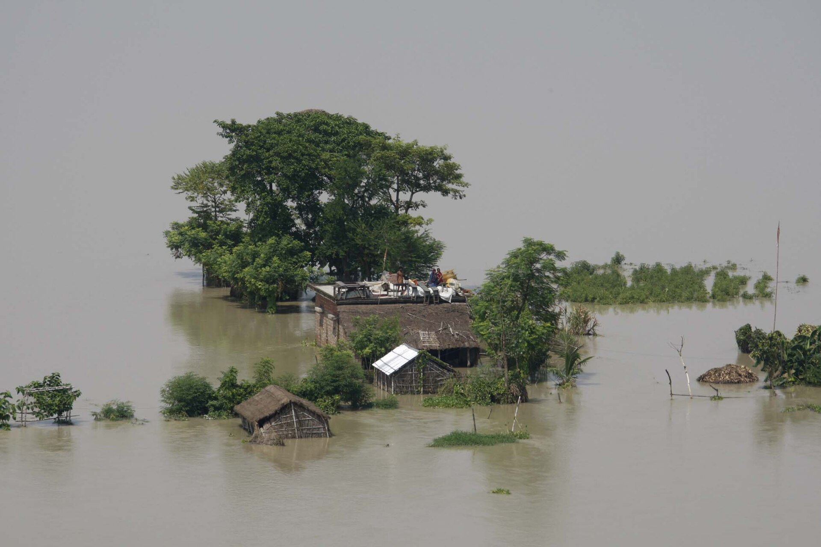
Bihar 2026: flooded in a 35 percent rain deficit
What happened
Ganga above its all-time high at Patna and Bhagalpur, 6 to 8 September
Nepal inflow above 5 lakh cusecs, Gandak record at Bagaha, 1 October
Six embankment breaches in ten hours, 200 villages flooded
About 50 lakh people across 15 districts, no official crop or cattle count
What it proves
The rain fell in Nepal and Uttar Pradesh. The flood arrived through saturated soils, barrages and failed embankments. Rainfall at the point is not the hazard.
Photo: Kosi flood, Bihar, Indian Air Force aerial survey, September 2008, Government Open Data License India via Wikimedia Commons. No openly licensed 2026 photographs were available.
Notes:
Say clearly that the photo is the 2008 Kosi flood, used because 2026 press photos are copyrighted. The same embankments failed again this year. Figures are from state bulletins and reporting through 7 October 2026.

Slide 5
Who pays when rain becomes impact
Households
Commuters
23 lakh homes went under in Chennai 2015. The hilltop ward and the reclaimed marsh received the same alert.
Drownings in flooded underpasses in Bengaluru, Faridabad, Delhi and Salem. One flooded afternoon on Bengaluru's Outer Ring Road cost Rs 225 crore.
Farmers
Operators
Cyclone Fengal put 1.29 lakh hectares of standing crop under water in three districts. Relief came months later with no record of the rain on that field.
Chennai's drains are built for 2 to 5 cm an hour. Michaung delivered 25 cm in a day. Pallikaranai marsh, the city's sponge, is 90 percent gone.
Notes:
Each card is one documented event. Full citations are in PROBLEM_STATEMENT_EVIDENCE.md.

Slide 6
The gap is resolution, not forecasting
What people get today
What they need to act
A district-scale forecast on a 10 to 25 km grid
Street-scale impact on a 5 to 30 metre grid
Rainfall in millimetres, no depth, no duration
Ponding depth, hours under water, roads passable
One alert for every ward, so people tune it out
Alerts only for the wards that will flood
A colour code with no reasons attached
Every score explained by its drivers
Warnings go out, ground truth never comes back
Community reports fused back into the model

Slide 7
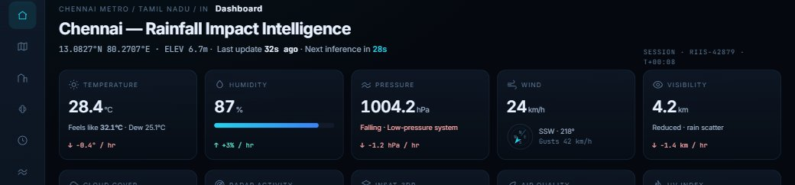
What RIIS does
Live data
Impact engine
Trained models
Actions
Weather, terrain, soil, drains, reservoirs, flood history
Ten weighted factors plus a DEM flood simulation
Tabular, sequence and spatial, with SHAP
Safe routes, farm advice, ward alerts, what-if maps
Notes:
Pipeline in one line: data in, impact engine and models in the middle, decisions out. The screenshot is the live dashboard.

Slide 8
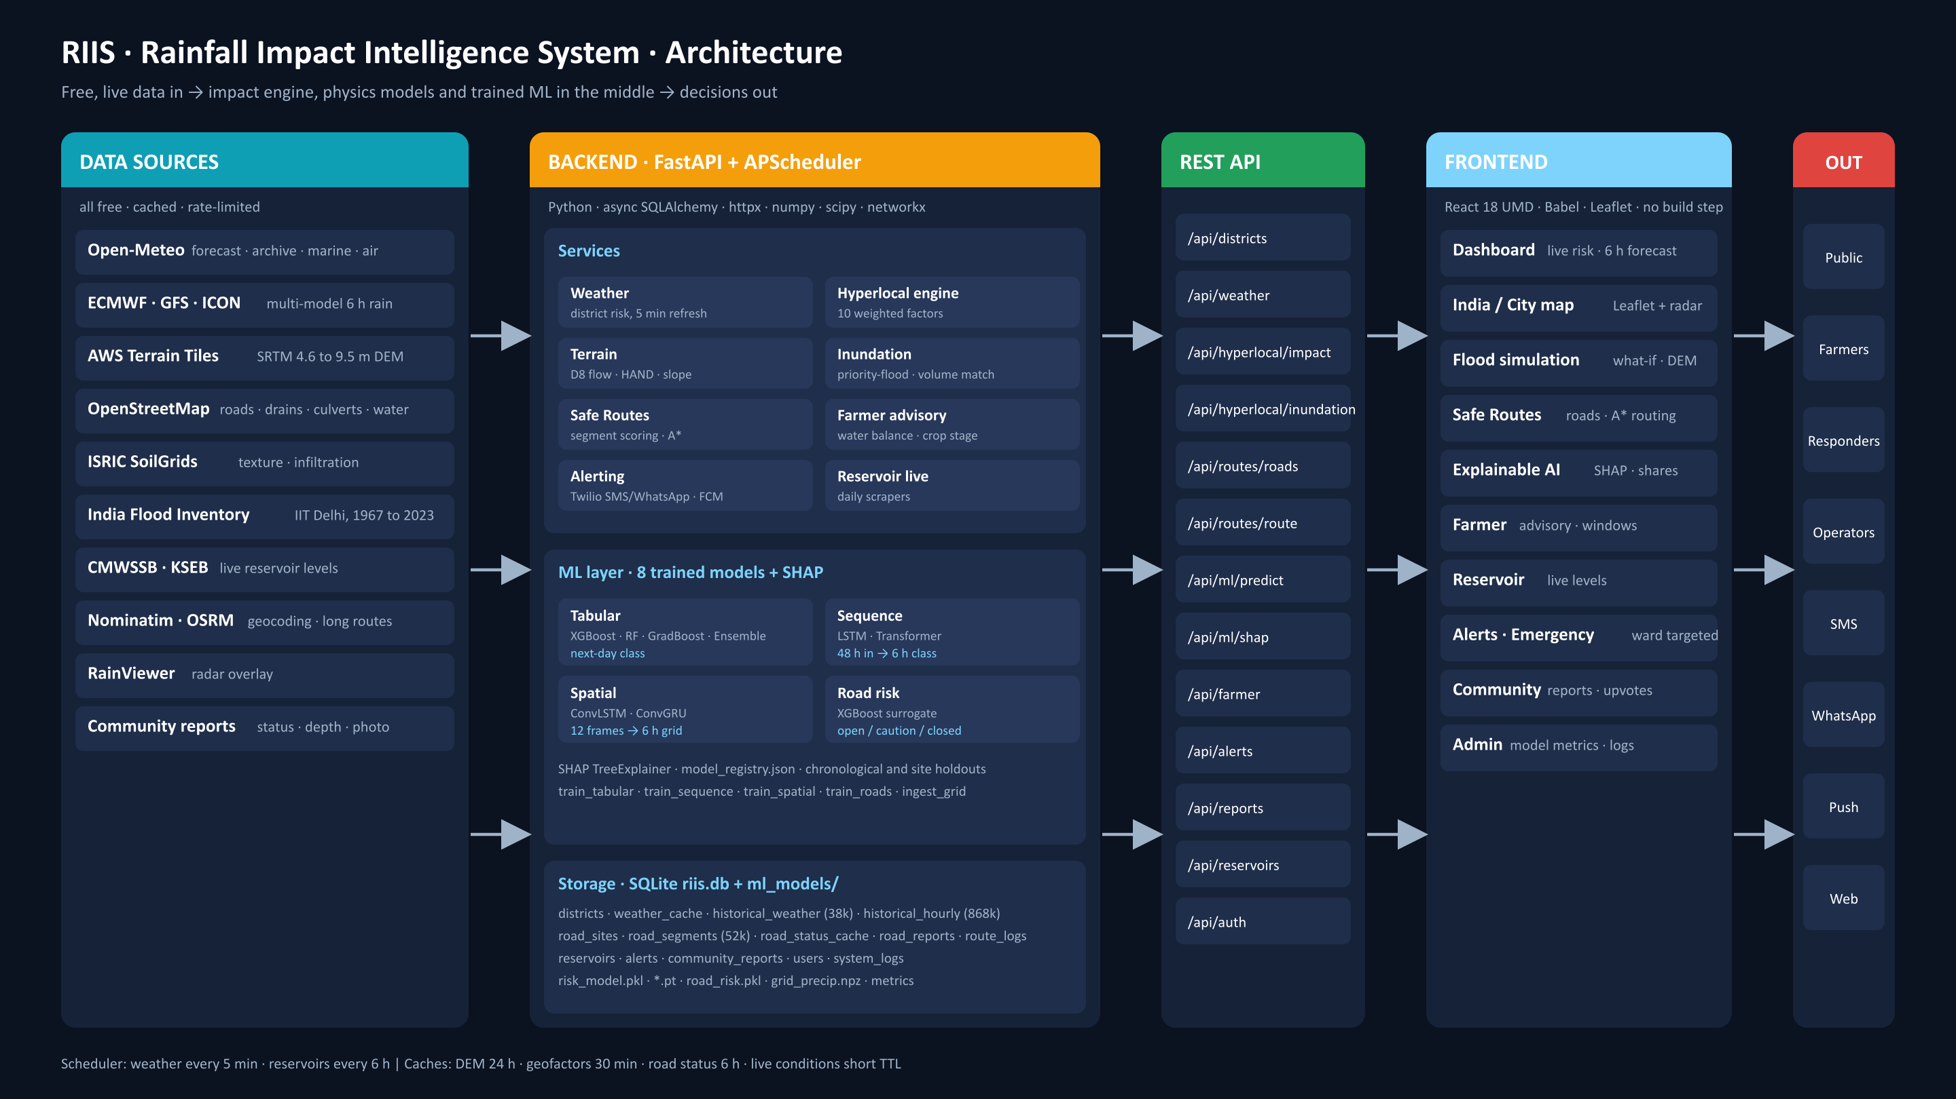
Architecture
Notes:
Left to right: free data sources, the FastAPI backend with services, the ML layer and SQLite storage, the REST API, the React frontend, and the outputs. Full-size image is outputs/RIIS_Architecture.png.

Slide 9
Built on real, free, live data
Open-Meteo archive
Open-Meteo forecast
AWS Terrain Tiles
OpenStreetMap
ERA5 and ERA5-Land, daily and hourly, 36 districts
Multi-model, marine tide, air quality, soil moisture
SRTM elevation at 4.6 m, flow routing, HAND
Drains, culverts, water bodies, land use, roads
ISRIC SoilGrids
India Flood Inventory
CMWSSB and KSEB
Nominatim and OSRM
Soil texture and infiltration, 250 m grid
IIT Delhi, district floods 1967 to 2023
Live reservoir levels scraped daily
Geocoding and long-distance route baseline
868k
hourly rows
38k
daily rows
52k
road segments
7
live sites

Slide 10
Ten factors, one explainable impact score
What feeds each factor
Intensity, duration, storm pattern and probability from the forecast
Soil texture, saturation and runoff coefficient from SoilGrids and archive rain
Slope, HAND and closed depressions from the terrain grid
Mapped drains and culverts, with a seasonal blockage factor
Reservoir levels, river proximity and tide stage
Population in the cell and return period from 30 years of rain
Each factor's share is returned, so every score comes with reasons

Slide 11
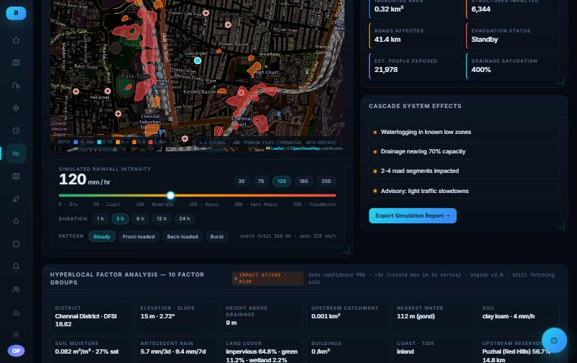
Water placed on real terrain
1
Fetch a 384 by 384 SRTM grid around the site, 4.6 m cells
2
Fill depressions with priority-flood, the Barnes algorithm
3
Runoff minus drainage capacity gives the volume that ponds
4
Binary-search the water surface that holds that volume
5
Stitch wet cells into depth polygons for the map
Notes:
This is the strongest algorithm in the project. It is physics and geometry, not ML, and it is what makes the road scoring and ponding depth real.

Slide 12
Eight trained models, honest numbers
Model | Family | Predicts | Test set | Key metric
XGBoost | Tabular | Next-day rain class | Jul to Dec 2025 | Heavy-rain AUC 0.87
Random Forest | Tabular | Next-day rain class | Jul to Dec 2025 | Heavy-rain AUC 0.87
Gradient Boost | Tabular | Next-day rain class | Jul to Dec 2025 | Heavy-rain AUC 0.85
Ensemble Vote | Weighted soft vote | Next-day rain class | Jul to Dec 2025 | Heavy-rain AUC 0.87
LSTM-Impact | Sequence, 48 h in | Next 6 h rain class | 79k windows | Heavy-rain AUC 0.88
Transformer | Sequence, 48 h in | Next 6 h rain class | 79k windows | Heavy-rain AUC 0.88
ConvLSTM | Spatial, 12 frames in | Next 6 h rain grid | Nov 2024 to Fengal | CSI 5 mm 0.44 vs 0.35
ConvGRU | Spatial, 12 frames in | Next 6 h rain grid | Nov 2024 to Fengal | CSI 5 mm 0.43 vs 0.35
Road risk | XGBoost surrogate | Segment open / caution / closed | Held-out city | Closed recall 0.94
All splits are chronological or by whole site. No random cross-validation. SHAP TreeExplainer serves attributions for the tree models.
Notes:
If asked about accuracy: the earlier version reported 99.95 percent because the label leaked from the features. We caught that, relabelled to next-day, and these are the honest numbers.

Slide 13
Heavy-rain skill across model families
How to read this
AUC measures how well each model separates heavy-rain days from the rest
Macro F1 is around 0.43 for all of them. The extreme class has about 70 test days, so every model struggles there
Safe-class F1 is 0.84 to 0.95. The system is good at saying when it is safe
The deep models do not beat the trees on this data. Thirty-six point stations at daily resolution favour tree models

Slide 14
Nowcast beats persistence at 1 and 5 mm
Setup
11 by 11 grid at 0.25 degrees over northern Tamil Nadu, hourly through 2024
Input: last 12 frames. Output: rain in the next 6 hours at every cell
Tested on November 2024 through Cyclone Fengal, the wettest block
RMSE 5.7 mm against 6.8 for persistence
Loses at 20 mm because the reanalysis grid smooths convective cores. IMERG satellite frames are the fix

Slide 15
Explainable by design
SHAP TreeExplainer runs on every tree-model prediction and returns per-feature attributions for the district
The impact engine returns each factor's weighted share, so a score of 72 comes with 'drainage 31 percent, saturation 24 percent'
The road model and the farmer advisory expose their drivers the same way
XGBoost feature importance, next-day model

Slide 16
Safe Routes: roads scored by depth, routed by A*
Fetch every road within the site from OpenStreetMap, 52,000 segments cached
Depth on road | Status | Why
under 15 cm | Open | Normal driving
15 to 30 cm | Caution | Cars lose braking, two-wheelers unsafe
30 to 60 cm | Closed to cars | Cars float at about 30 cm
over 60 cm | Closed to all | Buses and trucks stall
Sample the flood depth grid every 10 m along each segment
Classify by depth, with underpasses forced to caution or closed and bridges always open
A* on the road graph: closed edges removed, caution edges penalised, safe and normal route returned together
Road risk surrogate model
XGBoost over 18 terrain and scenario features, 134,400 simulated segment-scenarios across six cities, Coimbatore held out. Closed-road recall 0.94. Labels come from the ponding simulation, not observed floods, and the metrics file says so.
Live community reports override the simulation for six hours
Notes:
Demo this live if time allows: set a destination 1.5 km away, drag the rainfall slider, watch roads turn red and the route bend.

Slide 17
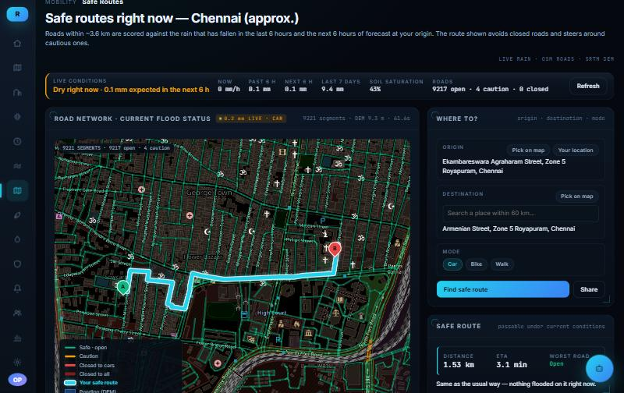
Safe Routes in action
Live mode, Chennai
Roads within about 3.6 km scored against the last 6 hours of observed rain and the next 6 hours of forecast
Green open, amber caution, red closed, with the safe route drawn in cyan
Origin is the device location, destination by search or a map click
Long trips hand the outer legs to OSRM and apply flood detours inside the grid

Slide 18
Decisions, not millimetres
Farmer advisory
Alerts and response
Seven days back and seven forward from the forecast, with soil moisture at three depths
Water balance from rain, ET0 and radiation, so irrigation advice is a number, not a guess
Waterlogging risk from the same ponding model used for the flood map, run on the next 72 hours
Crop and stage aware: lodging risk for ripening paddy, disease pressure from humidity
Spray, sowing and harvest windows, ranked advisory list
Alerts targeted by district and ward risk class, not broadcast statewide
SMS and WhatsApp through Twilio, push through Firebase, with subscriber management
Live reservoir levels for the Chennai lakes and Kerala dams, scraped daily
Community reports with upvotes and moderation, feeding the road status layer
What-if scenarios: any rainfall and duration, any point, mapped in seconds

Slide 19
What is real today, and what is not yet
Verified and running
Known limits
Eight models trained on real data with time or site holdouts, metrics on disk
Live weather for 36 districts refreshed on a schedule
Terrain flood simulation on real SRTM grids
Safe Routes with live and scenario modes, OSRM for long trips
Reservoir levels from two live sources
Farmer advisory and alert pipeline end to end
Extreme-class recall is low for every model. Rare events need more years and gauge data
Road model labels come from the simulation, not observed floods, until community reports accumulate
Nowcast grid is 0.25 degrees reanalysis, too coarse for convective cores
Mettur and Bhavanisagar reservoirs still carry seeded values, labelled as such
No IMD gauge or radar feed, because neither has a public API
Notes:
Say this slide out loud. Naming the limits is what makes the rest believable.

Slide 20
Next steps
GPM IMERG
Flood calibration
Community labels
Half-hourly satellite rain at 0.1 degrees for the ConvLSTM, replacing the reanalysis grid
Tune impact weights against India Flood Inventory event dates by district
Route road reports into the road model so it learns from observed closures
Time-stepped routing
Gauge ingestion
Mobile app
Routes that change as ponding grows through the event
TN SMART and IMD station rain when access is granted, to correct ERA5 bias per district
Same API, location-first, offline-tolerant alerts

Slide 21
Rain is forecast by district. Damage happens by street.
RIIS turns the first into a map of the second, with reasons attached, in time to act.
Live demo · localhost:5173 · Dashboard, Flood Simulation, Safe Routes, Farmer, Alerts

