Slide 1
Angular cuts of 9 deg
115_124
124_133
133_142
142_151
151_160

Slide 2
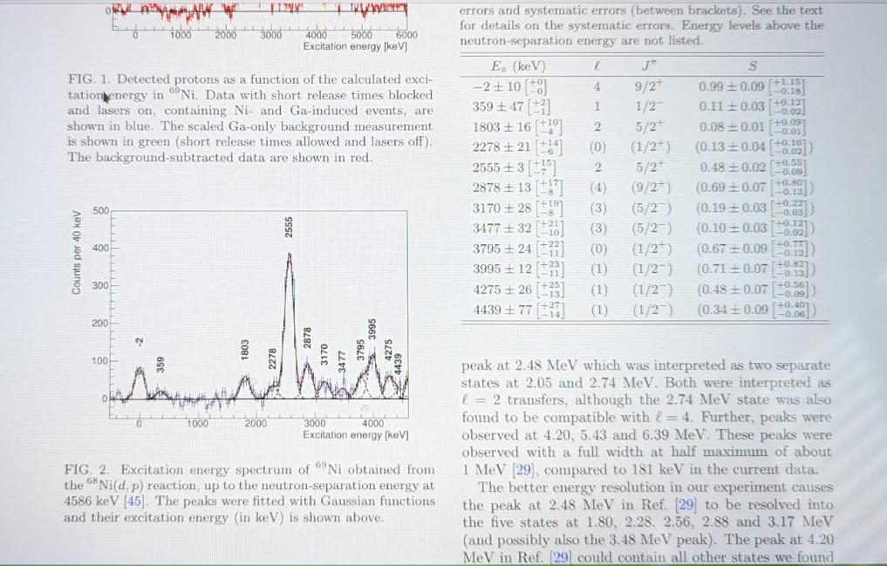

Slide 3
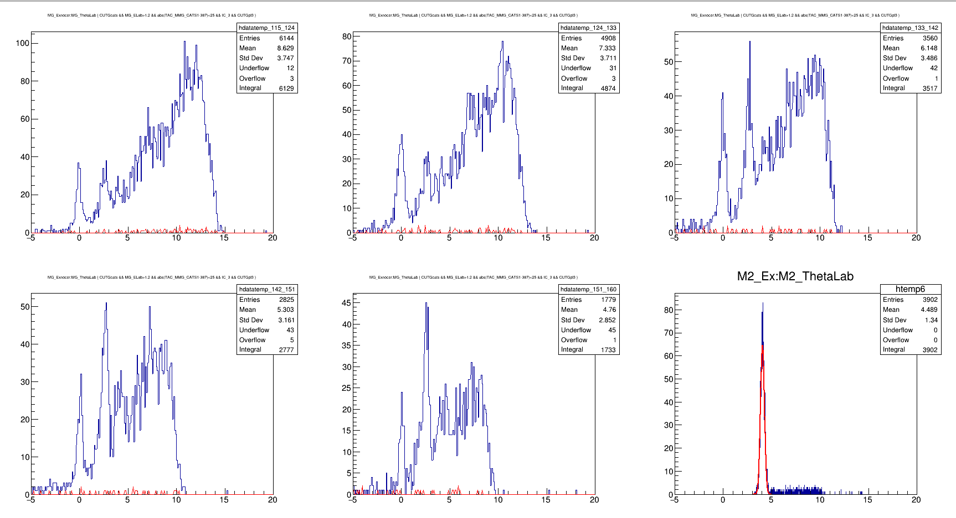
With Carbon in red (unscaled)

Slide 4
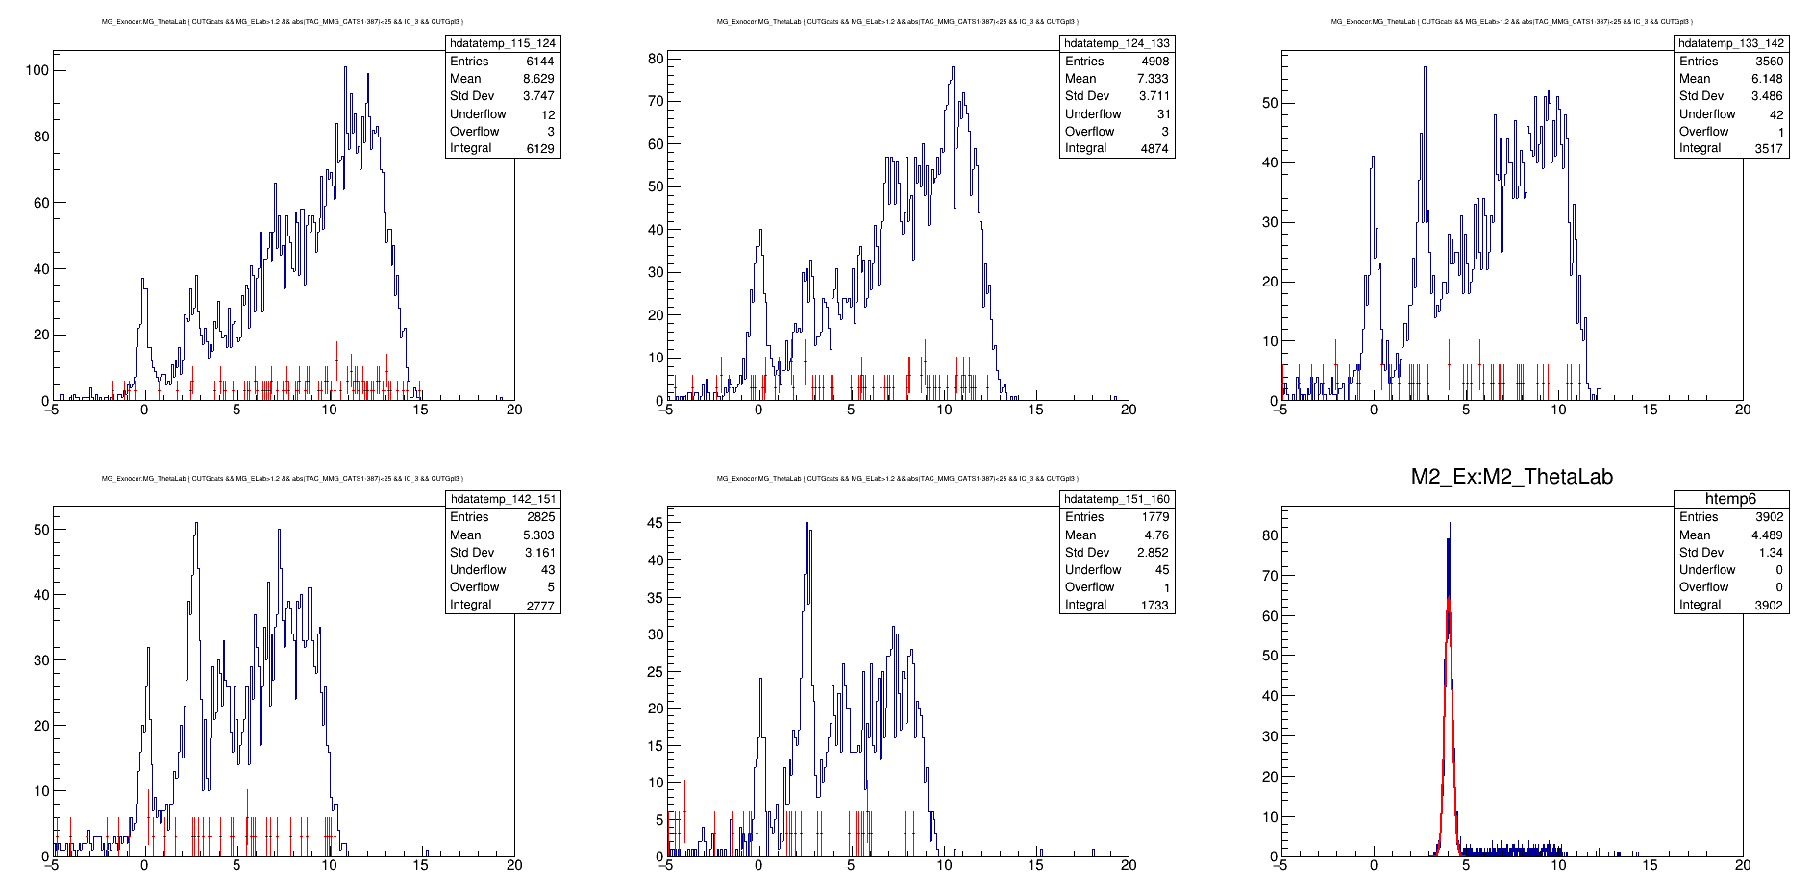
Carbon scaled to 3.0

Slide 5
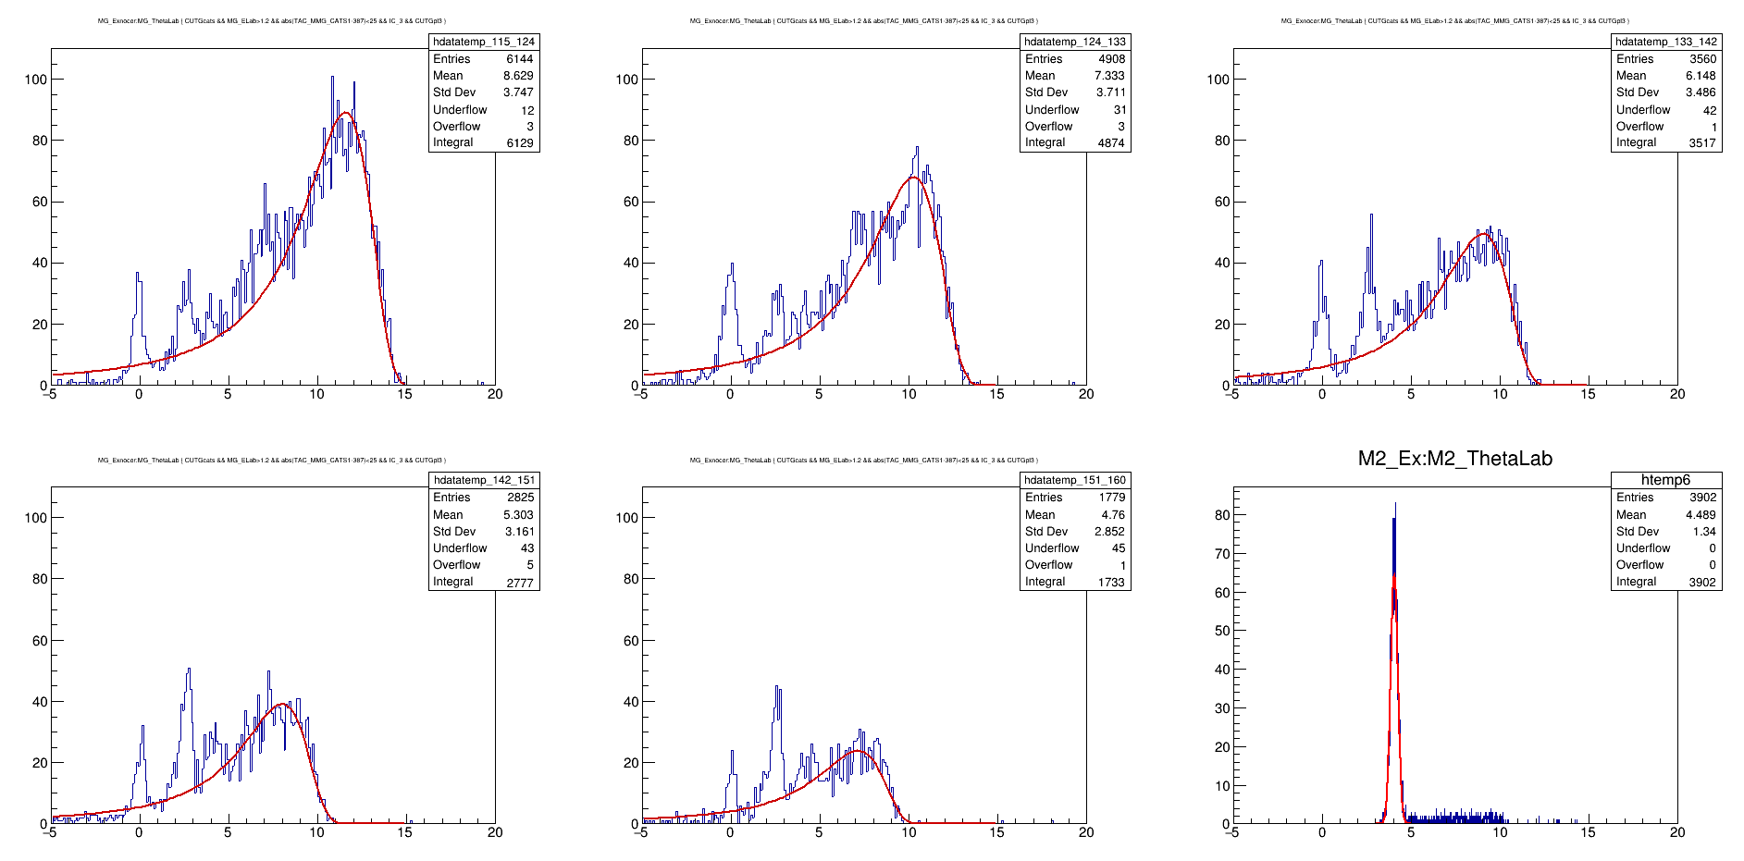
If drawn on same y-axis value

Slide 6
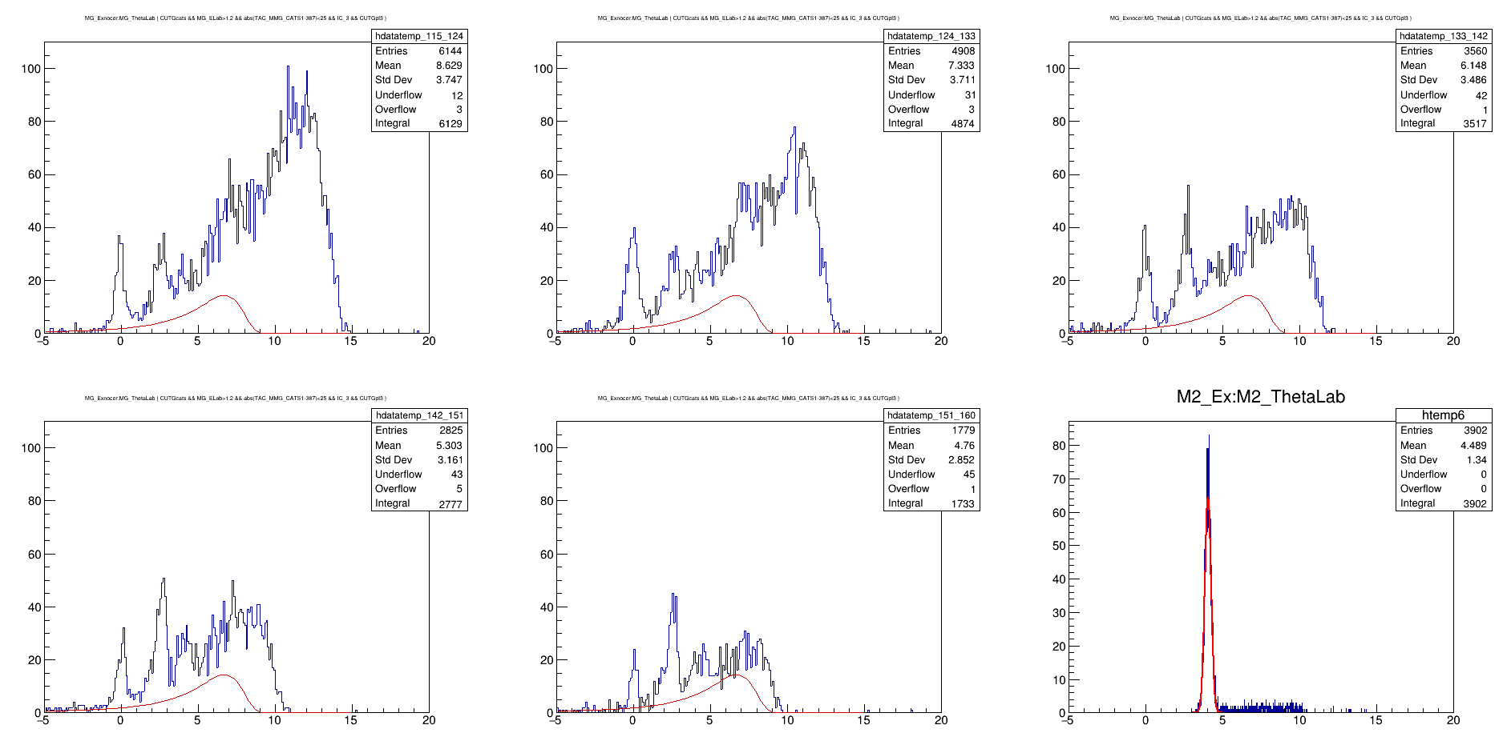
Fitted all with same landau (5th)

Slide 7
Carbon normalization
Thickness CD2 → 0.5 mg/cm²
Thickness C → 4 mg/cm²
Contribution of C in CD2 = 75% (so eff. thickness is now 0.5 * 0.75 = 0.375 mg/cm²) for the Carbon…
To take care of this in pure C run… scale → 4.0 / 0.375 = 10.67
So the scaling factor because of thickness is 0.375 / 4.0 =
              0.09375

Slide 8
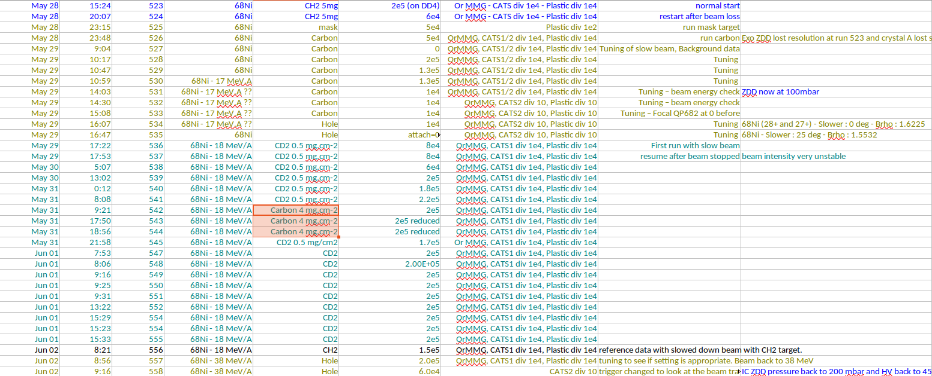
Carbon normalization
12 hrs C at 2E5 → 8.64 E9 events CD2 with multiple runs → 4.3 E10
Factor = 4.97

Slide 9
Carbon normalization
12 hrs C at 2E5 → 8.64 E9 events CD2 with multiple runs → 4.3 E10
Factor = 4.97
Total factor then becomes 4.97 * 0.09375 = 0.466

Slide 10
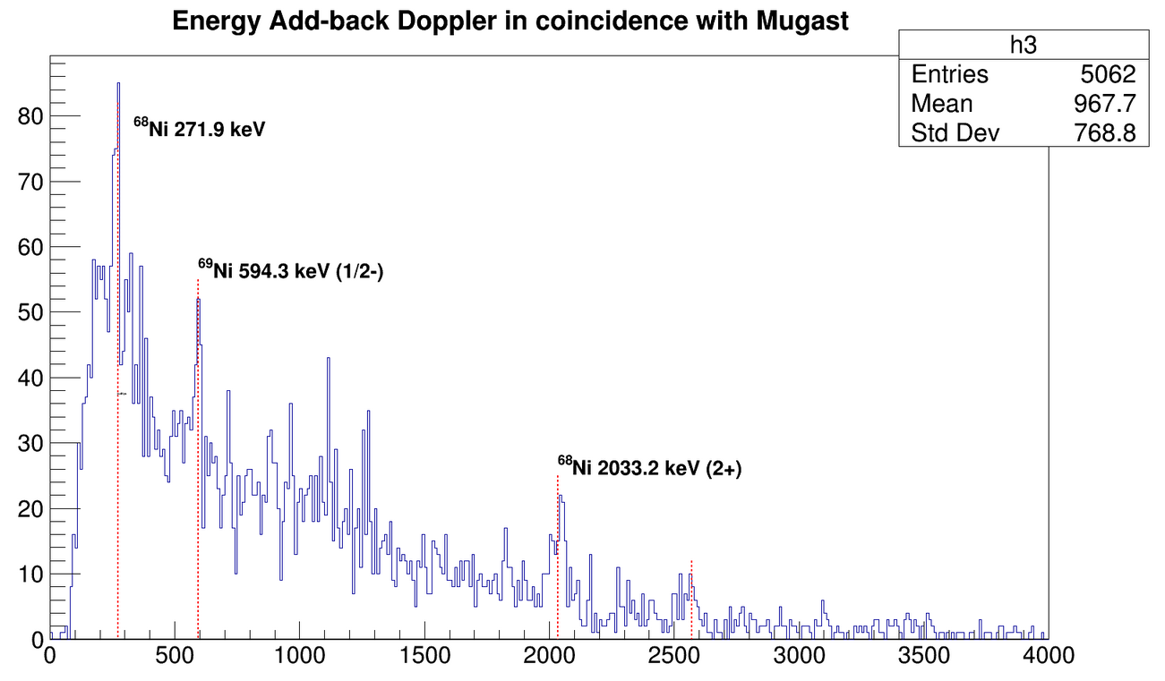
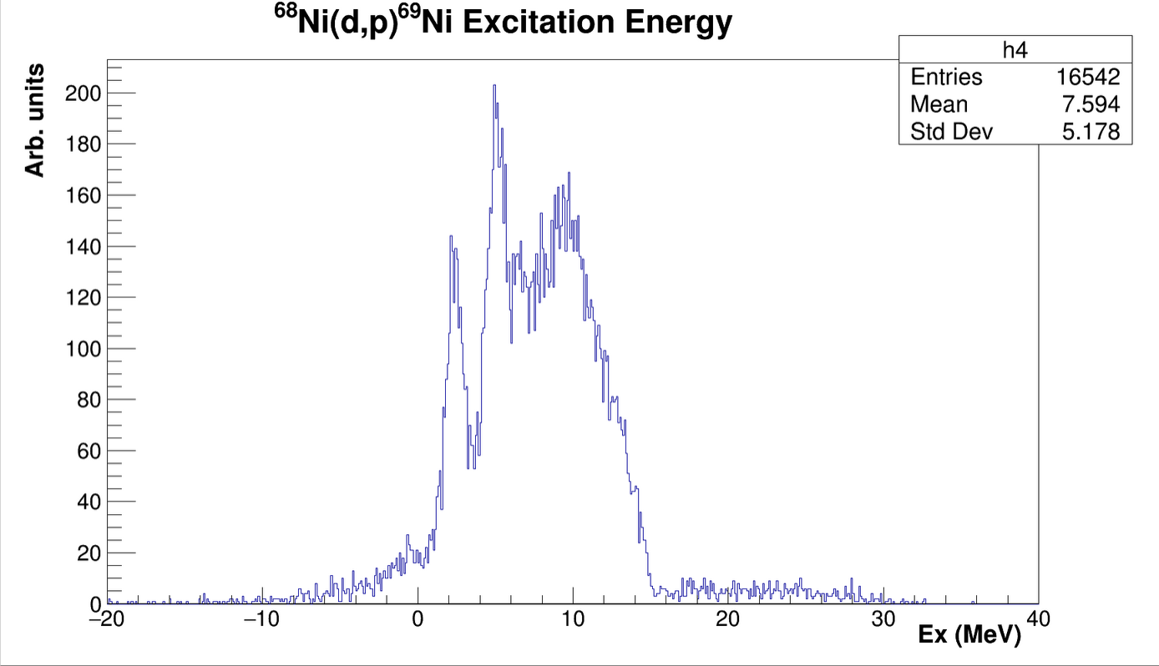
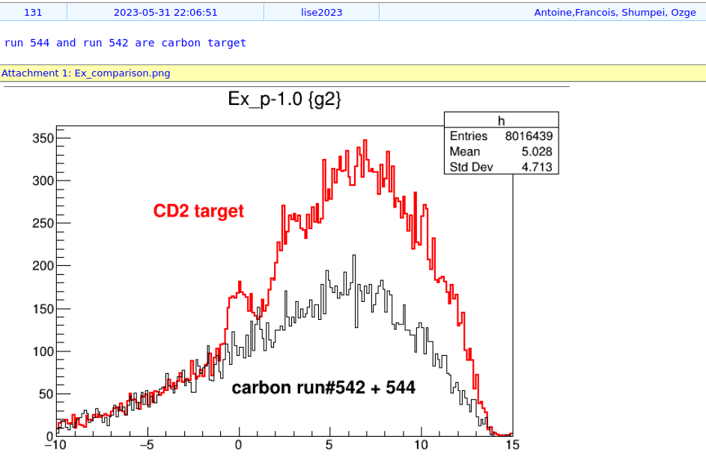
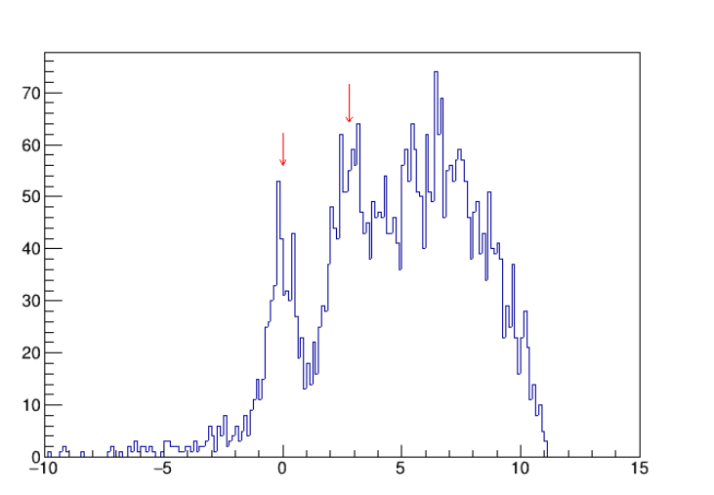
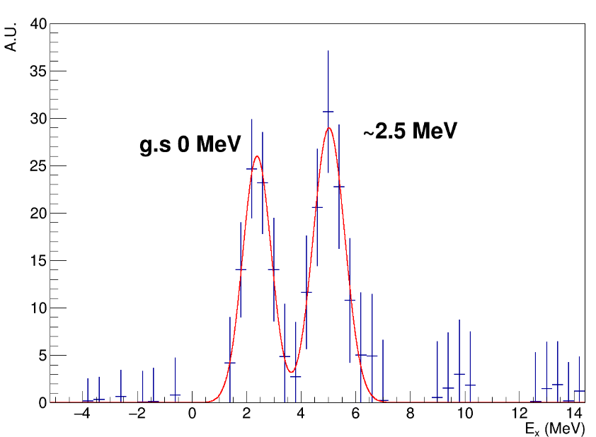

Slide 11
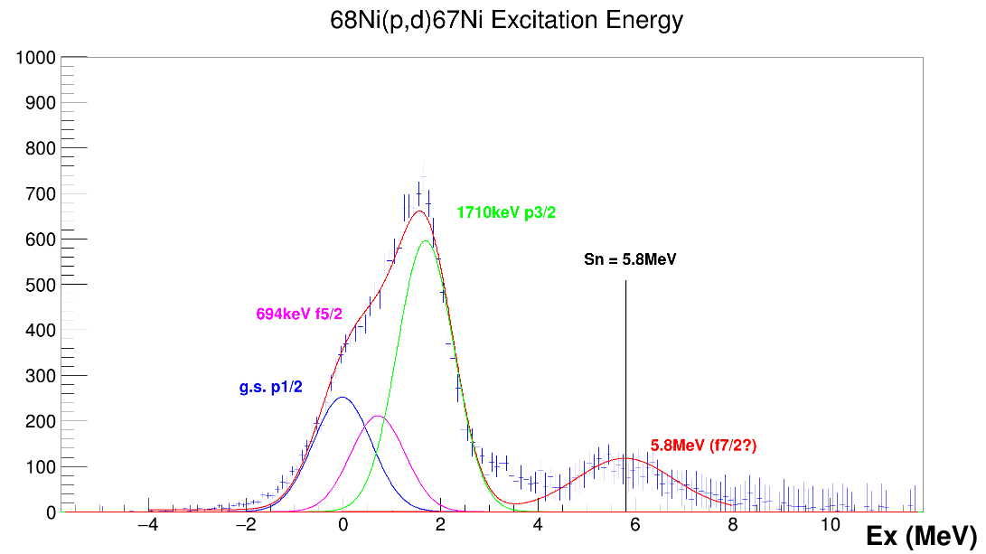
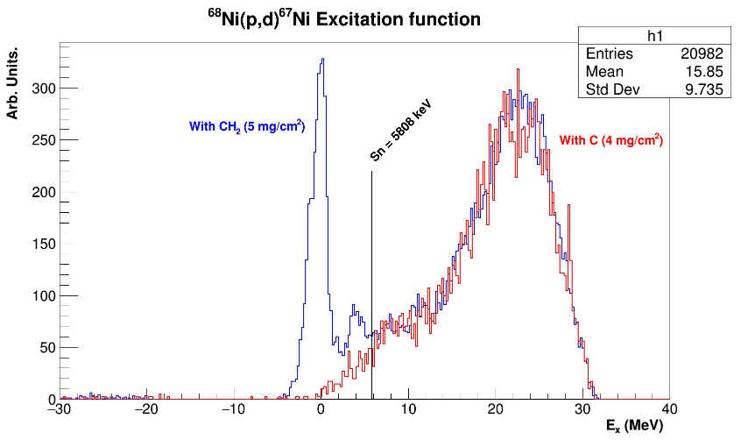
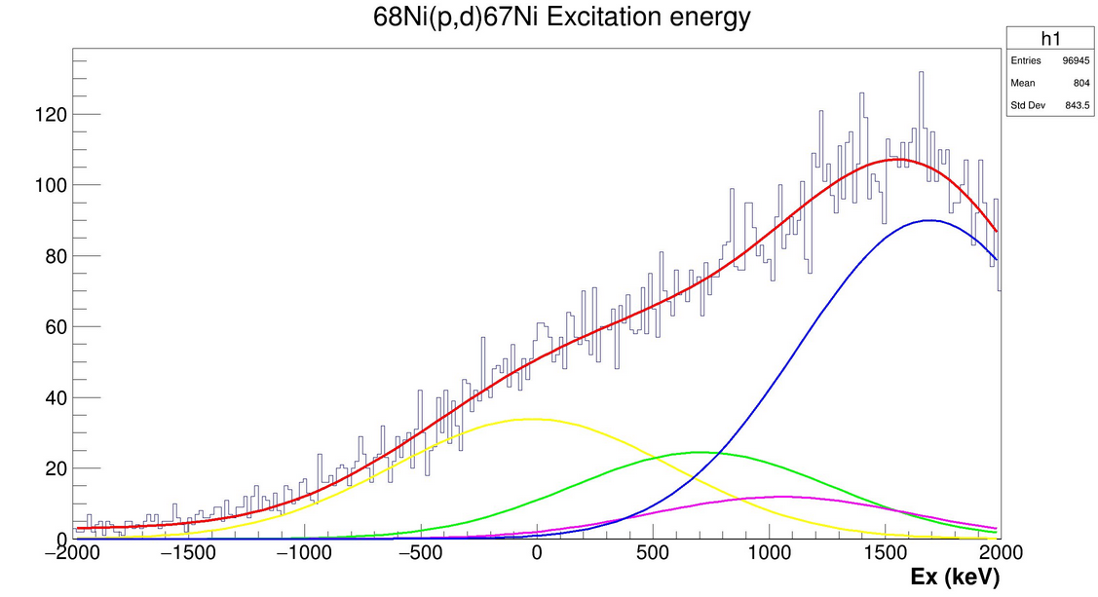

Slide 12
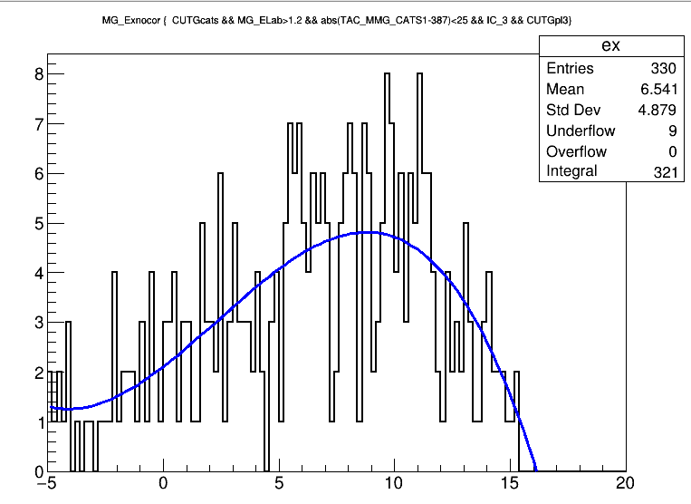
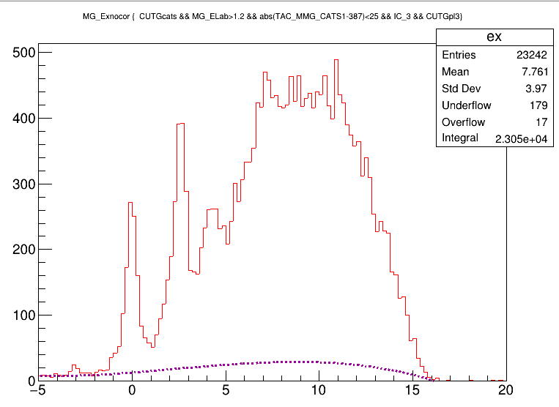
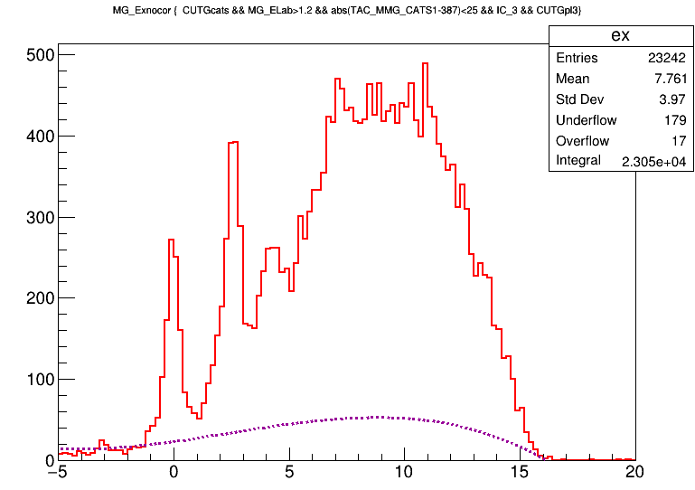
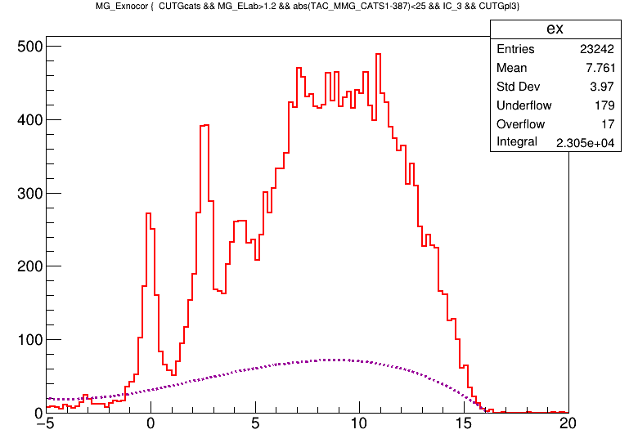
Carbon ex fit with pol3, rebin(8)
Scaled the C-fit by 6.0 with same binning
Scaled the C-fit by 15.0 with same binning
Scaled the C-fit by 11.0 with same binning

Slide 13
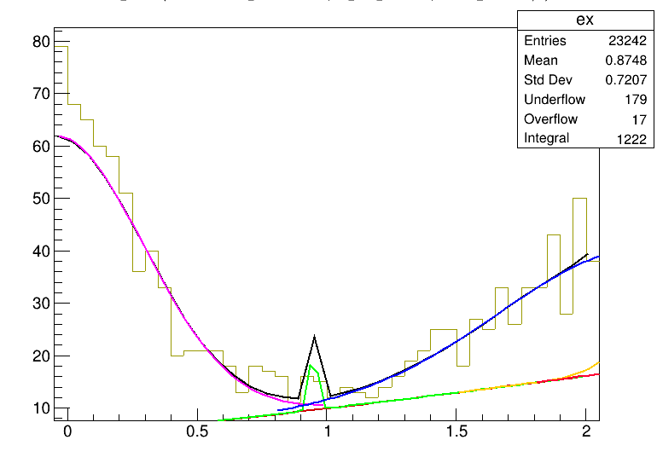
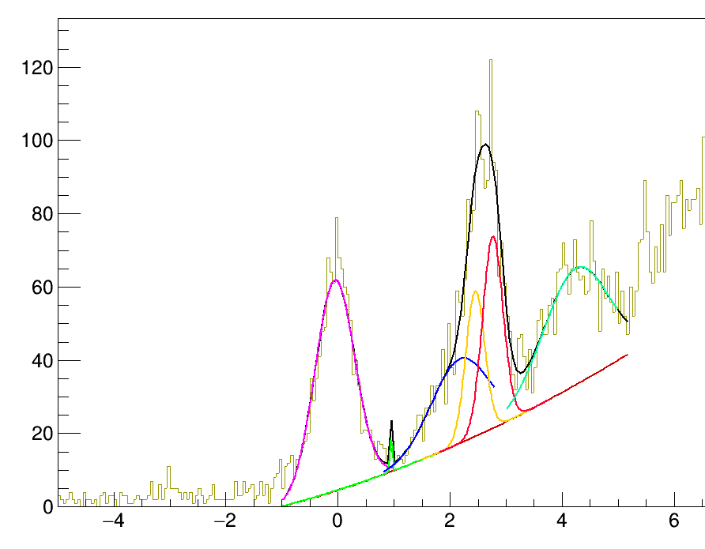

Slide 14
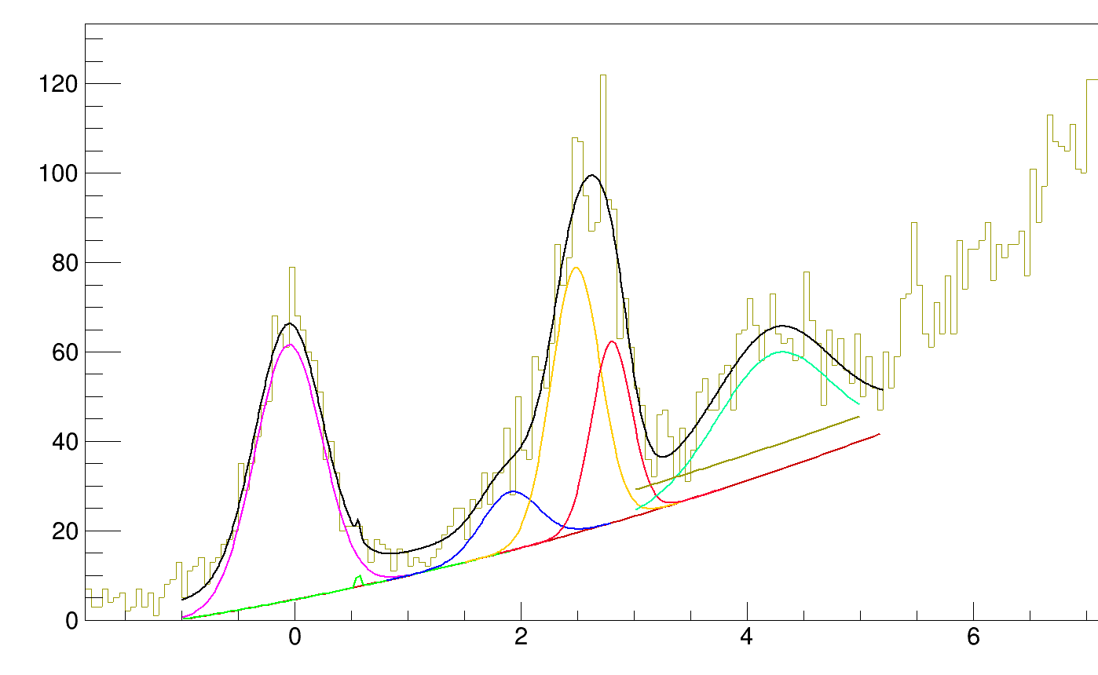
0.21
0.49
0.17
0.25
0.29
0.25

Slide 15
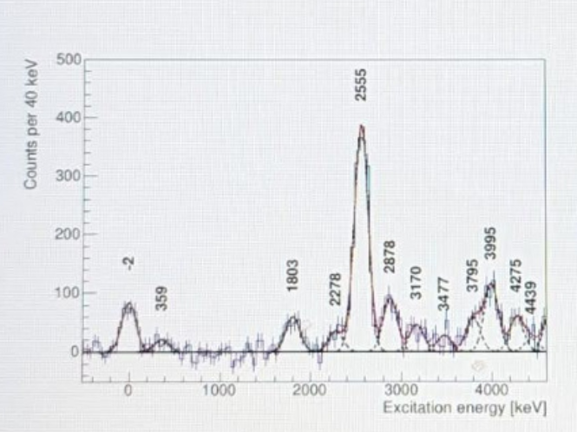
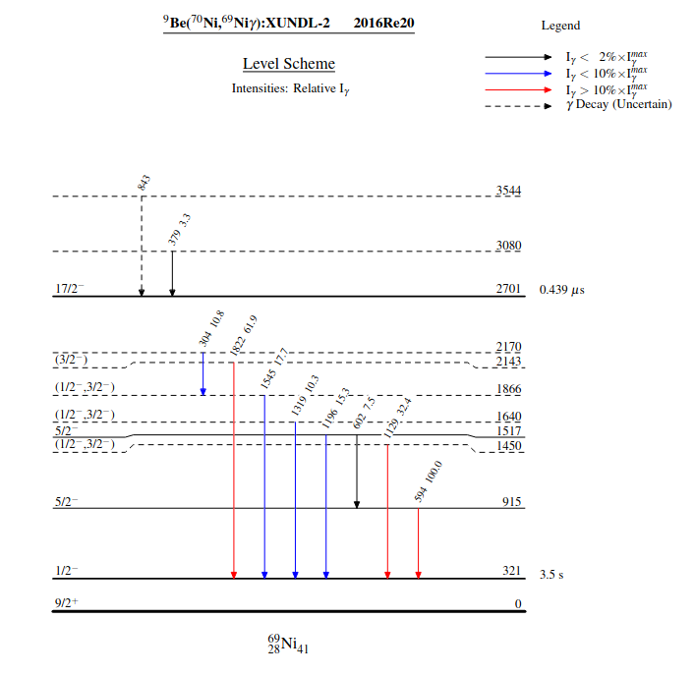
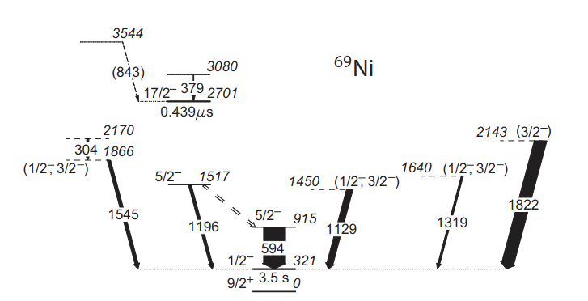

Slide 16
Procedure in mind
I take a background by eye for total ex. and individual angular ex (same BG for all angles).
Try to fit and constrain peaks by looking all 6 plots (5 angles and 1 full) so that the least chi sq is achieved for all of them.
Take these peaks as fixed and then fit with a better background (maybe with good Carbon and simulated phase space).

Slide 17
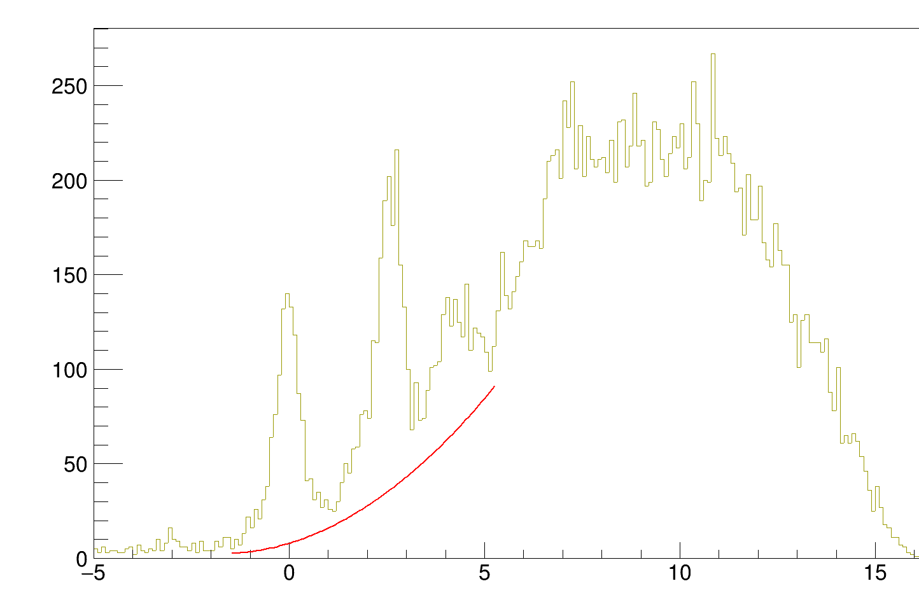
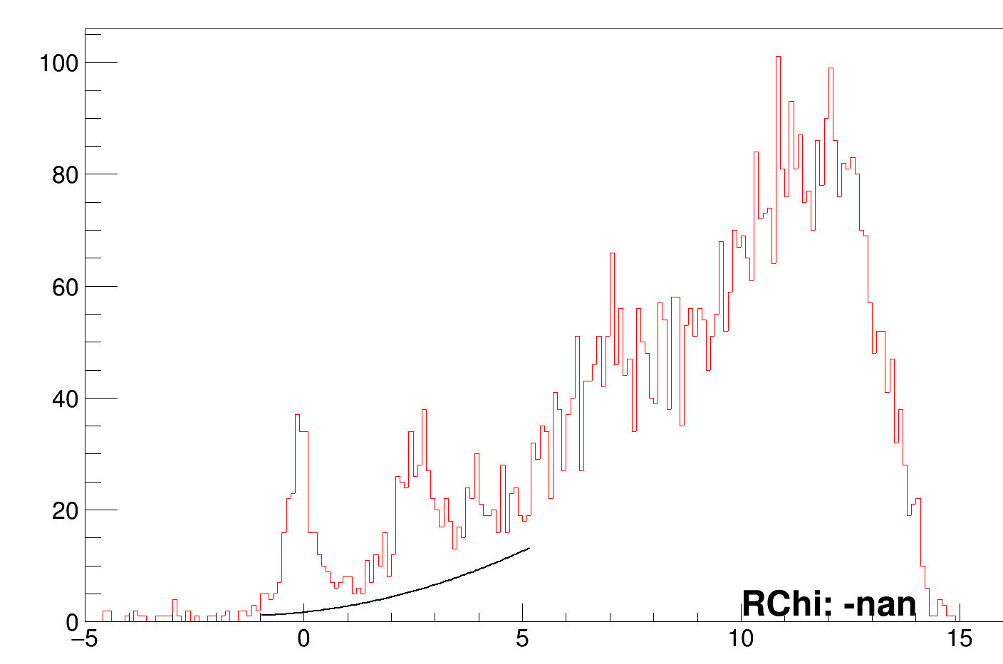
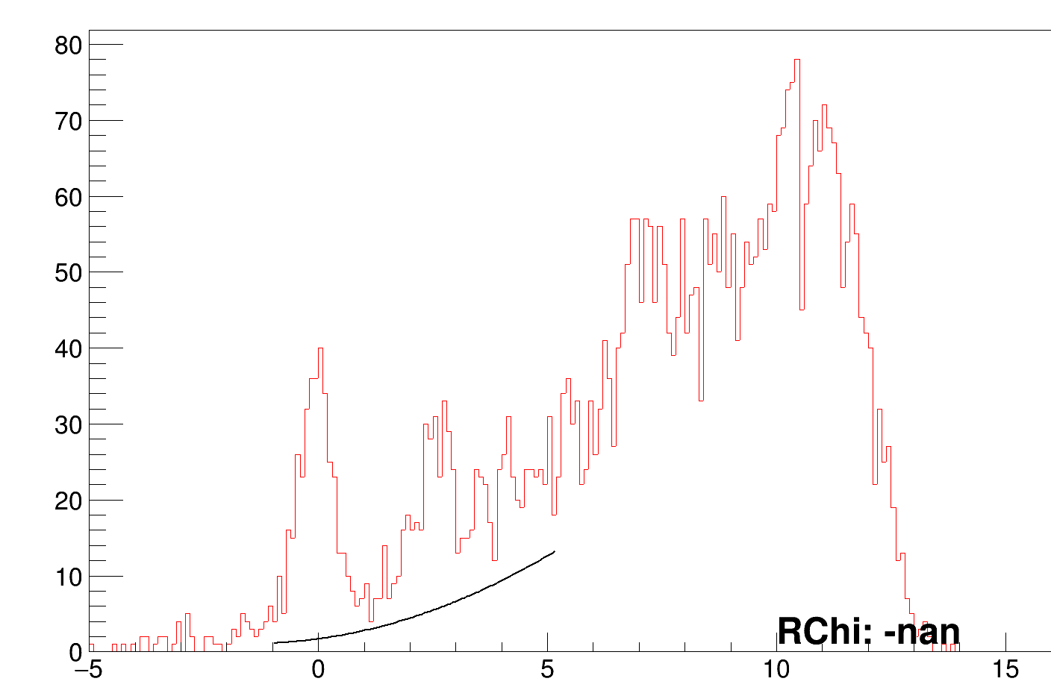
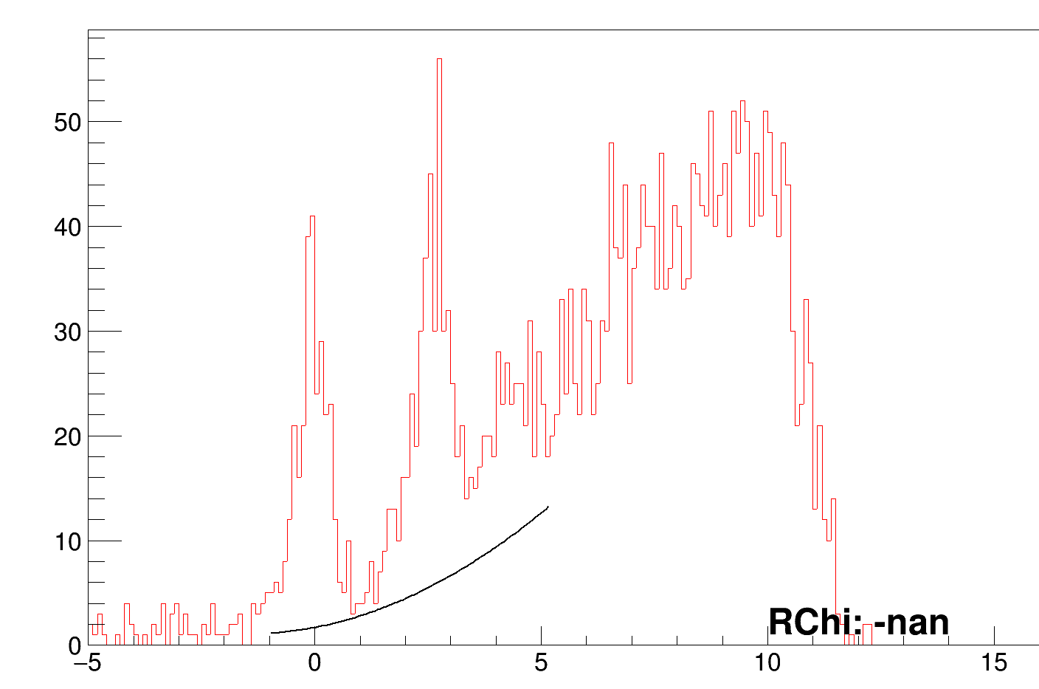
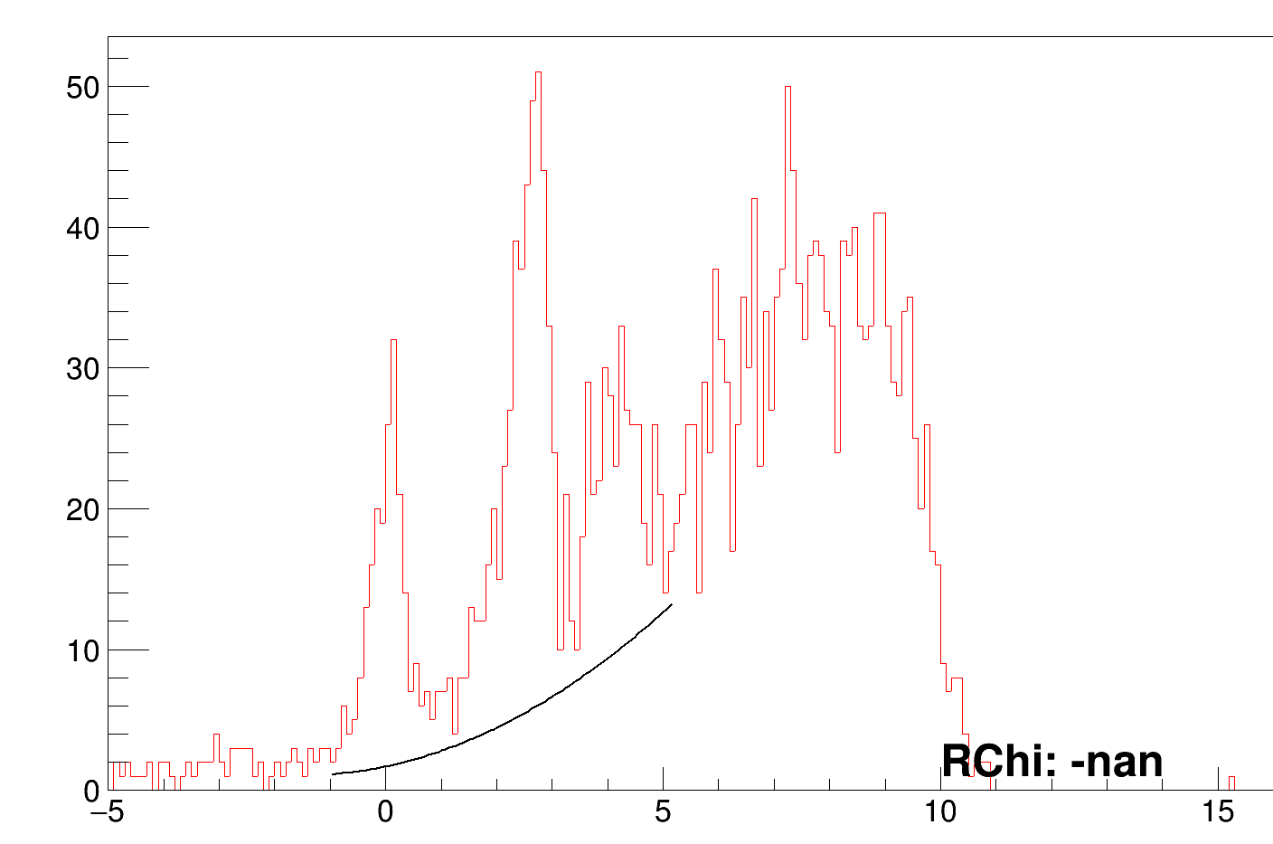
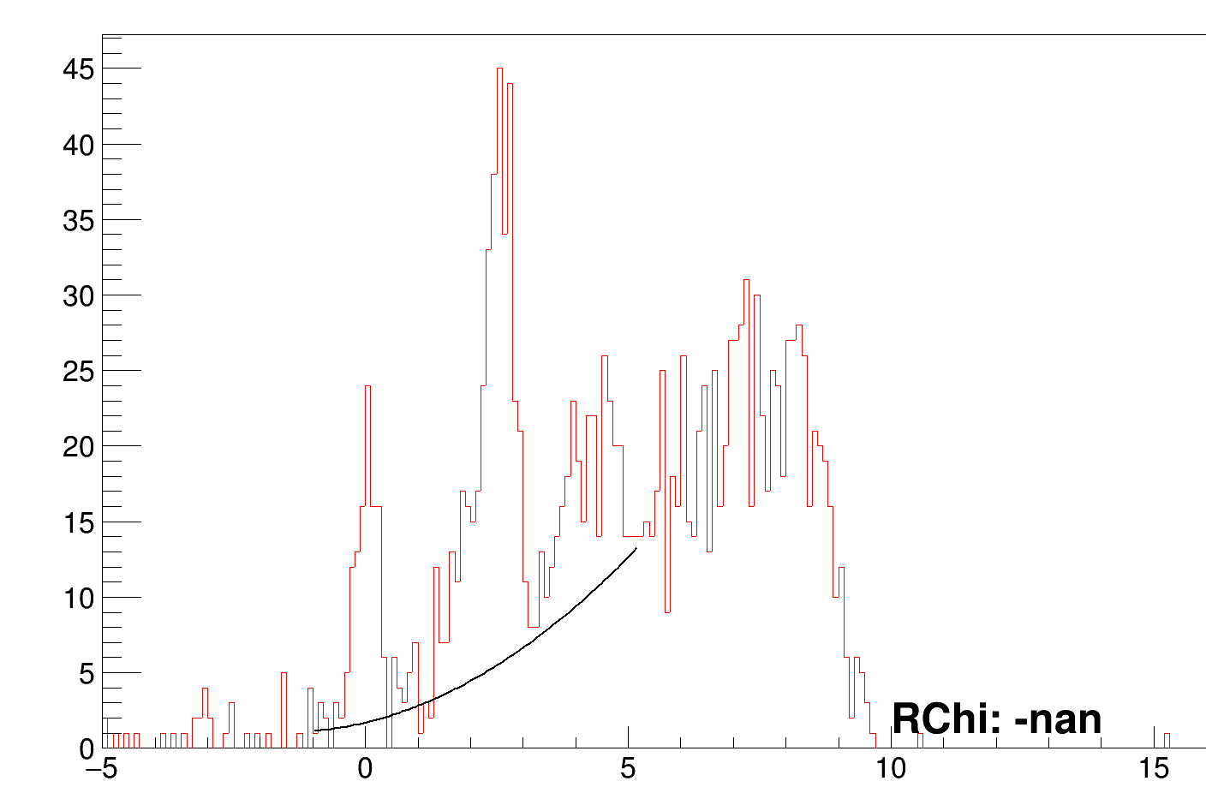
(1) Background selection
total
Cut1
cut2
cut3
cut4
cut5
Up to region 4, the same parameters for the BG seem okay… but for reg5, the stats become less and the same BG can’t be used anymore… Results from this background will be super ugly but still good I think.

Slide 18
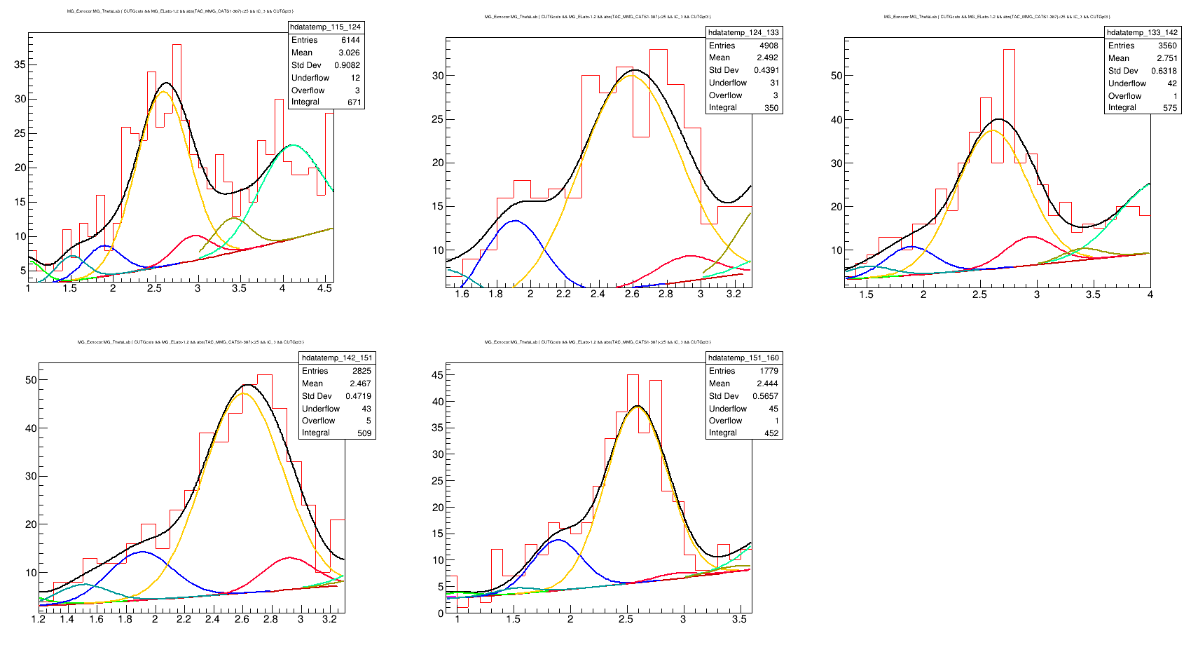
2.278 looks pretty clear in the (secret) paper… and we also seem to have something at about 2.3…. so adding that in ours

Slide 19
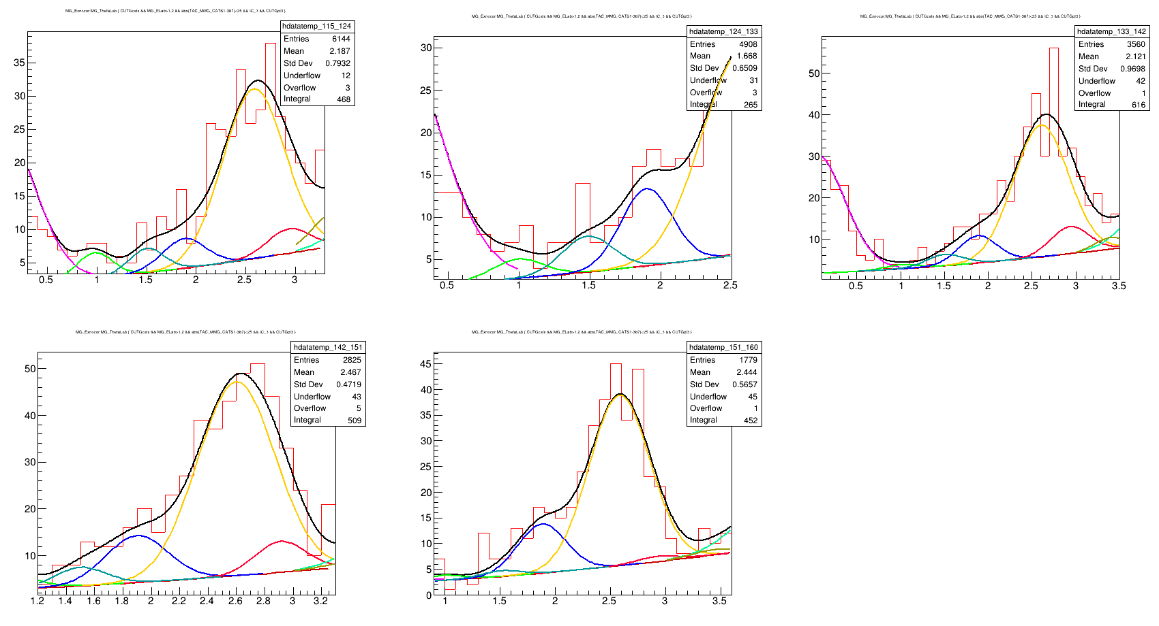
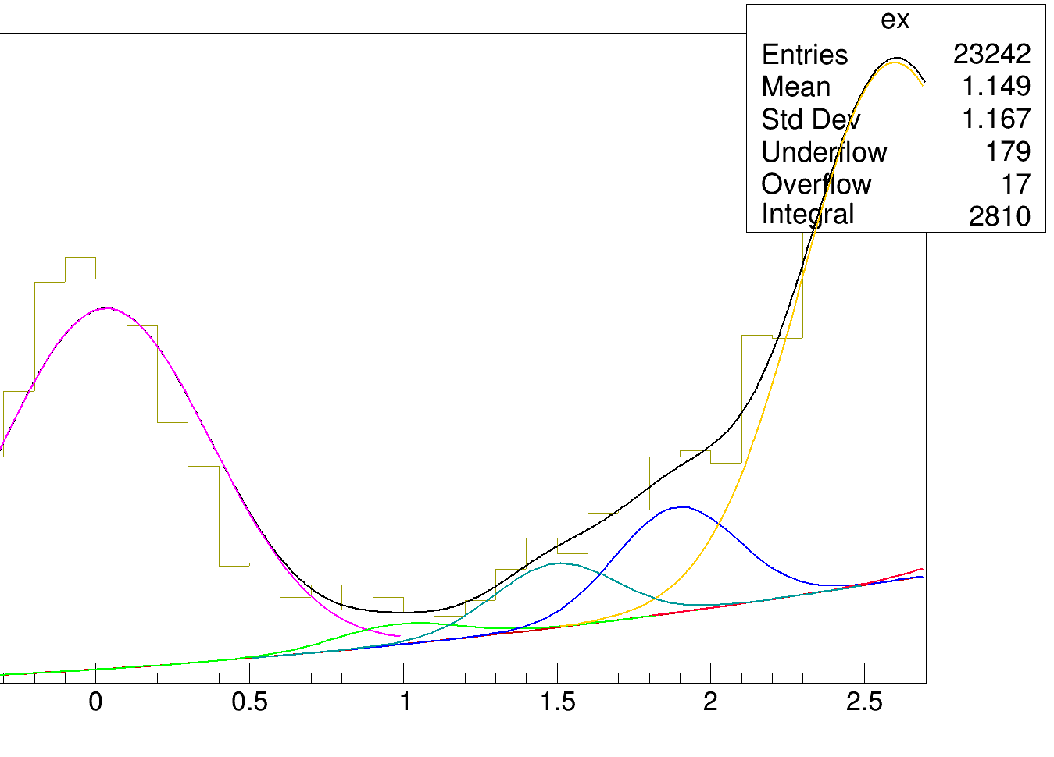
It looked like there was something at 1.5 too. Even if not, it helps fitting it better.

Slide 20
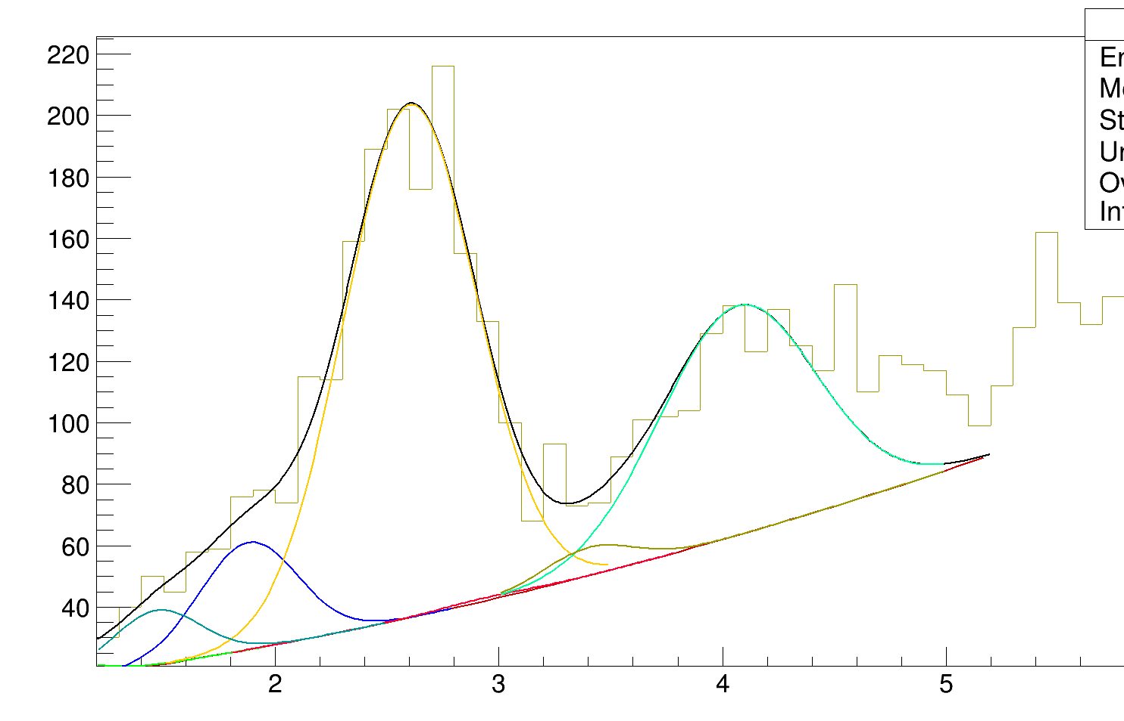
This region
Needs 4 peaks in my
Opinion… (marked)

Slide 21
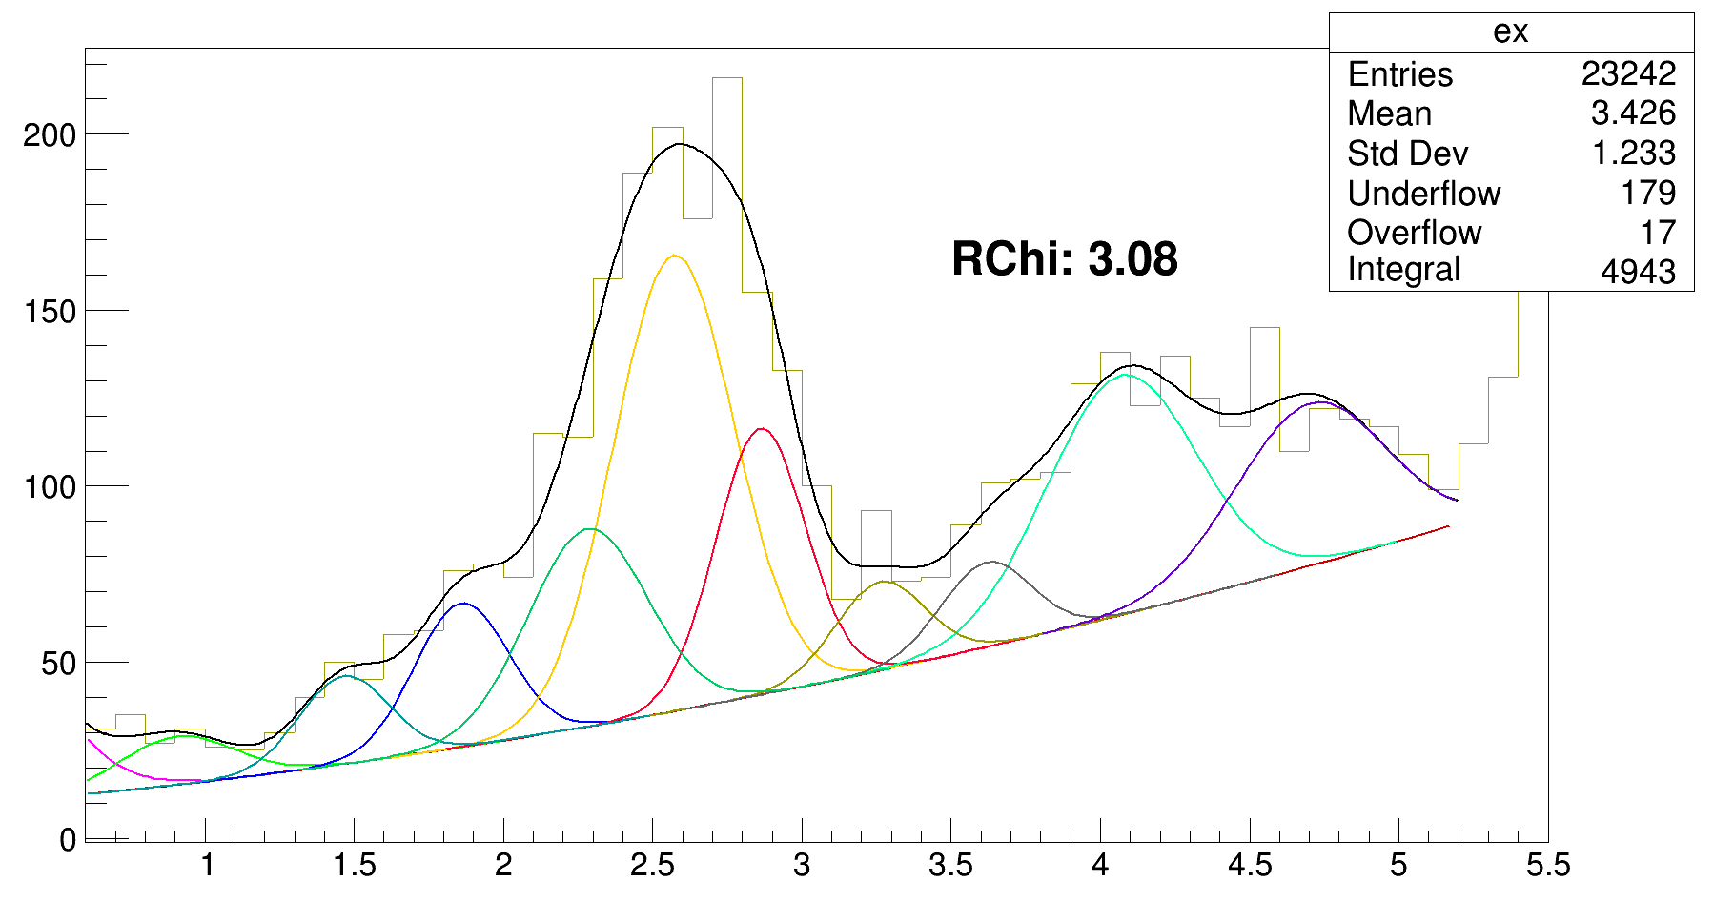
After the 4 peaks in the end… it still looks like there is need for one more at the marked place… I show the angular ones on the next page with this mark.
The energies I will on the last slide after all are fitted.
Rchi → Reduced chi sq

Slide 22
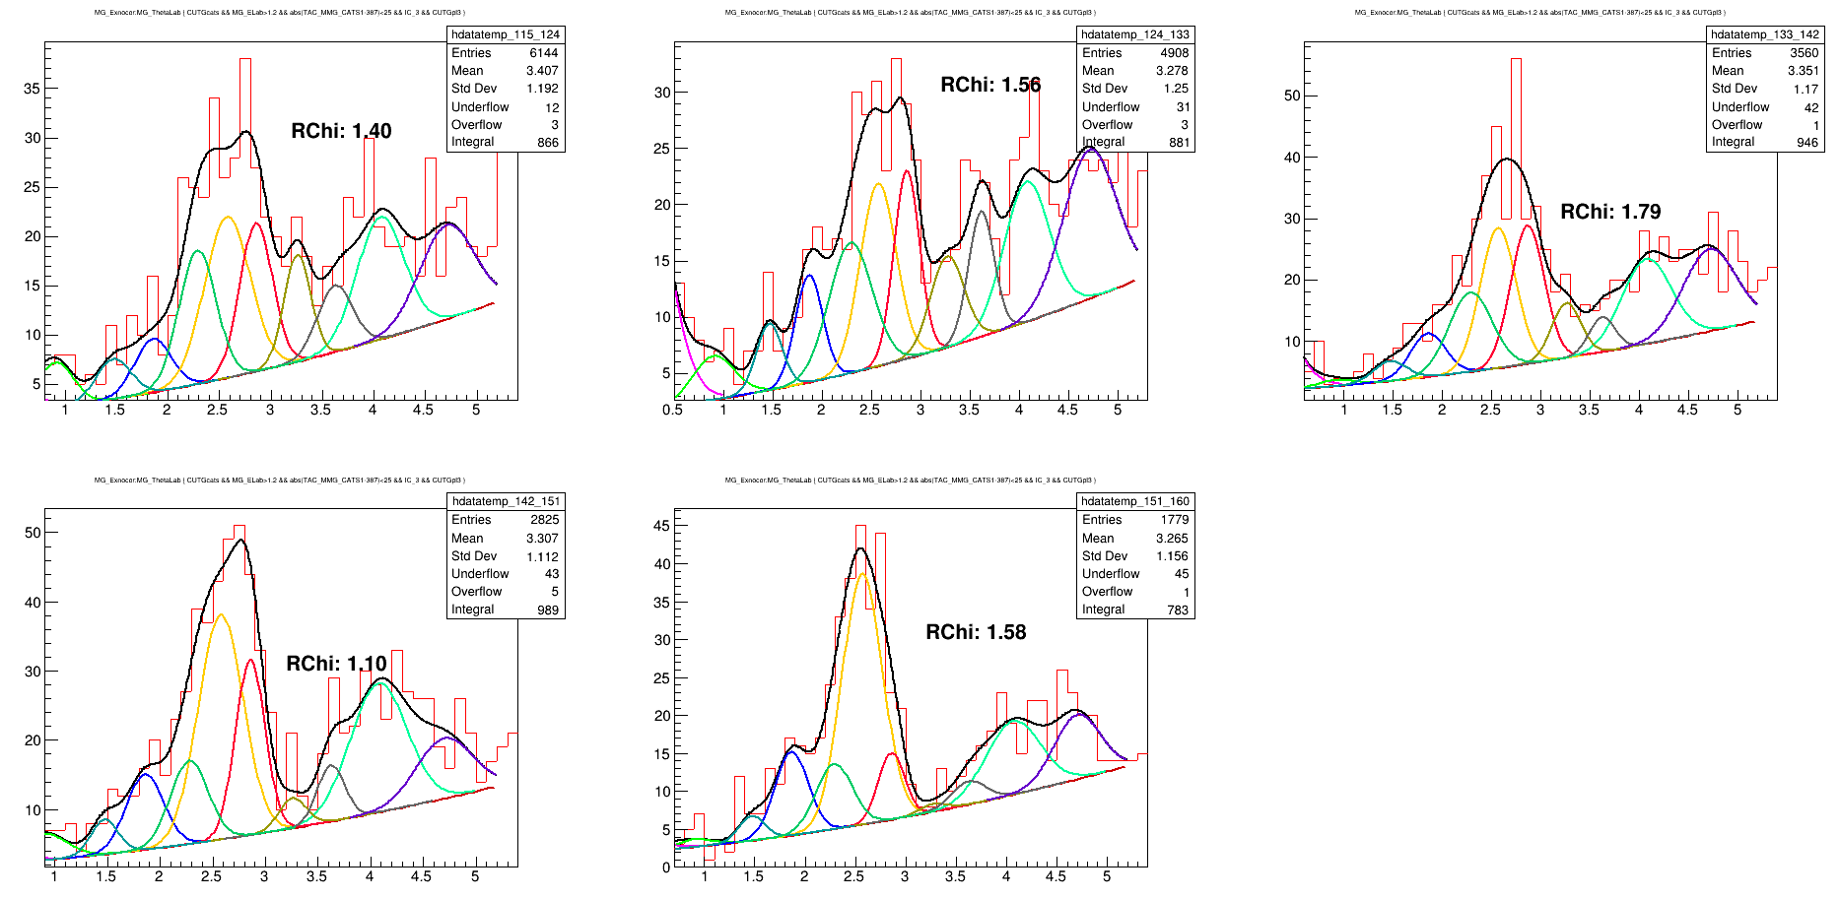

Slide 23
Angular cuts of 9 deg
115_124
124_133
133_142
142_151
151_160

Slide 24
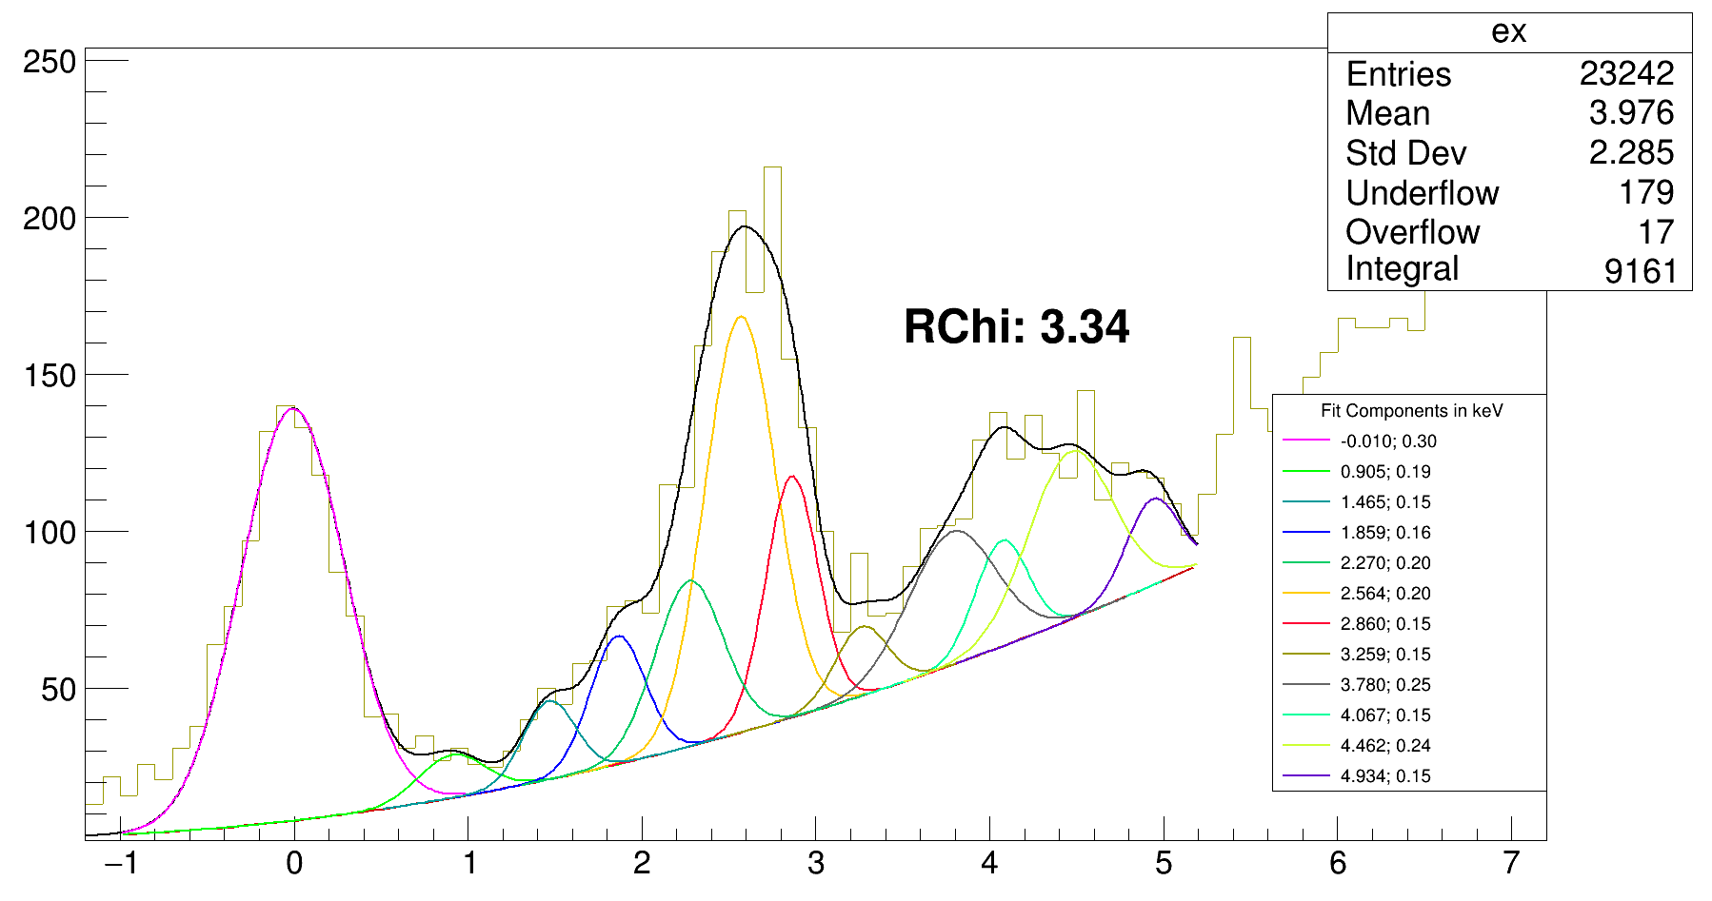
Full ex. spectrum
MeV*, Energy, sigma

Slide 25
Initial guess: 915 keV (from Ozge)
Breathing room: 10 keV (915 ± 10)
Ends up at: 905 keV
Restriction on sigma: 150 to 300 keV
Ends up at: 190 keV
-10 keV
Initial guess: 1500 keV (added)
Breathing room: 200 keV (1500 ± 200)
Ends up at: 1465 keV
Restriction on sigma: 150 to 250 keV
Ends up at: 150 keV
Initial guess: 1866 keV (from Ozge)
Breathing room: 10 keV (1866 ± 10)
Ends up at: 1859 keV
Restriction-sigma: 150 to 250 keV
Ends up at: 160 keV
Initial guess: 2280 keV (from the paper)
Breathing room: 10 keV (2280 ± 10)
Ends up at: 2270 keV
Restriction on sigma: 150 to 250 keV
Ends up at: 200 keV
Initial guess: 2550 keV (from Ozge)
Breathing room: 20 keV (2550 ± 20)
Ends up at: 2564 keV
Restriction on sigma: 150 to 250 keV
Ends up at: 200 keV

Slide 26
Initial guess: 2875 keV (from Ozge)
Breathing room: 15 keV (2875 ± 15)
Ends up at: 2860 keV
Restriction on sigma: 150 to 250 keV
Ends up at: 150 keV
-10 keV
Initial guess: 3300 keV (added)
Breathing room: 200 keV (3300 ± 200)
Ends up at: 3259 keV
Restriction on sigma: 150 to 250 keV
Ends up at: 150 keV
Initial guess: 3800 keV (from paper)
Breathing room: 20 keV (3800 ± 20)
Ends up at: 3780 keV
Restriction-sigma: 150 to 250 keV
Ends up at: 250 keV
Initial guess: 4057 keV (from Ozge)
Breathing room: 10 keV (4057 ± 10)
Ends up at: 4067 keV
Restriction on sigma: 150 to 250 keV
Ends up at: 150 keV
Initial guess: 4270 keV (added)
Breathing room:300 keV (4270 ± 300)
Ends up at: 4462 keV
Restriction on sigma: 150 to 250 keV
Ends up at: 240 keV

Slide 27
Initial guess: 4800 keV (added)
Breathing room: 300 keV (4800 ± 300)
Ends up at: 4934 keV
Restriction-sigma: 150 to 250 keV
Ends up at: 150 keV
-10 keV

Slide 28
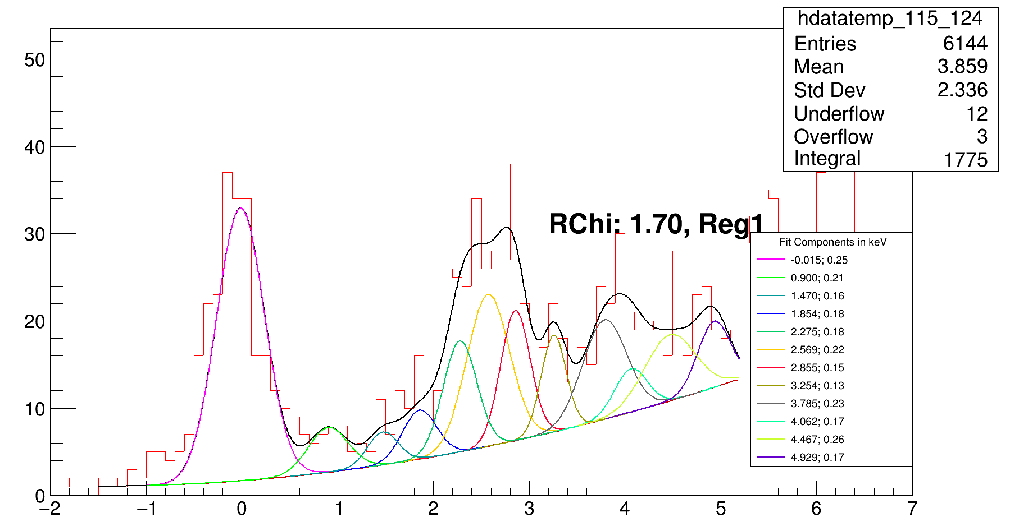
115_124
MeV*, Energy, sigma

Slide 29
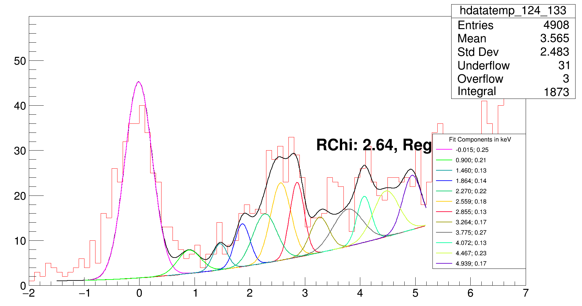
124_133
2
MeV*, Energy, sigma

Slide 30
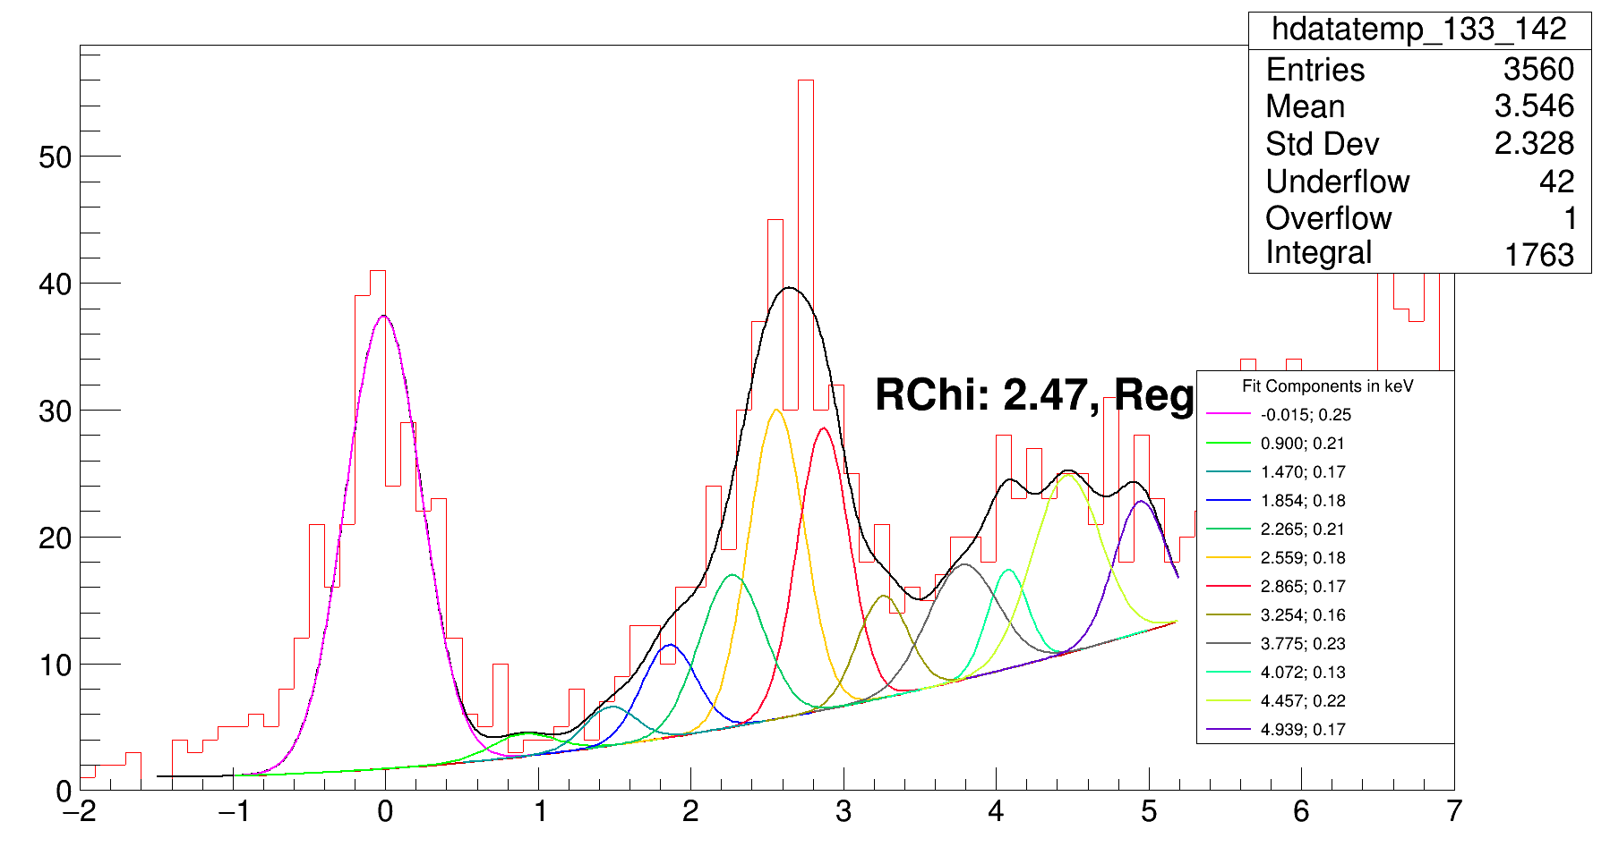
133_142
3
MeV*, Energy, sigma

Slide 31
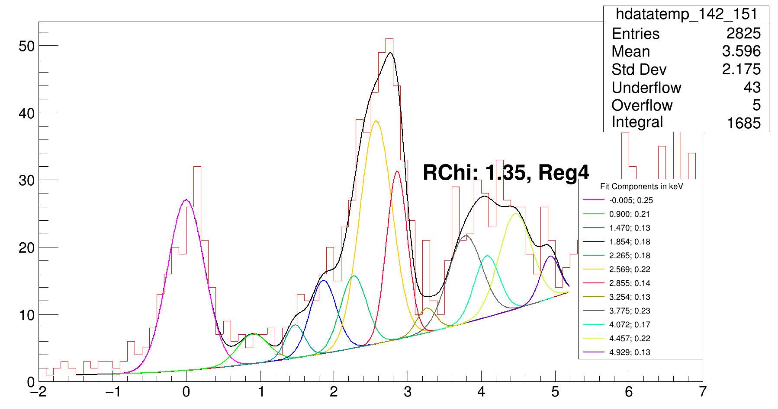
142_151
MeV*, Energy, sigma

Slide 32
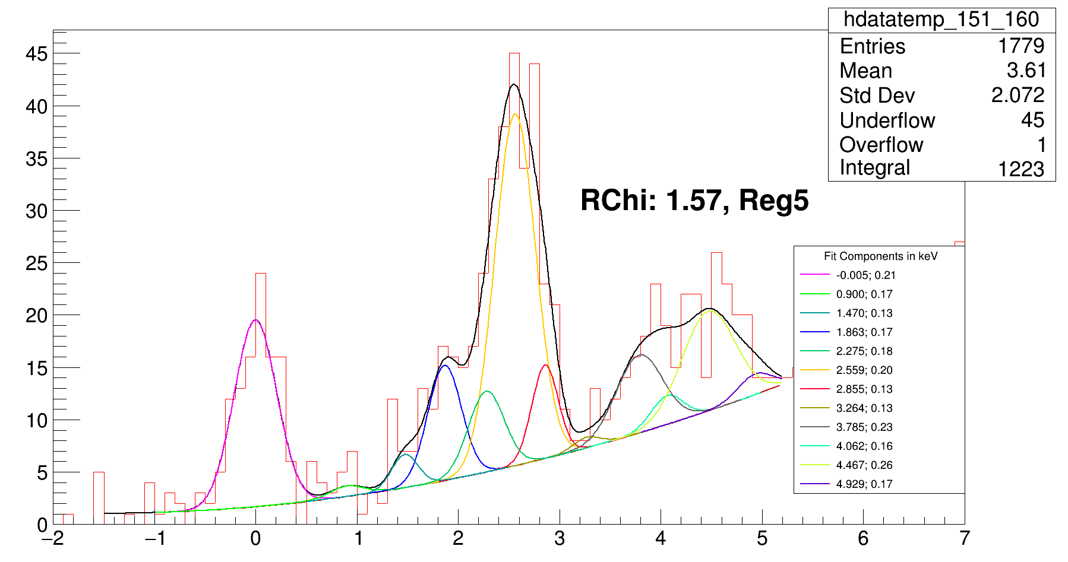
151_160
MeV*, Energy, sigma

Slide 33
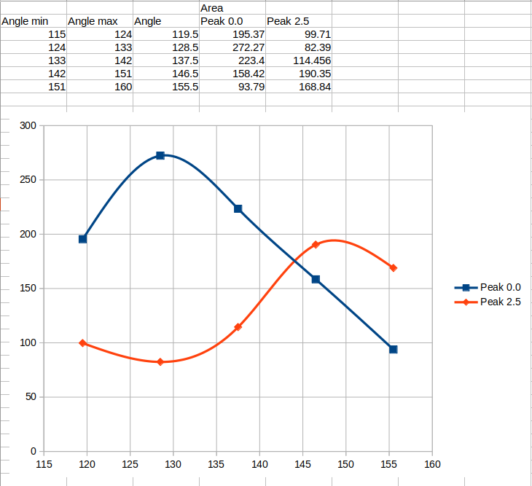

Slide 34
