Slide 1
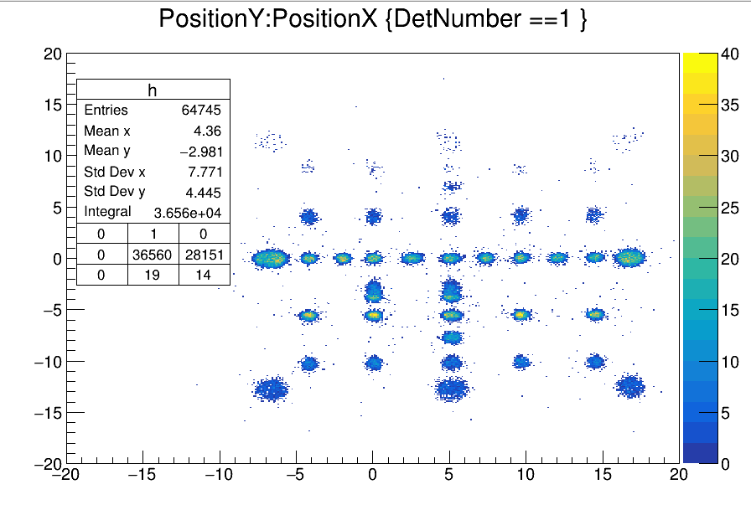
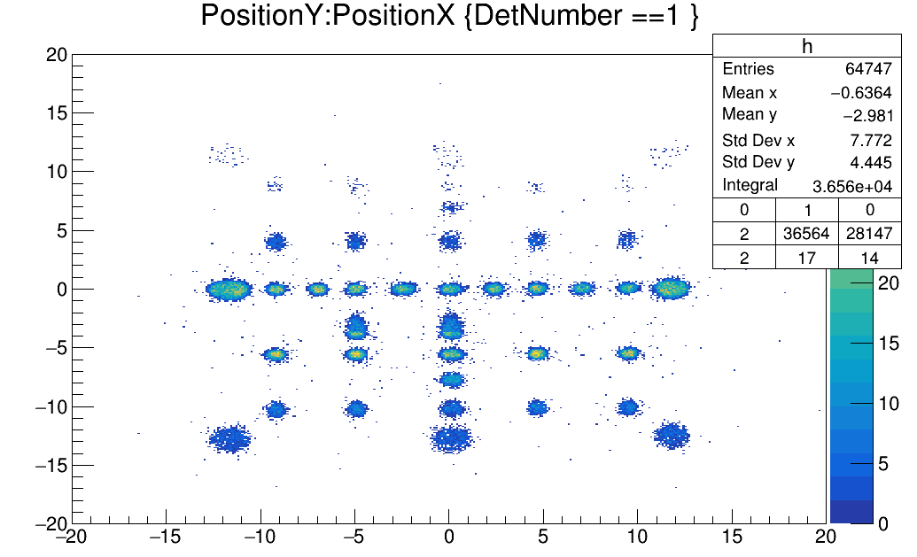
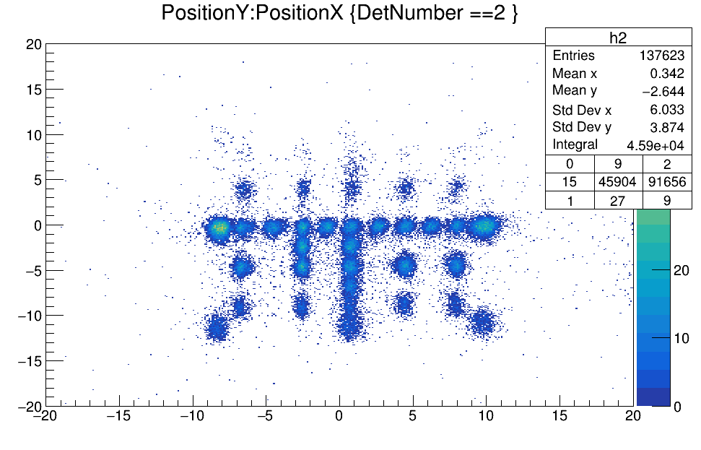
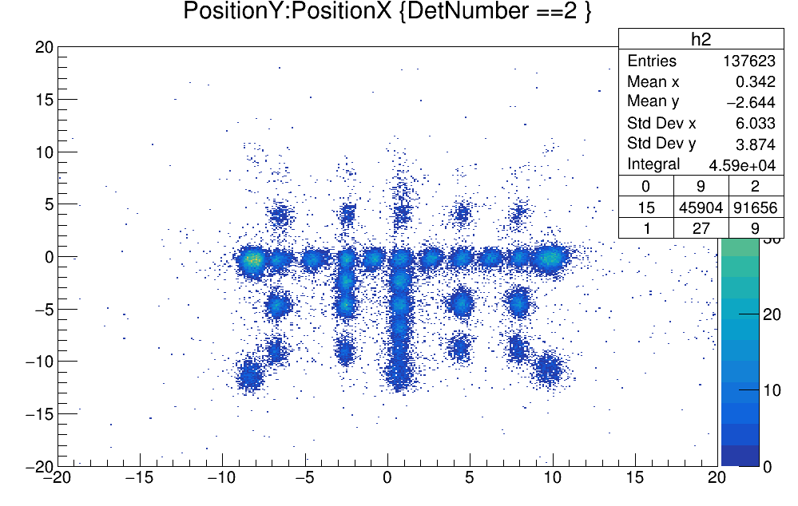
Run 504.root
Before After
Shifted CATS1 by 5 mm

Slide 2
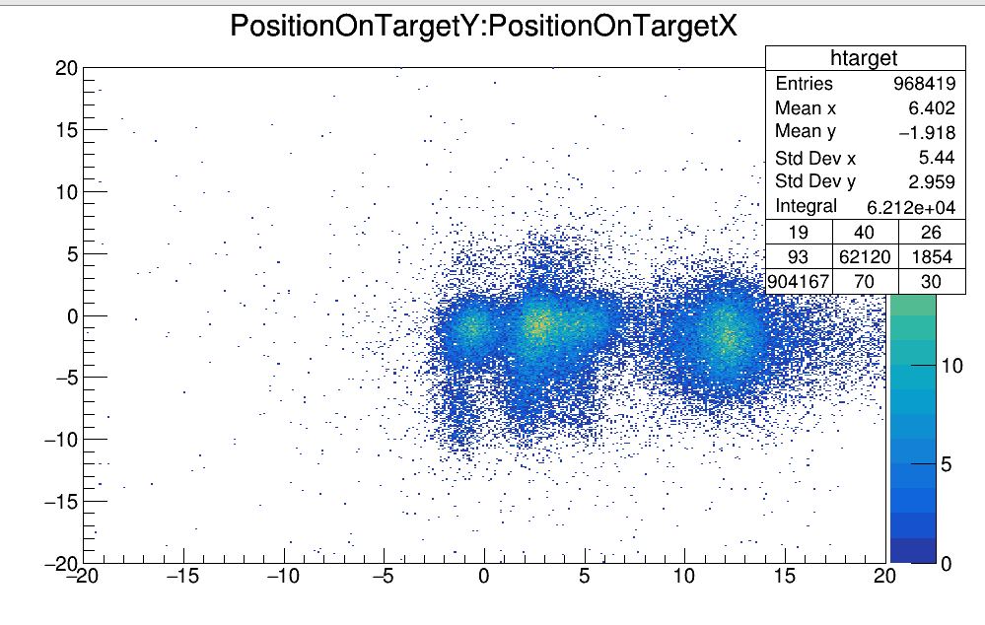
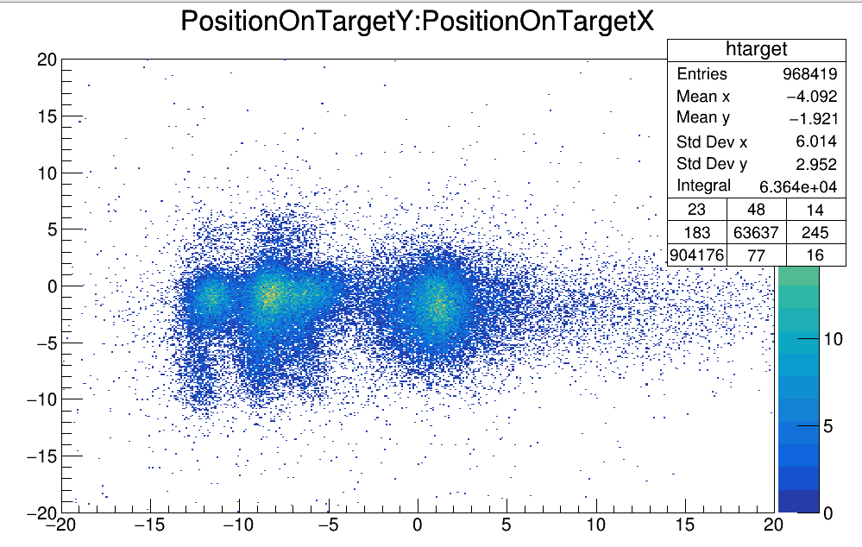
Run 504.root
Before After
Shifted CATS1 by 5 mm

Slide 3
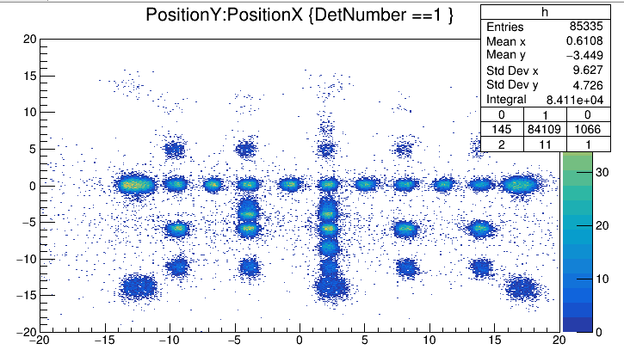
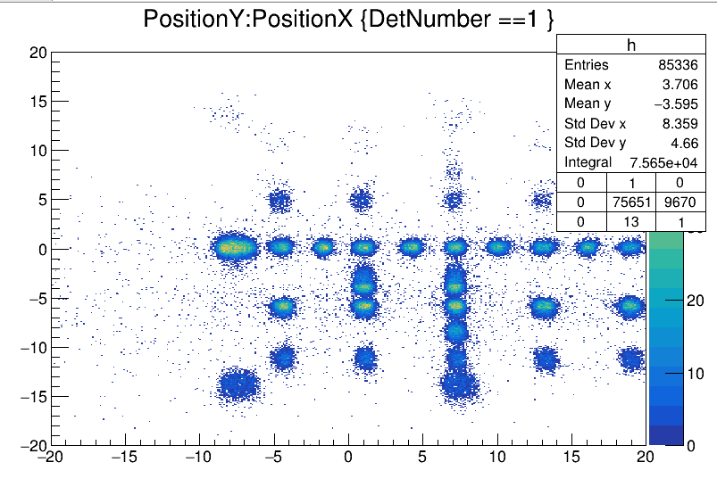
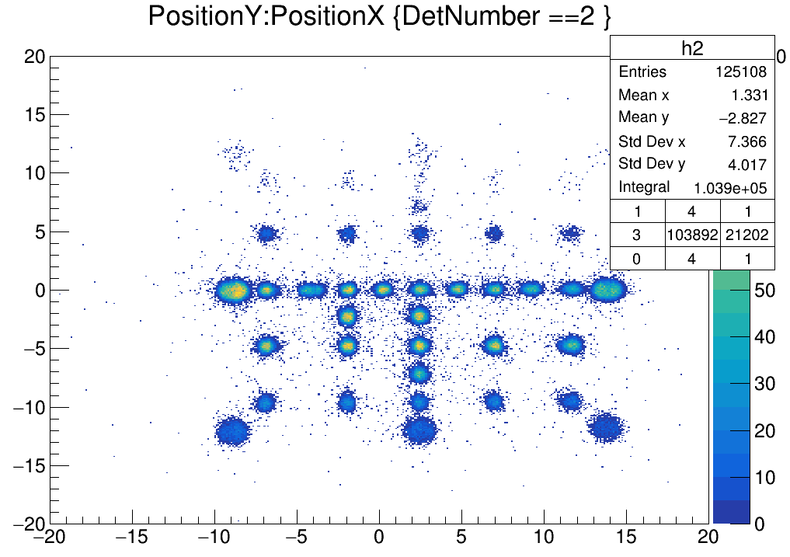
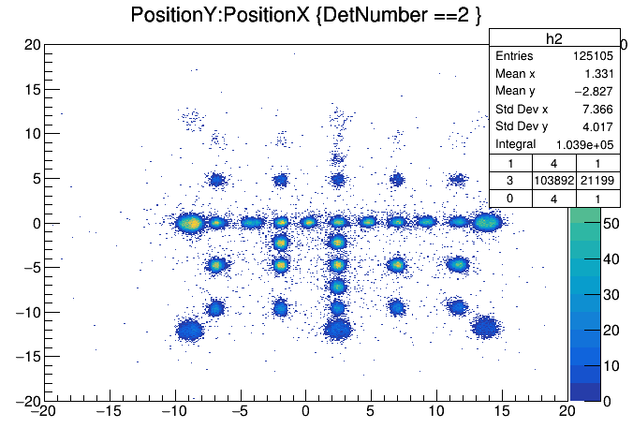
Run 504.root
Before After
Shifted CATS1 by 5 mm

Slide 4
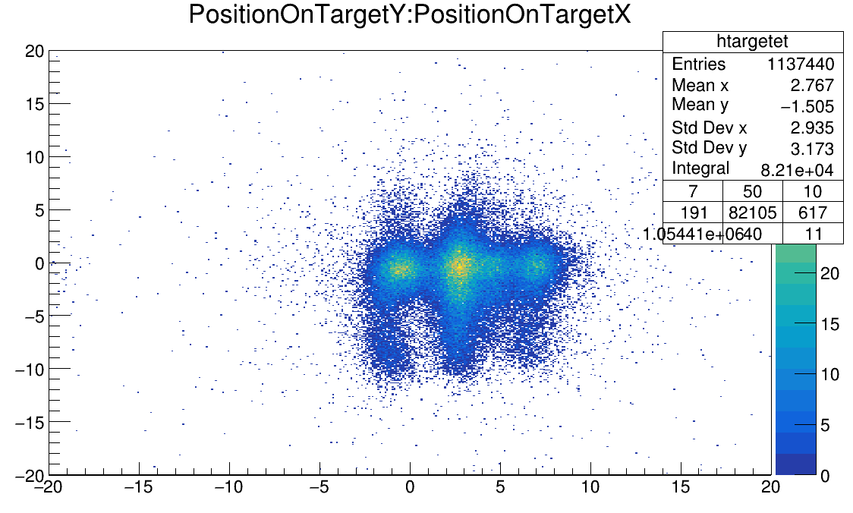
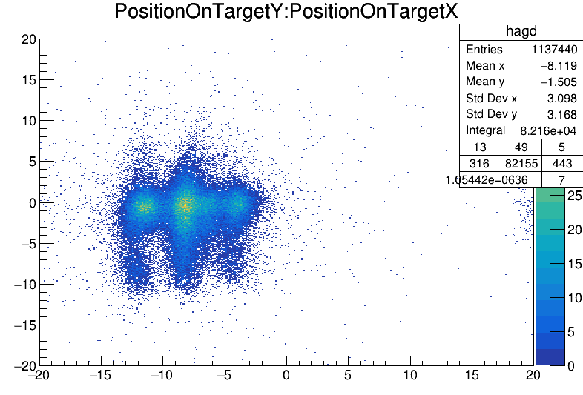
Run 504.root
Before After
Shifted CATS1 by 5 mm

Slide 5
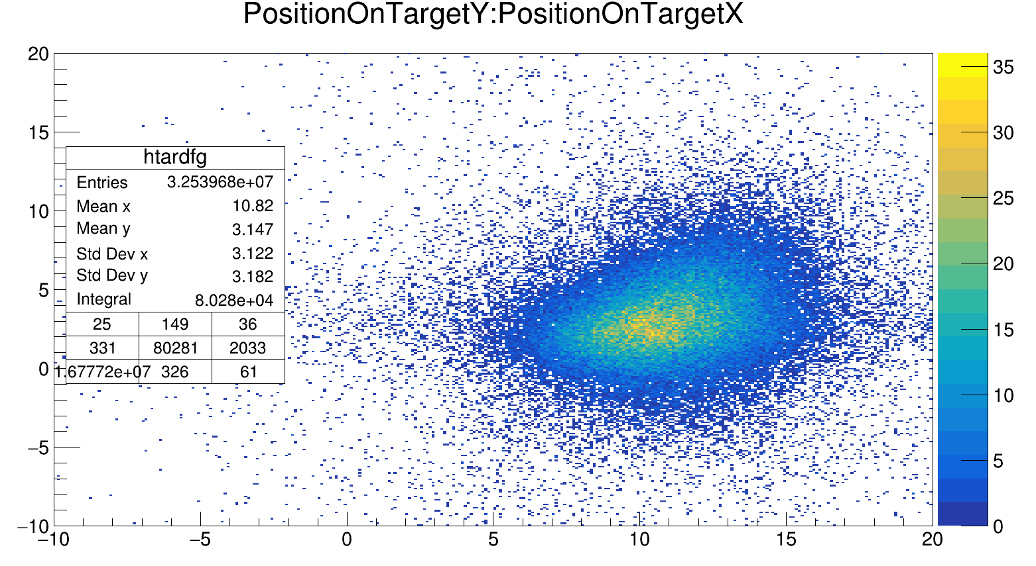
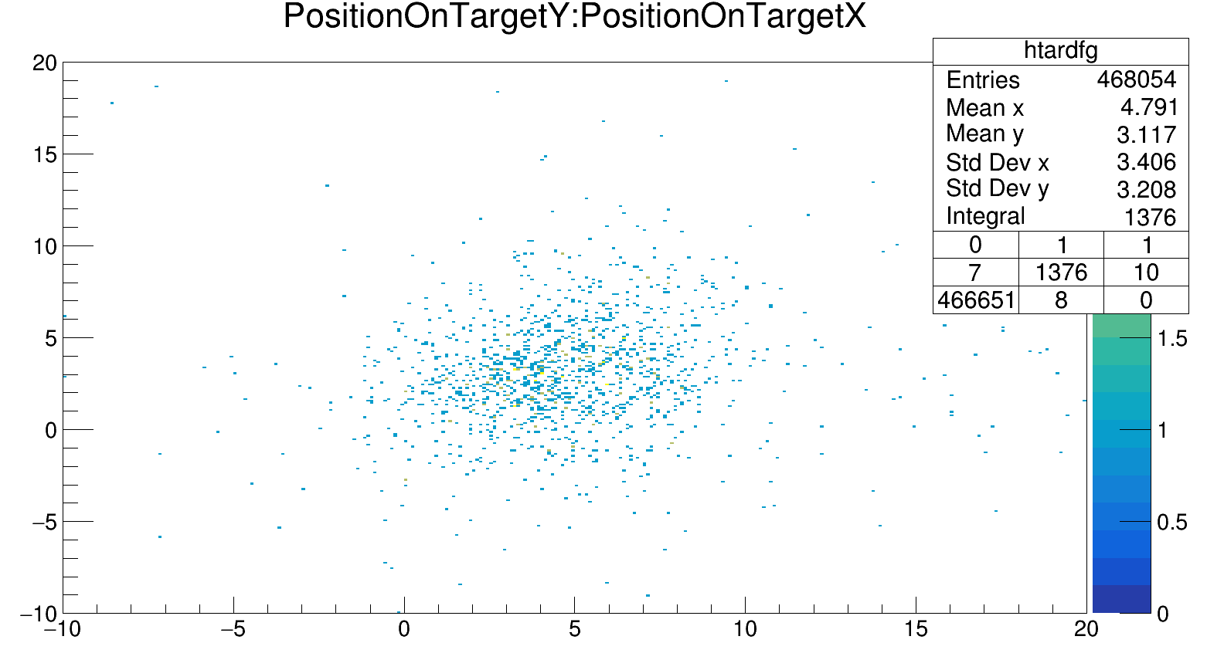
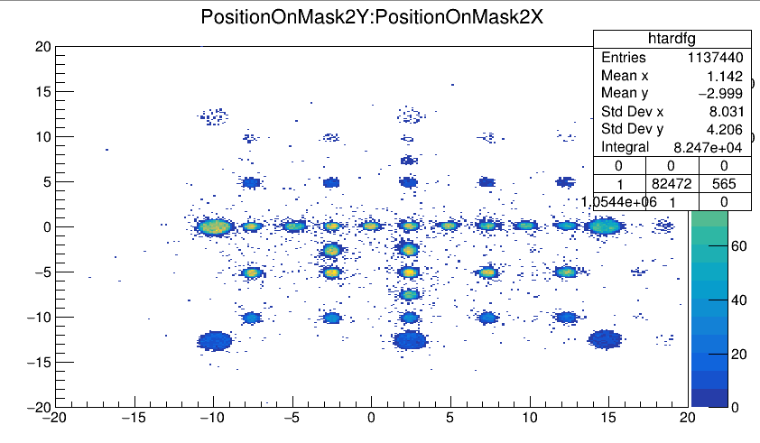
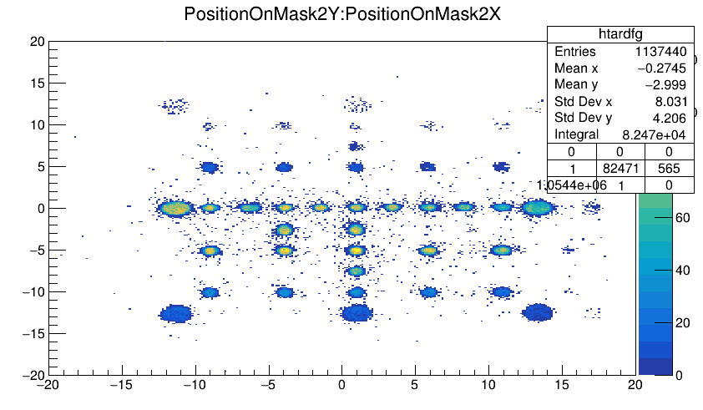
1
2
1
2

Slide 6
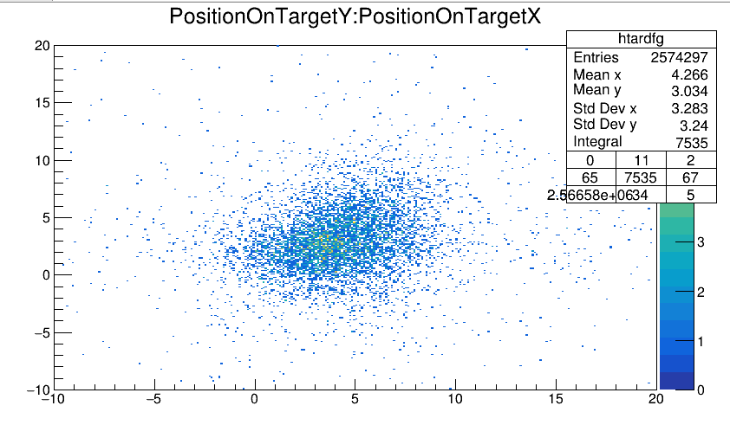
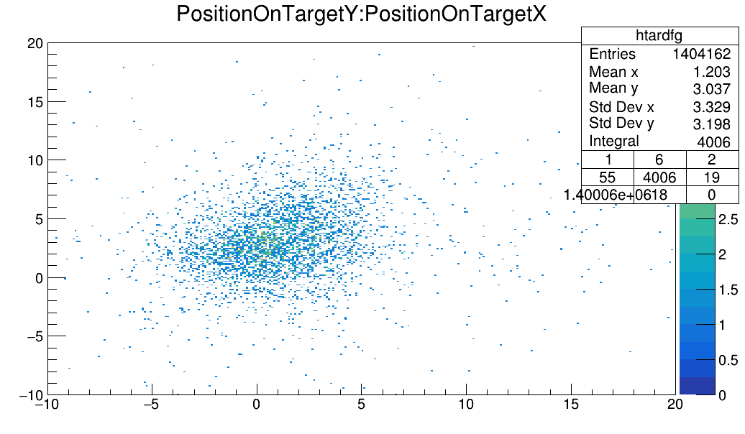
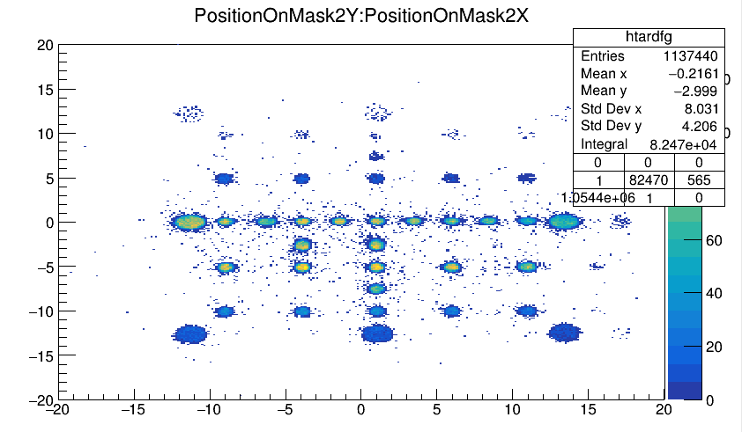
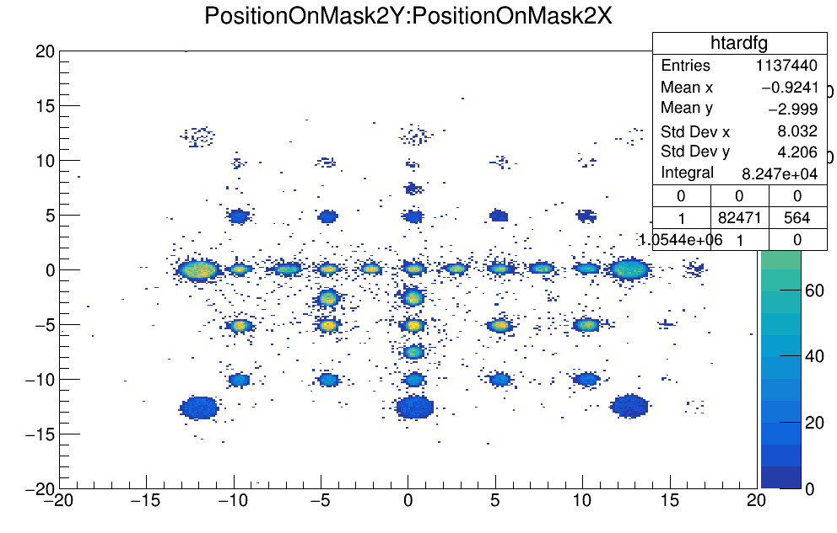
3
4
3
4

Slide 7
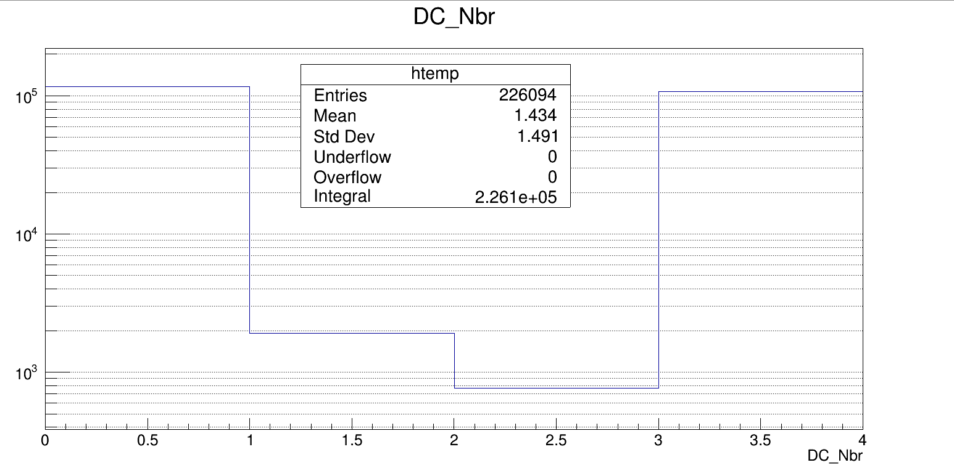
Identification of DC X and Y
I gate on different spots in the CATS to make assumption that the beam must be hitting this part based on where it hits the plastic (reconstructed)

Slide 8
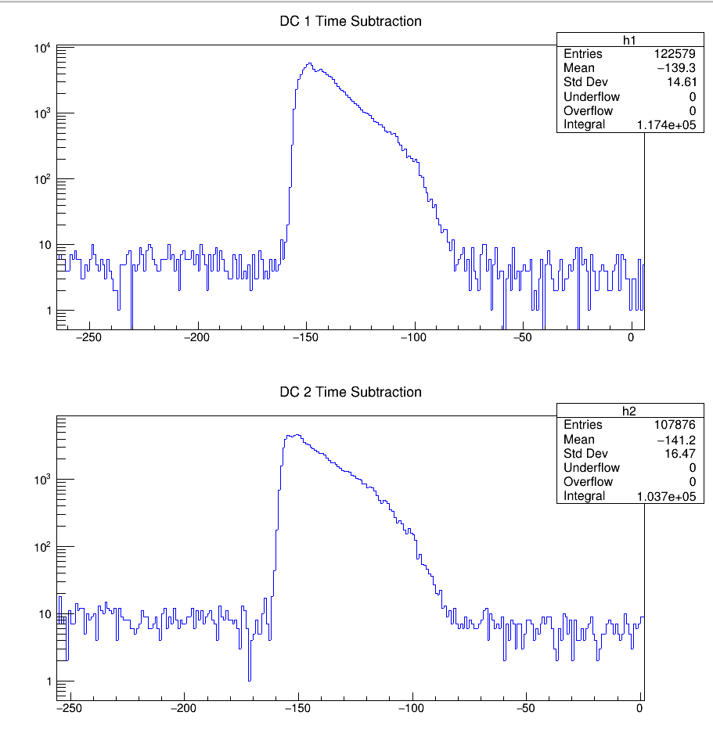
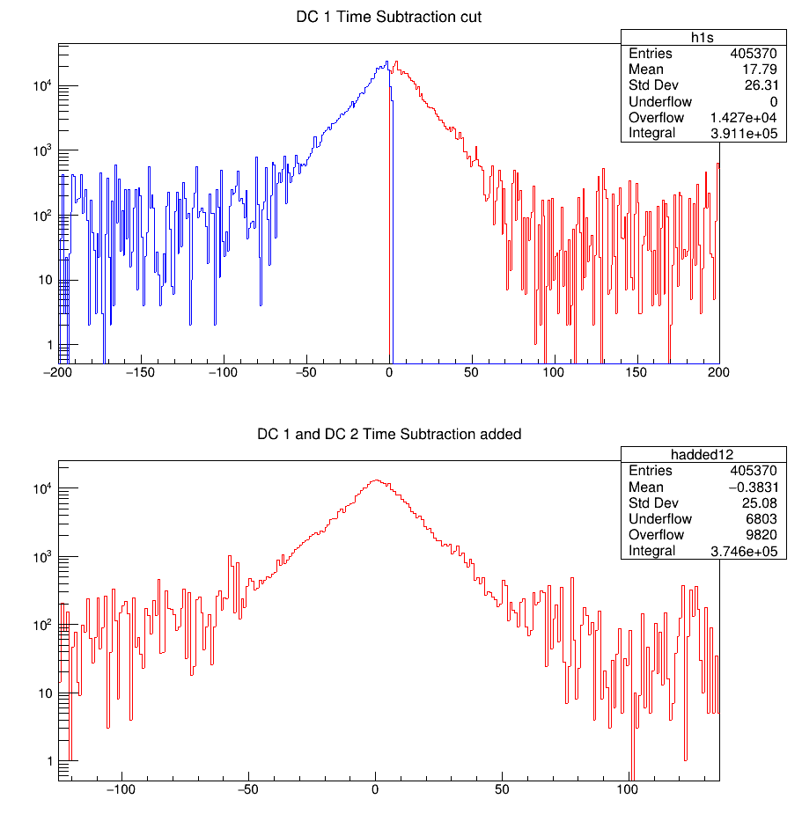

Slide 9
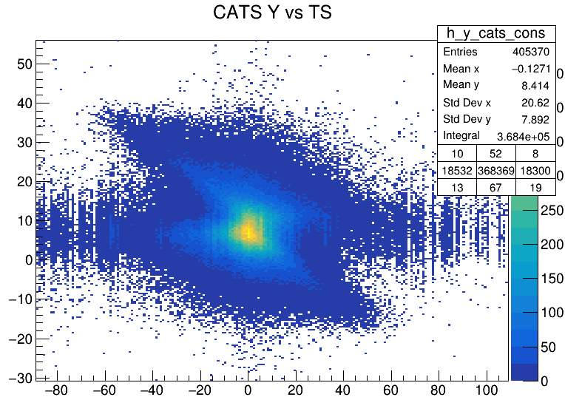
→ Conditioned GATCONF = 32, Pl.size = 2
→ Drift Time (D.T.1) =CATS_ts – DC1_ts
→ Drift Time (D.T.2) = CATS_ts – DC2_ts
→ D.T. added up to make one plot
→ order is 1 - 2
→ constructed y position on *DC 1*
→ plotted y_const vs DC1,2

Slide 10
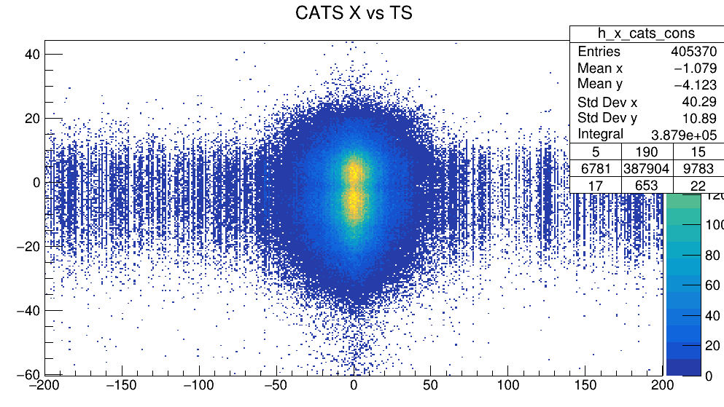
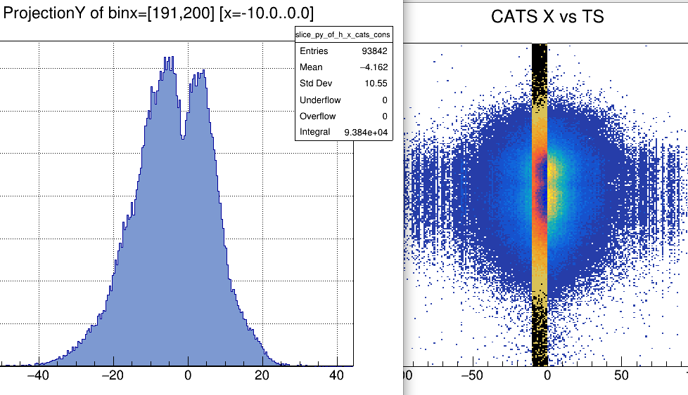
→ Conditioned GATCONF = 32, Pl.size = 2
→ Drift Time (D.T.1) =CATS_ts – DC1_ts
→ Drift Time (D.T.2) = CATS_ts – DC2_ts
→ D.T. added up to make one plot
→ constructed x position on *DC 1*
→ plotted x_const vs DC1,2
This tells that since, for a definite drift-time, the x construction is giving me 2 values…the DC1 and DC2 are horizontally split.
And DC3,4 are vertically split.

Slide 11
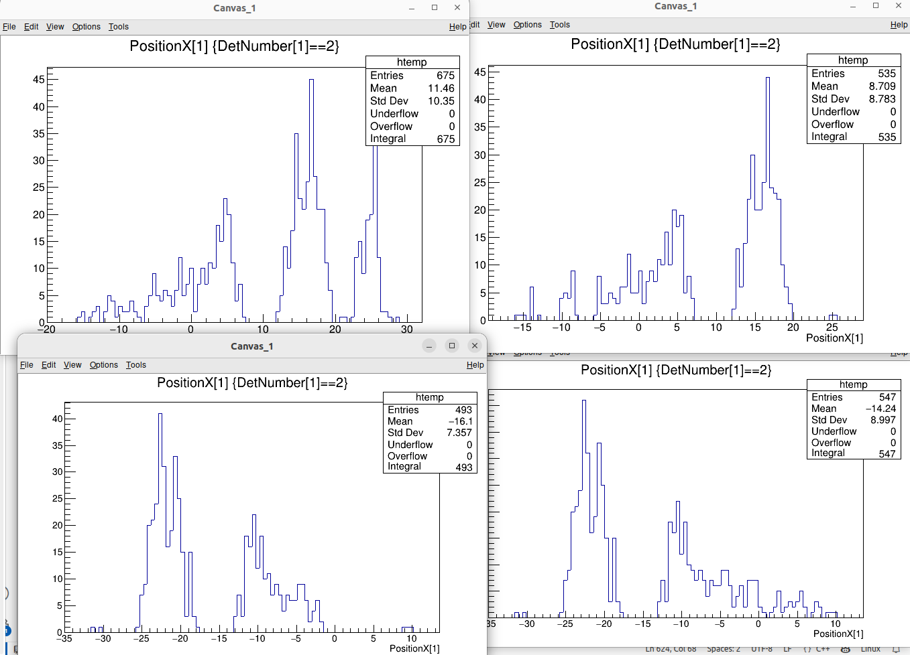
Without any inversion
Only 11-12 inverted
my inversion
10-11
11-12
12-10
Ozge’s inversion
10-11
11-12
12-10

Slide 12
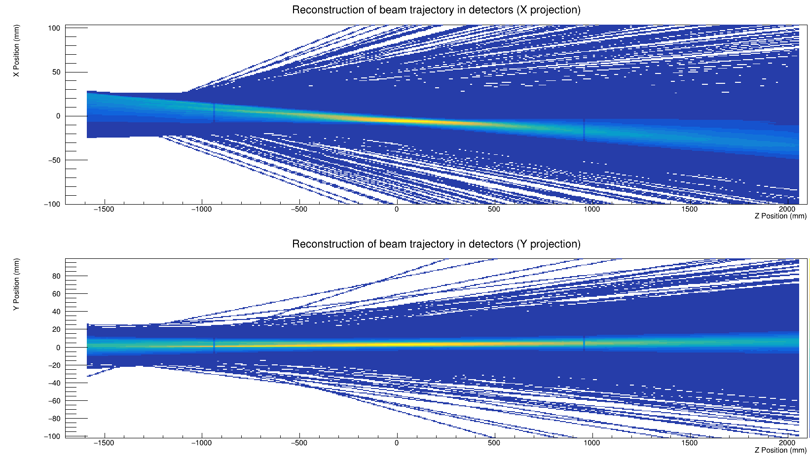
p,d run 523

Slide 13
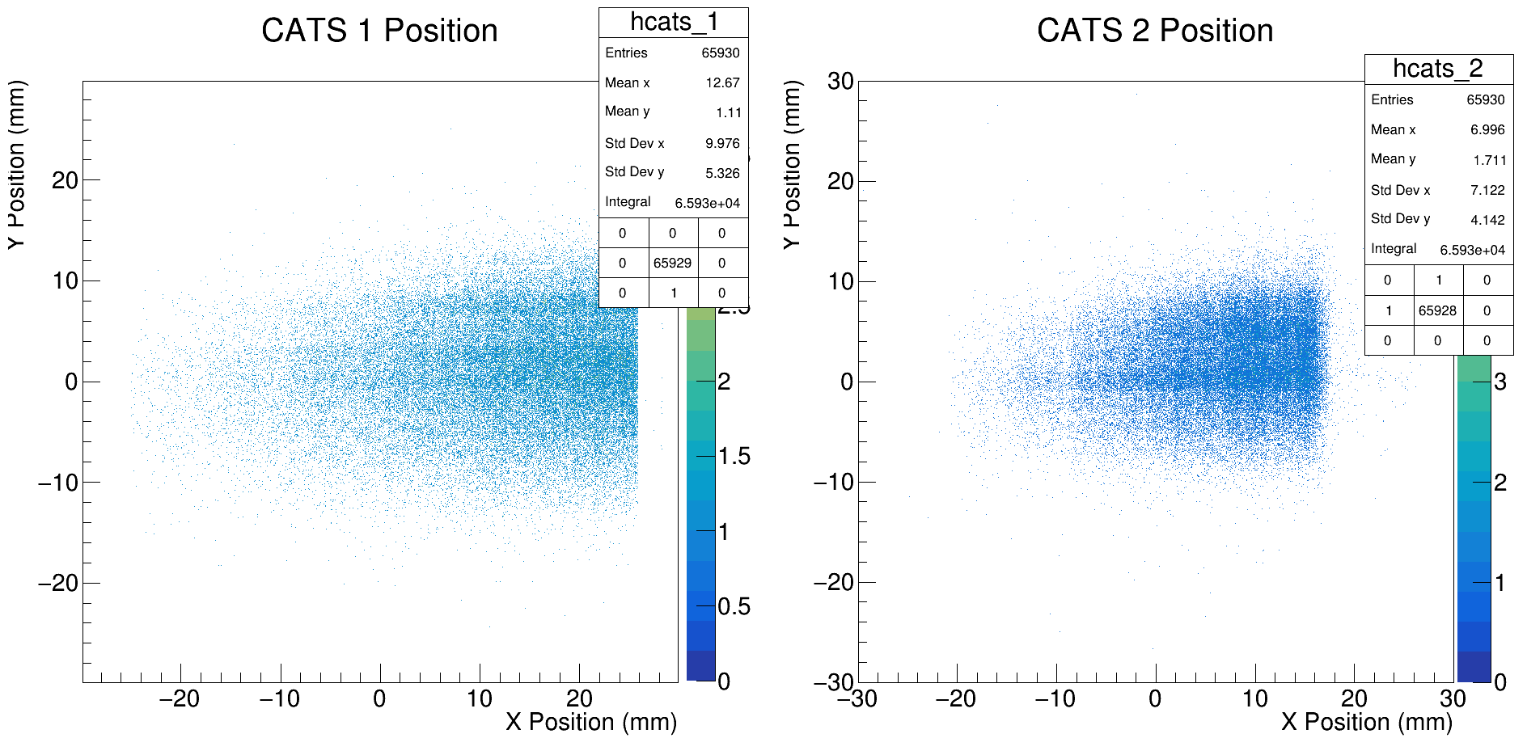
p,d run 523

Slide 14
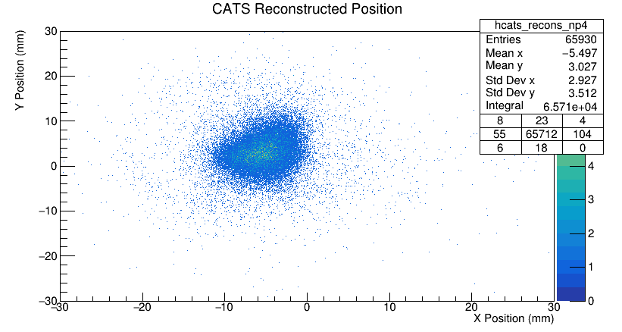
p,d run 523

Slide 15
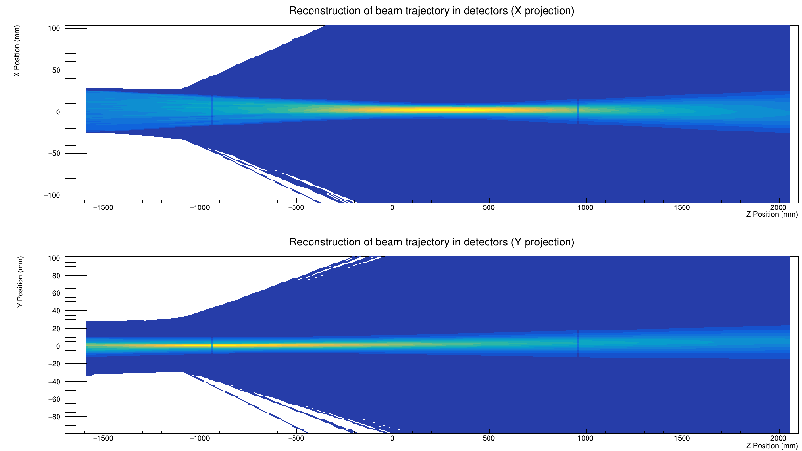
d,p by Ozge

Slide 16
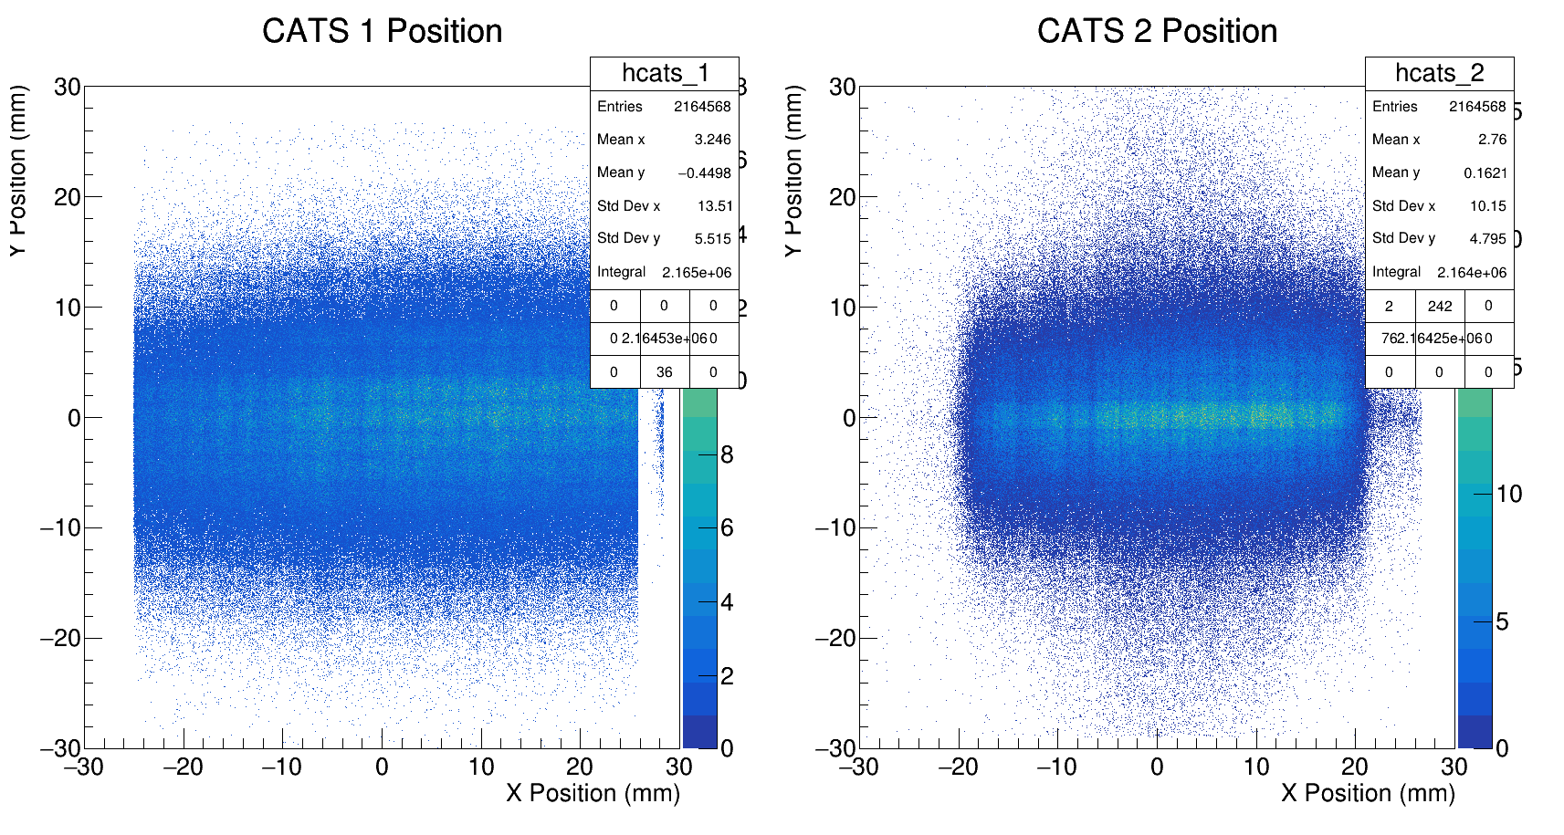
d,p by Ozge

Slide 17
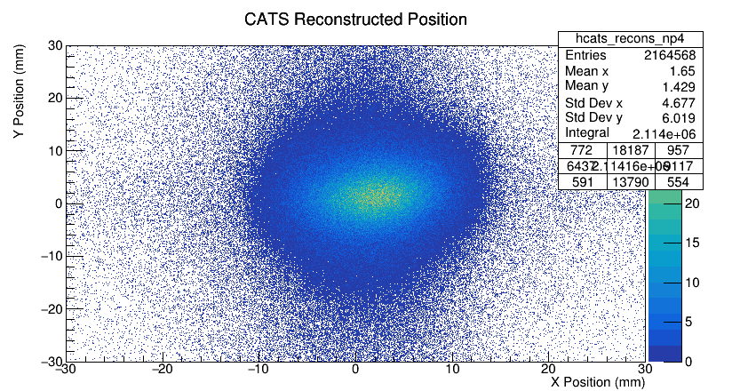
d,p by Ozge

Slide 18
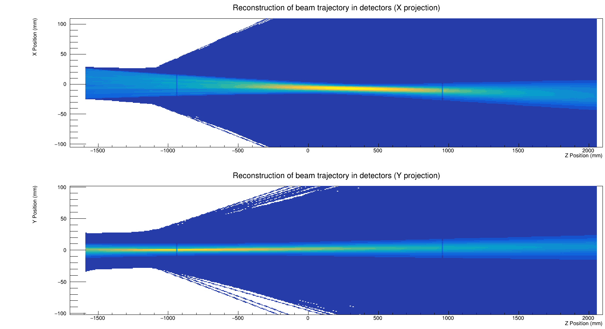
d,p by me, run 551

Slide 19
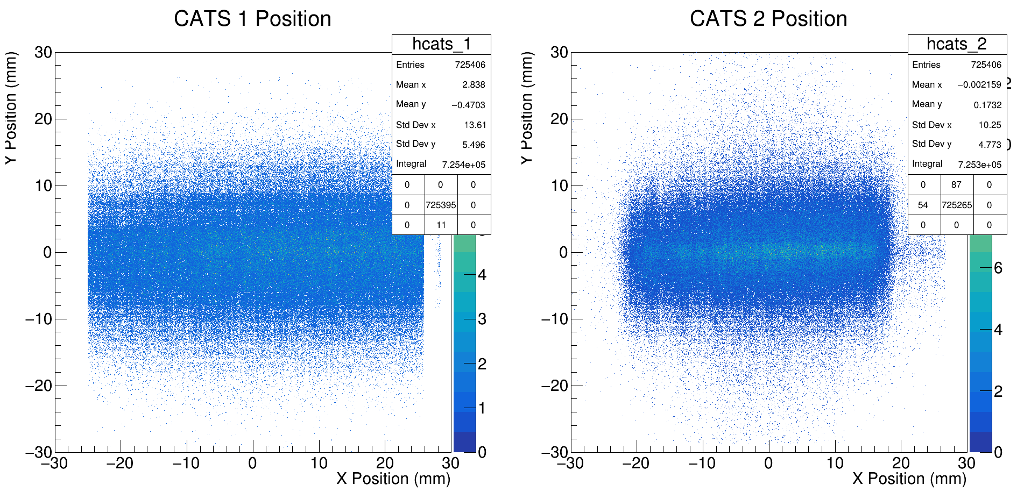
d,p by me, run 551

Slide 20
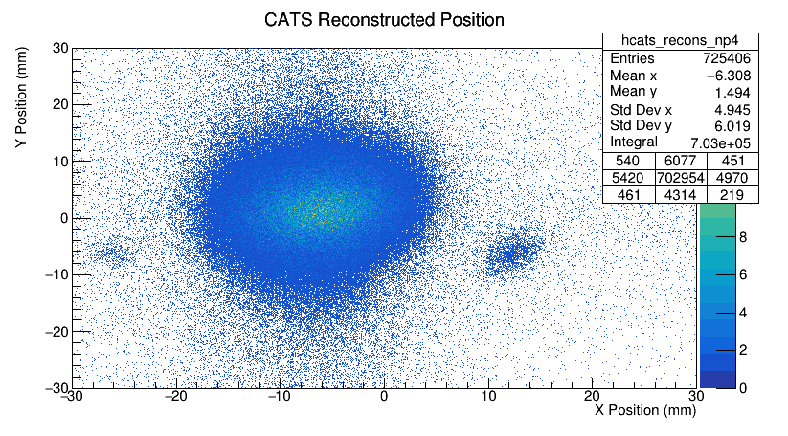
d,p by me, run 551

Slide 21
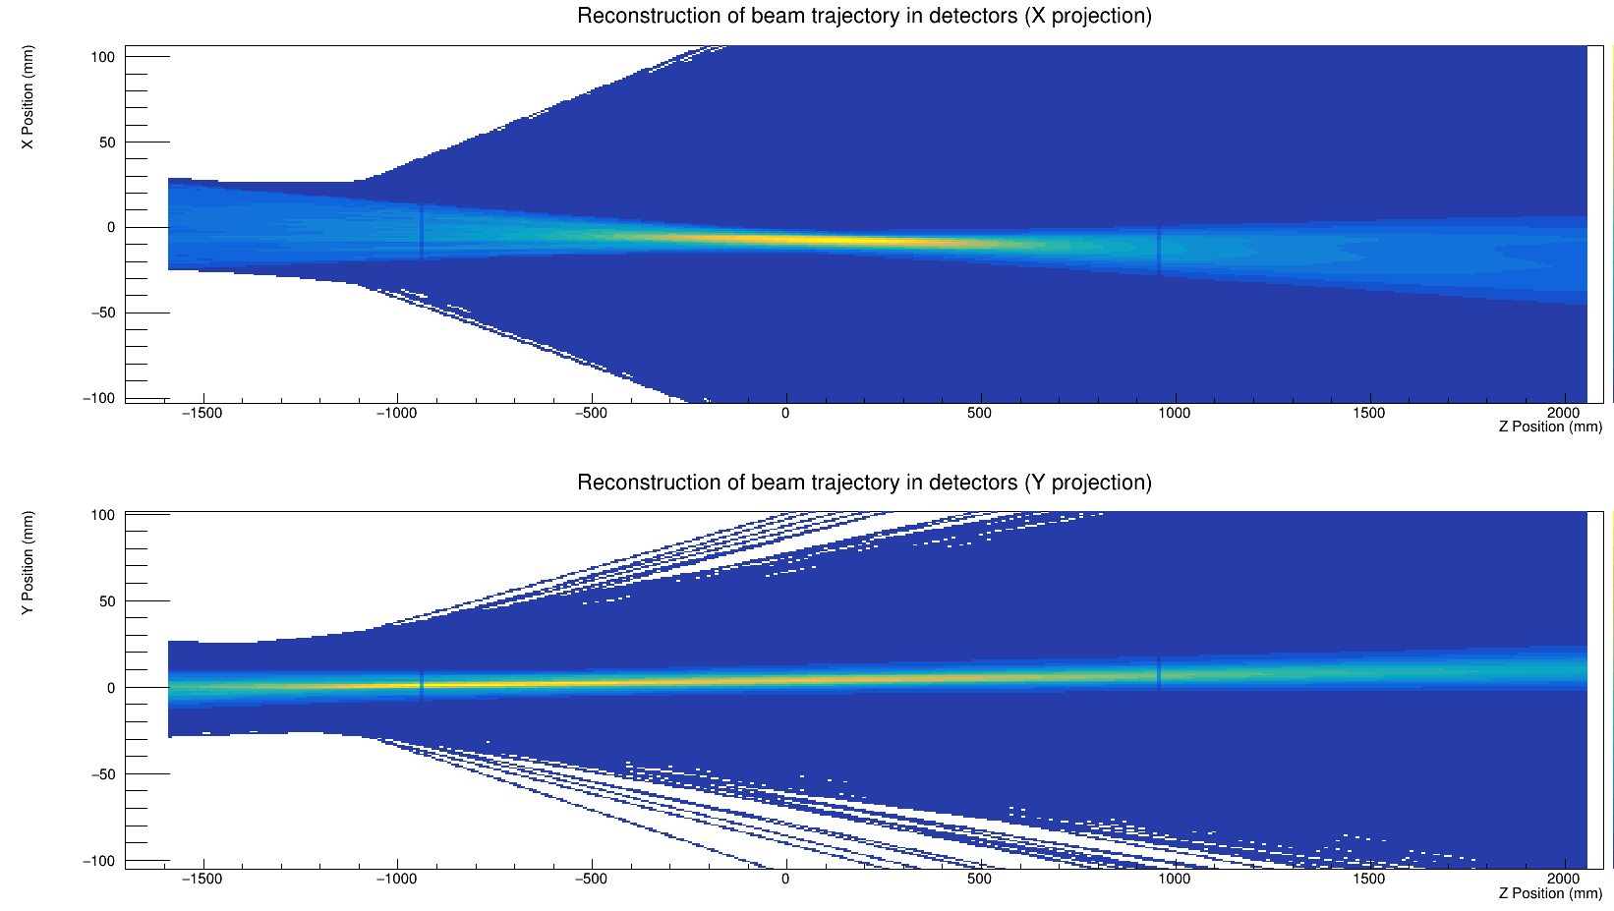
d,p by me, hole target run 558

Slide 22
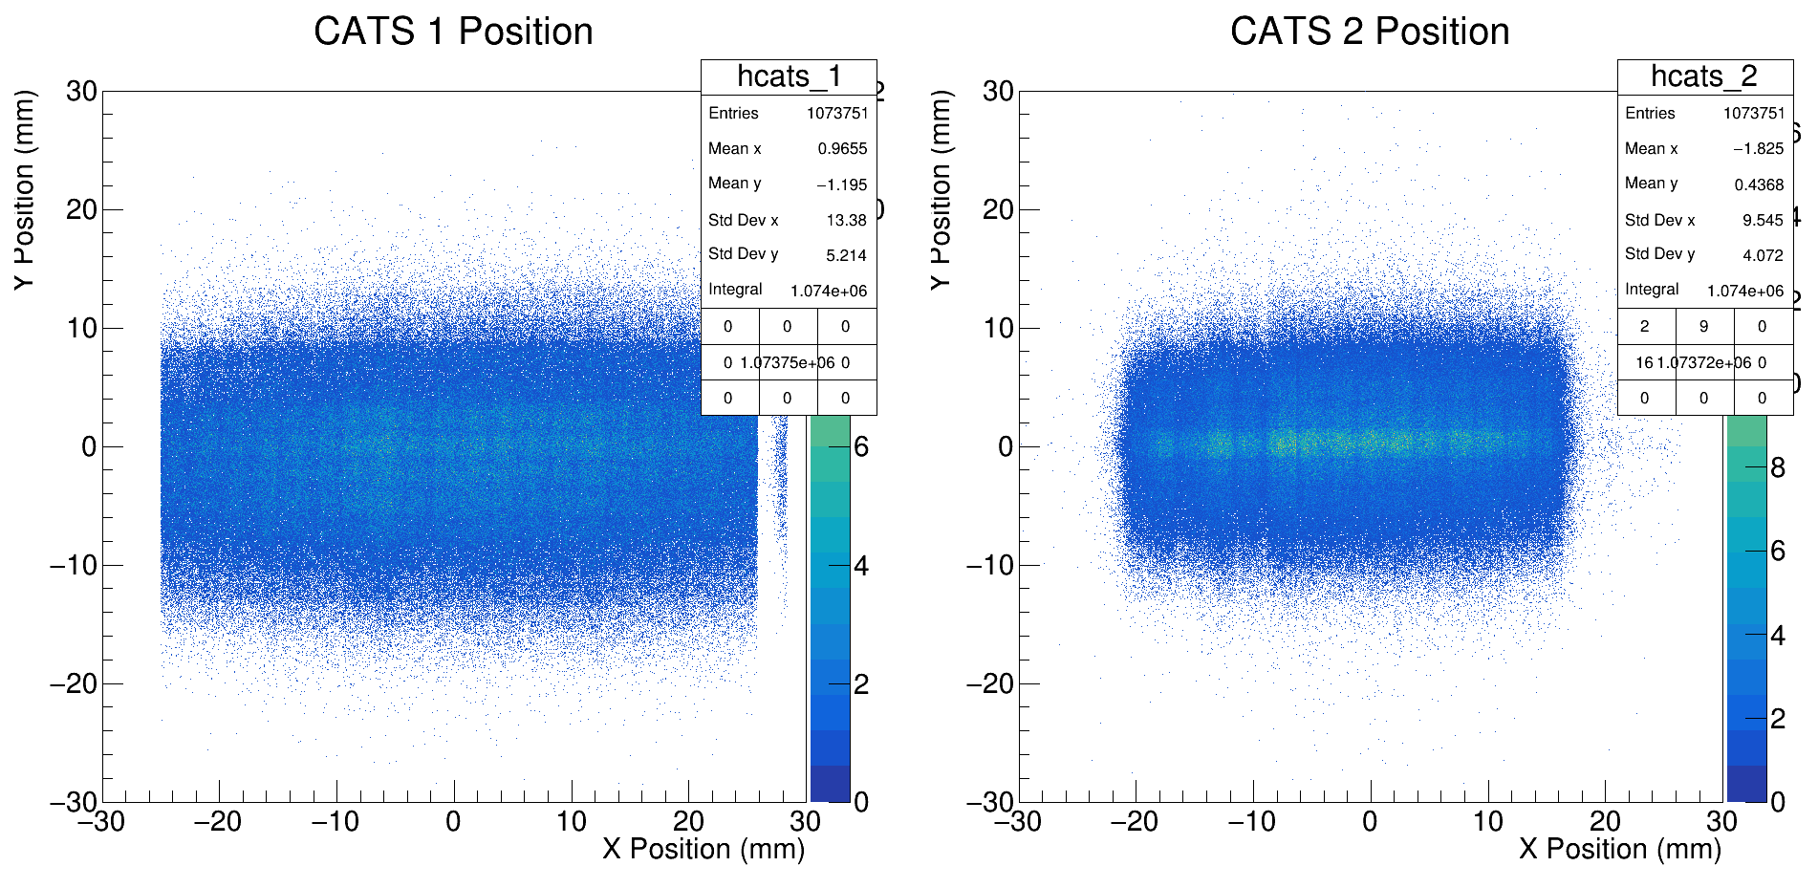
d,p by me, hole target run 558

Slide 23
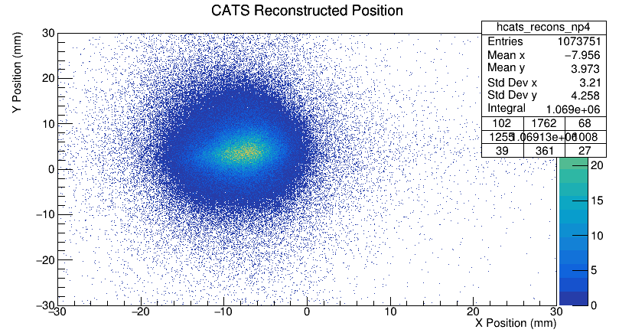
d,p by me, hole target run 558

Slide 24
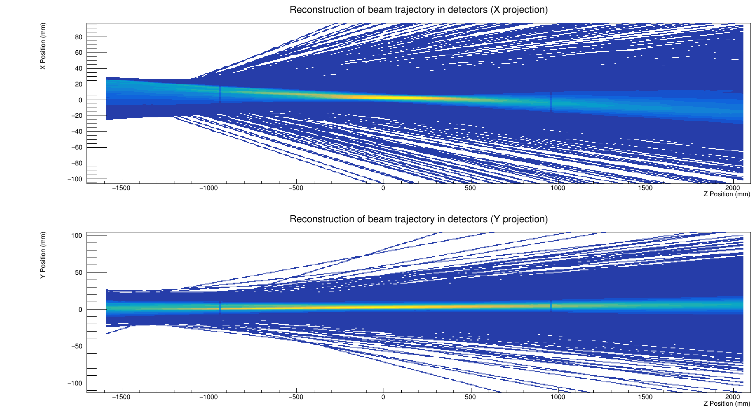
p,d run 523, (with np3)

Slide 25
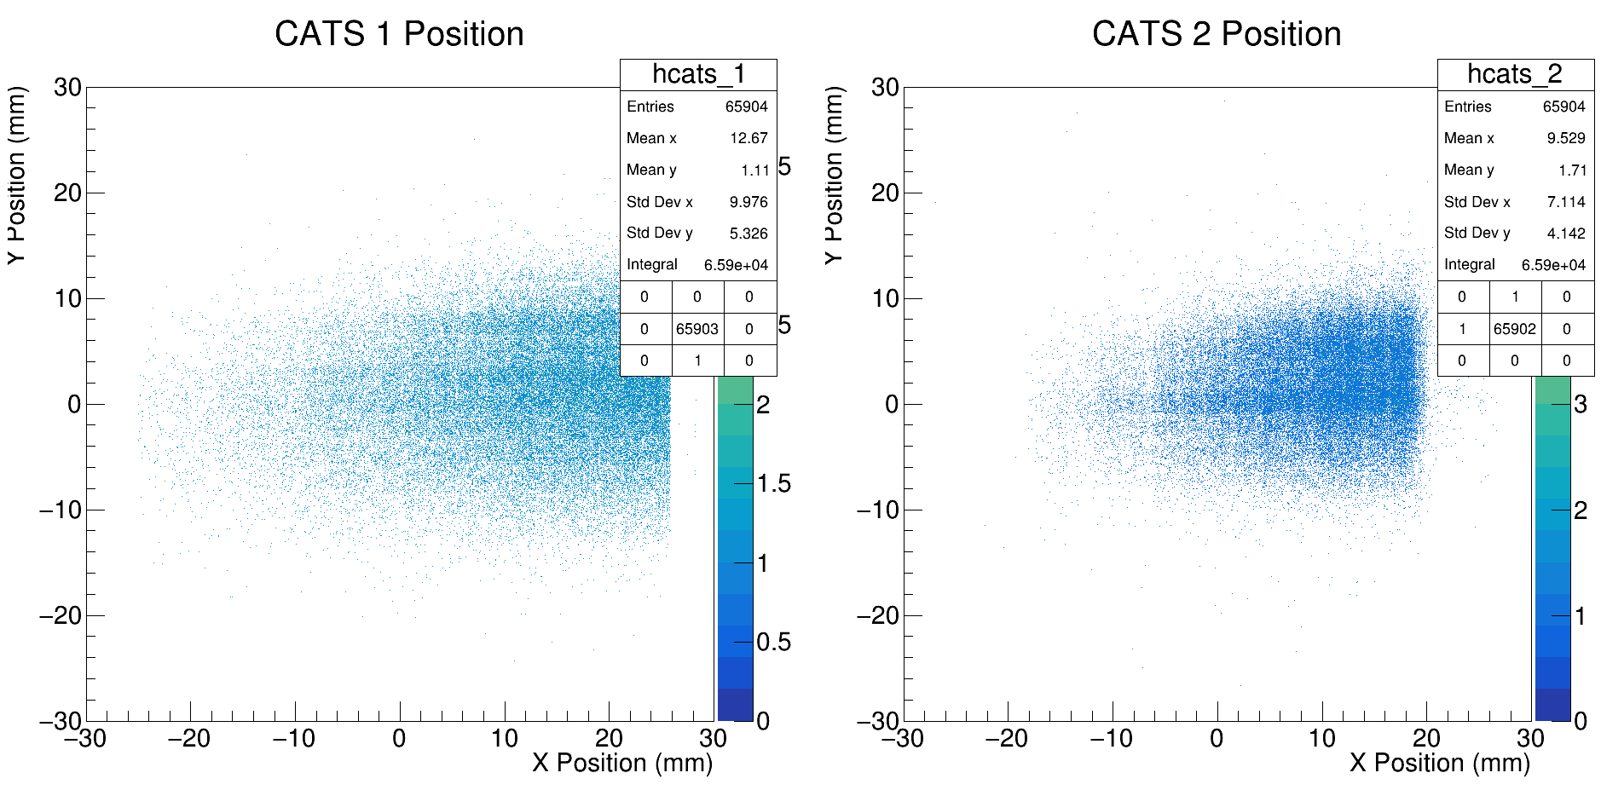
p,d run 523, (with np3)

Slide 26
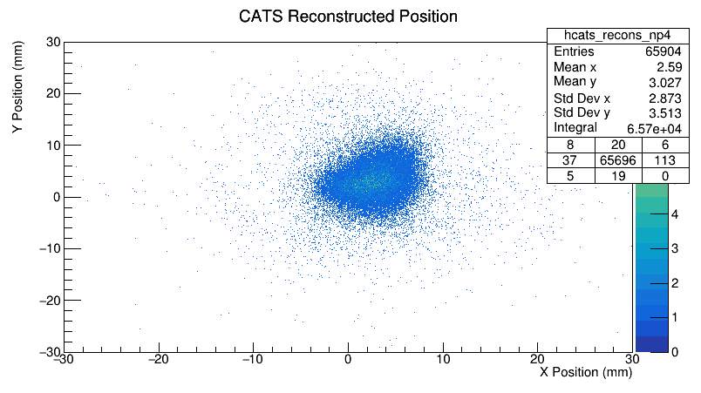
p,d run 523, (with np3)

