Slide 1
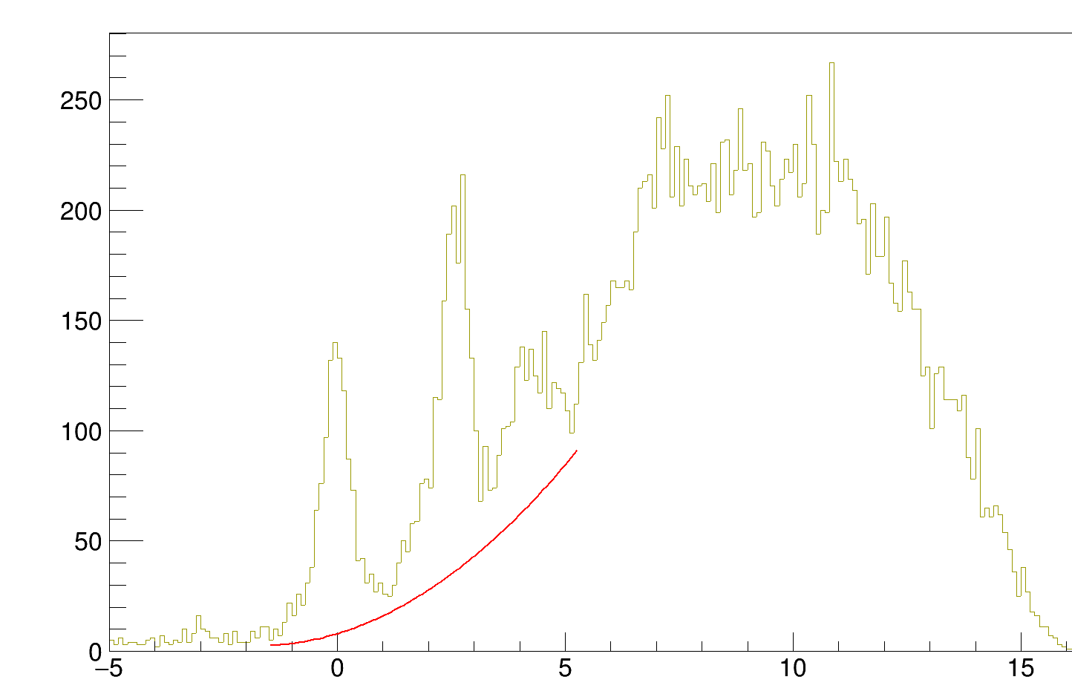
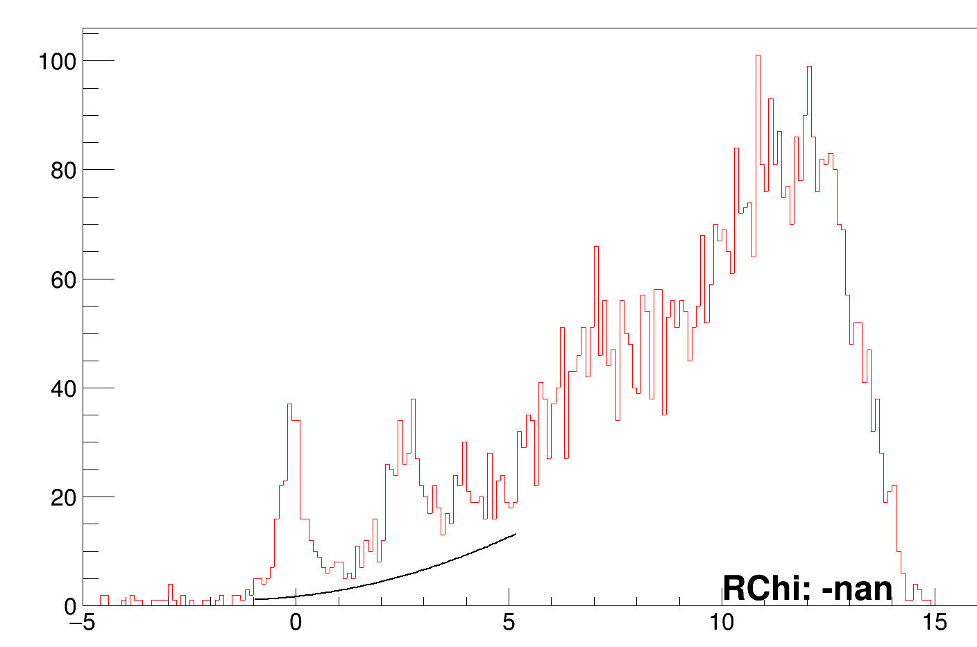
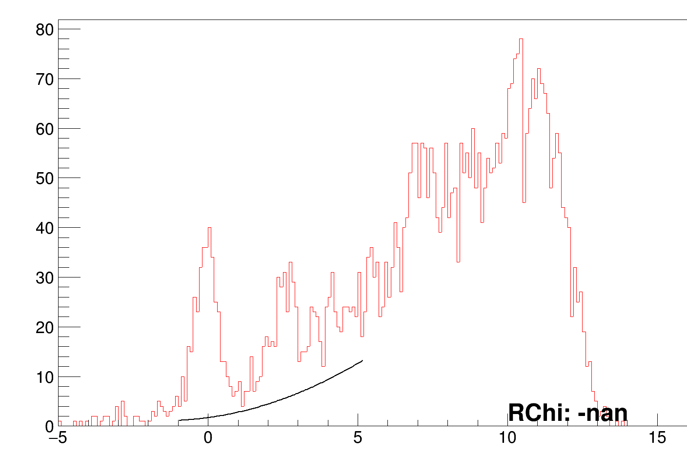
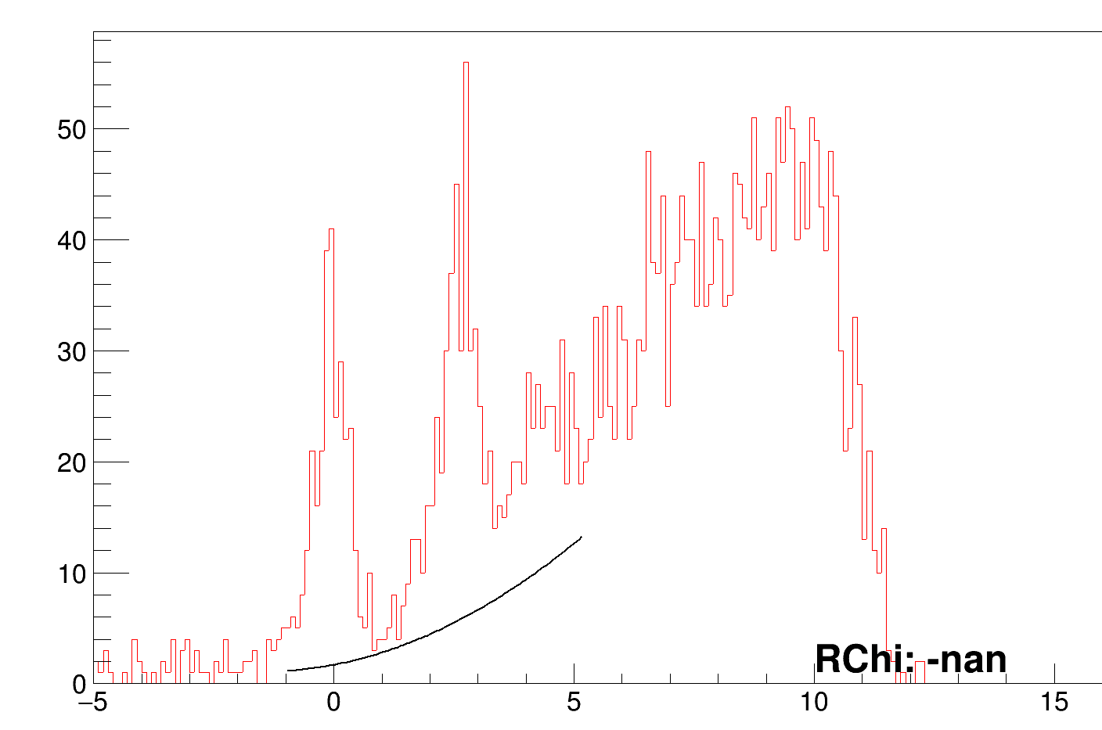
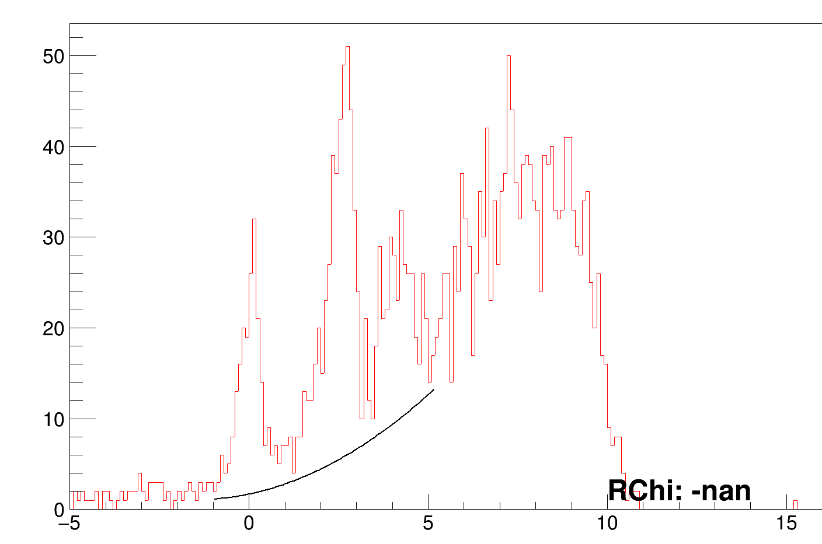
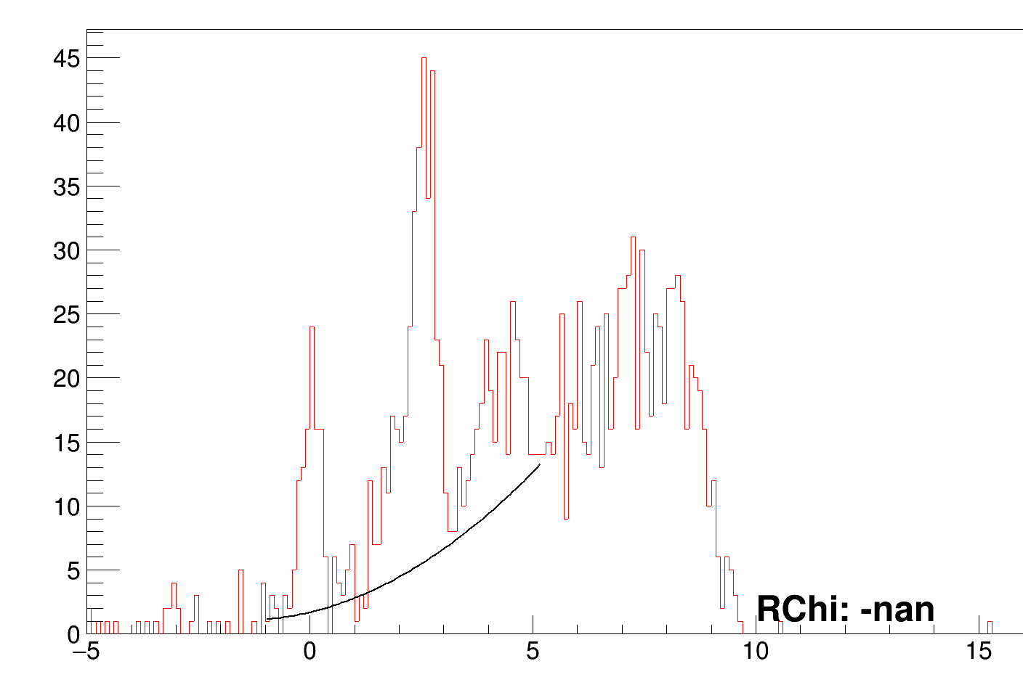
(1) Background selection
total
Cut1
cut2
cut3
cut4
cut5
Up to region 4, the same parameters for the BG seem okay… but for reg5, the stats become less and the same BG can’t be used anymore… Results from this background will be super ugly but still good I think.

Slide 2
Angular cuts of 9 deg
115_124
124_133
133_142
142_151
151_160

Slide 3
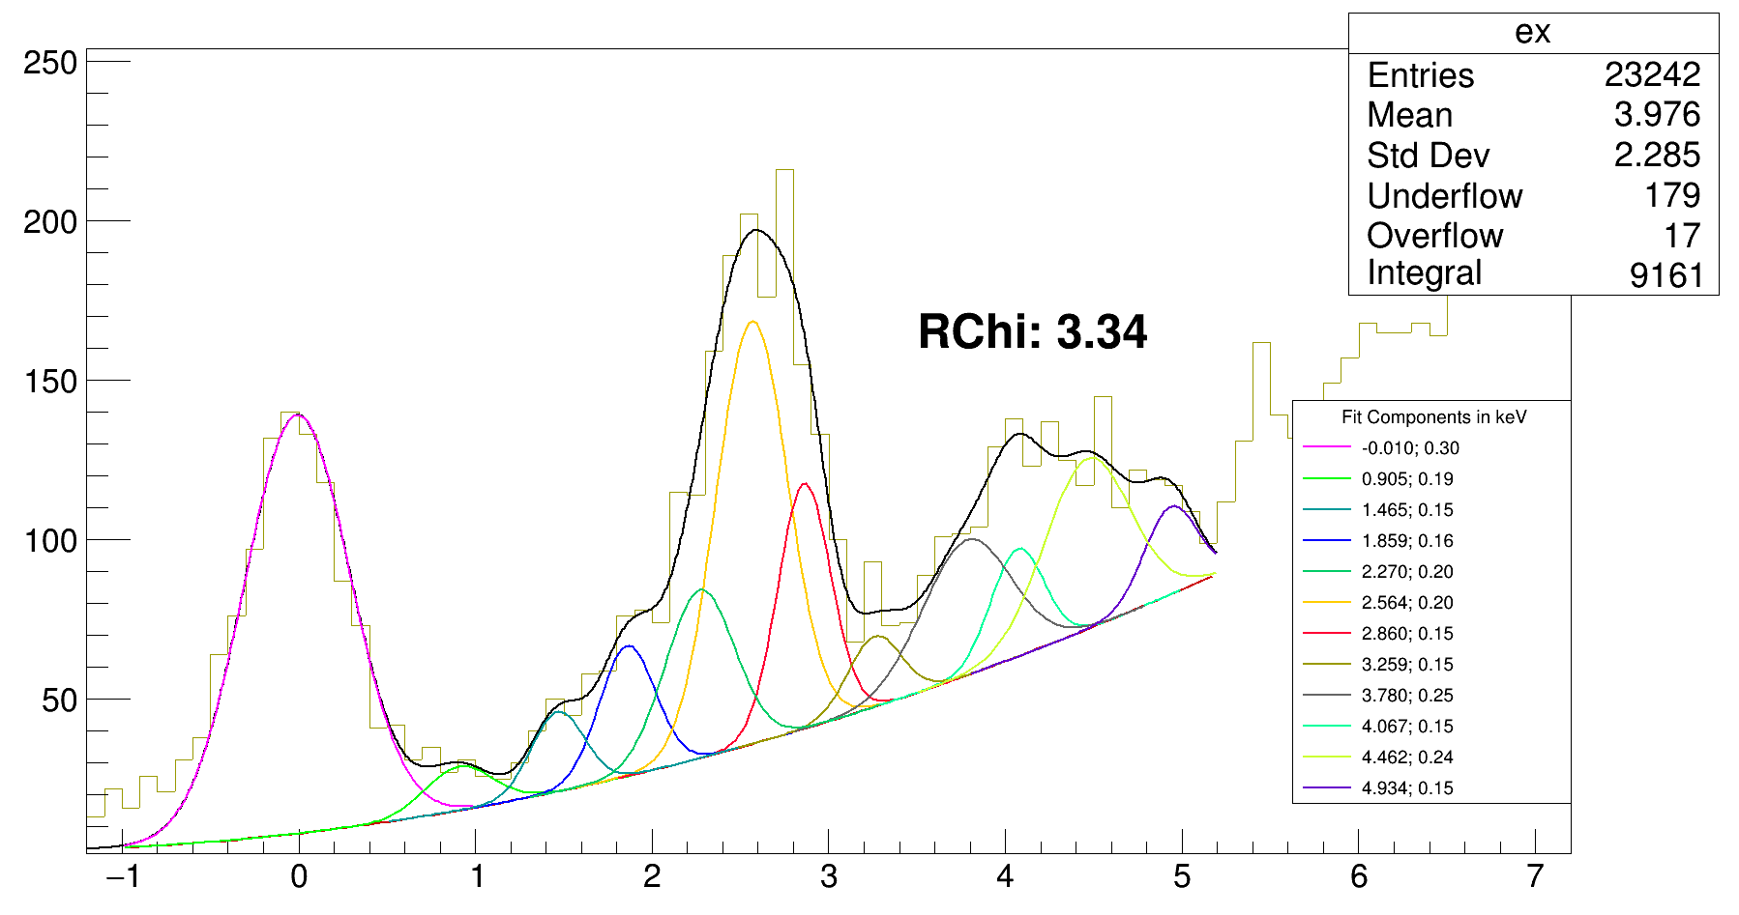
Full ex. spectrum
MeV*, Energy, sigma

Slide 4
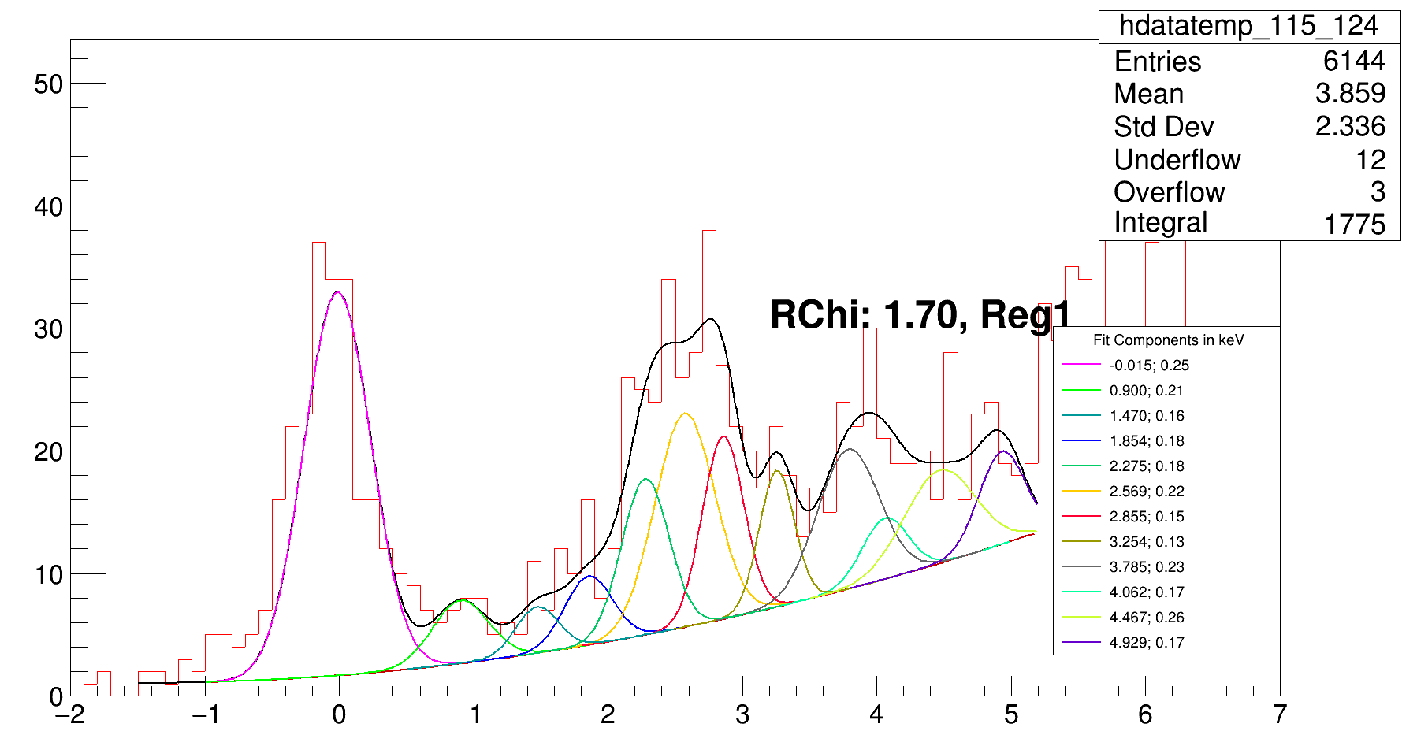
115_124
MeV*, Energy, sigma

Slide 5
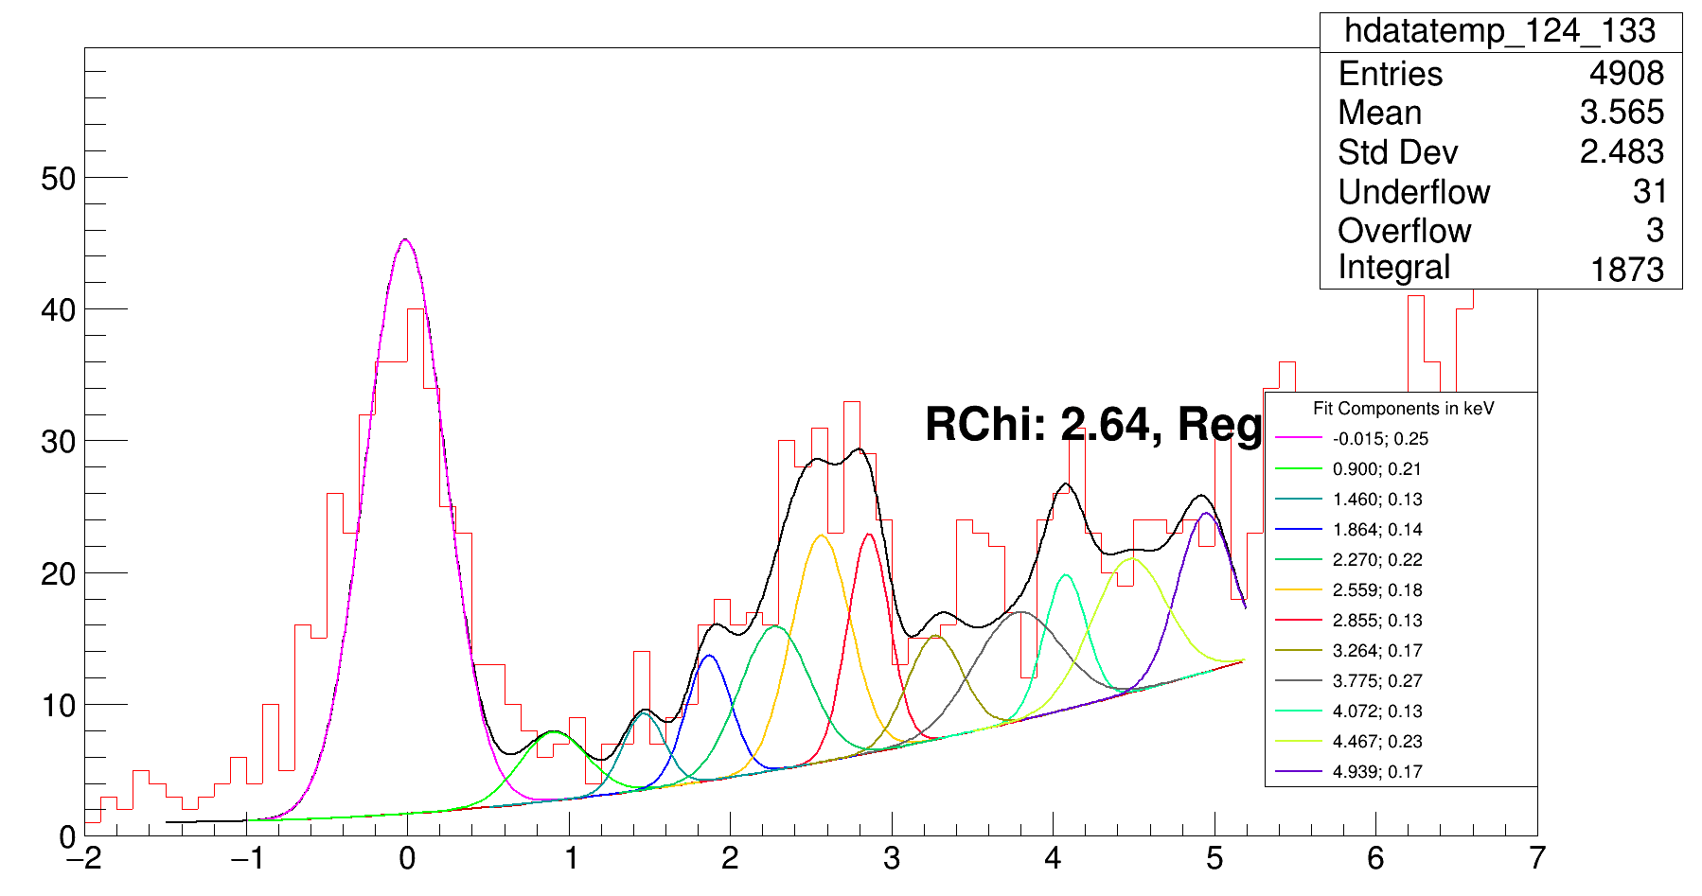
124_133
2
MeV*, Energy, sigma

Slide 6
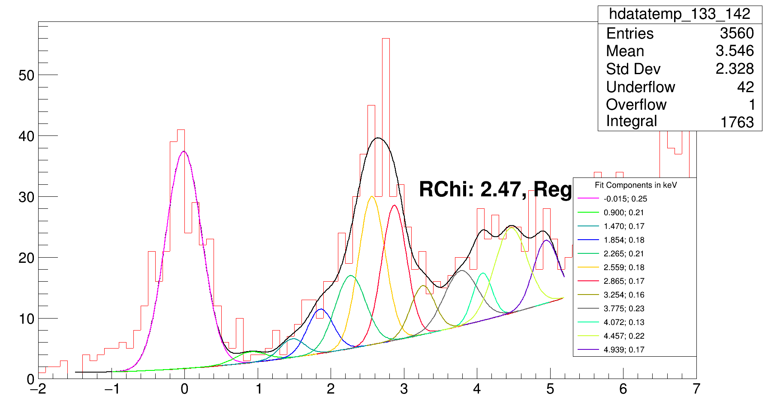
133_142
3
MeV*, Energy, sigma

Slide 7
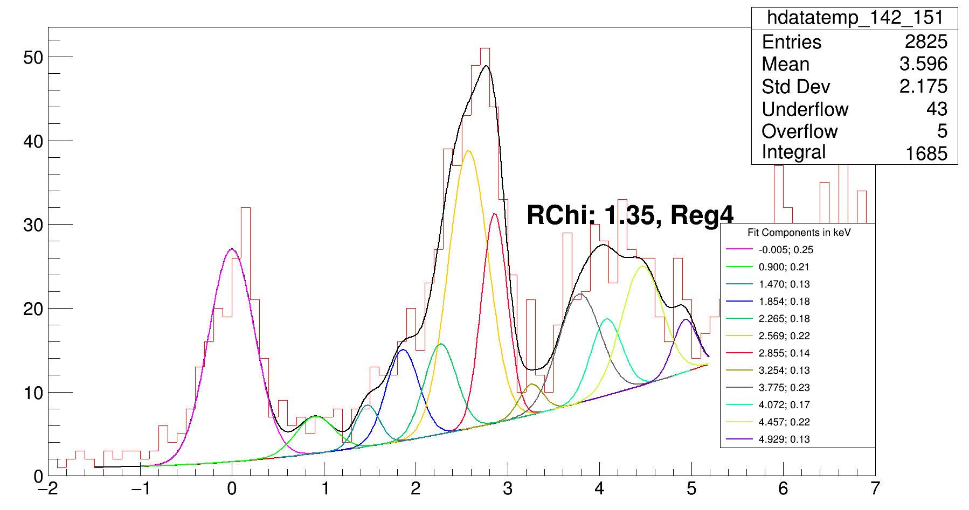
142_151
MeV*, Energy, sigma

Slide 8
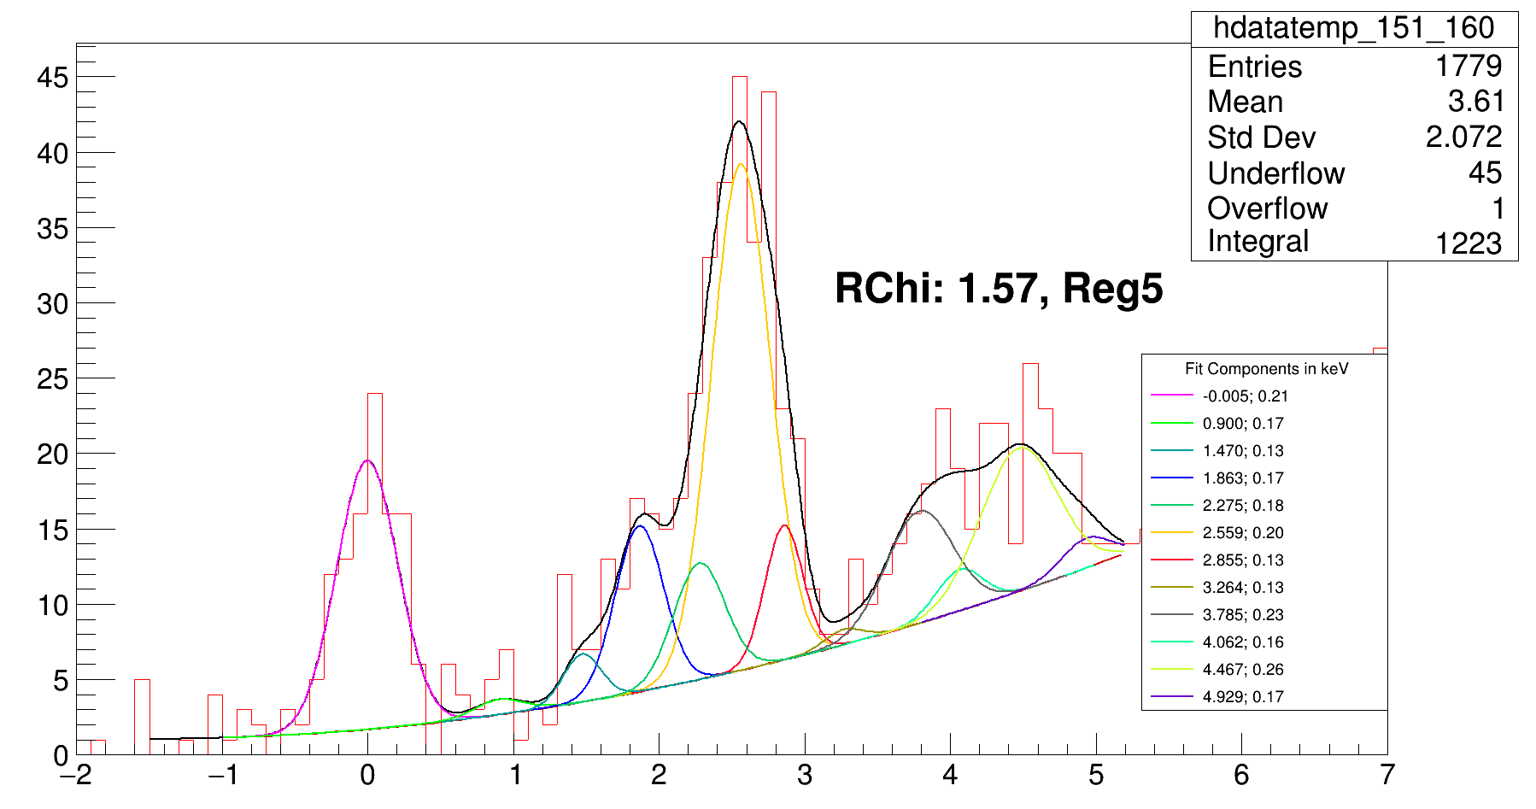
151_160
MeV*, Energy, sigma

