Slide 1
Study of the neutron Fermi surface of ⁶⁸Ni by using (d,p) reactions (E843)
LISE Workshop 2024
1

Slide 2
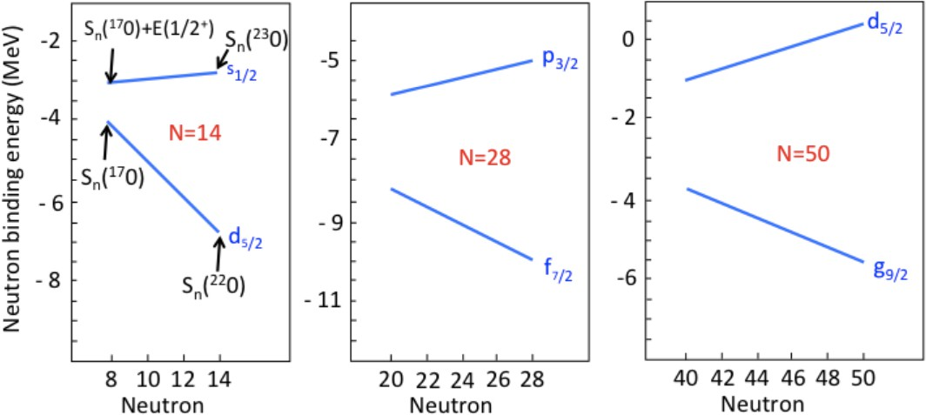
N=50 in neutron-rich Ni
⁷⁸Ni : Z=28 and N=50, “classical” magic numbers kept?
cf : Broken magic in ¹²Be(N=8), ³²Mg(N=20), ⁴⁴S(N=28),…
Mass measurement around ⁷⁸Ni β-decay life time around ⁷⁸Ni
High energy of 2⁺1 state of ⁷⁸Ni
J. Hakala et al., PRL 101 52502 (2008)
Z. Y. Xu et al., PRL 113 032505 (2014)
R. Taniuchi et al., Nature 569 53 (2019)
-> Detailed study of N=50 gap in Ni isotope
O. Sorin and M.-G., Porquet Phys. Scr. T152 014003
?
Z=8 O
Z=20 Ca
Z=28 Ni
⁶⁸Ni : Starting point of N=50 gap at N=40

Slide 3
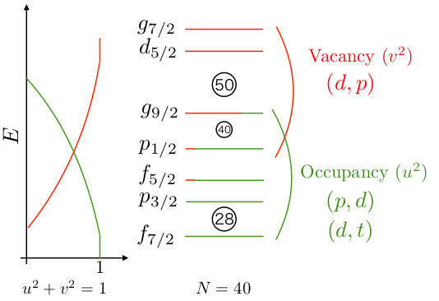
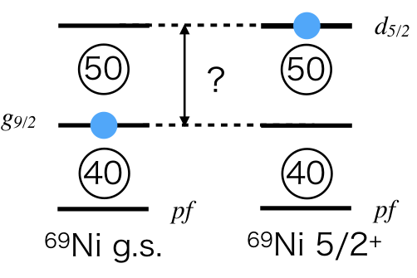
N=50 in neutron-rich Ni
$N=50gapenergy⇒\left\langle E\left(d_{5/2}\right)\right\rangle −\left\langle E\left(g_{9/2}\right)\right\rangle$
$\left\langle E\left(d_{5/2}\right)\right\rangle$
C²S⁺ , ⁶⁹Ni excitation energy (d5/2) → (d,p) reaction
C²S⁺ , ⁶⁹Ni excitation energy (g9/2) → (d,p) reaction
C²S⁻ , ⁶⁷Ni excitation energy (g9/2) → (p,d) reaction
$\left\langle E\left(g_{9/2}\right)\right\rangle$

Slide 4
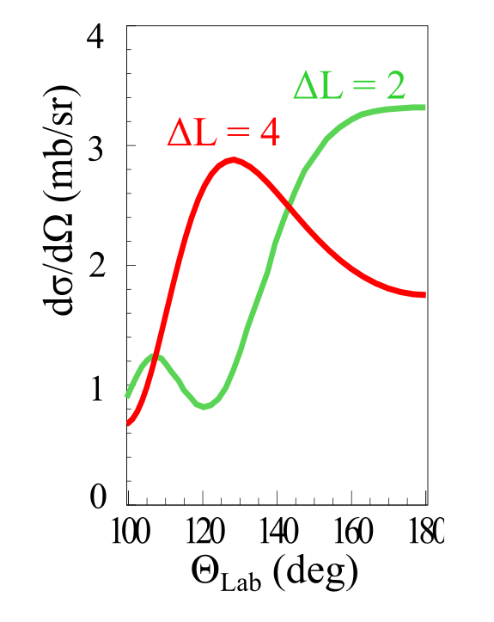
⁶⁸Ni(d,p)⁶⁹Ni
^{Previous Experiment}
⁶⁸Ni beam of 24.8 MeV/u
2.6 mg/cm² CD2 target
Candidate(s) of d5/2 state(s) at
2.5 MeV, but J^{π} not concluded
-> Determine Ex of d5/2 state(s) Conclude J^{π} assignment from angular distribution
Shell gap of N=50 at N=40 nucleus ⁶⁸Ni
Excitation energy of d5/2 state(s) in ⁶⁹Ni
C²S⁺ of g9/2 and d5/2 states
In ⁶⁸Ni(d,p)⁶⁹Ni reaction with determining the 2d5/2 strength, the spacing between the g9/2 and d5/2 neutron orbitals at N=40 is investigated. The reaction was studied before and 2d5/2 is measured at 2.5 MeV [2]. The state is suggested to be doublet at 2.1 and 2.8 MeV. The aim is to determine the excitation energies and confirm the ΔL of 2.8 MeV state.

Slide 5
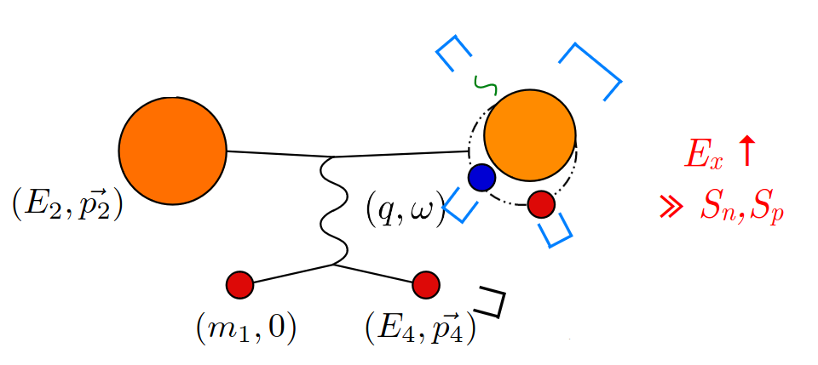
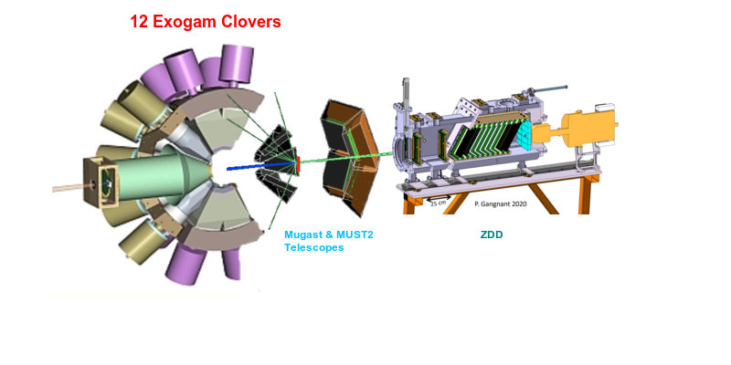
Experimental Setup
MUGAST@LISE Setup LISE2023
Scintillator
⁶⁹Ni
⁶⁷Ni
⁶⁶Ni
Chambers
Ionizing
⁶⁸Ni
@18MeV/u
@38 MeV/u
For (d,t) &(p,d) reactions
4 MUST2 telescope
@ 5º – 40º
80% acceptance
Missing mass
p, t, d,...
CD2 (0.5 mg/cm²)
CH2 (5 mg/cm²)
CD2, CH2 target
Pair of Drift Chambers (DC) for XY position measurement
10 tilted foils ionizing chambers coupled (IC) for ΔE energy loss and the PID
5 Plastic Scintillators for Energy and clean up the reaction residue.
1 Exogam Clover (HpGe) for tagging the isomeric decays
For (d,p) reaction
5 trapezoidal DSSDs (GRIT)
@ 110º-170º,
60% acceptance
CATS1 &2
Secondary beam E=10-50 MeV
For reconstructed beam position on target
ToF

Slide 6
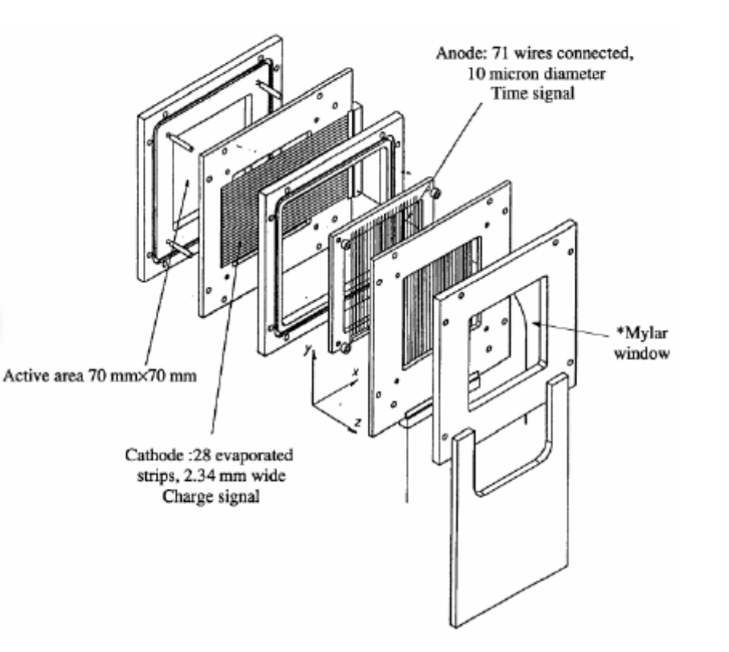
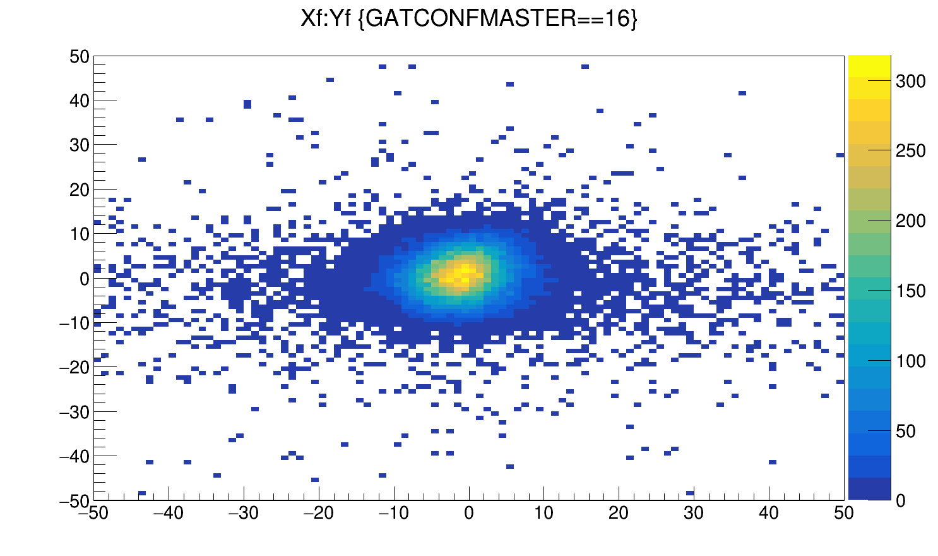
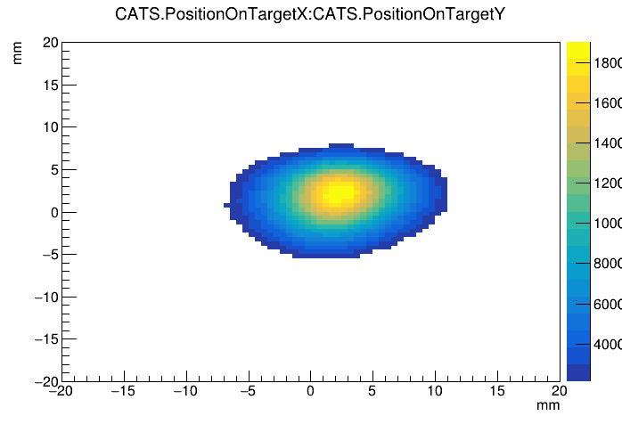
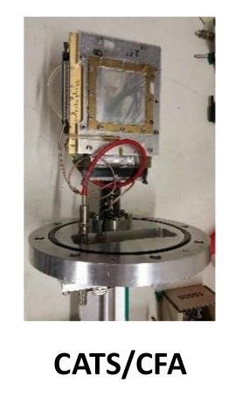
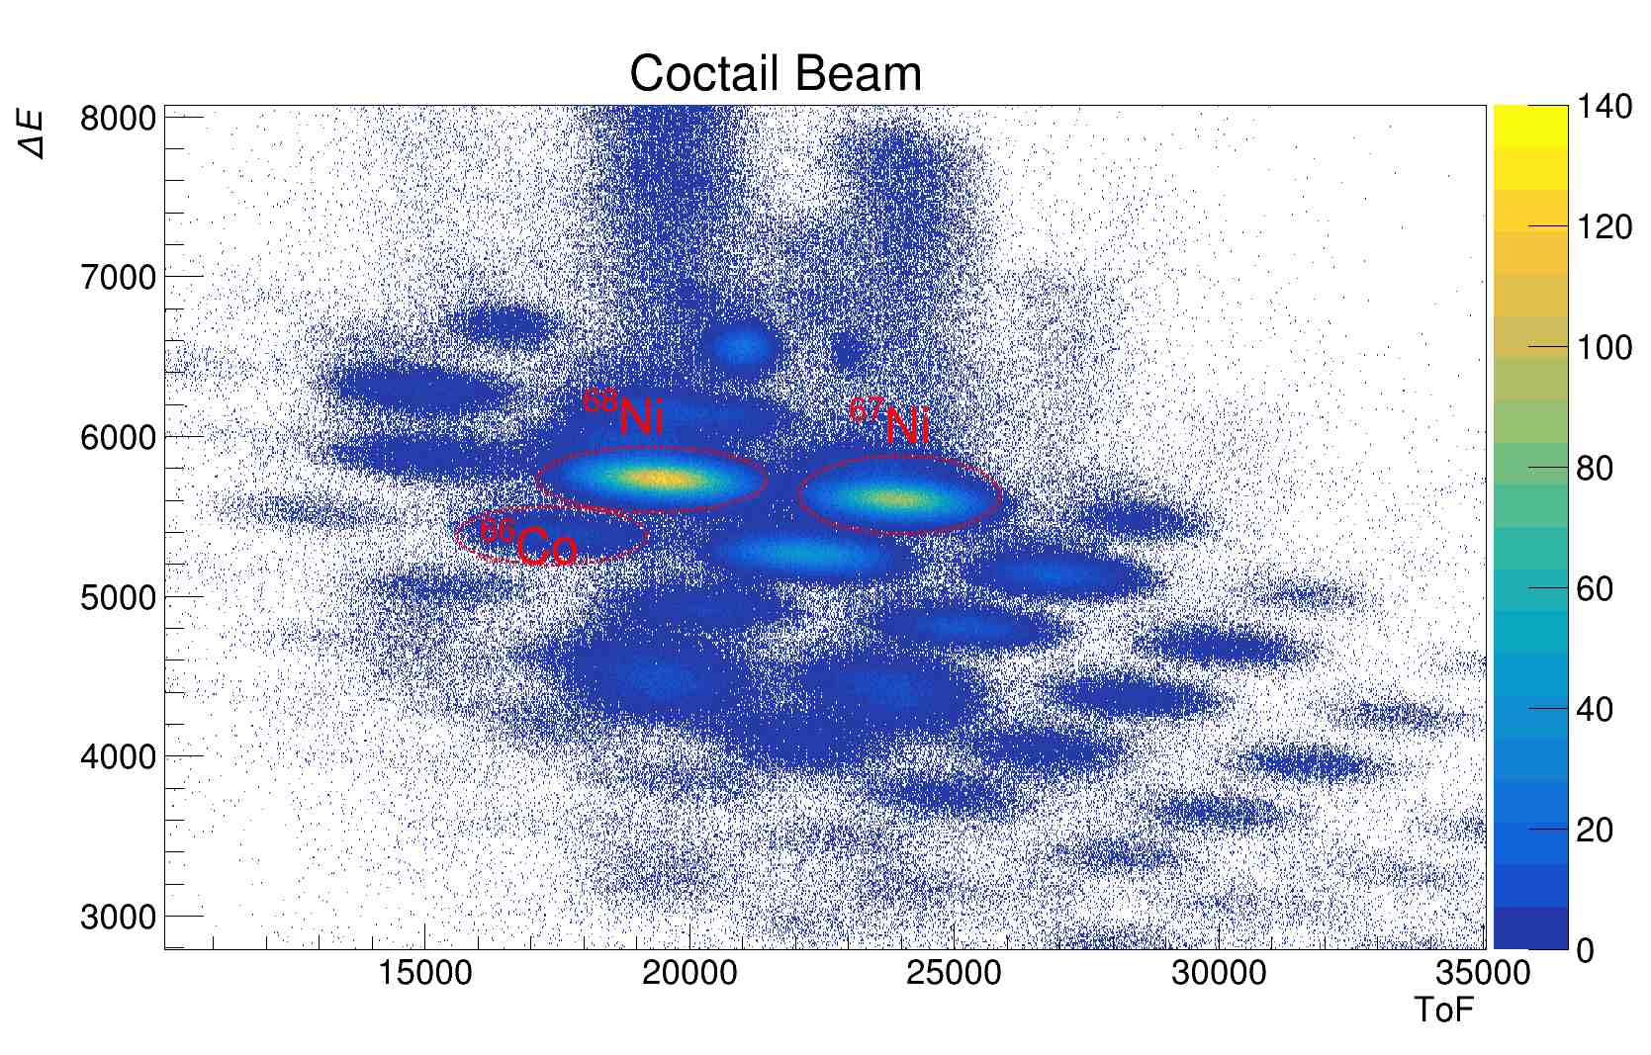
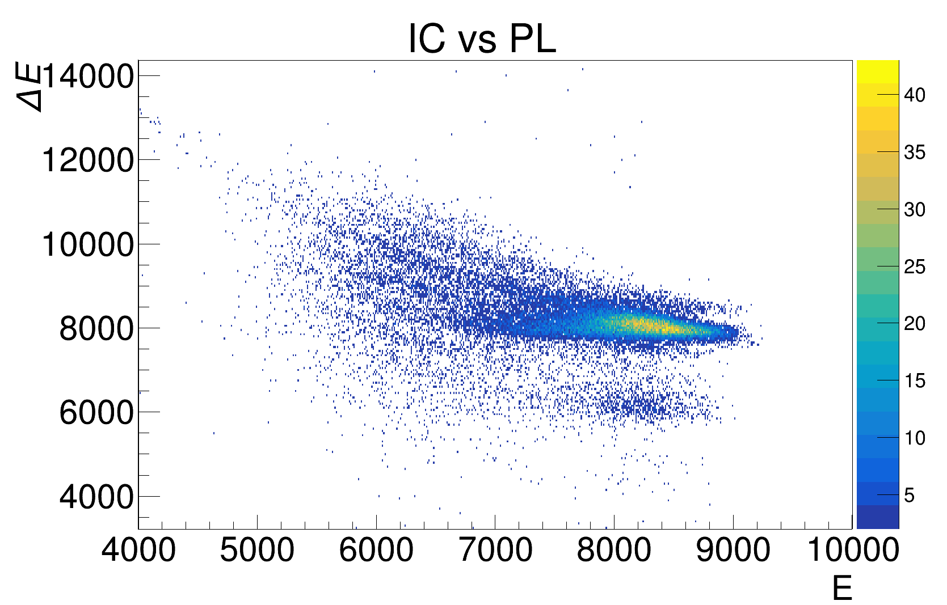
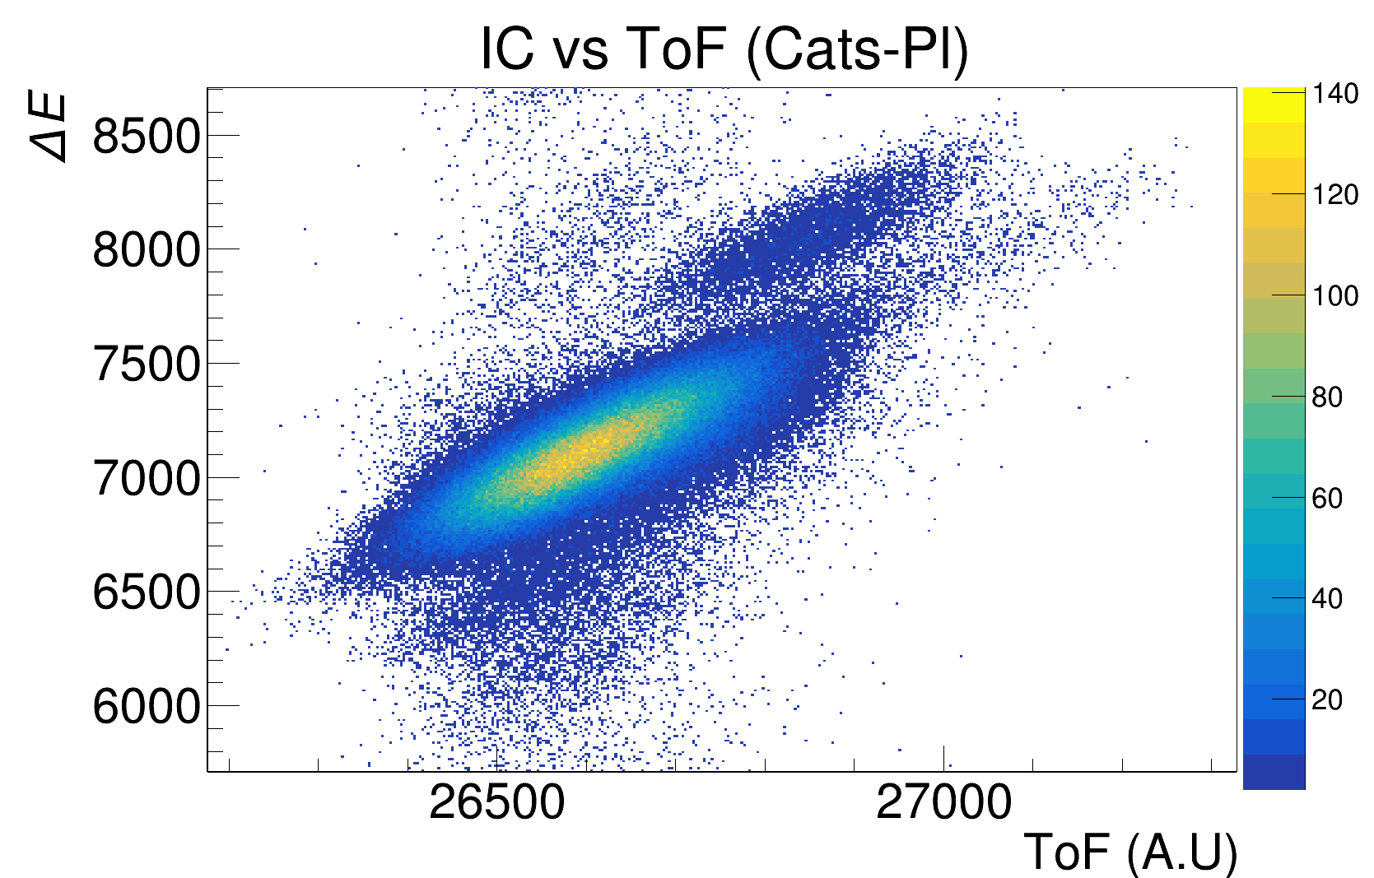
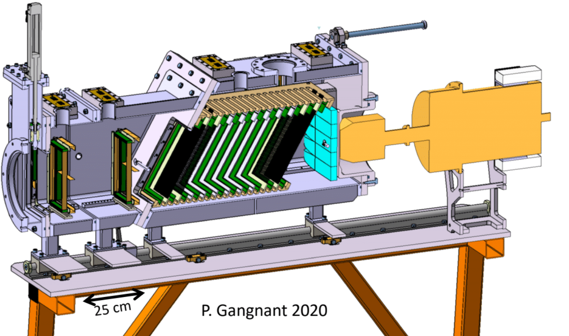
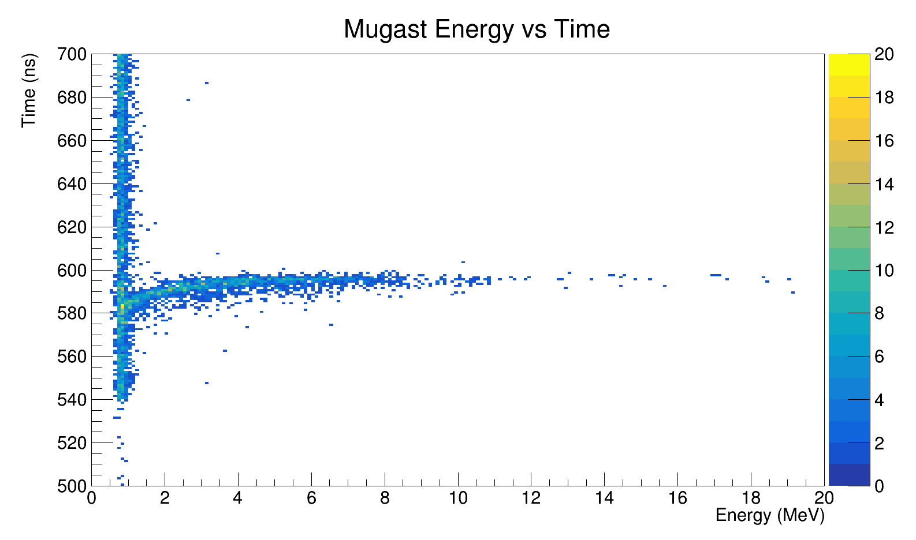
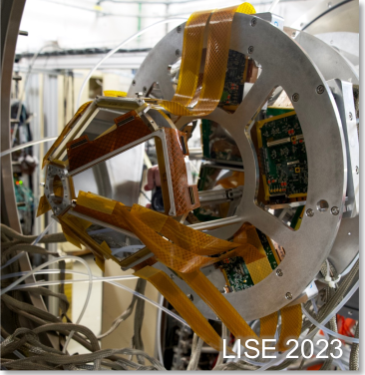
PID and particle detection

Slide 7
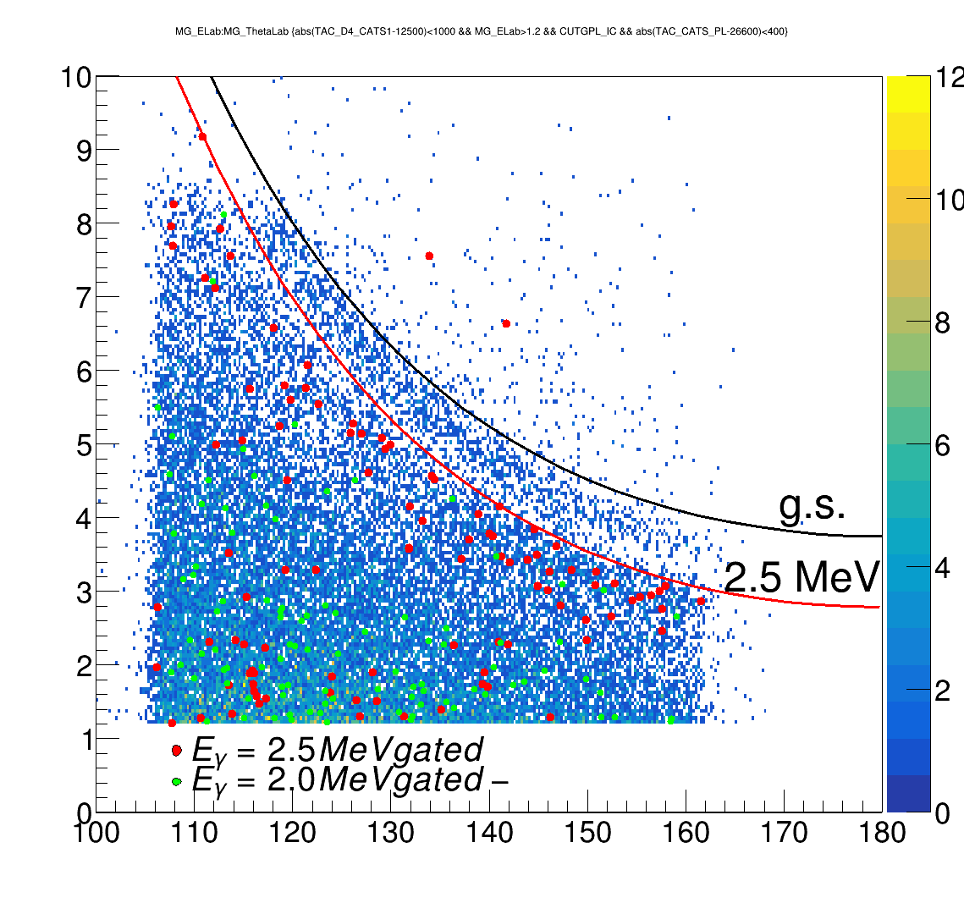
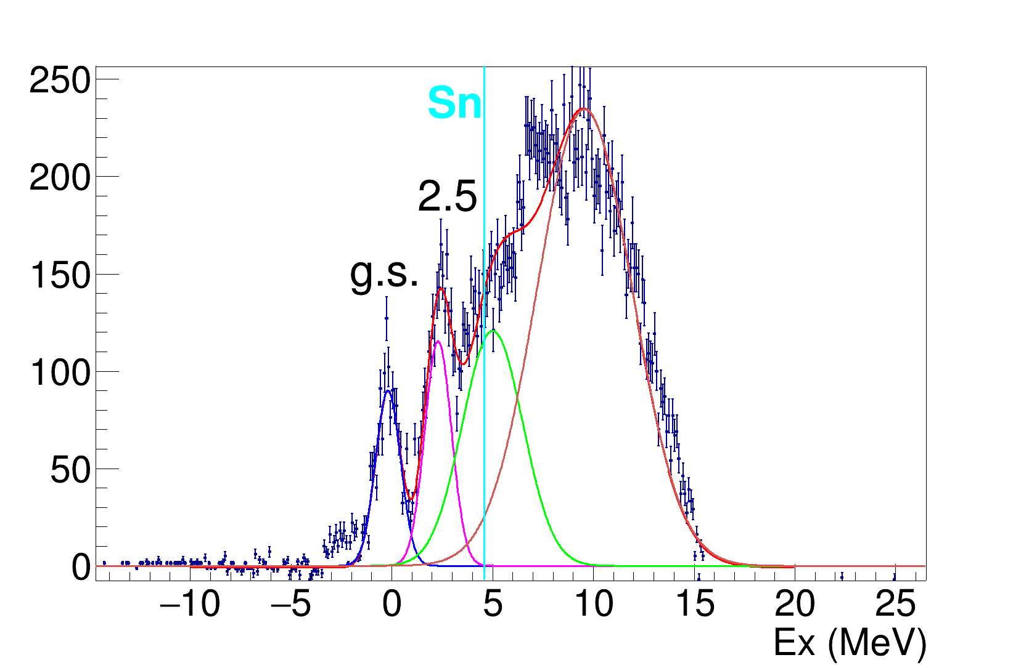
Kinematic lines
Ex

Slide 8
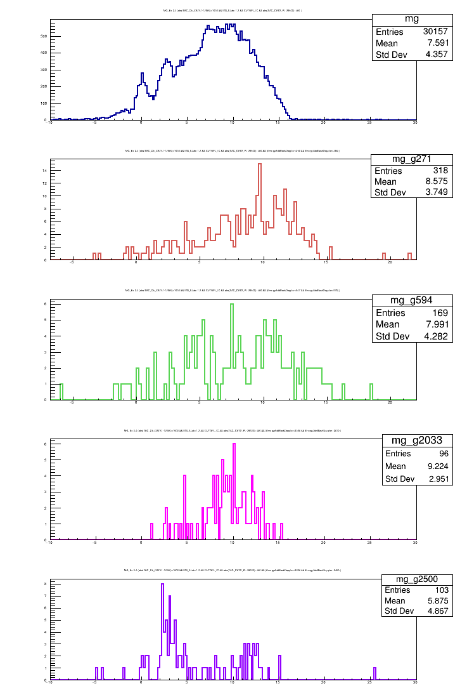
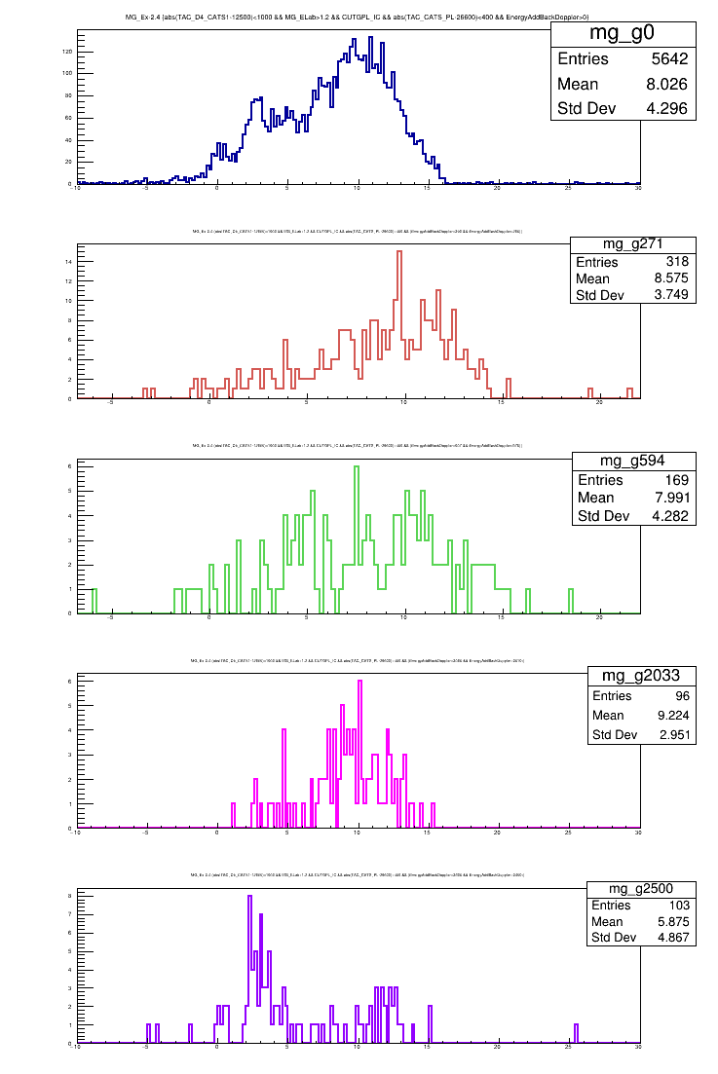
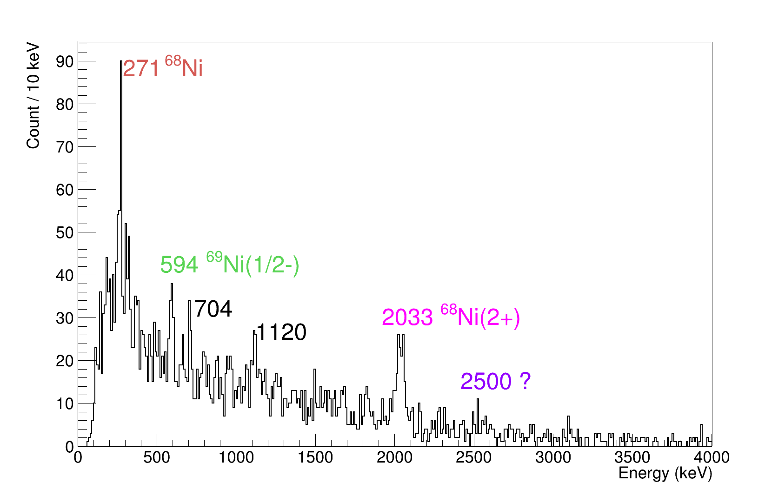
Ex vs Gamma
(17/2⁻)
0.43 μs
2700
(13/2⁻)
148
2552
(13/2⁺)
311
2241
594
(9/2⁻)
1959
1044
2241
(5/2⁻)
1959
915
594
(1/2⁻)
3.5 s
321
(9/2⁺)
0.0

Slide 9
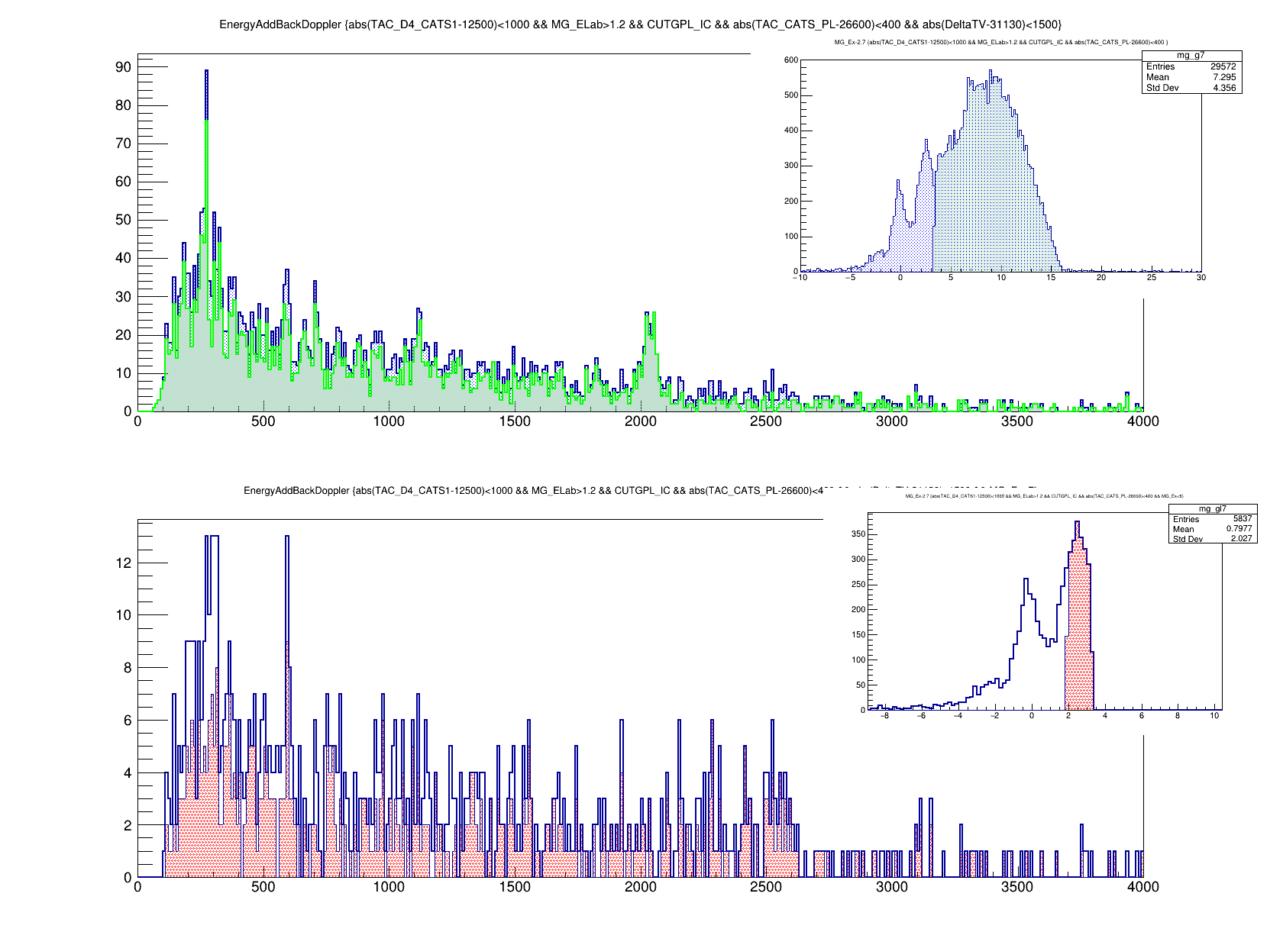
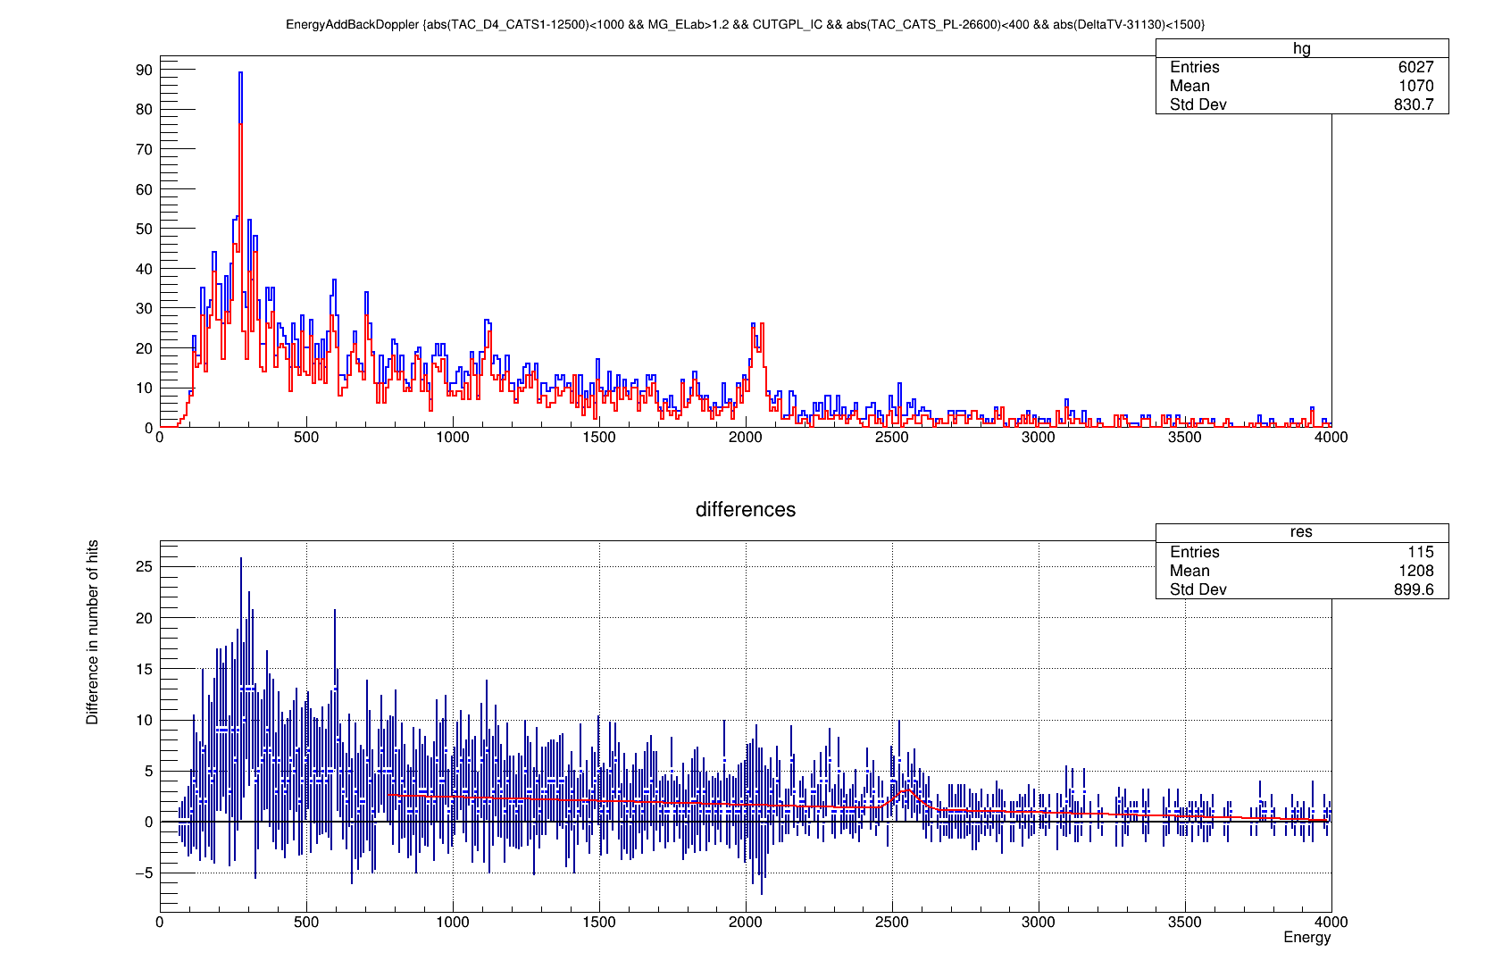

Slide 10
Summary
We re-measured the ⁶⁸Ni(p,d)⁶⁹Ni reaction for spectroscopy of the neutron particle states with upgraded setup, slow- downed beam, new detectors and thin target.
24 UTs are requested for the physics measurement and 5 UTs for the tuning, in total 29 UTs.

Slide 11
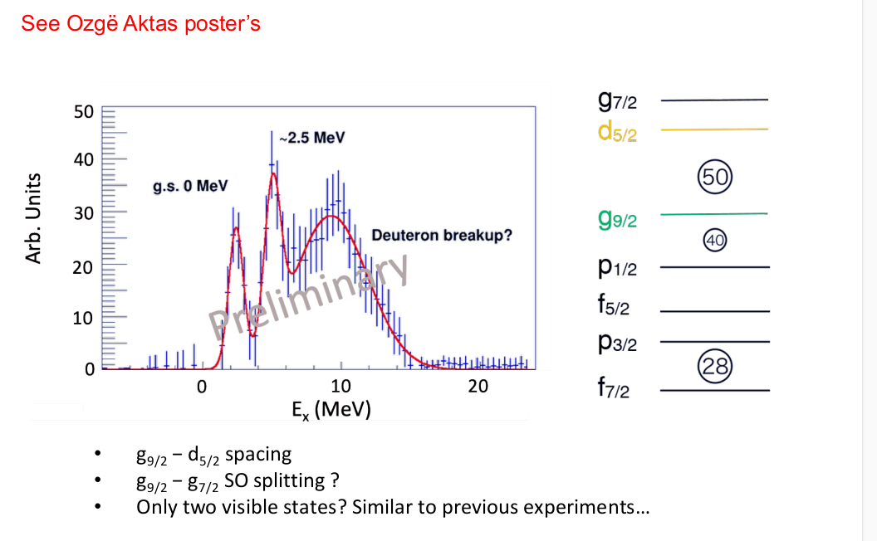
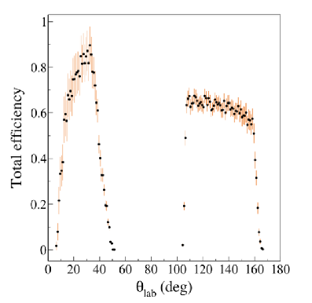
Recoil particle detection
30 15
25
(MeV)
(d,p)
(MeV)
20
10
(p, d) with
15 40 MeV/u
Elab
10
(d, t) with
18 MeV/u
Elab
5
g.s.
5
9.0 MeV
2.8 MeV
0
0
0 10 20 30 40 50
_{lab} (deg.)
100
120 140 160 180
_{lab} (deg.)
×10³
15
(p,d)
200
(d,p)
Current Previous
150
10
Counts
100
delayed γ-coin.
MUST2
GRIT
5
50
0
0
−2 −1 0 1 2
E_{x} (MeV)
3
4
−2 −1 0 1 2 3
4
E_{x} (MeV)
σ(Ex) = 0.14 MeV
σ(Ex) = 0.25 MeV
10

