Slide 1
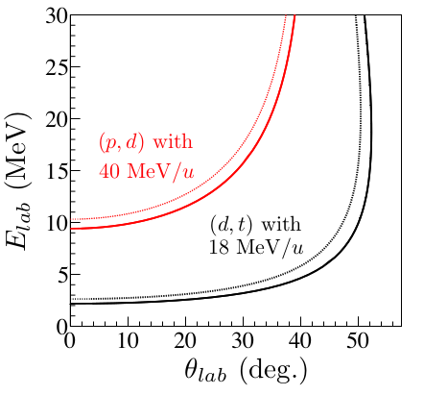
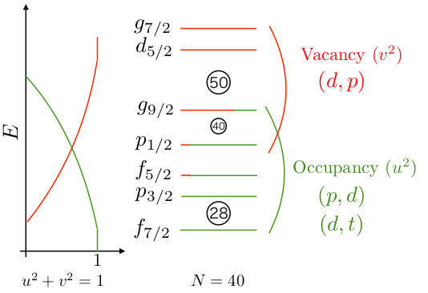
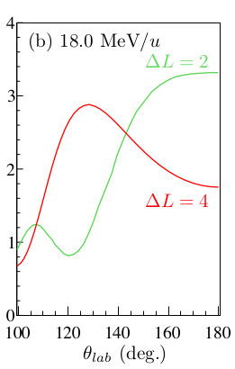
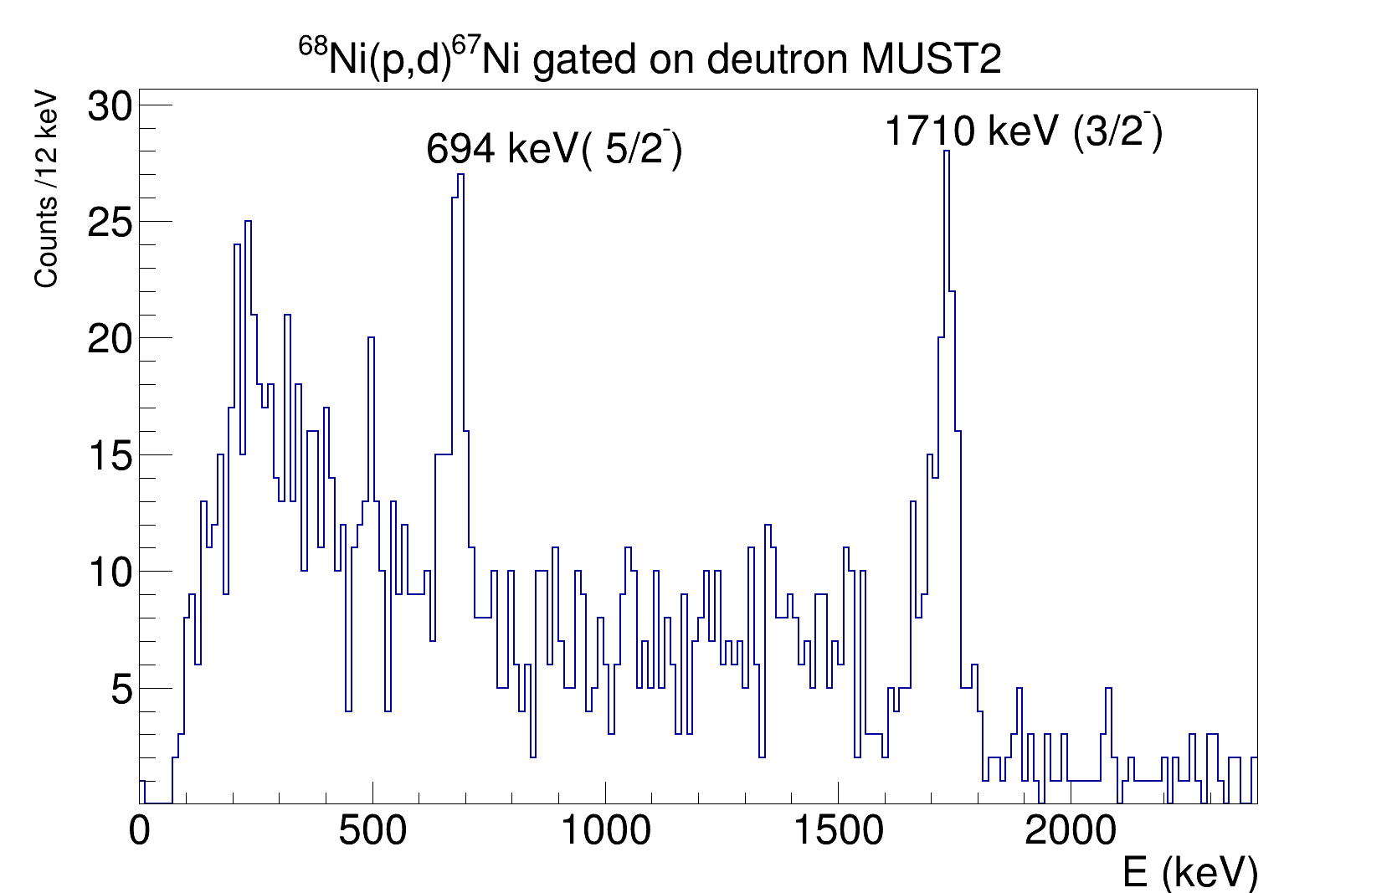
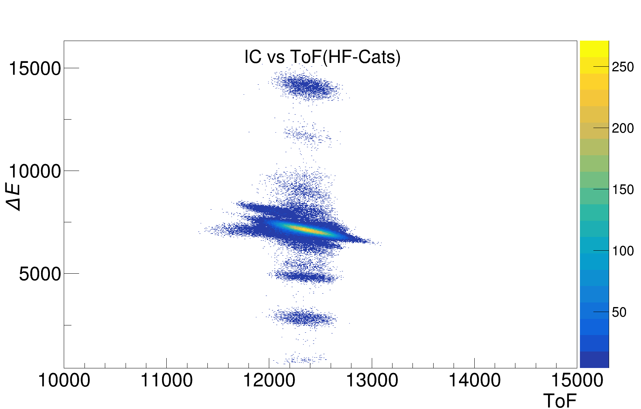
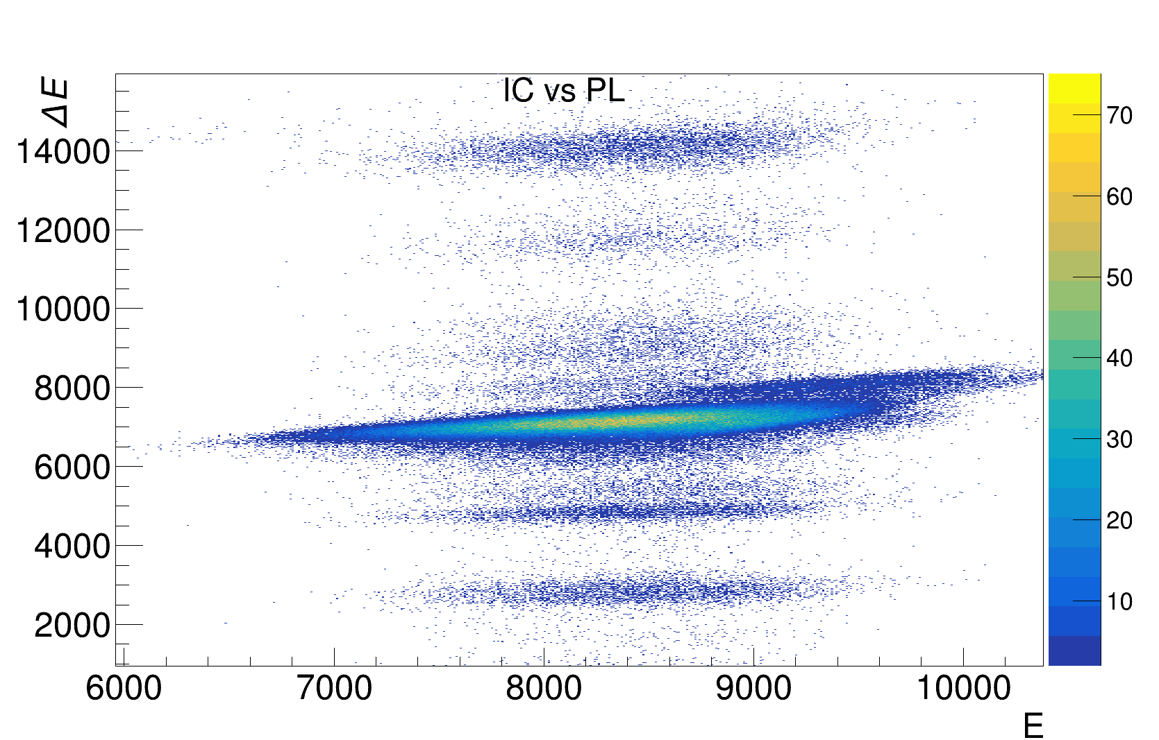

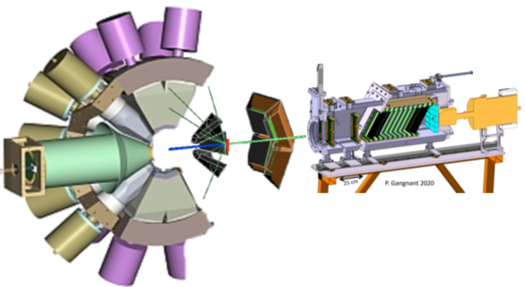
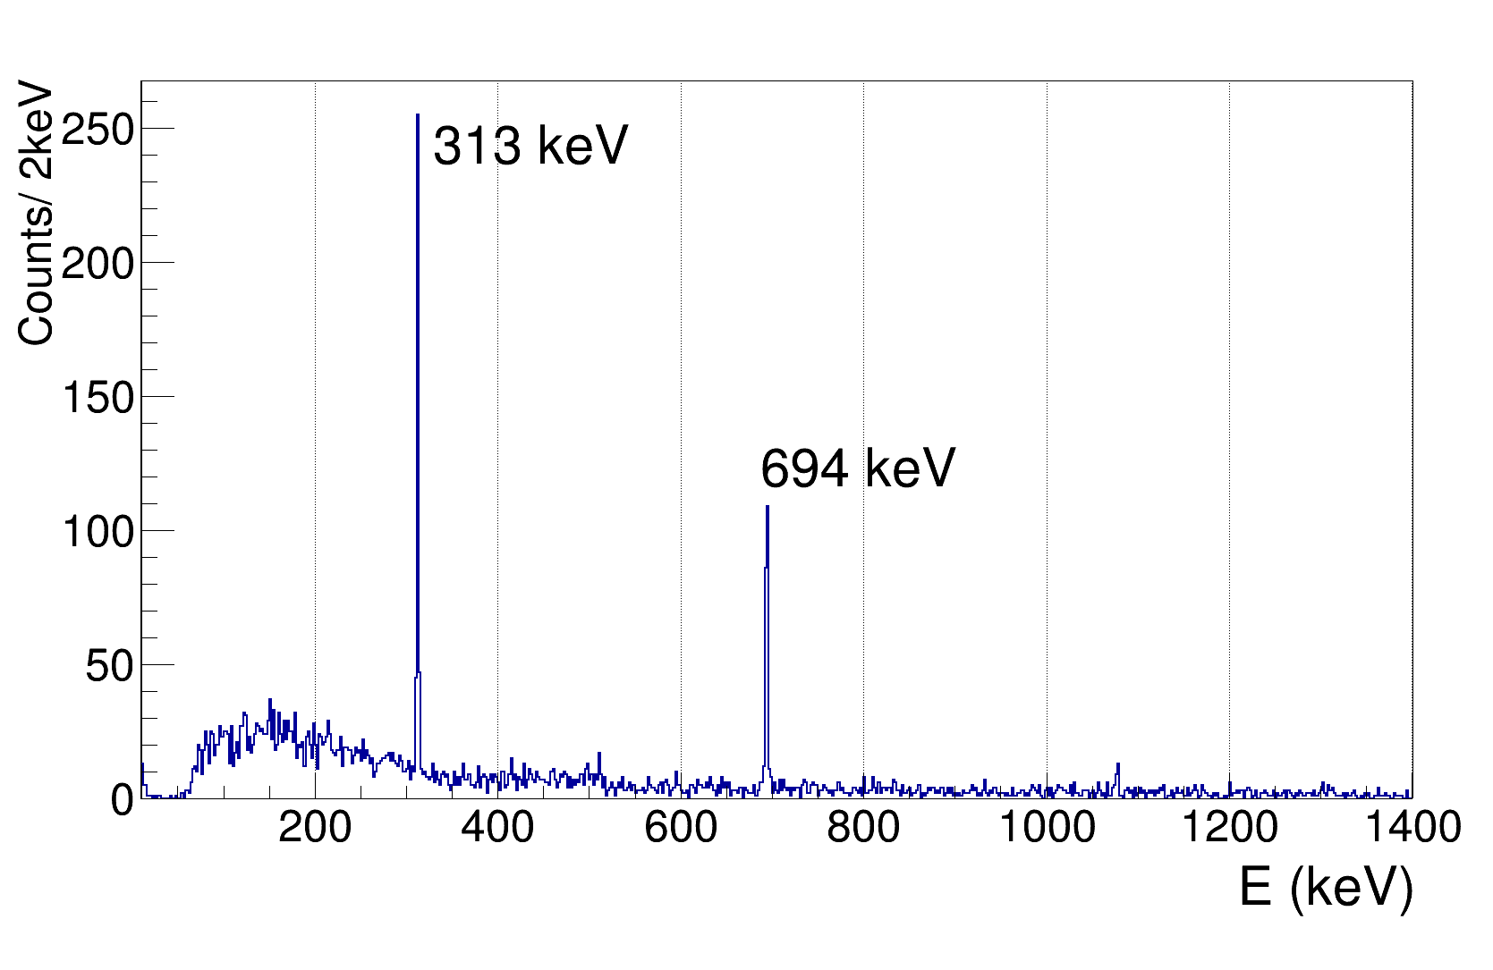
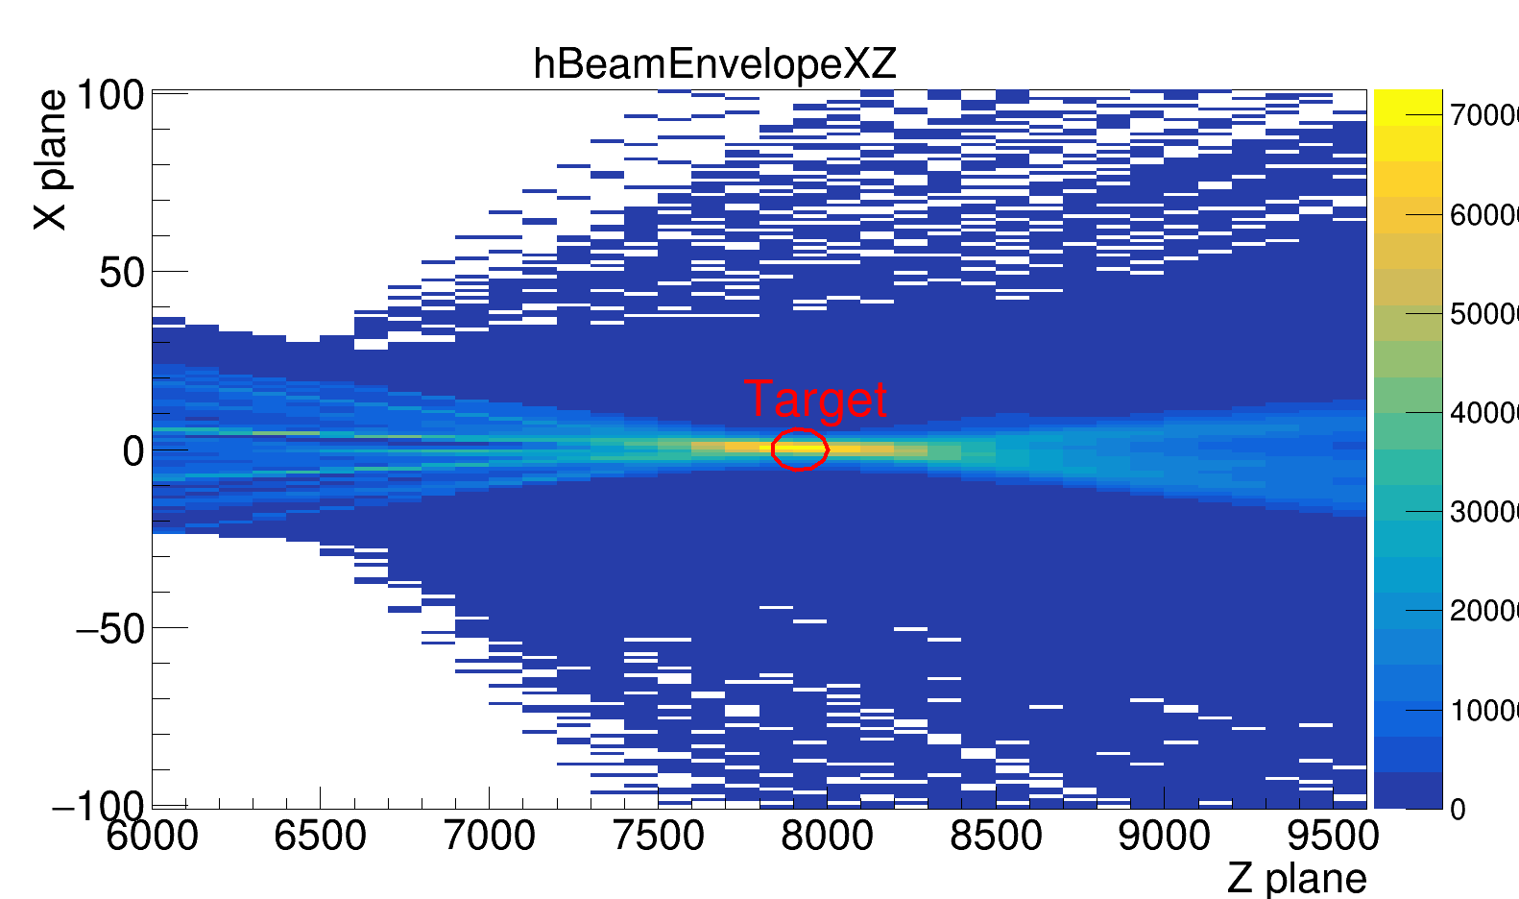
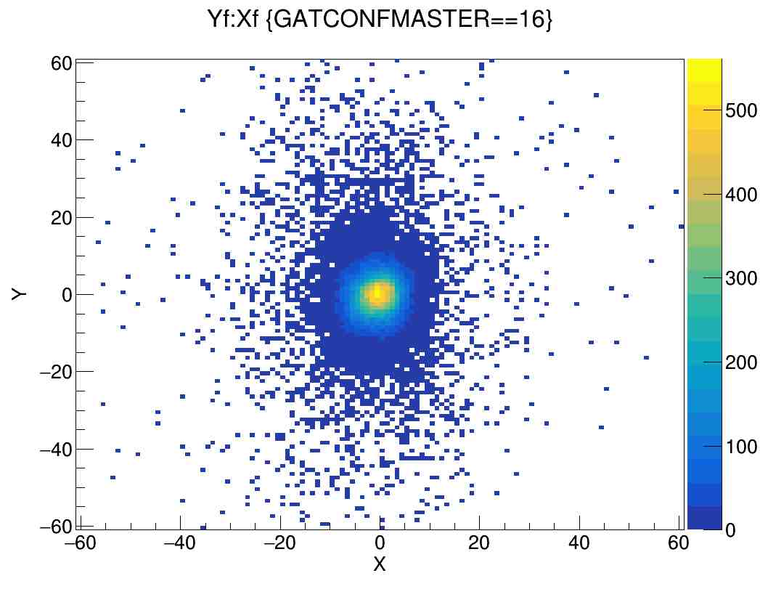
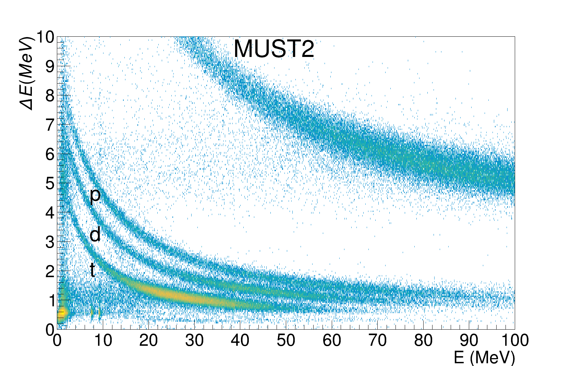
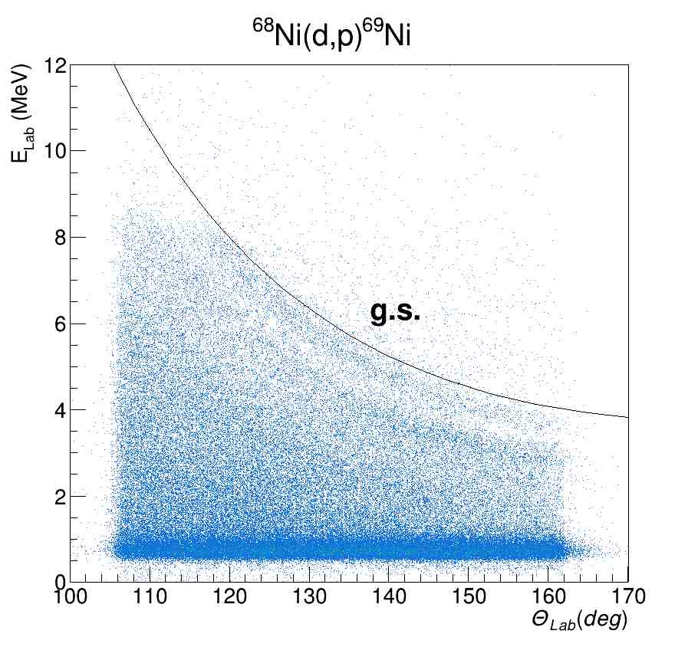
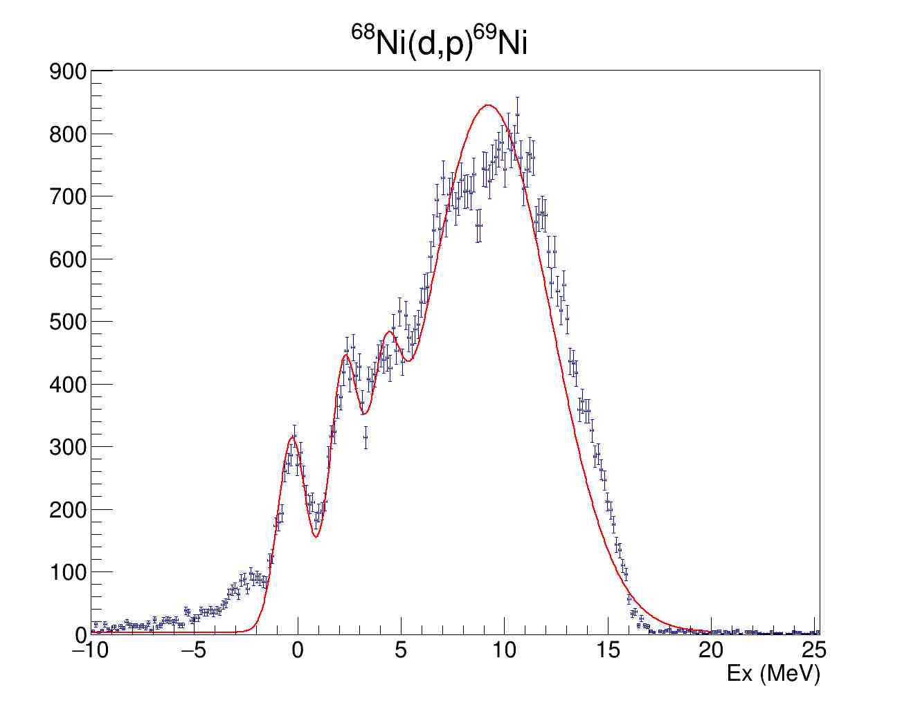
Study the Neutron Shell Structure of ⁶⁸Ni via Missing Mass Spectroscopy
Authors…
Affiliations...
Introduction
The motivation is to investigate the diffuseness of the neutron Fermi surface at the neutron number N=40 with ⁶⁸Ni(p,d)⁶⁷Ni reaction and study N=50 gap with ⁶⁸Ni(d,p)⁶⁹Ni reaction.
3/2⁻
1710
With ⁶⁸Ni(dp)⁶⁹Ni,
the spacing between the g9/2 and d5/2 neutron orbitals at N=40, and evolution of the N=50 shell gap
13.3 μs 9/2⁺
1007
(17/2⁻)
0.43 μs
2700
1710
5/2⁻
313
(13/2⁻)
148
2552
697
697
(13/2⁺)
311
593
2241
(9/2⁻)
1959
1/2⁻
${{}_{28}^{67}{Νi}}_{39}$
0.0
1044
2241
With ⁶⁸Ni(d,t)⁶⁷Ni & ⁶⁸Ni(p,d)⁶⁷Ni,
the occupancy of the f-p shells
also partial occupancy of the 1g9/2
The SO splitting of the 2p, 1f and 1g
neutron orbitals in ⁶⁸Ni
(5/2⁻)
1959
915
(1/2⁻)
3.5 s
594
DWBA calculations for 2.8 MeV state
(9/2⁺)
321
Figure 1: Occupancy and Vacancy for N=40 nuclei [1]
${{}_{28}^{69}{Νi}}_{40}$
0.0
Experimental Setup
⁷⁰Zn (62 MeV) + ⁹Be (500 μm) → ⁶⁸Ni (@LISE)
γ
γ
EXOGAM:
12 HpGe Clovers
In beam γ measurement
⁶⁸Ni
⁶⁹Ni ⁶⁷Ni
Beam @ LISE:
5x10⁴ pps ,~18 MeV/u
2x10⁵ pps, ~38 MeV/u
γ
(E3,p3)
γ
(m1,0)
(E4,p4)
67Ni isomer 13.3 μs
Targets:
CD2 (0.5 mg / cm²)
CH2 (5 mg / cm²)
Missing mass:
proton, deutron, ...
CATS1 &2
Secondary beam E=10-50 MeV
For reconstructed beam position on target
ToF
⁶⁸Ni
Target:
CD2, CH2
For (d,t) &(p,d)
4 MUST2 telescope
@ 5º – 40º
80% acceptance
ZDD:
Drift Chambers (DC) for XY measurement-
5 tilted foils ionizing chambers (IC) for ΔE
5 Plastic Scintillators (PL) for Energy and clean up the reaction residue.
1 Exogam Clover (HpGe) for the isomeric decays
For (d,p)
5 trapezoidal DSSDs (GRIT)/ MUGAST
@ 110º-170º,
60% acceptance
Results & Conclusion
The experiment was successfully performed in May 2023, around 22 UT beam time was used for the physics data. Two different beam energies are used for CD2 and CH2 target. Also Carbon target is used for the background information. The preliminary results for Kinematics and Missing mass excitation energies are shown in below Figures.
References
[3] J. Diriken et al, PRC 91 054321

Slide 2
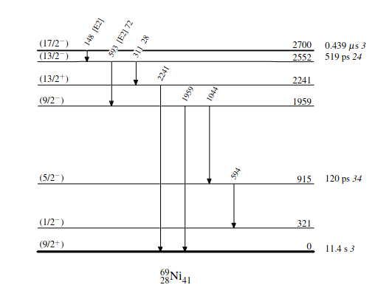
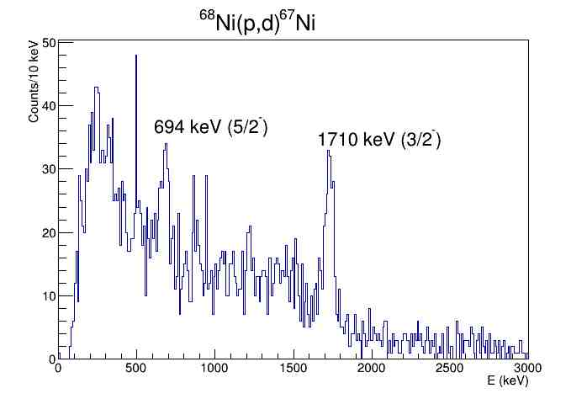
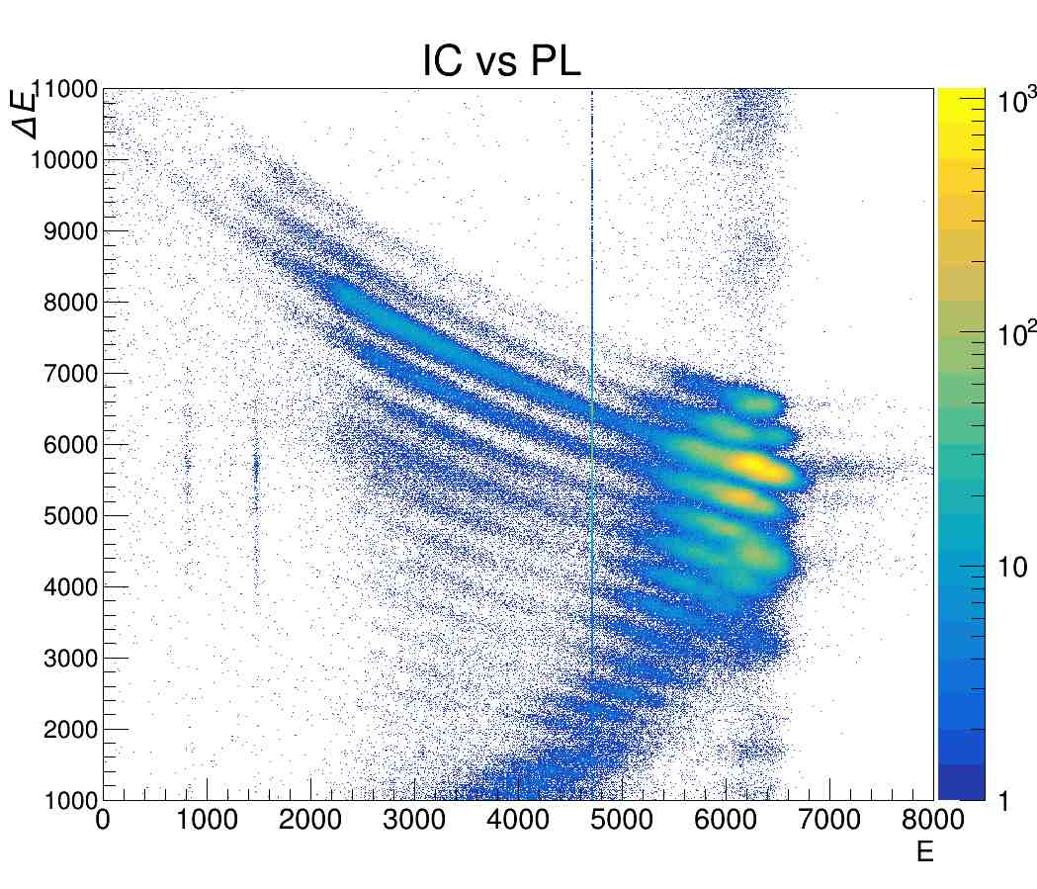
In ⁶⁸Ni(d,p)⁶⁹Ni reaction with determining the 2d5/2 strength, the spacing between the g9/2 and d5/2
neutron orbitals at N=40 is investigated.
The reaction was studied before and 2d5/2 is measured at 2.5 MeV [2].
The state is suggested to be doublet at 2.1 and 2.8 MeV.
The aim is to determine the excitation energies and confirm the ΔL of 2.8 MeV state, Figure 2.
1) The spacing between the g9/2 and d5/2 neutron orbitals at N=40, which can give insight into the evolution of the N=50 shell gap in the neutron-rich 78Ni nucleus.
2) The spin-orbit splitting of the 2p, 1f and 1g neutron orbitals in 68Ni, which can be compared to other Nickel isotopes.
3) The occupancy of the neutron orbitals in 68Ni, especially the fp shells but also the possible partial occupancy of the g9/2 orbital.
In neutron removal ⁶⁸Ni(d,t)⁶⁷Ni and ⁶⁸Ni(p,d)⁶⁷Ni reactions, we aimed to measure the occupancy of the neutron orbitals in ⁶⁸Ni,
especially the f-p shells but also the possible partial occupancy of the 1g9/2 orbital using the prompt-delay γ-ray spectroscopy.
The cross sections directly populated hole state in 67Ni measured using the known first four states from Ref [3].
Motivation :
The motivation is to investigate the diffuseness of the neutron Fermi surface at the neutron number N=40 with 68Ni(p,d)67Ni reaction and study N=50 gap with 68Ni(d,p)69Ni reaction.
1) The spacing between the g9/2 and d5/2 neutron orbitals at N=40, which can give insight into the evolution of the N=50 shell gap in the neutron-rich 78Ni nucleus.
2) The spin-orbit splitting of the 2p, 1f and 1g neutron orbitals in 68Ni, which can be compared to other Nickel isotopes. This could help explain some anomalies seen in previous studies.
3) The occupancy of the neutron orbitals in 68Ni, especially the fp shells but also the possible partial occupancy of the g9/2 orbital.
In the experiment we used the 68Ni(d,p)69Ni and 68Ni(d,t)67Ni reactions in inverse kinematics at 18 MeV/u and the 68Ni(p,d)67Ni reaction at 40 MeV/u. We detected ejectiles and recoils with MUGAST detectors and gamma rays with EXOGAM2. The setup also includes a new Zero Degree Detection system.
3/2⁻
1710
17/2⁻
0.43 μs
2700
13/2⁻
148
311
2552
13/2⁺
593
2241
13.3 μs 9/2⁺
1007
9/2⁻
1959
1710
5/2⁻
313
1044
697
697
2241
5/2⁻
1959
915
1/2⁻
0.0
594
1/2⁻
3.5 s
321
9/2⁺
0.0
MUGAST@LISE Setup LISE2023
CATS1 &2
Secondary beam E=10-50 MeV
For reconstructed beam position on target
ToF
For (d,t) &(p,d) reactions
4 MUST2 telescope
@ 5º – 40º
80% acceptance
Pair of Drift Chambers (DC) for XY position measurement
10 tilted foils ionizing chambers coupled (IC) for ΔE energy loss and the PID
5 Plastic Scintillators for Energy and clean up the reaction residue.
1 Exogam Clover (HpGe) for tagging the isomeric decays
For (d,p) reaction
5 trapezoidal DSSDs (GRIT)
@ 110º-170º,
60% acceptance
Figure 3 : DWBA calculations for 2.8 MeV state with ΔL =2 and 4 [1].
Figure 4 : Kinematics of 67Ni g.s. (solid) and 1.& MeV e.s. shown for two different reaction [1]

