Slide 1
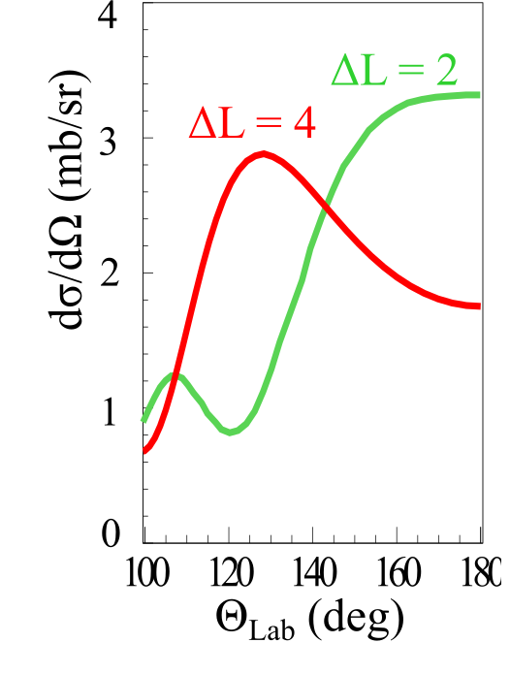
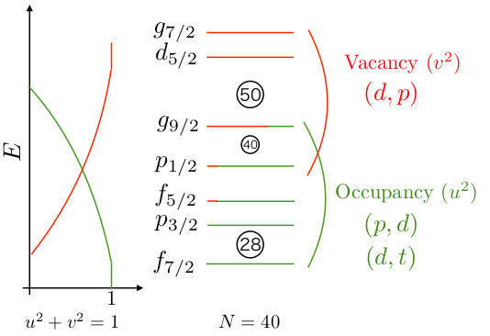
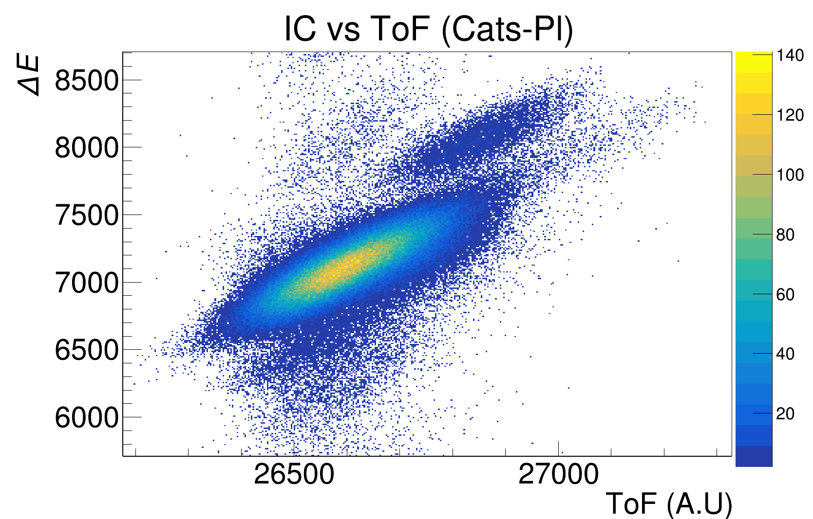
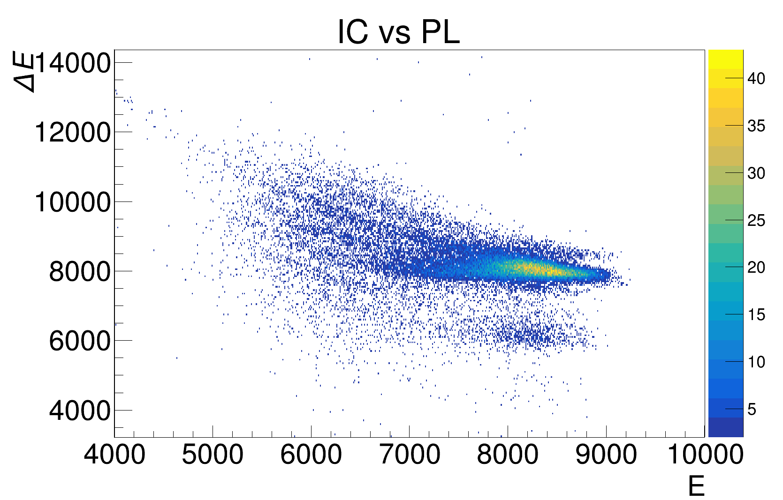

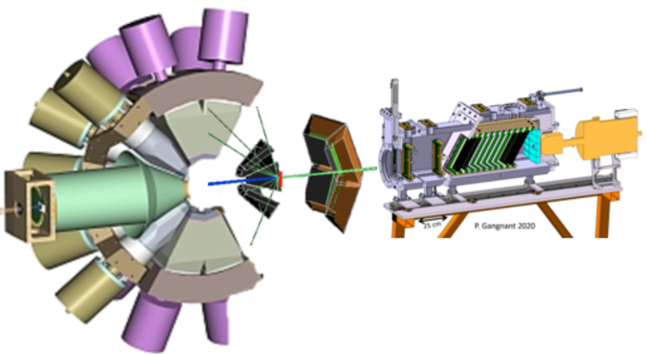
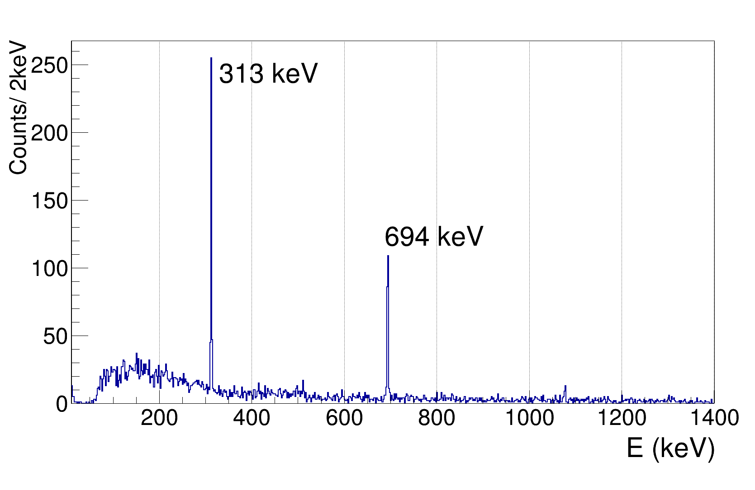
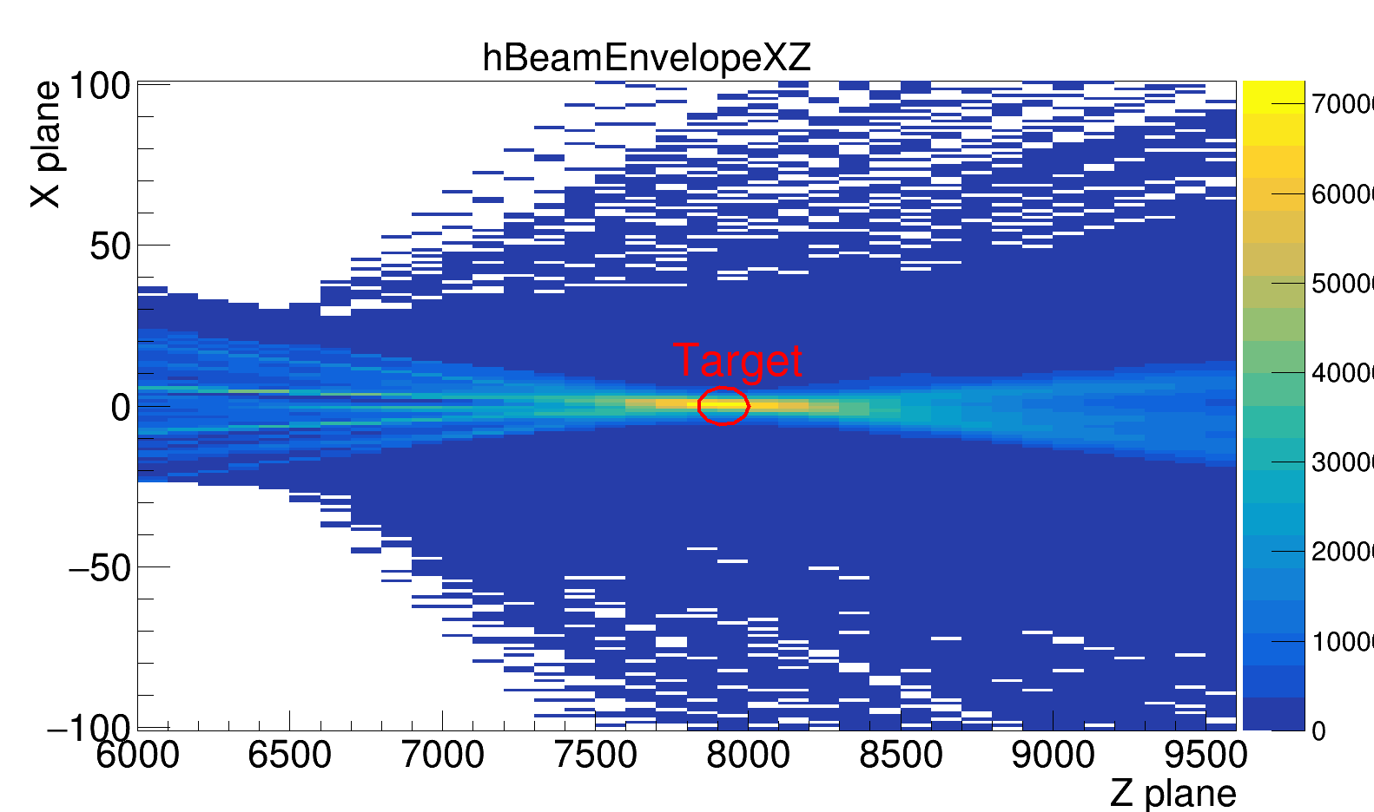
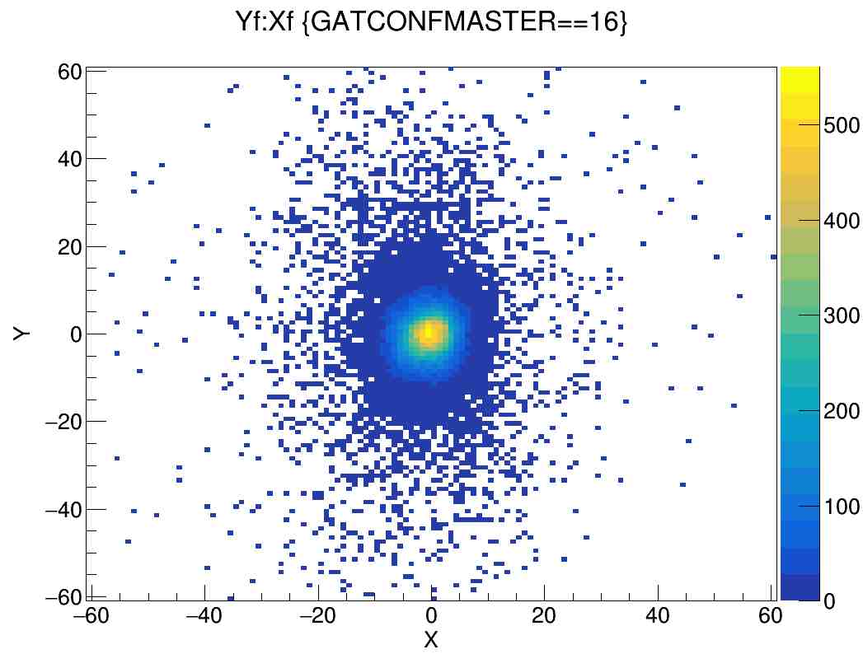
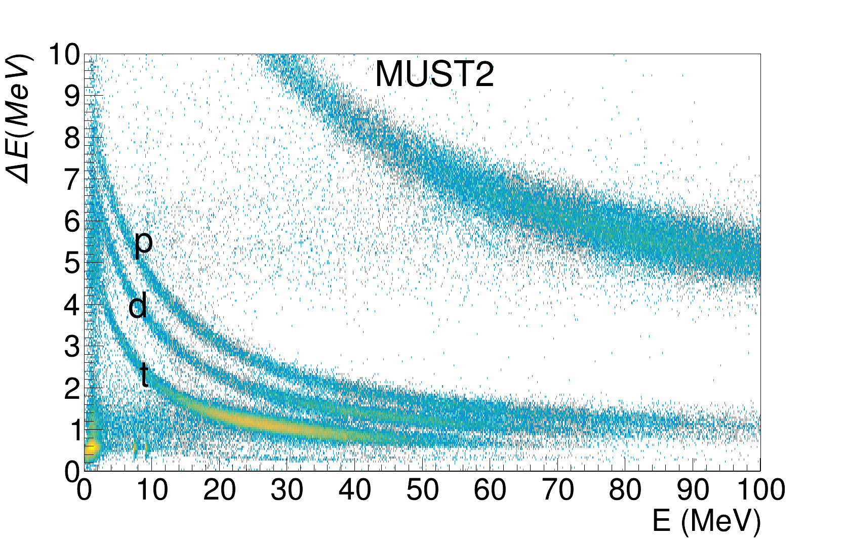
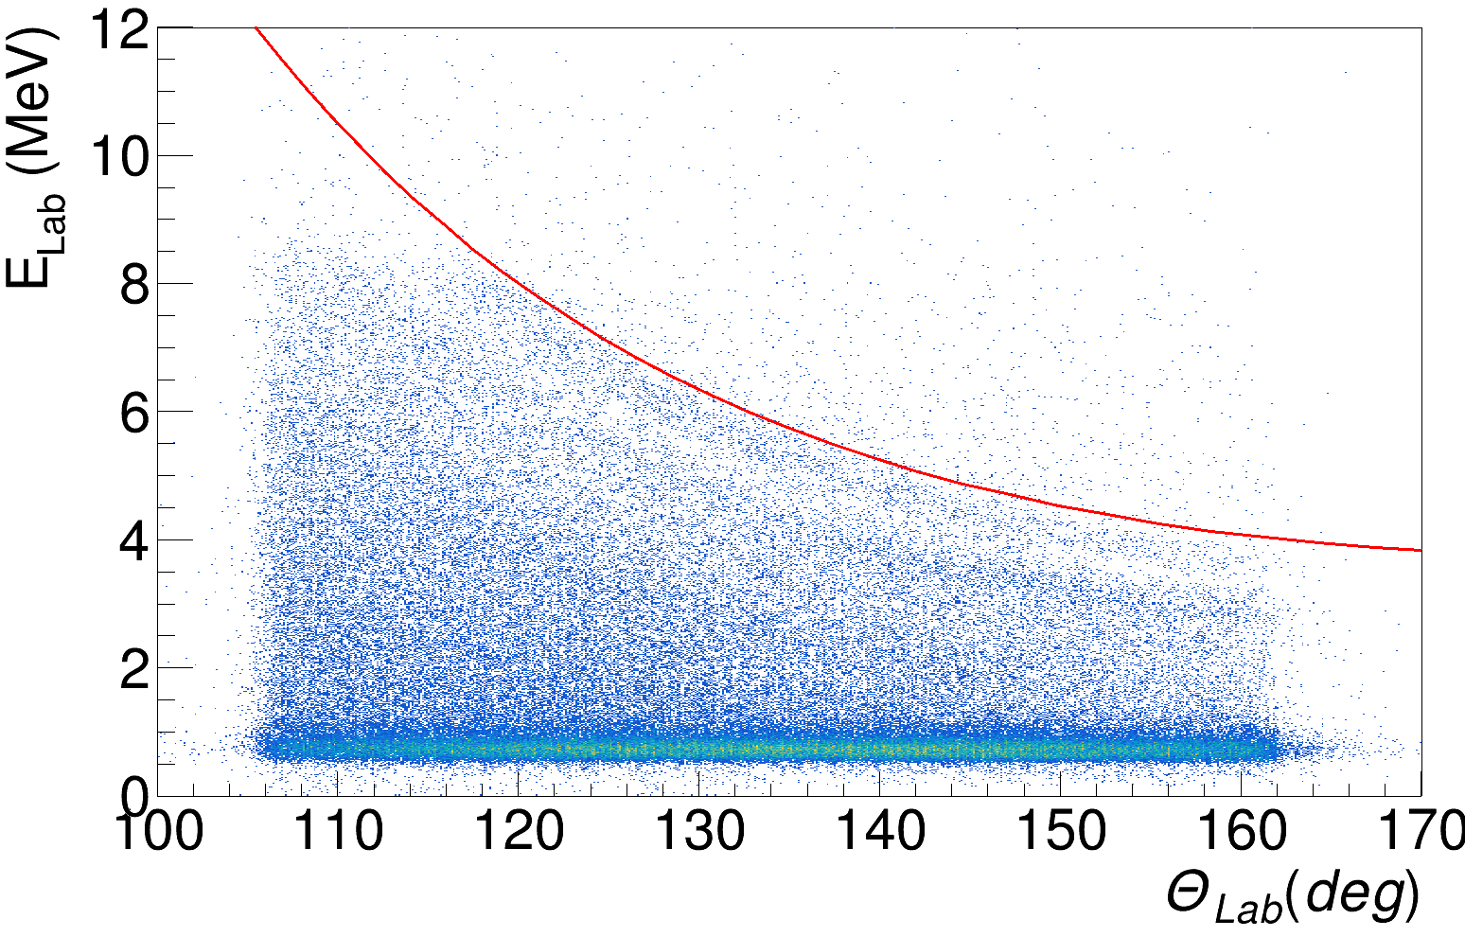
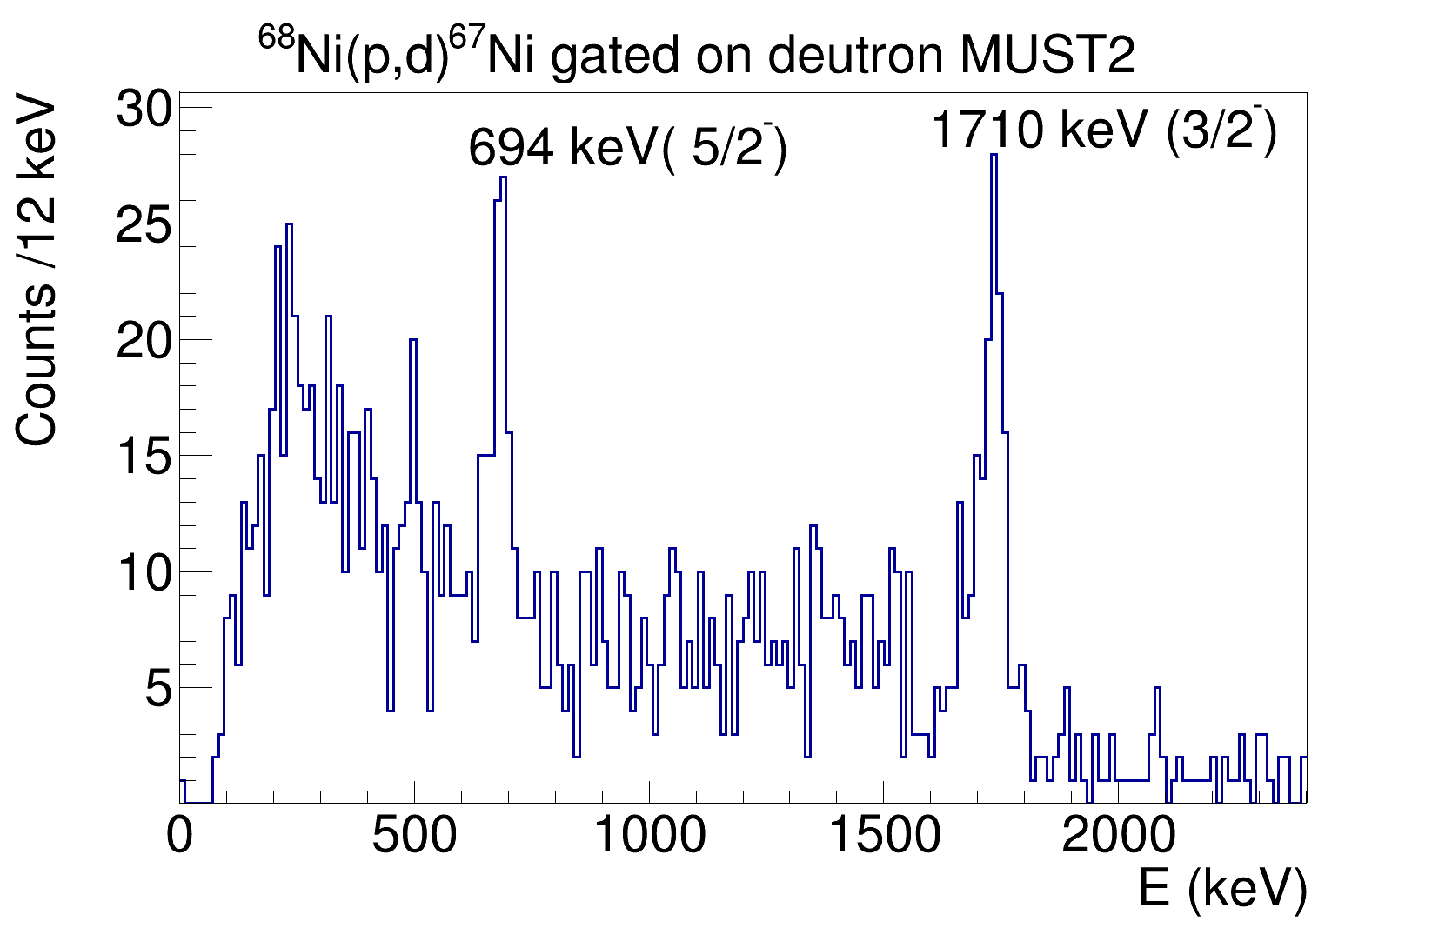
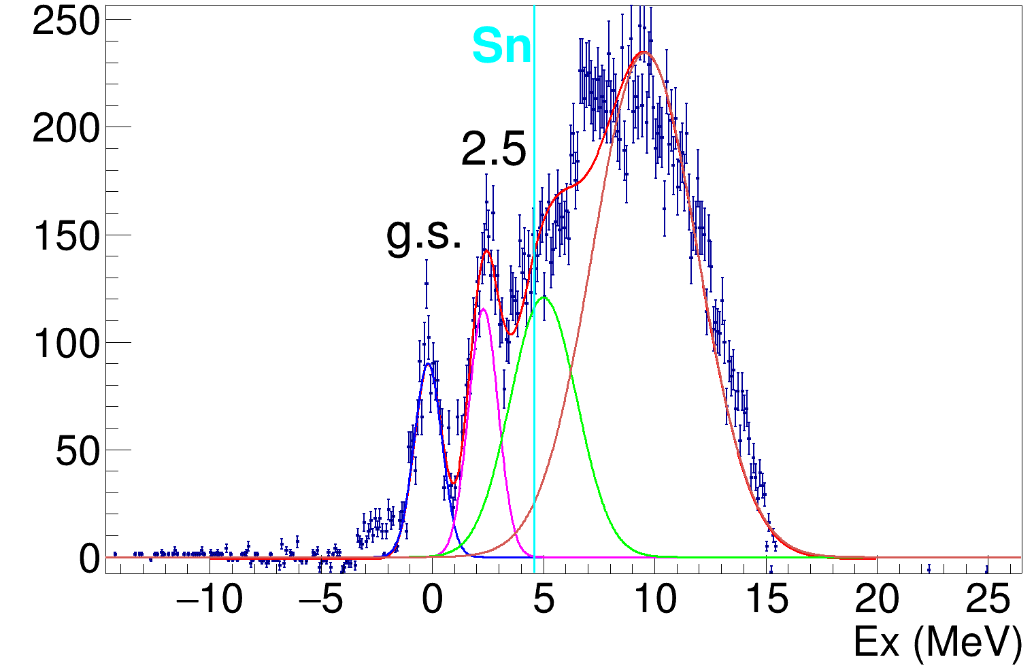
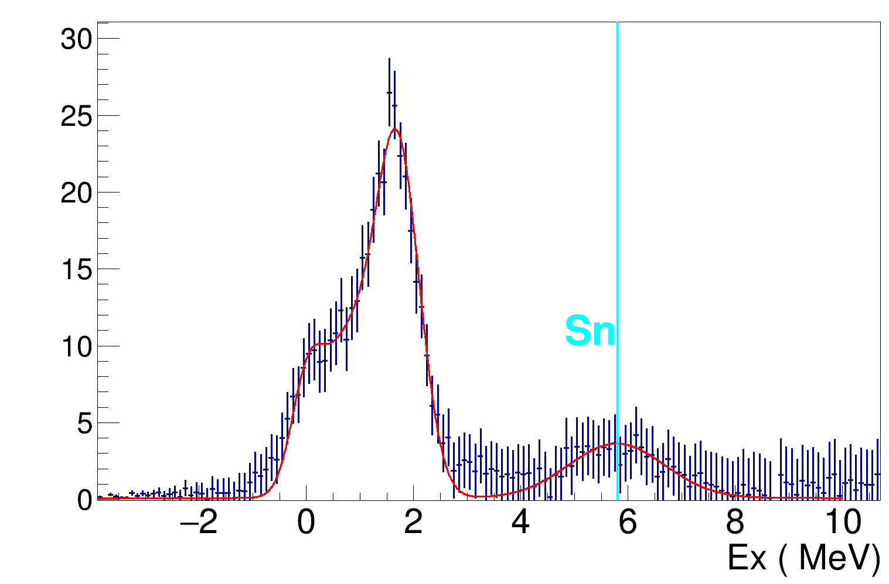
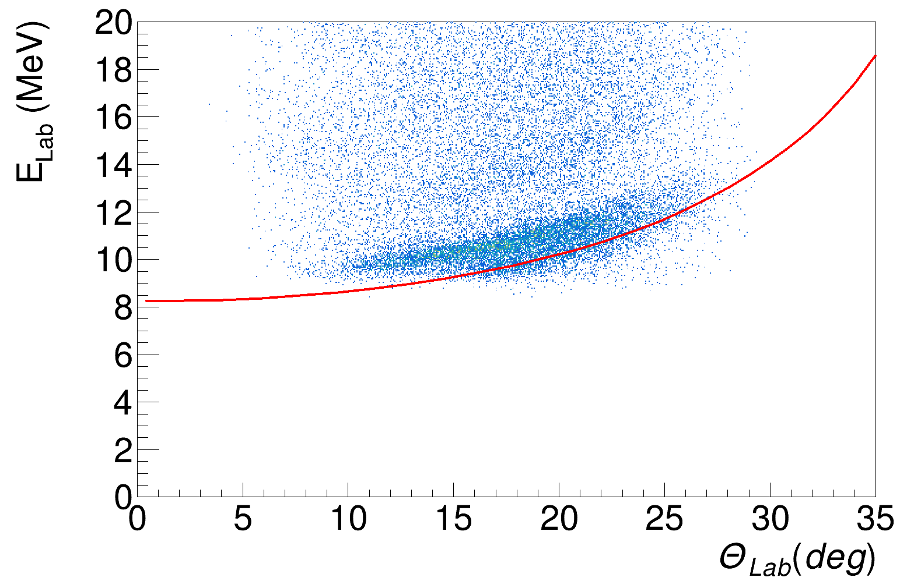




Study the Neutron Shell Structure of ⁶⁸Ni
via Missing Mass Spectroscopy
Ö.Aktas¹, S. Koyama¹, O. Sorlin¹,M. Assié², V. Girard-Alcindor², H. Jacob², Q. Delignac³,
and MUGAST@LISE Collaboration
¹GANIL CEA/DRF-CNRS/IN2P3, B.P. 55027, 14076 Caen, France,
² IJCLab Université Paris- Saclay, CNRS/IN2P3 91406 Orsay, France,
³ LP2I Laboratoire de Physique des 2 infinis 33170 Bordeaux, France
Introduction
The motivation is to investigate magicity at N=40, shell gap at N=50, and SO splittings of pfg shells in ⁶⁸Ni using neutron adding and removal reactions in inverse kinematics.
3/2⁻
1710
(17/2⁻)
0.43 μs
2700
(13/2⁻)
148
2552
(13/2⁺)
311
593
2241
13.3 μs 9/2⁺
1007
(9/2⁻)
1959
1710
5/2⁻
313
697
1044
697
2241
(5/2⁻)
1959
915
1/2⁻
0.0
(1/2⁻)
3.5 s
594
${{}_{28}^{67}{Νi}}_{39}$
(9/2⁺)
321
States of ⁶⁷Ni expected to populated by ⁶⁸Ni(d,t)⁶⁷Ni & ⁶⁸Ni(p,d)⁶⁷Ni reactions.
The observation of isomer is
linked to N=40 shell closure.
${{}_{28}^{69}{Νi}}_{40}$
0.0
DWBA calculations for L=2 and L=4. [1]
Level scheme of ⁶⁹Ni
Figure 1: Occupancy and Vacancy for N=40 nuclei [1]
We hope to identify 5/2⁺ leading to N=50 shell gap, and 7/2⁺ leading to SO splitting
Experimental Setup
⁷⁰Zn (62 MeV) + ⁹Be (500 μm) → ⁶⁸Ni (@LISE)
EXOGAM2:
12 HpGe Clovers
In beam γ measurement
γ
γ
⁶⁸Ni
⁶⁹Ni ⁶⁷Ni
For (d,p)
5 trapezoidal DSSSDs MUGAST @ 110º-170º,
60% acceptance
Beam @ LISE:
5x10⁴ pps ,~18 MeV/u
2x10⁵ pps, ~38 MeV/u
γ
(E3,p3)
γ
(m1,0)
(E4,p4)
Target:
CD2, CH2
Targets:
CD2 (0.5 mg / cm²)
CH2 (5 mg / cm²)
Missing mass:
Proton,
deuteron, triton
CATS1 &2
Secondary beam E=10-50 MeV
reconstructed position on target
Time of flight
67Ni isomer 13.3 μs
⁶⁸Ni
For (d,t) &(p,d)
4 DSSSDs & CsI
MUST2 @ 5º – 40º
80% acceptance
ZDD:
Drift Chambers (DC) for XY measurement
5 tilted foils ionizing chambers (IC) for ΔE
5 Plastic Scintillators (PL) for Energy and clean up the reaction residue.
1 Exogam Clover (HpGe) for the isomers
Results & Conclusion
The preliminary results from May 2023 for Kinematics and excitation energies (Ex) are shown from missing mass.
⁶⁸Ni(d,p)⁶⁹Ni
⁶⁸Ni(p,d)⁶⁷Ni
(a)
(b)
(a)
(b)
g.s.
2.7 MeV
(a) Kinematic curve for ⁶⁸Ni(d,p)⁶⁹Ni reaction.
(b) Ex spectrum displays some states on top of deuteron breakup above Sn, which will be subtracted later. Rough suppression of Carbon- induced reaction has been applied.
(a) Ex spectrum with the rough carbon component subtraction,insert deuteron gated g-ray spectrum shows that 2 excited states are populated. Further analysis will optimize Carbon subtraction.
(b) Kinematics of the ⁶⁸Ni(p,d)⁶⁷Ni reaction with calculated curve for the g.s. in red.
References
Fundings
[1] S. Koyama, e843_21 exp proposal,2021

