Slide 1
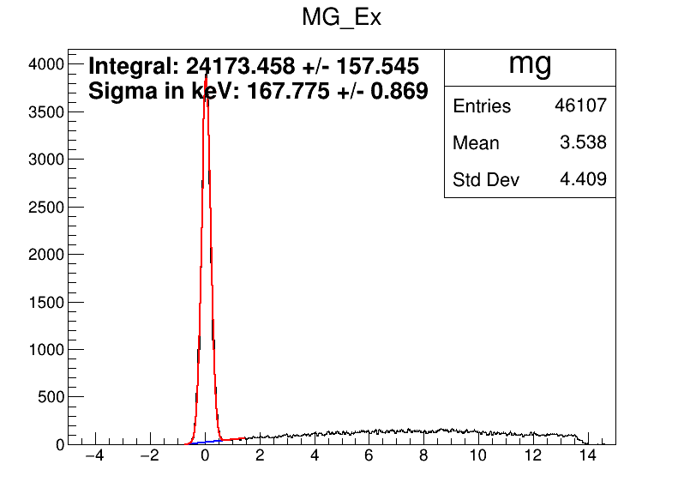
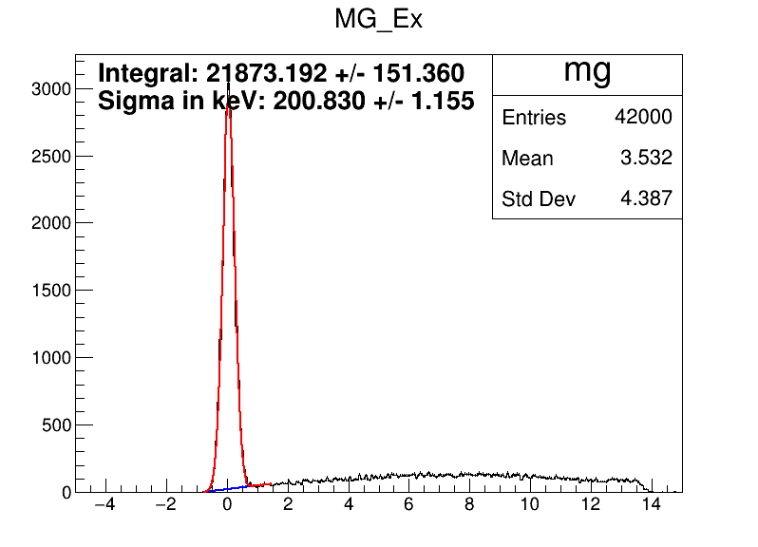
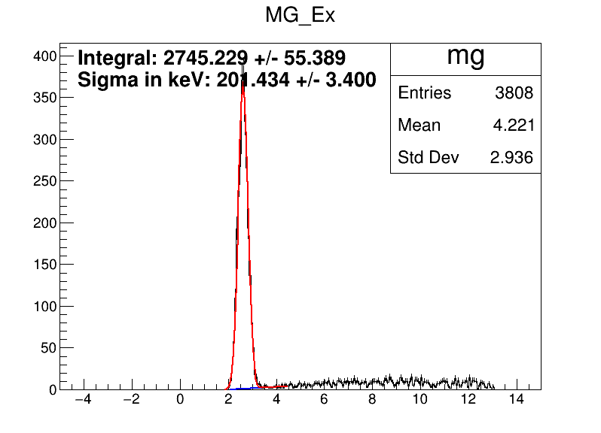
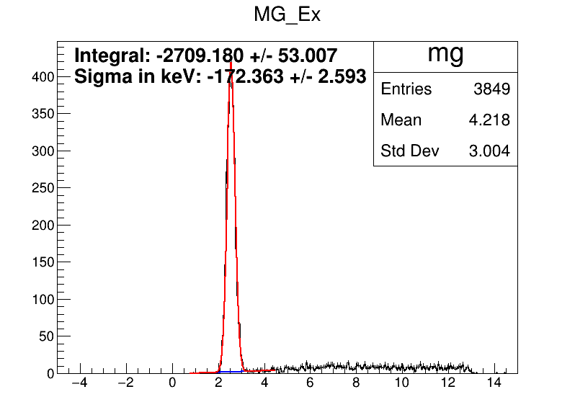
Simulations
Beam
Particle= 68Ni
Energy= 1122 MeV
SigmaEnergy= 0. MeV
ExcitationEnergy= 0.0 MeV
SigmaThetaX= 0.5 mrad
SigmaPhiY= 0.5 mrad
SigmaX= 1.5 mm
SigmaY= 1.5 mm
MeanThetaX= 0 mrad
MeanPhiY= 0 mrad
MeanX= 0 mm
MeanY= 0 mm
Beam
Particle= 68Ni
Energy= 1122 MeV
SigmaEnergy= 0. MeV
ExcitationEnergy= 0.0 MeV
SigmaThetaX= 0.5 mrad
SigmaPhiY= 0.5 mrad
SigmaX= 2.0 mm
SigmaY= 2.0 mm
MeanThetaX= 0 mrad
MeanPhiY= 0 mrad
MeanX= 0 mm
MeanY= 0 mm
g.s →
Sigma : 167 keV
2.5 Mev →
Sigma 172 keV
g.s →
Sigma : 200 keV
2.5 Mev →
Sigma 201 keV

Slide 2
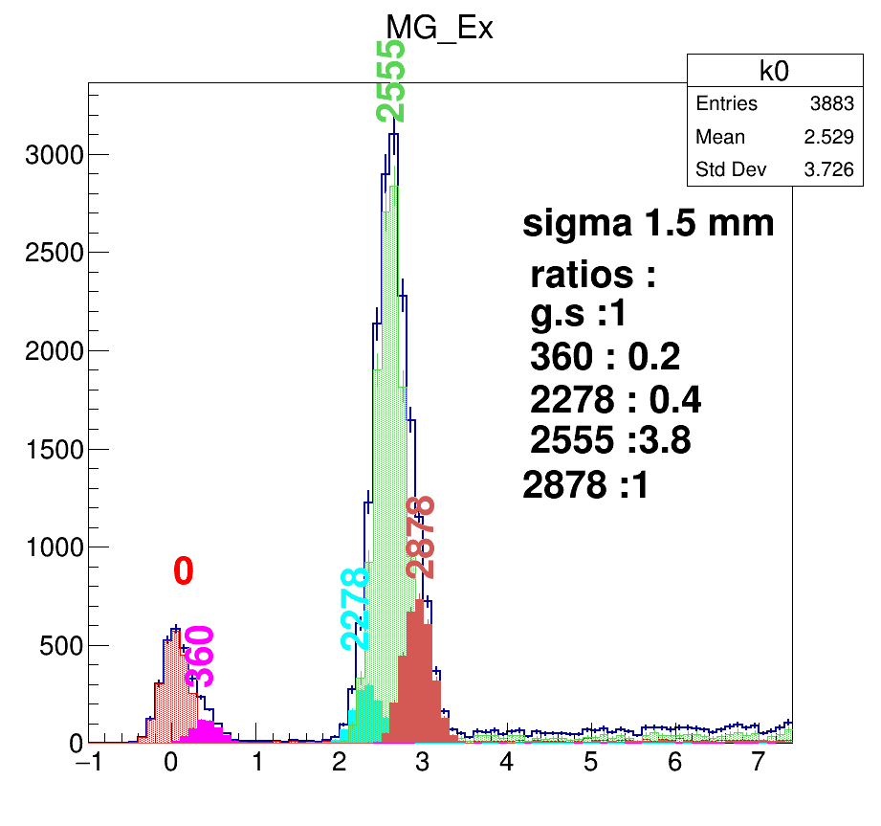
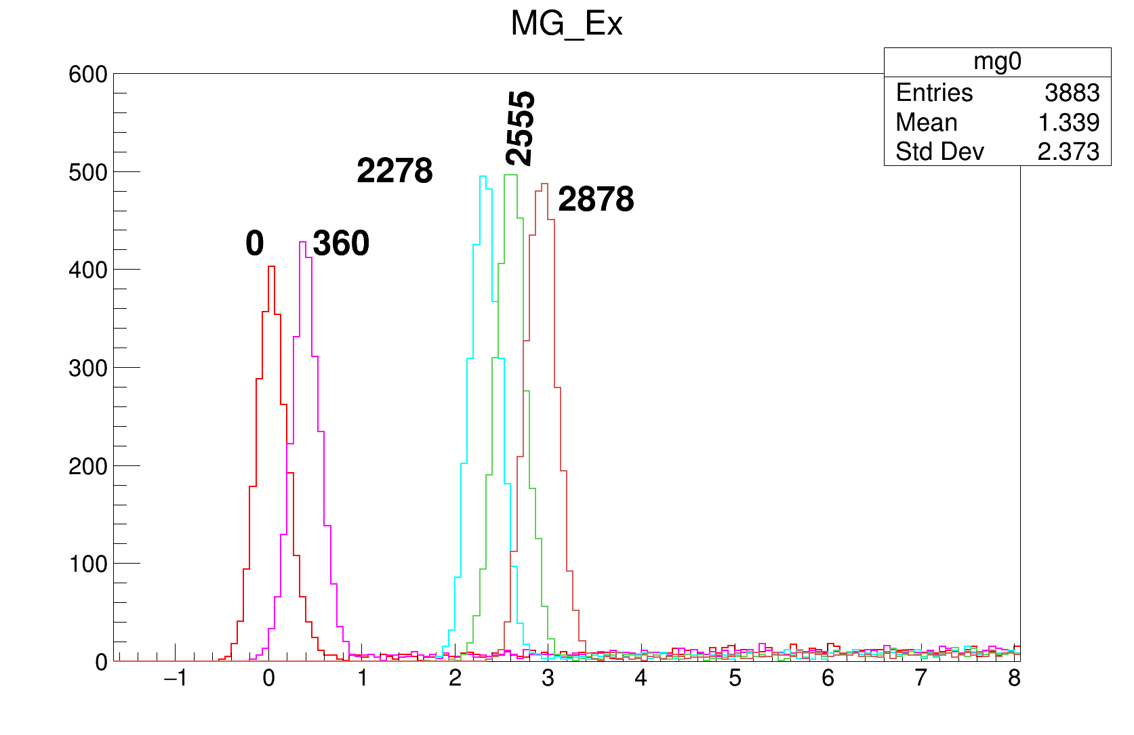
Cheating part just for me

Slide 3
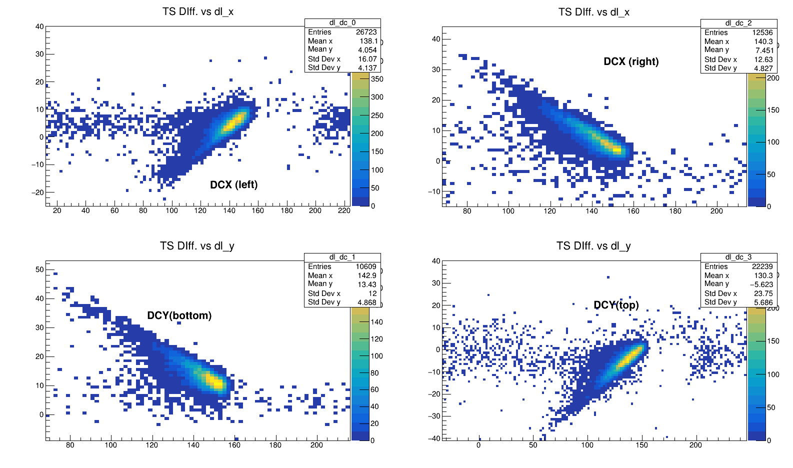

DC calibration

Slide 4
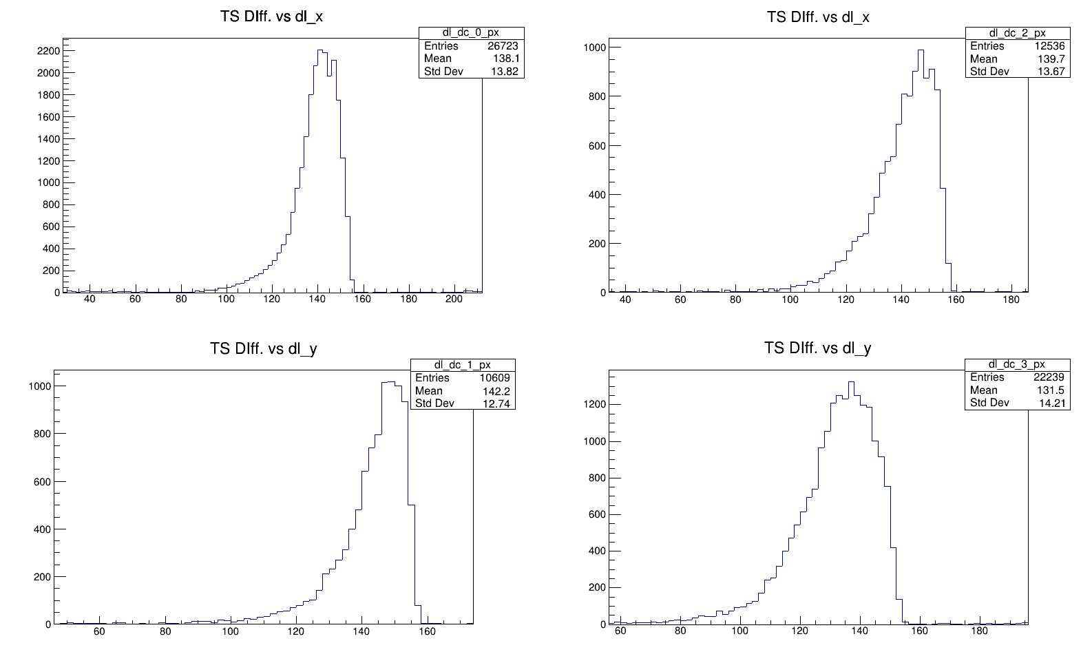

Slide 5
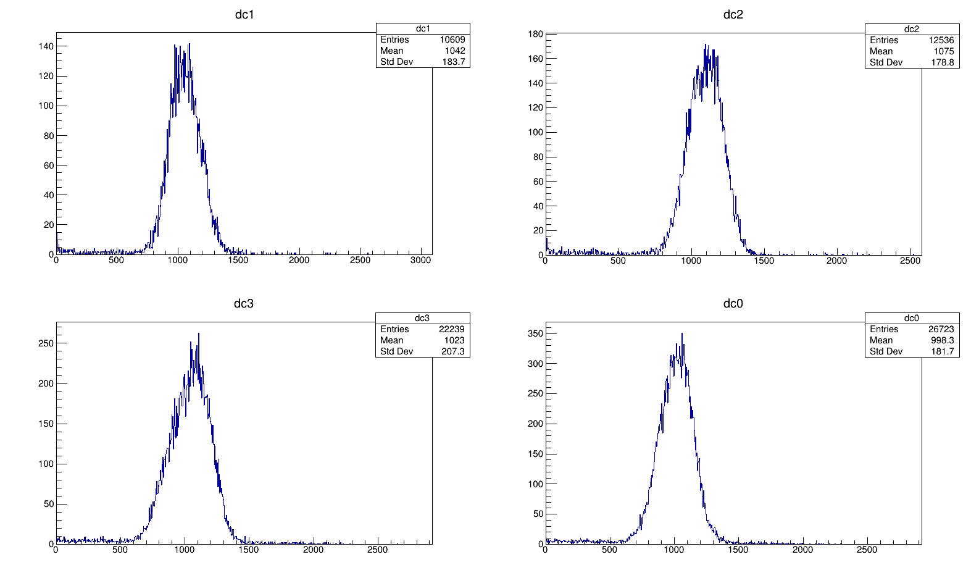
Y
X
With respect to IC_1
X efficiency %73
Y efficiency = %61
Y
X

Slide 6
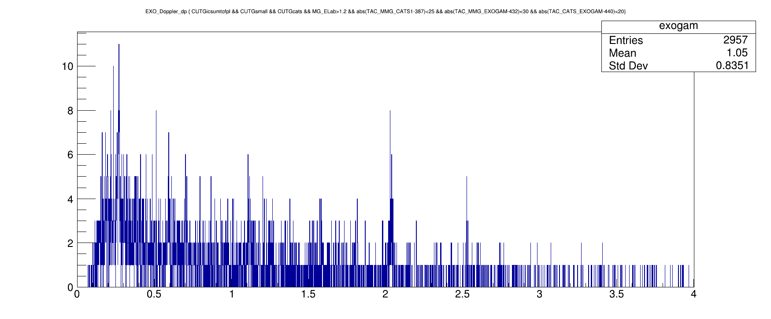
Gamma-ray correlations
594 (5/2⁻) 69Ni
2.033 ⁶⁸Ni
1129 ⁶⁹Ni

Slide 7
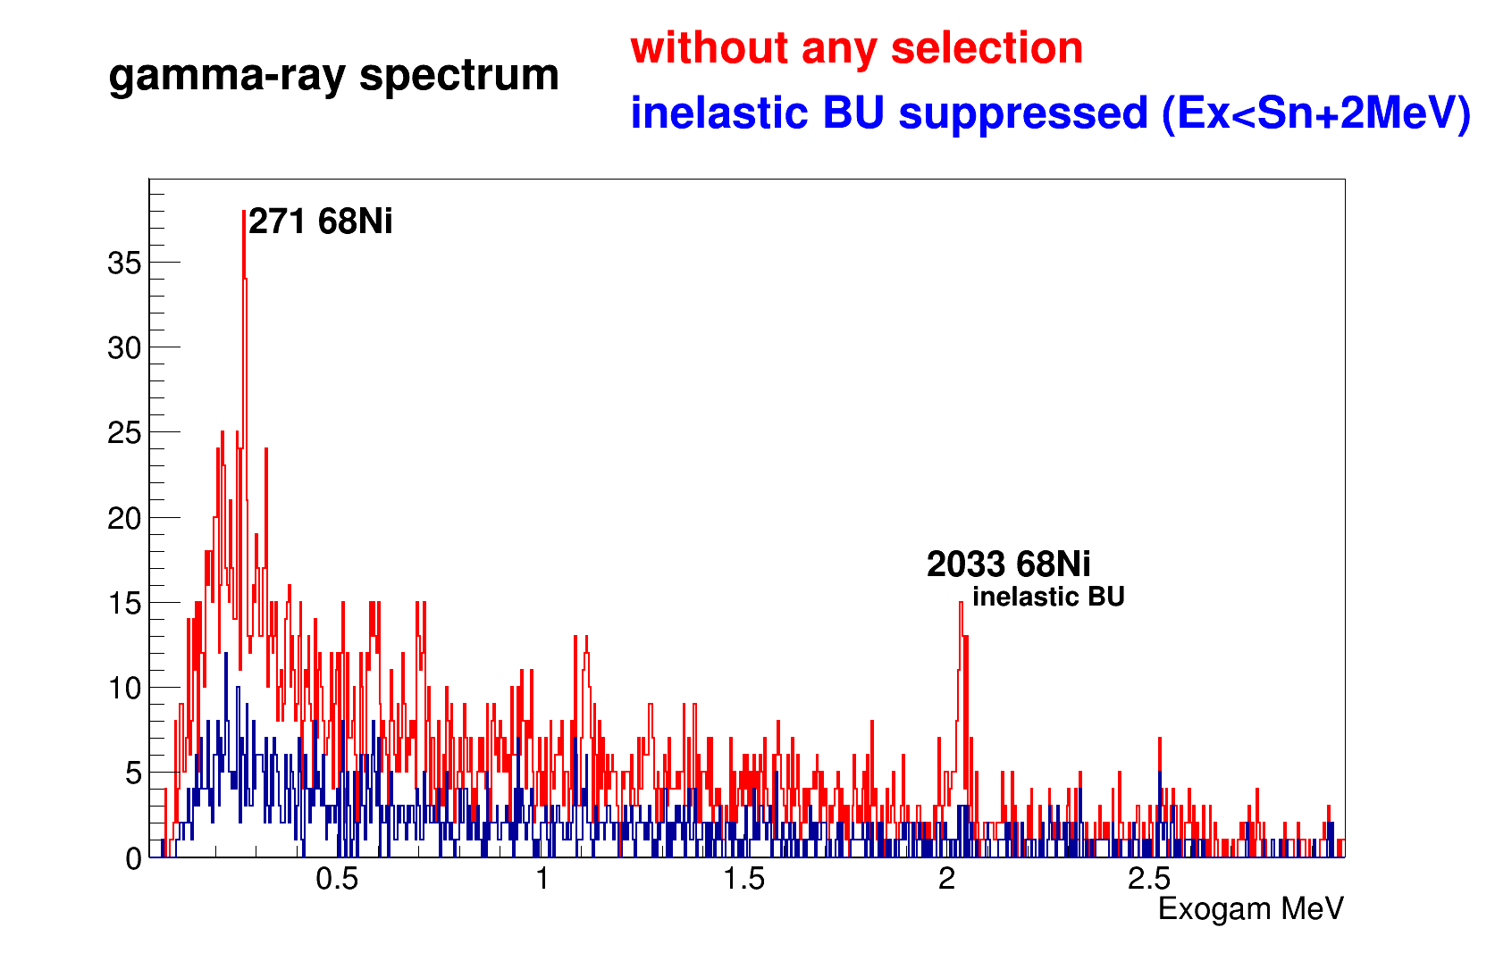
594 (5/2⁻) 69Ni
1077 68Zn

Slide 8
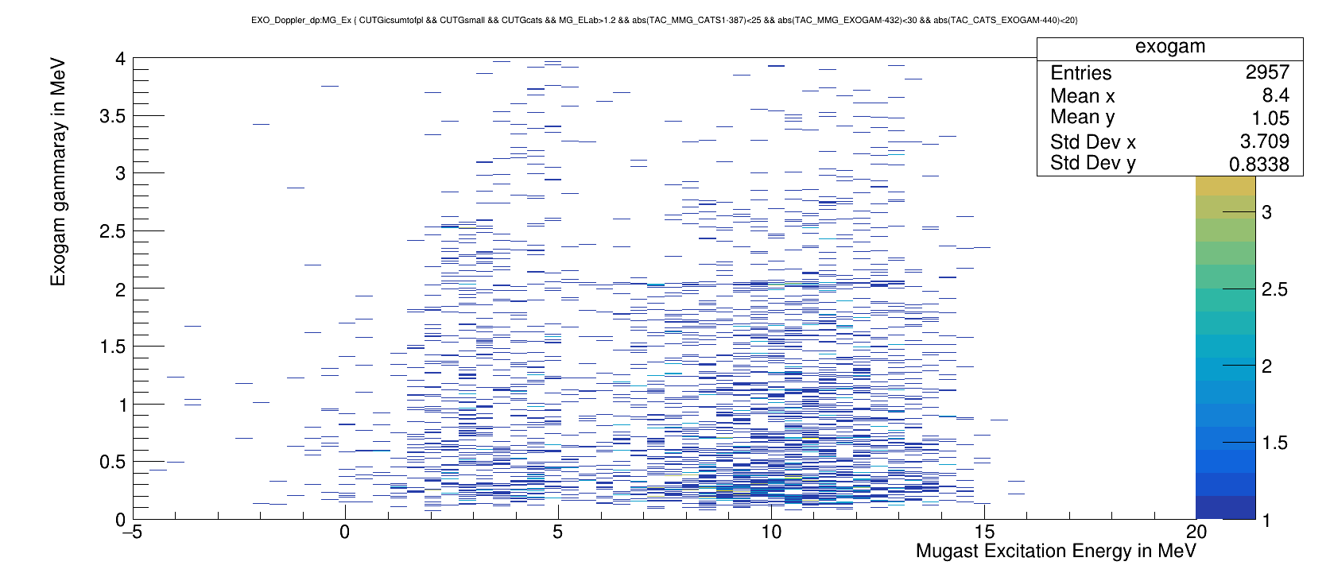

Slide 9
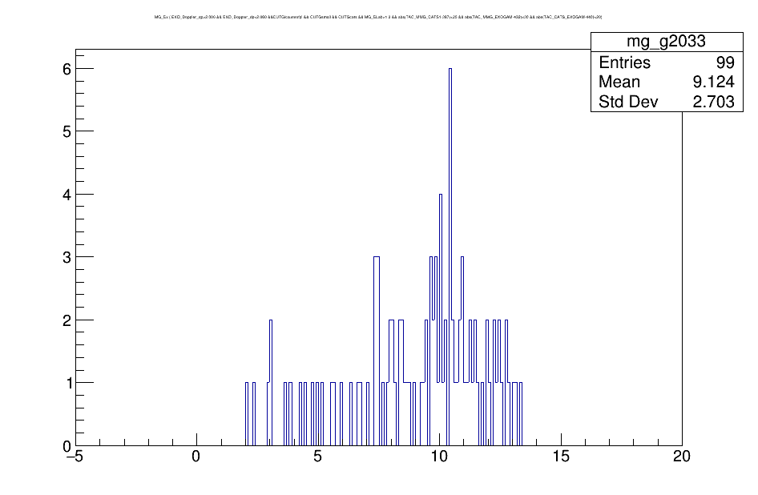
Excitation energy
matching with 2.03 Mev gamma-ray

Slide 10
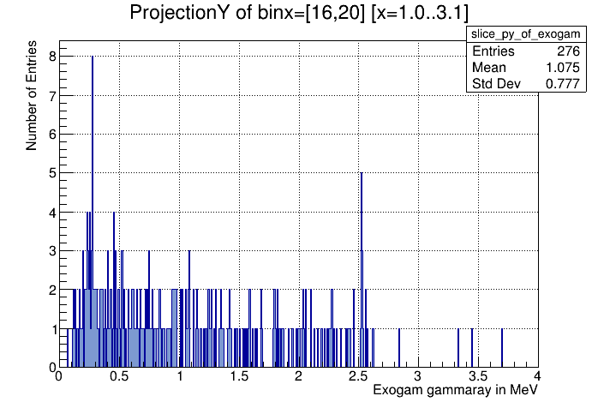
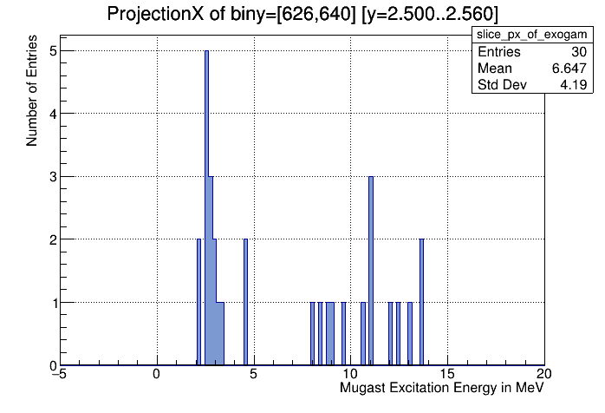
Gated on gamma-ray
2.56 MeV
Gated on Excitation energy

Slide 11
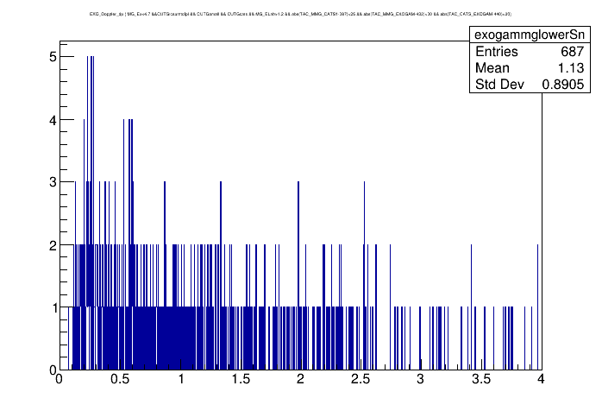
Gammaray’s with
Excitation energy is lower than Sn 4.7 MeV

