Slide 1
April 22
Simulation silicon thickness
Sigma values corrected new values gammaray correlations detailed possible Ex energies angular correlations ?
Last meetings
April 8 :
-simulation and experiment proton energy was not matching
-Sigma values on Ex is discussed.
March 24 :
-Gamma ray correlations discussed not finalized.

Slide 2
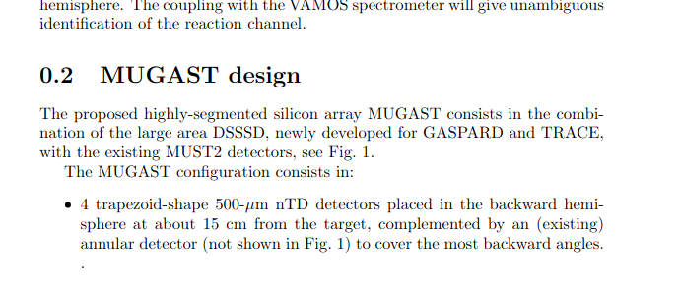
NPLIb/detector/mugast
IN simulation dedector file :
const G4double SiliconThickness = 300 * micrometer;
While real value should be 500 mm

Slide 3
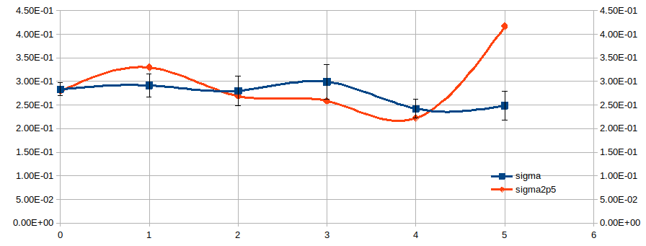
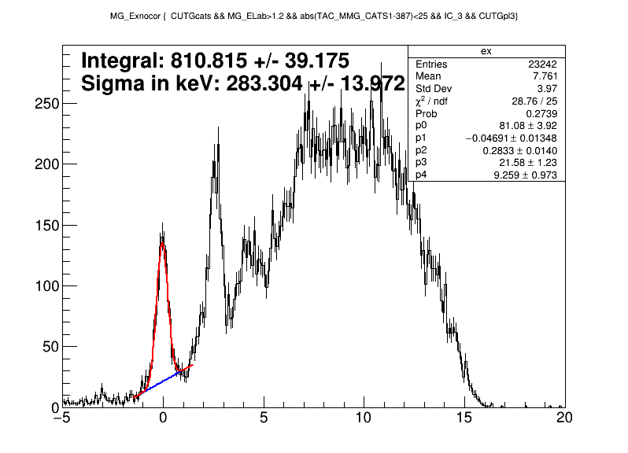
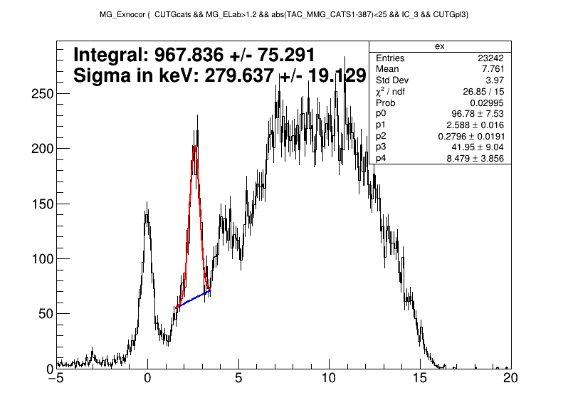

Slide 4
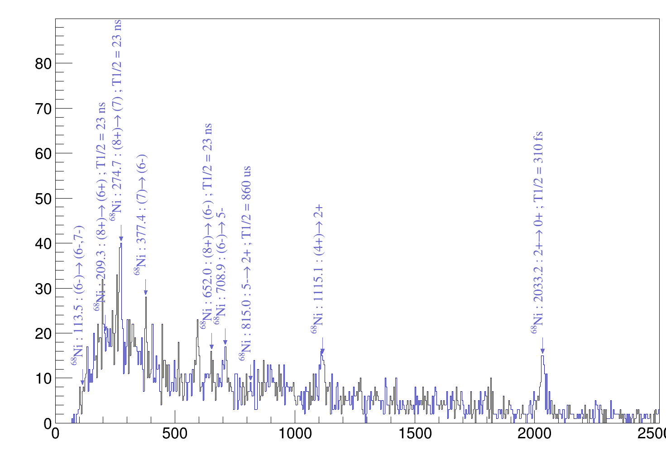
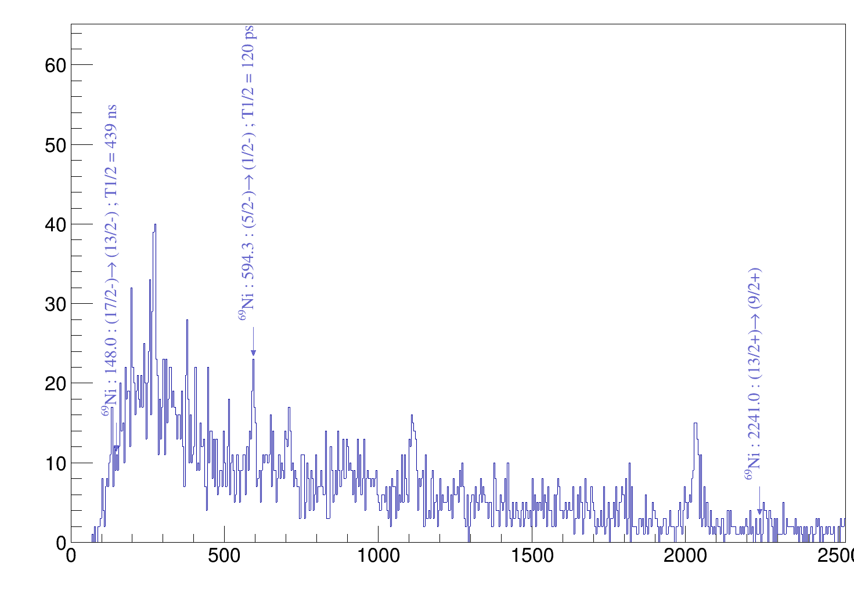
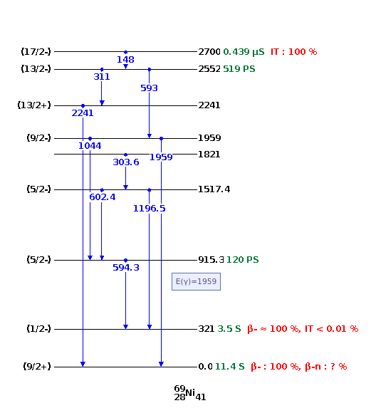

Slide 5
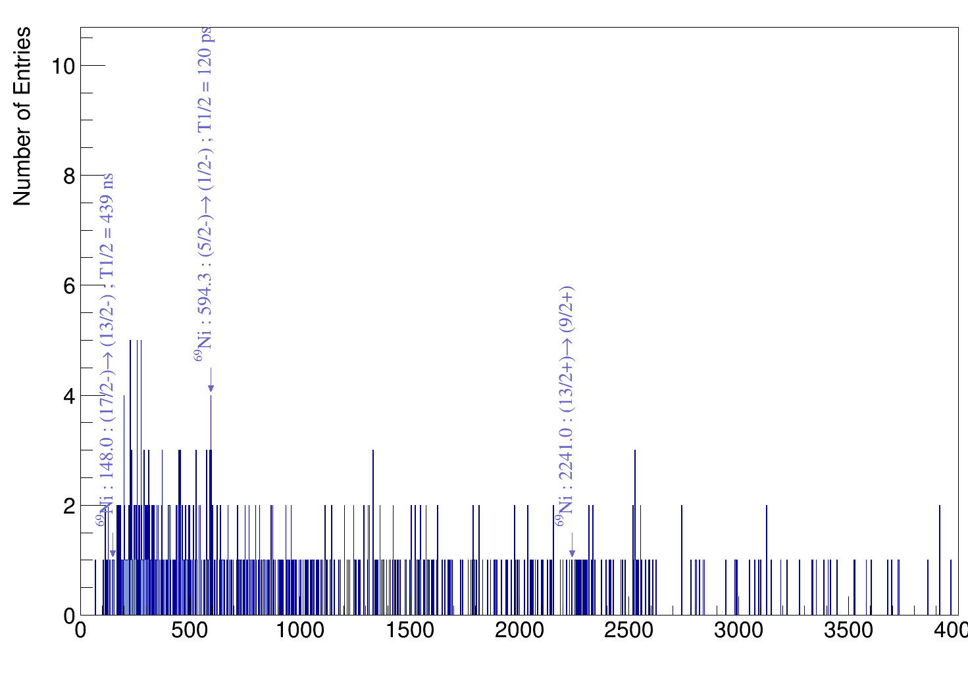

Slide 7
