Slide 1
Pencil beam sigma
Simulation results updated
Cut in the Tof, and no Tof
Drift Chamber constructed
1
2
3
4

Slide 2
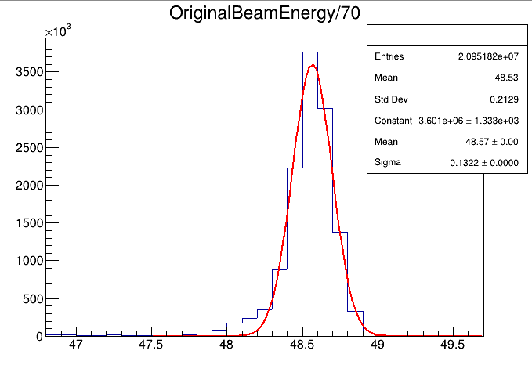
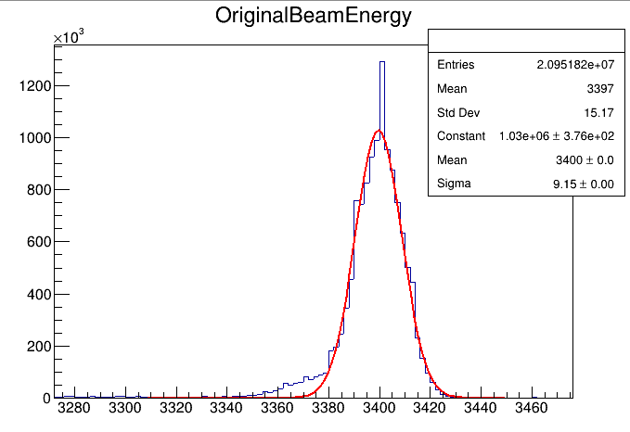
Run 500 70 Zn pencil beam sigma = 9 MeV
1

Slide 3
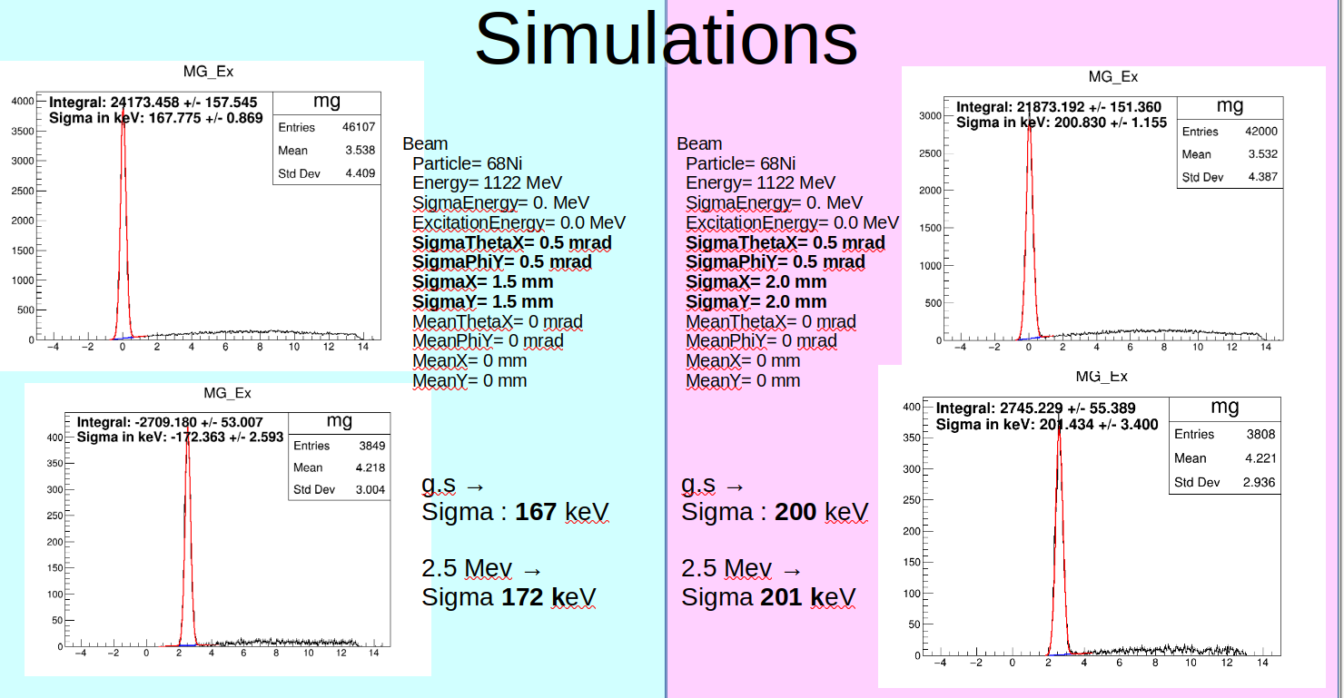
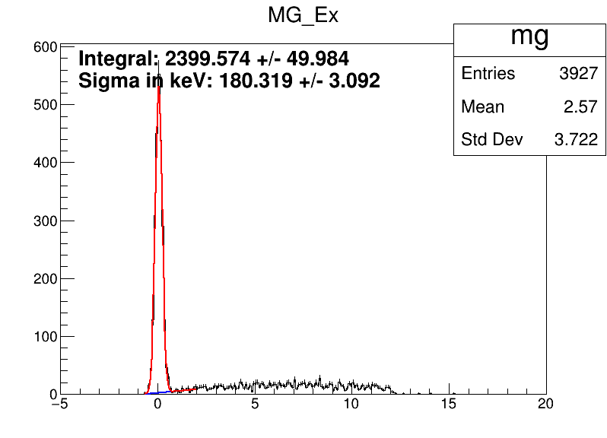
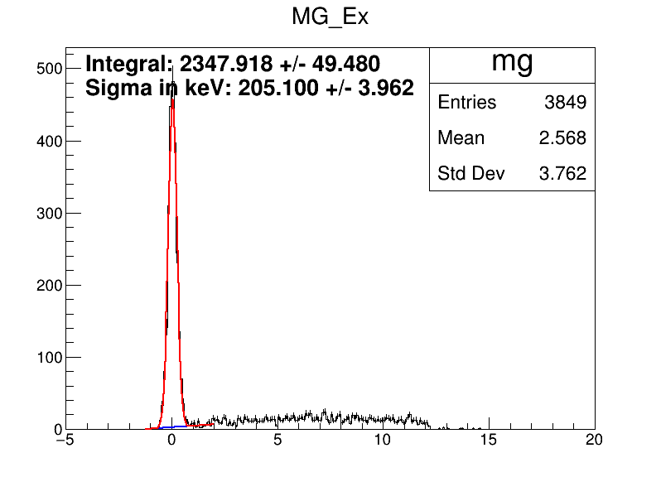
Simulation effect comparison with previous results
2
With sigma 9 MeV
Gs→ 180 keV
2.5 Mev → 189 keV
With sigma 9 MeV
Gs→ 205 keV
2.5 Mev → 215 keV

Slide 4
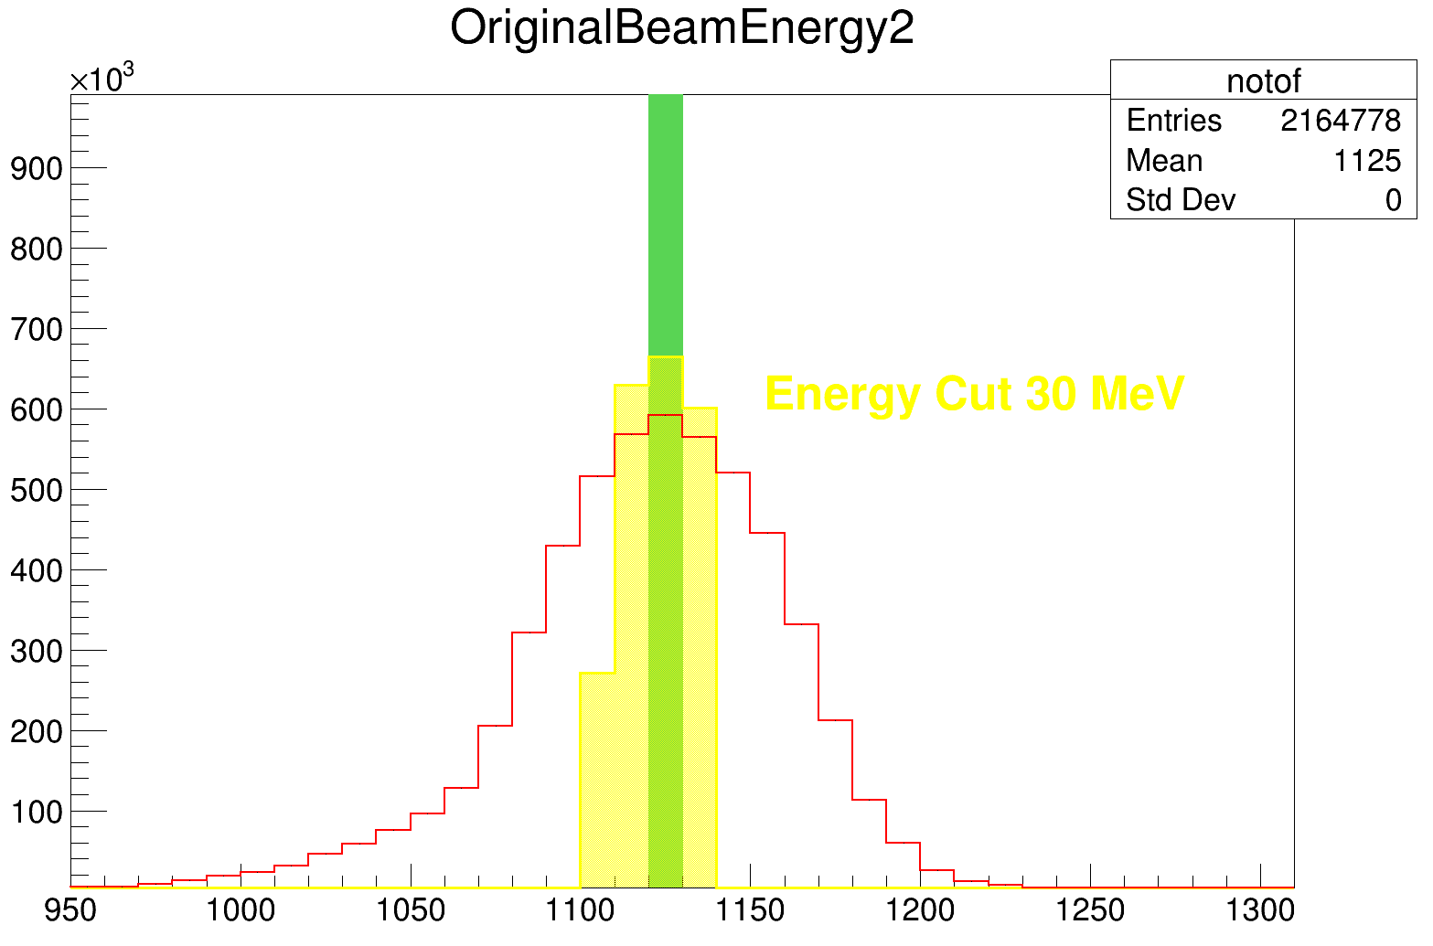
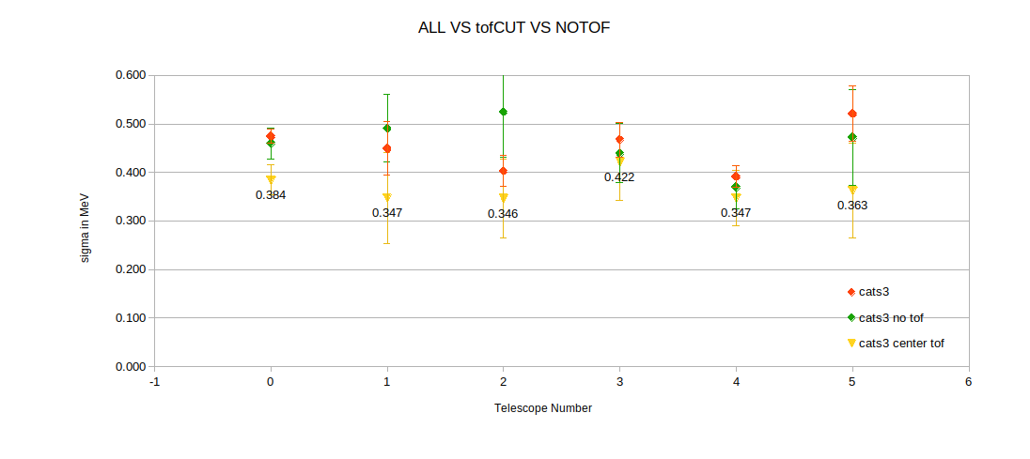
Cut in the Tof, and no Tof
3
Simulation sigma value 205

Slide 5
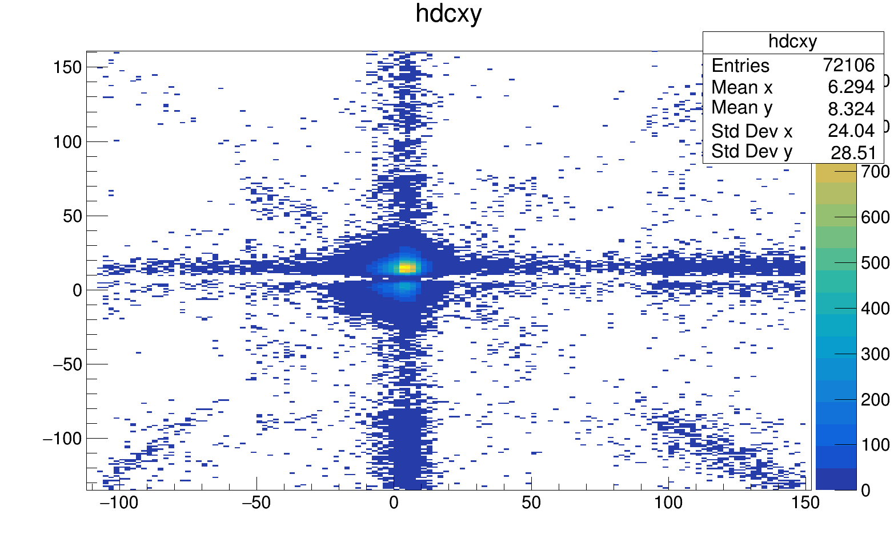
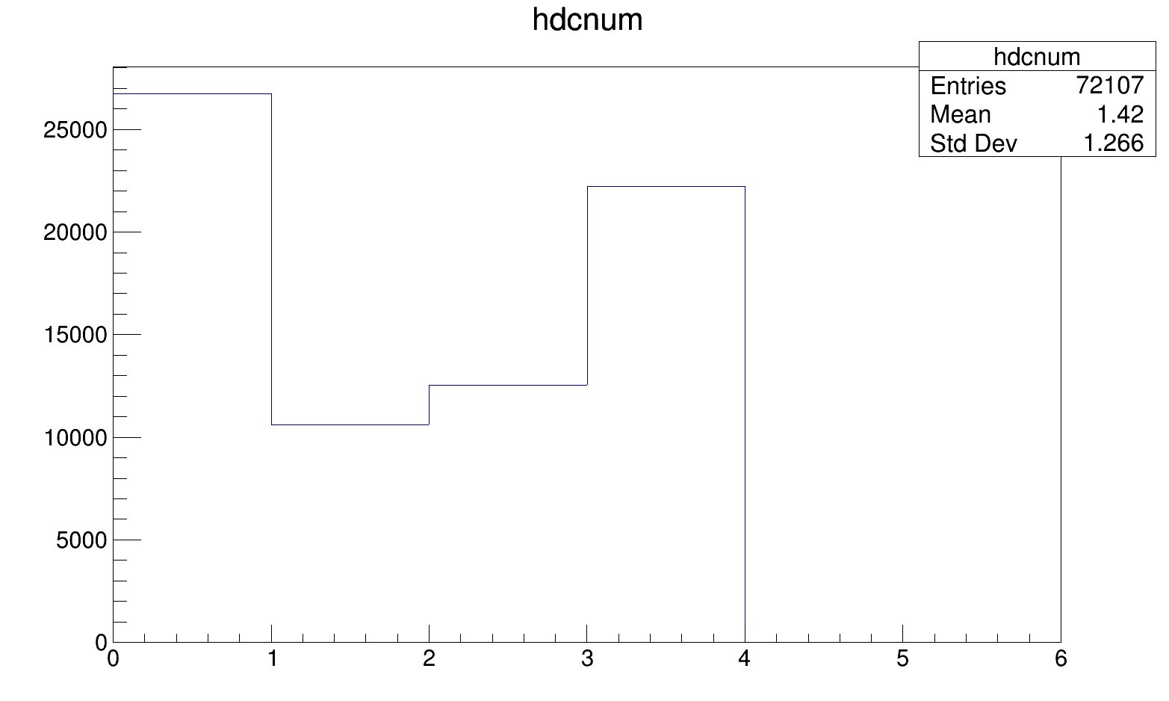
Drift Chamber constructed
4
Empty target and trigger plastic

