Slide 1
Analysis report
Ozge Aktas
34Si on C target
Run # 1131- 1151 (1 day)

Slide 2
Until now
Exogam re calibrated
Exo ZDD recalibrated
Addback procedure implemented
Doppler correction
The beam line dedector checked :
  To choose cleaner configuration.
Plastic DE E isotopes identified,
  cross checked with exogam nad compared with DSSD.

Slide 3
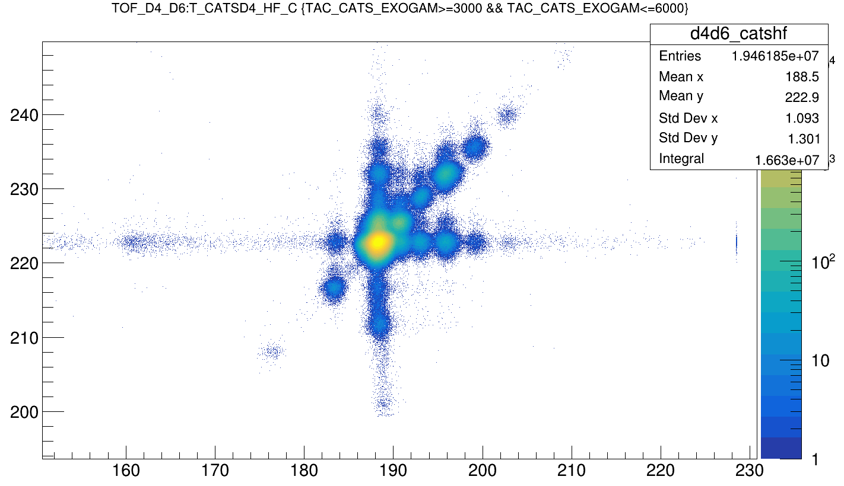
LISE→
TOF_D4_D6 vs CATSD4_HF

Slide 4
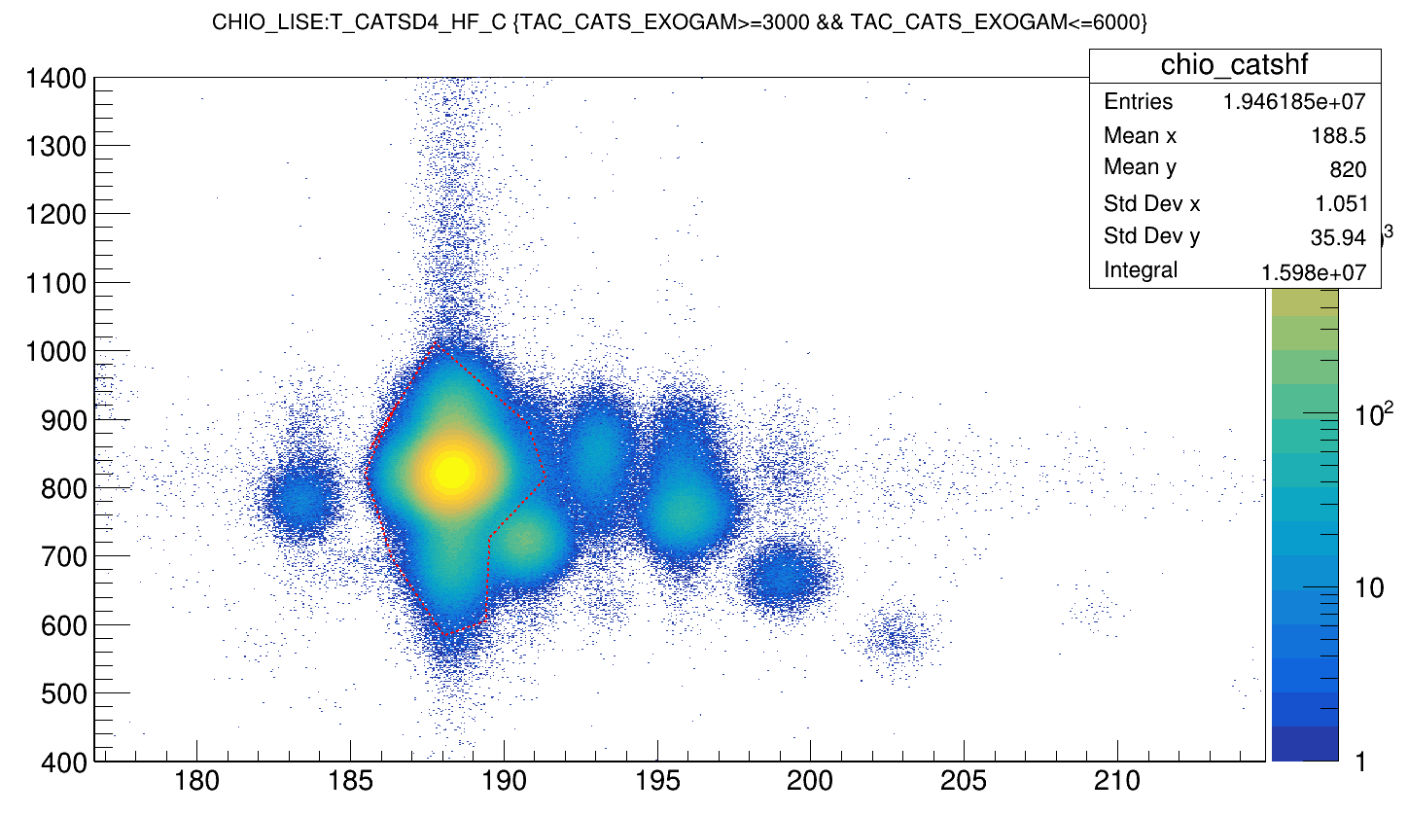
CHIO vs CATSD4_HF

Slide 5
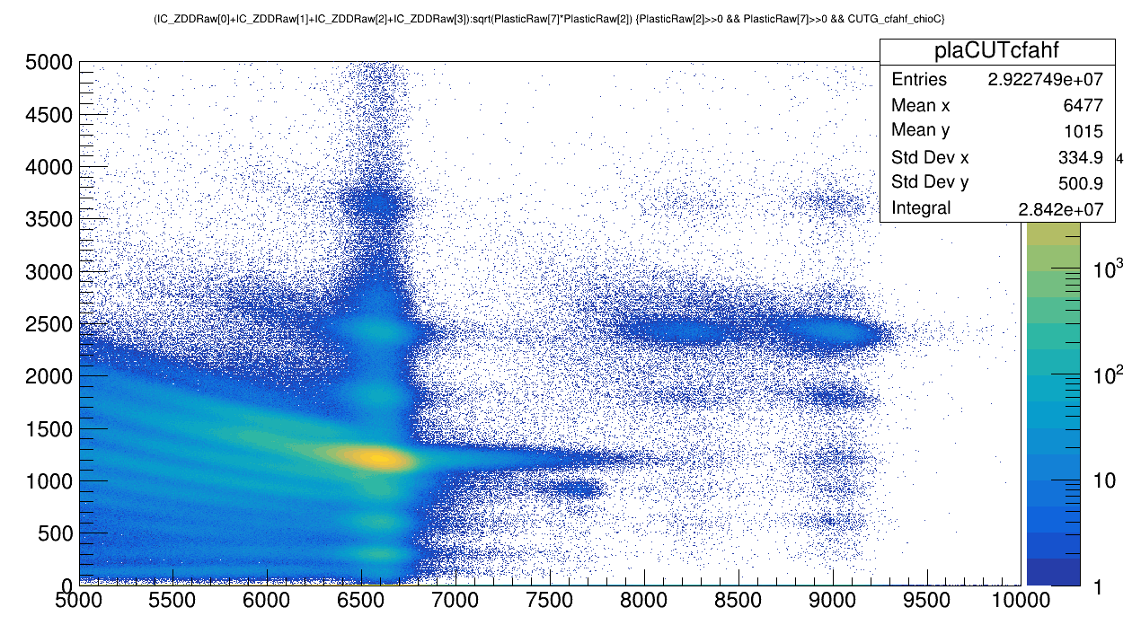
ZDD
Plastic vs IC (Si34 selected in tof_d4d6 vs catsd4 pid)

Slide 6
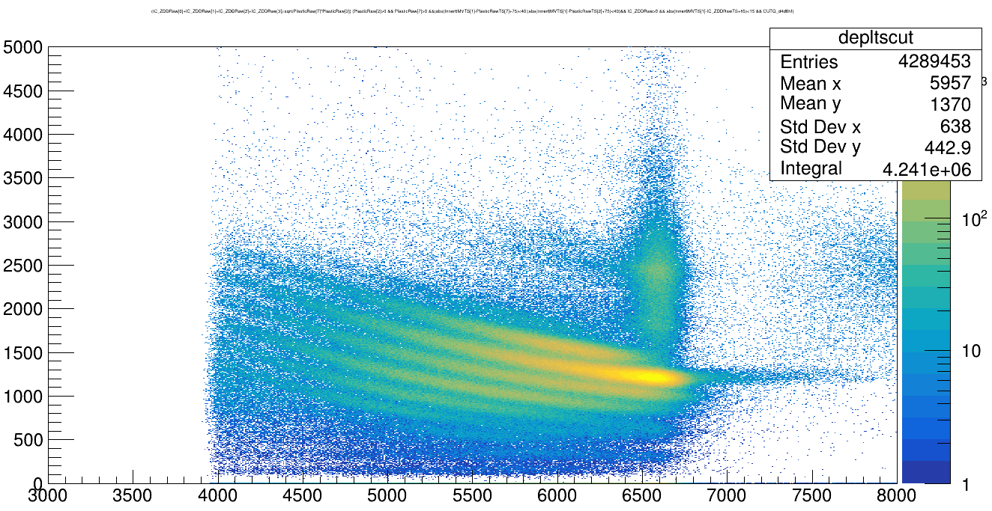
ZDD
PL vs IC_ZDD (time correlation cuts with Exogam first hit)
1
1 Phosphorus
2 Silicon
3 Aluminium
4 Magnesium

Slide 7
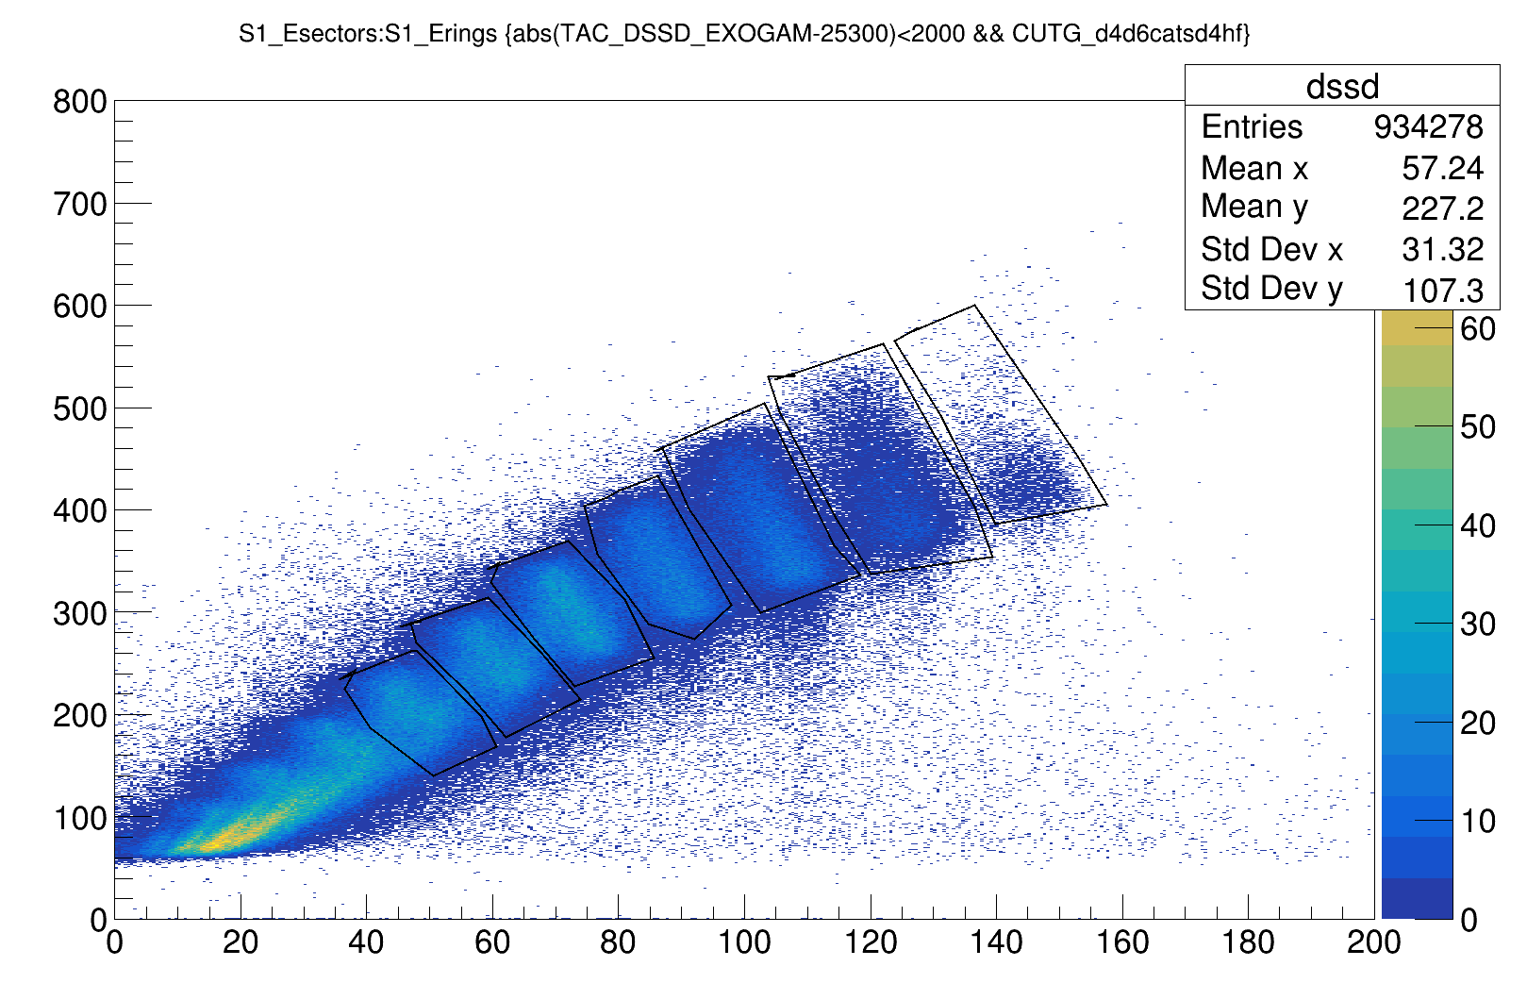
Si
Si
Al
Mg
Na
Ne
F

Slide 8
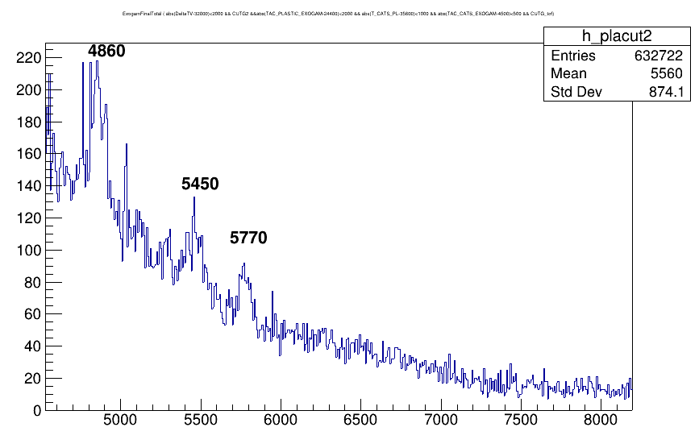
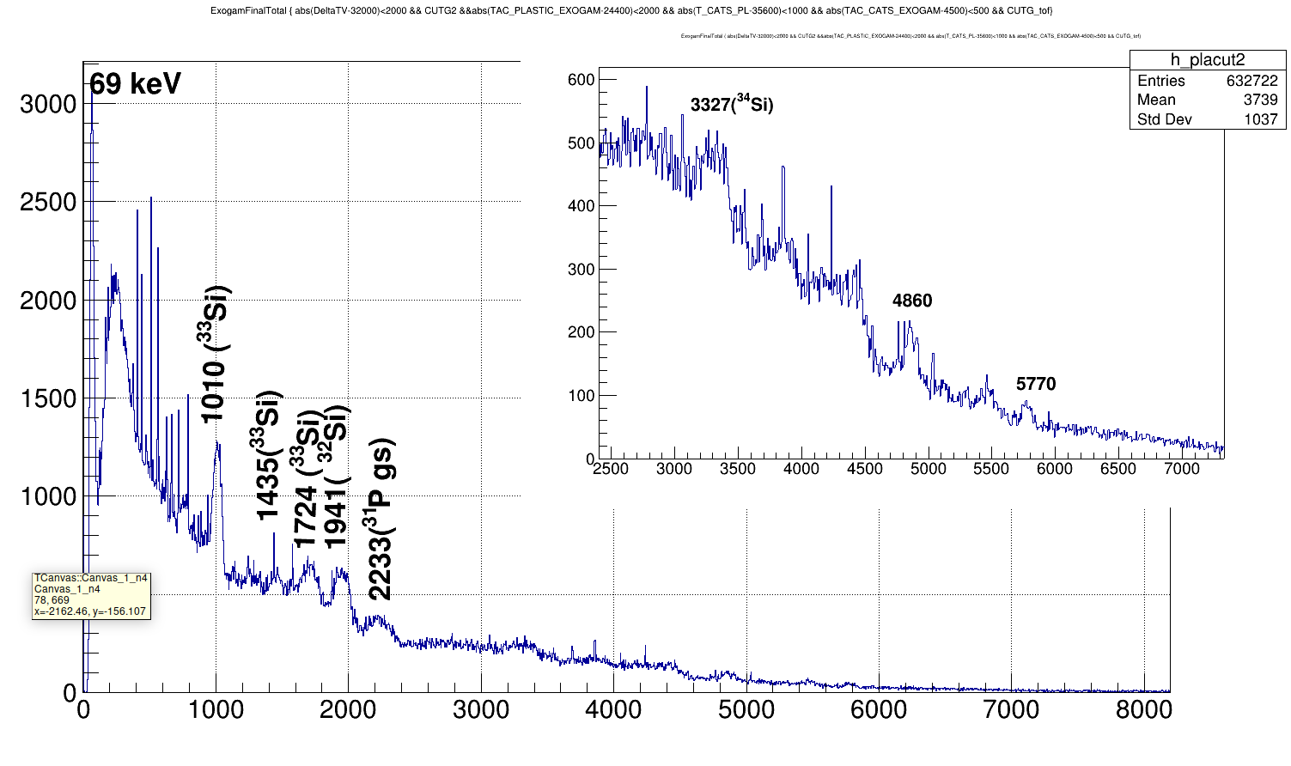
Silicon isotopes correlation with ZDD
4860 keV → 31Si or 32P gs
5770 keV - > 31P gs contamination
69 keV → ? maybe→ 32Si beta decay to 32P (t1/2=153y) Beta E = 69 keV
5450 → ?

Slide 9
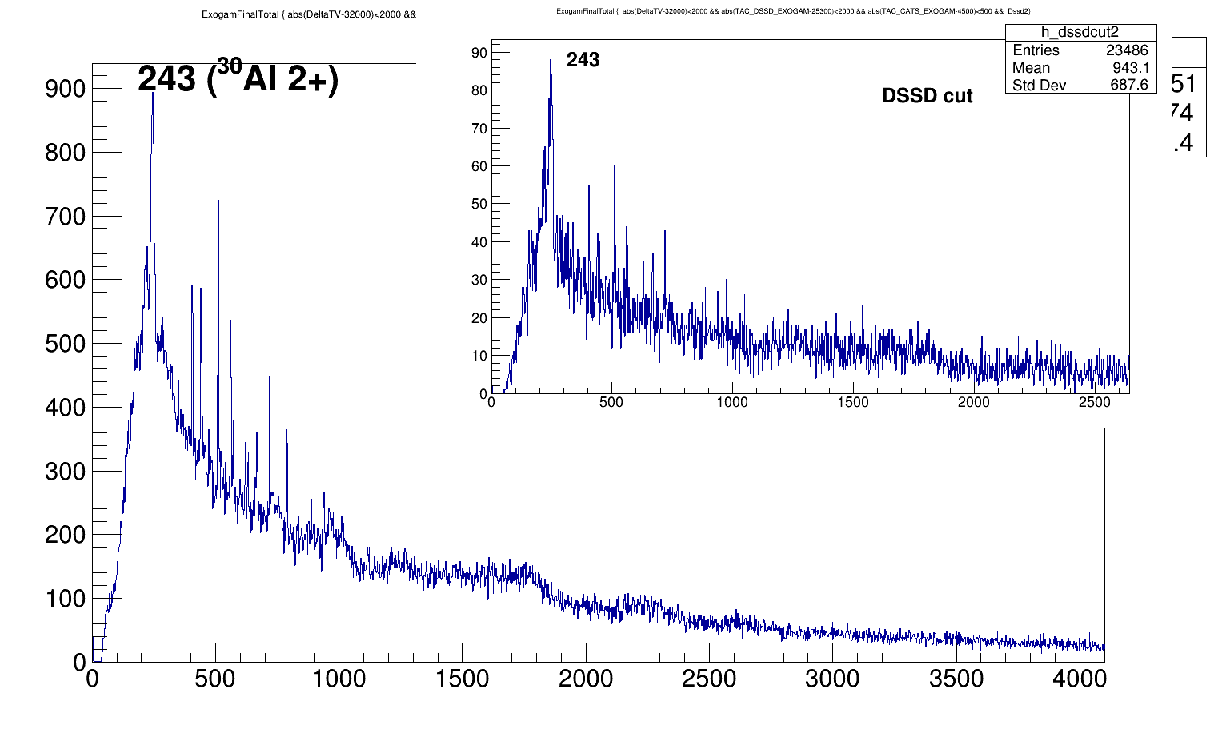
Al, PL3 /DSSD2 cuts

Slide 10
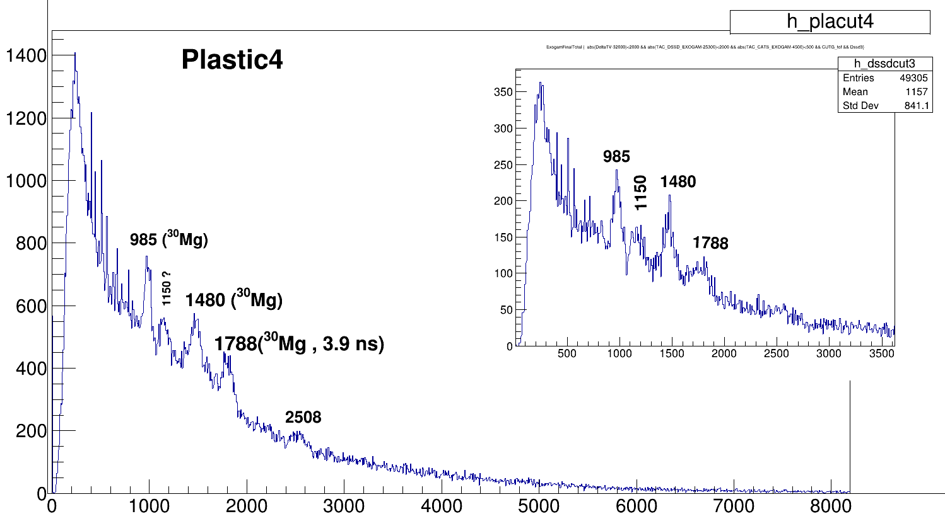
Mg pl4/dssd cuts
1788 → 30Mg (0+→ 0+) 3.9 ns ~ 12 cm legnth for c ,& for 0.3c → 36 cm
→ 32Mg(2- , 3- → 2-, 3-) but we don’t see the cascade to gs (2152 kev & 885 kev)
1150 → 28Mg (3- → 4+) or (0+→ 1+) again cascade decay is not visible (3087 keV & 1473 keV)

Slide 11
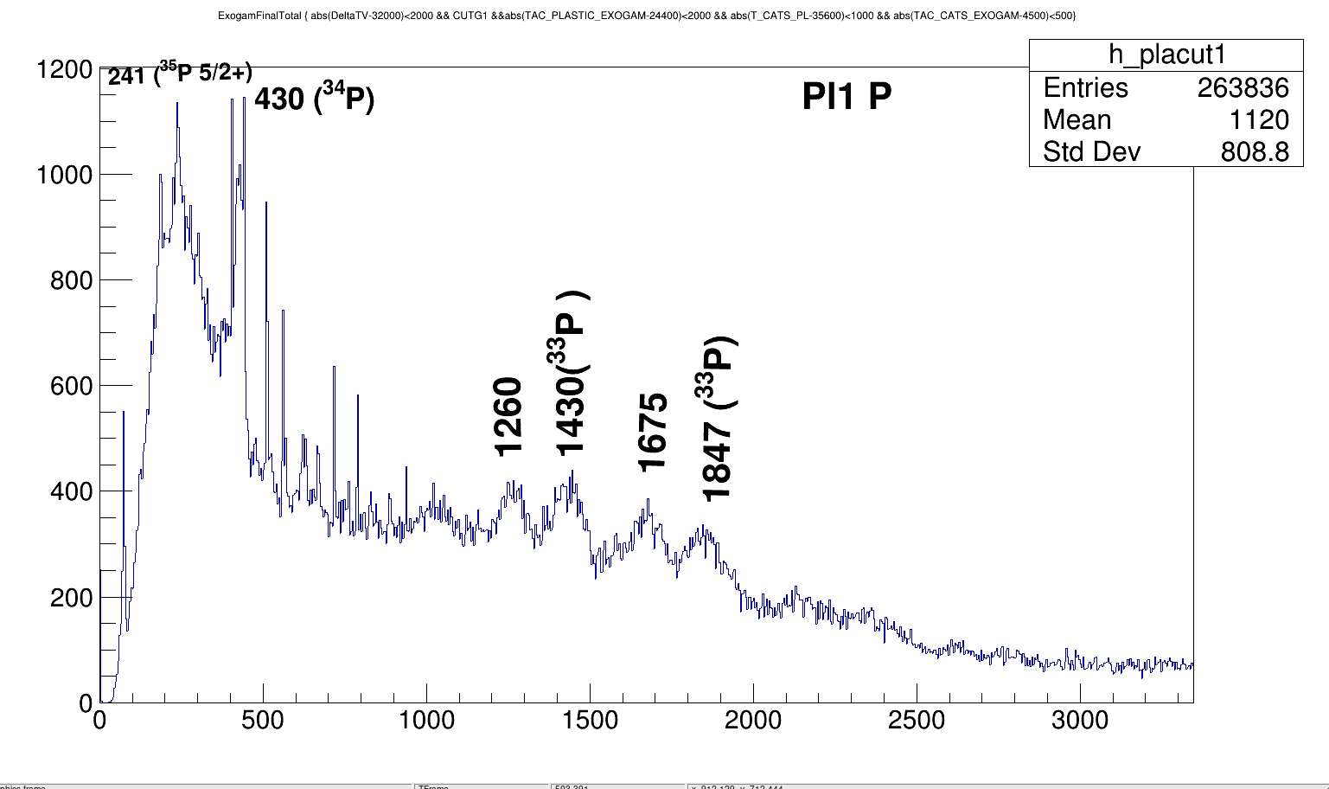
P isotopes only in ZDD plastic

Slide 12
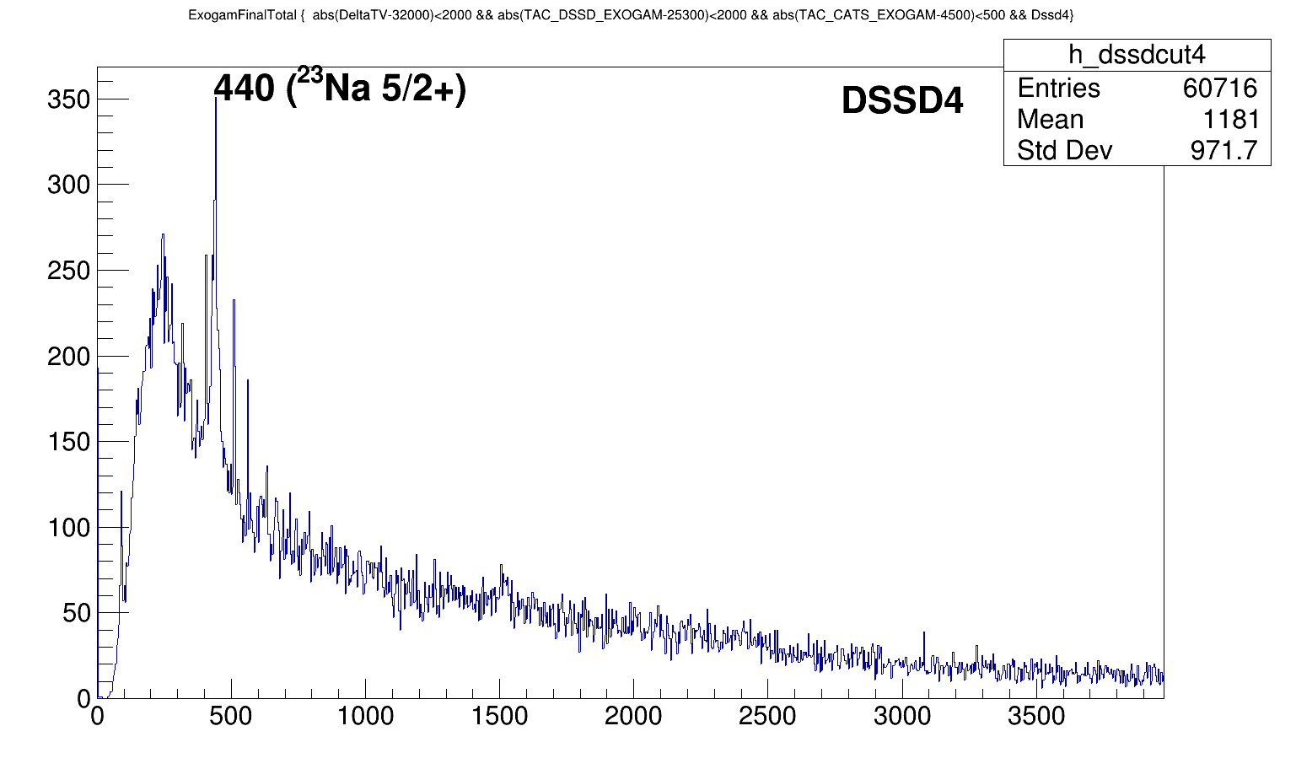
23Na Dssd4

Slide 13
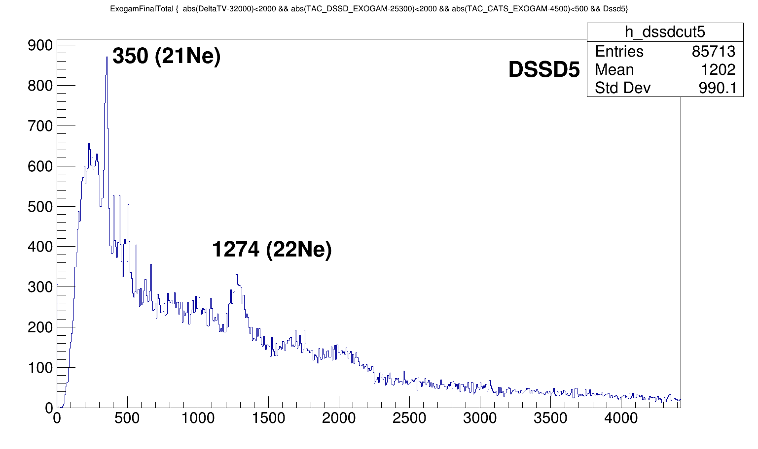
Ne DSSD5

Slide 14
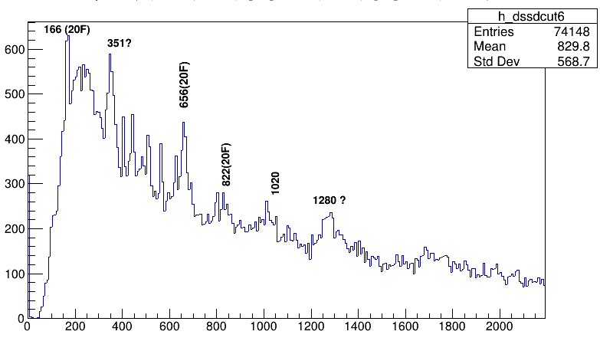
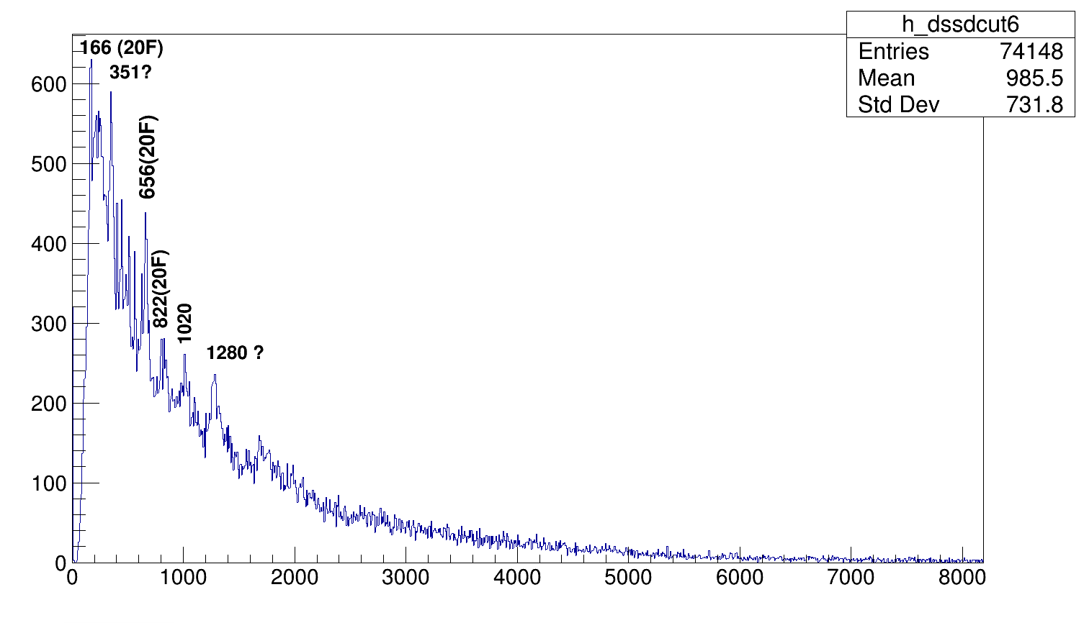
Flor DSSD

Slide 15
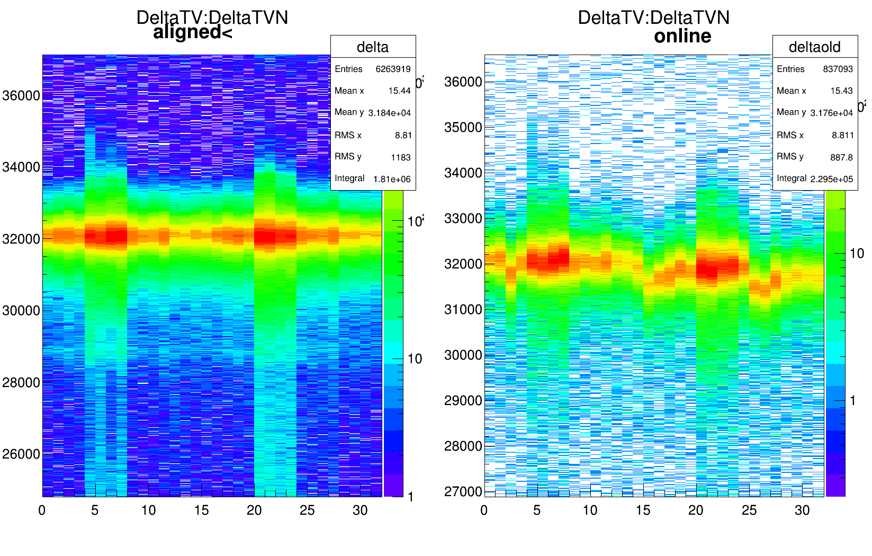
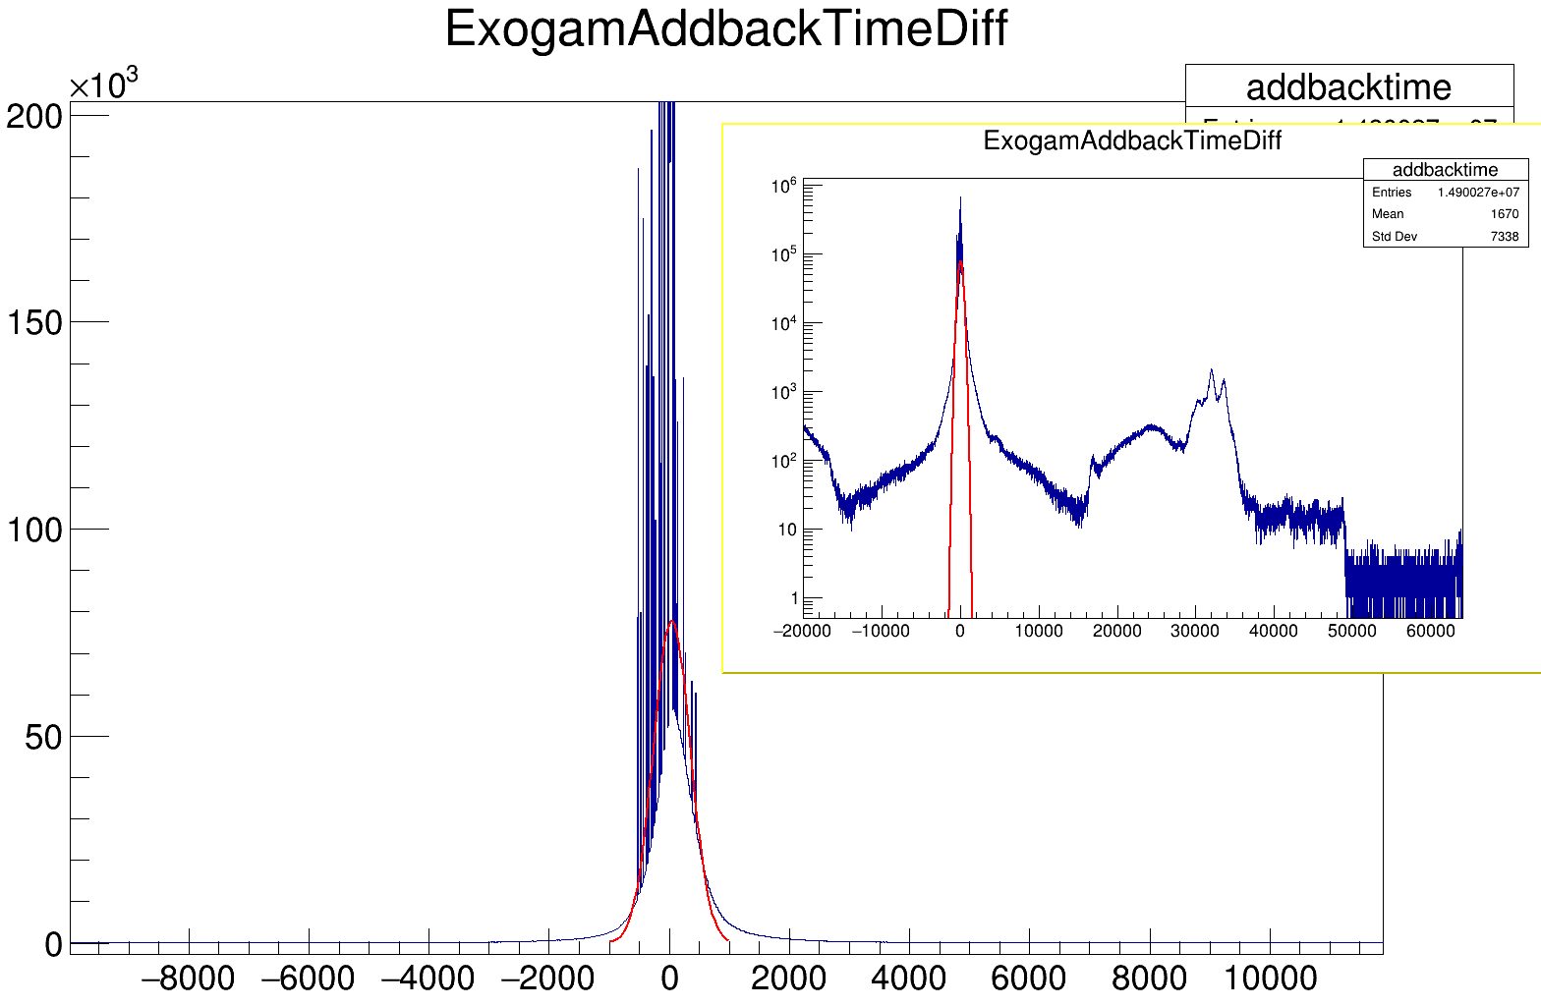
DeltaTV alignment for addback time
Time diff btw two crystal
Addback time →
-1000 to 1000 (channel)

Slide 16
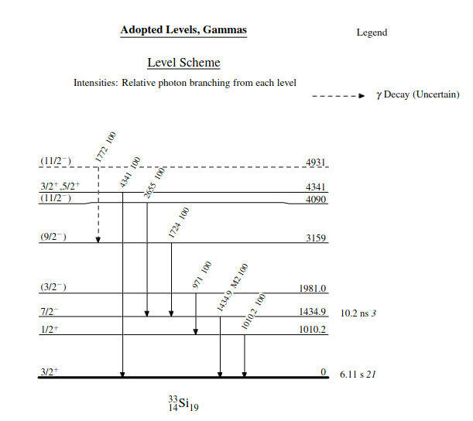
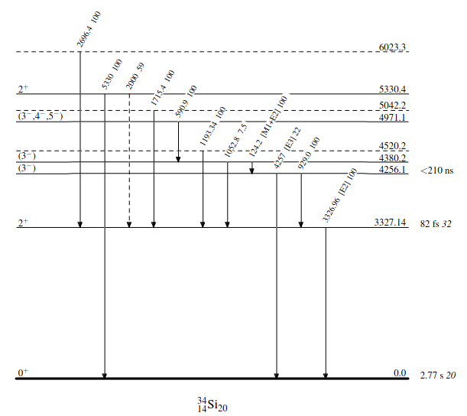

Slide 17
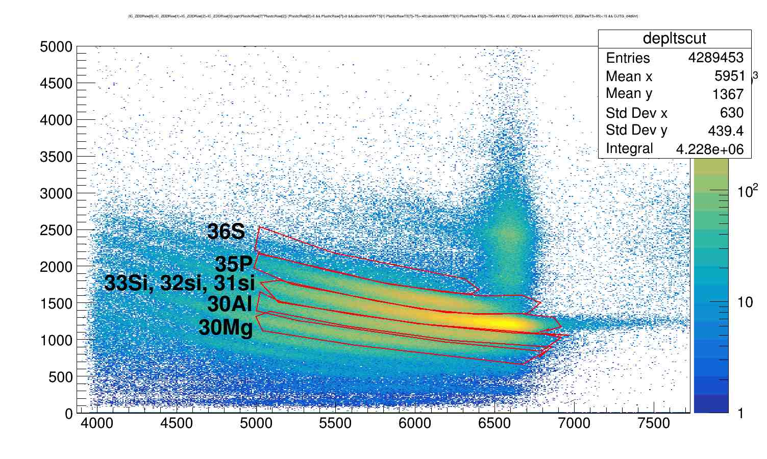

Slide 18
Doppler correction
Float_t Analyse_E823::Doppler_Correction(float Theta_Gamma, float Phi_Gamma, float Theta_Part, float Phi_Part, float Beta_Part, float energie_Mes){ //rad, v/c
float energievraie,cosinusPSI;
cosinusPSI =TMath::Sin(Theta_Part)*TMath::Cos(Phi_Part)*TMath::Sin(Theta_Gamma)*TMath::Cos(Phi_Gamma)+
TMath::Sin(Theta_Part)*TMath::Sin(Phi_Part)*TMath::Sin(Theta_Gamma)*TMath::Sin(Phi_Gamma)+
TMath::Cos(Theta_Part)*TMath::Cos(Theta_Gamma);
energievraie = energie_Mes*(1.-Beta_Part*cosinusPSI)/sqrt(1.-Beta_Part*Beta_Part);
return energievraie;
Theta_Gamma=exogamCrystalPositions[crystalAddbackIndexes[i]*4].Theta();
Beta_Part = Float_t ejectileBetaDefault = 0.305;

Slide 19
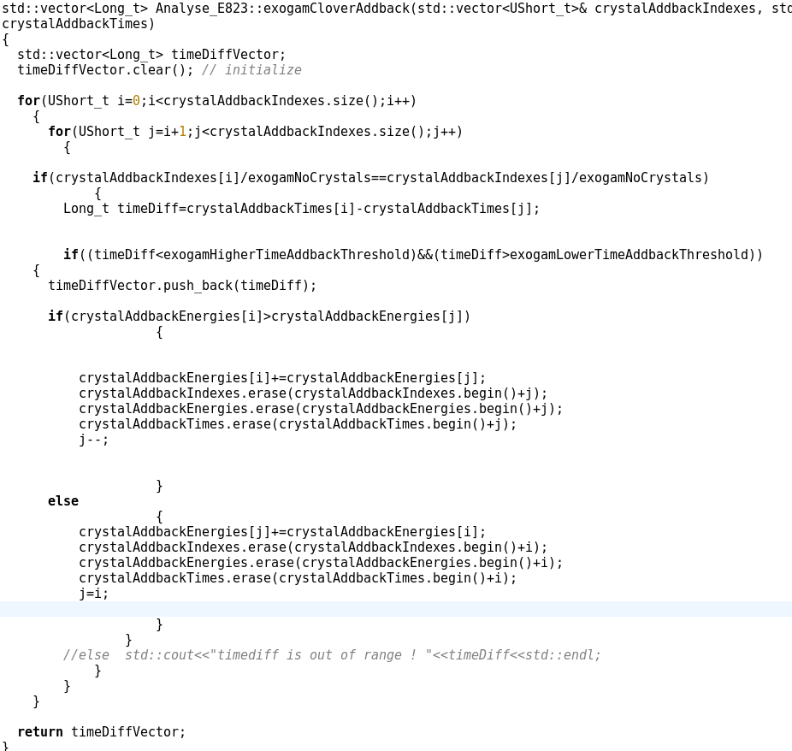
addback

Slide 20
Time diff btw two crystal
Time is from TDC , not timestamp

Slide 21
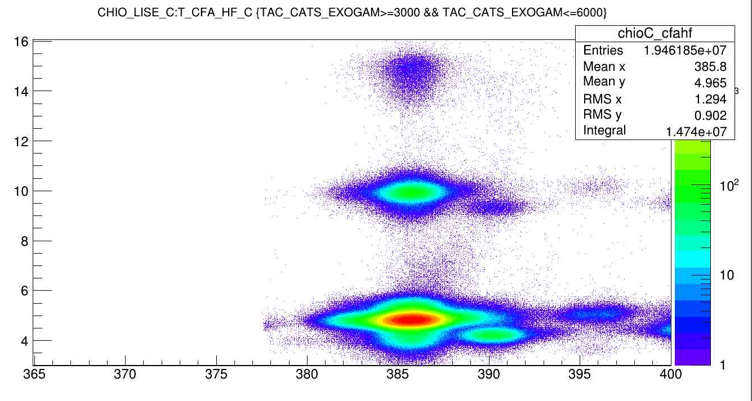
CHIO_LISE vs CFA_HF

