Slide 1
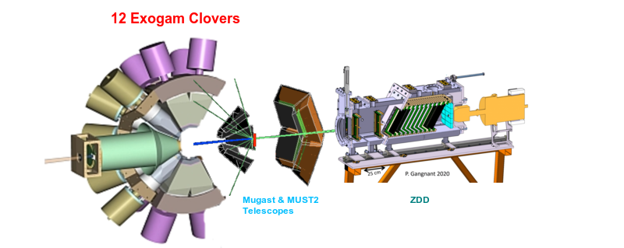
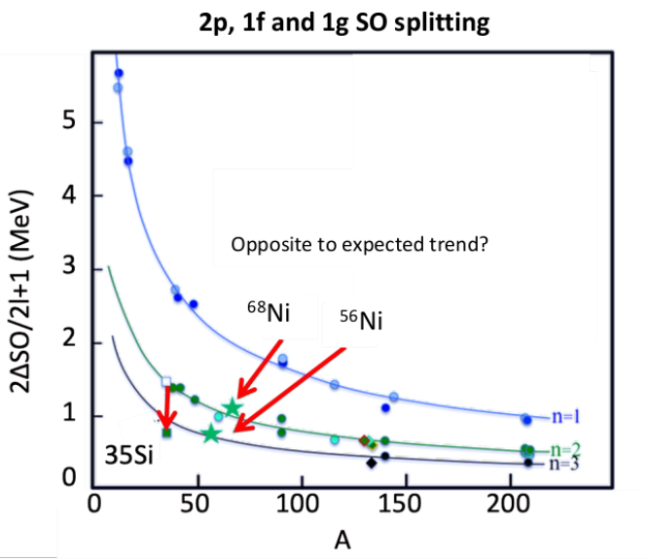
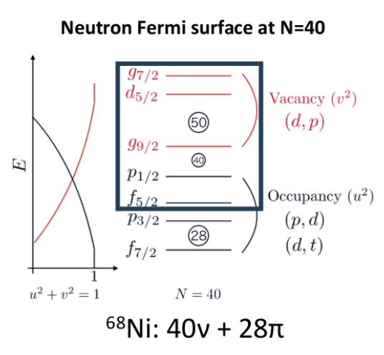
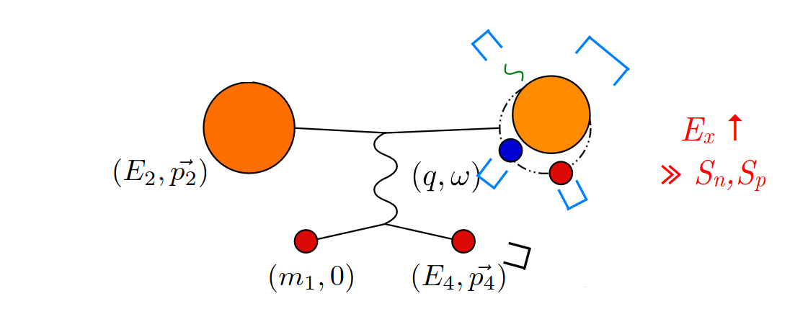
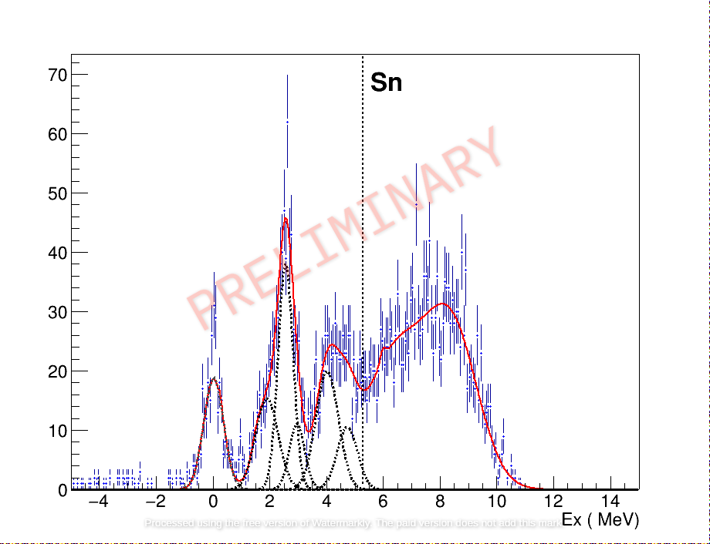
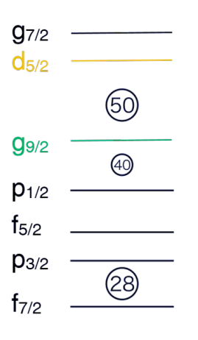
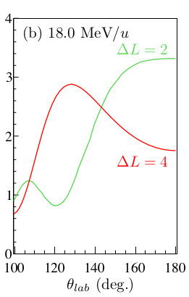
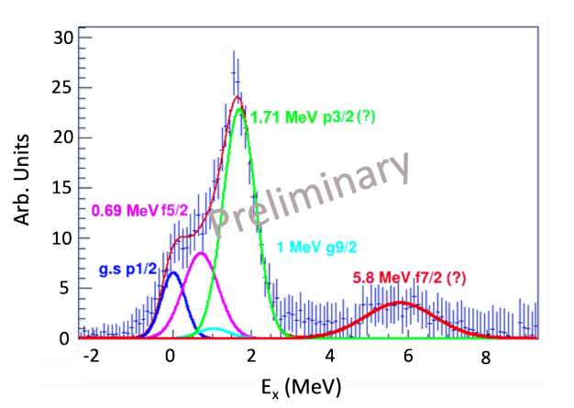
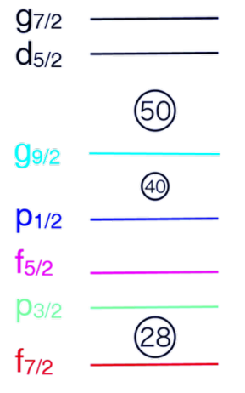
Study of the neutron Fermi surface of ⁶⁸Ni via Missing Mass Spectroscopy
Evolution of shell gap of N=50 at N=40 nucleus ⁶⁸Ni ?
Spectroscopic factor of particle and hole states
of pfg – shells ⁶⁸Ni(d,p)⁶⁹Ni ⁶⁸Ni(p,d)⁶⁷Ni
Inverse trend of 2p SO splitting
from ⁵⁶Ni to ⁶⁸Ni?
⁶⁹Ni
⁶⁷Ni
⁶⁶Ni
⁶⁸Ni
@18MeV/u
@38 MeV/u
CD2 (0.5 mg/cm²)
CH2 (5 mg/cm²)
Missing mass
p, t, d,...
O. Sorlin et al, PLB 809 135740
⁶⁸Ni(p,d)⁶⁷Ni
⁶⁸Ni(d,p)⁶⁹Ni
.
g9/2- d5/2 spacing
g9/2 - g7/2 SO splitting ?
At least 5 visible states to identify
f5/2 – f7/2 SO splitting
p1/2 – p3/2 SO splitting
2.5 MeV states is ΔL =2 or ΔL=4 ?

Slide 2
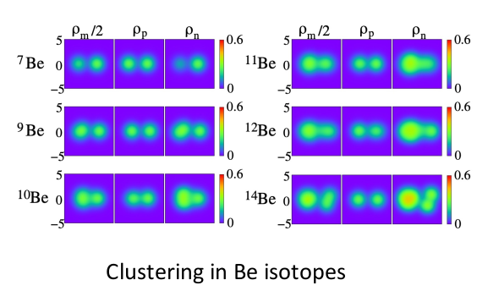
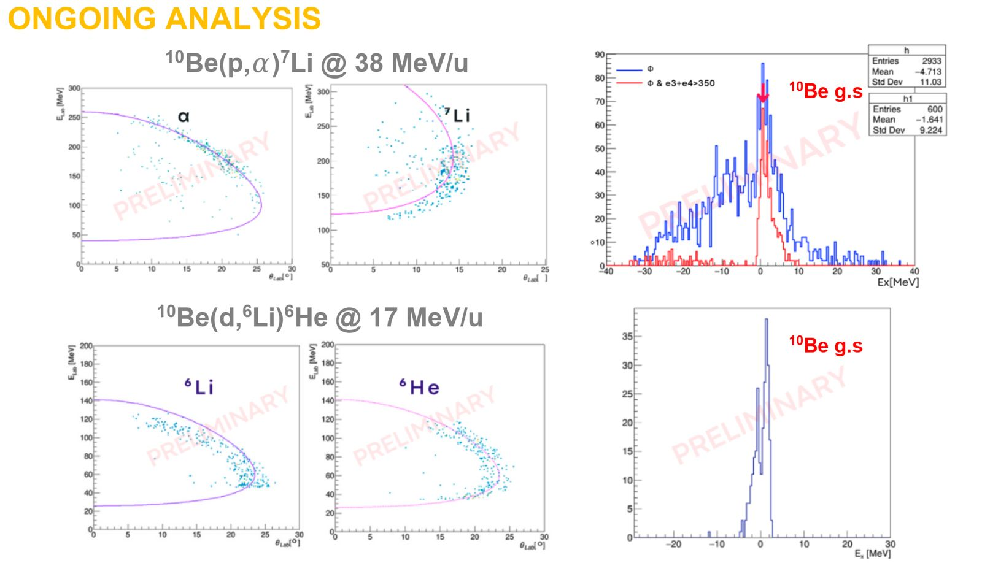
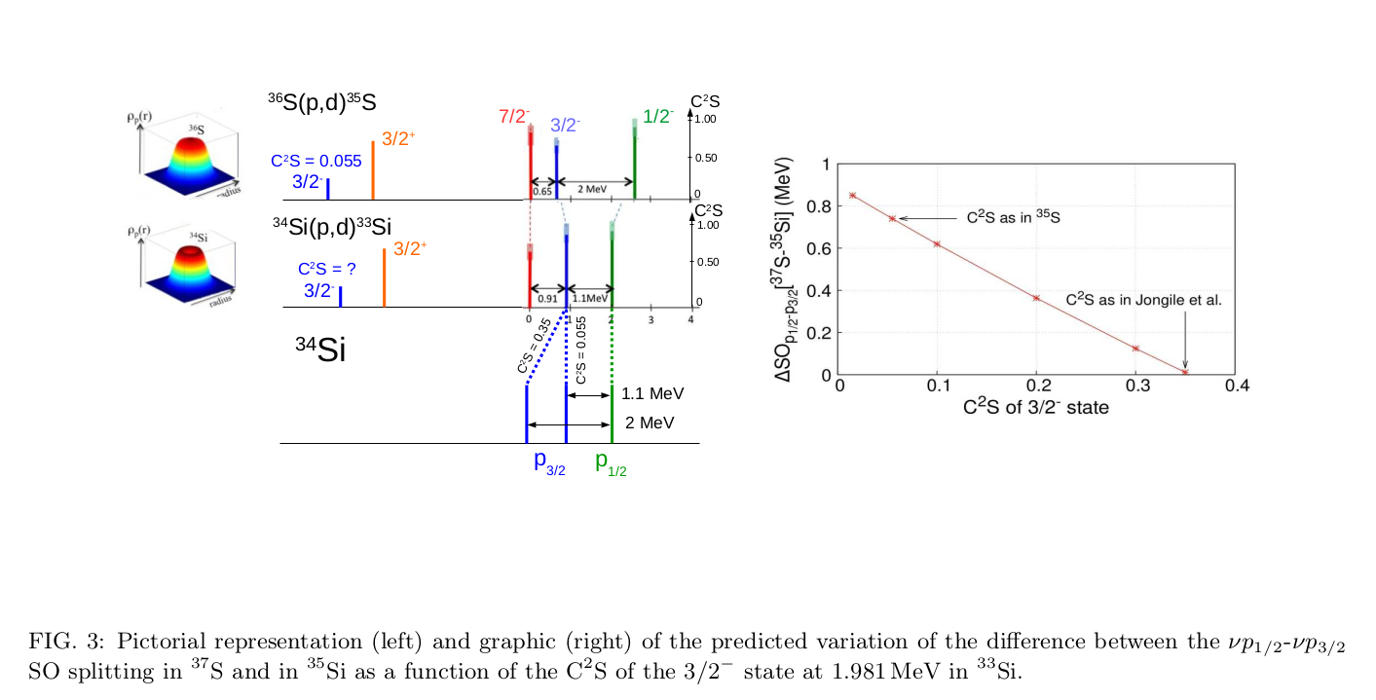
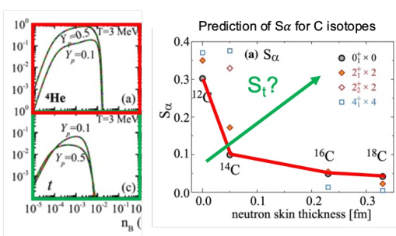
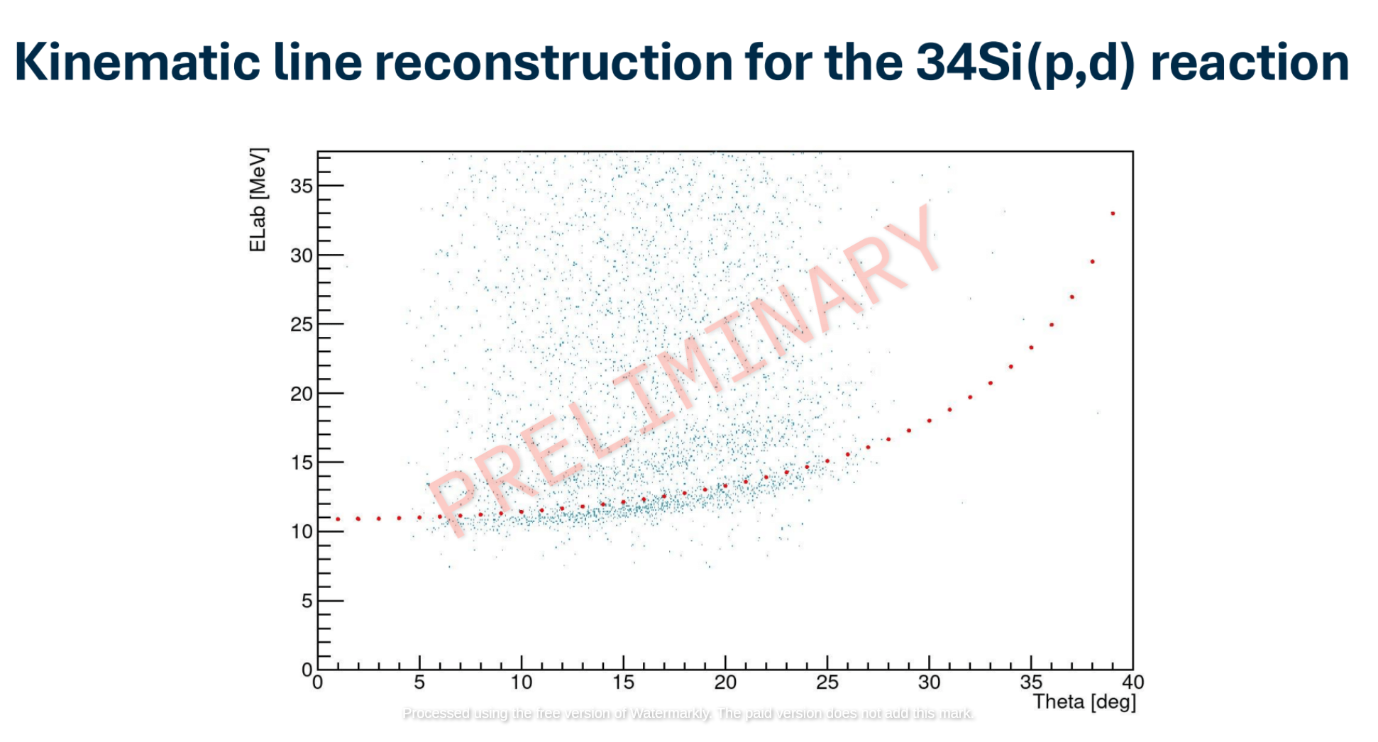
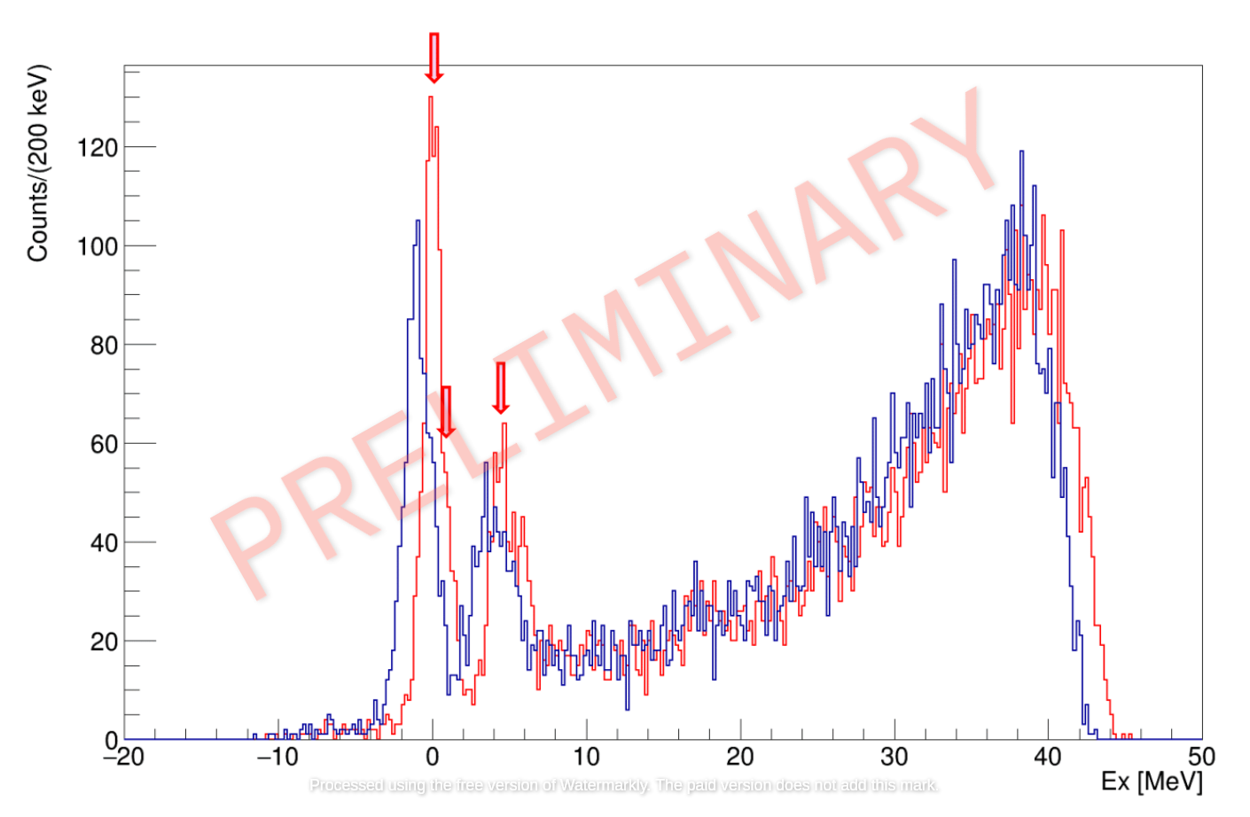
MUGAST@LISE : LISE2024 campaign
F. Galtarossa, O. Sorlin
V.Girard-Alcindor, D. Beaumel
Reaction Studied :
  ^{10,12}Be(p, α)^{7,9}Li - ¹⁰Be(d,⁶Li)⁶He
Phenomena studied : Cluster structure of the ground state of light exotic nuclei beyond α - clustering
Reaction Studied :
³⁶S(p, d)³⁵S - ³⁴Si(p,d)³³Si
Phenomena studied : Evolution of the neutron
1d3/2-1d5/2 spin-orbit splitting in N = 19 isotones and Fermi surface in ³⁴Si
Expected triton clustering in neutron rich isotopes
Q. Zhao Eur. Phys. J.A 57:157 (2021)
Z.-W. Zhang and L.-W Chen, Phys. Rev. C 95, 064330 (2017).

