Slide 1
Mugast calibration
27 feb 2024
Ozge A.

Slide 2
Run table for Time and Energy calibration
Mugast | strip | Run# for Time | Run# for Energy
MG1 | X | 101 | 573
 | y | 102 | s
MG2 | x | 103 | s
 | y | - | s
MG3 | x | 103 | s
 | y | 104 | s
MG4 | x | 105 | s
 | y | - | s
MG5 | x | 105 | s
 | y | 106 | s

Slide 3
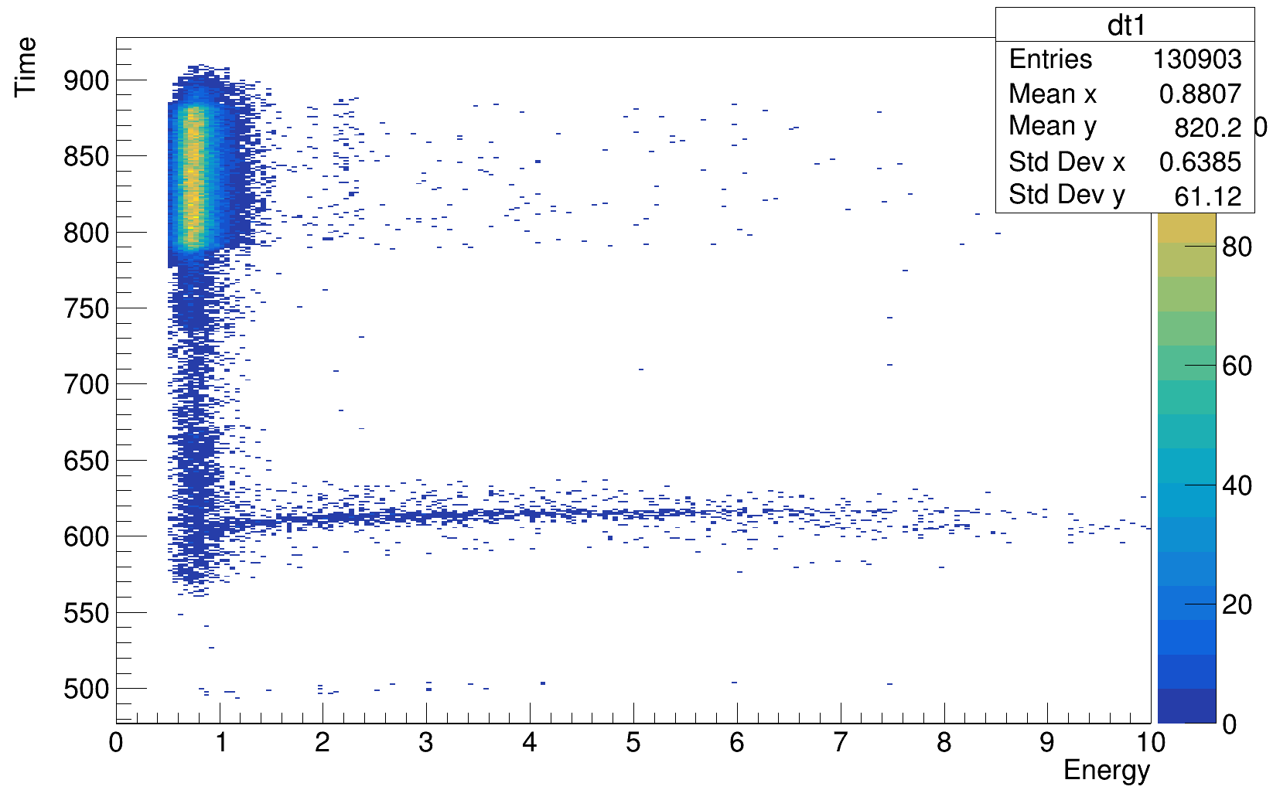
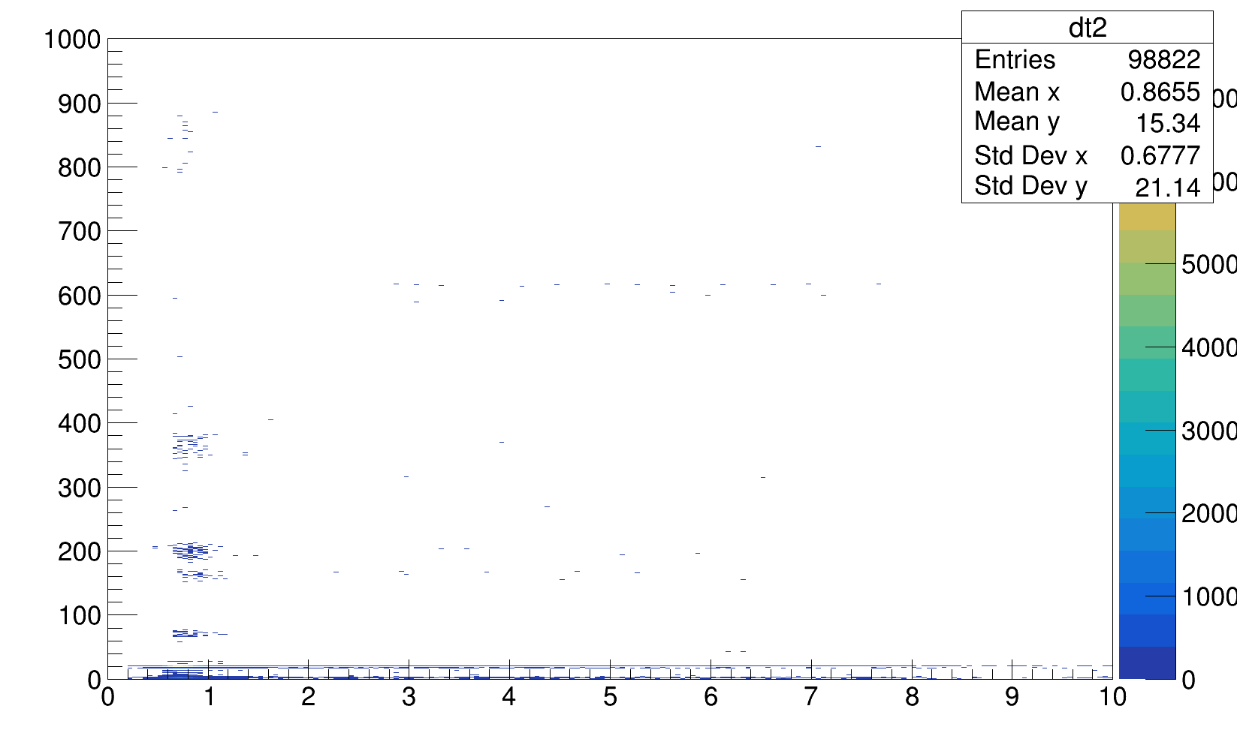
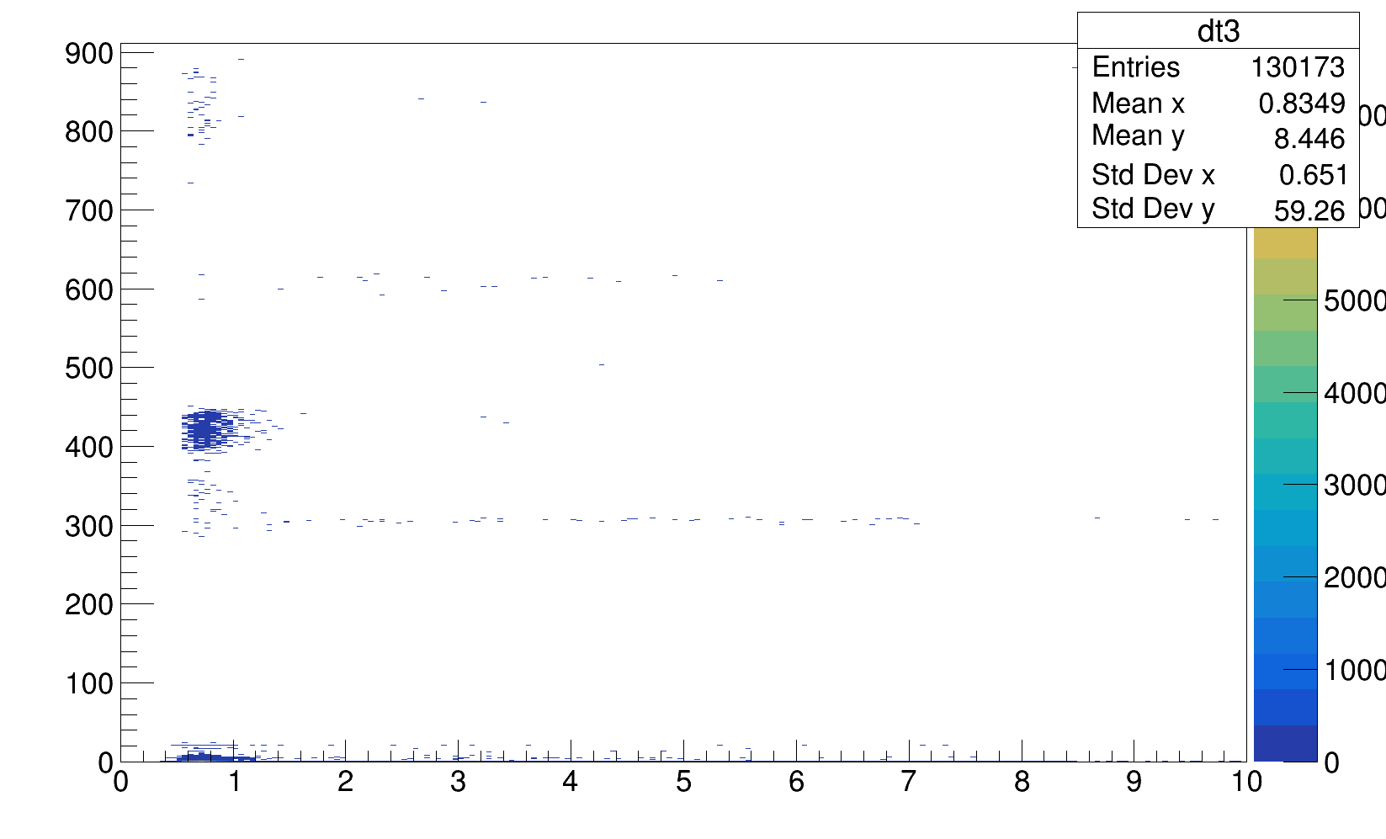
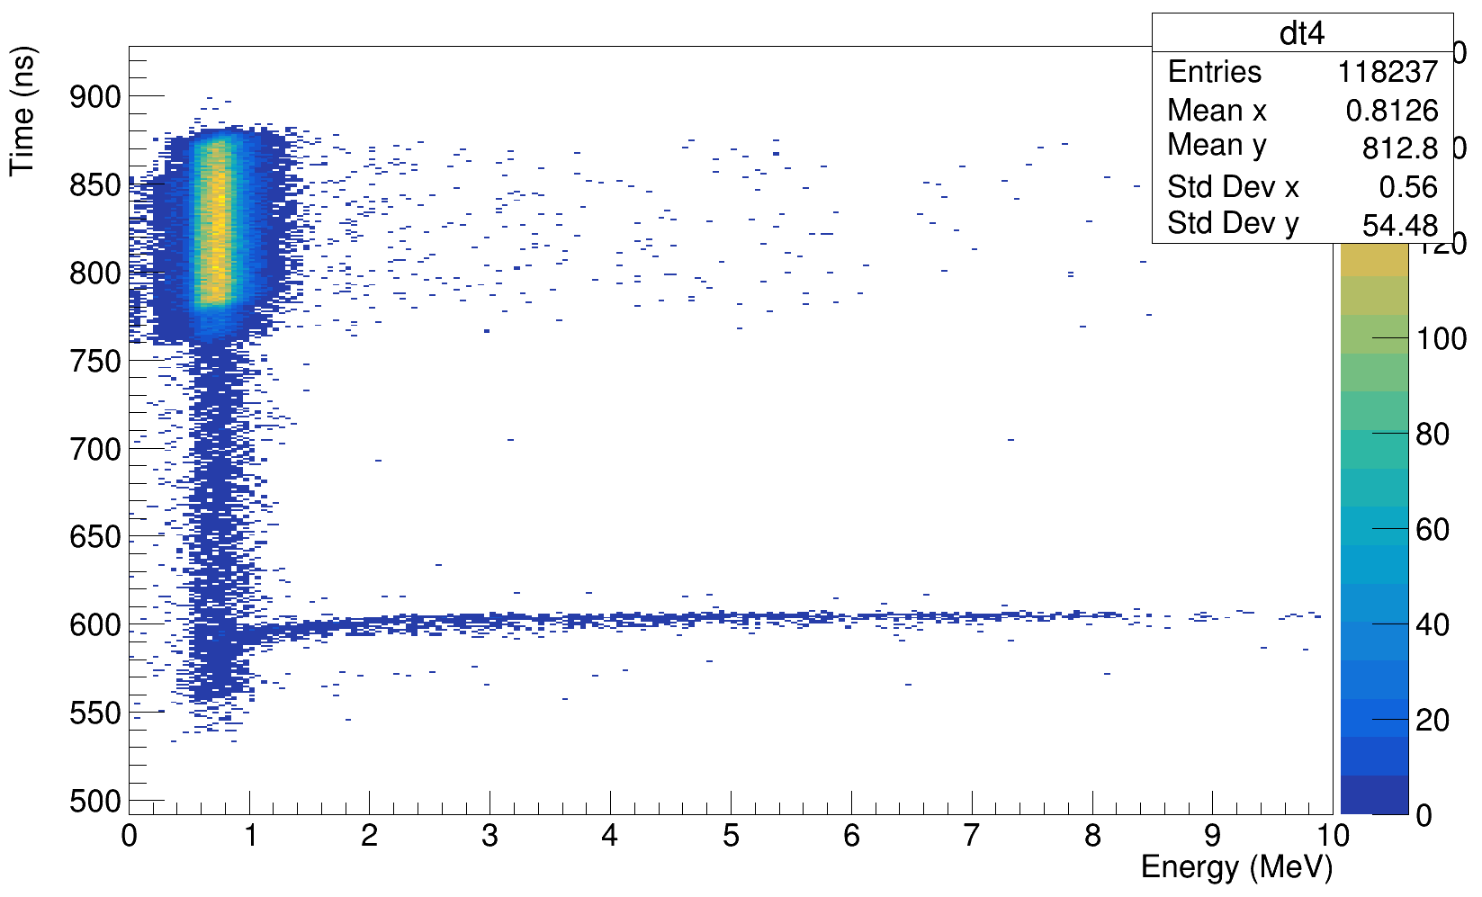
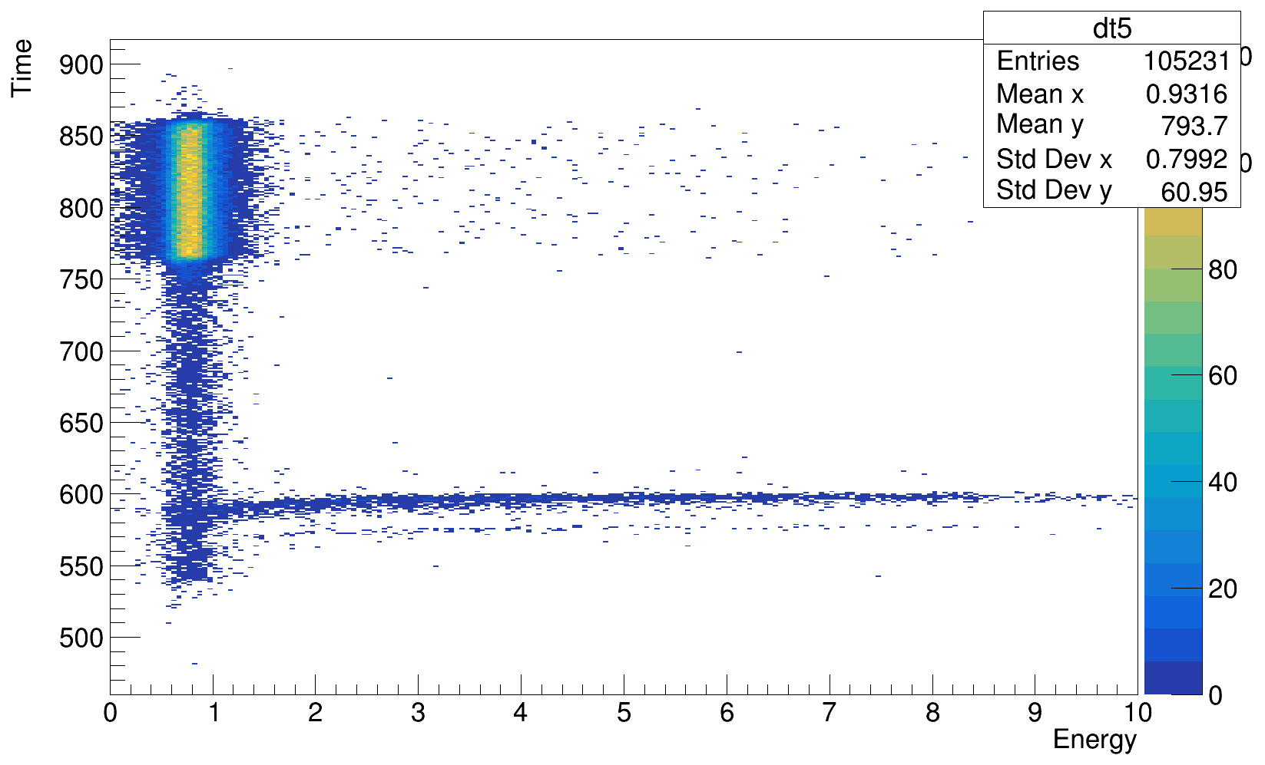
Results time with X strips
Telescope 2 and 3 X strip time is not responding (possible CFD problem maybe), for T1, T4 and T5 Time sigma ~ 280 ns

Slide 4
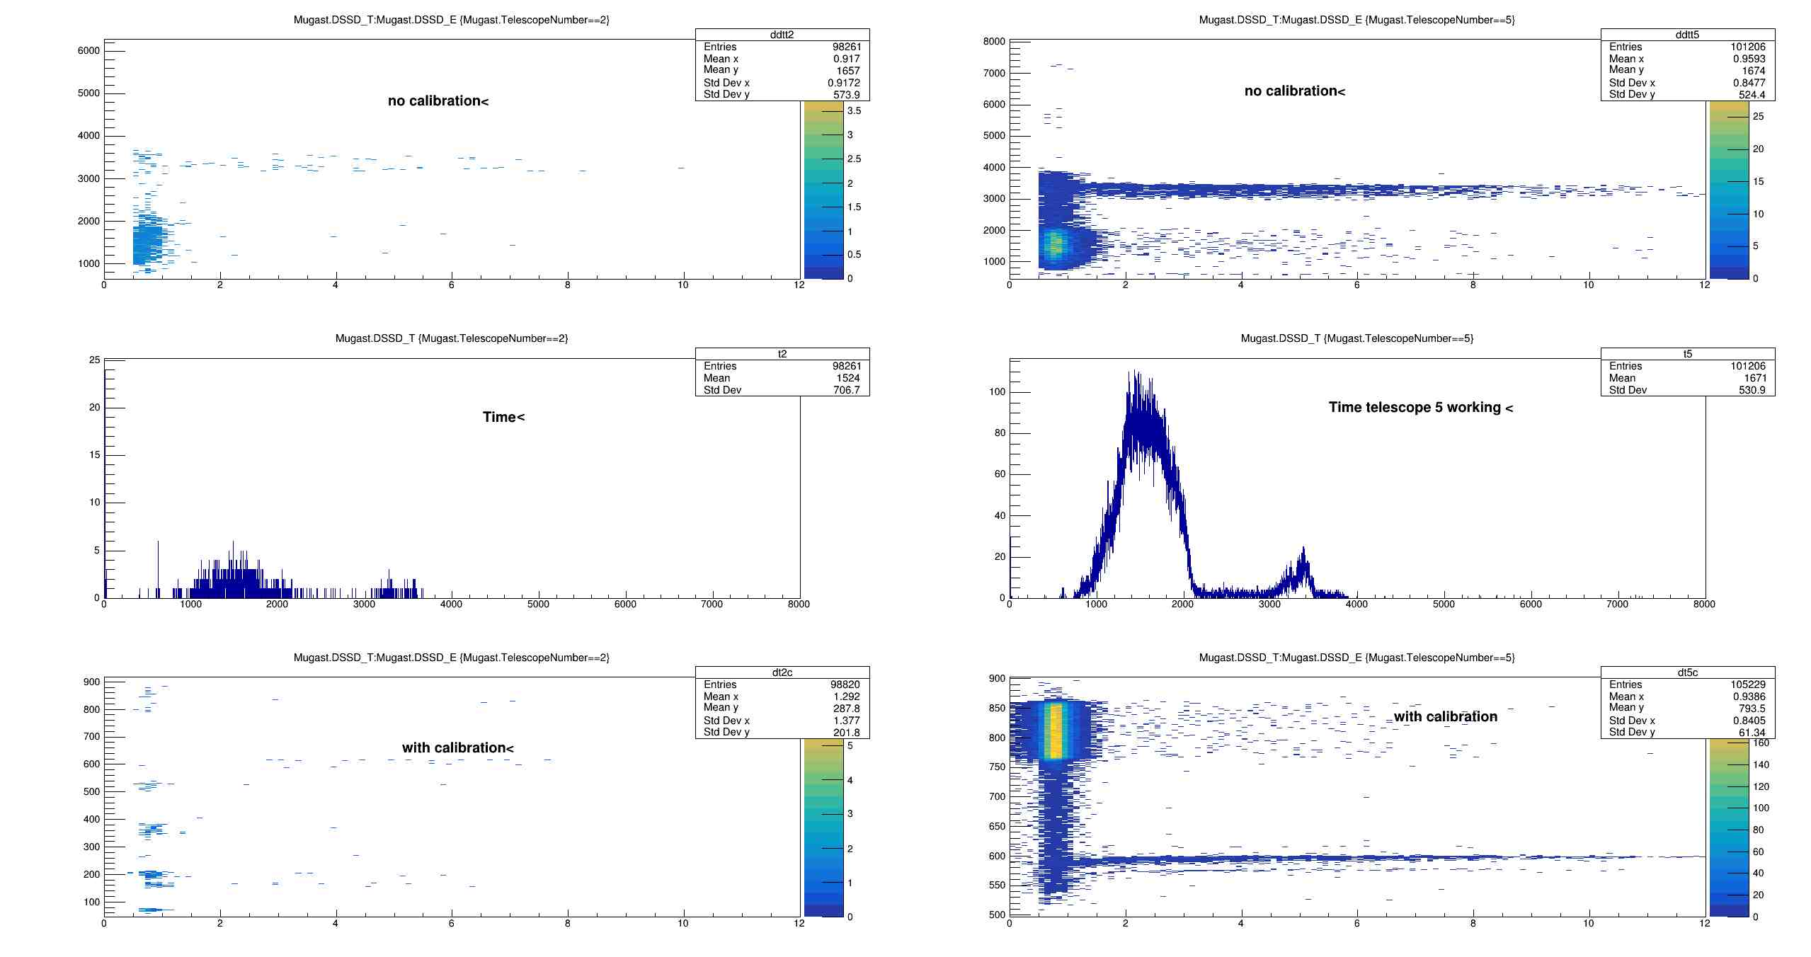
Telescope 2 (not working) and 5 (working) comparison

Slide 5
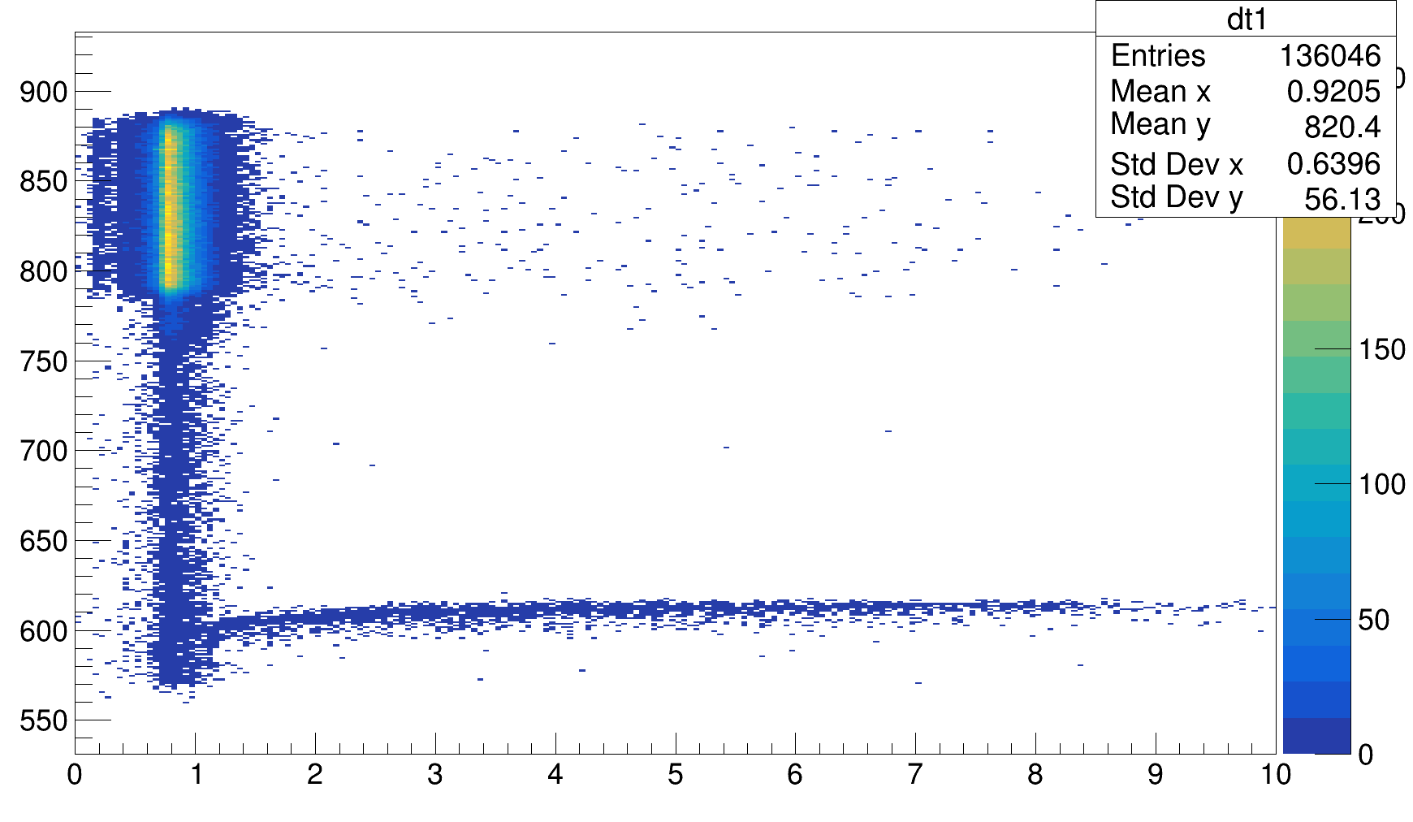
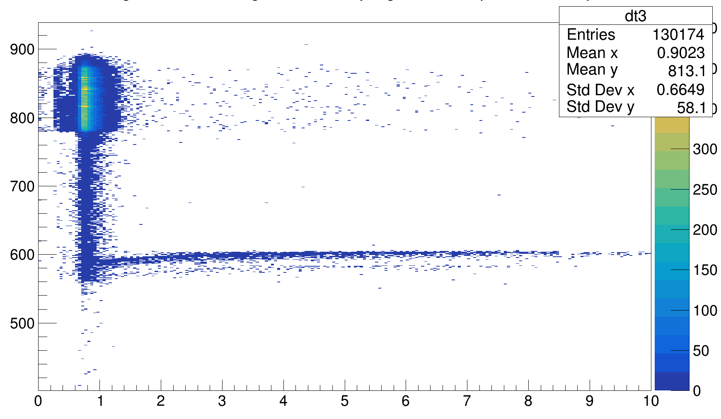
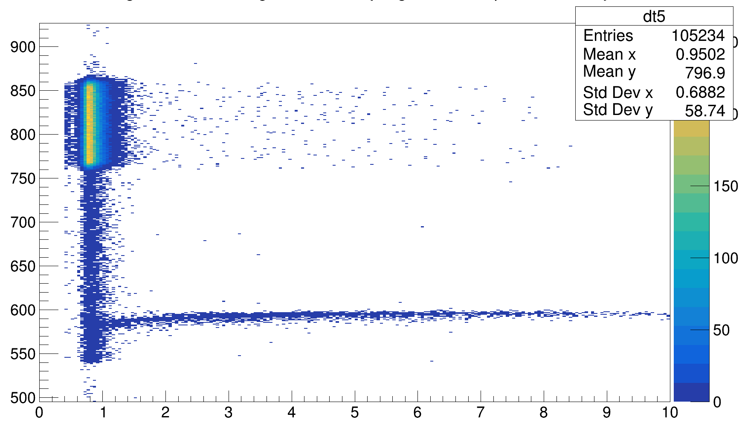
Time results of Strip Y
We only have calibration on T1, T3 and T5.
Since T3 X strips are not responding well.
I will use Y strip for T3,
Therefore I can have T1,T2,T3 and T5 telescope time information.
I change the TMugastPhysics library to take different strips for different telescope, which is not pushed in gitlab yet.

Slide 6
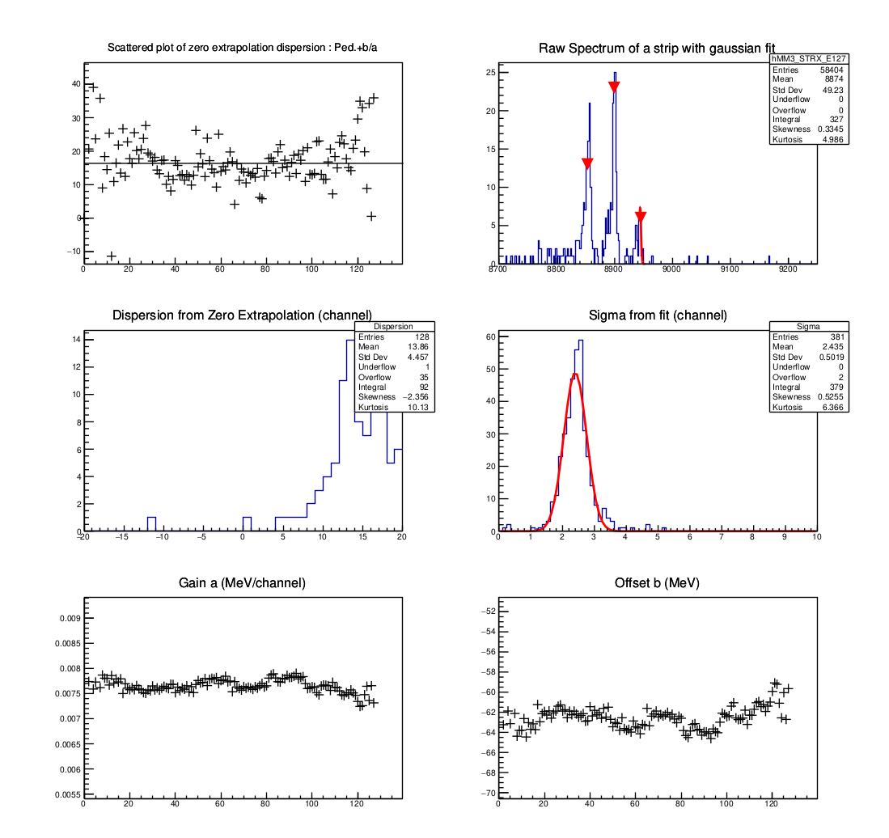
Energy calibration
I use EnergyCalibrator.C code with Run573 end of the experiment. Zero Extrapolation method.
The calibration parameters didn’t change when we compare with the beginning of the experiment , DSSD was stable during experiment.
For 2.4 MeV sigma = 0.35

Slide 7
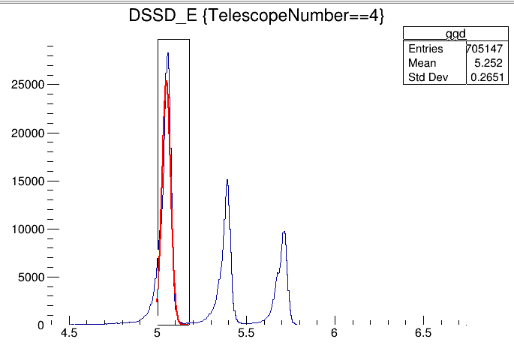
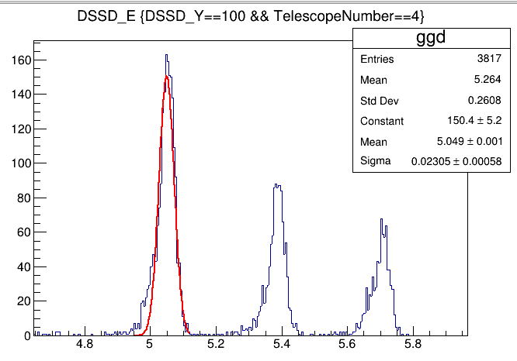
Mugast energy calibration
For random single strip in Y:
1 Constant 1.50338e+02
2 Mean 5.04926e+00
3 Sigma 2.30650e-02
For one teslescope 4 Y:
1 Constant 2.53331e+04
2 Mean 5.04908e+00
3 Sigma 2.43750e-02
Root file : r573_EY_TX / r573_EX_TX

Slide 8
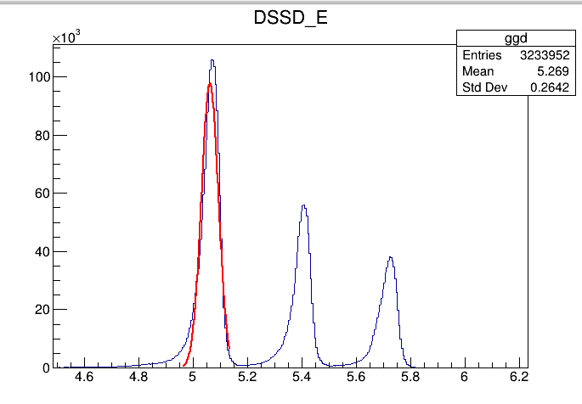
For all in Energy Y
1 Constant 9.77186e+04
2 Mean 5.06148e+00
3 Sigma 3.11182e-02

Slide 9
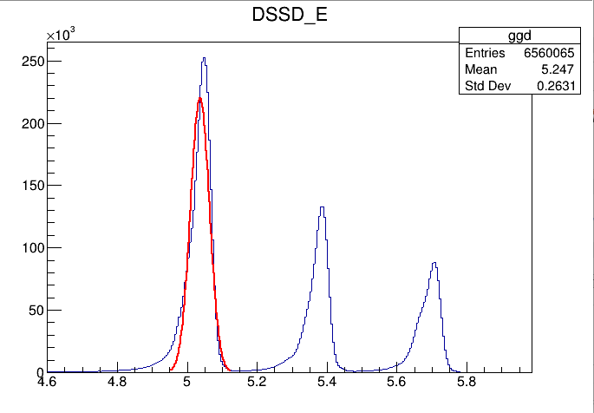
For Energy X
1 Constant 2.20425e+05
2 Mean 5.03649e+00
3 Sigma 2.70858e-02

Slide 10
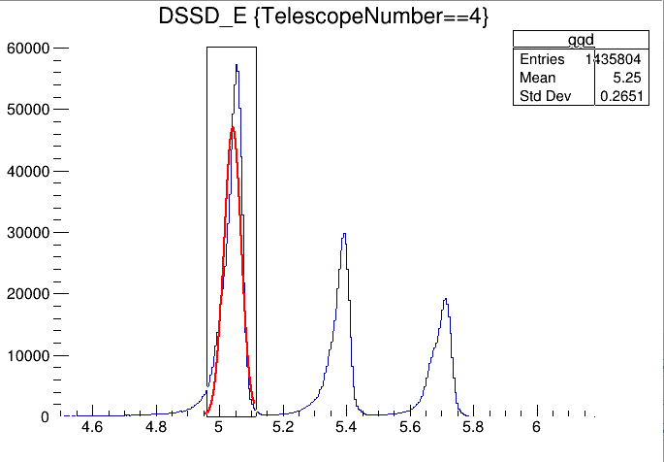
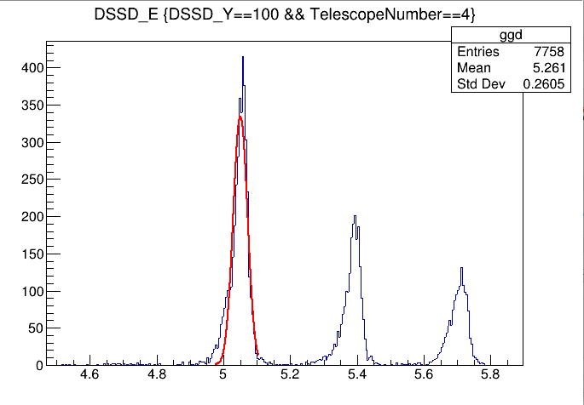
For one telescope 4 :
1 Constant 4.70283e+04
2 Mean 5.04117e+00
3 Sigma 2.71832e-02
For random strip :
1 Constant 3.34030e+02
2 Mean 5.05021e+00
3 Sigma 2.13179e-02

