Slide 1
TOF calculation
Used runs:
68Ni
  Run507 in exp. data = Run432 in Lise data
  Lise++ file : e843_extended_Ok_Foc62_Run432.lpp
  Information from LISE online notes:
  Run 432 (68Ni with wedge @ ~ 40 MeV/A) -> F31 to +3/+13; F43 to +-15; F51 = -17/+25; Brho2_RMN = 2.1687 => Brho2_L++ =2.1671
Used runs:
68Ni beam:
  Run503 in exp. data = Run424 in Lise data
  Lise++ file : e843_extended_Ok_Foc62_Run425.lpp
  Information from LISE online notes:
  Run 424 (68Ni without wedge)
  -> F31 to +4/+13; F43 to +-15; Brho2_RMN = 2.5126 => Brho2_L++ =2.5107

Slide 2
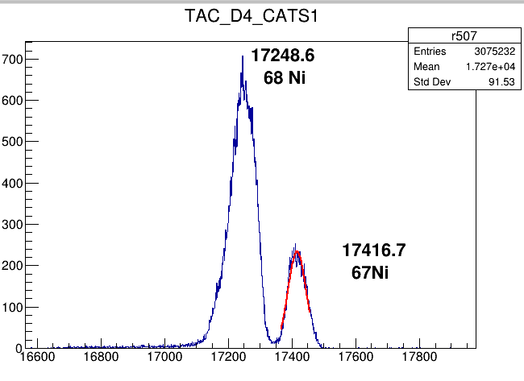
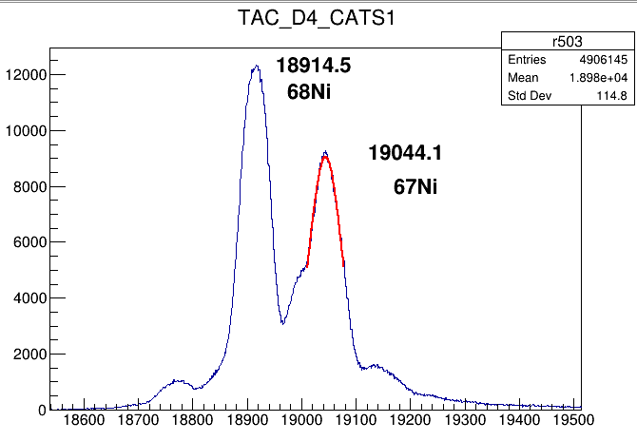
T-CATS1-D4
 |  |  | Notebook values |  |  | calculated |  |  |  | channels
Runexp | RunLISE | isotope | brho | Energy | velocity | distance cm | TOF catsd4 | distance cm | TOFDD6-DD4 | Cats-D4 | DD6-DD4
507 | 432 | 68Ni | 2.1671 | 37.7436 | 8.28462 | 2639 | 318.542069521595 | 2150 | 259.51703276 | 17240.0 | 32035.0
507 | 432 | 67Ni | 2.1671 | 37.7436 | 8.39881 | 2639 | 314.211179917155 | 2150 | 255.9886460105 | 17416.0 | 32035.0
503 | 425 | 68Ni | 2.5107 | 50.32794 | 9.47515 | 2639 | 278.518018184409 | 2150 | 226.9093365276 | 18914.8
503 | 425 | 67Ni | 2.5107 | 51.80388 | 9.60235 | 2639 | 274.828557592673 | 2150 | 223.9035236166 | 19043.0

Slide 3
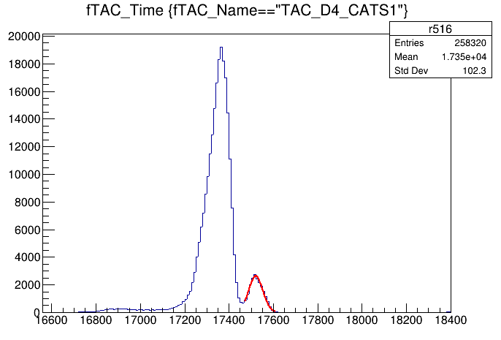
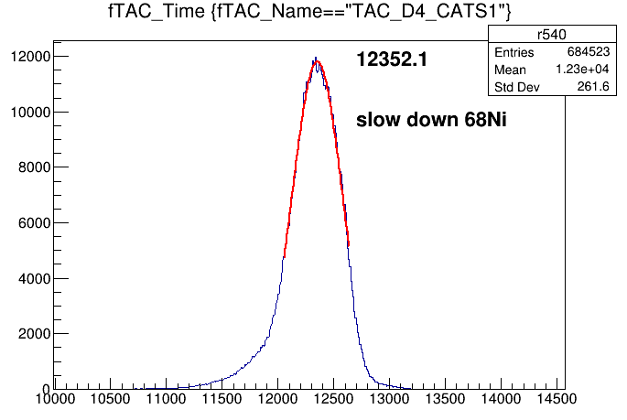
 |  |  | Notebook values |  |  | calculated |  |  |  | channels
Runexp | RunLISE | isotope | brho | Energy | velocity | distance cm | TOF catsd4 | distance cm | TOFDD6-DD4 | Cats-D4 | DD6-DD4
507 | 432 | 68Ni | 2.1671 | 37.7436 | 8.28462 | 2639 | 318.542069521595 | 2150 | 259.51703276 | 17240.0 | 32035.0
507 | 432 | 67Ni | 2.1671 | 37.7436 | 8.39881 | 2639 | 314.211179917155 | 2150 | 255.9886460105 | 17416.0 | 32035.0
503 | 425 | 68Ni | 2.5107 | 50.32794 | 9.47515 | 2639 | 278.518018184409 | 2150 | 226.9093365276 | 18914.8
503 | 425 | 67Ni | 2.5107 | 51.80388 | 9.60235 | 2639 | 274.828557592673 | 2150 | 223.9035236166 | 19043.0
2639
2150

Slide 4
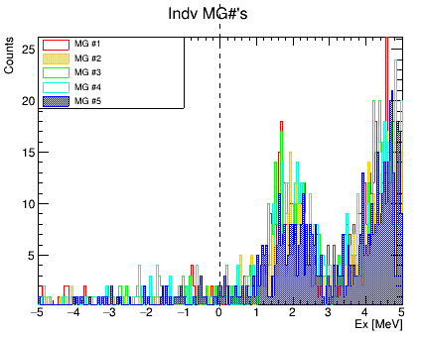
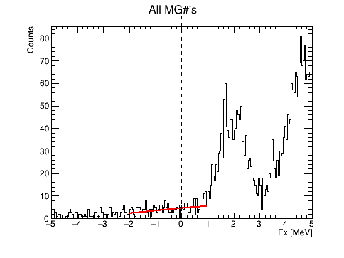
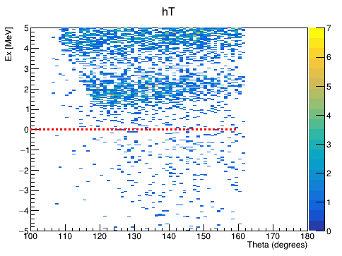
slope | gain | Channel Slow down | tof | L | velocity | Beam E | MG_Ex
-0.024050 | 732.91 | 12352.1 | 435.847 | 2639 | 6.054877 | 19.60022 | 2 MeV

Slide 5
slope | gain | channel | tof | L | velocity | Beam E | MG_Ex
-0.019593 | 597.109 | 12352.1 | 355.085 | 2150 | 6.054877 | 19.60022 | 2 MeV

Slide 6
Second method using only one run and tac calibrator slope,
finding Time refarance 0

Slide 7
T-CATS1-D4
TOF = (Time_0_ref - TAC_CATS1_D4)*slope
 |  |  | calculated |  |  |  | channels |  | Time 0 ref
Runexp | RunLISE | isotope | distance cm | TOF catsd4 | distance cm | TOF L21 | Cats-D4 | Slope | L26 | L 21
507 | 432 | 68Ni | 2639 | 318.542069521595 | 2150 | 259.51703276 | 17240.0 | 0.02554 | 29712.2 | 27394.2
503 | 425 | 68Ni | 2639 | 278.518018184409 | 2150 | 226.9093365276 | 18914.8 | 0.02554 | 29812.5 | 27793.2
 | Slowed down data TOF calculated from cal parameters |  |  | TOF L# | VelocL26 | E Beam | channel | MG_Ex | TKE
540 |  | 68Ni | 2639 | 443.379 | 5.952 | 19.07 | 12352.1 | 1.5 MeV
540 |  | 68Ni | 2150 | 384.1771 | 5.5963 | 16.93 | 12352.1 | 0 MeV | 1159.9214 MeVu

Slide 8
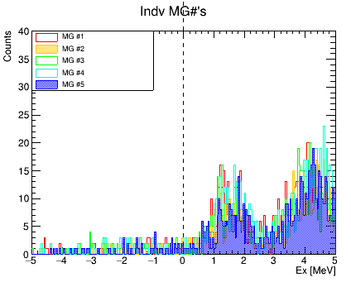
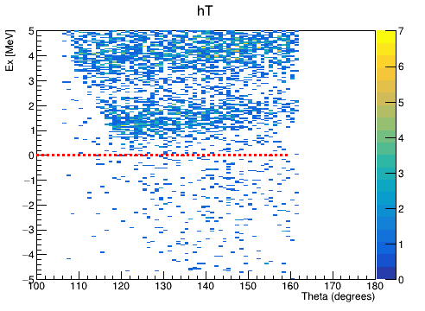
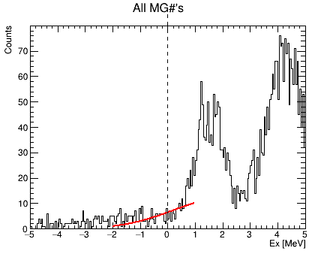
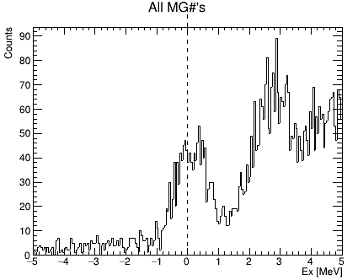
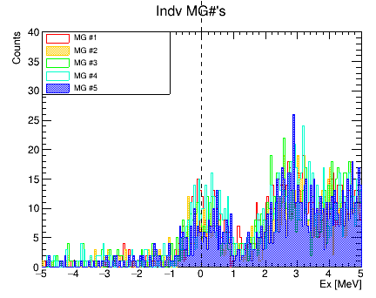
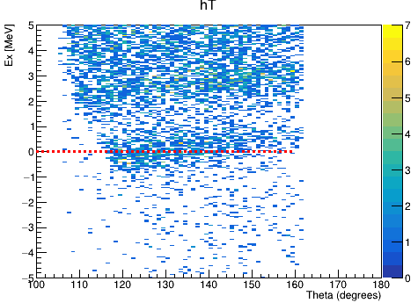

Slide 9
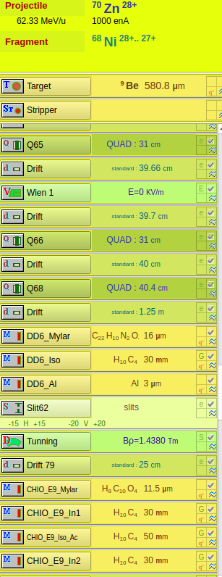
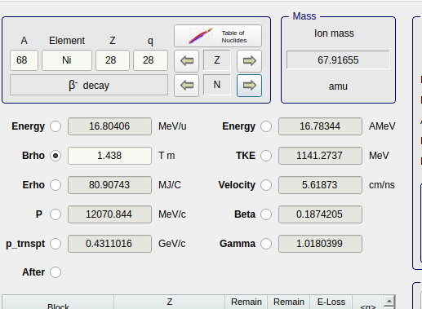
LISE++ for slowed down beam
Measured v = 5.5963
LISE++ calculated = 5.6187
Brho 1.4380Tm

Slide 10
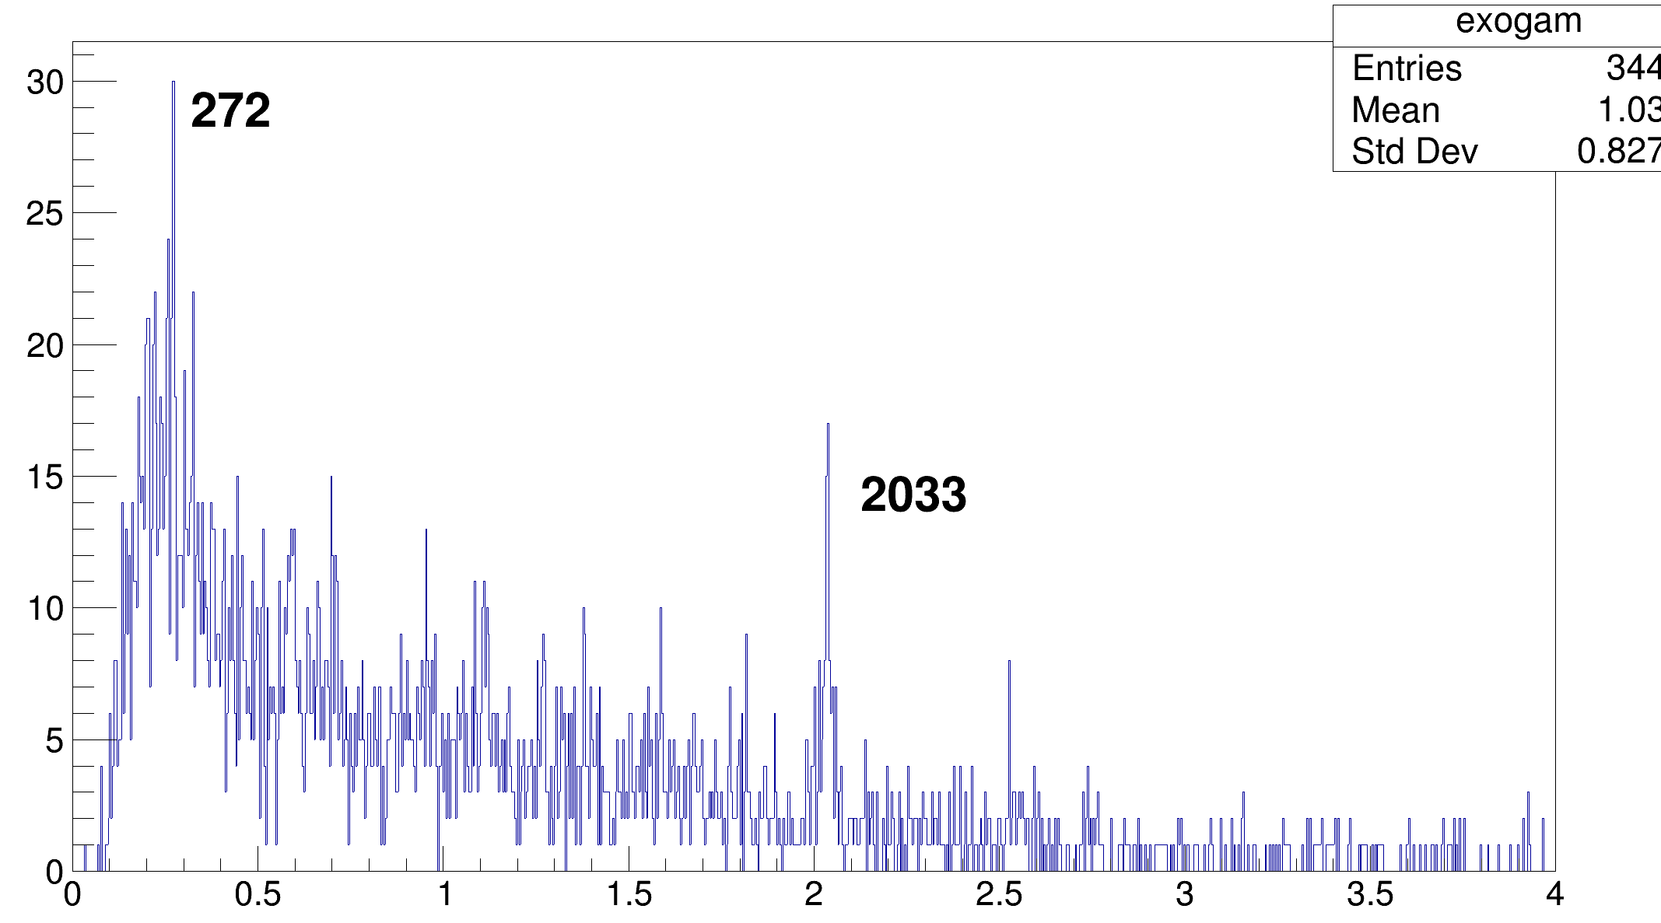
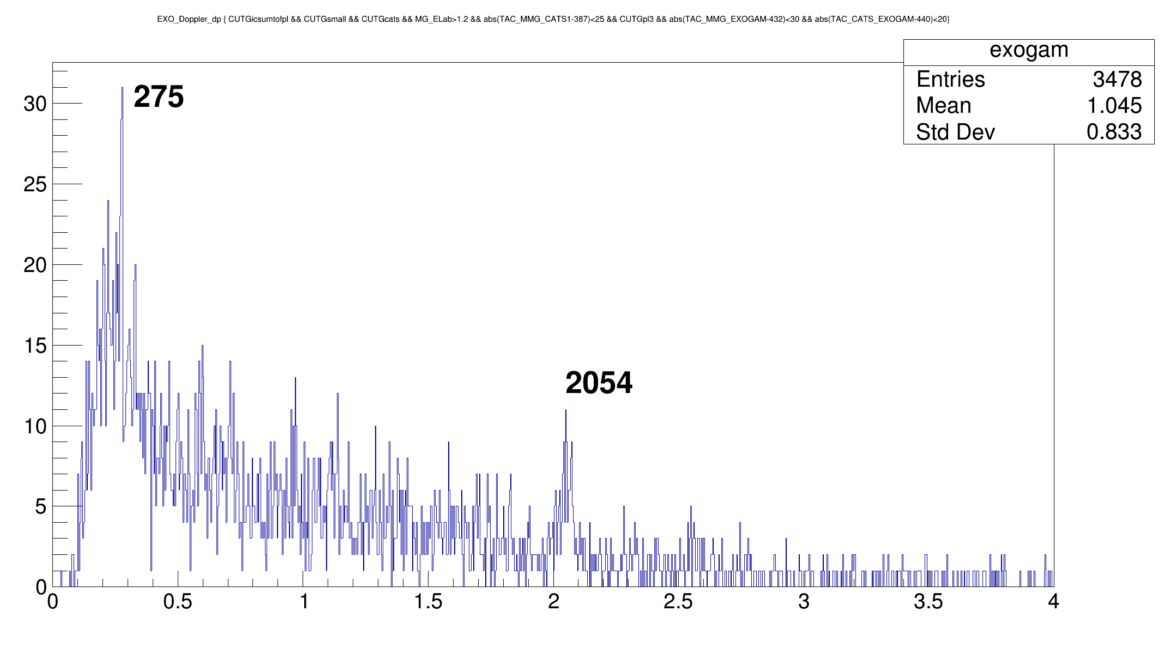
Another method is to check doppler correction Exogam
Beta for L21 calibration is 0,1825
Beta for L26 calibration is 0,1882

Slide 11
The problem, can be :
Wrong cable of tac : cats mixed with D6 (really low probablity)
Wrong listing of tac channel (I checked other tac channels T-DD6-DD4 and T-CATSD6-D4 from lise daq, it gives the same energy 19 MeV)
Lise tacs are not trustable, since there is an integration window problem most probably.

Slide 12
Mixing channel (most probable scenario since D6-D4 is 21 meter)
TAC_CATS_D4 → TAC_D6_D4 (lise)
TAC_D6_D4 (lise)→ TAC_CATS_D4
Then D6-D4 should give correct results in 26 meter

Slide 13
T-DD6-DD4
TOF = (Time_0_ref - TAC_DD6_DD4)*slope
 |  |  | calculated |  |  |  | channels |  | Time 0 ref
Runexp | RunLISE | isotope | distance cm | TOF catsd4 | distance cm | TOF L21 | D4-D6 | Slope | L26 | L 21
507 | 432 | 68Ni | 2639 | 318.542069521595 | 2150 | 259.51703276 | 32035 | 0.00749 | 74563 | 66659.9
503 | 425 | 68Ni | 2639 | 278.518018184409 | 2150 | 226.9093365276 | 36663 | 0.00749 | 73823.8 | 66938
 | Slowed down data TOF calculated from cal parameters |  |  | TOF L# | VelocL26 | E Beam | channel | MG_Ex
540 |  | 68Ni | 2639 | 414.16 | 6.3719 | 21.78 | 19268.7 | 2.5 MeV
540 |  | 68Ni | 2150 | 354.96 | 6.057 | 19.6 | 19268.7 | 2 MeV

Slide 14
T-CATSD6-DD4
TOF = (Time_0_ref - TAC_CATSD6_DD4)*slope
 |  |  | calculated |  |  |  | channels |  | Time 0 ref
Runexp | RunLISE | isotope | distance cm | TOF catsd4 | distance cm | TOF L21 | D4-D6 | Slope | L26 | L 21
507 | 432 | 68Ni | 2639 | 318.542069521595 | 2150 | 259.51703276 | 24366.2 | 0.00691
503 | 425 | 68Ni | 2639 | 278.518018184409 | 2150 | 226.9093365276 | 18279.3 | 0.00691
 | Slowed down data TOF calculated from cal parameters |  |  | TOF L# | VelocL26 | E Beam | channel | MG_Ex
540 |  | 68Ni | 2639 | 414.16 | 6.3719 | 21.78 | 19268.7 | 2.5 MeV
540 |  | 68Ni | 2150 | 354.96 | 6.057 | 19.6 | 19268.7 | 2 MeV

Slide 15
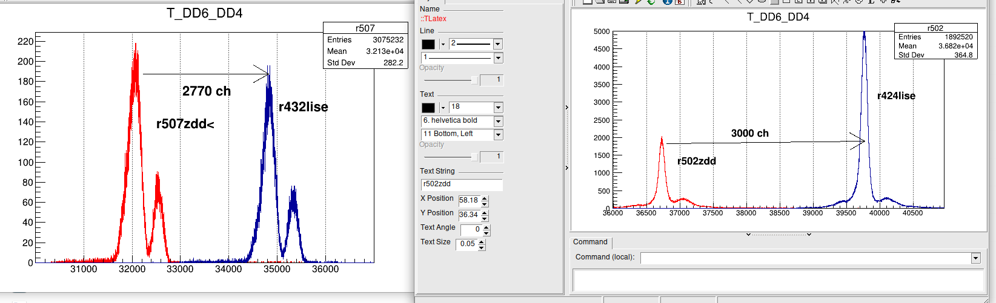
Integration gate problem
During the analysis, I compare the Lise runs with zdd runs. Since we have the same signal, I was expecting to see same results for two tacs that we copy from them.
But I see such comparison during this analysis: there is shift in both channel and amplitude. Which simply can be explained by the signal attenuation. However if it is only attenuated, the shift (2770 ch) should be same for each run, while the situation is not like that.
Therefore, there is more serious issue here :

Slide 16
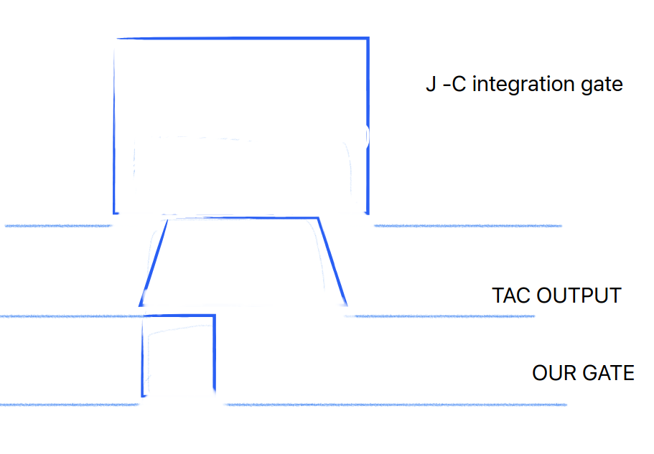
Possible scenario :
Most probably, our integration gate is smaller than what he used, and we are integrating in the rise part of the logic signal, so there is lots of fluctuations, and the signal is not reliable.
This scenario makes lise copy tacs, unreliable.

Slide 17
BACKUP
ASSUME 67Ni is not 67 Ni

Slide 18
T-CATS1-D4
 |  |  | Notebook values |  |  | calculated |  |  |  | channels
Runexp | RunLISE | isotope | brho | Energy | velocity | distance cm | TOF catsd4 | distance cm | TOFDD6-DD4 | Cats-D4 | DD6-DD4
507 | 432 | 68Ni | 2.1671 | 37.7436 | 8.28462 | 2639 | 318.542069521595 | 2150 | 259.51703276 | 17240.0 | 32035.0
503 | 425 | 68Ni | 2.5107 | 50.32794 | 9.47515 | 2639 | 278.518018184409 | 2150 | 226.9093365276 | 18914.8
Slope : -0.02388,
gain 730.0388
Tof; 435.054
velocity: 6.0659 Energy : 19.66
No change in beam energy

Slide 19
T-DD6-DD4
TOF = (T_DD6_DD4 -Time_ref_0)*slope
 |  |  | calculated |  |  |  | channels |  | Time 0 ref
Runexp | RunLISE | isotope | distance cm | TOF catsd4 | distance cm | TOF L21 | D4-D6 | Slope | L26 | L 21
507 | 432 | 68Ni | 2639 | 318.542069521595 | 2150 | 259.51703276 | 32035 | 0.00749 | 10464.9 | 2589.7
503 | 425 | 68Ni | 2639 | 278.518018184409 | 2150 | 226.9093365276 | 36663 | 0.00749 | 73823.8 | 66938
 | Slowed down data TOF calculated from cal parameters |  |  | TOF L# | VelocL26 | E Beam | channel | MG_Ex
540 |  | 68Ni | 2639 | 65.94 | 65 | -------------- | 19268.7 | 2.5 MeV
540 |  | 68Ni | 2150 | 124.92 | 17 | -------- | 19268.7 | 2 MeV

Slide 20
T-CATS1-D4
TOF = (TAC_CATS1_D4 -Time_ref_0)*slope
 |  |  | calculated |  |  |  | channels |  | Time 0 ref
Runexp | RunLISE | isotope | distance cm | TOF catsd4 | distance cm | TOF L21 | Cats-D4 | Slope | L26 | L 21
507 | 432 | 68Ni | 2639 | 318.542069521595 | 2150 | 259.51703276 | 17240.0 | 0.02554 | 4767.71 | 6342
503 | 425 | 68Ni | 2639 | 278.518018184409 | 2150 | 226.9093365276 | 18914.8 | 0.02554 | 29812.5 | 27793.2
 | Slowed down data TOF calculated from cal parameters |  |  | TOF L# | VelocL26 | E Beam | channel | MG_Ex
540 |  | 68Ni | 2639 | 196.77452 | 13.44 | 110 | 12352.1 | ---
540 |  | 68Ni | 2150 | 156.56 | 13.7326 | 116.666 | 12352.1 | ------

Slide 21
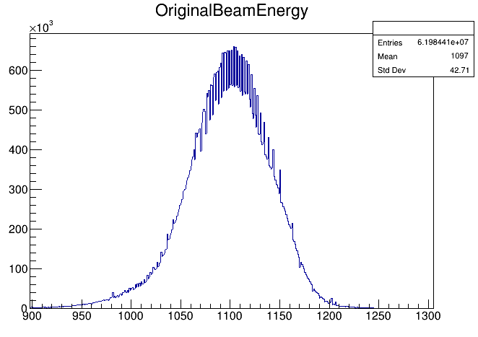
MG_Ex with TOF cuts

Slide 22
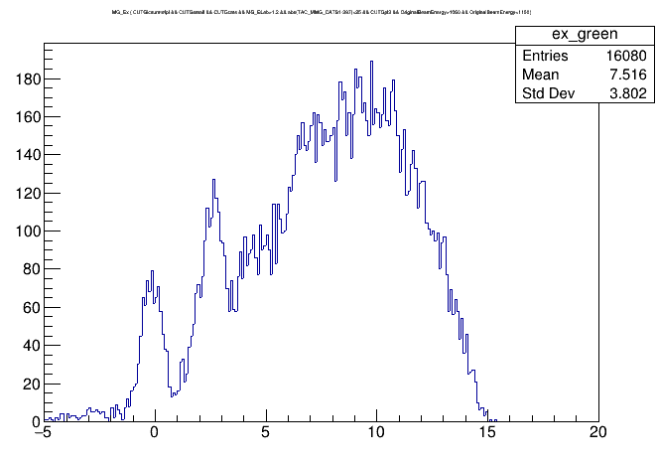
Green region

Slide 23
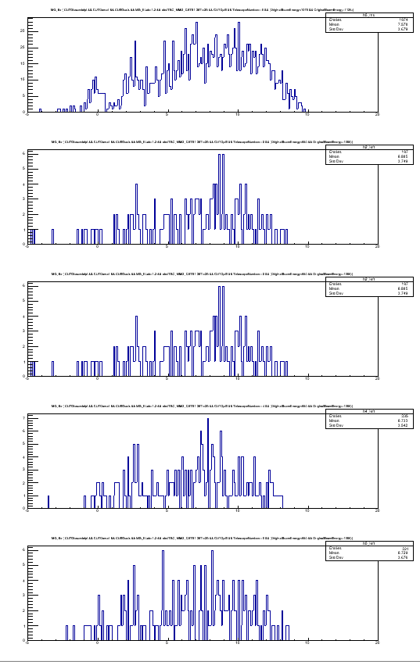
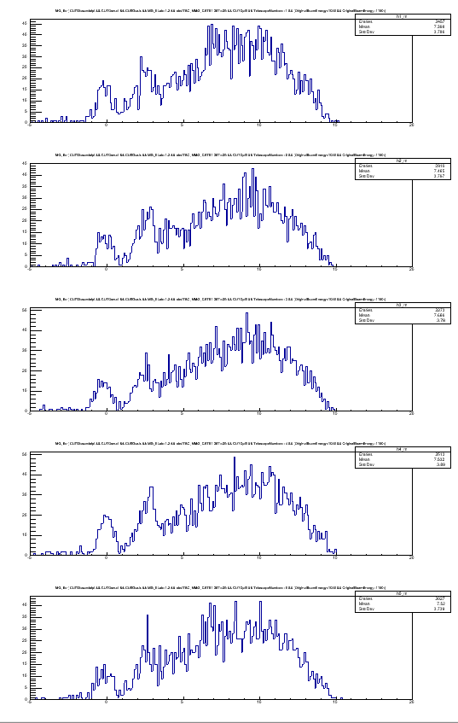
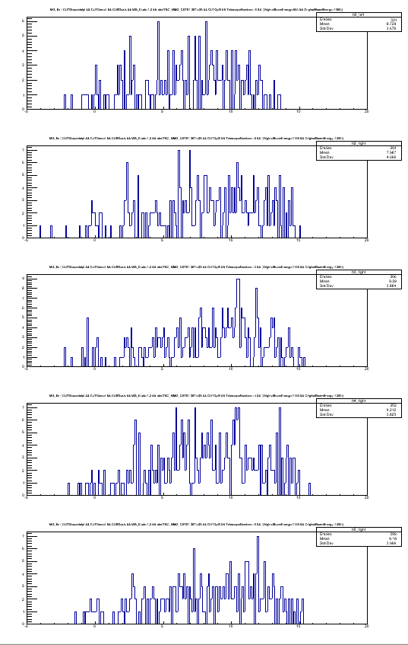

Slide 25
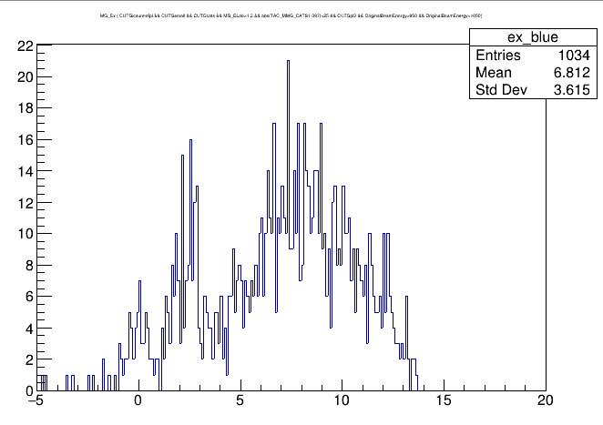
Blue region

Slide 26
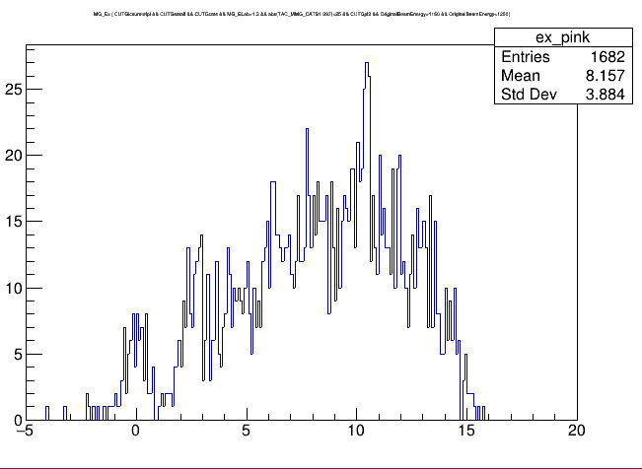
Pink region

Slide 27
