Slide 1
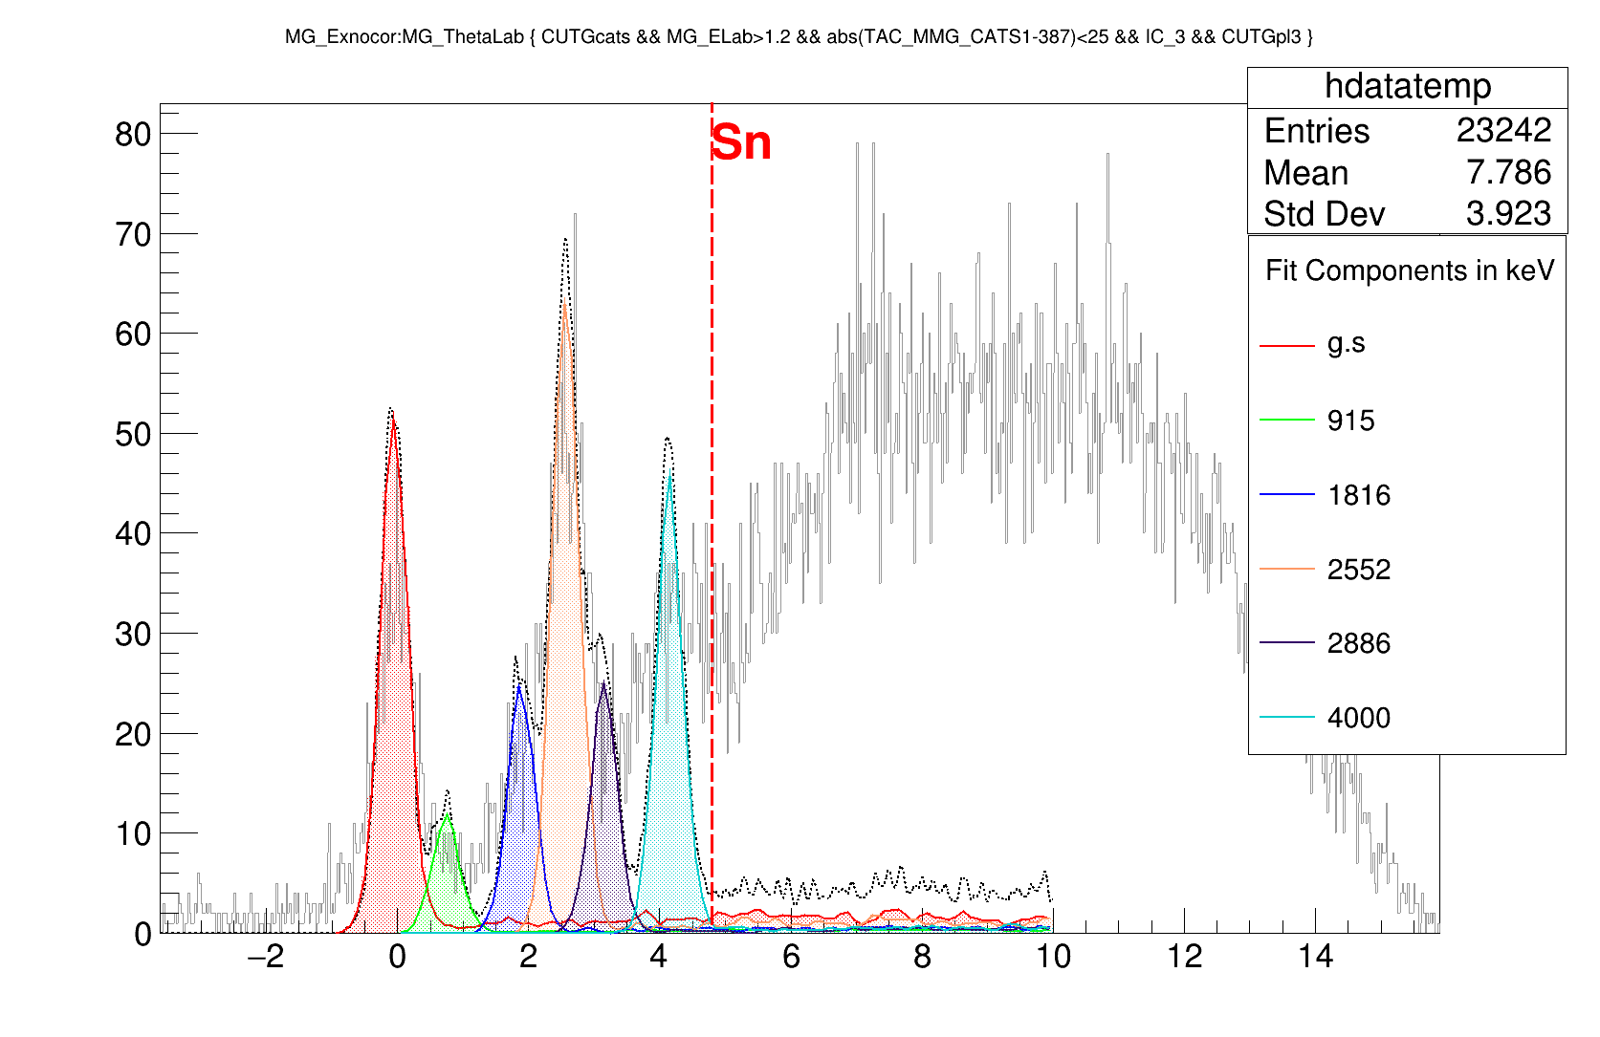
68Ni(d.p)69Ni reaction in 16.5 MeV
Ex (MeV)

Slide 2
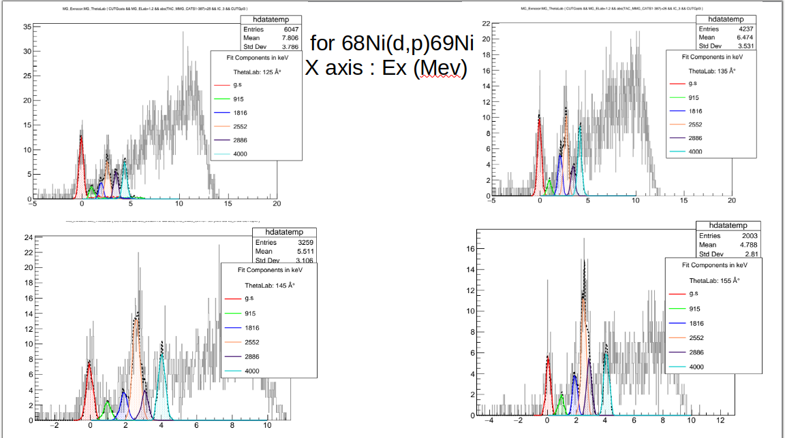

Slide 3
