Slide 1
Efficiency_I.C. D6
Runs used: NPRootA_shumpei/run_0521_*.root
Total Entries: 319,256,597
GCM Entries: 19,529,571
Time: TAC_D4_CATS1

Slide 2
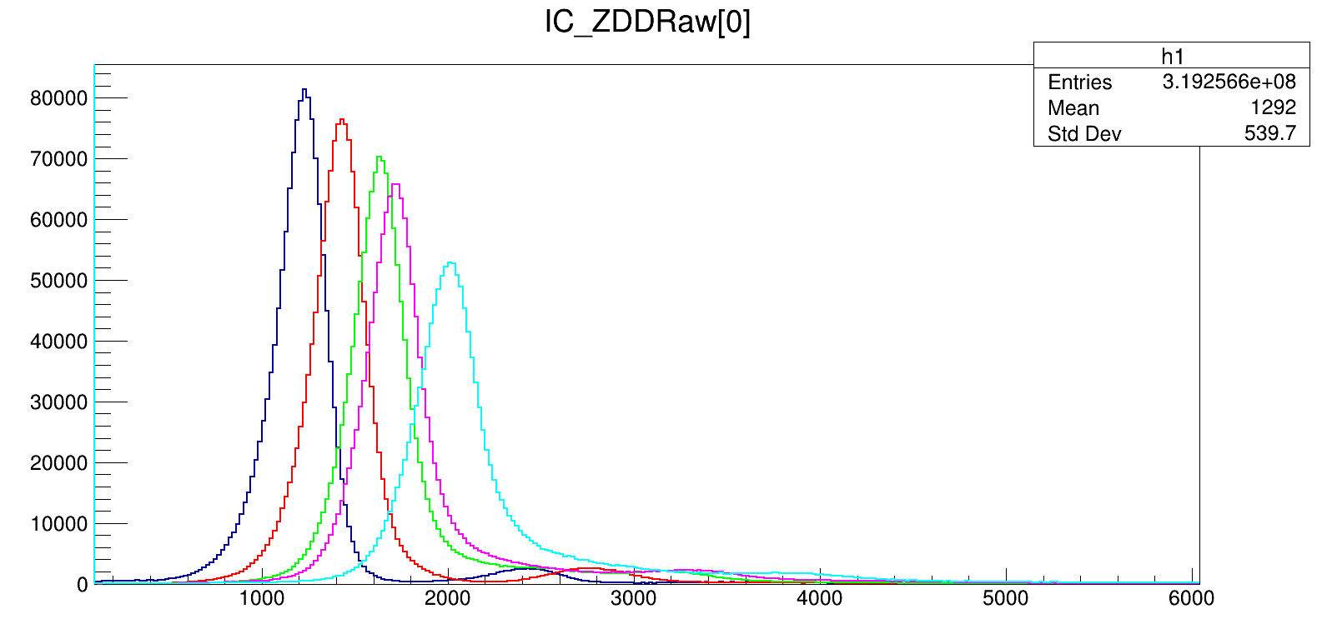
Raw (no condition)

Slide 3
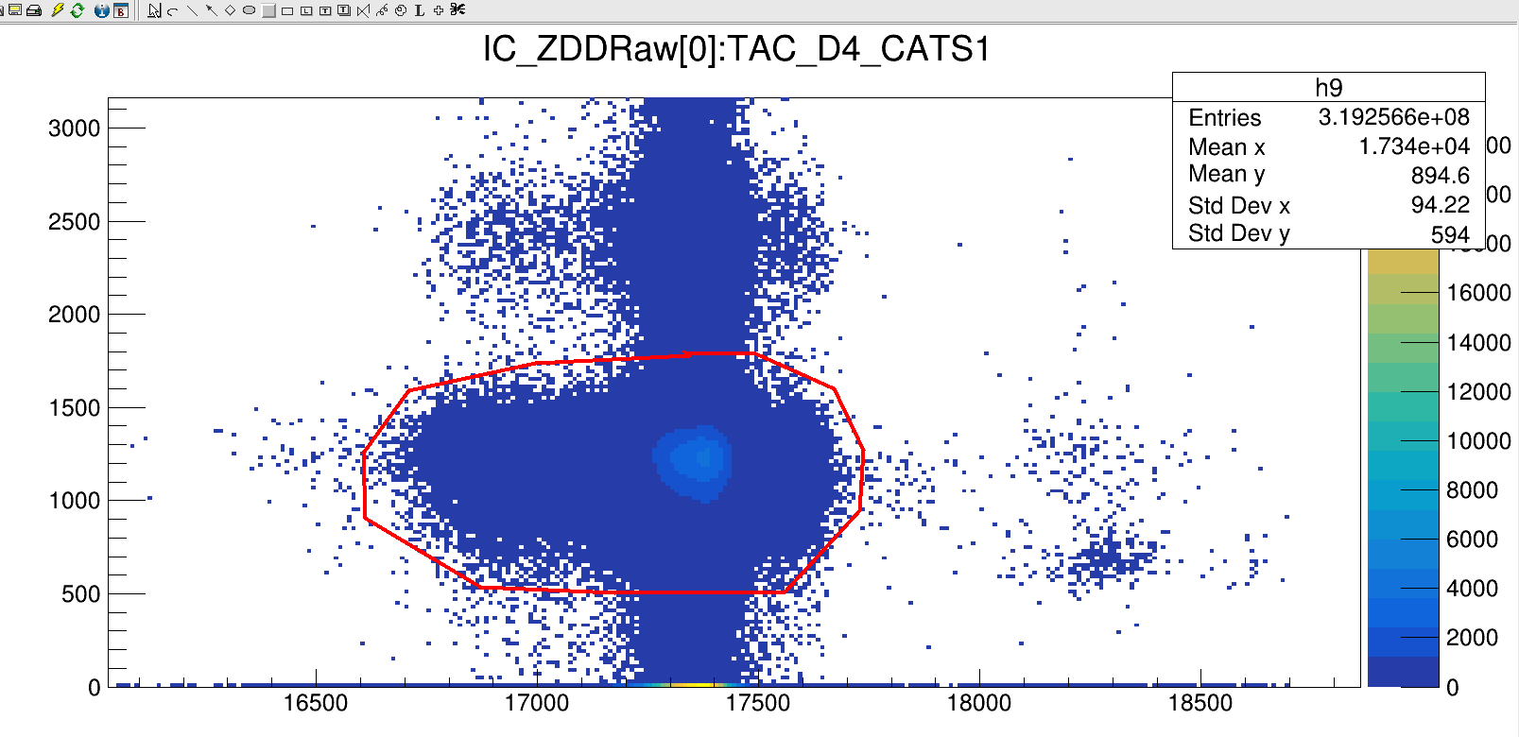
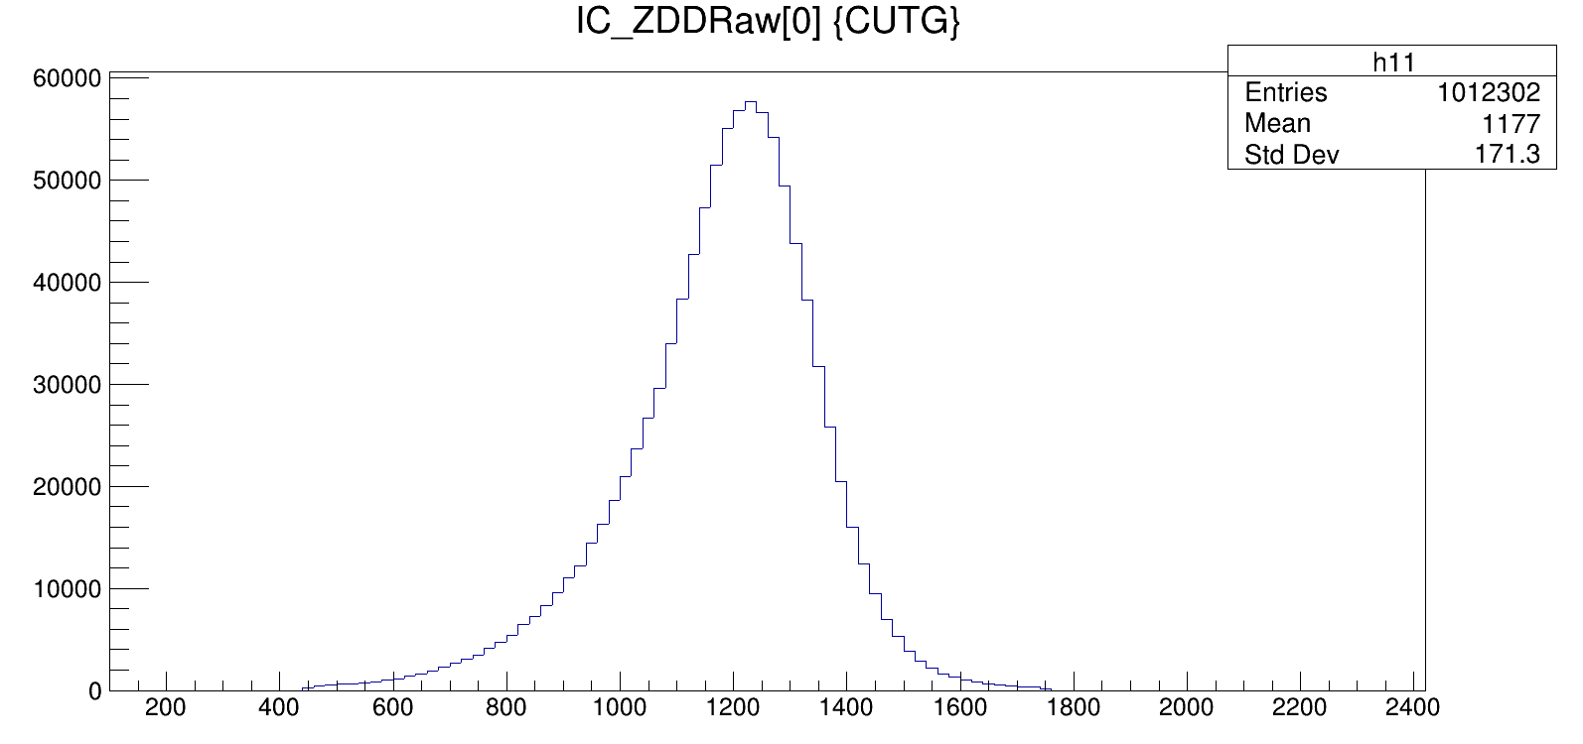
Raw (Single spot of TAC & CHIO)
Entries = 1011172
Ef.(raw) = 1011172/19529571= 5.1%
R{spot/all_spec} = 1011172/1484165 = 68%
R{spot/all_inc_0}= 1011172/18262961= 5.54%

Slide 4
Eff. Raw (no condition/GCM)
I.C. | All_Counts (100,20100) | Ef. (GATCON) (%) | All_Counts (0,20000) | Ef. (GATCON) (%)
1 | 1,484,165 | 7.59957809621113 | 18,262,961. | 0.93514399
2 | 1,500,085 | 7.68109550383877 | 18,277,372. | 0.93588190
3 | 1,489,254 | 7.62563601627501 | 18,267,145. | 0.93535823
4 | 1,486,847 | 7.61331111676749 | 18,264,728. | 0.93523447
5 | 1,427,495 | 7.30940275134564 | 18,205,598. | 0.93220675

Slide 5
CHIO {TAC_CATS_PL>0}
 | Counts(0,20000) | counts with | eff. With | eff. With counts
I.C. |  | tac_cats_pl | all counts | (100,20100)
1 | 18262961.00 | 1208203.00 | 6.62 | 81.41
2 | 18277372.00 | 1208096.00 | 6.61 | 80.54
3 | 18267145.00 | 1207790.00 | 6.61 | 81.10
4 | 18264728.00 | 1207222.00 | 6.61 | 81.19
5 | 18205598.00 | 1206482.00 | 6.63 | 84.52

Slide 6
Eff_CHIO (TAC_PL[i]>0 || PL[j]>0)
I.C. | IC (||TAC_PL[i]) | Eff. PL/GCM (%)
1 | 1461213.0 | 7.48
2 | 1461062.0 | 7.48
3 | 1460568.0 | 7.47
4 | 1459641.0 | 7.47
5 | 1458722.0 | 7.46

Slide 7
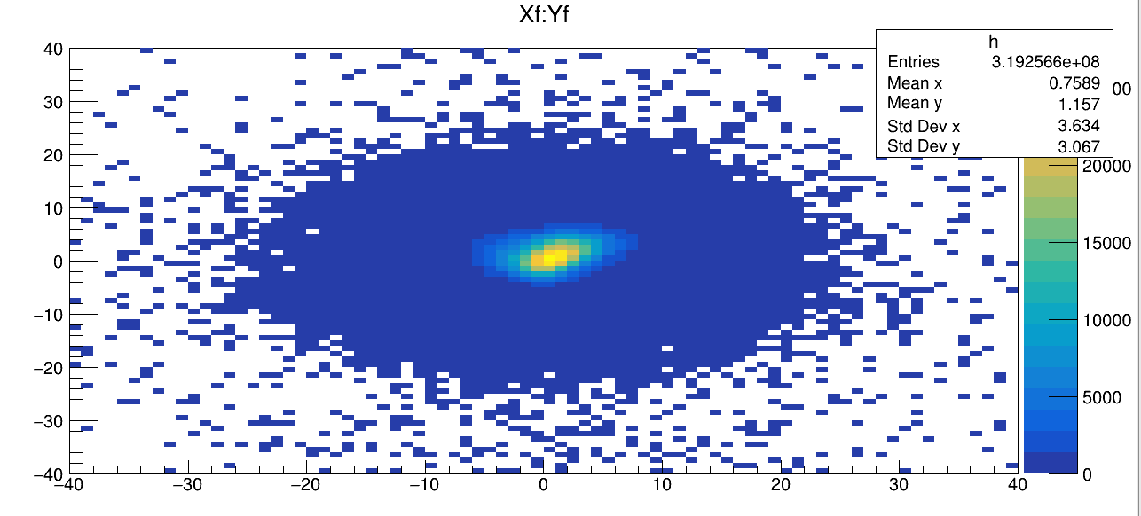
With target cut (-40<Xf,Yf<40)
Counts_Echio[0]=136!!

Slide 8
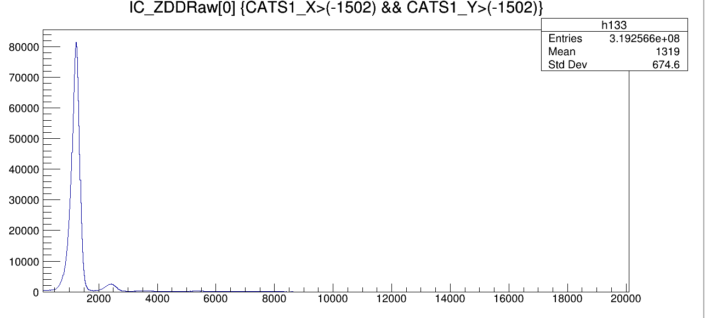
With CATS1_X && CATS1_Y > -1502
I.C. | CATS1_X&&Y>-1502 | Eff.CATS/GCM
1 | 1484165 | 7.59957809621113
2 | 1500085 | 7.68109550383877
3 | 1489254 | 7.62563601627501
4 | 1486847 | 7.61331111676749
5 | 1427495 | 7.30940275134564

Slide 9
CHIO_1 while others were hit
I.C. 1 | CATS1_X&&Y>-1502 | Ratio
Raw | 1,484,165 | 1
W/ 2 | 1,458,319 | 0.982585494
W 2,3 | 1,409,696 | 0.949824312
W/ 2,3,4 | 1,369,397 | 0.922671671
W/ 2,3,4,5 | 1,286,054 | 0.866516863

