Slide 1
Efficiency_I.C. D6
Runs used: RootA_tuned/r0521_*.root
Total Entries: 341,670,904
GCM Entries: 17,432,883
Time: TAC_D4_CATS1

Slide 2
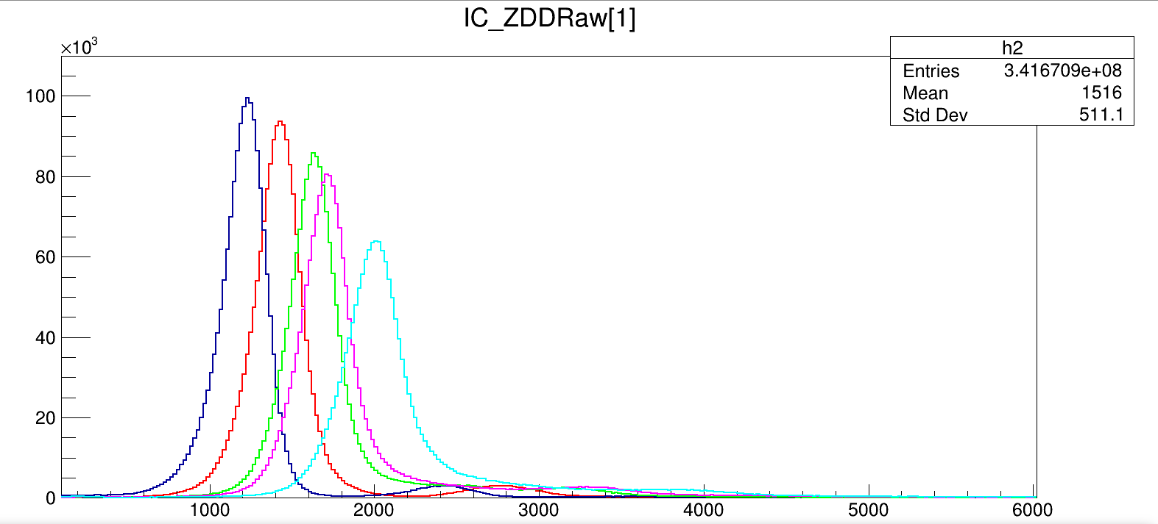
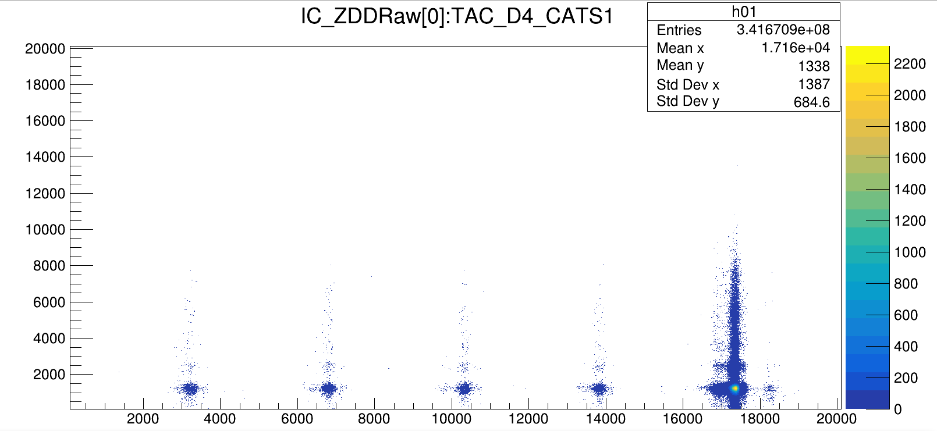
Raw (no condition)

Slide 3
Eff. Raw (no condition/GCM)
I.C. | All_Counts | Ef. (GATCON) (%)
1 | 1,788,611 | 10.259983962492
2 | 1,804,340 | 10.3502100025567
3 | 1,786,444 | 10.2475534310647
4 | 1,782,368 | 10.2241723299583
5 | 1,698,959 | 9.74571446386694

Slide 4
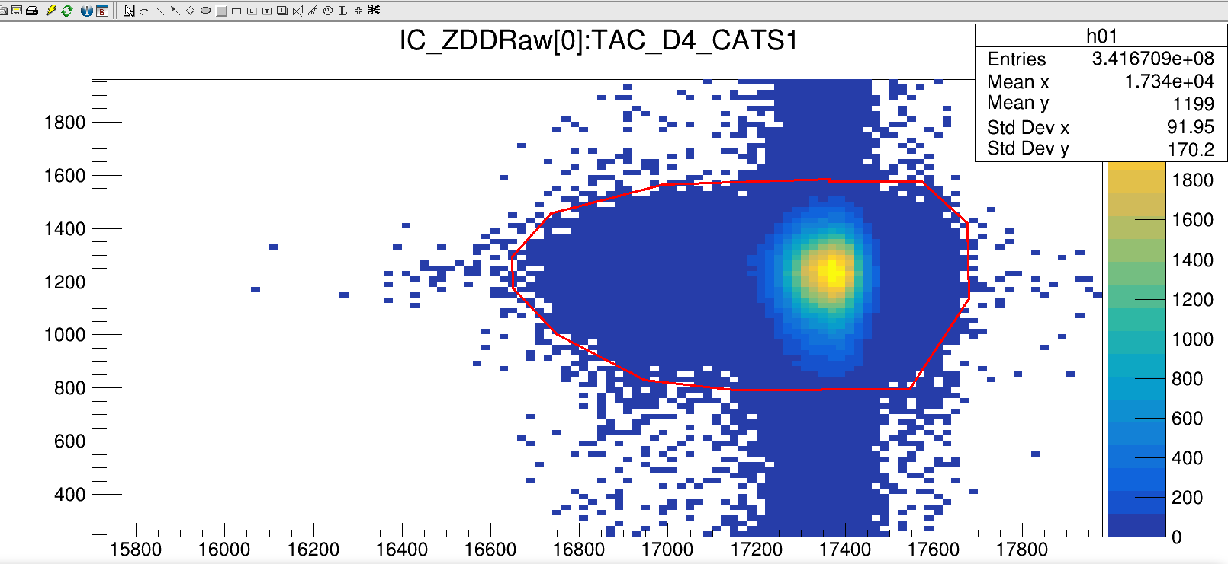
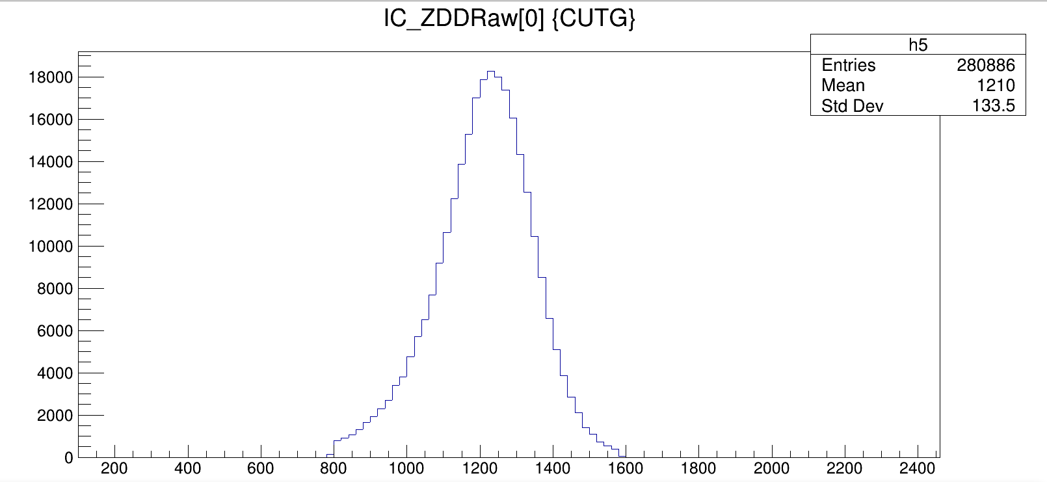
Raw (Single spot of TAC & CHIO)
Entries = 280886
Ef.(raw) = 280886/17432883= 1.61%]
R{spot/all_spec} = 280886/1788611 = 15.7%

Slide 5
Eff_CHIO (TAC_PL[i]>0 || PL[j]>0)
I.C. | IC (||TAC_PL[i]) | Eff. PL/GCM (%)
1 | 1,109,819 | 6.3662390208206
2 | 1,122,965 | 6.44164823454617
3 | 1,133,205 | 6.50038780160459
4 | 1,132,013 | 6.4935501488767
5 | 1,088,471 | 6.24378079058983

Slide 6
Eff_CHIO (TAC_CATS_PL>0)
I.C. | IC (TAC_CATS_PL>0) | Eff. CATS_PL (%)
1 | 1,015,426 | 5.82477379100175
2 | 1,023,870 | 5.87321098868156
3 | 1,023,654 | 5.87197195093892
4 | 1,021,517 | 5.85971350808699
5 | 989,030 | 5.67335878982266

