Slide 1
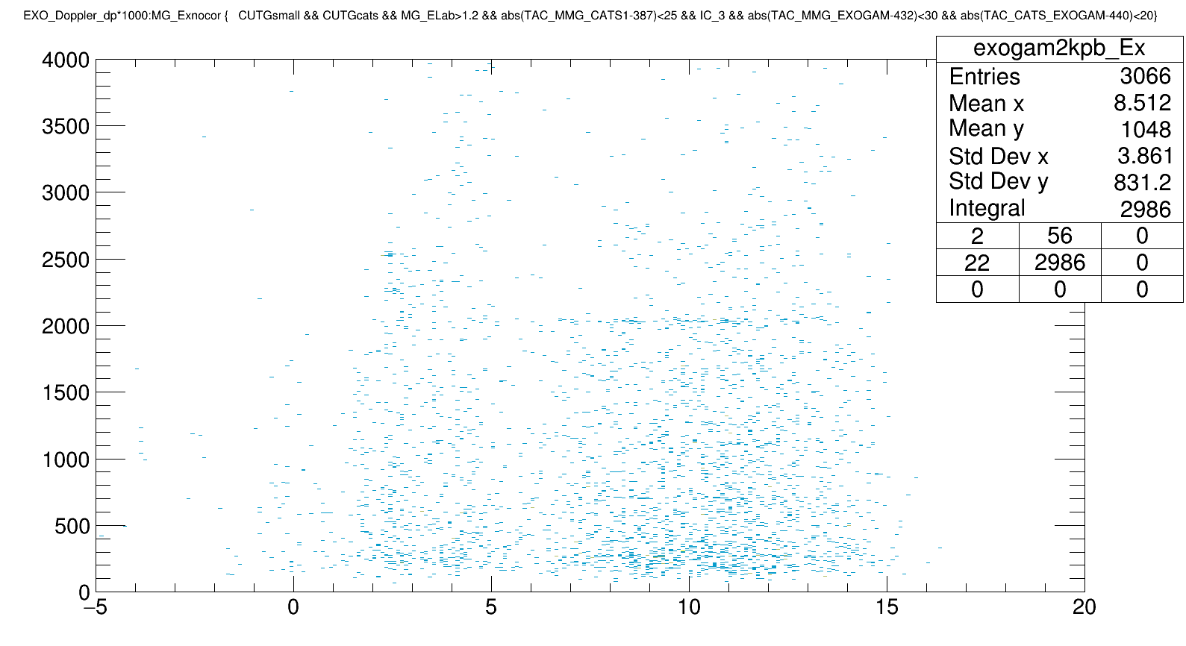
Explanation for counts
I need to ask what
this CUTGsmall is
Ozge’s
Cuts Ozge is using in this:
(1) Beam Spot
(2) E > 1.2
(3) TAC_MMG_CATS
(4) TAC_MMG_EXO
(5) TAC_CATS_EXO
(6) IC3
(7) CUTGsmall

Slide 2
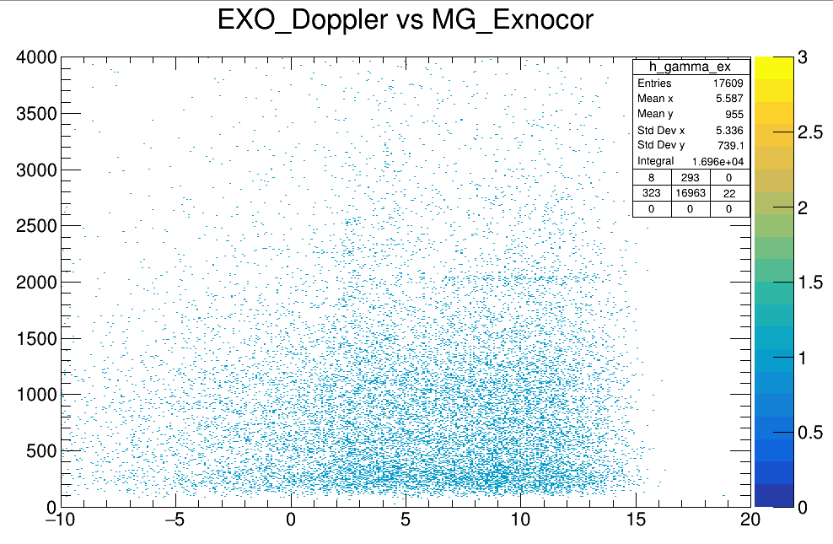
Taking all the cuts as Ozge (except for CUTGsmall until I understand what that is), this 2d plot looks like the following for me:

Slide 3
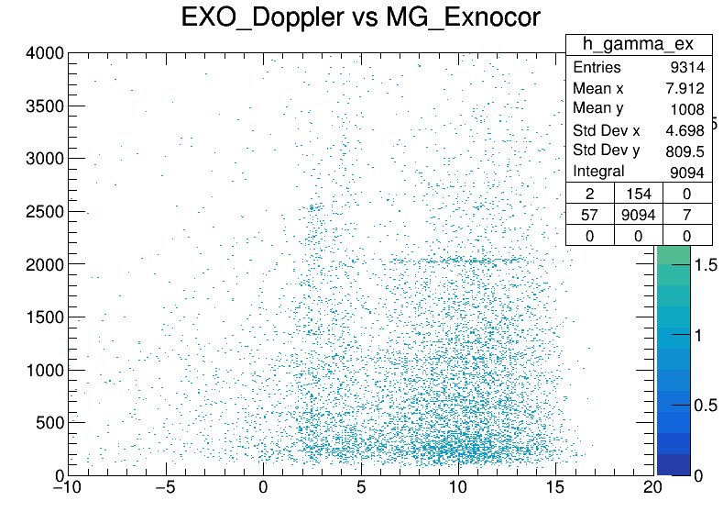
With only the E_lab > 1.0 and TAC_CATS_PL:
TAC_CATS_PL cuts much of the events.
Ozge is taking different cuts for total “ex-energy spectrum” and the “ex-energy vs gamma ray” plot which makes sense because we should only make the second one for the events which also triggered the exogam (through the TAC prompt).

Slide 4
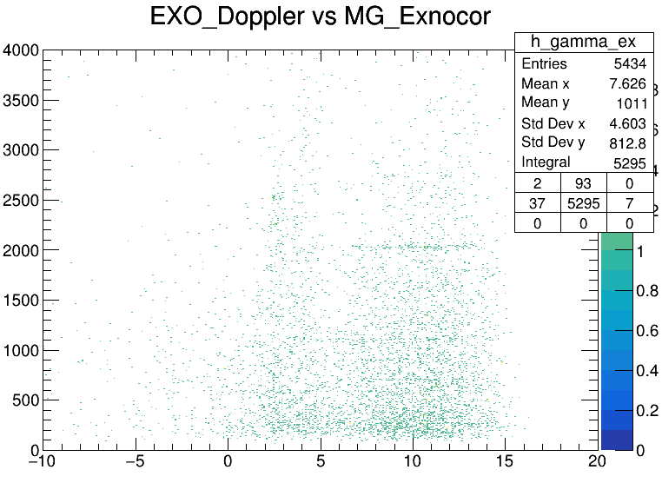
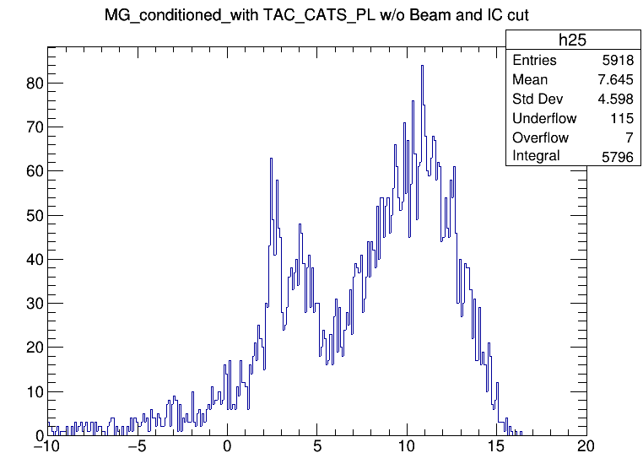
Even if I take all the cuts from Ozge (except the CUTGsmall) along with the TAC_CATS_PL, I have ~5k entries.

Slide 5
The cuts that were already established are:
(1) proton energy > 1.0 MeV
(2) Beam spot
(3) TAC_CATS_PL
(4) TAC_MMG_CATS
But the TACs on Exogam are important to be included.
If we don’t do so… then the efficiency correction in Exogam needs also to be done for the geometry because even though the TAC_CATS_PL guarantees that the event went through, the gamma rays can go in any direction out of which we have only measured the ones at out geometric area of Exogams.
Once we include the TACs of Exogam, then we can be sure that we only have to deal with the intrinsic efficiency of the clovers. Which is better because if we have an intrinsic efficiency of ~5%, the extrinsic efficiency can be much less than ~1%. And so the error induced will also come from area calculation.

Slide 6
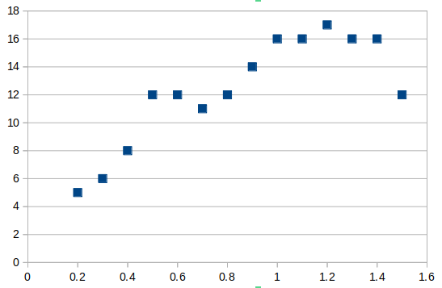
Drawn (-10 MeV, 20 MeV, 100 keV/bin)
Conditions on the following spectrum:
(1) TAC_CATS_PL,
(2) E(Mg) > 1.0 MeV
(3) Beam Energy > 900 MeV.
(4) beam spot.
(5) TAC_MMG_CATS
(6) TAC_MMG_EXO
(7) TAC_CATS_EXO
[Bin range]; centroid | Counts/8keV → [560,608] (594 keV)
-0.30 – 0.70; 0.2 | 5
-0.20 – 0.80; 0.3 | 6
-0.10 – 0.90; 0.4 | 8
0.00 – 1.00; 0.5 | 12
0.10 – 1.10; 0.6 | 12
0.20 – 1.20; 0.7 | 11
0.30 – 1.30; 0.8 | 12
0.40 – 1.40; 0.9 | 14
0.50 – 1.50; 1.0 | 16
0.60 – 1.60; 1.1 | 16
0.70 – 1.70; 1.2 | 17
0.80 – 1.80; 1.3 | 16
0.90 – 1.90; 1.4 | 16
1.00 – 2.00; 1.5 | 12

Slide 7
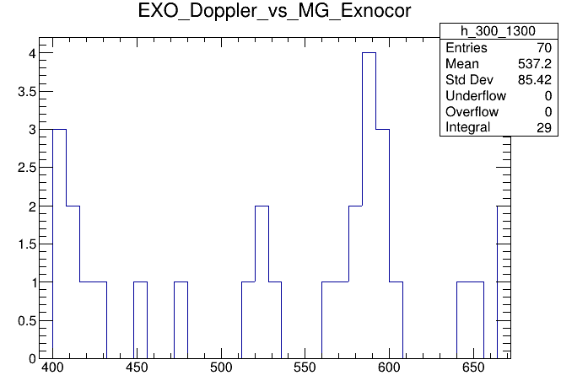
But I think bins from 560-608 with 8 keV per bin is too much for counting gammas.

