Slide 1
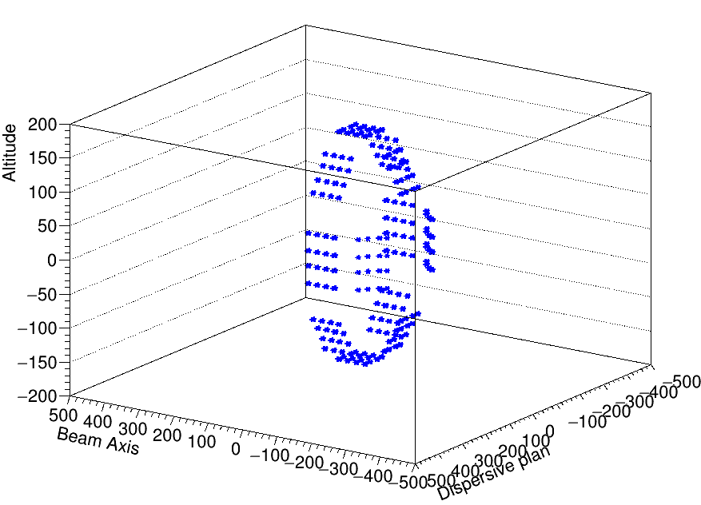
CANDY
EXOGAM
Efficiency calibrations and comparison
Ozge Aktas

Slide 2
Depends on the position
Low energy region
High energy region
Relative intrinsic efficiencies
conclusion
1
2
3
4
5

Slide 3
EXOGAMpositions
F12
F2: Θ=135°;Φ=180°
F3: Θ=135°;Φ=45°
F4: Θ=135°;Φ=90°
F5: Θ=135°;Φ=270°
F6: Θ=90°;Φ=0°
F7: Θ=90°;Φ=315°
F8: Θ=90°;Φ=270°
F9: Θ=90°;Φ=225°
F10: Θ=90°;Φ=180°
F11: Θ=90°;Φ=135°
F12: Θ=90°;Φ=90°
F13: Θ=90°;Φ=45
F11
F13
F4
F10
F2
F3
F6
F5
14
Target
F9
F7
F8

Slide 4
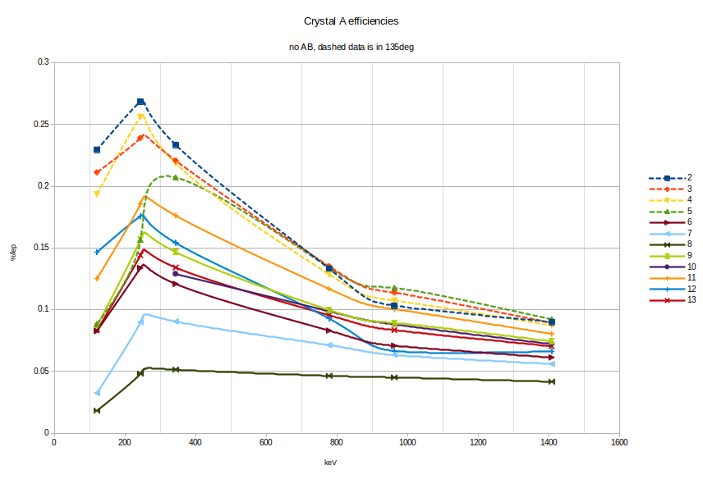
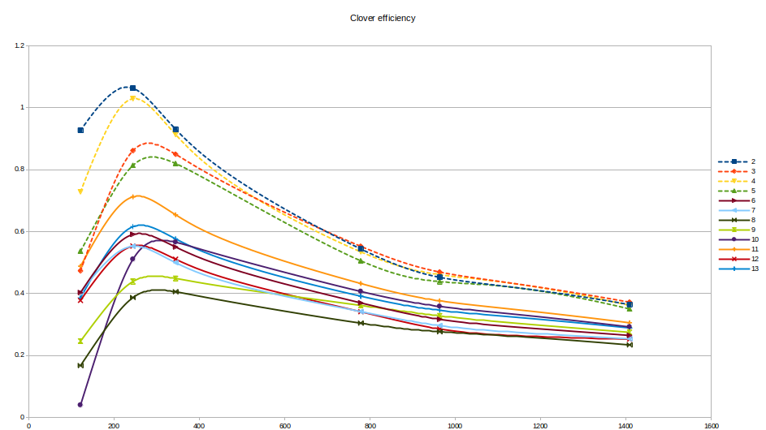
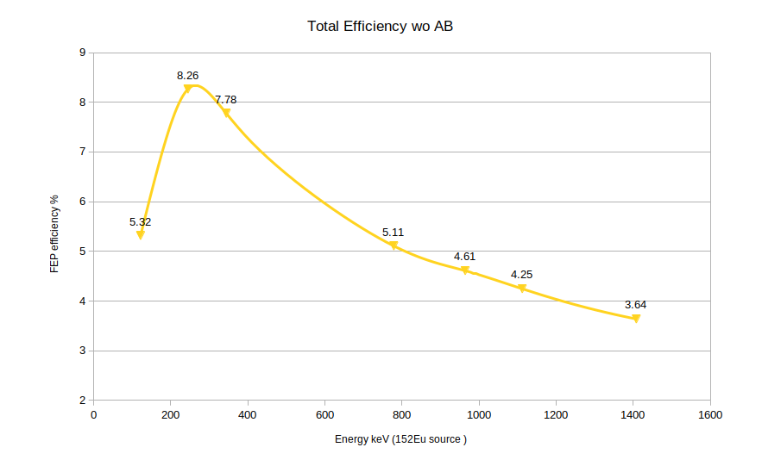
Efficiency of crystals , clover and all at the end of second experiment without Addback
Each crystal has same radius, and d should be equal for each of them which is target distance 14 cm
The efficiency for each crystal is different although they supposed to have the same solid angle and similar intrinsic efficiency
There is a systematically different efficiencies for two different angle 90 and 135 degree.
Two possibility :
source is not in the correct position and solid angle is different for 90-135 degree
source is in good position but the 90degree clovers are not placed well.

Slide 5
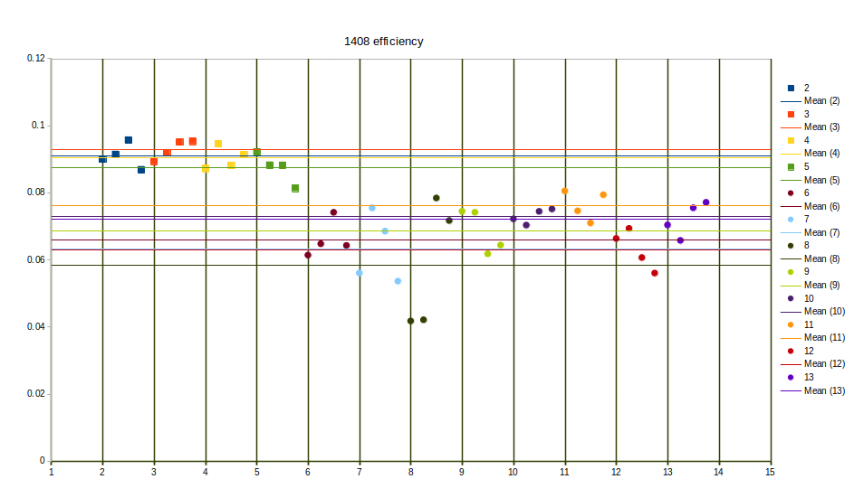
Systematically 90degree clovers has low efficiency in 1408 keV source line (squares- 135 degree, circles 90degree

Slide 6
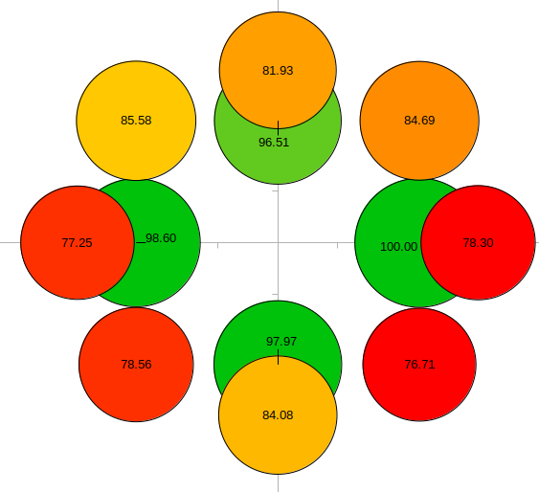
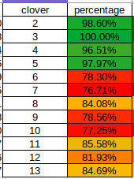
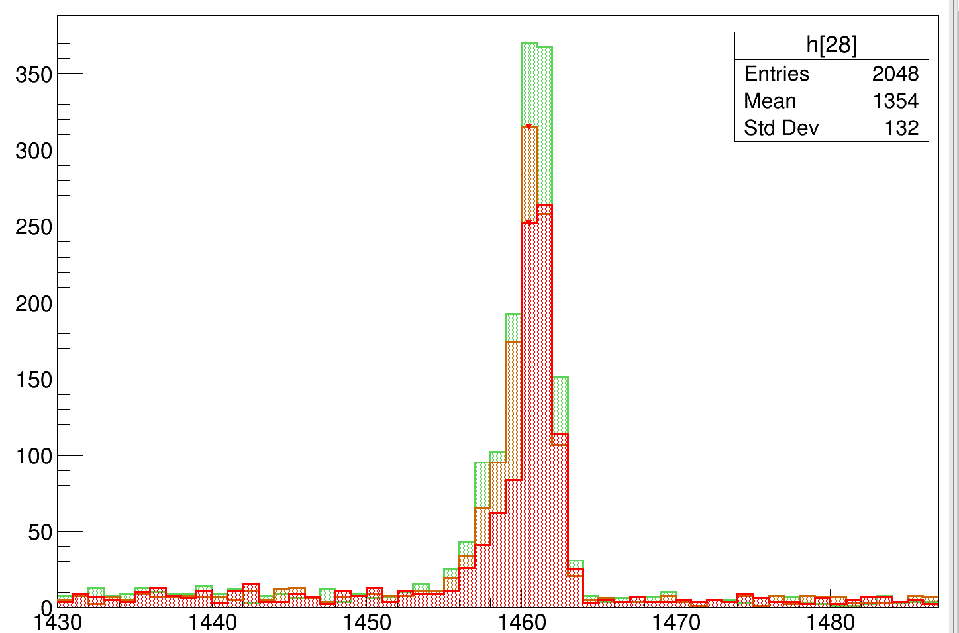
Intrinsict efficiency- relative
The idea is to compare the intrinsict efficiency of each crystal.
One way to be sure about the target distance 14 cm is to compare high energy 1.4 MeV peak in different angles.
But to make such comparison, we have to make assumptions that each crystal has a same intrinsic efficiency.
To find out relative intrinsic efficiency we can use 1460 keV line from background.
This g-ray is isotropic and coming to crystals in every angle. Therefore the efficiency of this line is not depend on the positioning of the clovers.
2
F12
F11
F13
F4
F10
F6
F2
F3
F5
F9
F7
F8

Slide 7
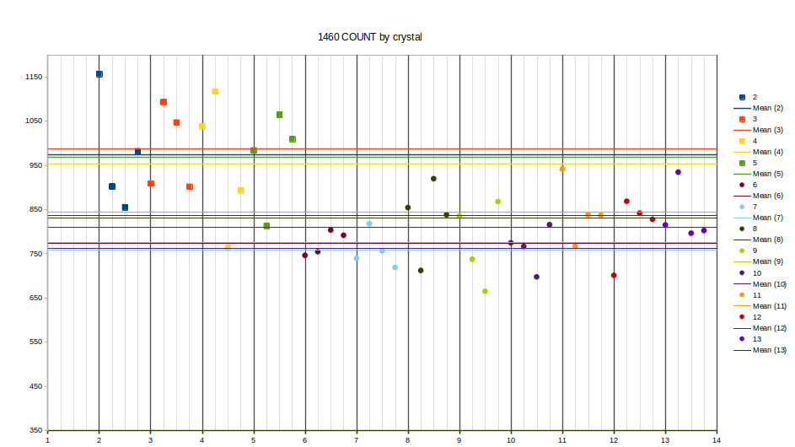
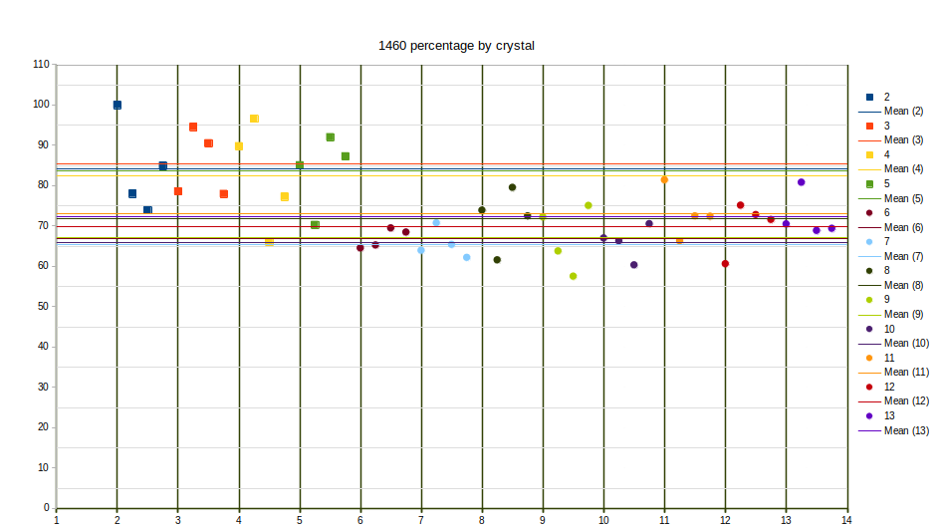
40P line 1460 keV is isotropic so for each crystal we should have a same count
Crystals doesn’t have same intrinsic efficiency
Crystal in 135 degree (squares) has better intr. Efficiency then 90degree ones
Around 15 % efficiency differences between two groups
Now compare this with 1408 keV line from source

Slide 8
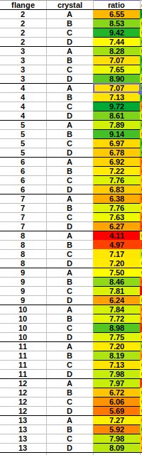
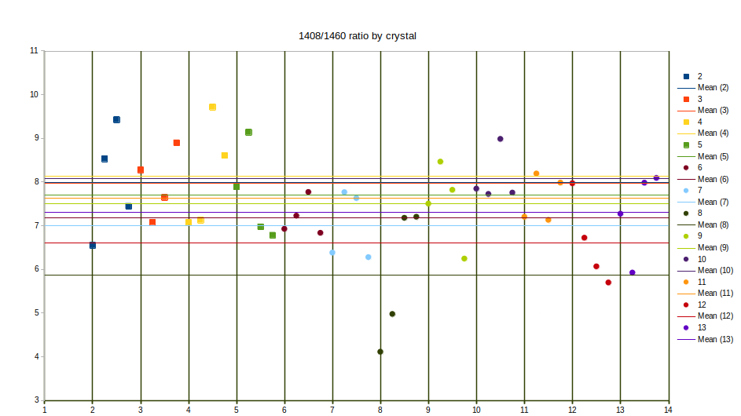
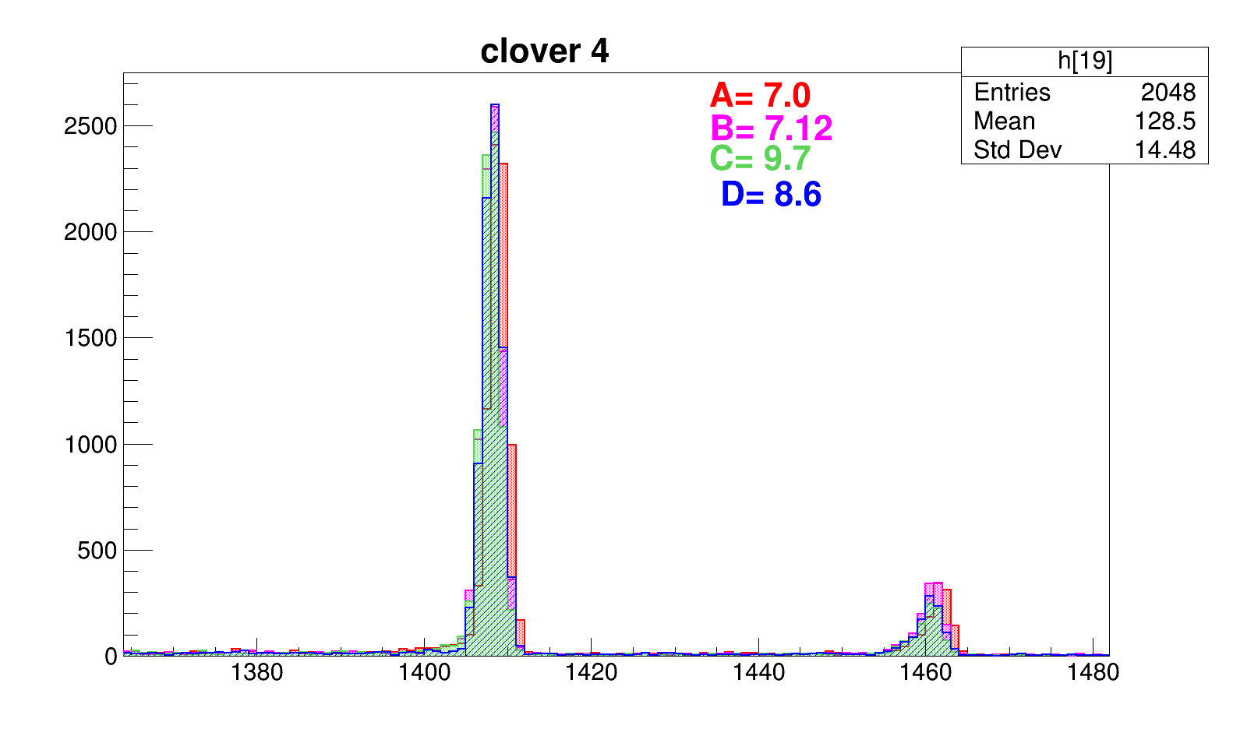
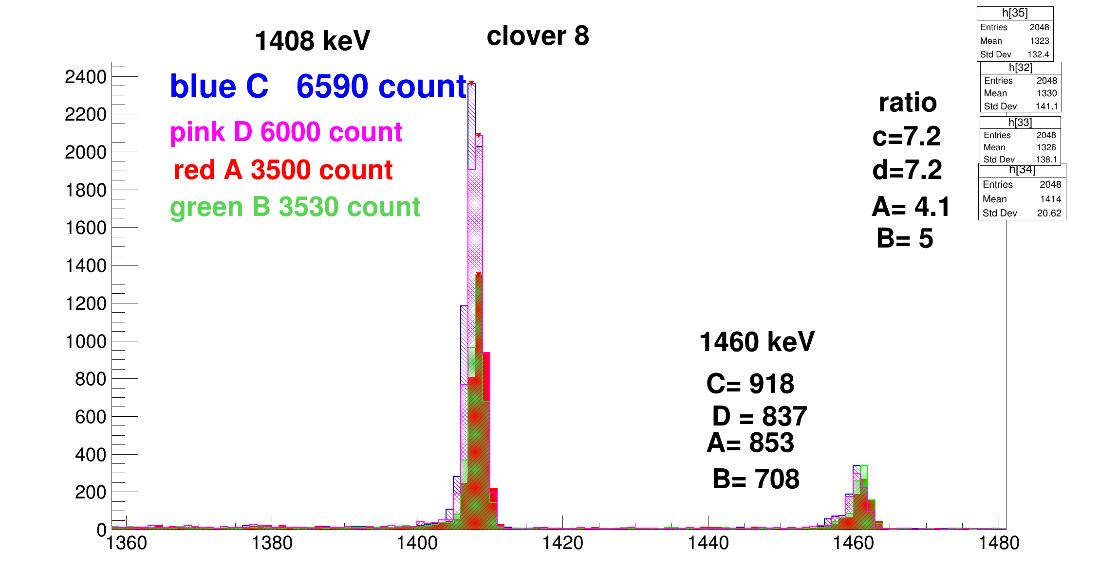

Slide 9
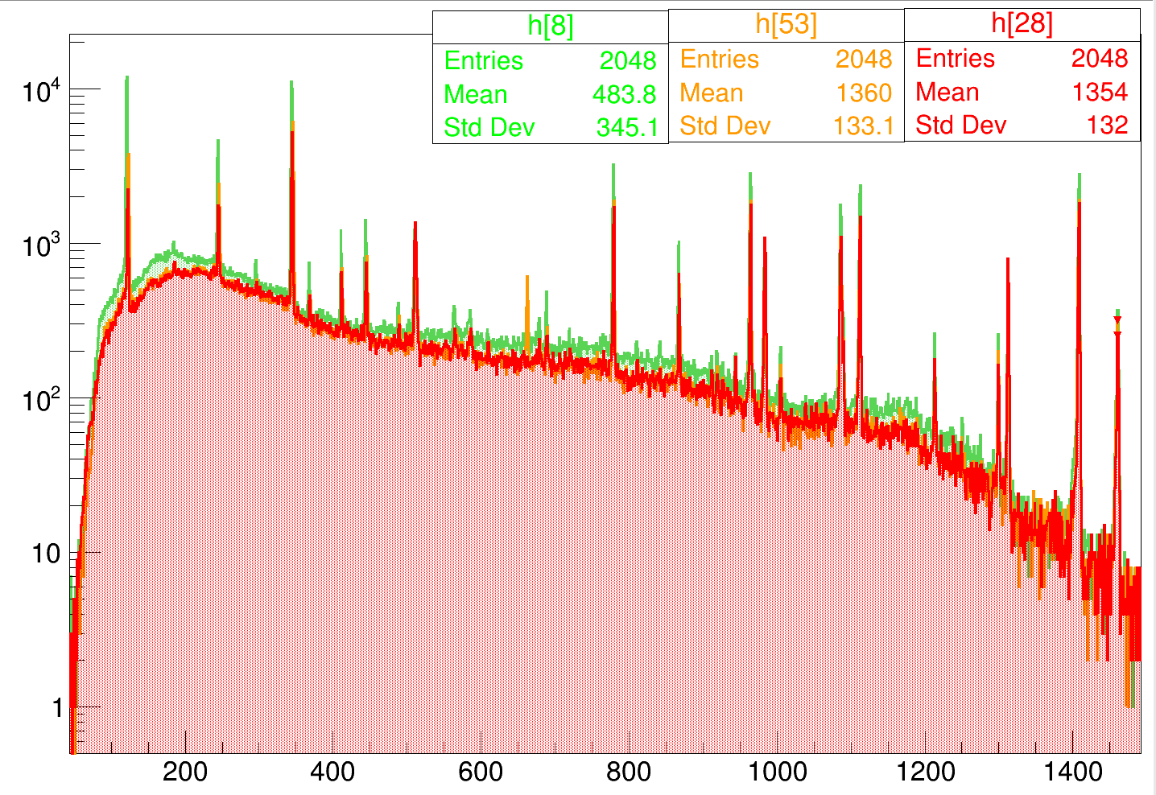

Slide 10
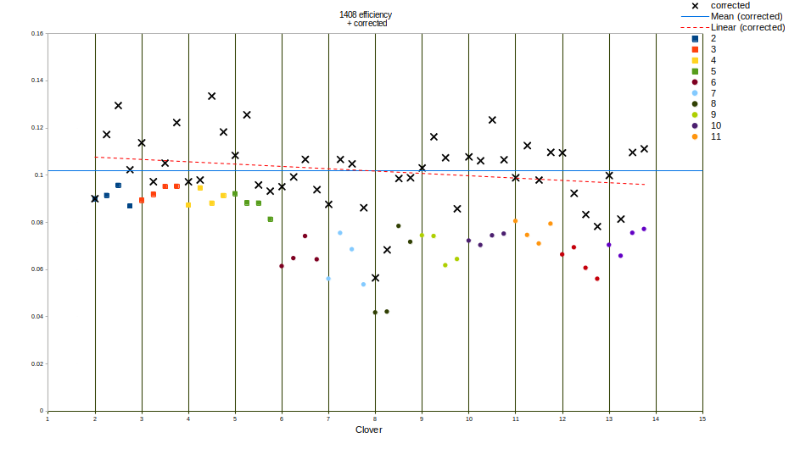
1408 source
Effcor = (eff/N1460)*N1460max
1408/1460ratio
After 1408/1460 keV ratio correction
The effect of the degree dependence is less visible.
Its hard to say target position is wrong.
Different efficiency mostly depend on internal efficiency of crystal.

Slide 11
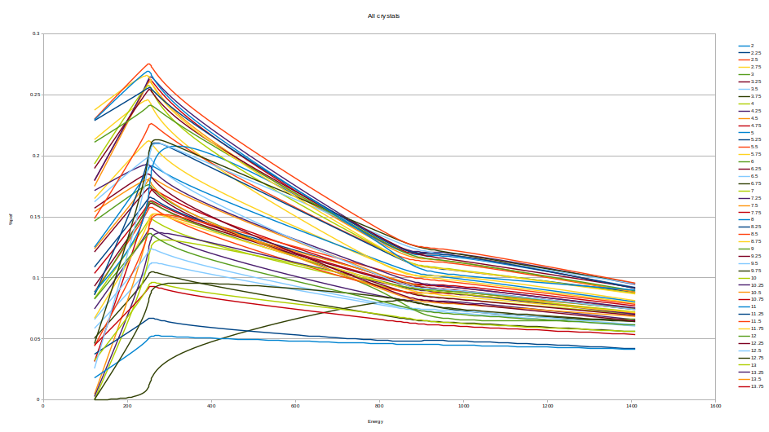

Slide 12
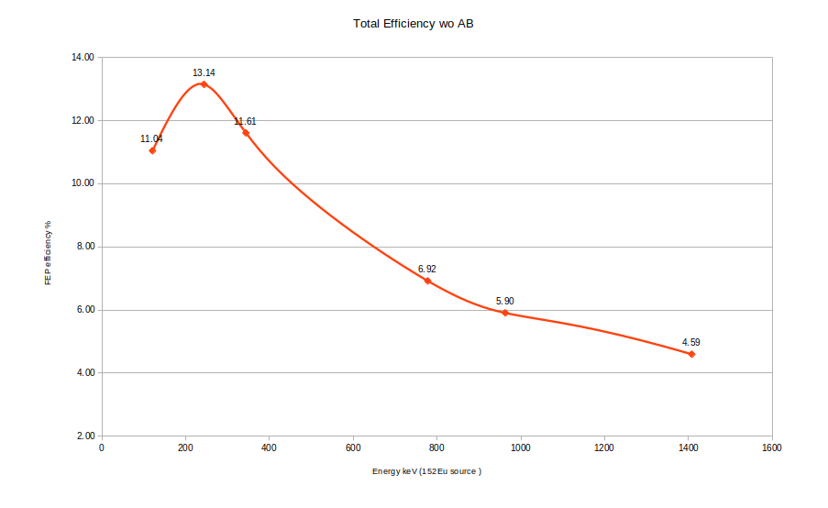
If all crystal has the same efficiency with crystal 2C (highest efficiency one)
With the Addback factor we reach 7% efficeincy in 1.4 MeV

Slide 13
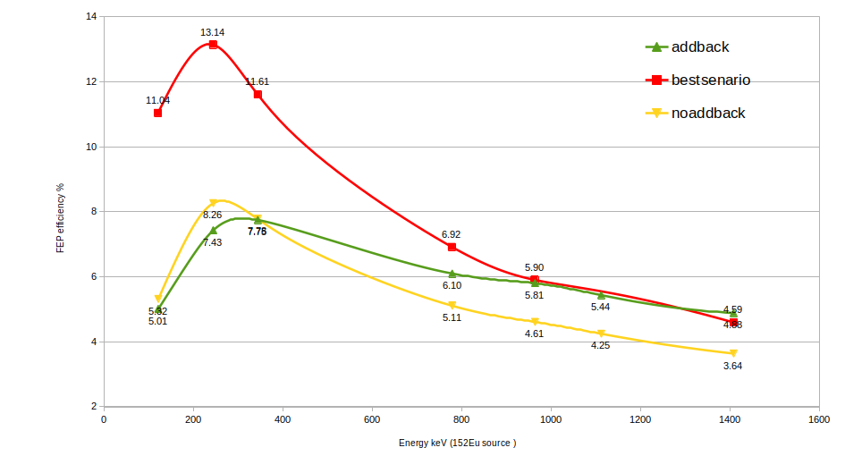

Slide 14
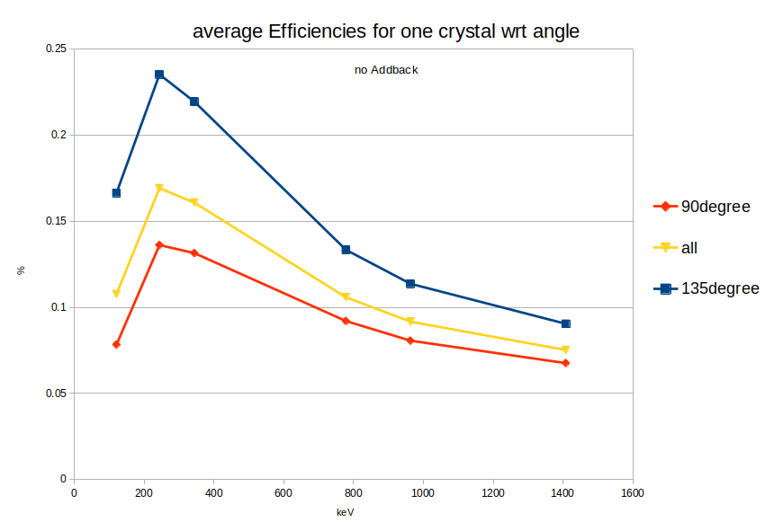

Slide 15
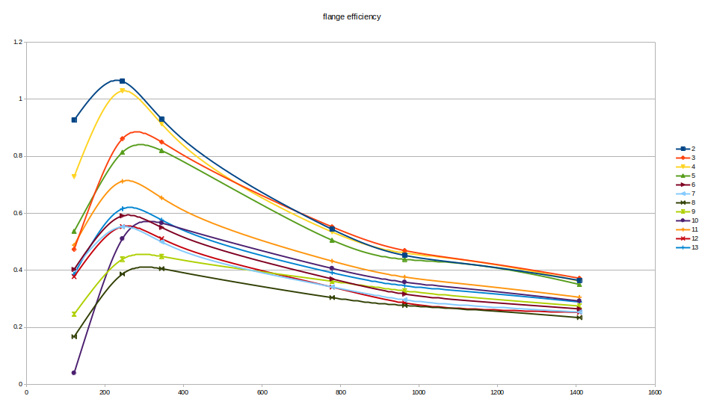
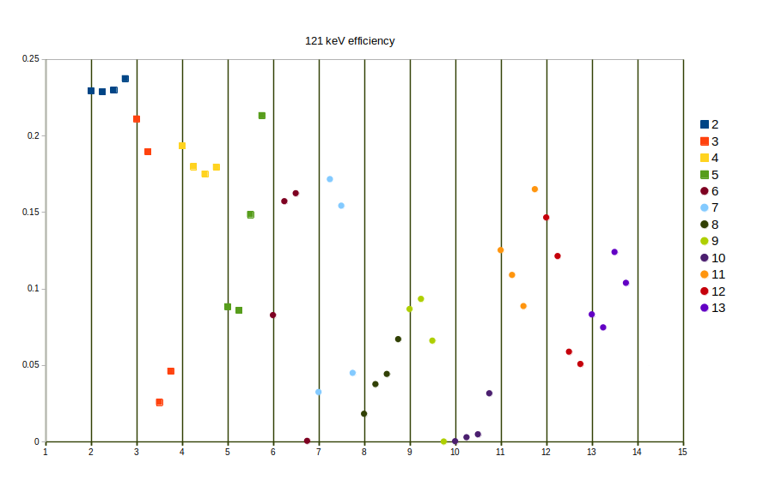
Low energy region
According to Emmanuel , there is a material between detectors and source. He saw an absorption in the low energy region.
The highest efficiency should be around 121 keV
While we can see it is at 244 keV.
Threshold is generally less than 100 keV
Some crystals are more damage than the others

Slide 16
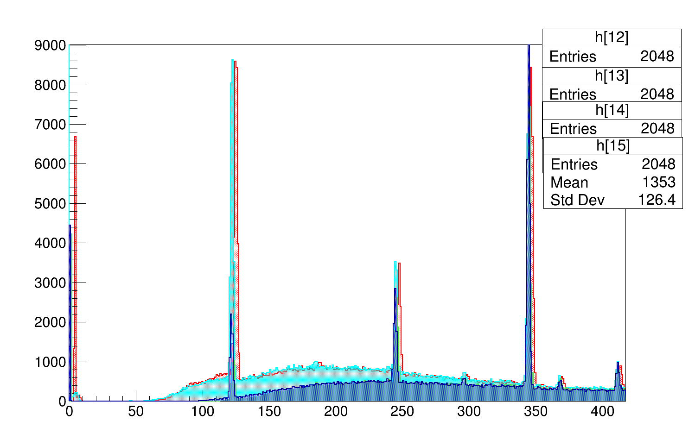
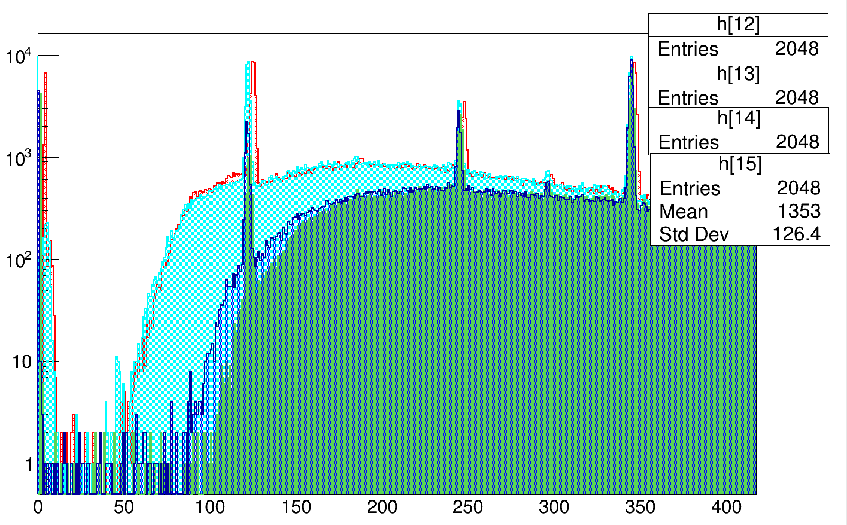
Clover 3 @135 degree
Check the threshold vs absorption

Slide 17
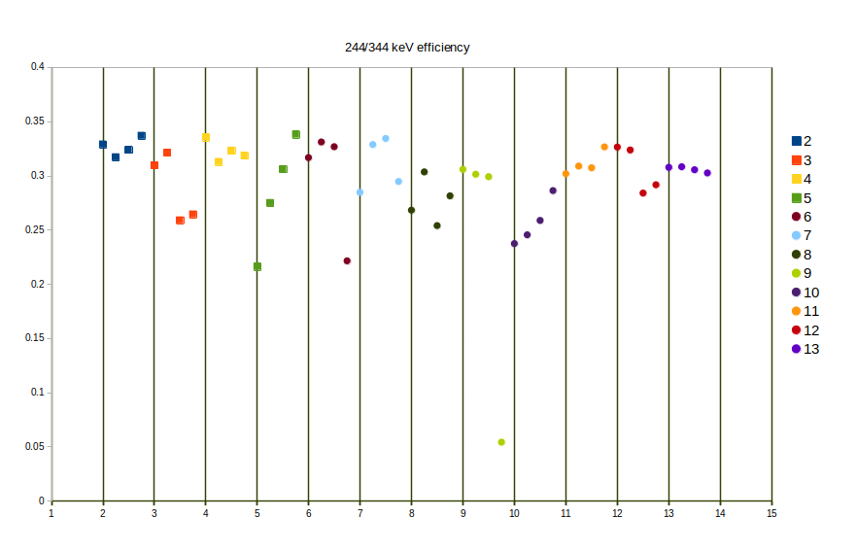
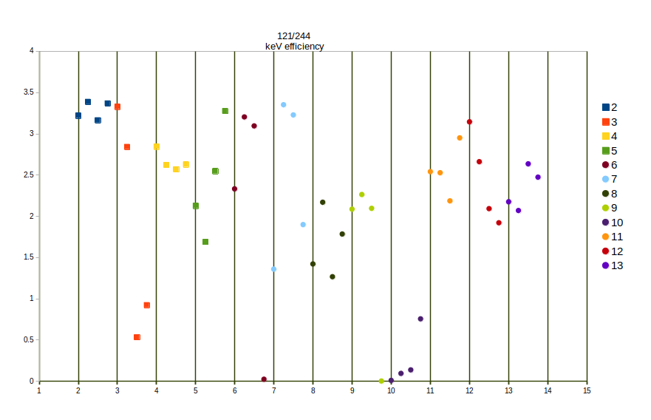
For absorption ratio

Slide 18
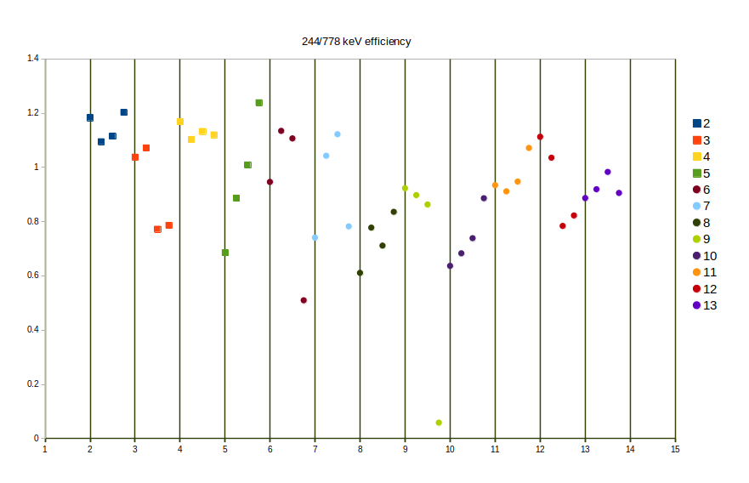
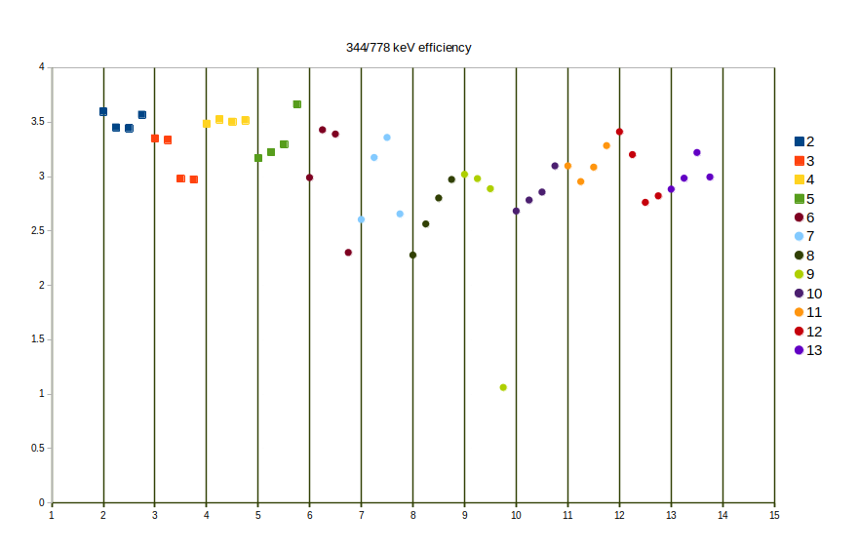

Slide 19
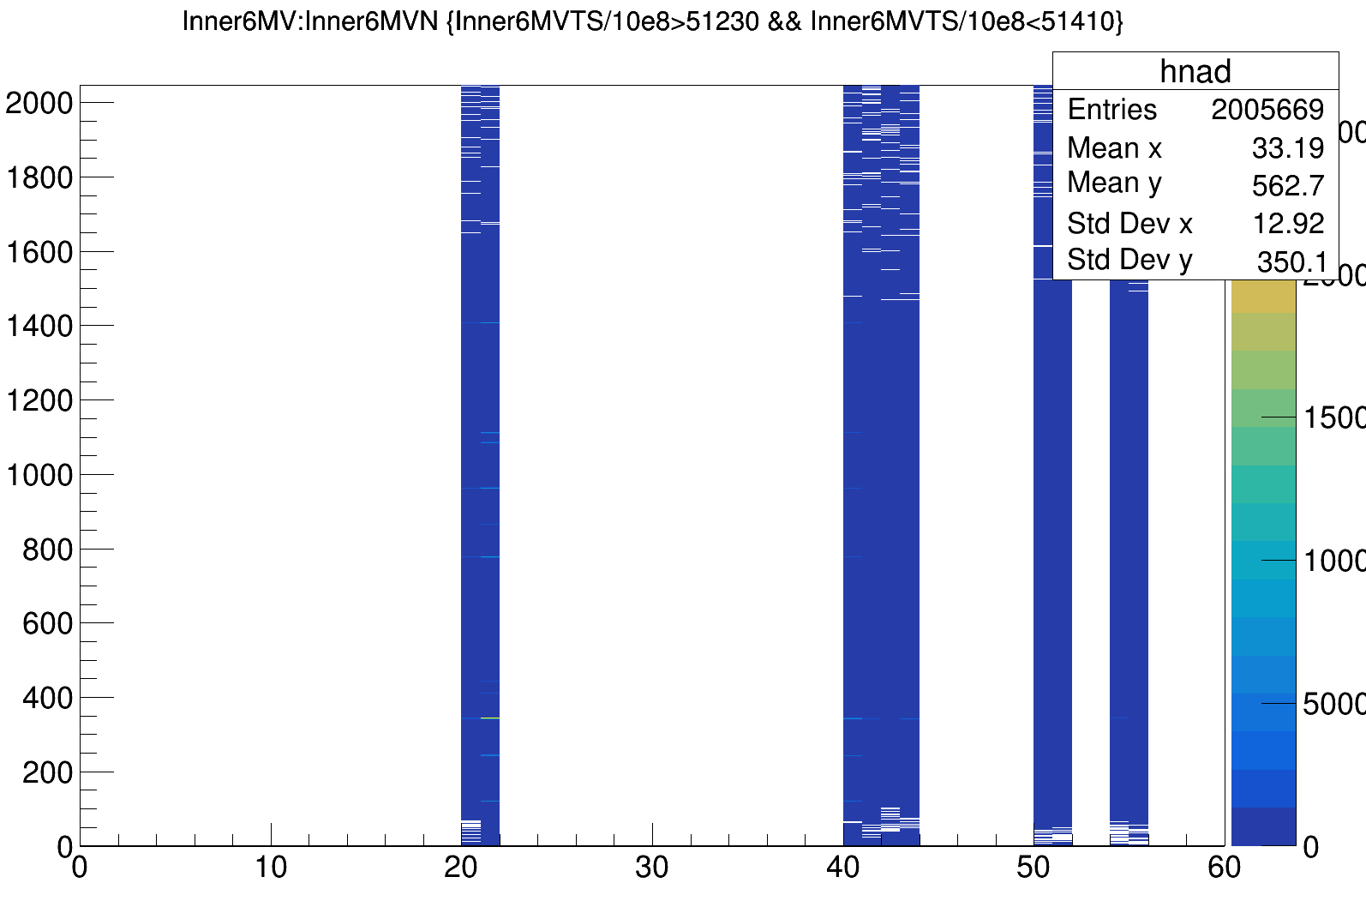
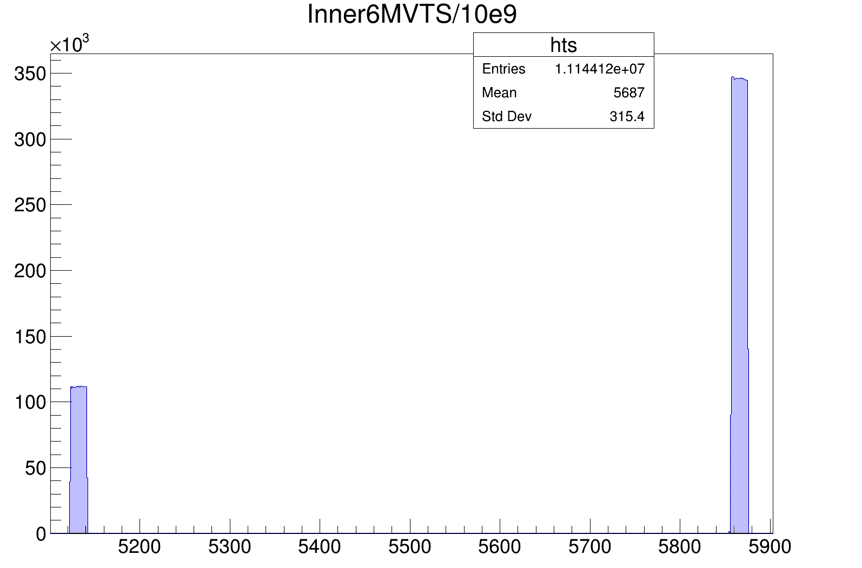
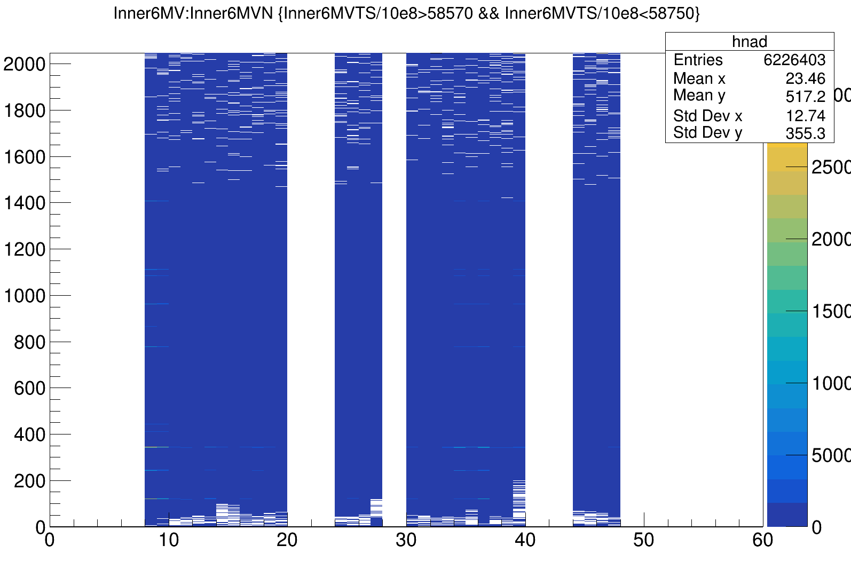
Run425 after e805, Eu source not useful there is no time alignment.
Even 3 clover have 0 ts all the time

Slide 20
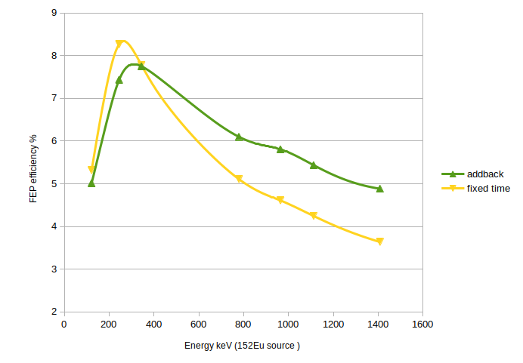

Slide 22
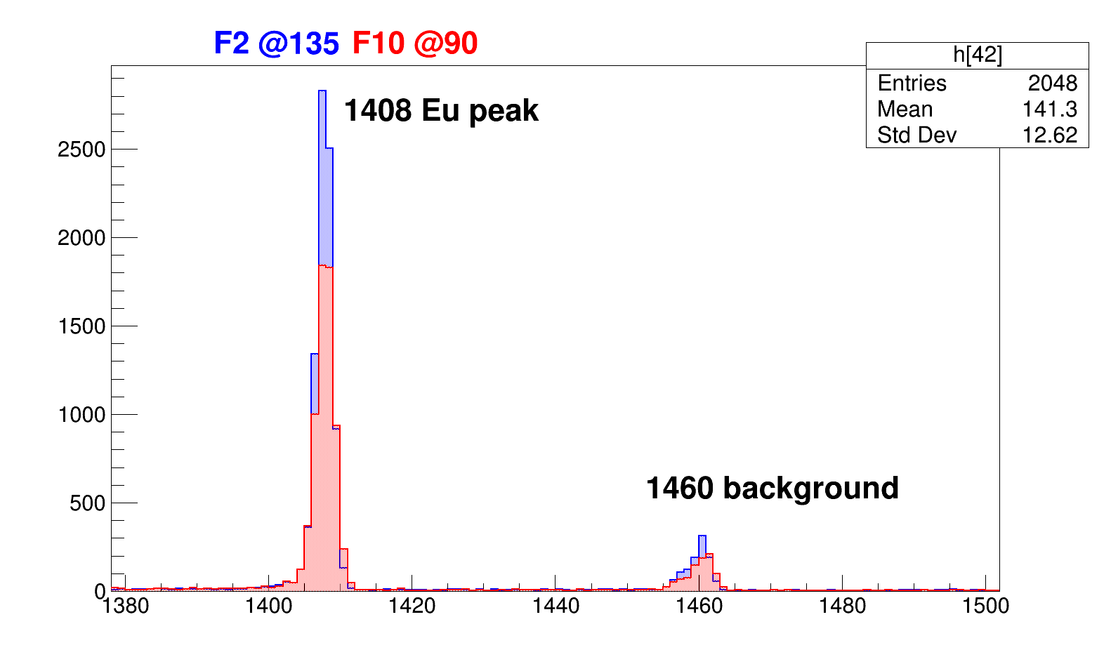
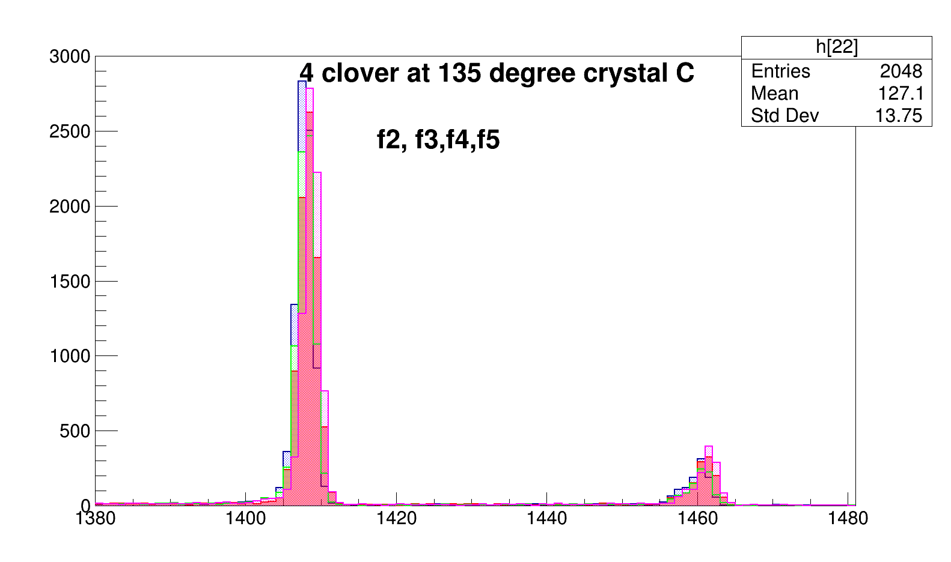
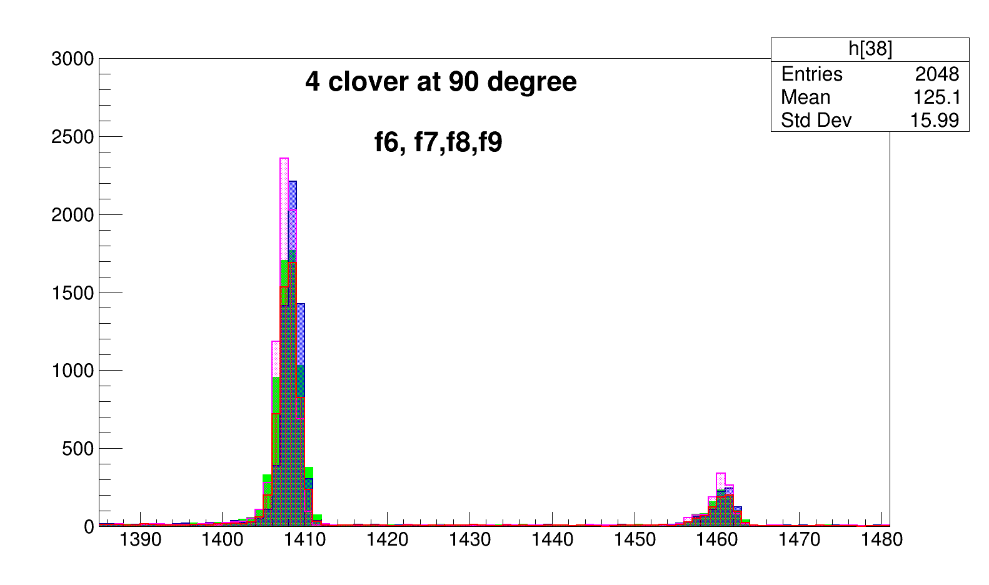
F12
F11
F13
F4
F10
F2
F3
F6
F5
F9
F7
F8

Slide 23
Week 2
Second part (06 Nov.)
-60Co efficiency run comparison for the source position
-target/source position calculation
Effect of MUST2 trapozeid in low energy region

Slide 24
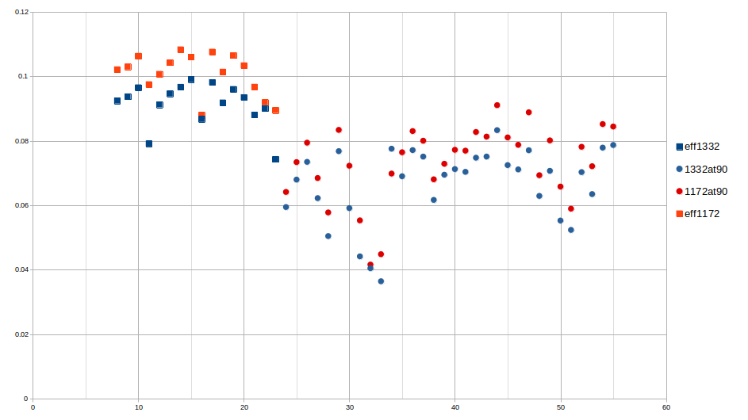
60co results run 568
Same trend as 152Eu source, the efficiency in 90 degree is lower than 135 degree.
Blue points for 1332 keV
Red point for 1172 keV
Square is 135deg
Dot is 90 deg

Slide 25
target distance (d) effect in solid angle
According to my understanding target can change position in Z direction
Exogam 135
Exogam 90
Point source
EXOGAM :
Chaque cristal mesure 6 cm de diamètre à l’arrière (ils sont biseautés à l’avant pour assurer la compacité de l’ensemble et les faces ont un diamètre de 4.5 cm) et 9 cm de long. Le volume utile de détection est donc d’environ 250 cm3.
→
r=2.25 cm
Ω
d
r
Detector

Slide 26
Change in the z direction calculation
Procedure :
Calculate the solid angle efficiency for both angles in different distance shifts
Two different method possible after this point:
  find two crystal in different angles that has the same counts for 1460 keV background peak. So the intrinsic efficiency of these two crystal is comparable
      group : clover7 crystal B (7B)in 90 degree vs clover 5 crystal B (5B)in 135.
      Second group: 8C in 90 vs 2B in 135
  Check the efficiency in 1408 keV or 60Co source
  Correct the 1408 kev efficiency according to solid angle
  Fit the corrected eff of two coupled crystals with pol1
  Using the slope of the pol1 find the zero crossing which will be target distance
  Check the efficiency in 1408 keV or 60Co source for all crystals
  Correct the 1408 kev efficiency according to solid angle
  Fit the corrected eff of crystals with pol1
  Using the slope of the pol1, find the zero crossing which will be target distance

Slide 27
Z cm | 90º | 135 +Z direction | 135º -Z direction
0.25 | 14.00 | 14.18 | 13.82
0.5 | 14.01 | 14.36 | 13.65
0.75 | 14.02 | 14.54 | 13.48
1 | 14.04 | 14.72 | 13.31
1.25 | 14.06 | 14.91 | 13.15
1.5 | 14.08 | 15.10 | 12.98
1.75 | 14.11 | 15.29 | 12.82
2 | 14.14 | 15.48 | 12.66
2.25 | 14.18 | 15.67 | 12.51
2.5 | 14.22 | 15.87 | 12.36
2.75 | 14.27 | 16.06 | 12.21
3 | 14.32 | 16.26 | 12.07
Exogam 135
Exogam 90
14 cm
Target move to
-z direction
Target move to
+z direction

Slide 28
Since we found that our 135 degree detector has better efficiency than the 90 degree detector,
the source is probably moved in -Z direction so
source is closer to 135 degree detectors with respect to 90 degree ones
Now we will use the pairs that we choose to find the shift in the target position
Pairs: 7B 5B and 8C 2B
Eff 90degre | 90º | Eff 135 +Z | 135 +Z direction | Eff 135 -Z | 135º -Z direction | Z cm
2.016E-03 | 14.00 | 1.967E-03 | 14.18 | 2.067E-03 | 13.82 | 0.25
2.014E-03 | 14.01 | 1.919E-03 | 14.36 | 2.119E-03 | 13.65 | 0.5
2.011E-03 | 14.02 | 1.872E-03 | 14.54 | 2.172E-03 | 13.48 | 0.75
2.006E-03 | 14.04 | 1.826E-03 | 14.72 | 2.226E-03 | 13.31 | 1
2.001E-03 | 14.06 | 1.782E-03 | 14.91 | 2.281E-03 | 13.15 | 1.25
1.994E-03 | 14.08 | 1.738E-03 | 15.10 | 2.338E-03 | 12.98 | 1.5
1.986E-03 | 14.11 | 1.696E-03 | 15.29 | 2.395E-03 | 12.82 | 1.75
1.977E-03 | 14.14 | 1.655E-03 | 15.48 | 2.454E-03 | 12.66 | 2
1.967E-03 | 14.18 | 1.615E-03 | 15.67 | 2.513E-03 | 12.51 | 2.25
1.955E-03 | 14.22 | 1.577E-03 | 15.87 | 2.574E-03 | 12.36 | 2.5
1.943E-03 | 14.27 | 1.539E-03 | 16.06 | 2.635E-03 | 12.21 | 2.75
1.930E-03 | 14.32 | 1.502E-03 | 16.26 | 2.697E-03 | 12.07 | 3

Slide 29
Pairs: 7B 5B
and
8C 2B
Clover 5 and 7 is better to compare, since there could be chamber effect in clover 8 which is directly under the target holder

Slide 30
1.49 cm
5B at
135 degree
7B
At 90 deg

Slide 31
2.28 cm

Slide 32
The target is 2.28 cm shifted to the -Z direction
Exogam 135
Exogam 90

Slide 33
If the source has equal distance to each clover, the efficiency curves will be like this.
This is the results of efficiency curves if we move the target 2.28 cm to -Z direction.

Slide 34
All crystals after position correction

Slide 35
MUST2 absorption
Square is at the end of second experiment
Dash is at the end of first experiment

Slide 36
Square with Must2
Star without Must2
For 135 degree detectors
Not clear to say something about absorption effect.

Slide 37
Run425 after e805, Eu source without MUST2 detectors

