Slide 1
Meeting 12/03/25
IC cuts and statistics

Slide 2
Procedure
Check one by one ic cuts
Check what is outside your cut wrt Ex
Check ic tof cuts, ic sum ?
Check ic ts cuts are good
efficiency

Slide 3
First of all, use data with TS cuts

Slide 4
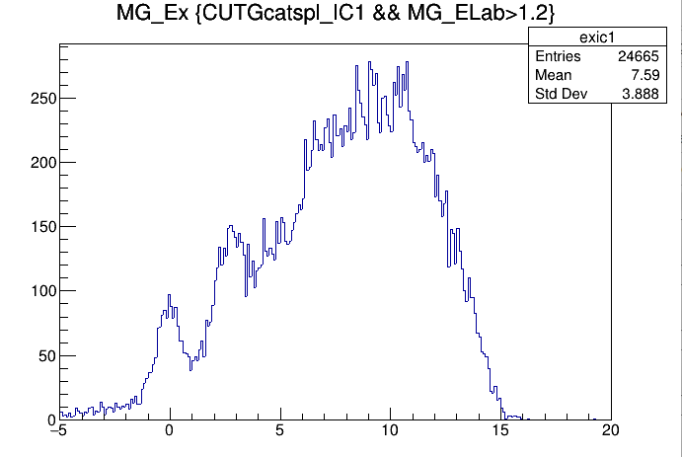
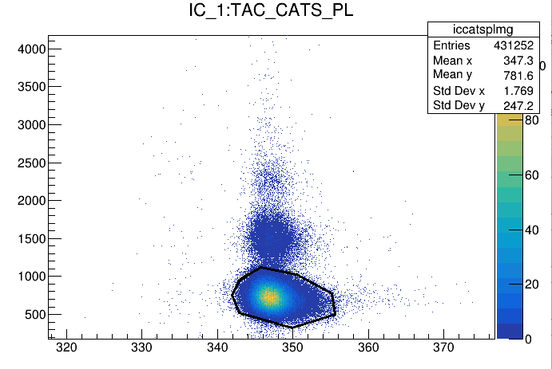
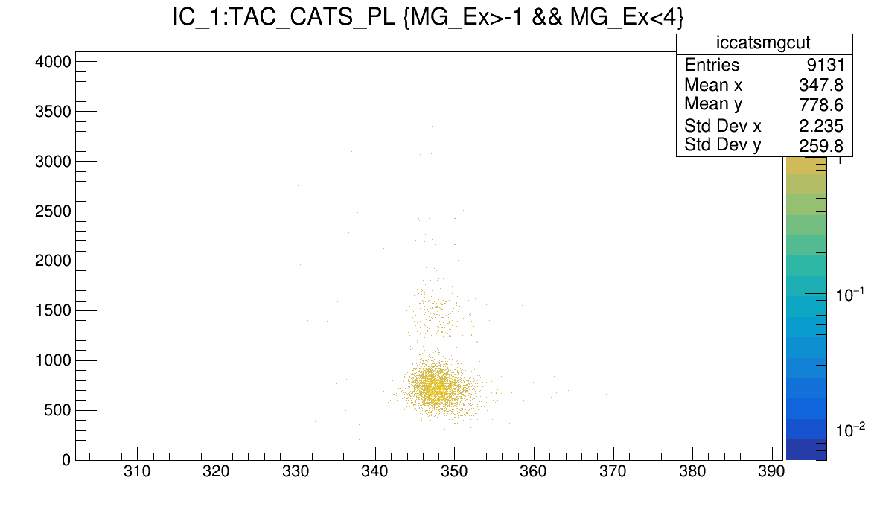
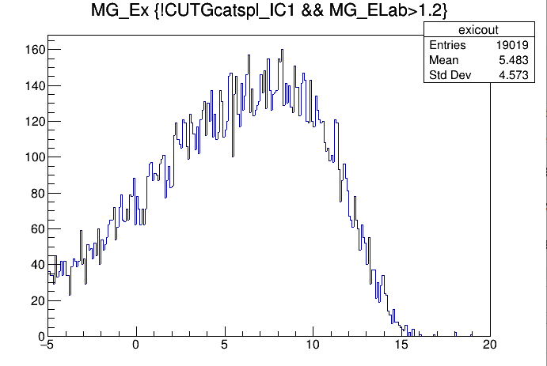
Inside gate
Outside gate

Slide 5
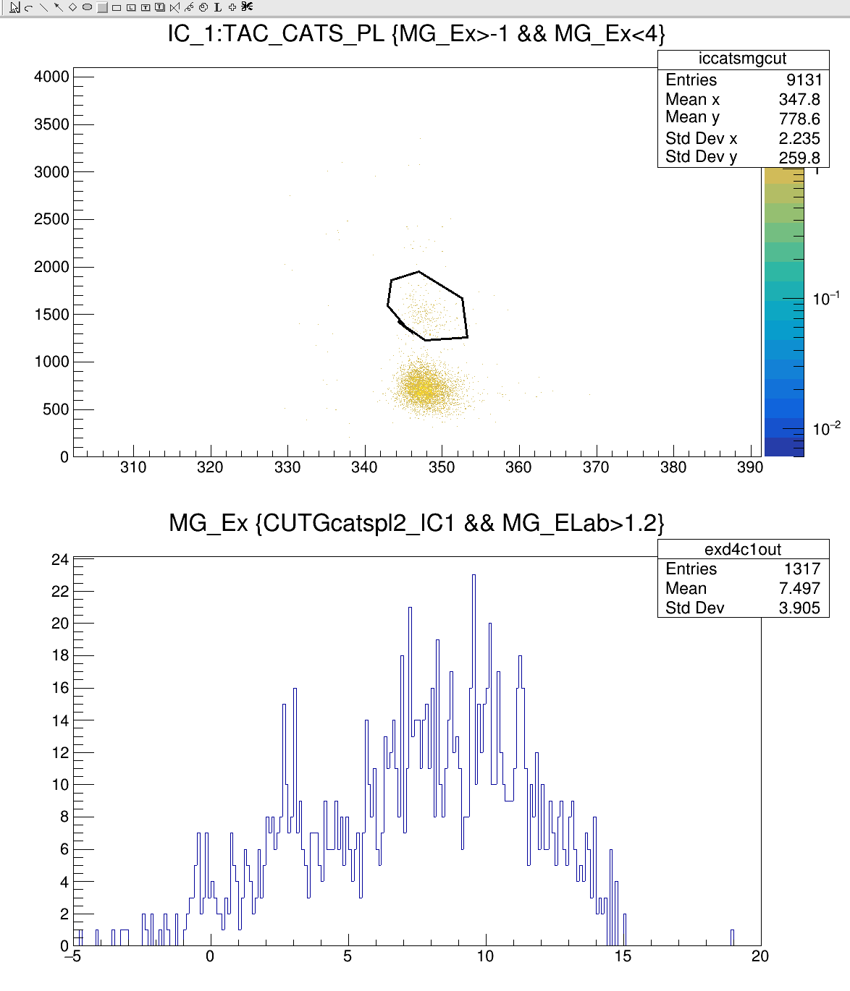
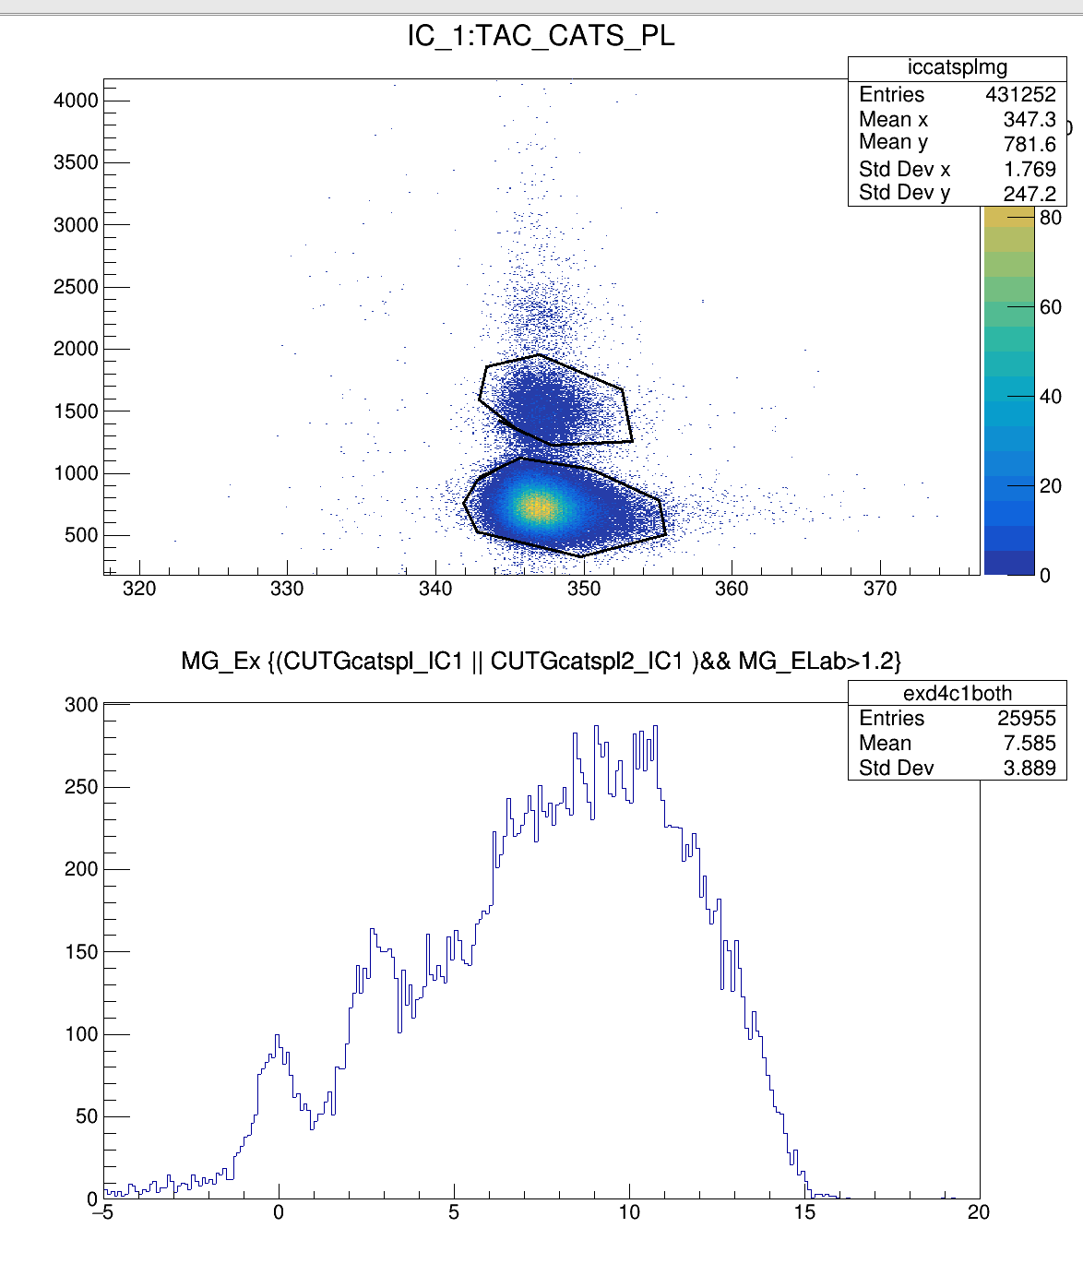

Slide 6
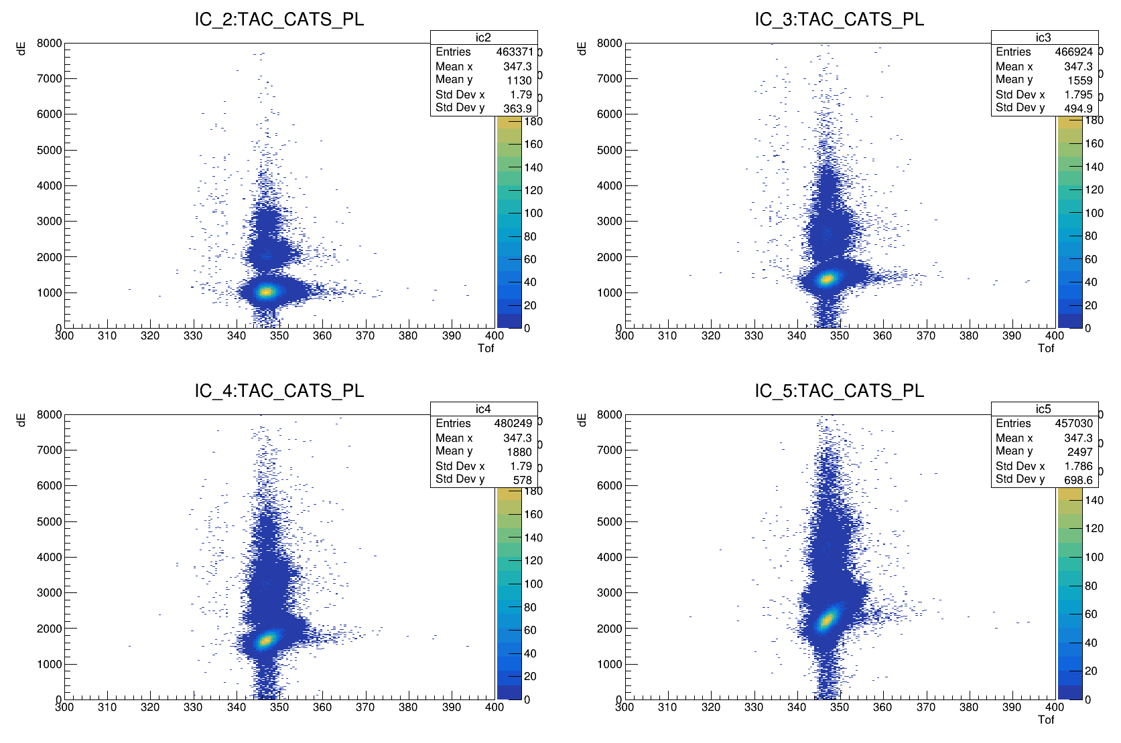

Slide 7

Black is with mg_ex condition

Slide 8
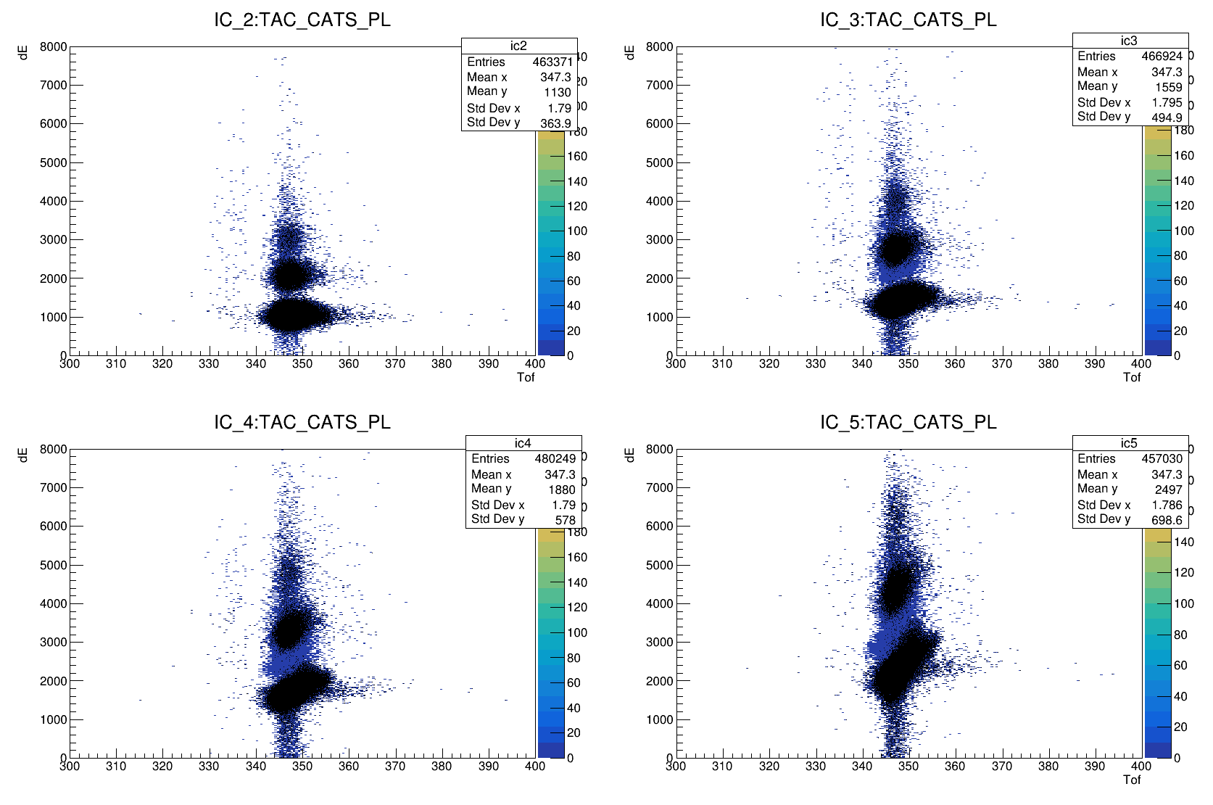
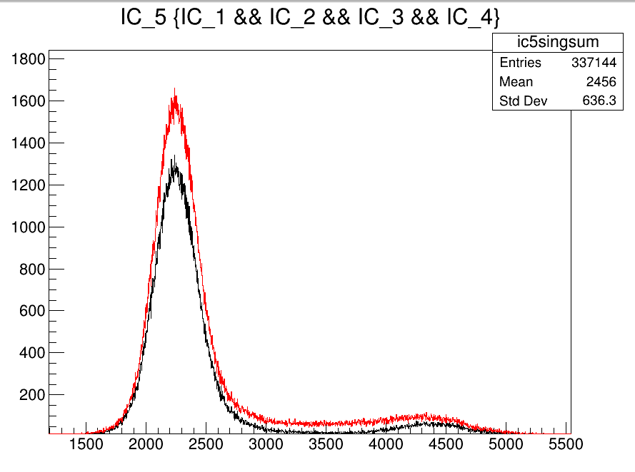
Black is with all ic channels are required
Red is ic_5 no condition
Black is with other Ic triggered

Slide 9
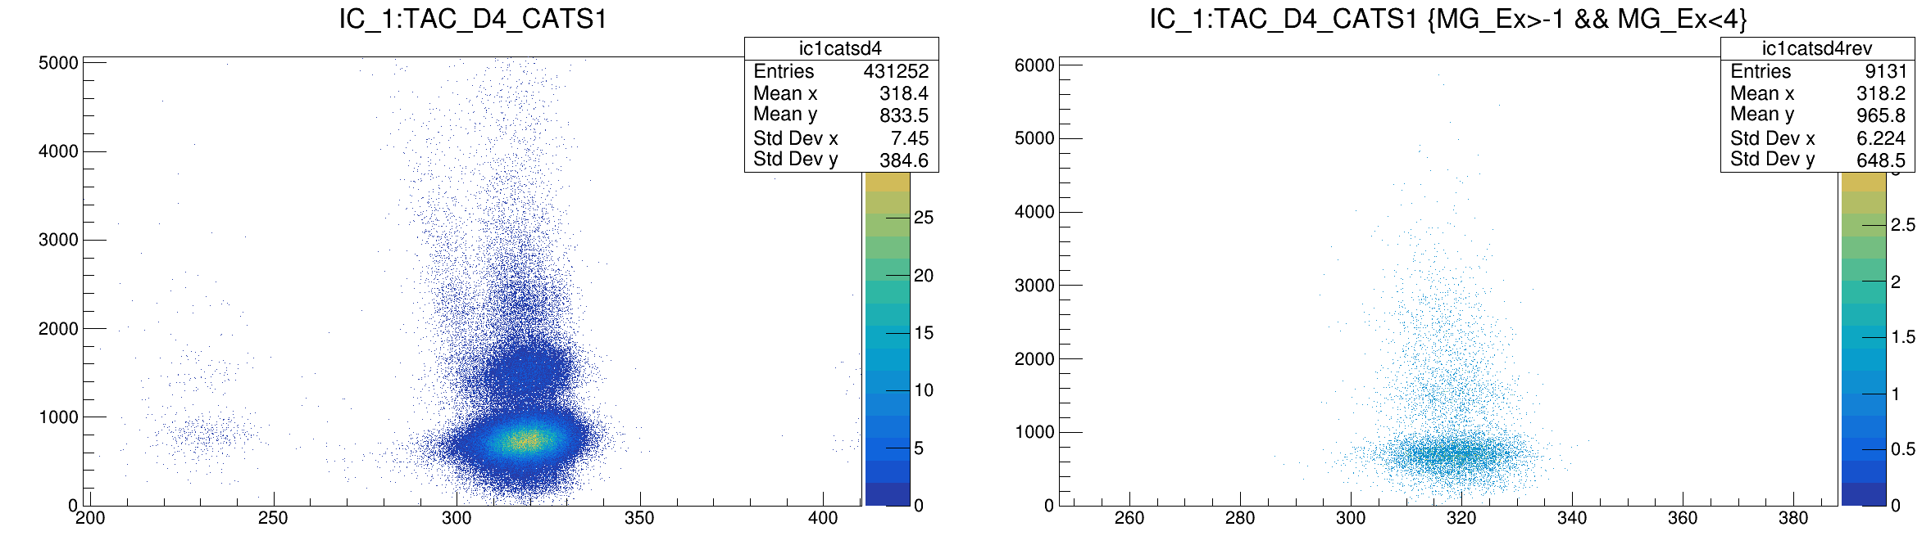
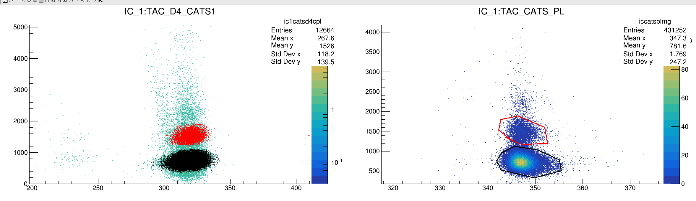

Slide 10
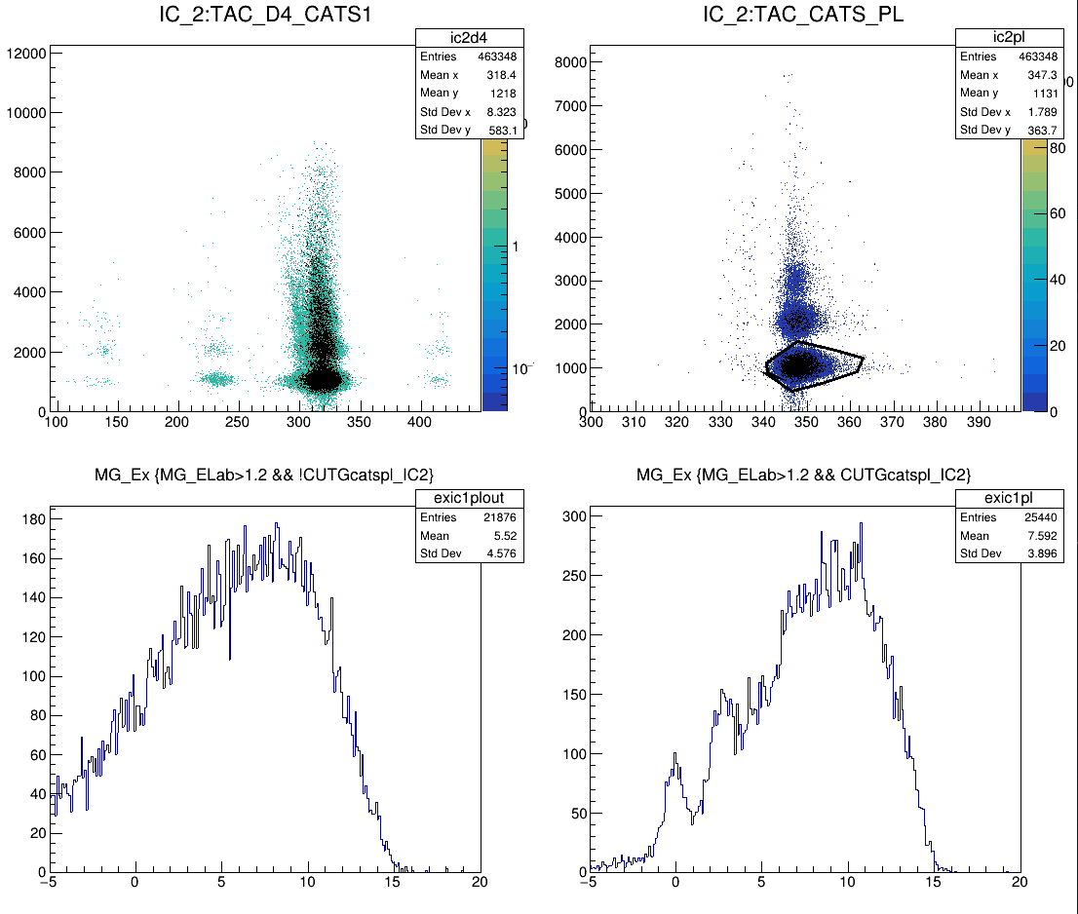

Slide 11
I think the gate is not necessary, we just need to require that ZDD is there.
And it cleans the data already, and we don’t lose the statistics

Slide 12
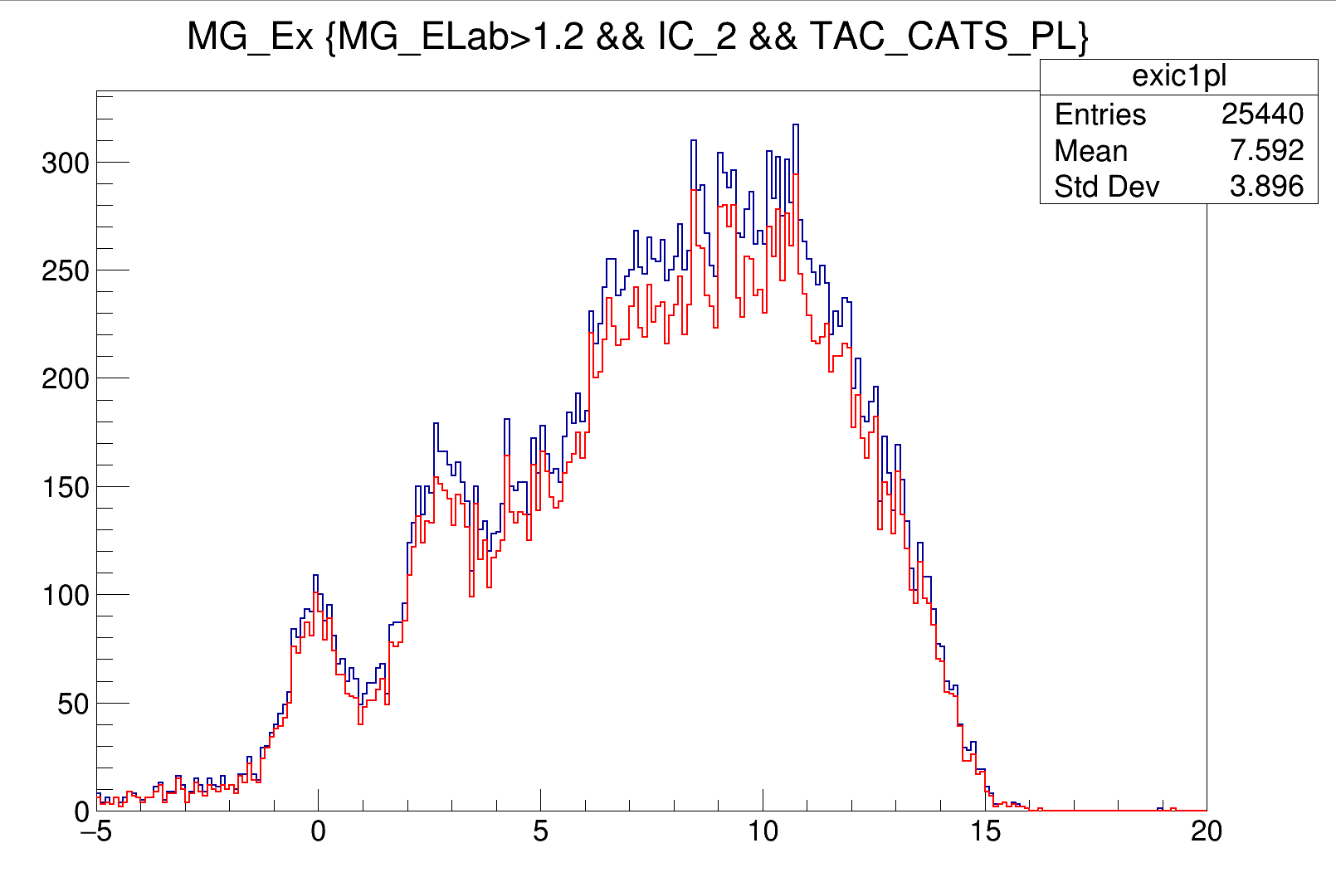
Blue → IC_2 and TAC excist
28100 entries
Red → gate on IC_TAC
25440 entries

Slide 13
So if I require all ionisation chamber registered, I have 22% of the events in IC1 stopped until the last IC. Same think can be done for other ionisation chambers, the important results will be the effect of requesti on all IC in MG_Ex

Slide 14
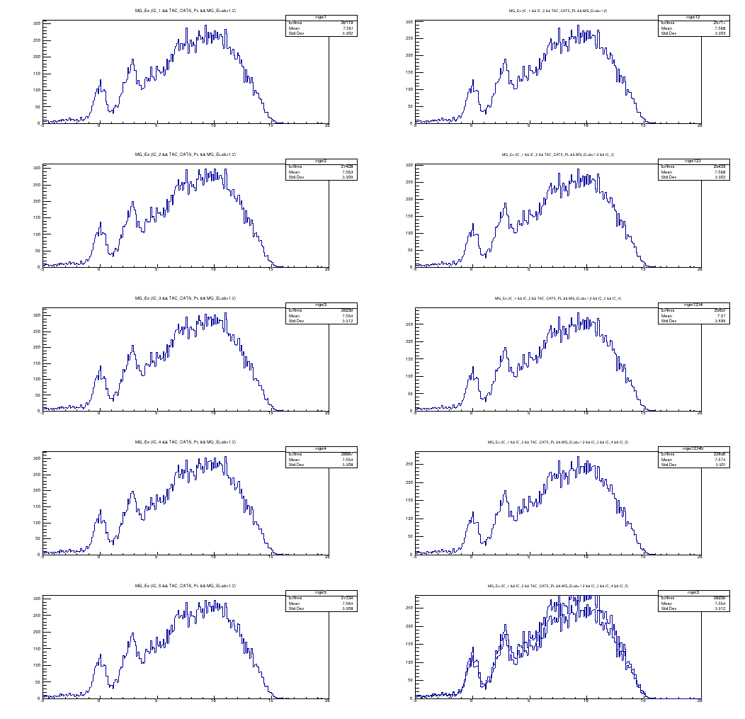
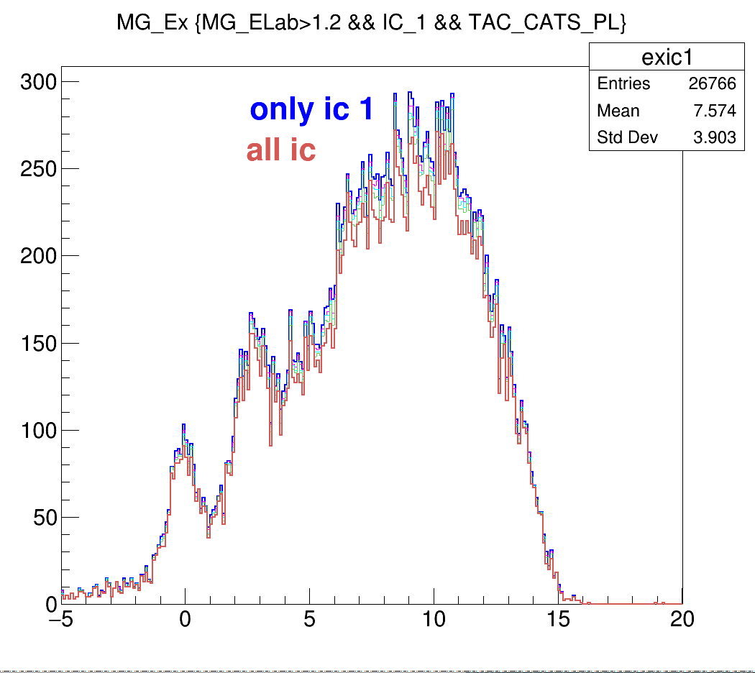

Slide 15
Purple → count rate in MG_Ex
Green → integral under the g.s. peak without background
Red→ integral under the 2.5 mev peak without background

Slide 16
According to relative ratio, if I take only ic_3 I can get highest statistics, and including all ic I loose 17% of the events

Slide 17
When we look at the Excitation Energy counts requiring all Ionization chamber only decrease the count rate 9 %. Of course important one id the background peak ratio. For such analysis.

Slide 18
Another IC statistics is :
IC_1 alone has 431266 entry
And only 341615 entry is correlated with MG_Ex (79%)
And if we require all IC → IC_Sum (337062) correlated with MG_Ex is 279215 from here the 82 percent of the events that interact with IC is correlated with MG_Ex

Slide 19
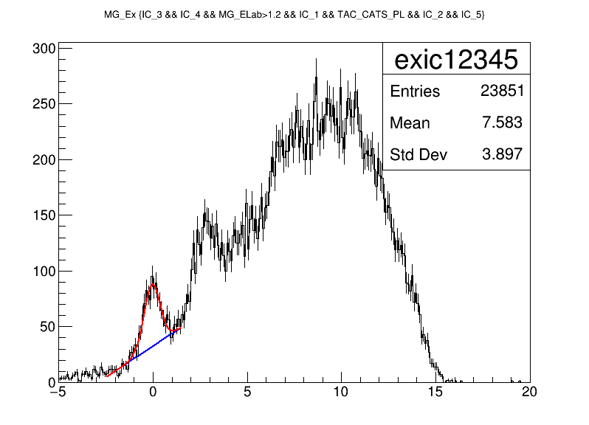
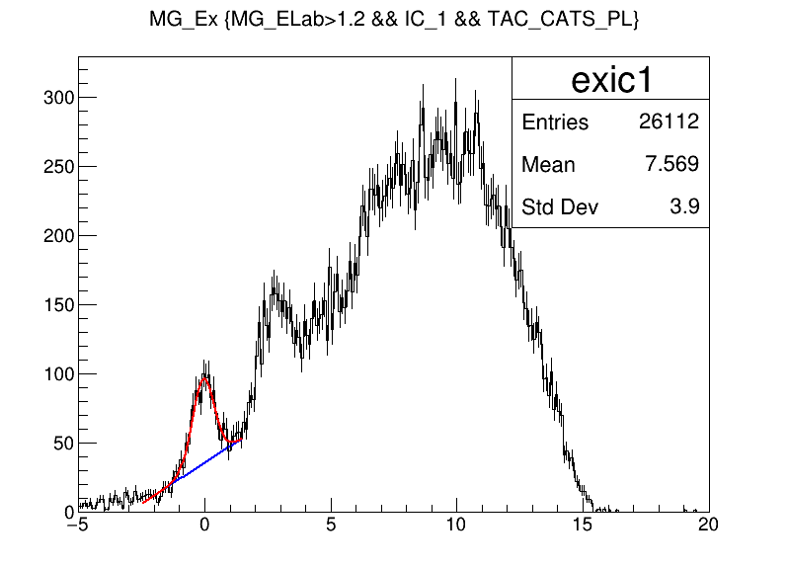
Gausn (0)+pol1(3) fit
Gaussian Sigma (p2): 0.432888
Gaussian Integral (p0): 60.626243
Background Integral: 108.318819
Net Peak Integral: 168.945062
Gaussian Sigma (p2): 0.441949
Gaussian Integral (p0): 676.70049
Background Integral: 118.945625
Net Peak Integral: 186.615675
Nearly no effect on using all IC
Now I will include the other detectors such as pl.

Slide 20
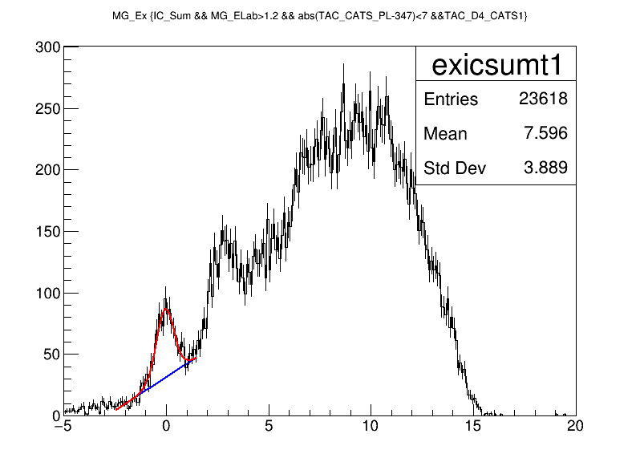
Extra check for TAC cuts or selection :
Instead of exist, I really chose the peak (there are some chnl zero ) → MG_Ex decrease to 23618
Gaussian Sigma (p2): 0.439262
Gaussian Integral (p0): 61.587271
Background Integral: 103.920349
Net Peak Integral: 165.507620
1 p0 6.15873e+01 5.83926e+00
2 p1 -5.83565e-02 3.36744e-02
3 p2 4.39262e-01 3.57530e-02
4 p3 3.14183e+01 1.98125e+00
5 p4 1.08764e+01 1.01396e+00

Slide 21
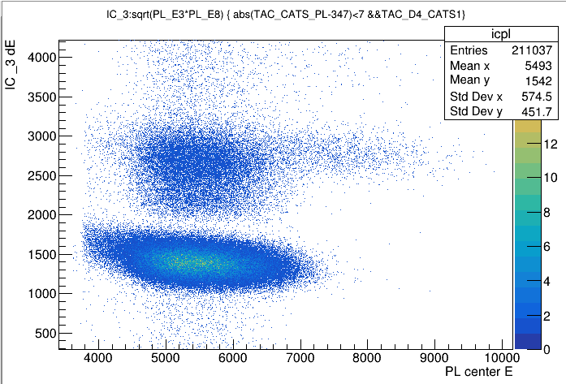
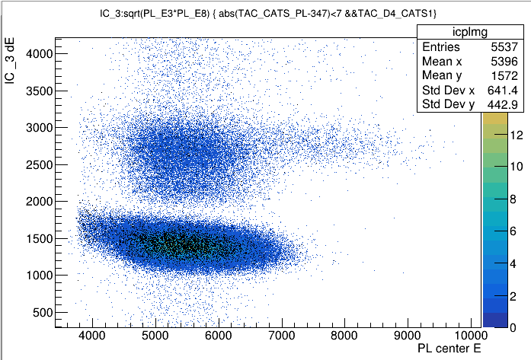
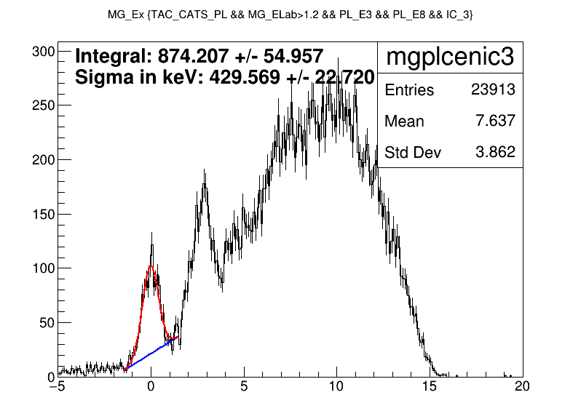
Plastic cuts correlations
With mugast condition

Slide 22
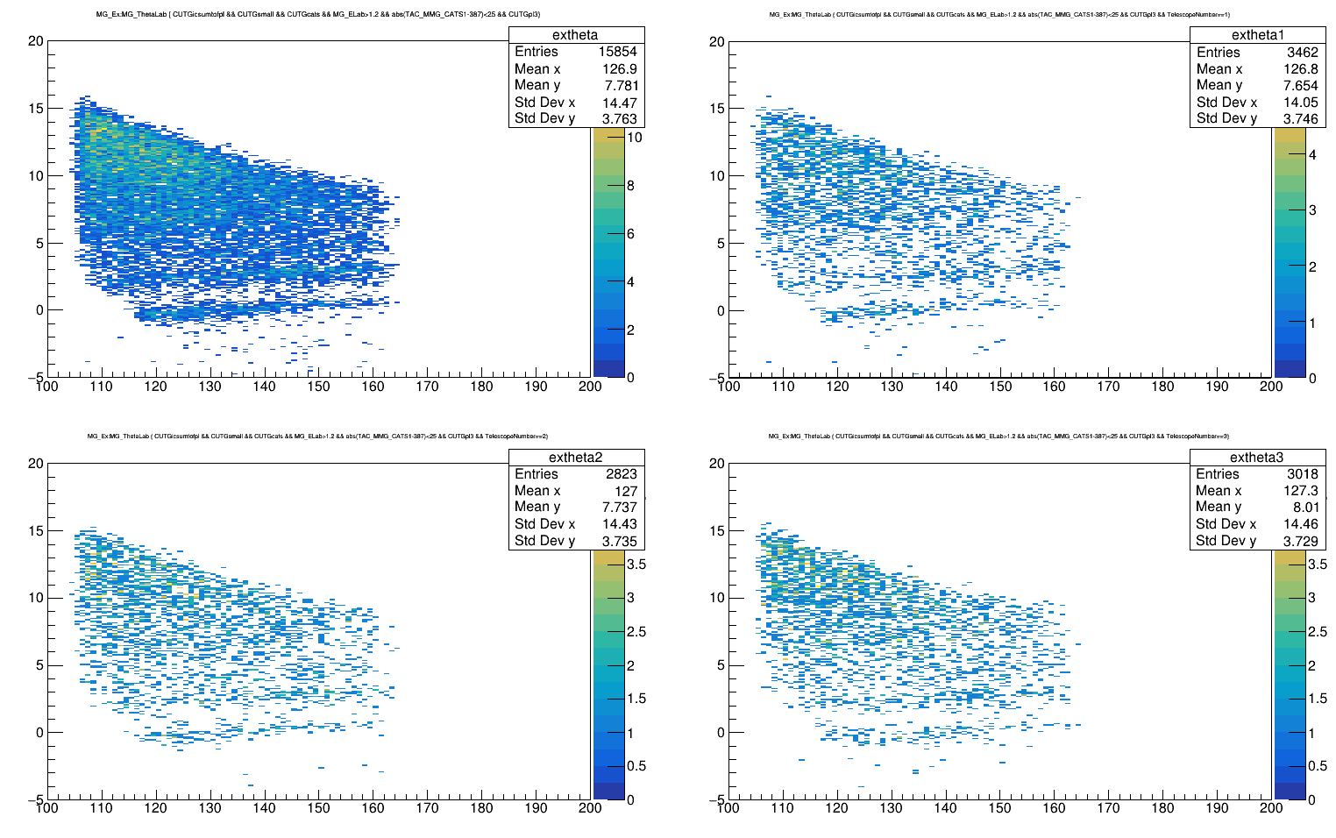
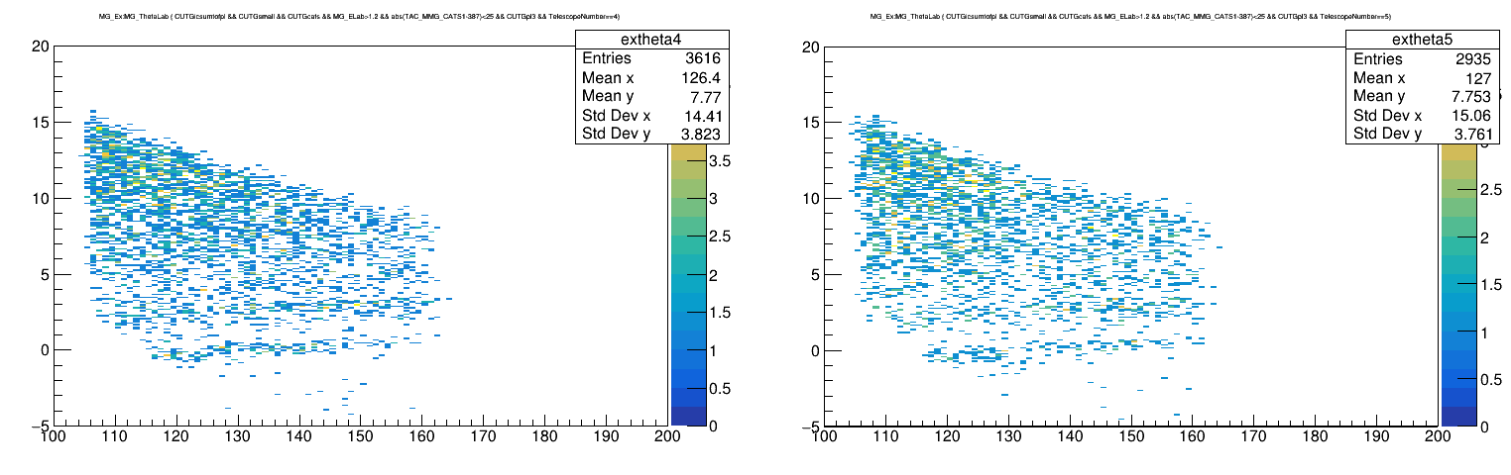
CATS correlations

Slide 23
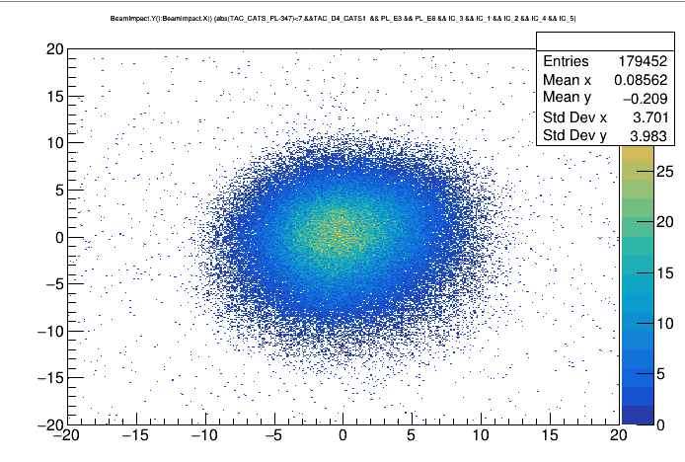
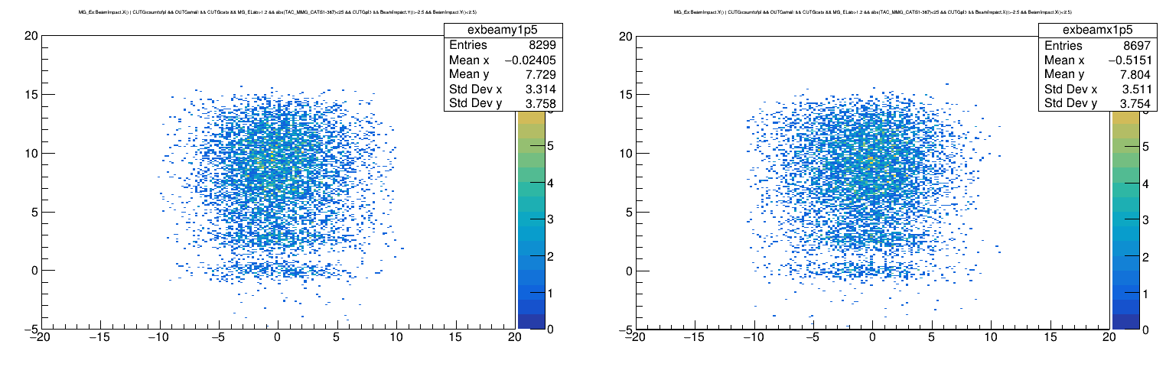

Slide 24
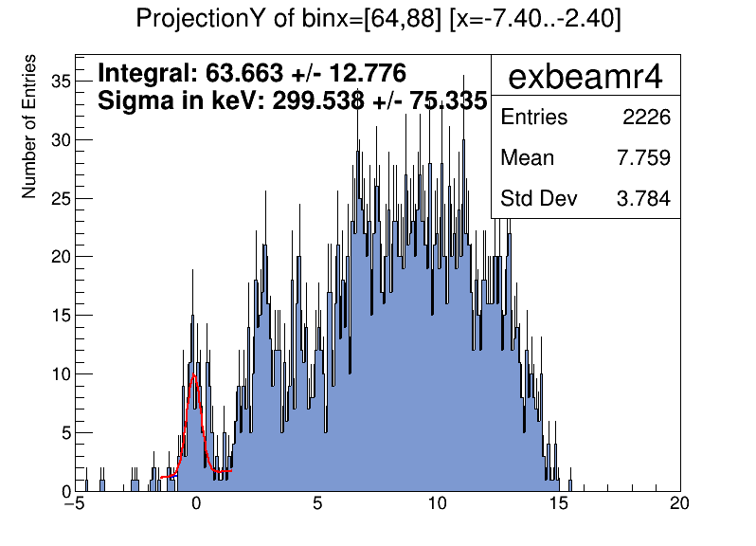
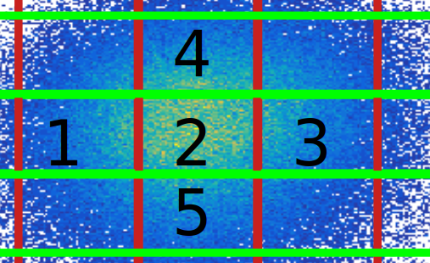
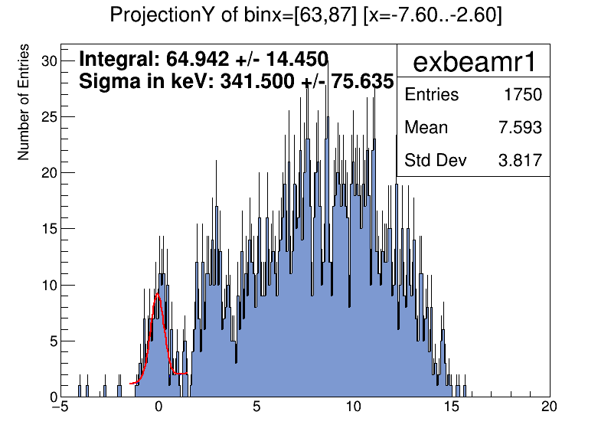
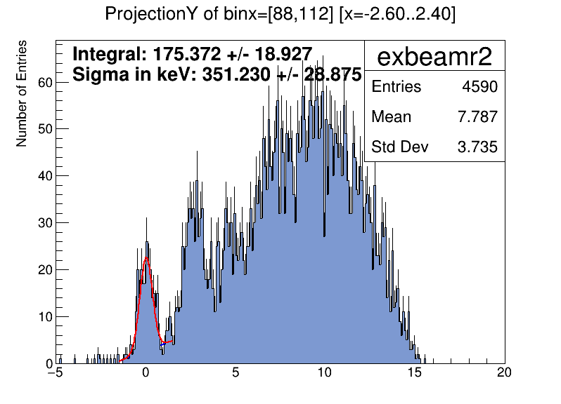
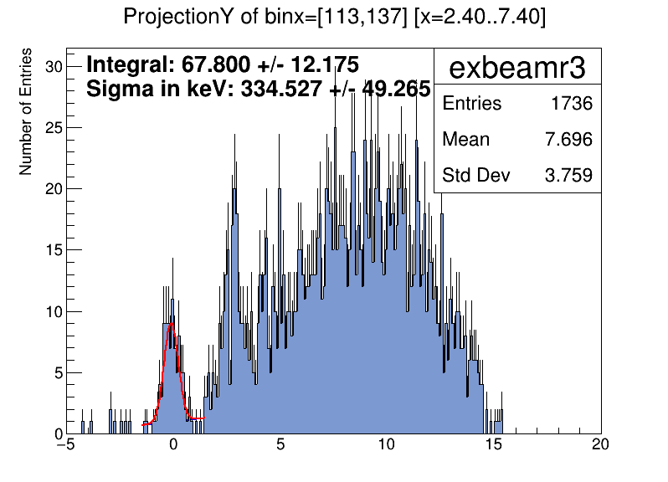
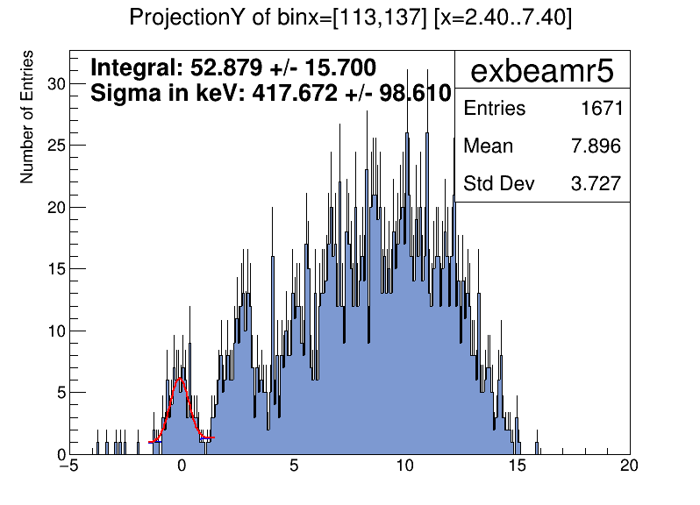
4
1
2
3
5

Slide 25
sim

