Slide 1
Analysis meeting #4
CATS calibration
MUGAST Time calibration
30 January 2024

Slide 2
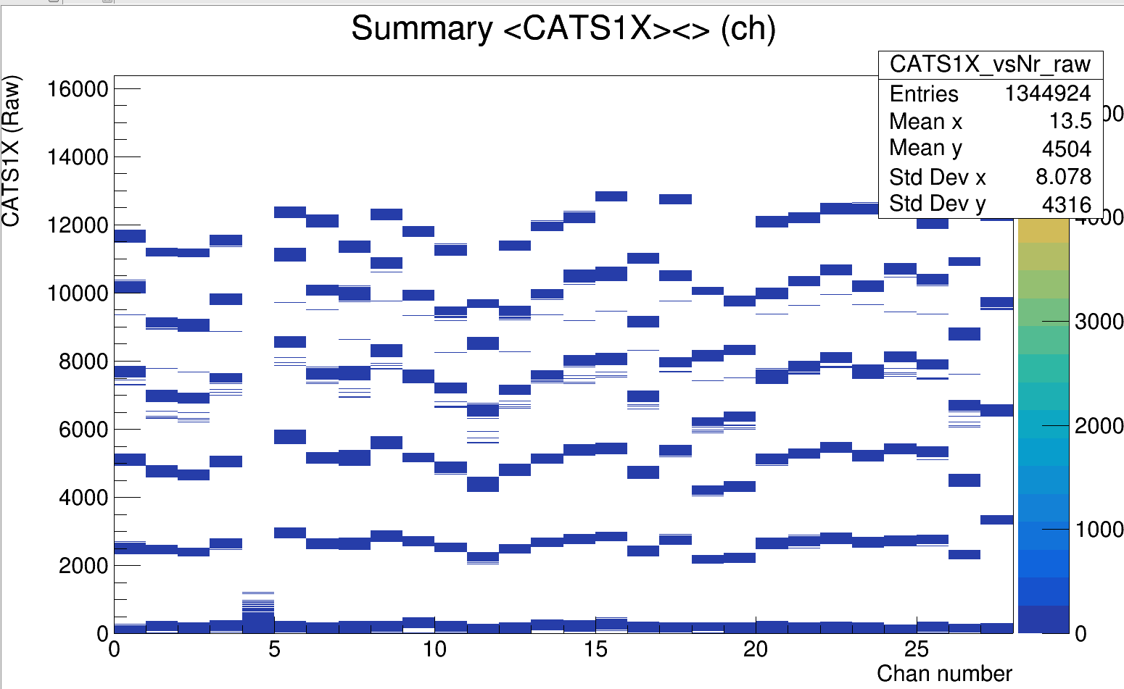
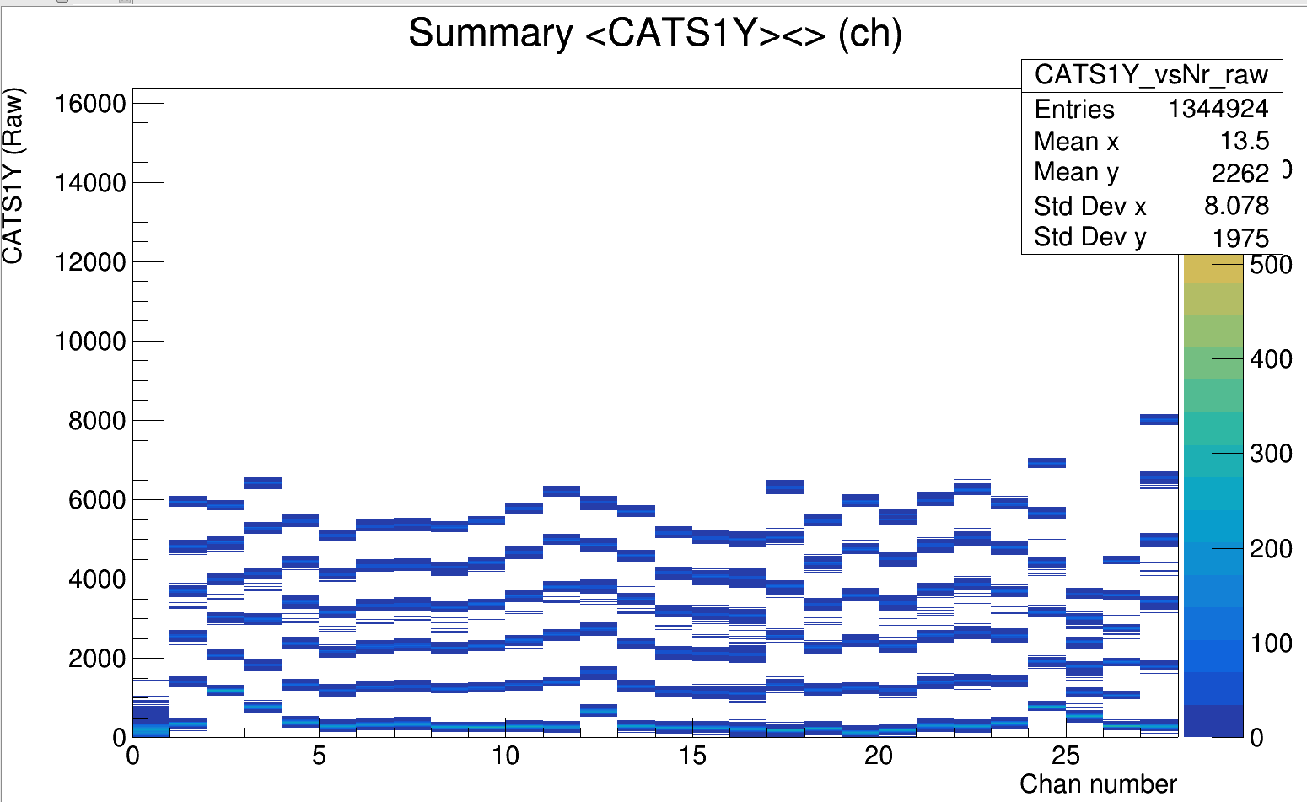
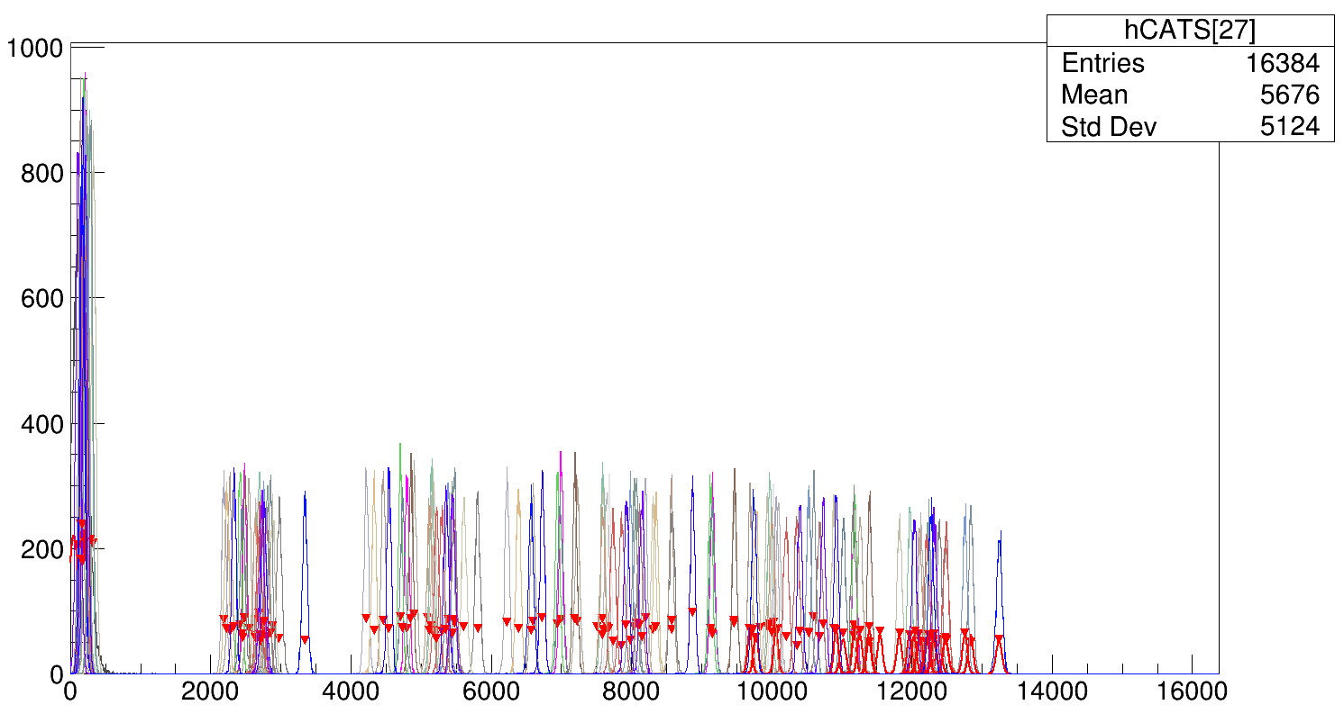
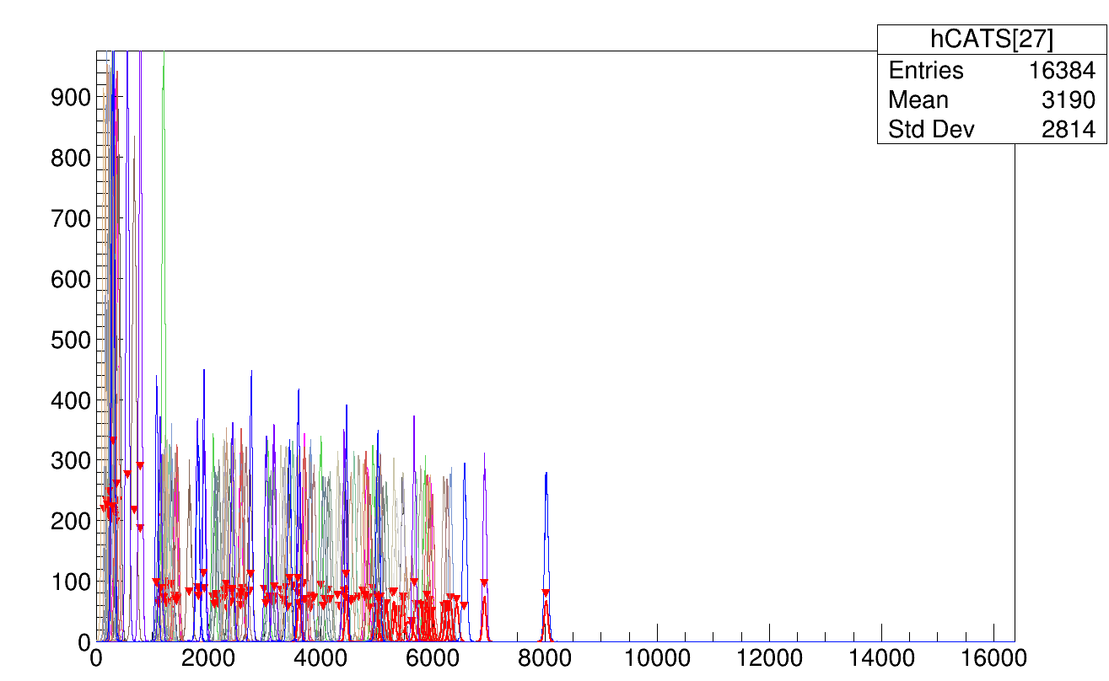

Slide 3
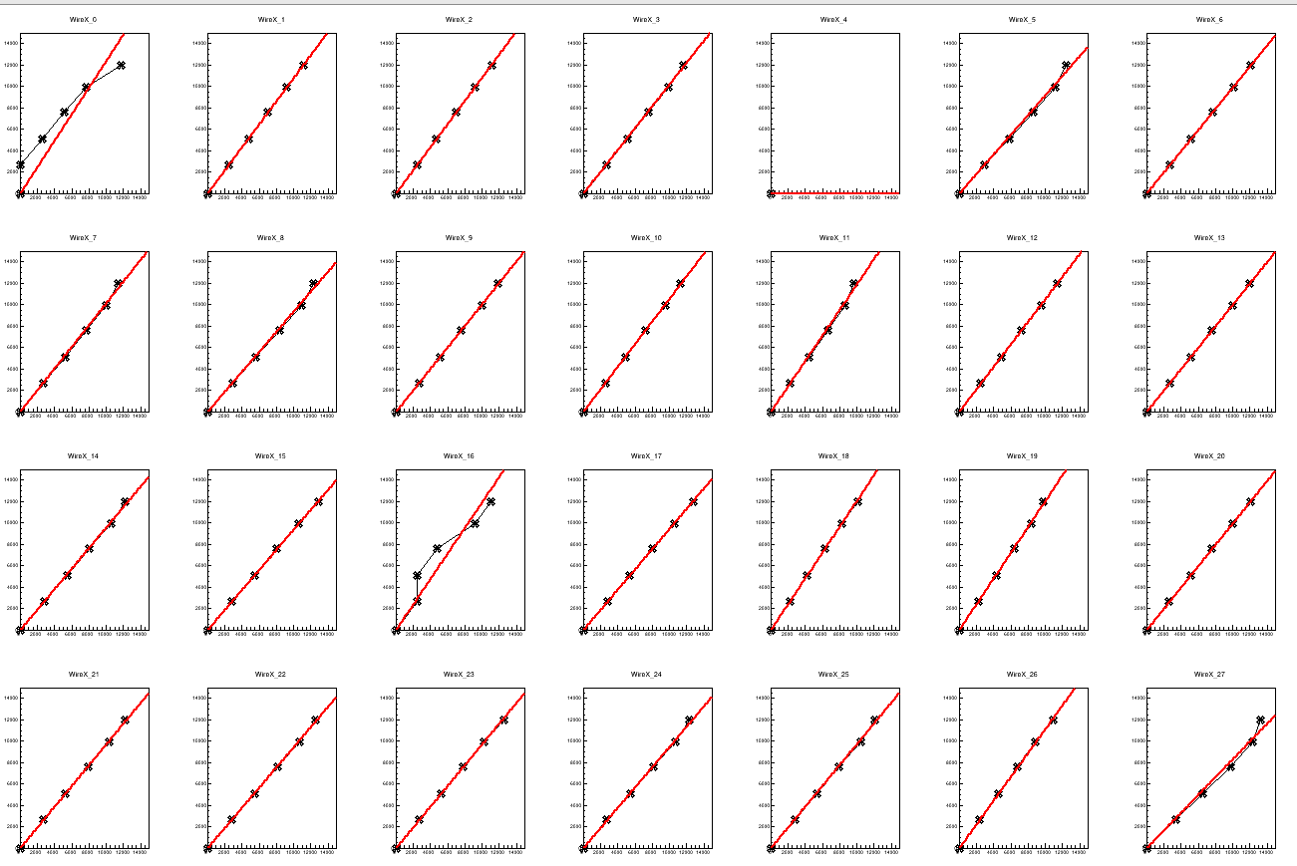
CATS calibration pol1 without pedestal

Slide 4
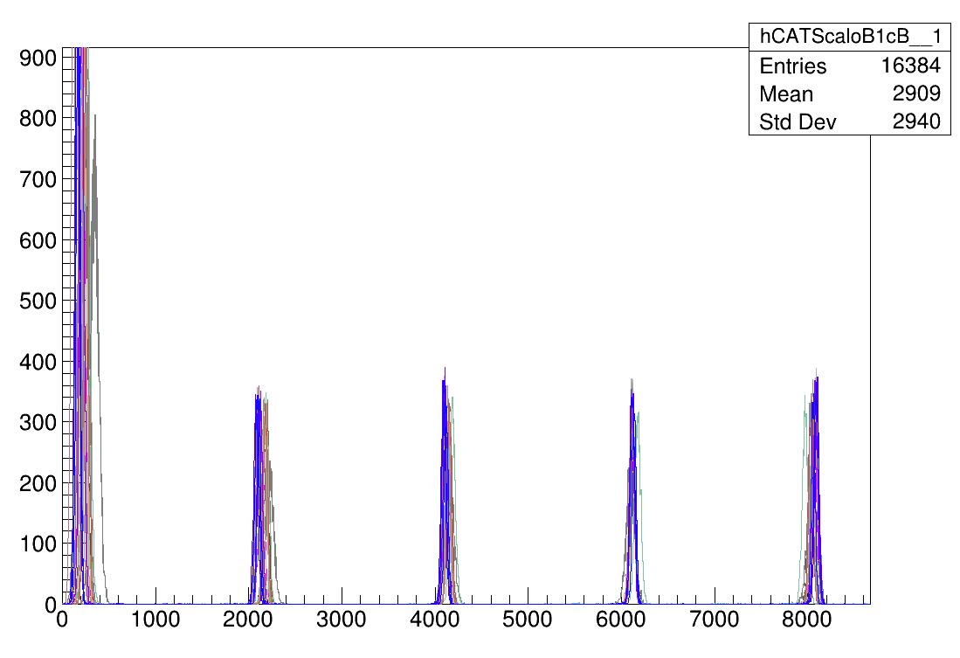
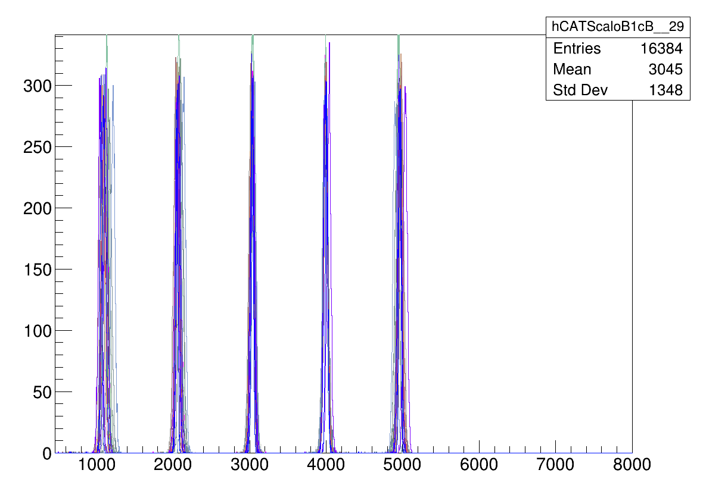

Slide 5
Mugast calibration
FSC calibration runs:
from 2023/05/24
R101, 102 MUVI1 X,Y
103, 104 MUVI2 X,Y
105, 106 MUVI3 X,Y
Mugast raw
From 2023/03/30
  200,201,202,203,204,205
  No clear information in elog for this runs which one is better to use ?
101 and 200 histograms are different in MG1
For time calibration
Pol2 or Pol1 fit ?

Slide 6
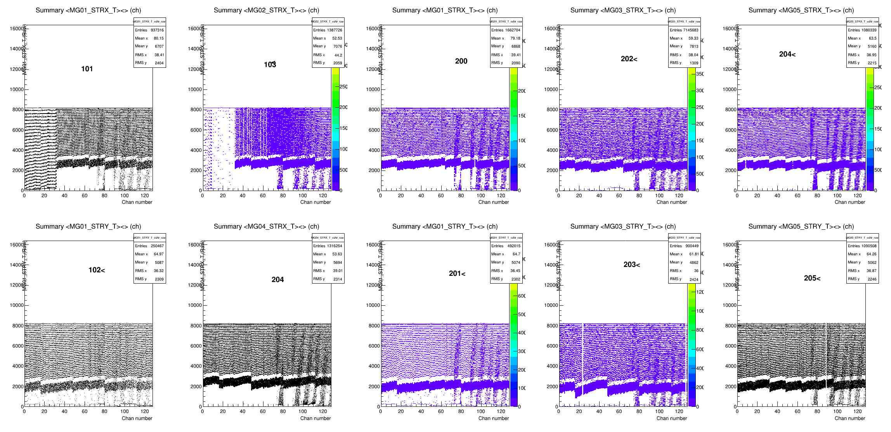

Slide 7
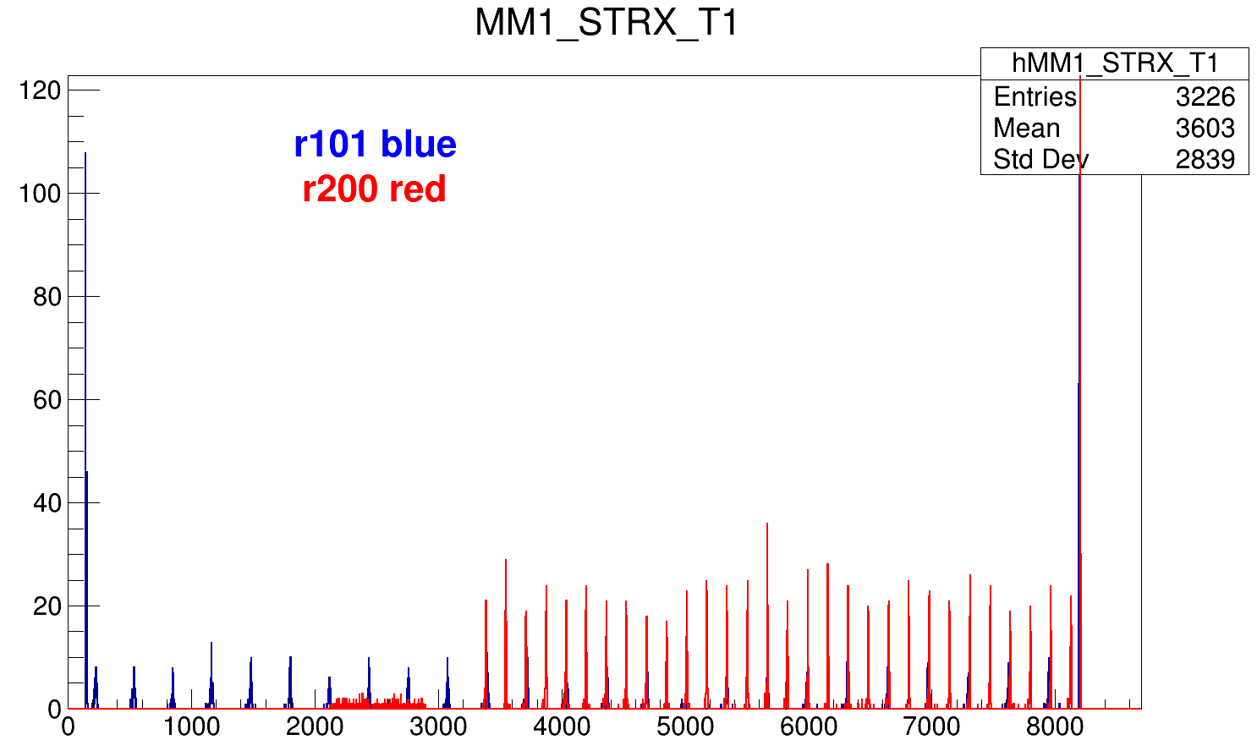
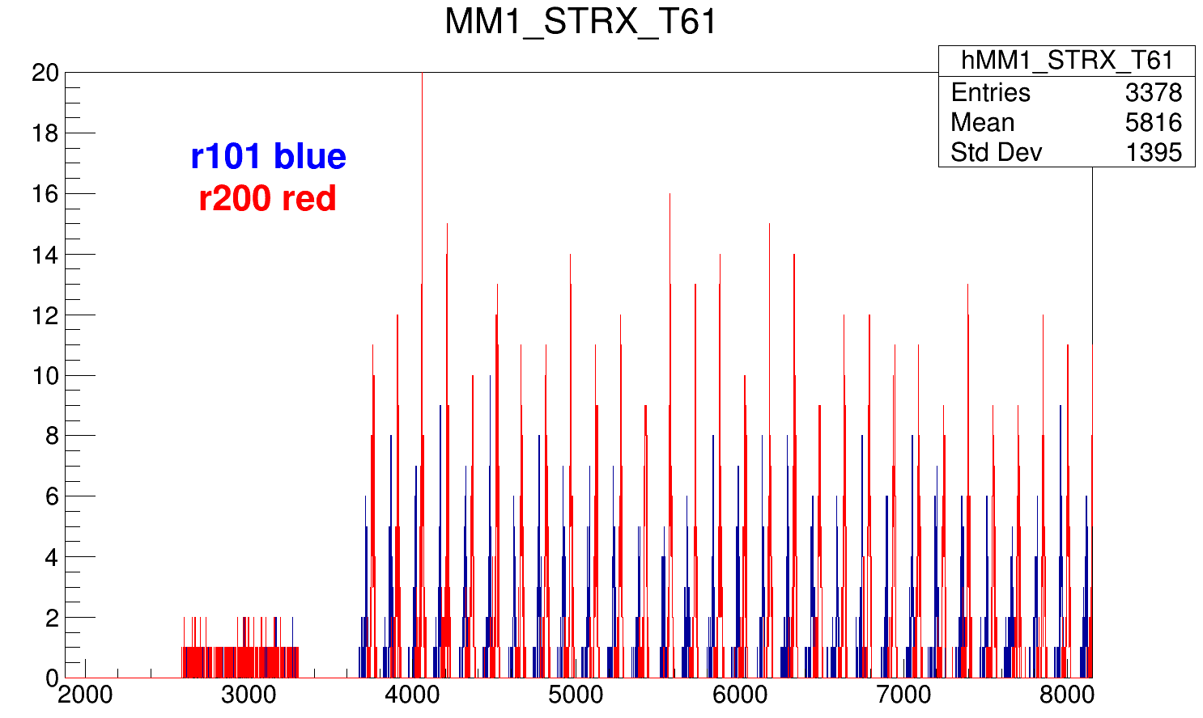

Slide 8
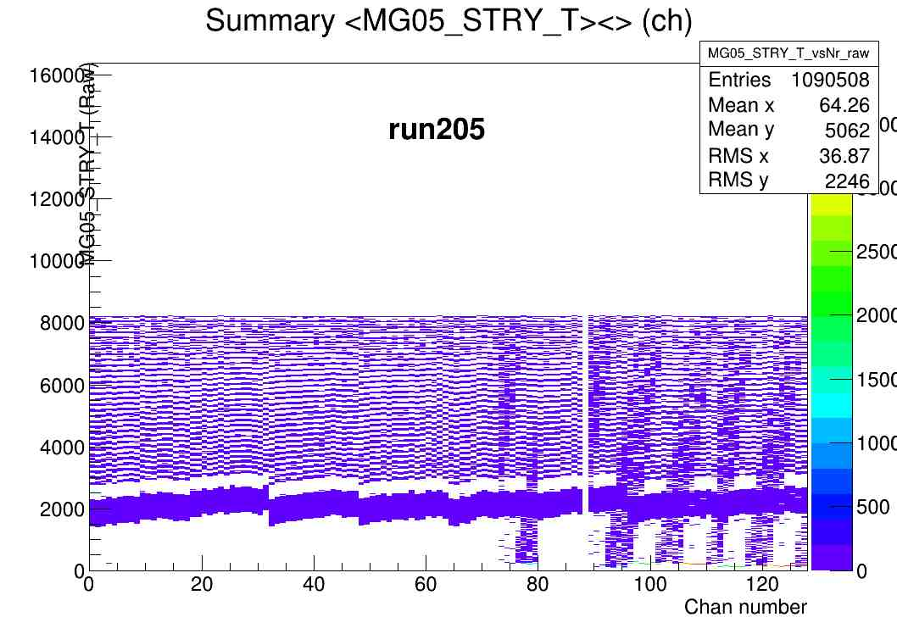
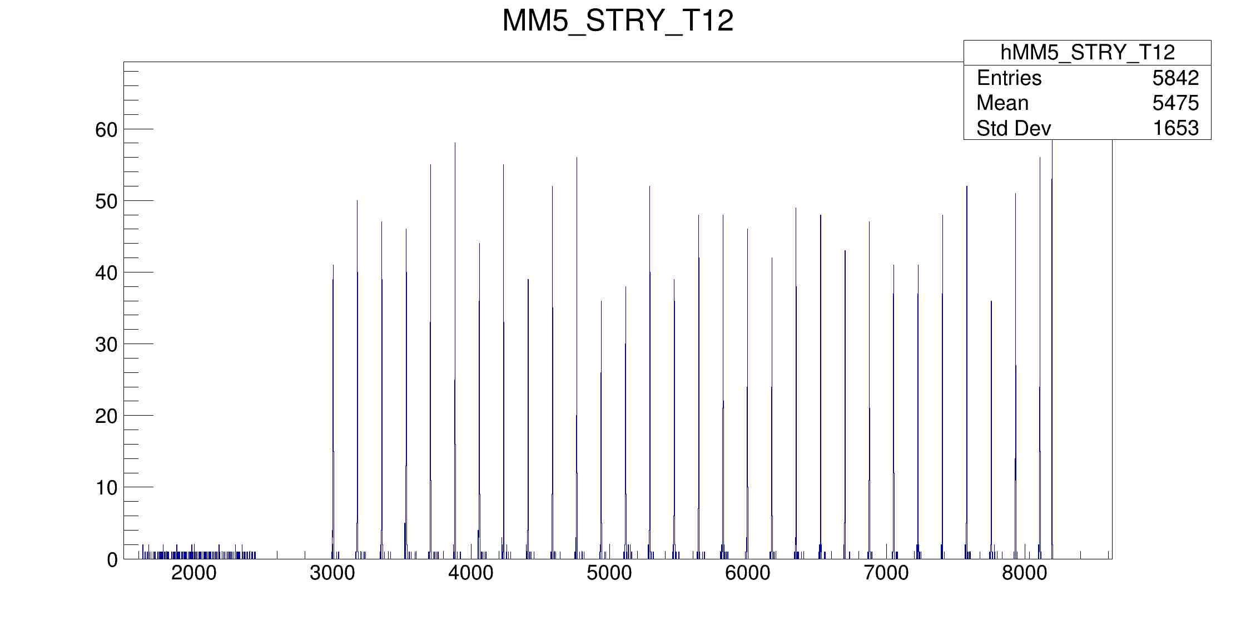
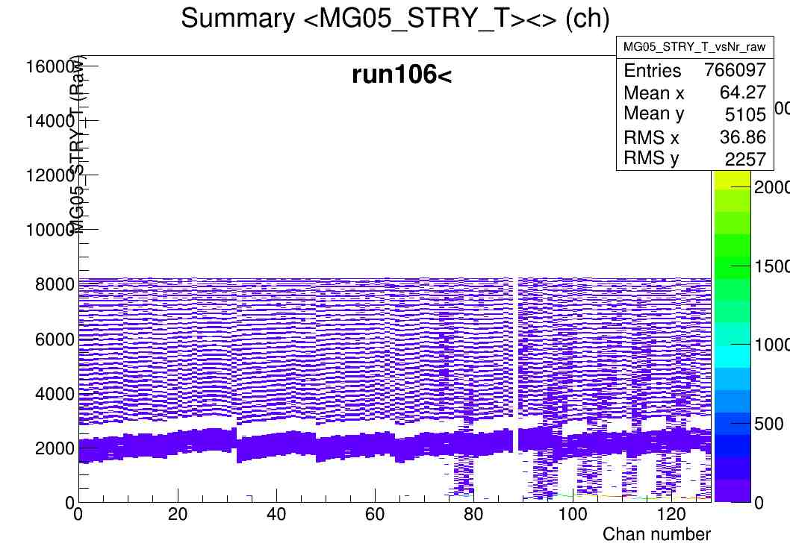
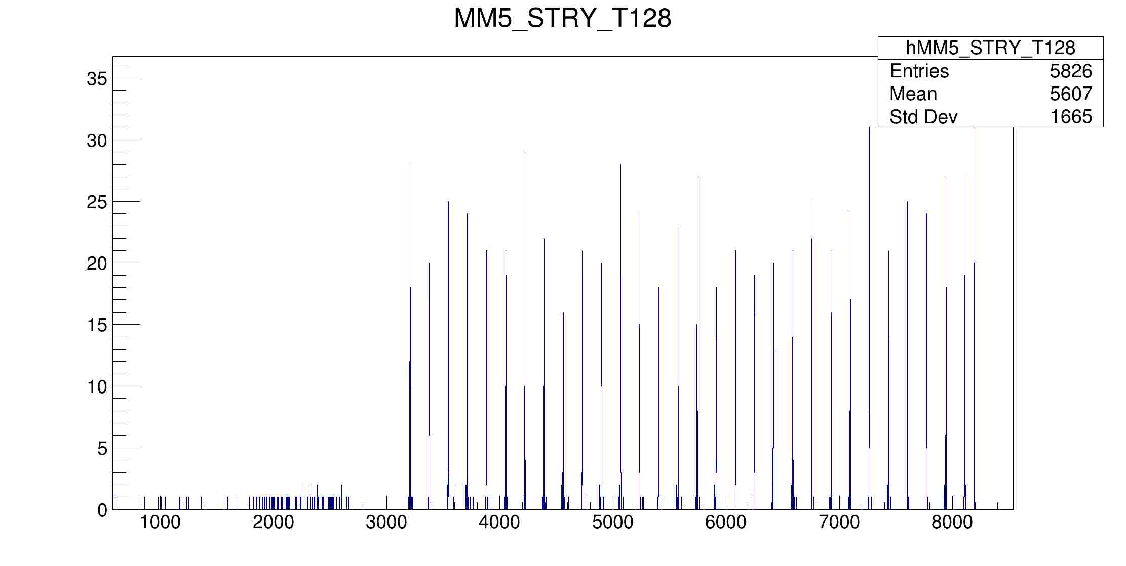

Slide 9
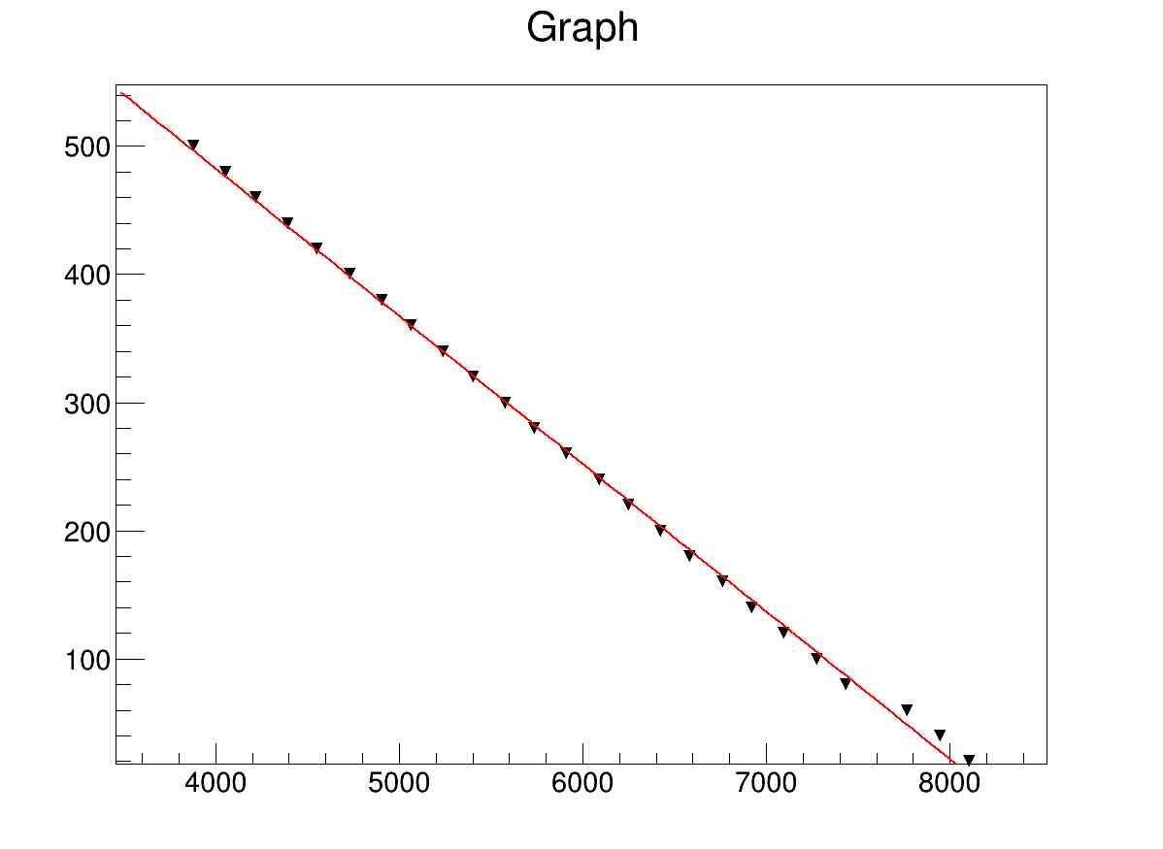
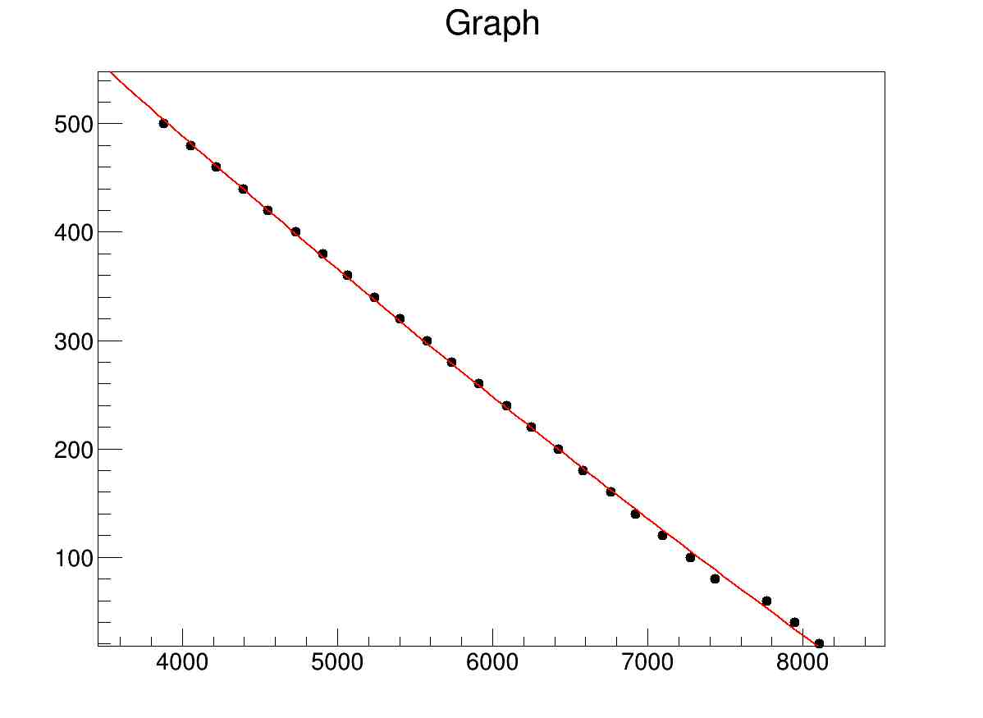
X axis is channel
Y axis supposed to be frequency*peaknumber,
according to previous analysis code (npeak-i)*20 is used , but I don’t know exactly what should I use for Y axis. What is the time calibrator freq ?
Pol1 parameters
943.41, -0.115207
Pol2 parameters :
1031 , 0.146, 2.58e-6

Slide 10
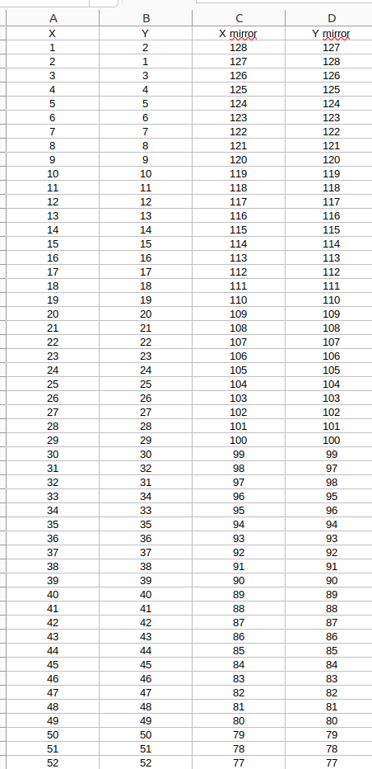
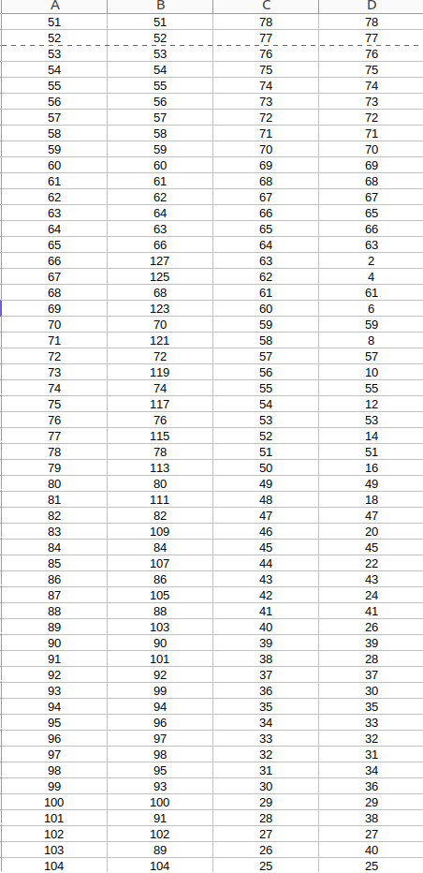
How to check if they are fine ? Which histogram or tree branches ?
Strip mugast excel file , do I need to switch the strip numbers ?

