Slide 1
Cats effect
BeamImpact = TVector3((CATS->PositionOnTargetX),(CATS->PositionOnTargetY),0);
Runfiles: Analysis/L21_Ref27330_catsnocorrettion_SetRefTS

Slide 2
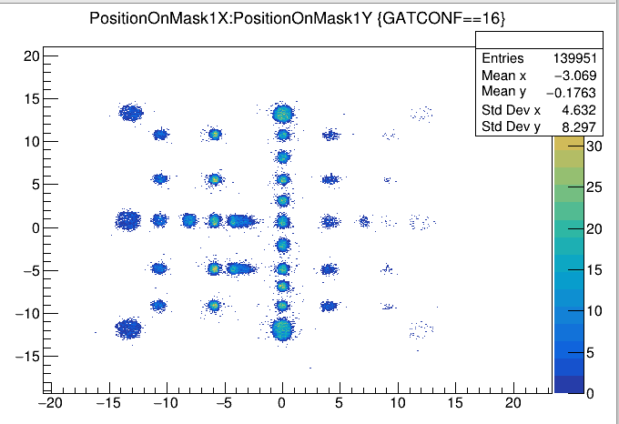

Slide 3
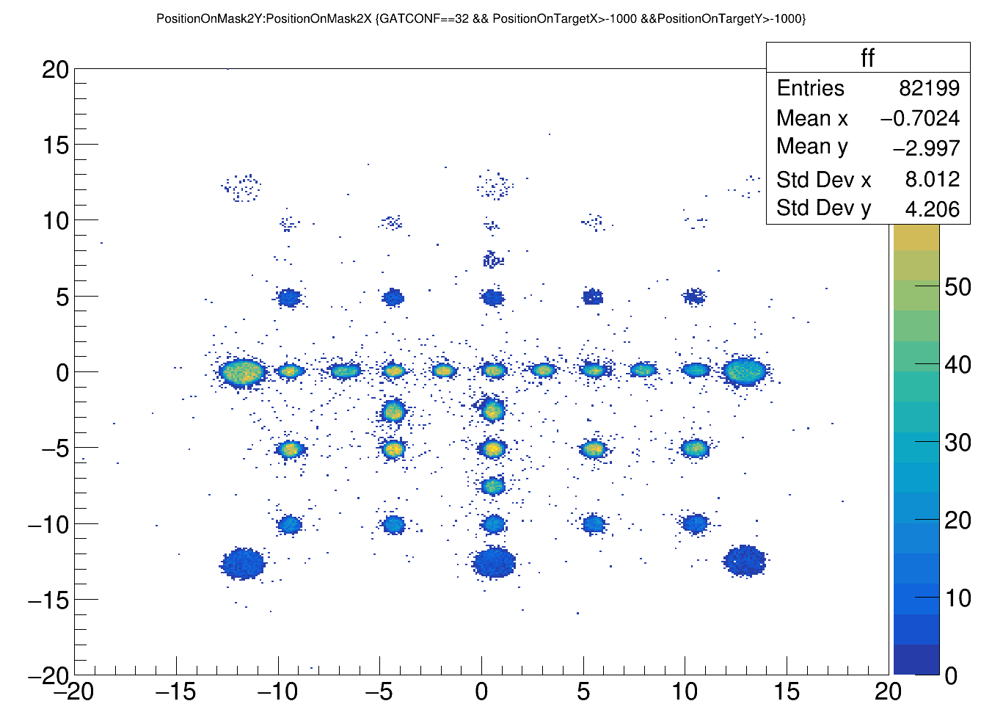
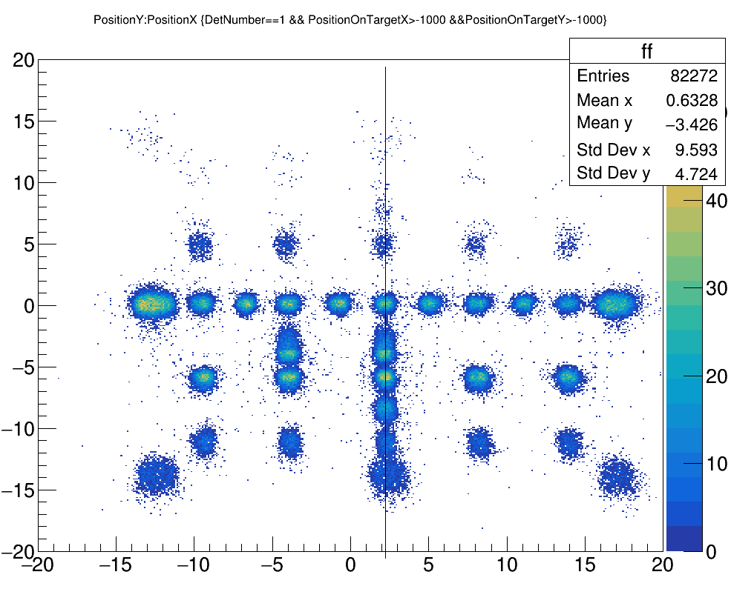

Slide 4
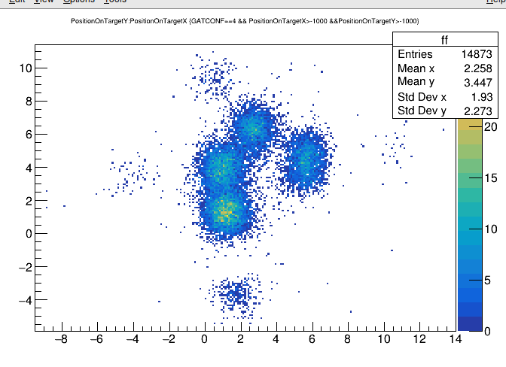
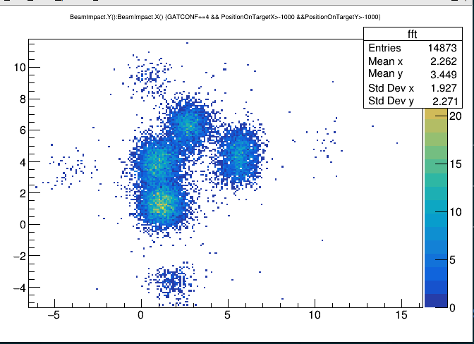

Slide 5
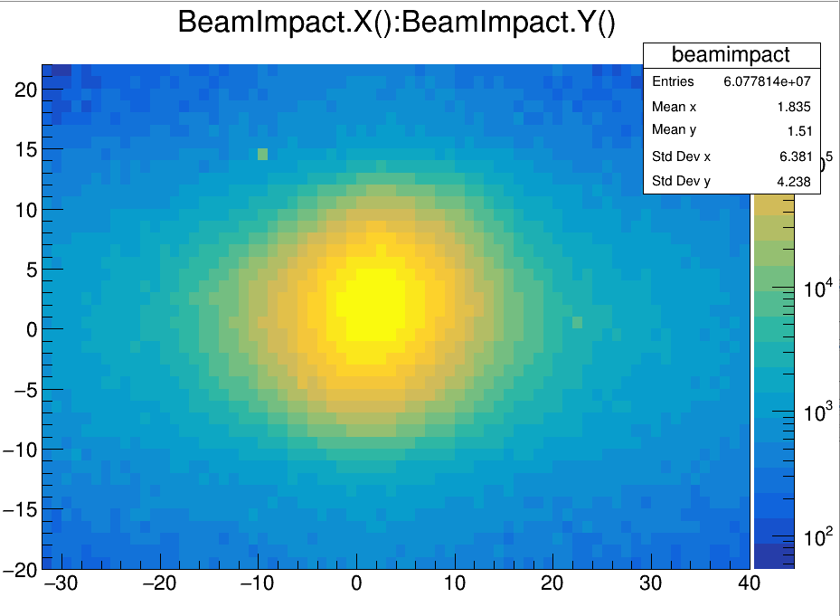

Slide 6
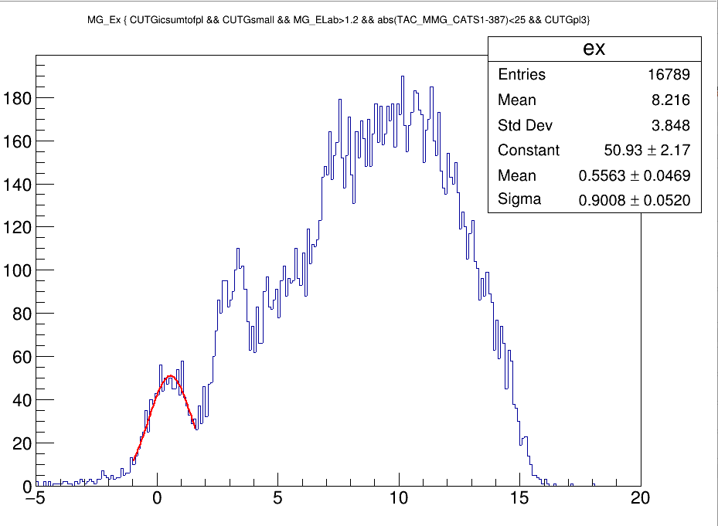

Slide 7
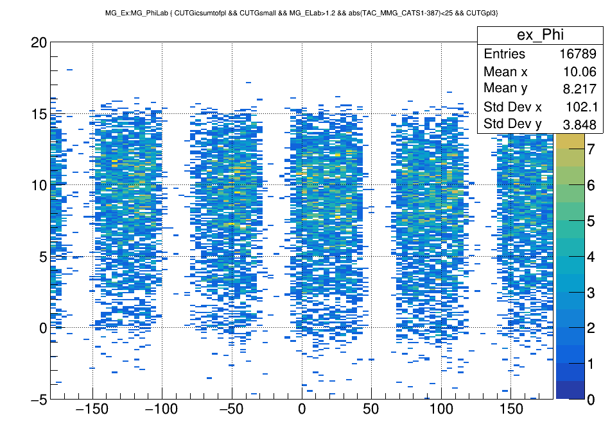

Slide 8
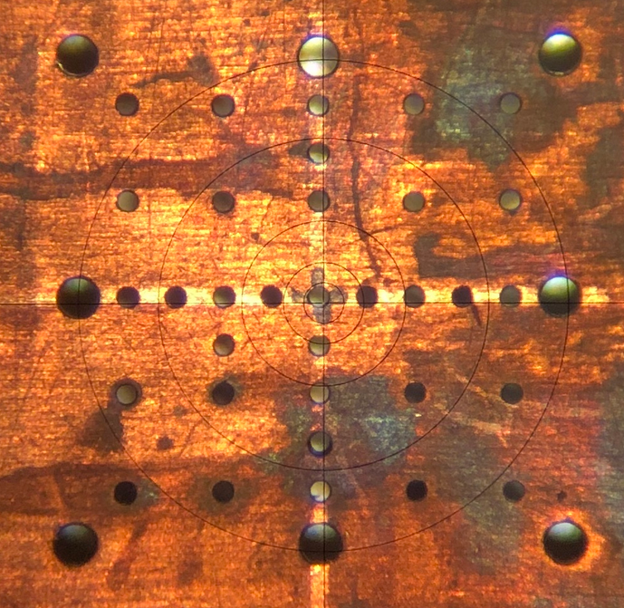

Slide 9
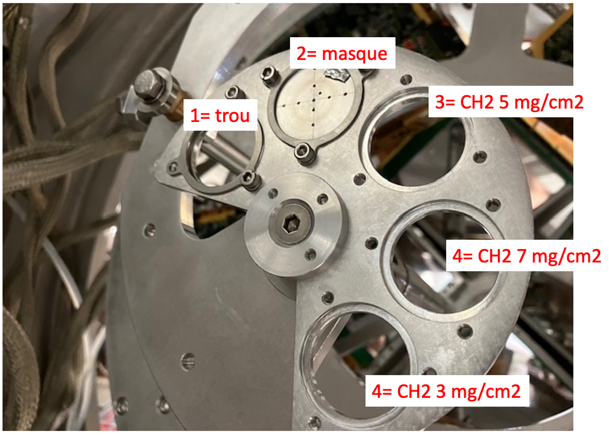
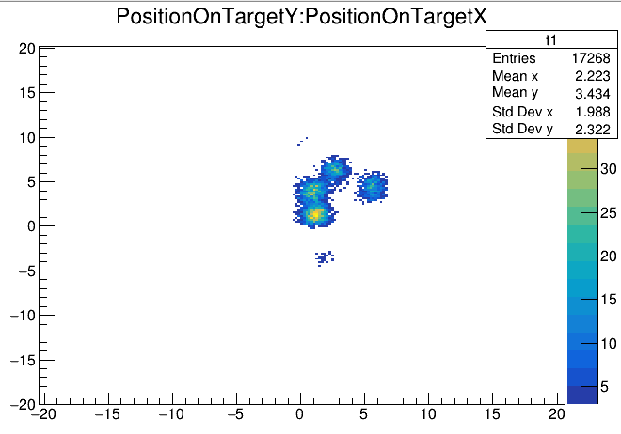

Slide 10
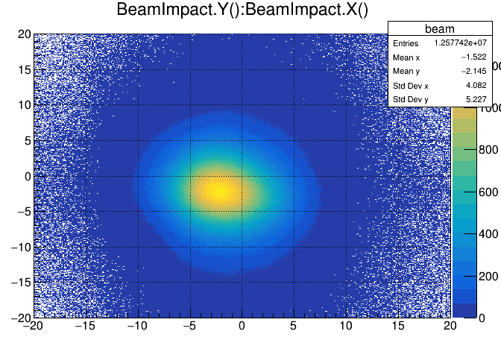
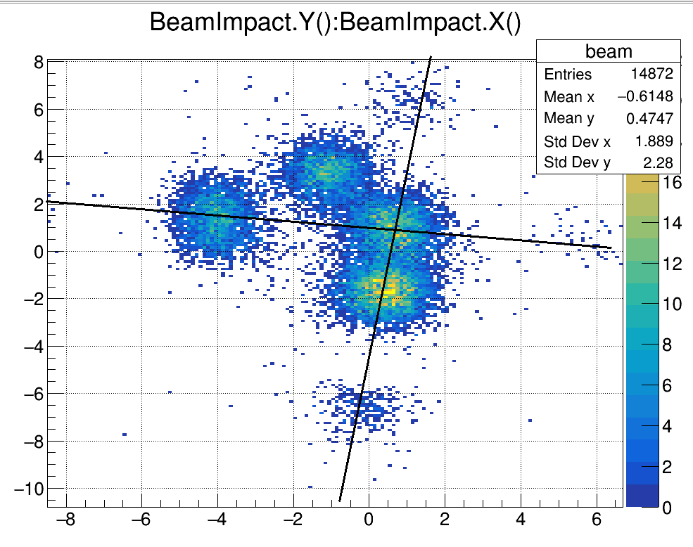
Cats6
BeamImpact = TVector3(-(CATS->PositionOnTargetX),(CATS->PositionOnTargetY),0); ///new one cats6

Slide 11
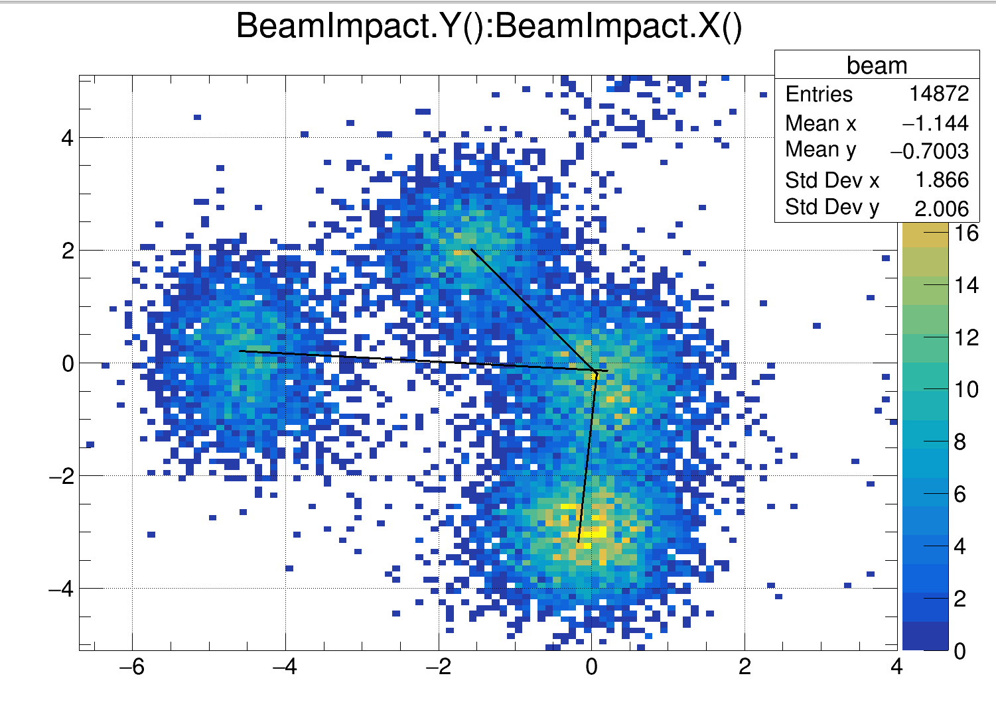
Cats7
BeamImpact = TVector3(-(CATS->PositionOnTargetX)-0.5,(CATS->PositionOnTargetY)-1.3,0);//cats7

Slide 12
Ex

Slide 13
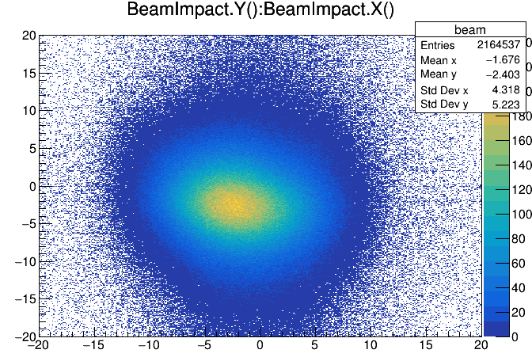
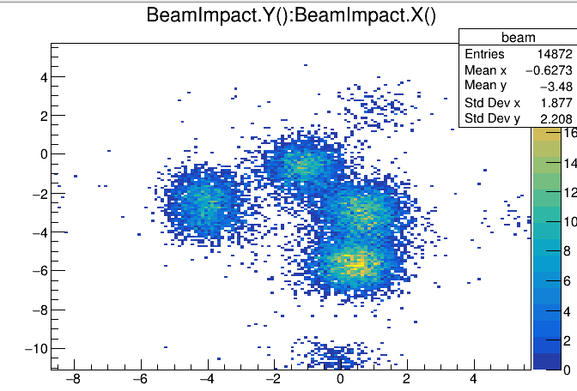
Cats5
BeamImpact = TVector3(-(CATS->PositionOnTargetX),(CATS->PositionOnTargetY)-4,0);

Slide 14
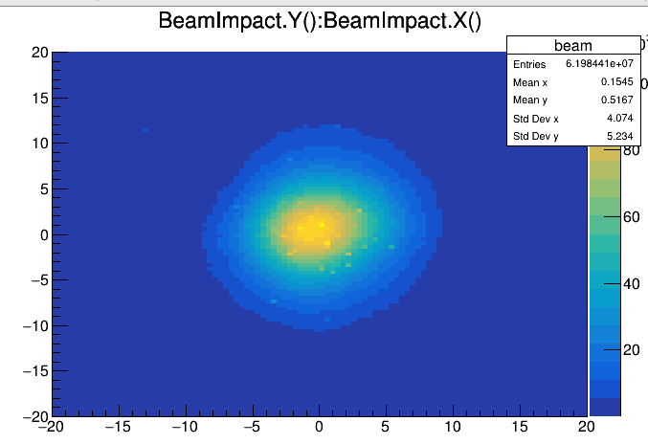
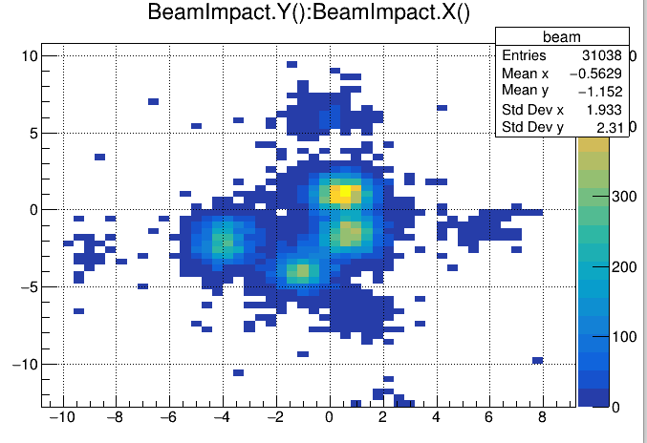
cats3
BeamImpact = TVector3(-(CATS->PositionOnTargetX)+1.7,-(CATS->PositionOnTargetY)+2.3,0);

Slide 15
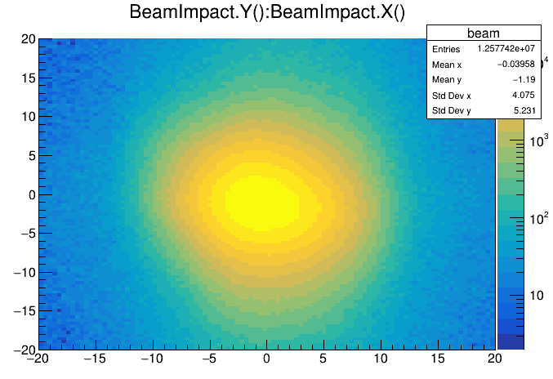
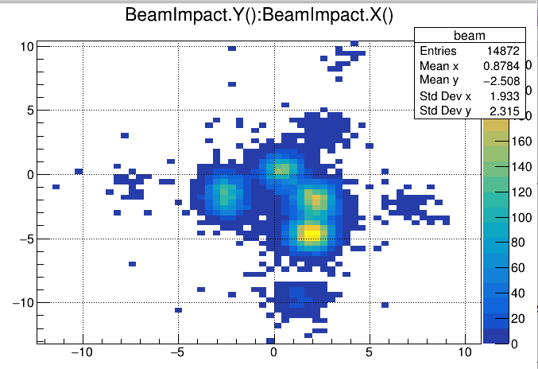
Cats8→
BeamImpact = TVector3(-(CATS->PositionOnTargetX)+1.5,(CATS->PositionOnTargetY)-3,0); ///new one cats8

Slide 16
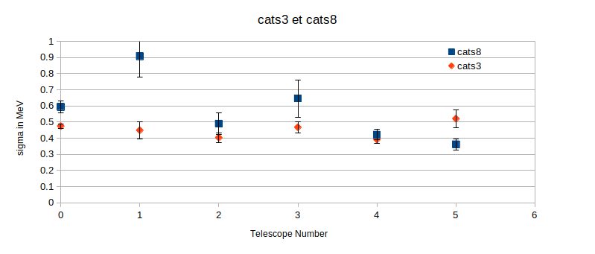

Slide 17
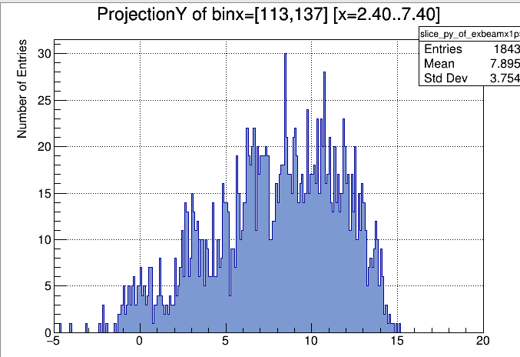
Cats regions
Region 4

