Slide 1
e843
MUGAST@LISE analysis meeting
10.12.2024
Ozge Aktas

Slide 2
OUTLINE
Recent Excitation Energy for 68Ni(d,p)69Ni reaction
  Problems to solve ?
68Ni inelastic breakup component
Exogam
  Exogam correlation for excited states
What to do next

Slide 3
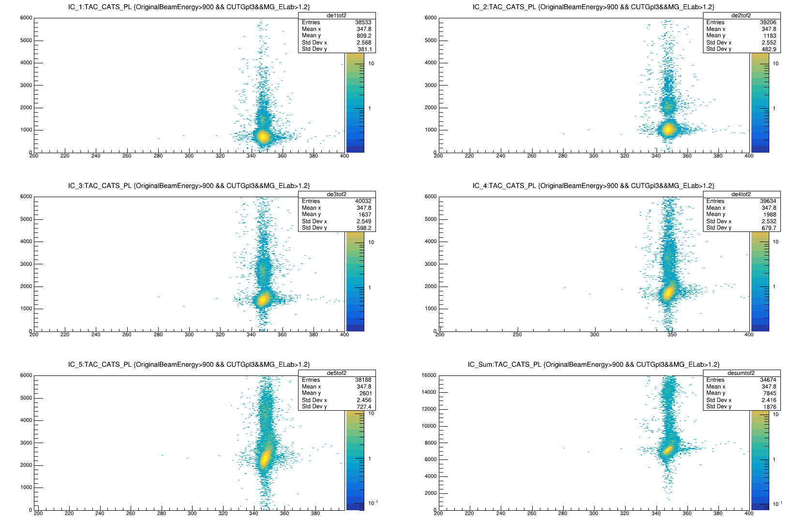
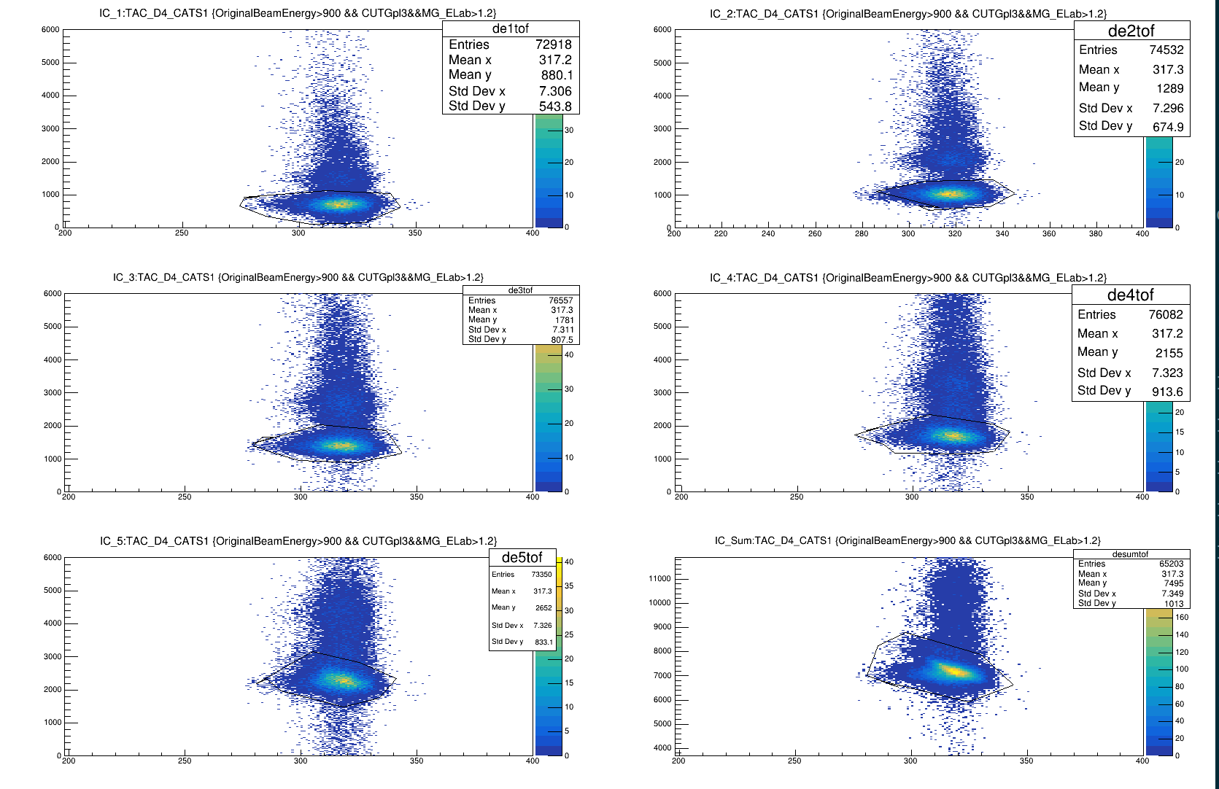
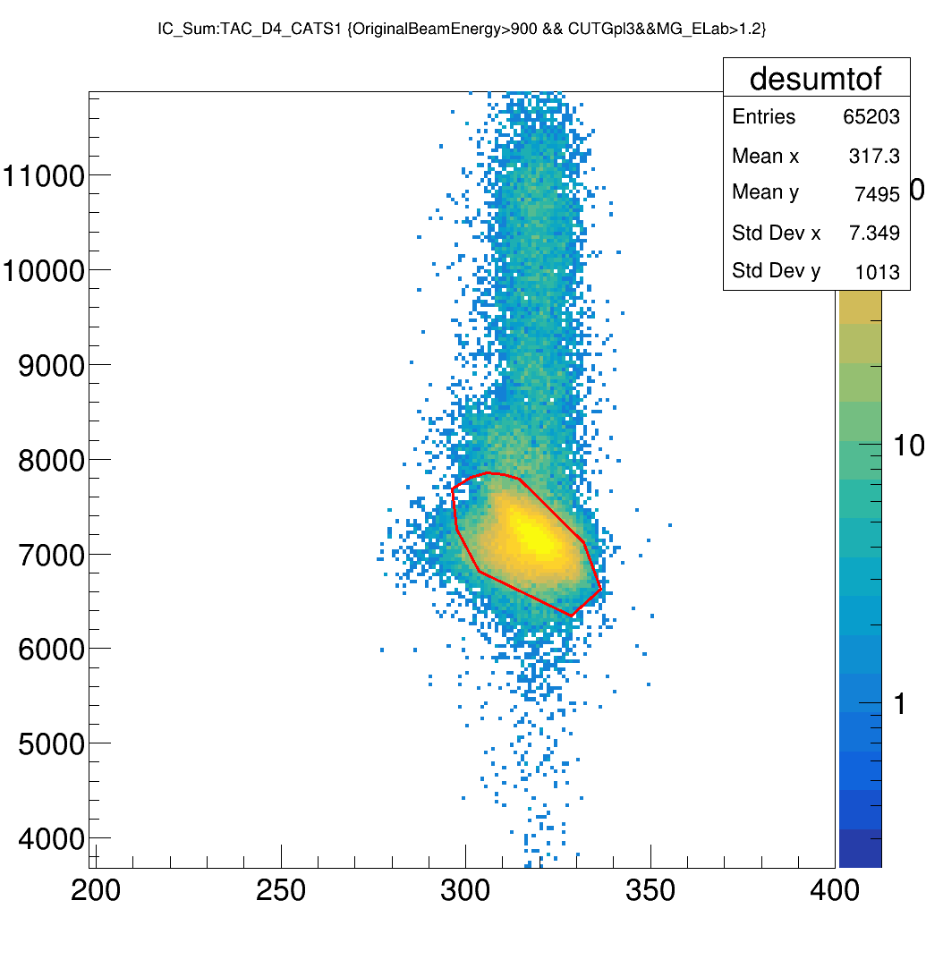
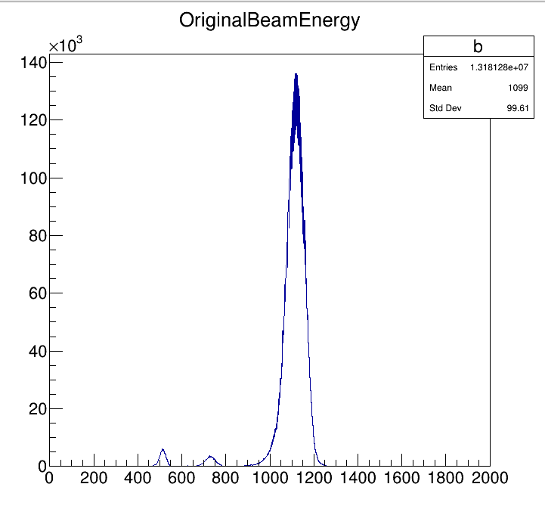
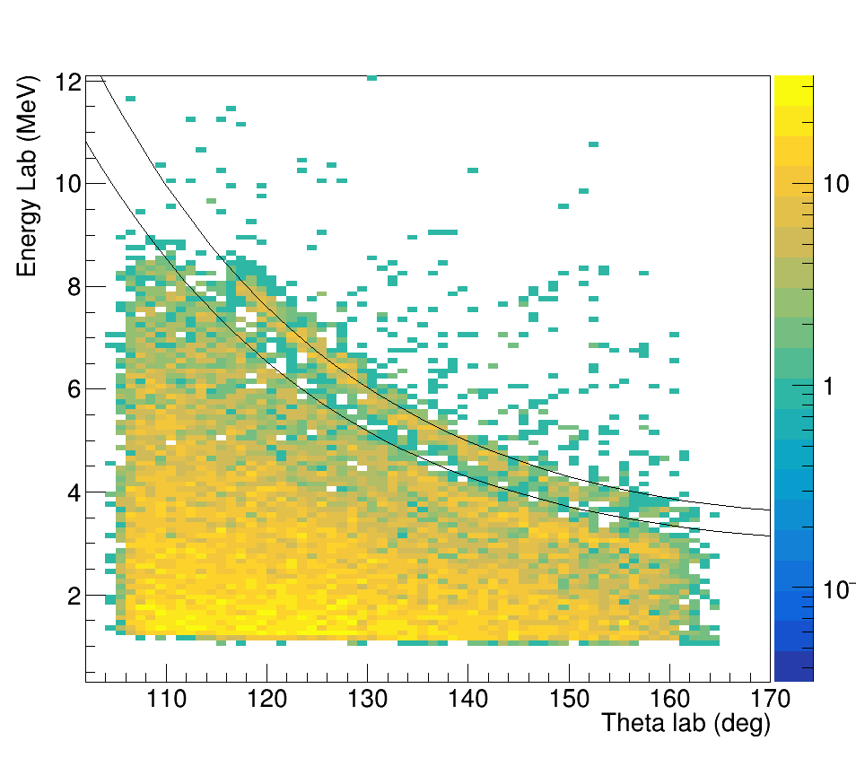
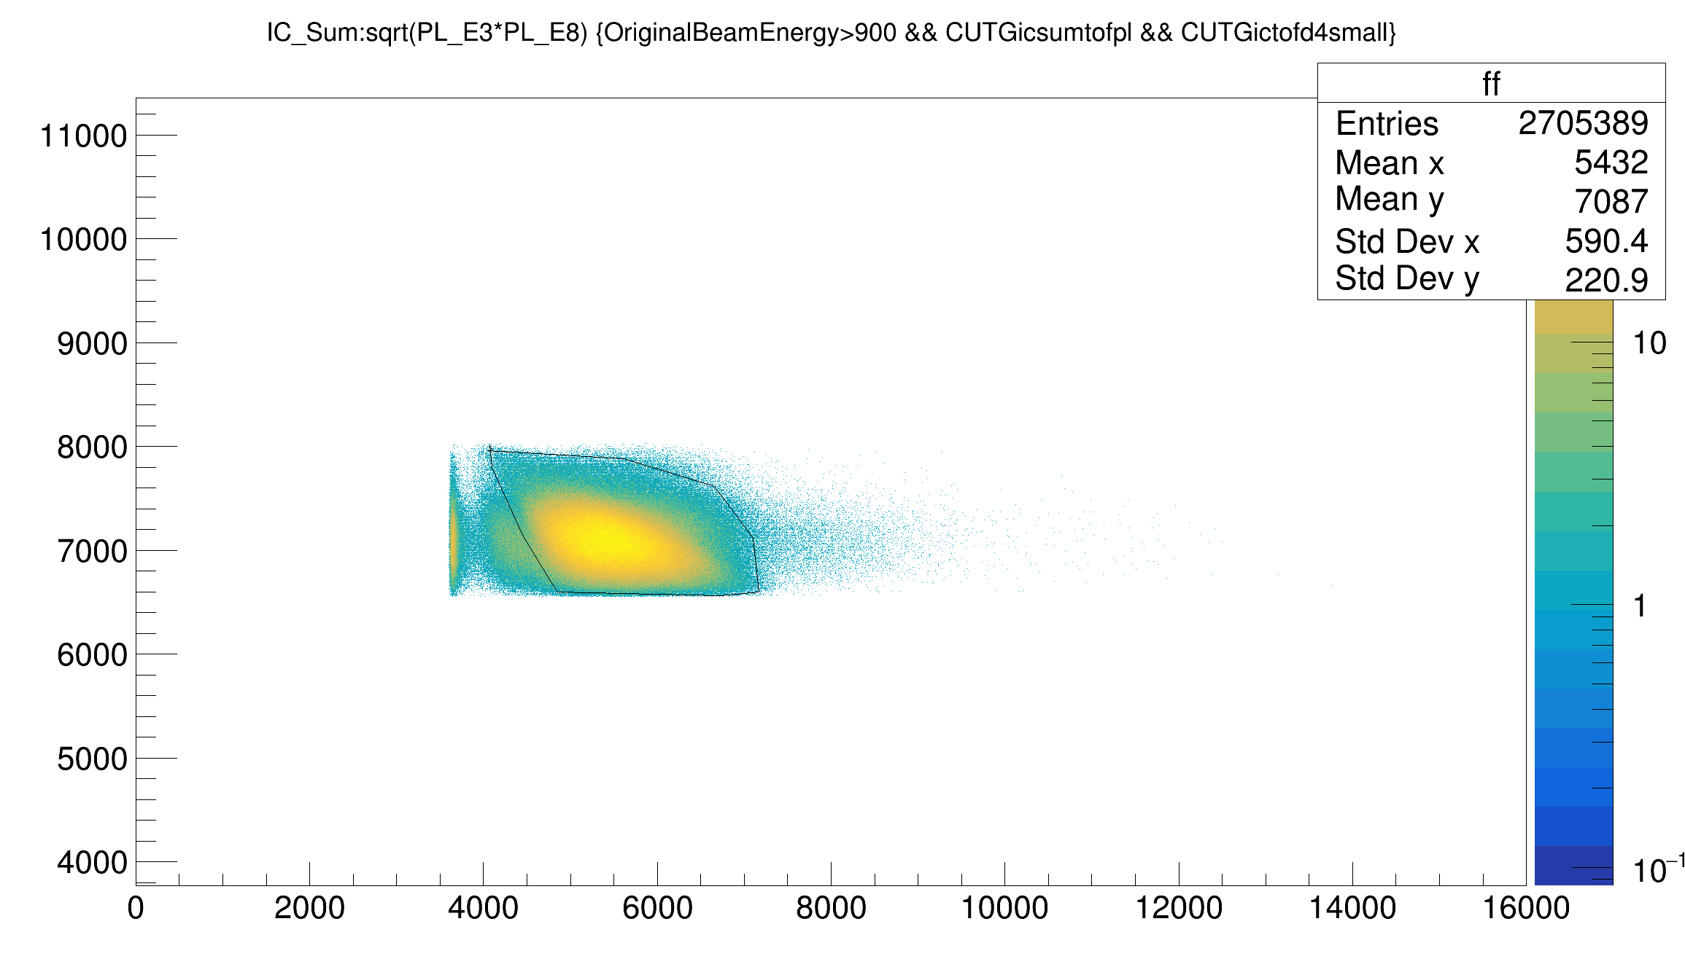
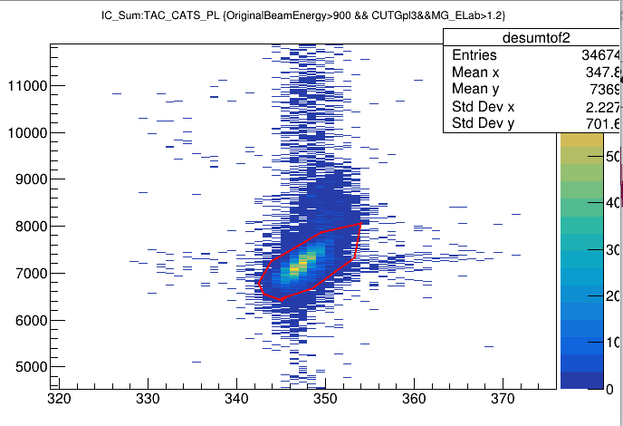
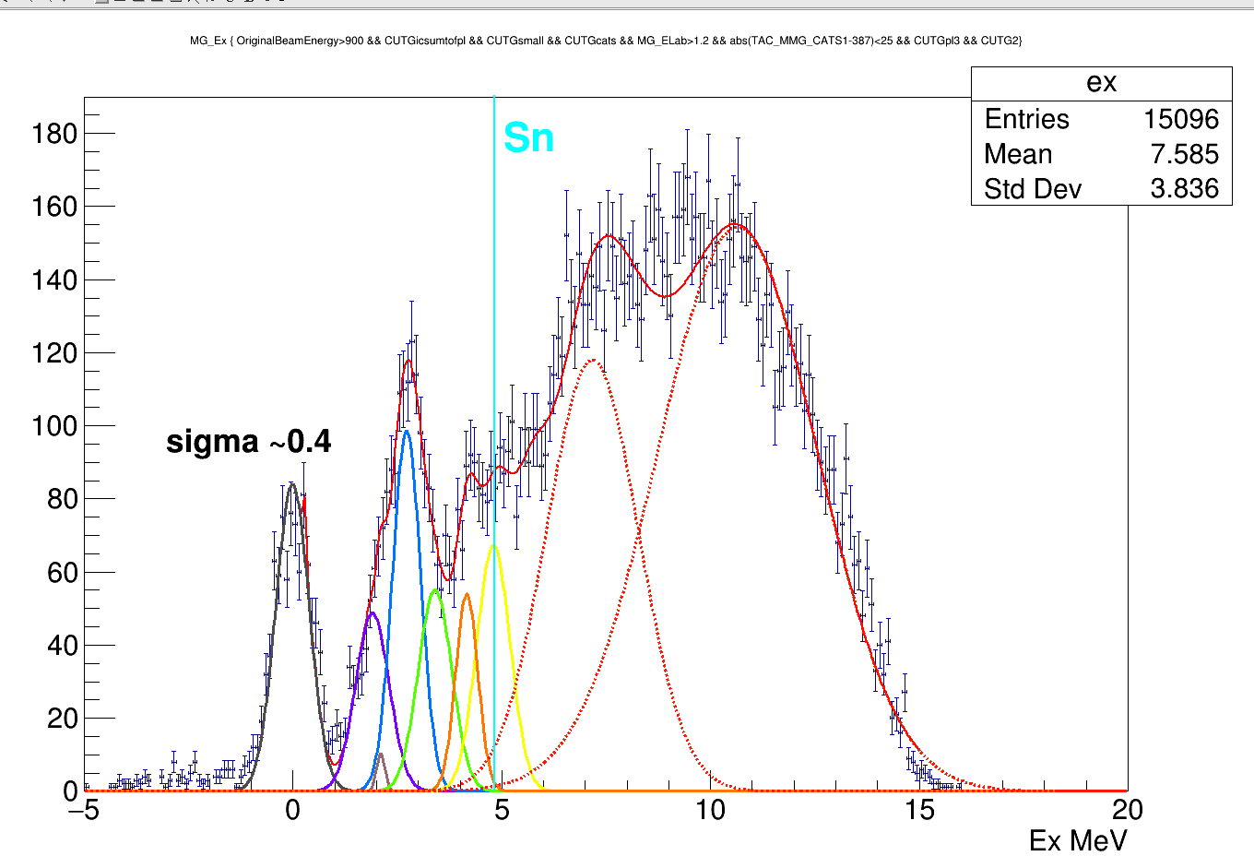
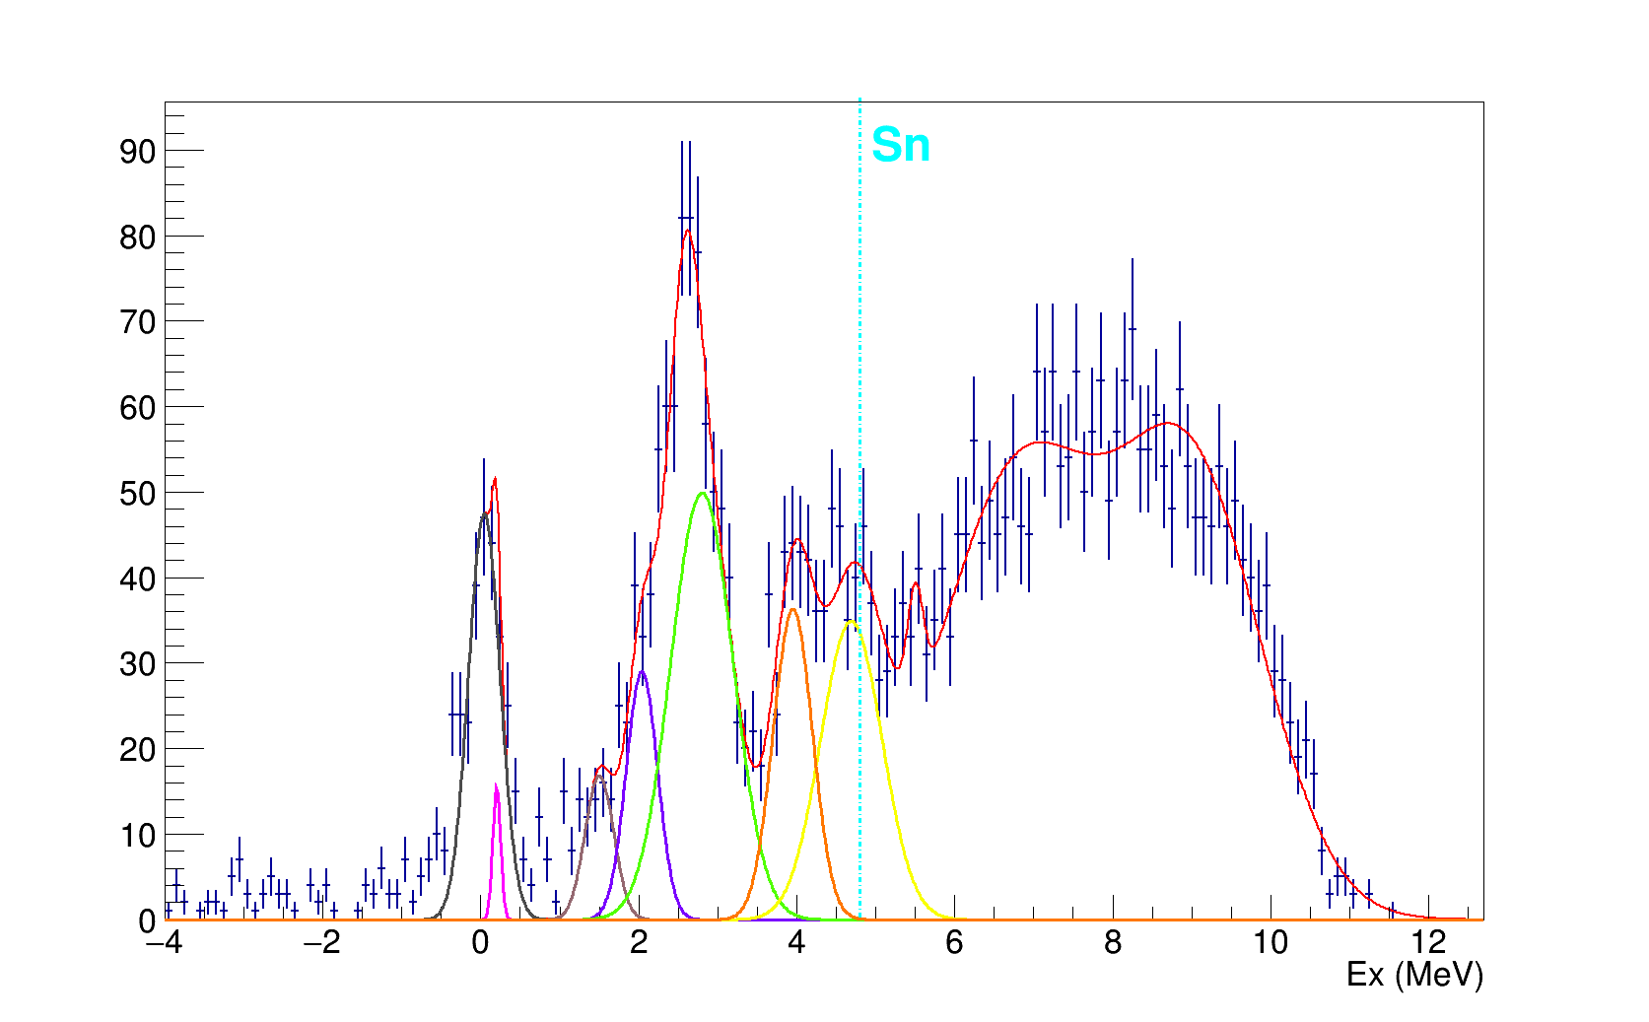
Ex with all cuts
Cuts & Selections
  OriginalBeamEnergy → Tof
  IC-dE – Tof: D4-CATS
  IC-dE – Tof :CATS-PL
  IC dE- Plastic E
  Theta Lab > 130

Slide 4
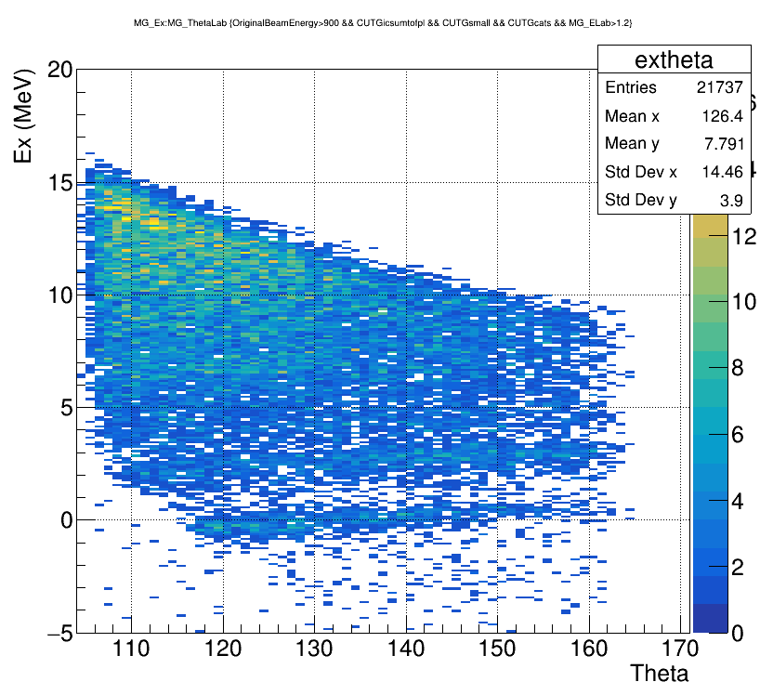
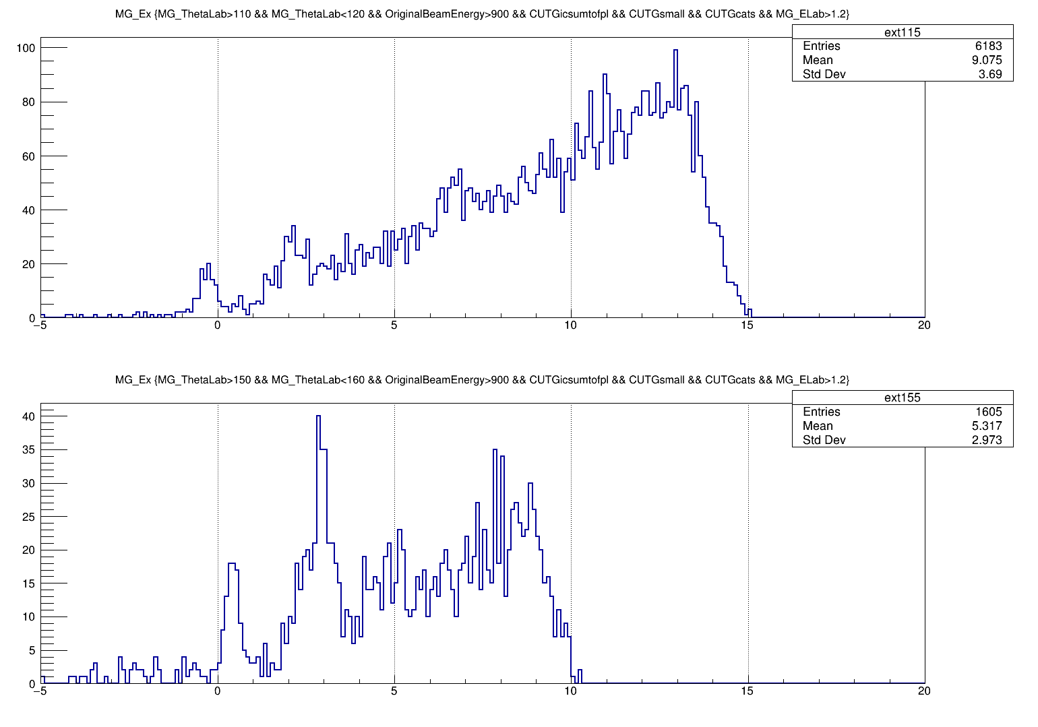
Questions to solve
Theta =115
Theta =155

Slide 5
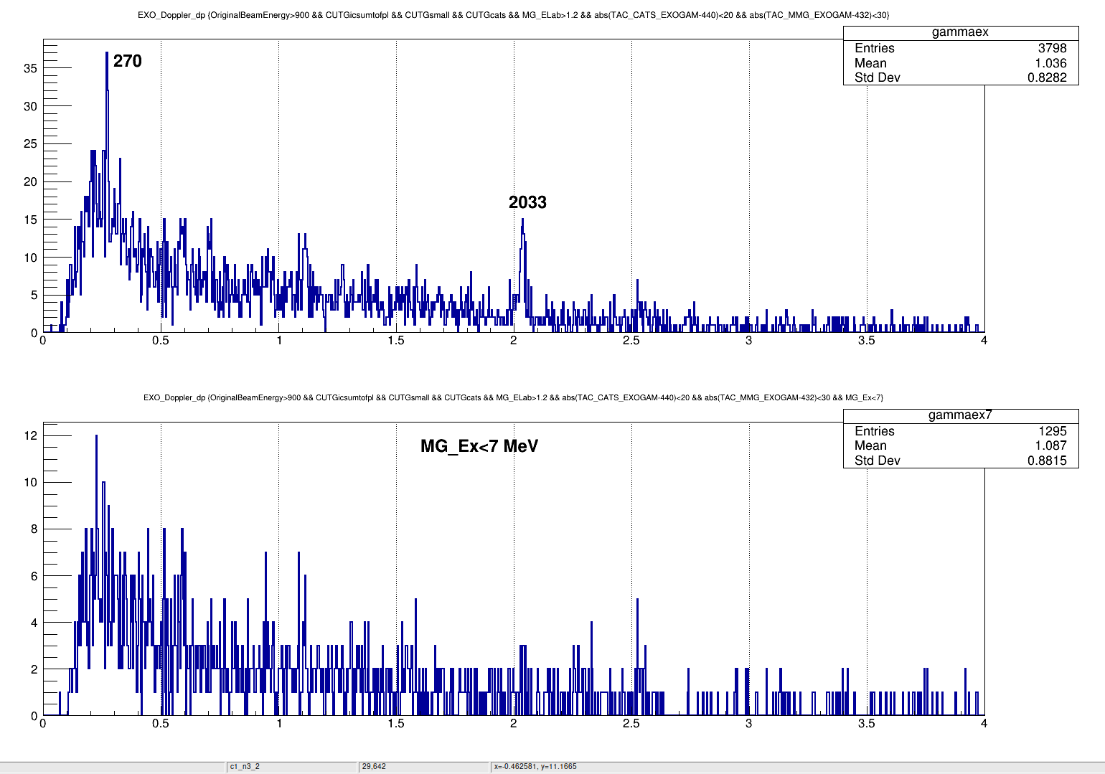
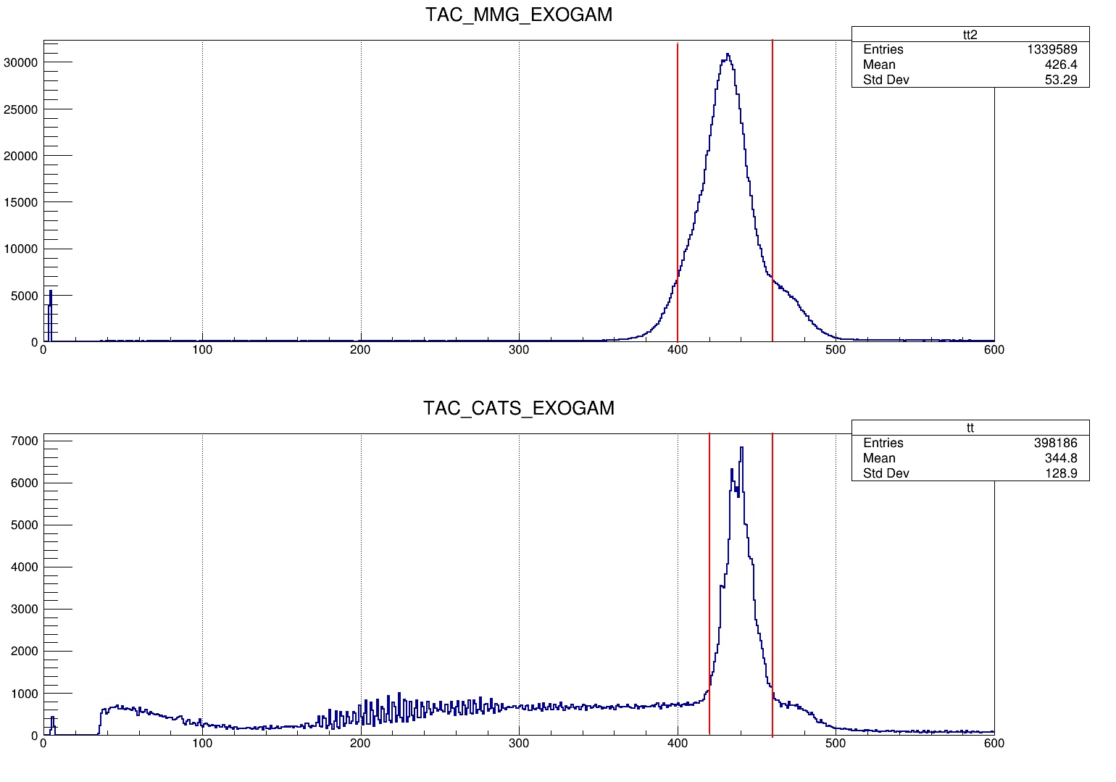
For Exogam correlations extra cuts in TACs
Inelastic B-U contamination from 68Ni
B-U removed with Ex <Sn+2 MeV

Slide 6
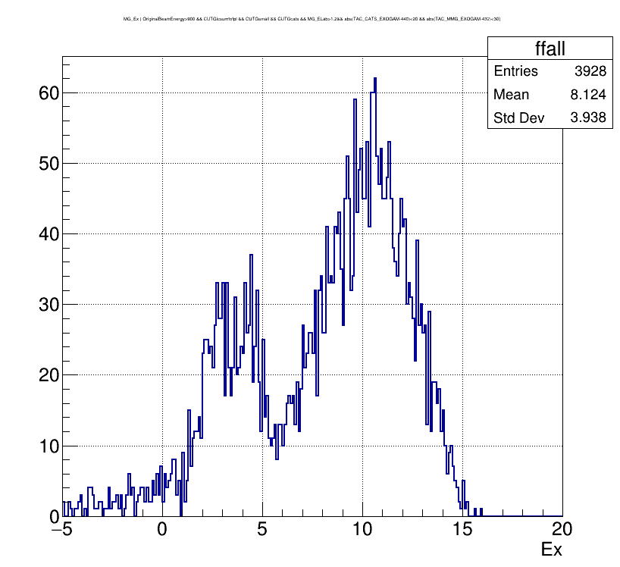
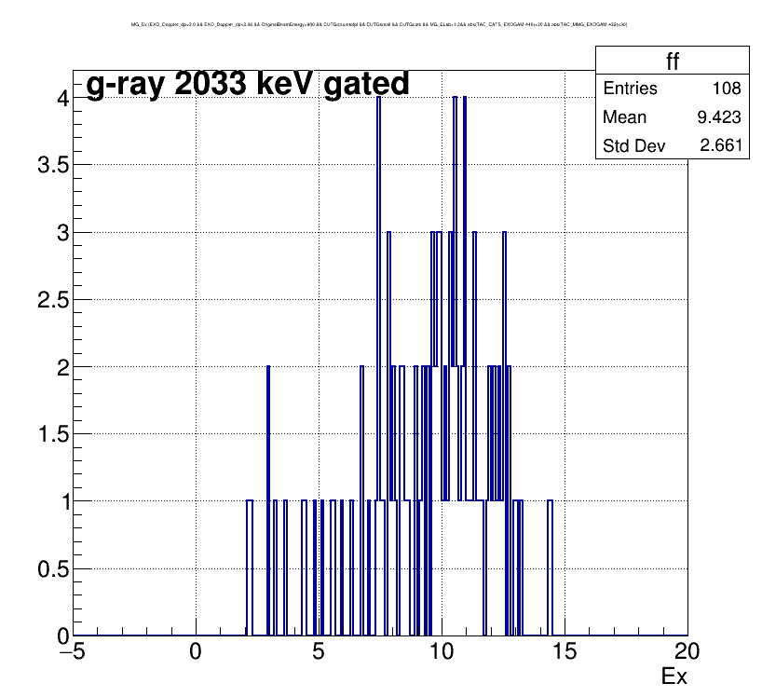
Break Up components – inelastic 68Ni
Exogam tac gated & 2033 gated Ex
Normally, it should start from 7 MeV (Sn(4.8 MeV)+2 MeV) , but even removing background, we couldn’t clean the Ex until 7 MeV
Most probably there is gamma-ray correlated to 2-5 MeV states. Above Sn 5 to 7 Mev can be populated with unbound neutron states decaying to 2+ 68Ni.
Next step is simulate Phase Space and get the contribution of ine.BU reaction.
2+ → 0+ = 2033 keV
Excited states that populates gamma-rays

Slide 7
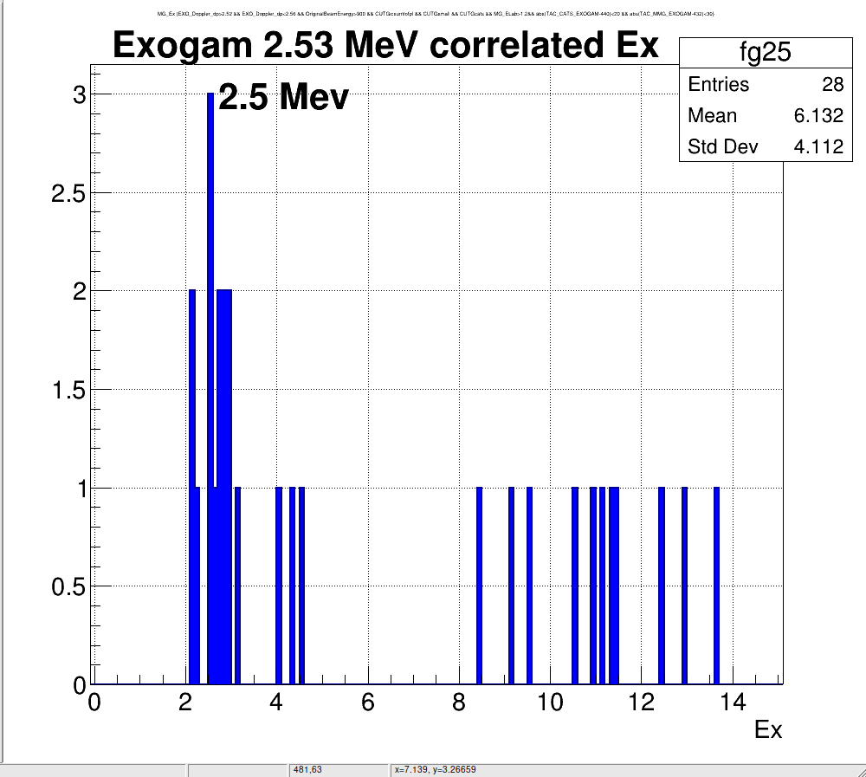
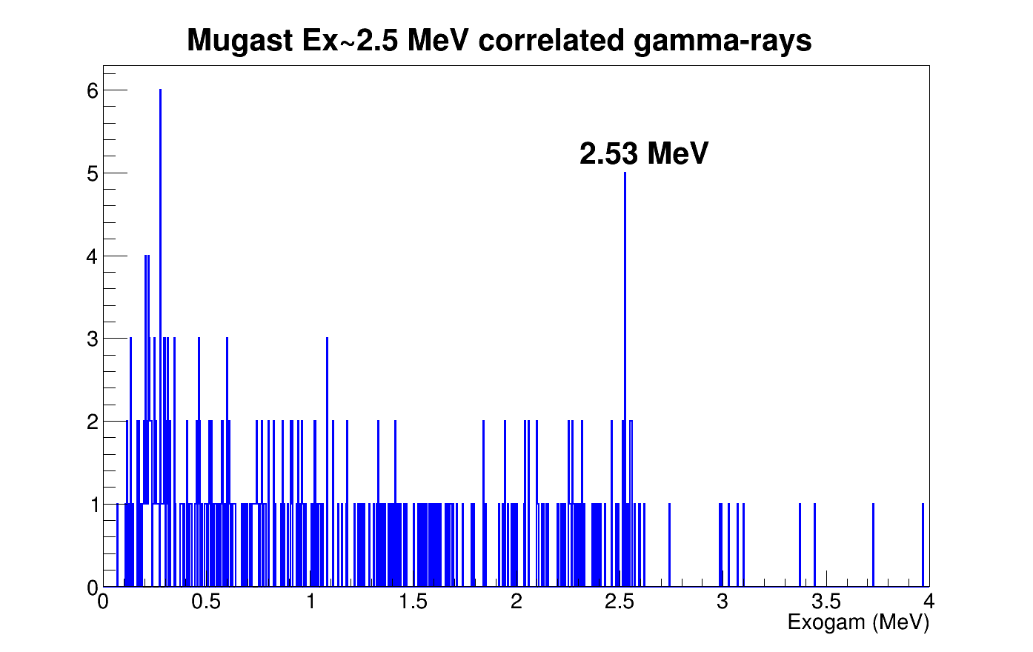
Exogam correlation with 2.5 MeV state(s)

Slide 8
TO DO List
Using the BU cross section information define the deuteron BU component (Phase Space) simulation
Simulate inelastic BU
Theta proton -Theta Heavy ion correlation (DC)
Add CATS in simulation to fix angular dependency

Slide 9
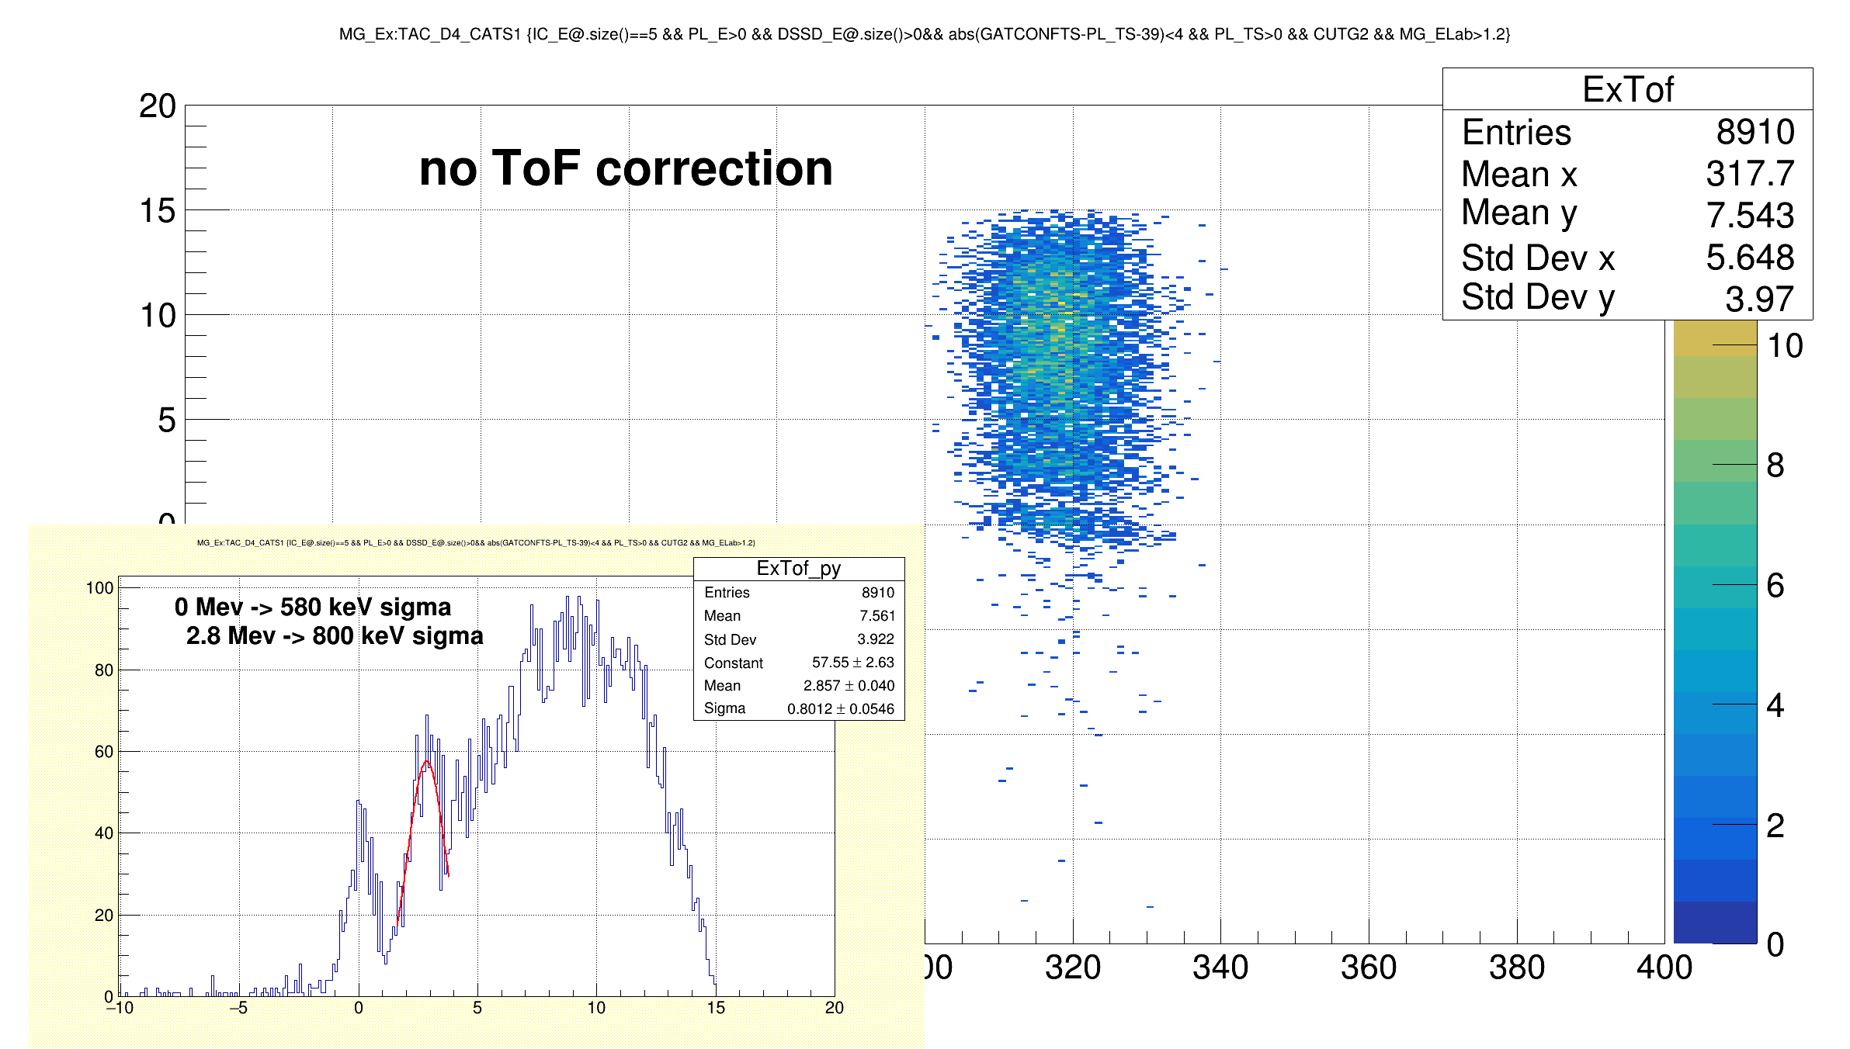
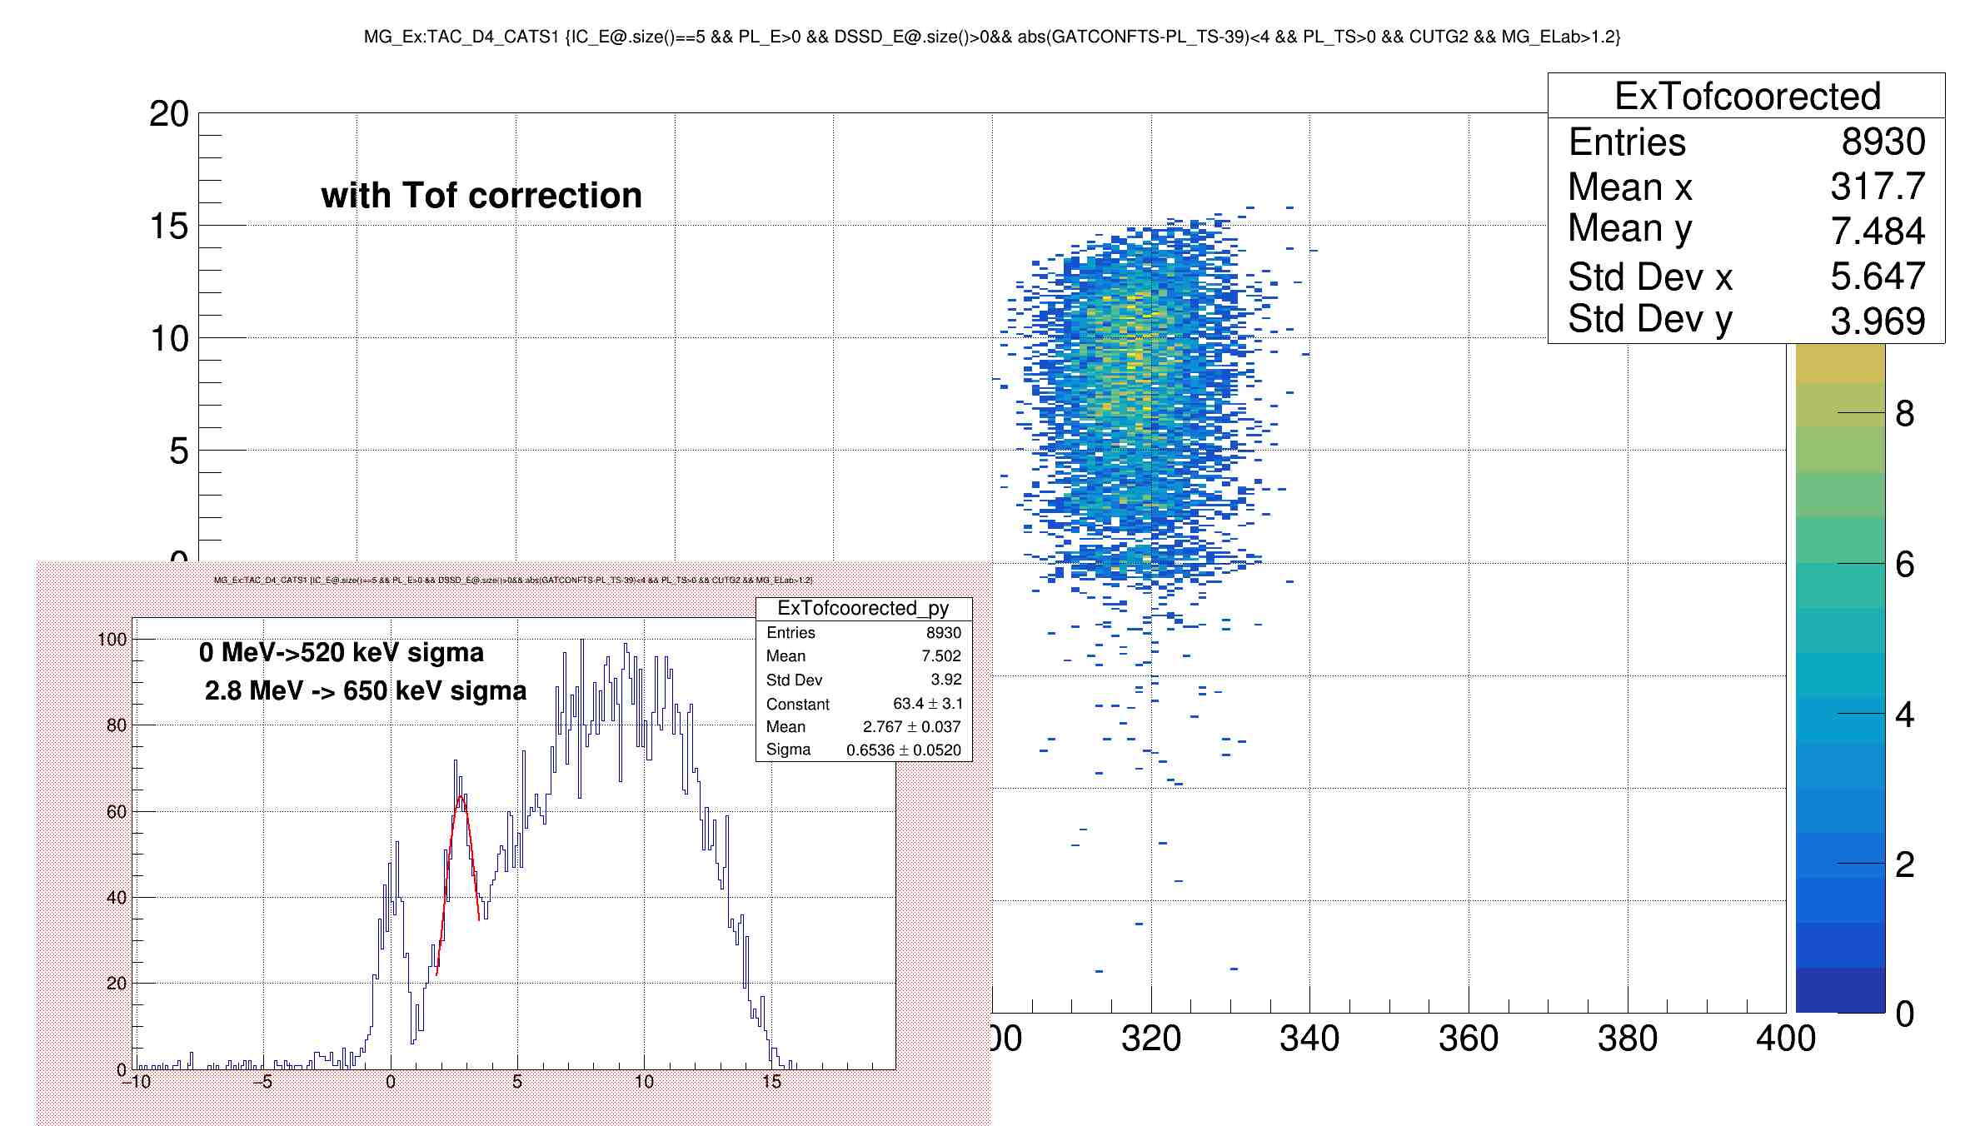

Slide 10
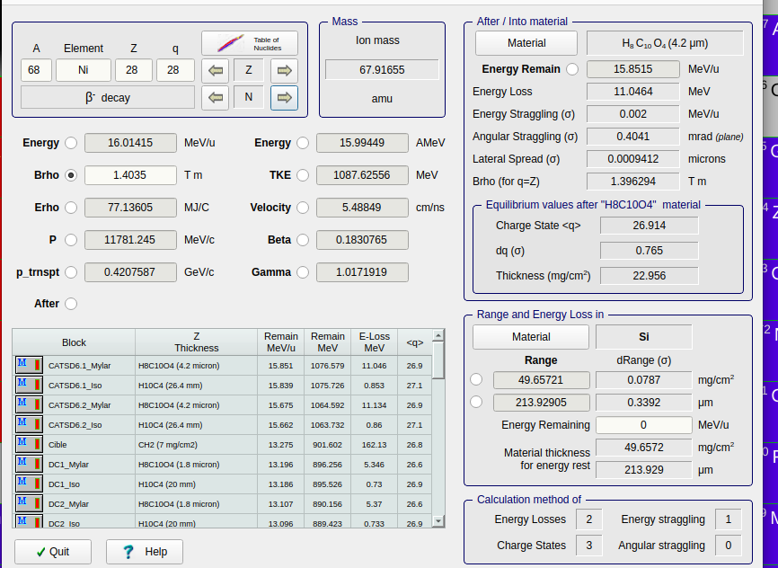
TAC_D4_CATS1
d4_cats | channel 70Zn | tof 70zn
 | 18993 | 261.375
 | channel 68Ni | tof 68ni
 | 17341 | 318.3249
 | channel 68ni slowed | tof calculated | velocity calculated | brho2 | Energy
 | 12627 | 480.832056704332 | 5.48840278680243 | 1.4 | 16.01 MeV/u

Slide 11
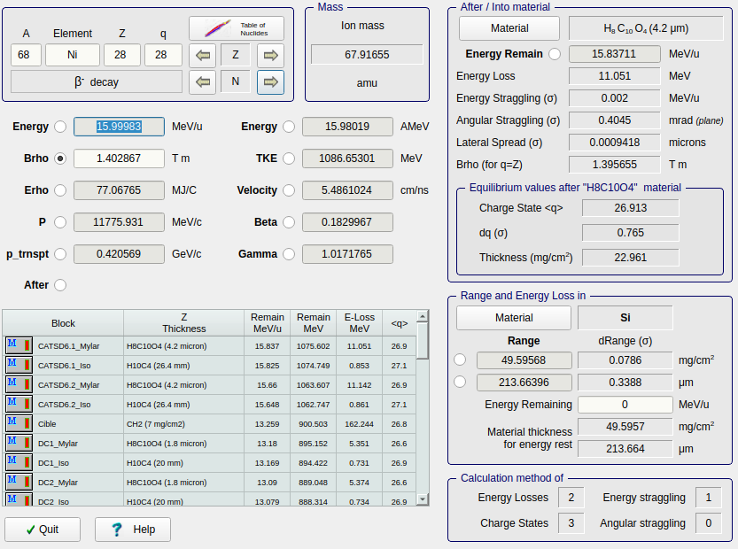
T_DD6_DD4
dd6_dd4 | channel 70Zn | tof 70Zn
 | 36607 | 212.646
 | channel 68Ni | tof 68Ni
 | 32121 | 258.9783
 | channel 68ni slowed | tof 68ni slowed calculated | velocity calculated | brho2 | Energy MeV/u
 | 19304 | 391.35251919264 | 5.4861024133159 | 1.402867 | 15.99983

Slide 12
New tof calculation :
For d4 cats and dd6 dd4
Given during the experiment
calculated
 | Channel | brho2 | velocity | distance | tof | slope | gain
d4_cats 70zn | 18993 (17.87) | 2.5898 | 10.09658 | 2639 | 261.37563 | -0.034473 | +916.126483
dd6_dd4 70zn | 36607 (67.4) | 2.5898 | 10.09658 | 2147 | 212.646262398 | -0.01032819 | +590.7303
d4_cats 68Ni | 17341 (47.5) | 2.1687 | 8.29027 | 2639 | 318.3249
dd6_dd4 68Ni | 32121 (135) | 2.1687 | 8.29027 | 2147 | 258.9783
It is not possible to use J-C DD4 CATS1 tac, I think they change the range of the tac, because the 68Ni 38 Mev is flying faster than 70Zn which is not possible.

Slide 13
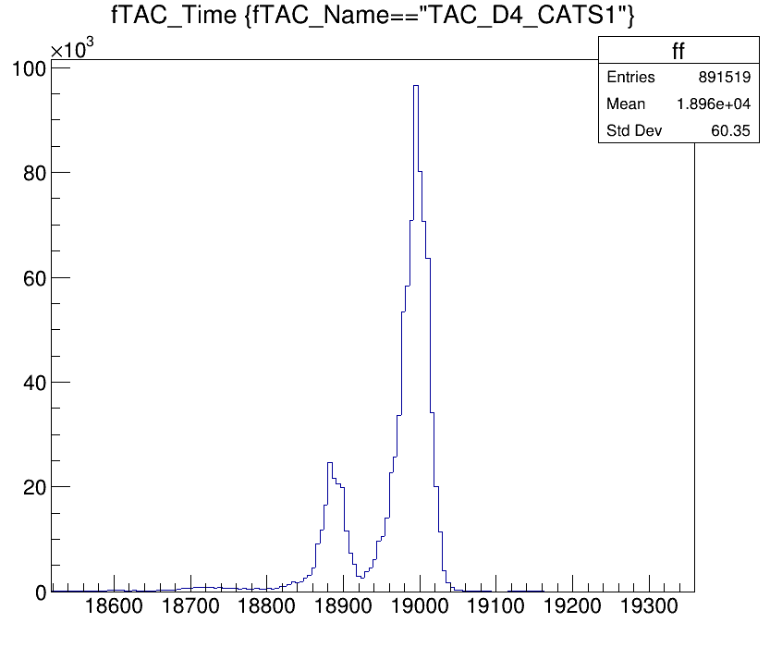
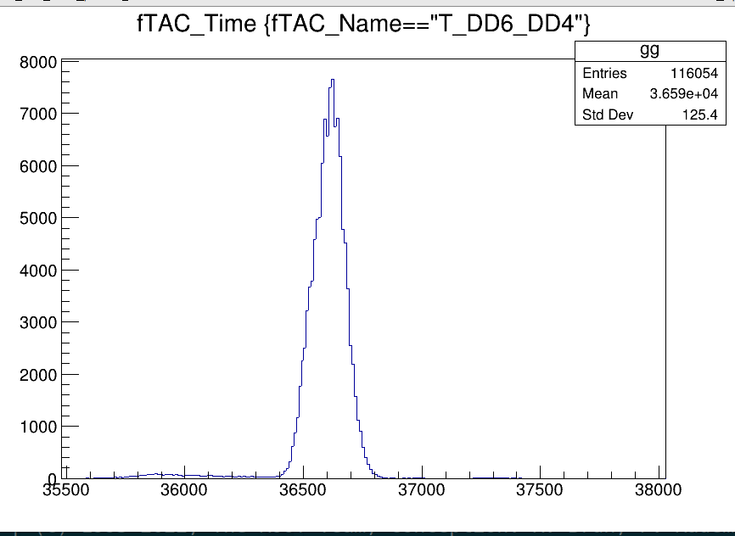
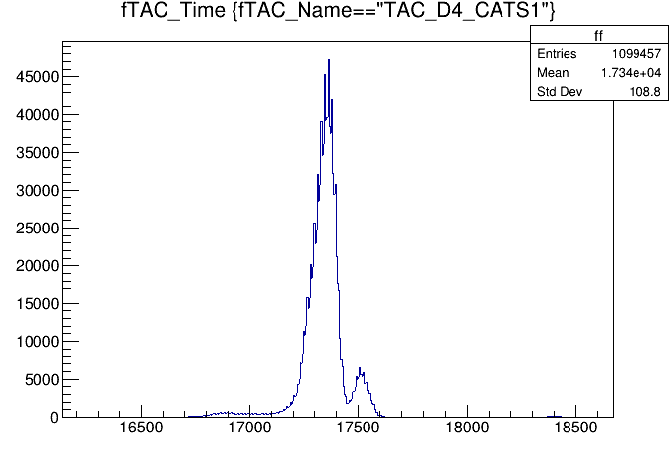
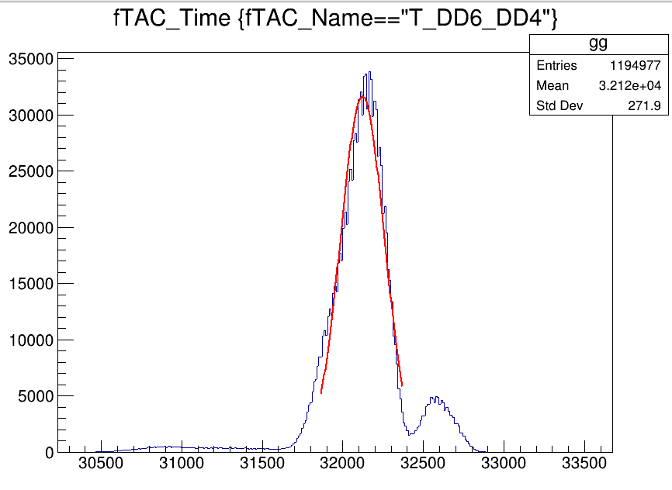
70zn
70zn
68Ni
68Ni

Slide 14
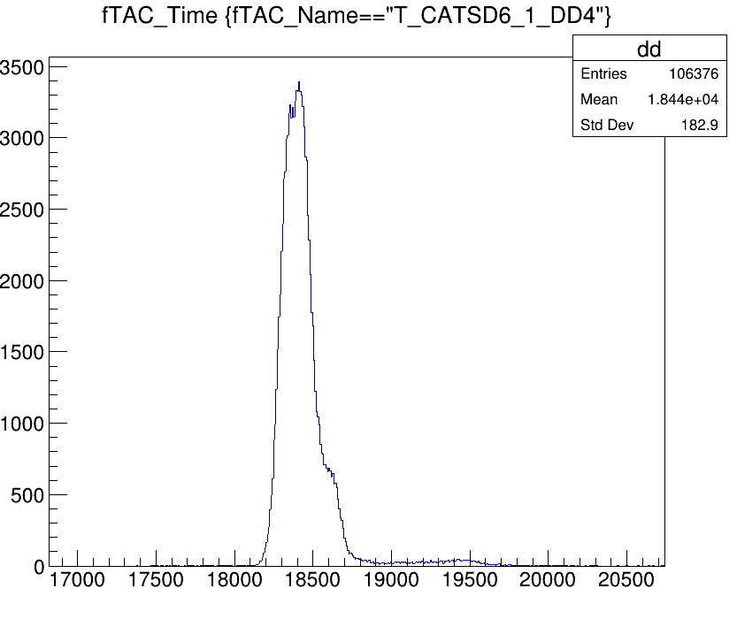
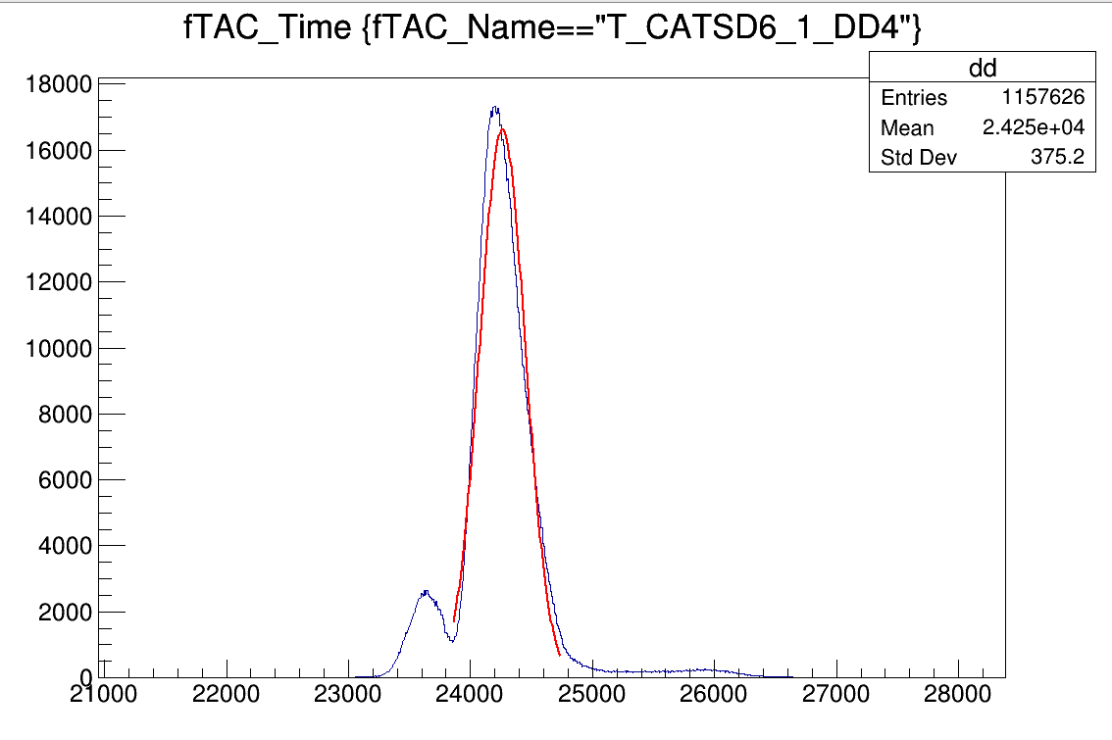
70zn
68Ni

Slide 16
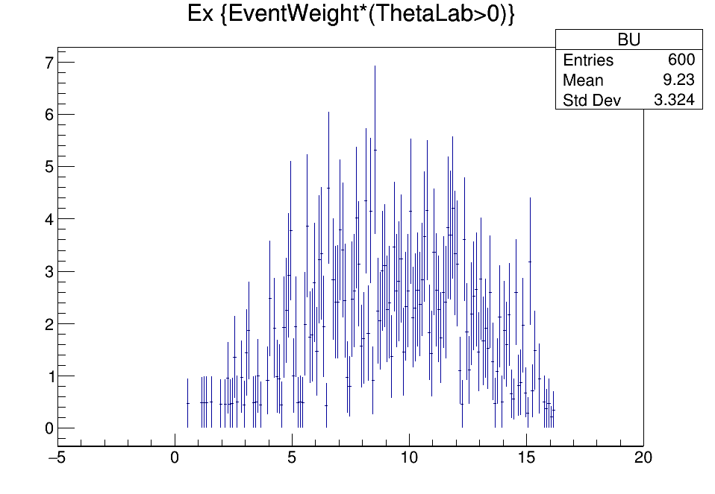
Deuteron break-up simulation in phase space → I need angular cross section to remove it from Ex

Slide 17
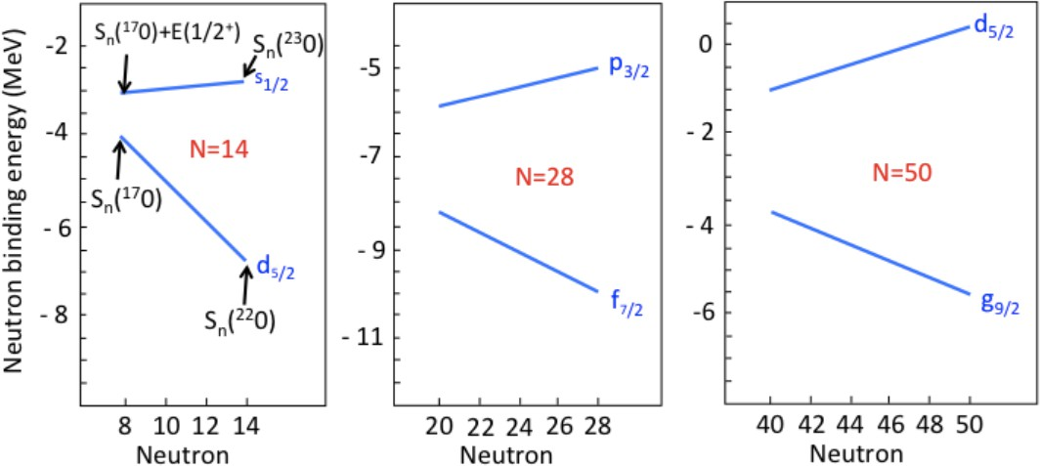
N=50 in neutron-rich Ni
<number>/13
⁷⁸Ni : Z=28 and N=50, “classical” magic numbers kept?
Mass measurement around ⁷⁸Ni → J. Hakala et al., PRL 101 52502 (2008)
β-decay life time around ⁷⁸Ni → Z. Y. Xu et al., PRL 113 032505 (2014)
High energy of 2⁺1 state of ⁷⁸Ni → R. Taniuchi et al., Nature 569 53 (2019)
→ Detailed study of N=50 gap in Ni isotope
⁶⁸Ni : Starting point of N=50 gap at N=40
Z= 8O
Z= 20Ca
Z= 28Ni
O. Sorin and M.-G., Porquet Phys. Scr. T152 014003

Slide 18
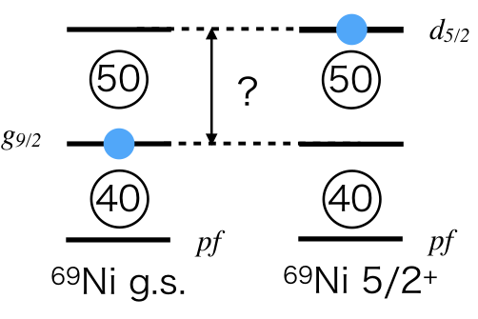
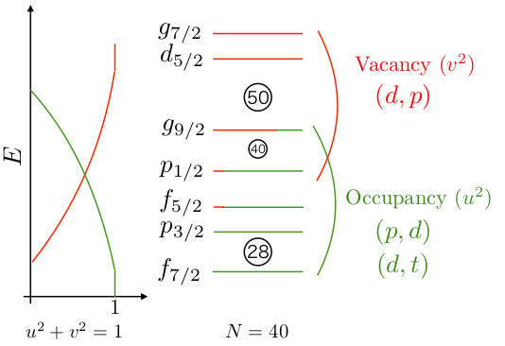
N=50 in neutron-rich Ni
<number>/13
C²S⁺ , ⁶⁹Ni excitation energy (d5/2) → (d,p) reaction
C²S⁺ , ⁶⁹Ni excitation energy (g9/2) → (d,p) reaction
C²S⁻ , ⁶⁷Ni excitation energy (g9/2) → (p,d) reaction
Shell gap of N=50 at N=40 nucleus ⁶⁸Ni
Excitation energy of d5/2 state(s) in ⁶⁹Ni
C²S⁺ of g9/2 and d5/2 states
Notes:
In ⁶⁸Ni(d,p)⁶⁹Ni reaction with determining the 2d5/2 strength, the spacing between the g9/2 and d5/2 neutron orbitals at N=40 is investigated. The reaction was studied before and 2d5/2 is measured at 2.5 MeV [2]. The state is suggested to be doublet at 2.1 and 2.8 MeV. The aim is to determine the excitation energies and confirm the ΔL of 2.8 MeV state.

Slide 19
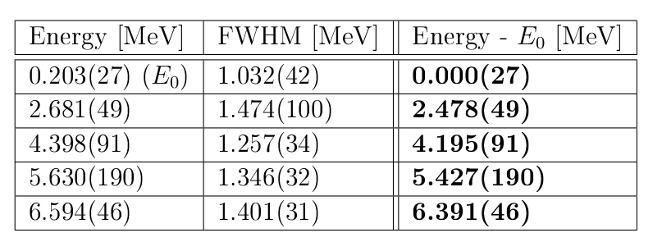
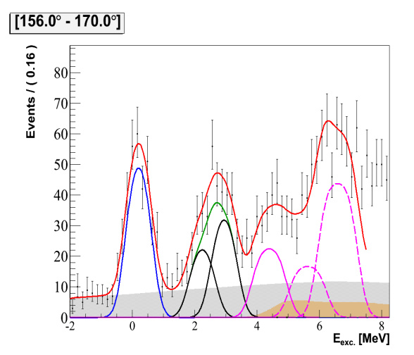
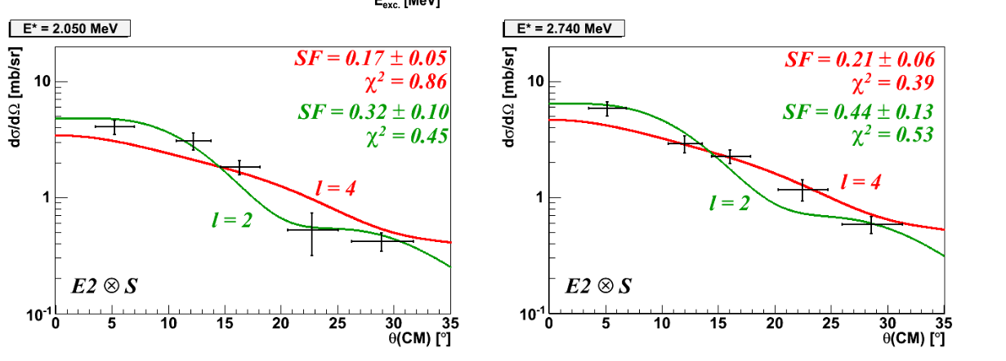
⁶⁸Ni(d,p)⁶⁹Ni
<number>/13
Previous Experiment
(2009 @ Ganil)
⁶⁸Ni beam of 24.8 MeV/u
2.6 mg/cm² CD2 target
Candidate(s) of d5/2 state(s) at 2.5 MeV, but J^{π} not concluded
They found the FWHM of 2.5 MeV state is 1.5 times larger than g.s.
And they conclude with saying, there is a possibility of doublet in 2.5 MeV peak as a 2.05 and 2.74 MeV states.
M. Moukaddam., Phd thesis

Slide 20
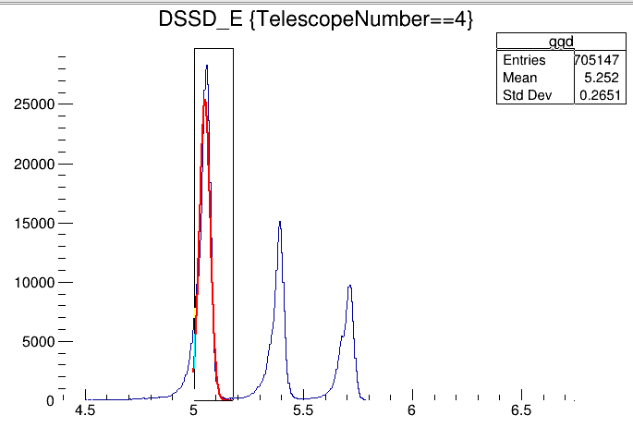
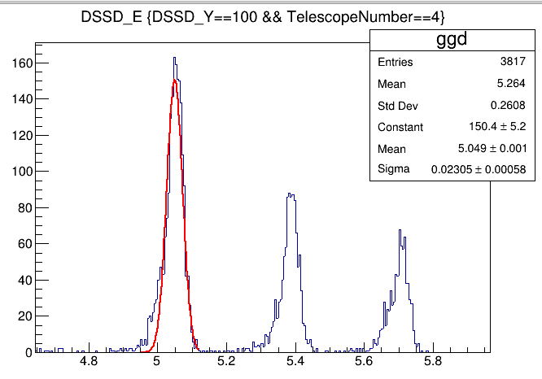
Mugast energy calibration
For random single strip in Y:
1 Constant 1.50338e+02
2 Mean 5.04926e+00
3 Sigma 2.30650e-02
For one teslescope 4 Y:
1 Constant 2.53331e+04
2 Mean 5.04908e+00
3 Sigma 2.43750e-02
Root file : r573_EY_TX / r573_EX_TX

Slide 21
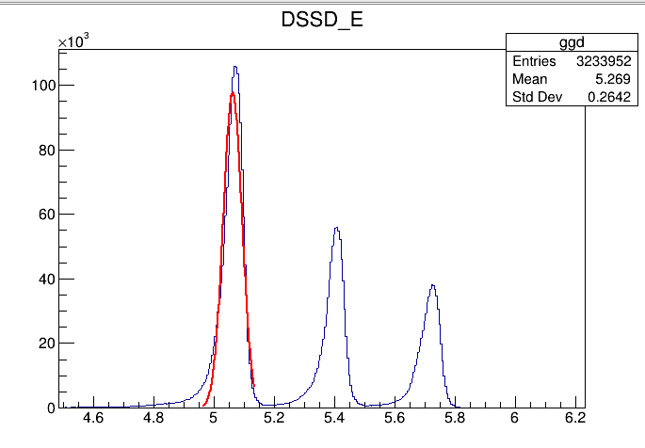
For all in Energy Y
1 Constant 9.77186e+04
2 Mean 5.06148e+00
3 Sigma 3.11182e-02

Slide 22
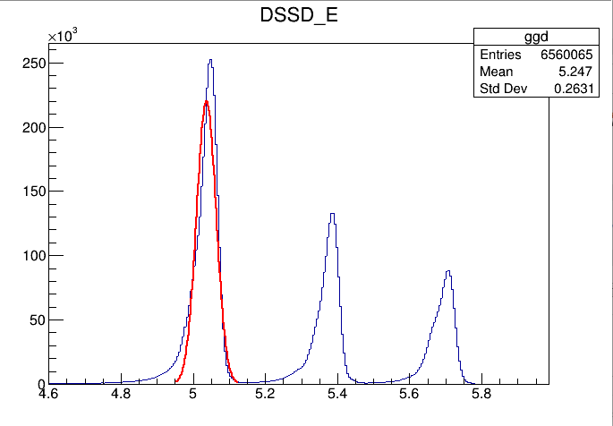
For Energy X
1 Constant 2.20425e+05
2 Mean 5.03649e+00
3 Sigma 2.70858e-02

Slide 23
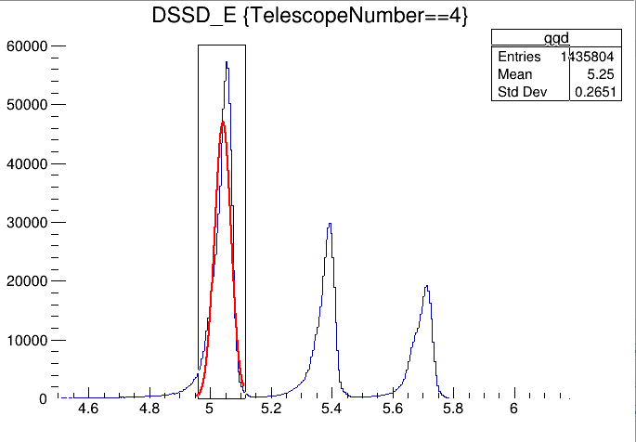
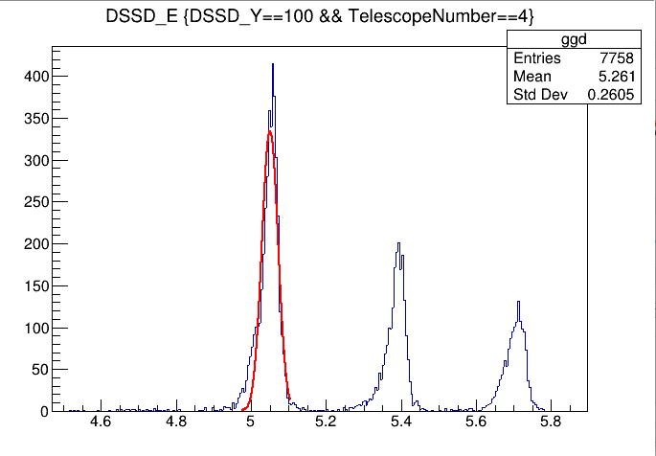
For one telescope 4 :
1 Constant 4.70283e+04
2 Mean 5.04117e+00
3 Sigma 2.71832e-02
For random strip :
1 Constant 3.34030e+02
2 Mean 5.05021e+00
3 Sigma 2.13179e-02

