Slide 1
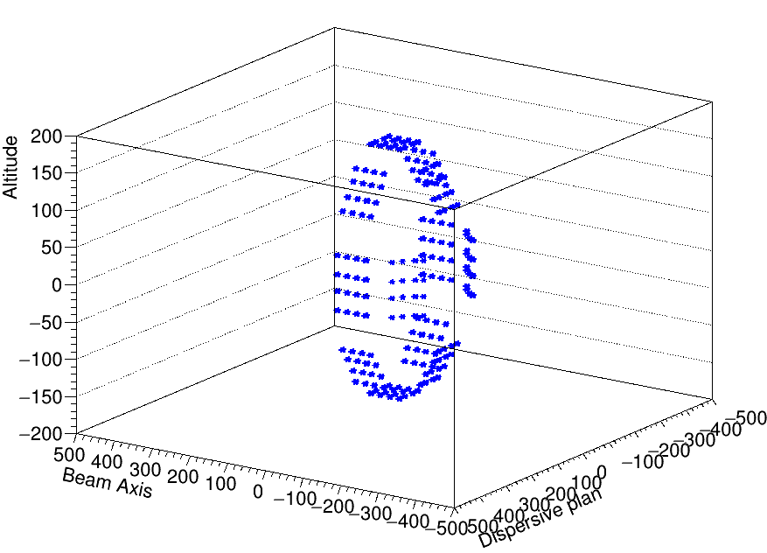
CANDY
EXOGAM
Efficiency calibrations and comparison
Ozge Aktas

Slide 2
Depends on the position
Low energy region
High energy region
Relative intrinsic efficiencies
conclusion
1
2
3
4
5

Slide 3
EXOGAMpositions
F12
F2: Θ=135°;Φ=180°
F3: Θ=135°;Φ=45°
F4: Θ=135°;Φ=90°
F5: Θ=135°;Φ=270°
F6: Θ=90°;Φ=0°
F7: Θ=90°;Φ=315°
F8: Θ=90°;Φ=270°
F9: Θ=90°;Φ=225°
F10: Θ=90°;Φ=180°
F11: Θ=90°;Φ=135°
F12: Θ=90°;Φ=90°
F13: Θ=90°;Φ=45
F11
F13
F4
F10
F2
F3
F6
F5
14
Target
F9
F7
F8

Slide 4
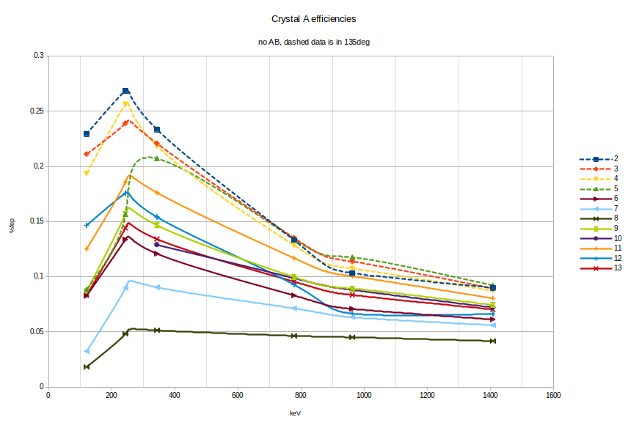
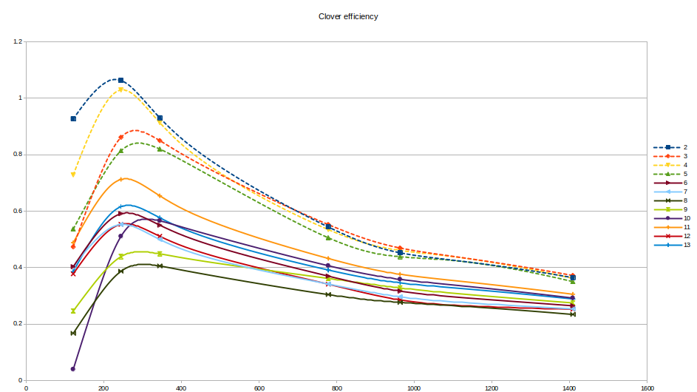
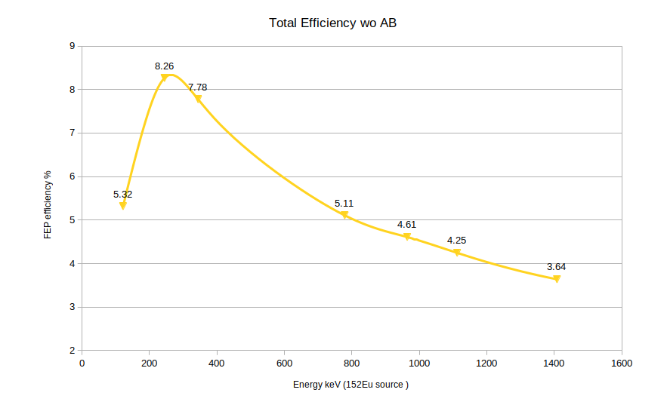
Efficiency of crystals , clover and all at the end of second experiment without Addback
Each crystal has same radius, and d should be equal for each of them which is target distance 14 cm
The efficiency for each crystal is different although they supposed to have the same solid angle and similar intrinsic efficiency
There is a systematically different efficiencies for two different angle 90 and 135 degree.
Two possibility :
source is not in the correct position and solid angle is different for 90-135 degree
source is in good position but the 90degree clovers are not placed well.

Slide 5
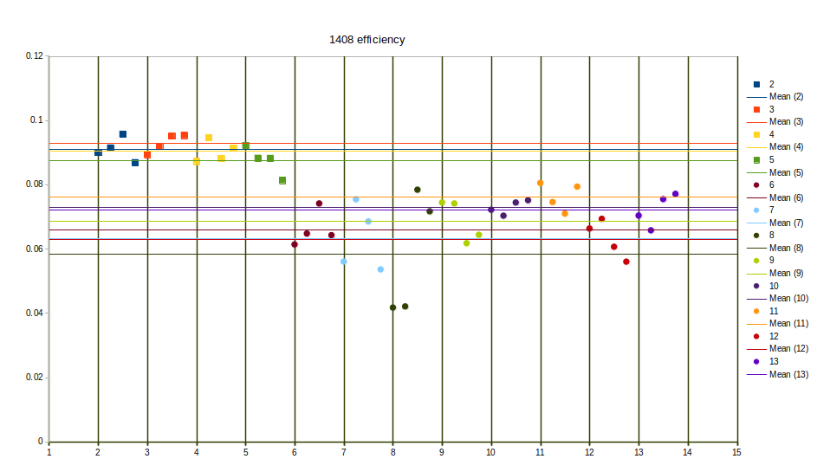
Systematically 90degree clovers has low efficiency in 1408 keV source line (squares- 135 degree, circles 90degree

Slide 6
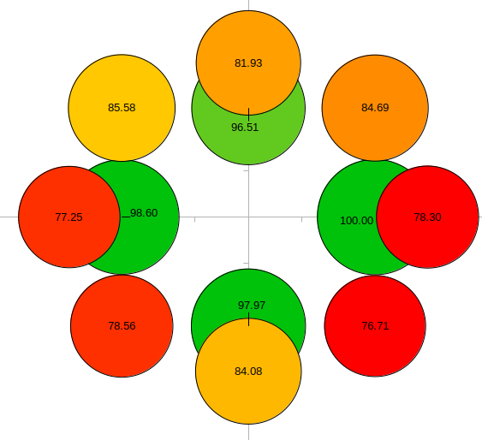
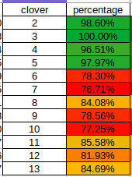
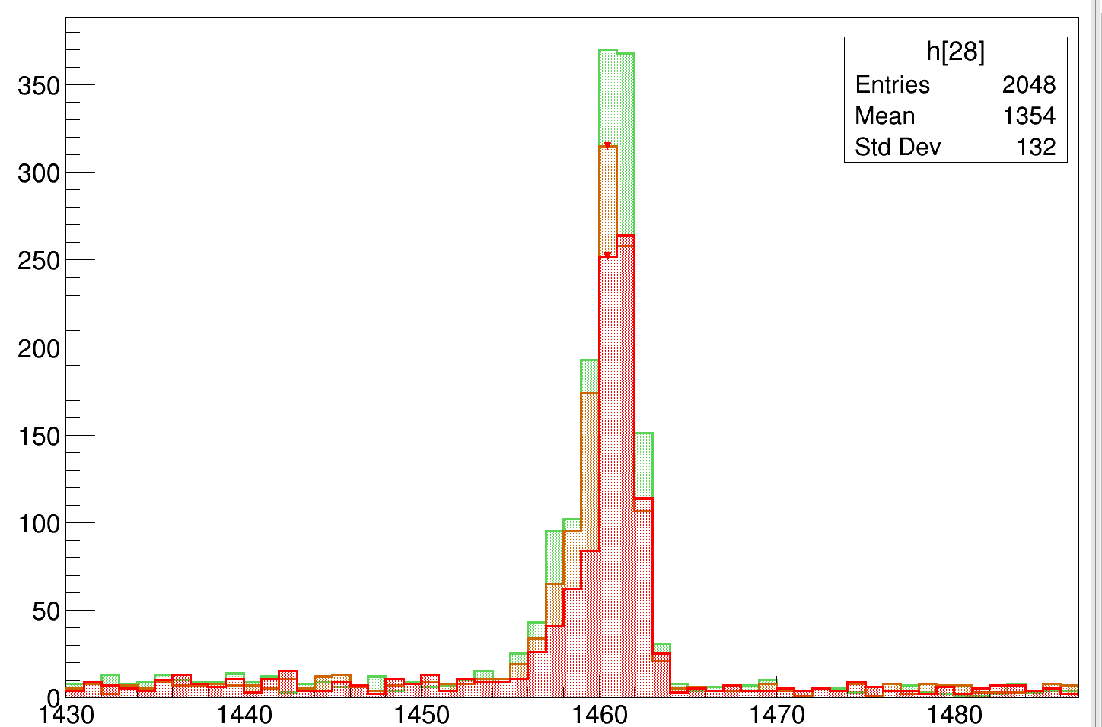
Intrinsict efficiency- relative
The idea is to compare the intrinsict efficiency of each crystal.
One way to be sure about the target distance 14 cm is to compare high energy 1.4 MeV peak in different angles.
But to make such comparison, we have to make assumptions that each crystal has a same intrinsic efficiency.
To find out relative intrinsic efficiency we can use 1460 keV line from background.
This g-ray is isotropic and coming to crystals in every angle. Therefore the efficiency of this line is not depend on the positioning of the clovers.
2
F12
F11
F13
F4
F10
F6
F2
F3
F5
F9
F7
F8

Slide 7
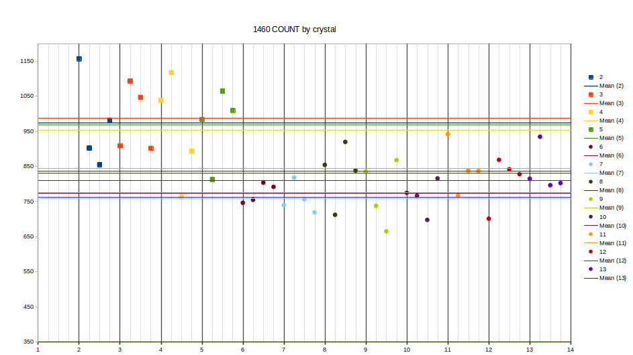
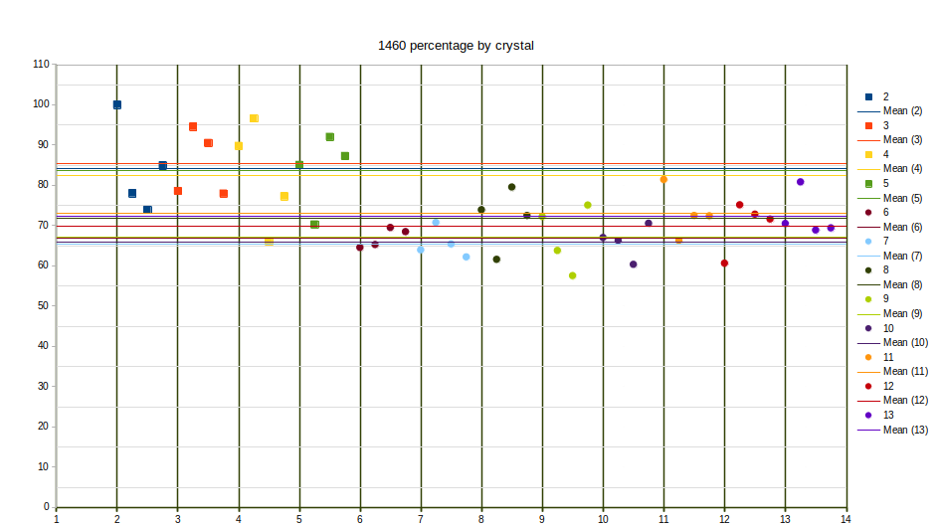
40P line 1460 keV is isotropic so for each crystal we should have a same count
Crystals doesn’t have same intrinsic efficiency
Crystal in 135 degree (squares) has better intr. Efficiency then 90degree ones
Around 15 % efficiency differences between two groups
Now compare this with 1408 keV line from source

Slide 8
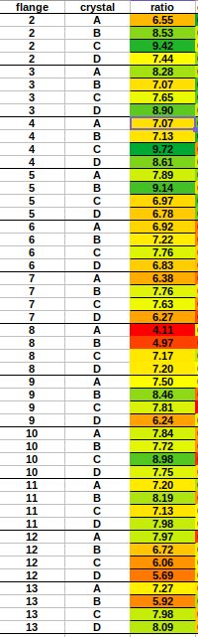
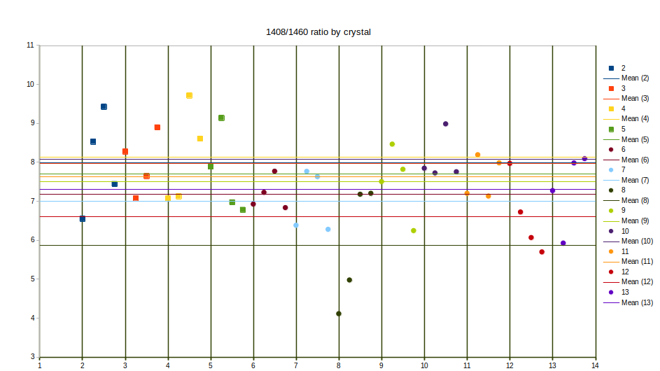
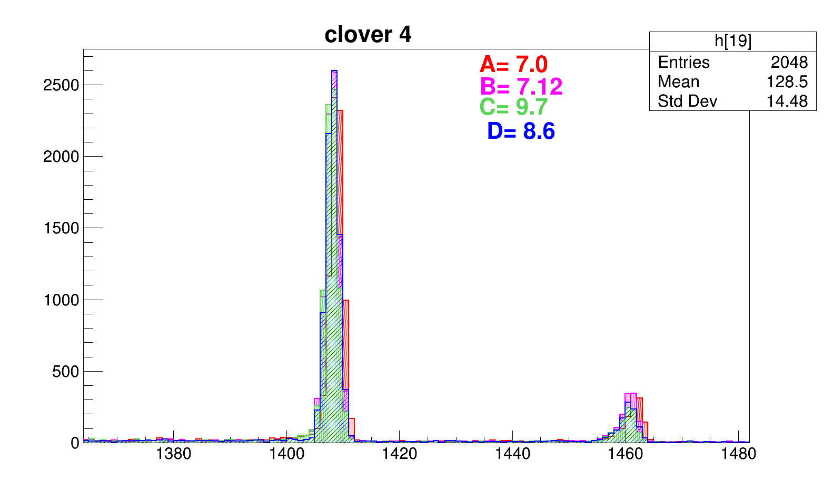
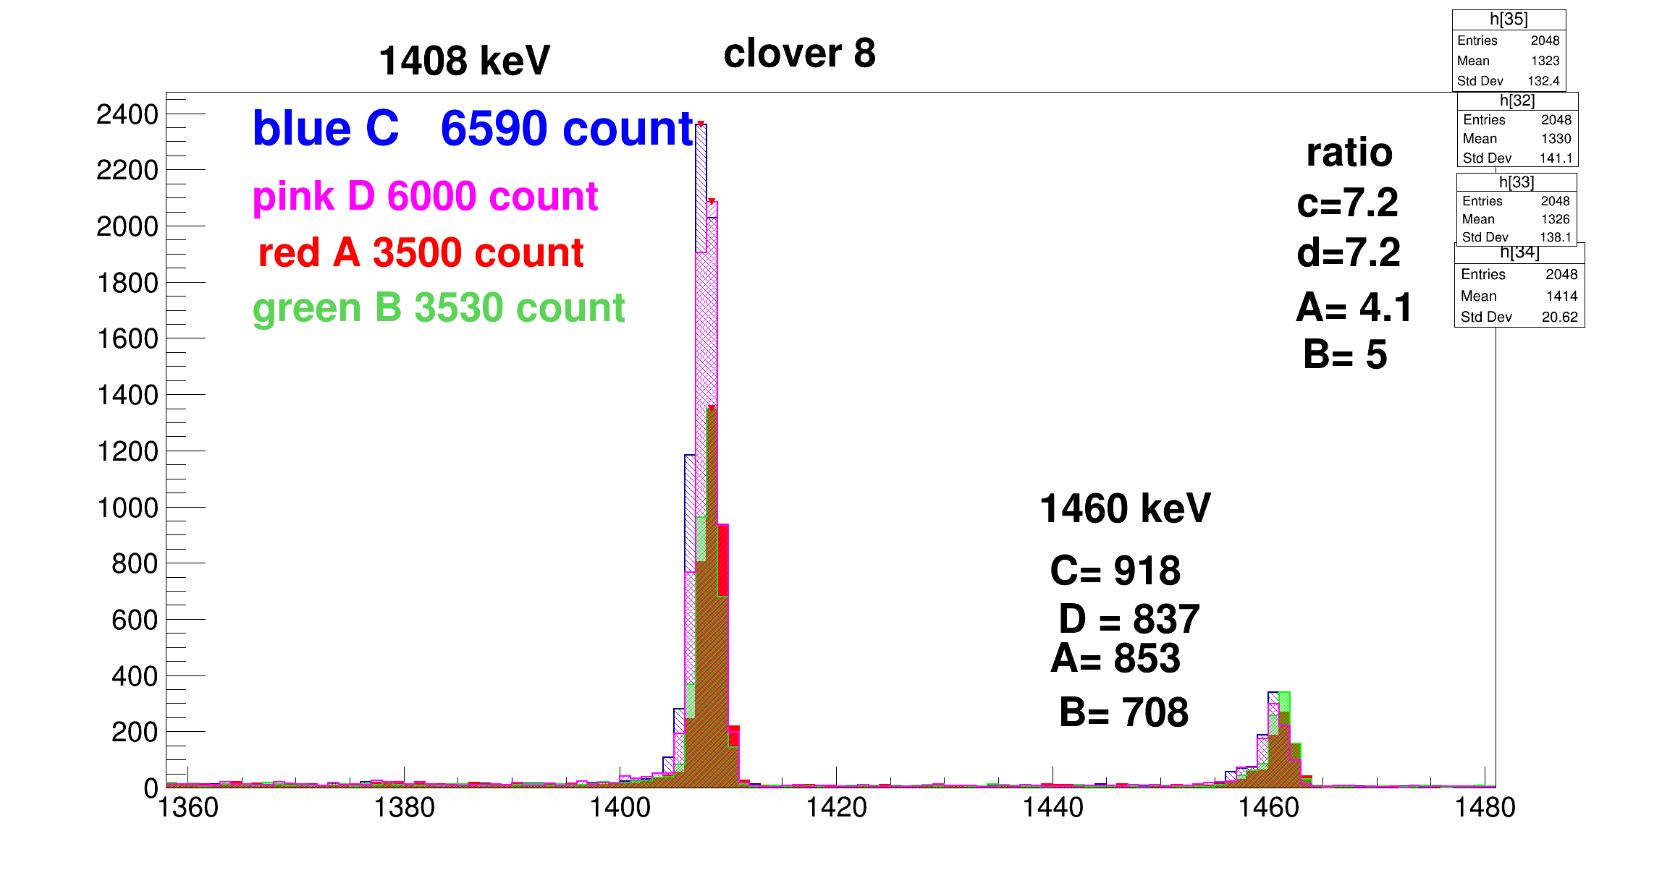

Slide 9
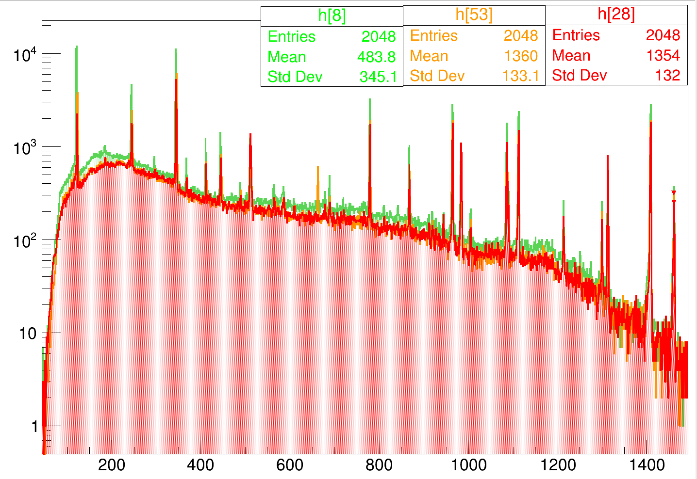

Slide 10
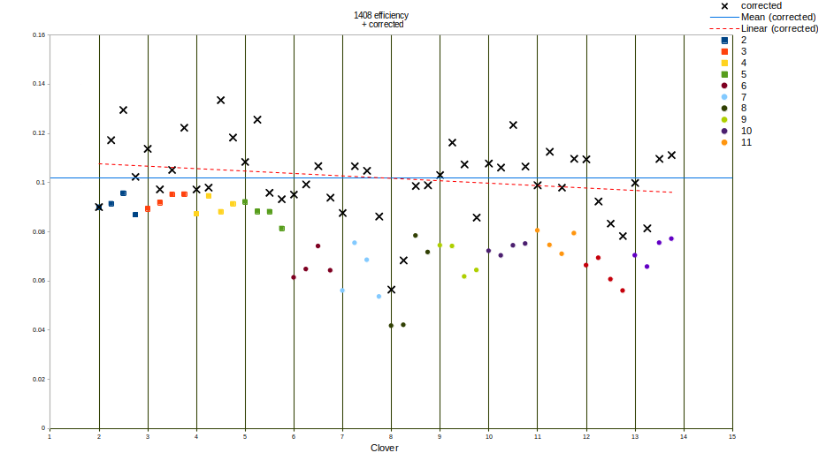
1408 source
Effcor = (eff/N1460)*N1460max
1408/1460ratio
After 1408/1460 keV ratio correction
The effect of the degree dependence is less visible.
Its hard to say target position is wrong.
Different efficiency mostly depend on internal efficiency of crystal.

Slide 11
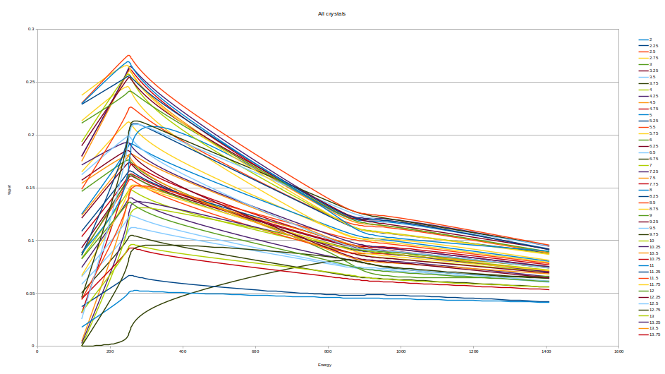

Slide 12
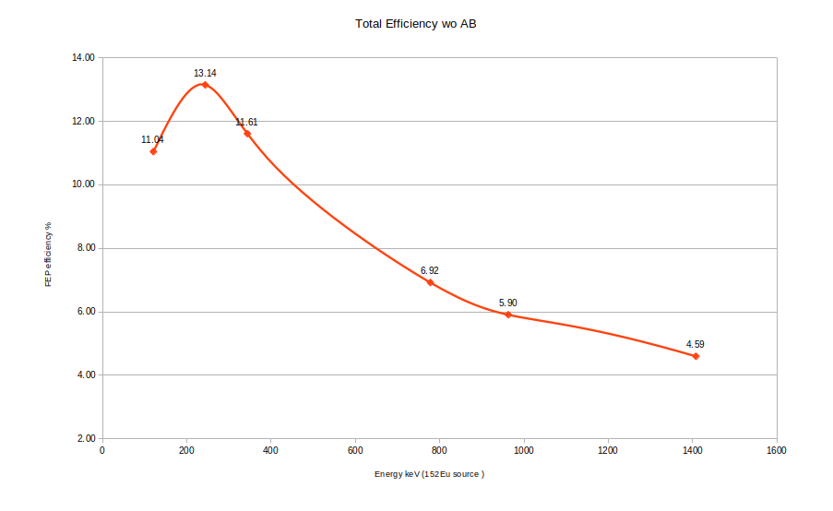
If all crystal has the same efficiency with crystal 2C (highest efficiency one)
With the Addback factor we reach 7% efficeincy in 1.4 MeV

Slide 13
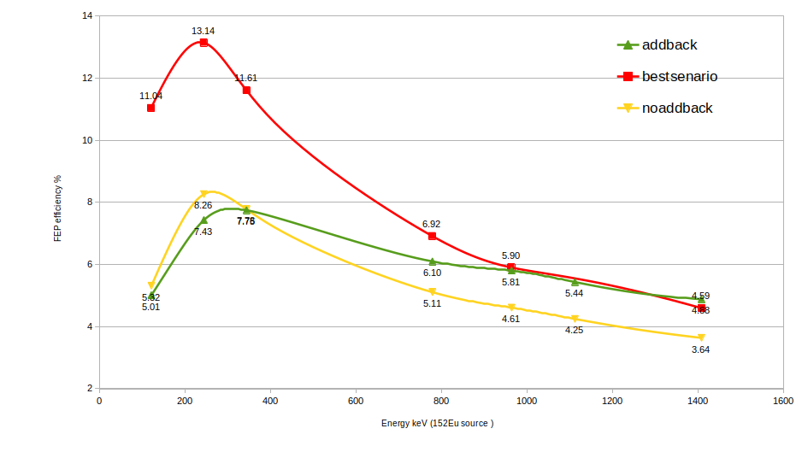

Slide 14
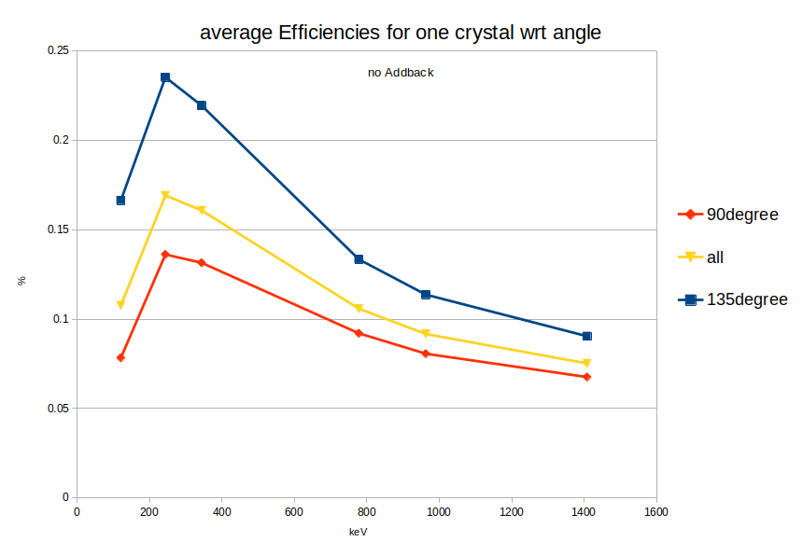

Slide 15
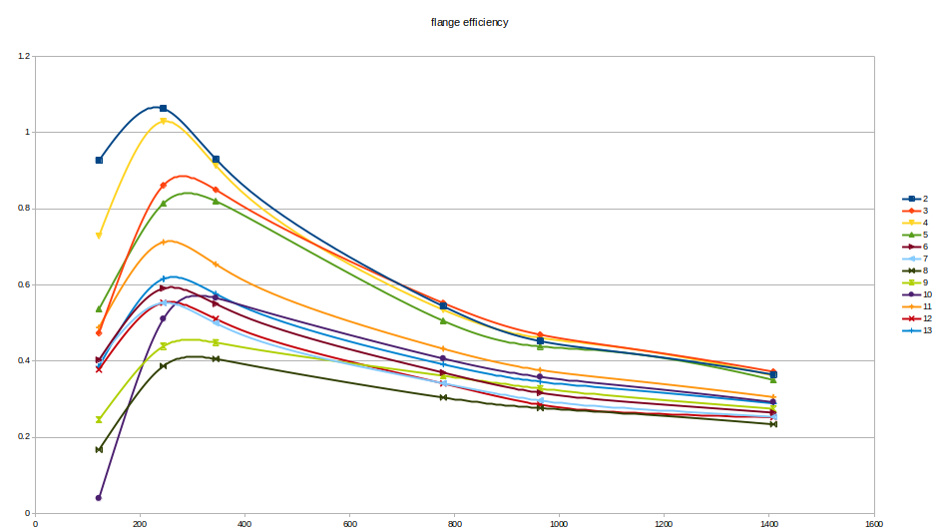
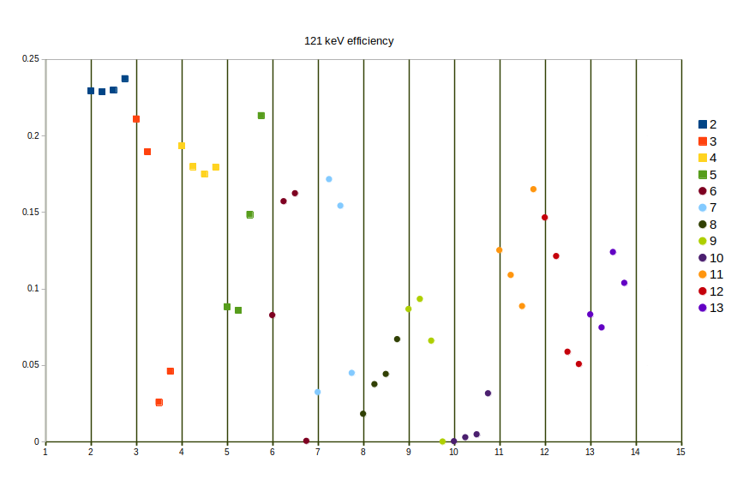
Low energy region
According to Emmanuel , there is a material between detectors and source. He saw an absorption in the low energy region.
The highest efficiency should be around 121 keV
While we can see it is at 244 keV.
Threshold is generally less than 100 keV
Some crystals are more damage than the others

Slide 16
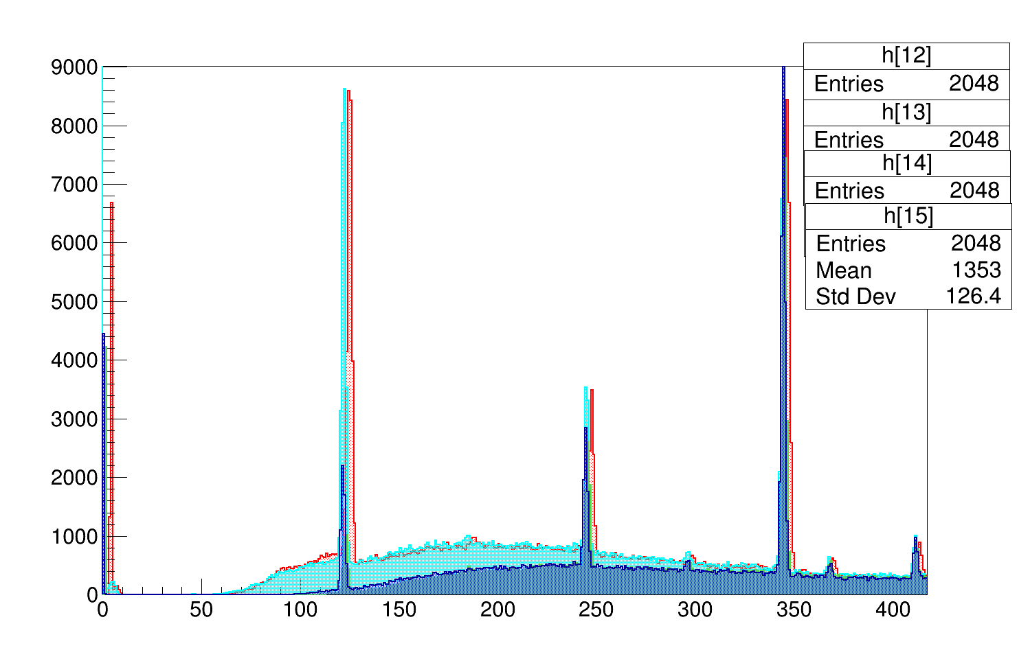
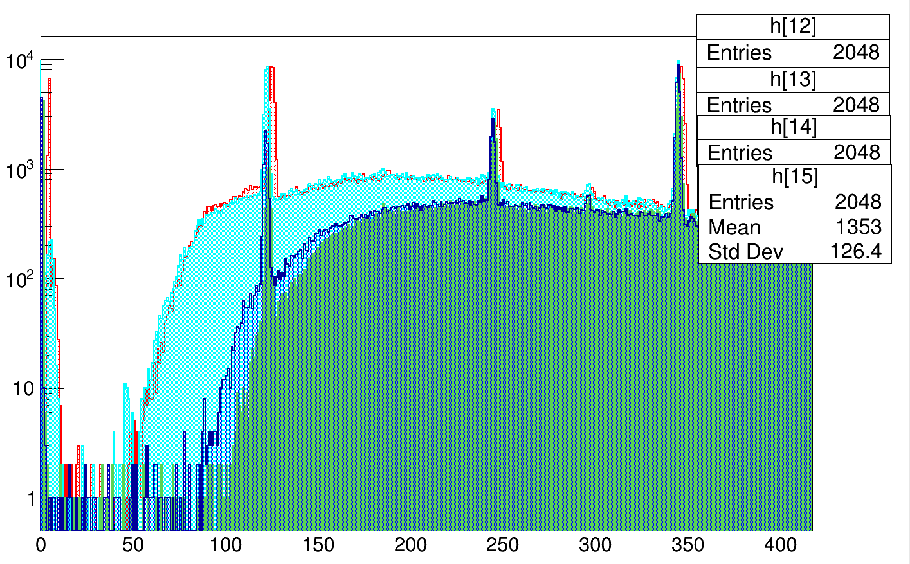
Clover 3 @135 degree
Check the threshold vs absorption

Slide 17
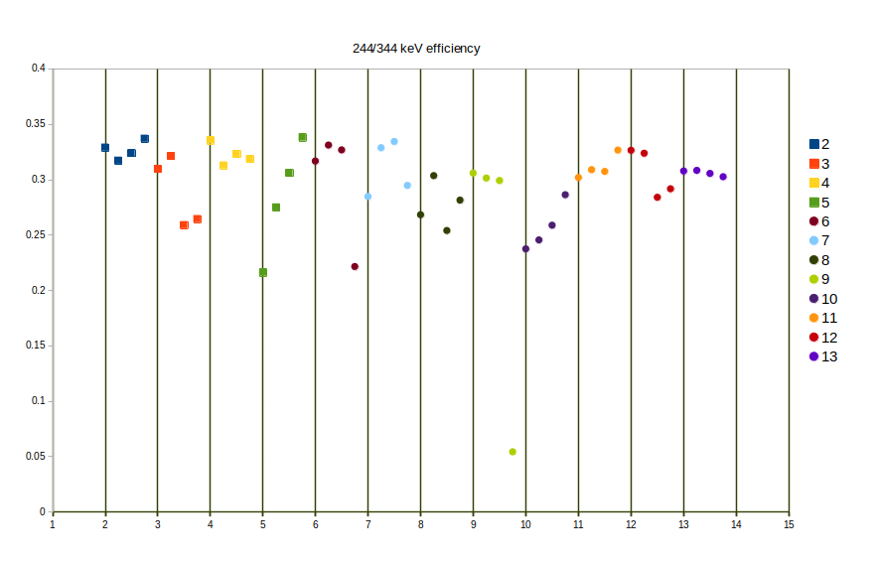
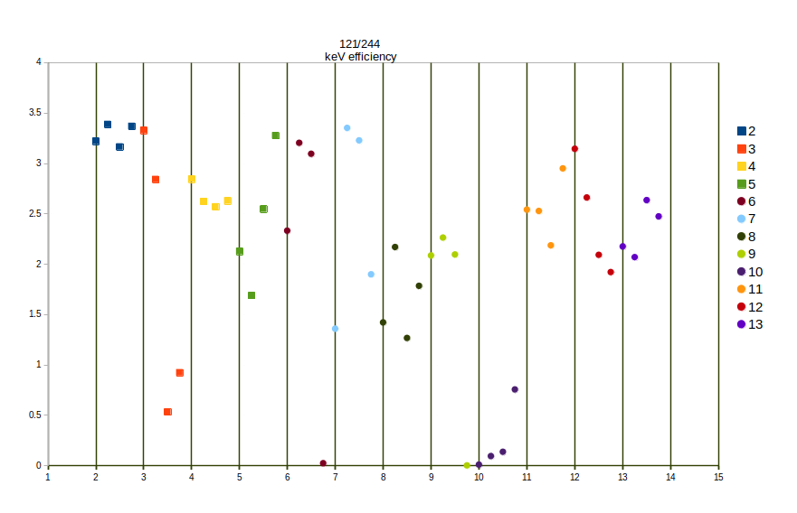
For absorption ratio

Slide 18
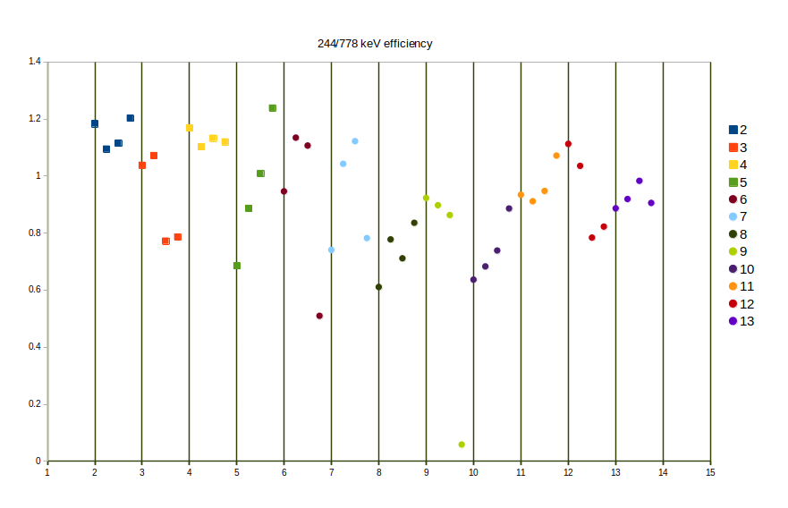
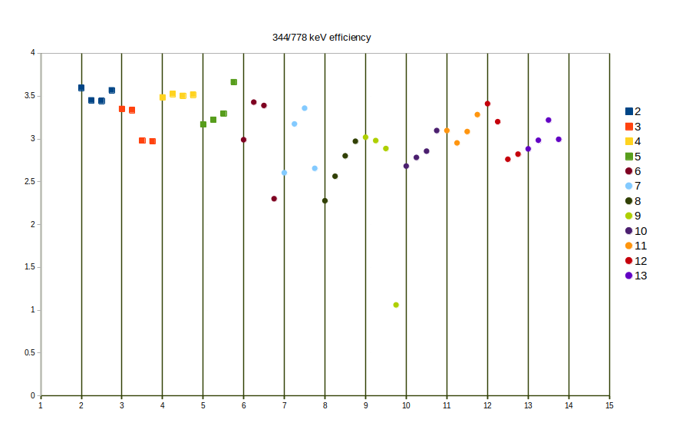

Slide 19
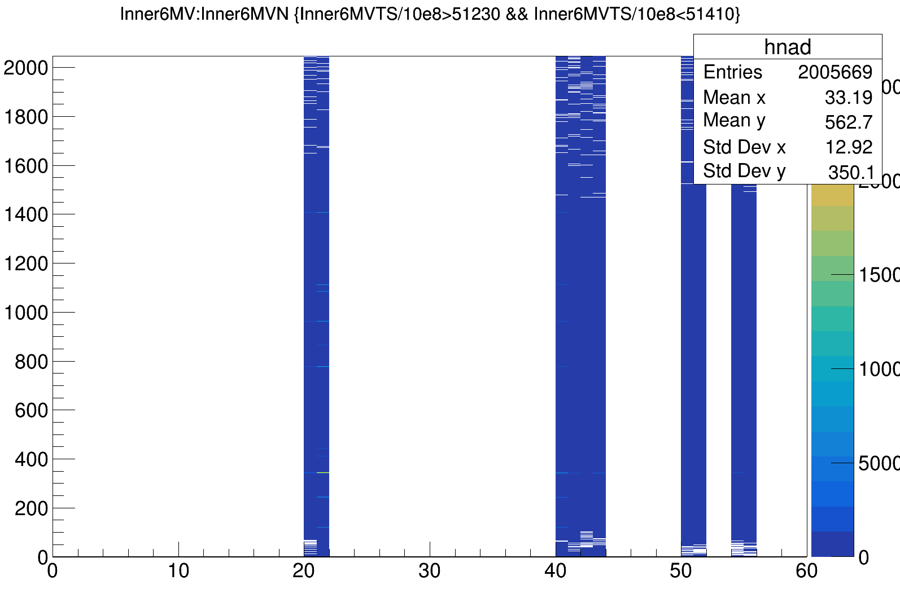
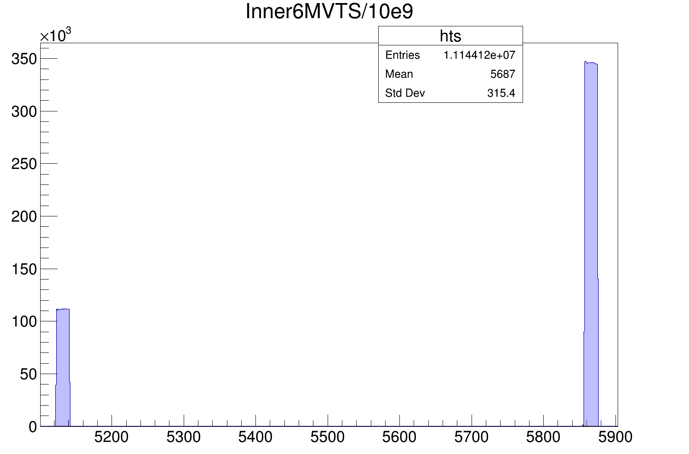
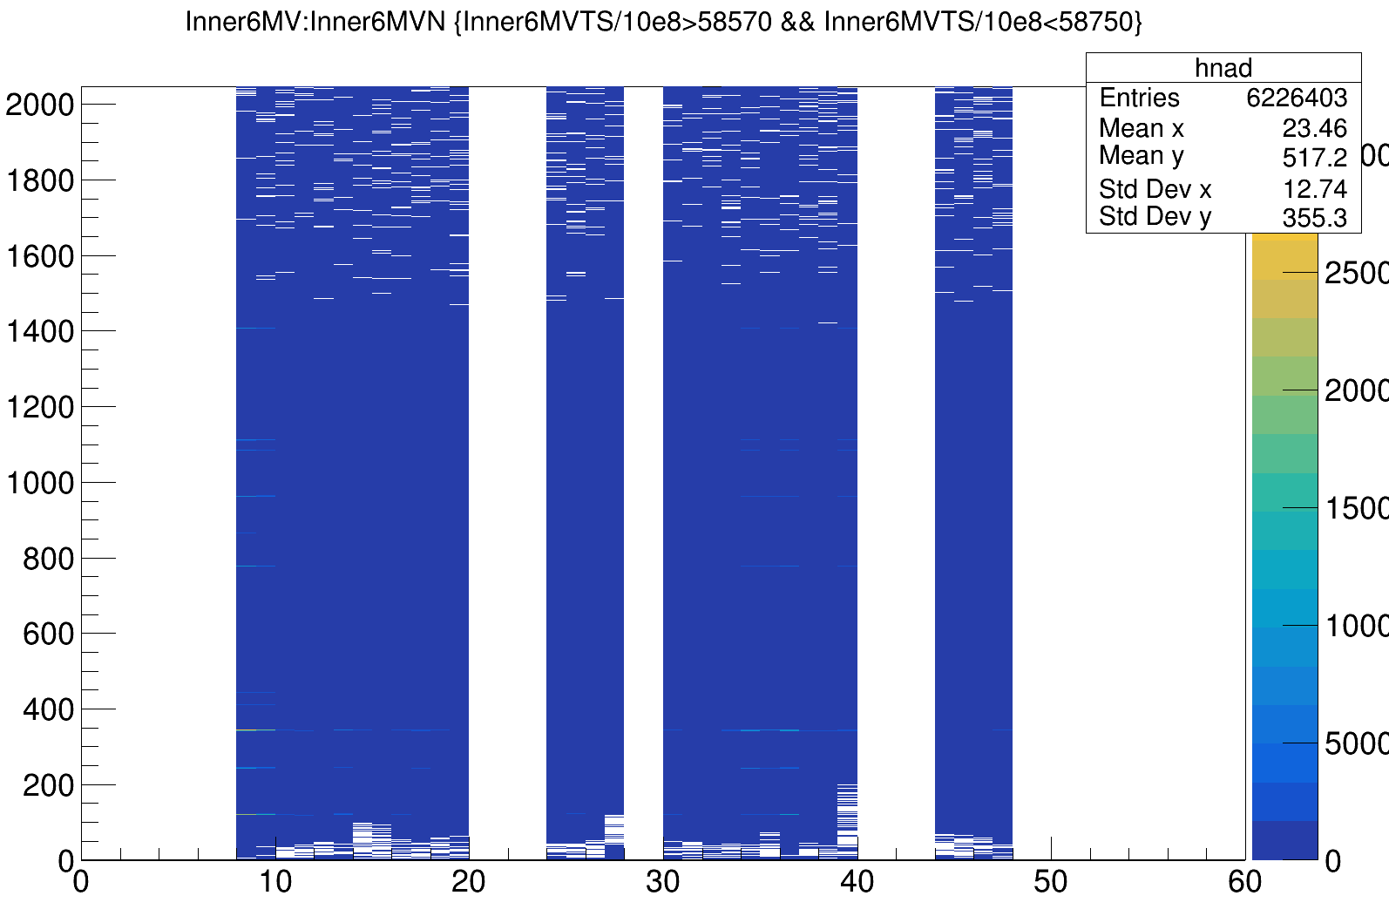
Run425 after e805, Eu source not useful there is no time alignment.
Even 3 clover have 0 ts all the time

Slide 20
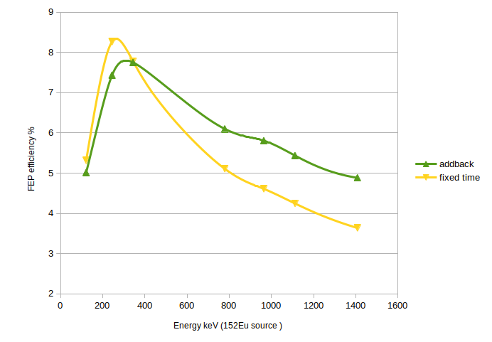

Slide 22
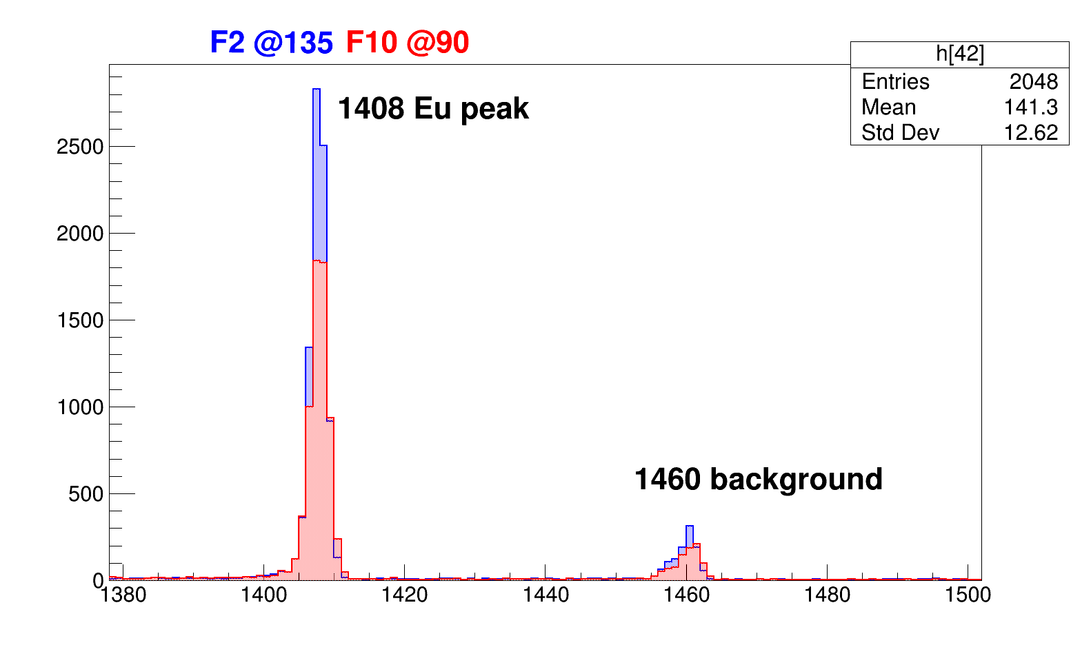
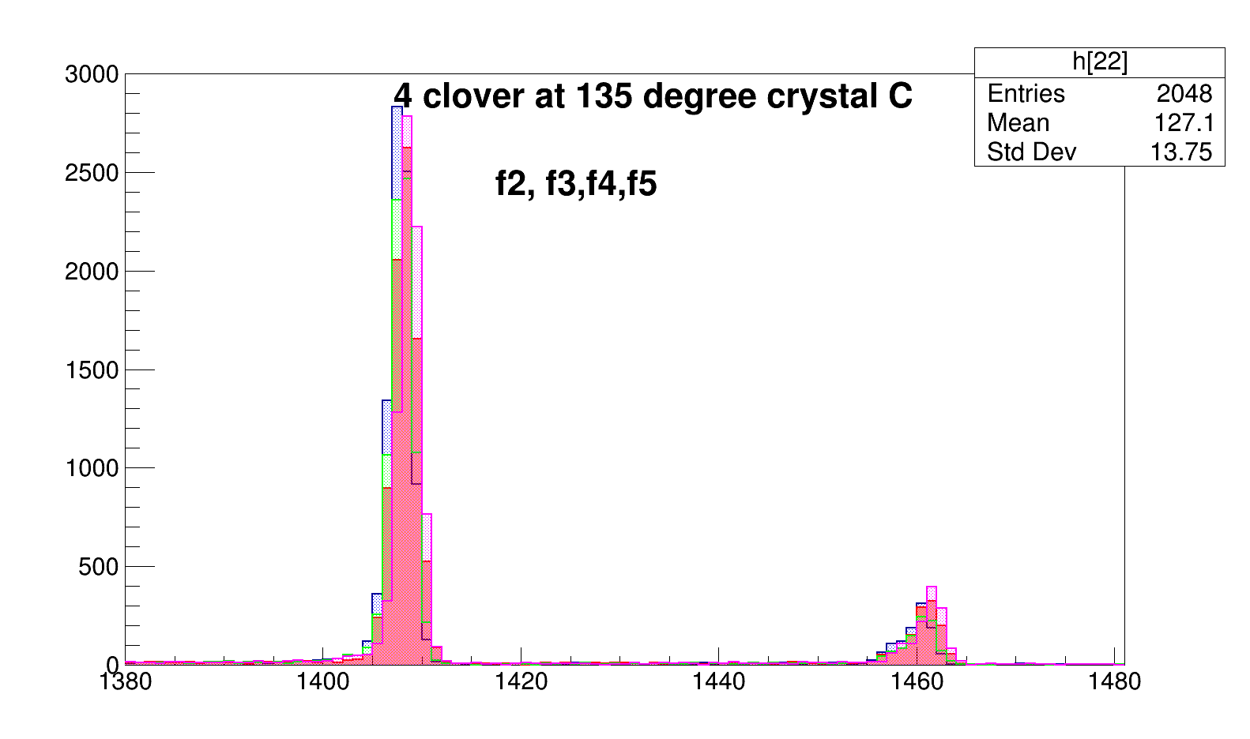
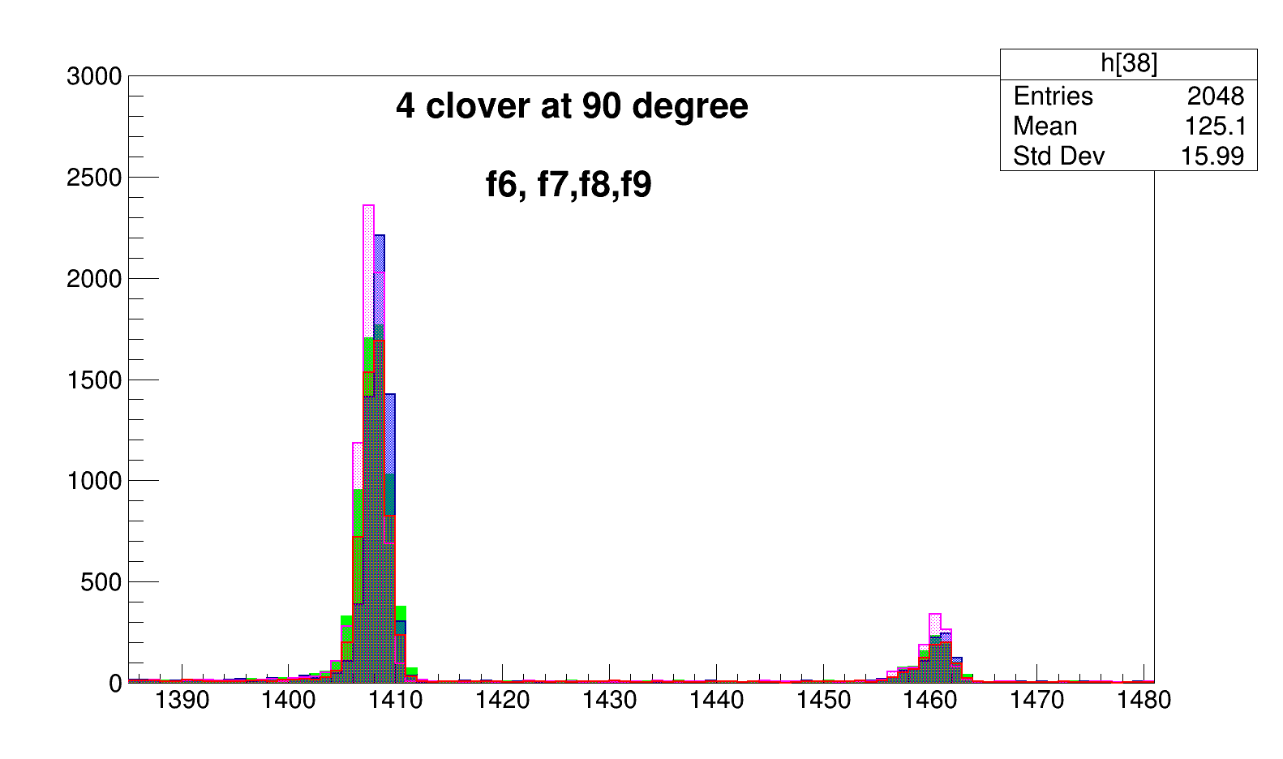
F12
F11
F13
F4
F10
F2
F3
F6
F5
F9
F7
F8

