Slide 1
Week 2
Second part (06 Nov.)
-60Co efficiency run comparison for the source position
-target/source position calculation
Effect of MUST2 trapozeid in low energy region

Slide 2
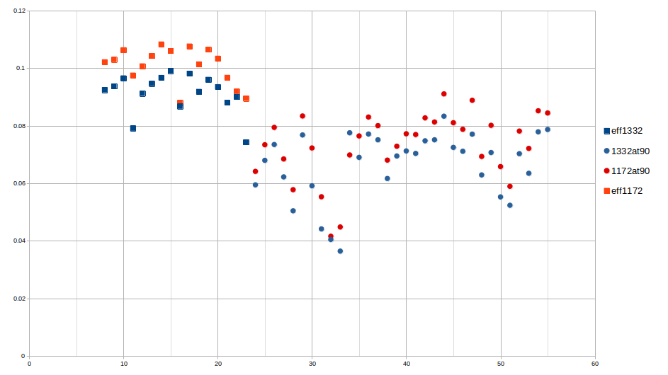
60co results run 568
Same trend as 152Eu source, the efficiency in 90 degree is lower than 135 degree.
Blue points for 1332 keV
Red point for 1172 keV
Square is 135deg
Dot is 90 deg

Slide 3
target distance (d) effect in solid angle
According to my understanding target can change position in Z direction
Exogam 135
Exogam 90
Point source
EXOGAM :
Chaque cristal mesure 6 cm de diamètre à l’arrière (ils sont biseautés à l’avant pour assurer la compacité de l’ensemble et les faces ont un diamètre de 4.5 cm) et 9 cm de long. Le volume utile de détection est donc d’environ 250 cm3.
→
r=2.25 cm
Ω
d
r
Detector

Slide 4
Change in the z direction calculation
Procedure :
Calculate the solid angle efficiency for both angles in different distance shifts
Two different method possible after this point:
  find two crystal in different angles that has the same counts for 1460 keV background peak. So the intrinsic efficiency of these two crystal is comparable
      group : clover7 crystal B (7B)in 90 degree vs clover 5 crystal B (5B)in 135.
      Second group: 8C in 90 vs 2B in 135
  Check the efficiency in 1408 keV or 60Co source
  Correct the 1408 kev efficiency according to solid angle
  Fit the corrected eff of two coupled crystals with pol1
  Using the slope of the pol1 find the zero crossing which will be target distance
  Check the efficiency in 1408 keV or 60Co source for all crystals
  Correct the 1408 kev efficiency according to solid angle
  Fit the corrected eff of crystals with pol1
  Using the slope of the pol1, find the zero crossing which will be target distance

Slide 5
Z cm | 90º | 135 +Z direction | 135º -Z direction
0.25 | 14.00 | 14.18 | 13.82
0.5 | 14.01 | 14.36 | 13.65
0.75 | 14.02 | 14.54 | 13.48
1 | 14.04 | 14.72 | 13.31
1.25 | 14.06 | 14.91 | 13.15
1.5 | 14.08 | 15.10 | 12.98
1.75 | 14.11 | 15.29 | 12.82
2 | 14.14 | 15.48 | 12.66
2.25 | 14.18 | 15.67 | 12.51
2.5 | 14.22 | 15.87 | 12.36
2.75 | 14.27 | 16.06 | 12.21
3 | 14.32 | 16.26 | 12.07
Exogam 135
Exogam 90
14 cm
Target move to
-z direction
Target move to
+z direction

Slide 6
Eff 90degre | 90º | Eff 135 +Z | 135 +Z direction | Eff 135 -Z | 135º -Z direction | Z cm
2.016E-03 | 14.00 | 1.967E-03 | 14.18 | 2.067E-03 | 13.82 | 0.25
2.014E-03 | 14.01 | 1.919E-03 | 14.36 | 2.119E-03 | 13.65 | 0.5
2.011E-03 | 14.02 | 1.872E-03 | 14.54 | 2.172E-03 | 13.48 | 0.75
2.006E-03 | 14.04 | 1.826E-03 | 14.72 | 2.226E-03 | 13.31 | 1
2.001E-03 | 14.06 | 1.782E-03 | 14.91 | 2.281E-03 | 13.15 | 1.25
1.994E-03 | 14.08 | 1.738E-03 | 15.10 | 2.338E-03 | 12.98 | 1.5
1.986E-03 | 14.11 | 1.696E-03 | 15.29 | 2.395E-03 | 12.82 | 1.75
1.977E-03 | 14.14 | 1.655E-03 | 15.48 | 2.454E-03 | 12.66 | 2
1.967E-03 | 14.18 | 1.615E-03 | 15.67 | 2.513E-03 | 12.51 | 2.25
1.955E-03 | 14.22 | 1.577E-03 | 15.87 | 2.574E-03 | 12.36 | 2.5
1.943E-03 | 14.27 | 1.539E-03 | 16.06 | 2.635E-03 | 12.21 | 2.75
1.930E-03 | 14.32 | 1.502E-03 | 16.26 | 2.697E-03 | 12.07 | 3
Since we found that our 135 degree detector has better efficiency than the 90 degree detector,
the source is probably moved in -Z direction so
source is closer to 135 degree detectors with respect to 90 degree ones
Now we will use the pairs that we choose to find the shift in the target position
Pairs: 7B 5B and 8C 2B

Slide 7
Pairs: 7B 5B
and
8C 2B
Clover 5 and 7 is better to compare, since there could be chamber effect in clover 8 which is directly under the target holder

Slide 8
1.49 cm
5B at
135 degree
7B
At 90 deg

Slide 9
2.28 cm

Slide 10
The target is 2.28 cm shifted to the -Z direction
Exogam 135
Exogam 90

Slide 11
If the source has equal distance to each clover, the efficiency curves will be like this.
This is the results of efficiency curves if we move the target 2.28 cm to -Z direction.

Slide 12
All crystals after position correction

Slide 13
MUST2 absorption
Square is at the end of second experiment
Dash is at the end of first experiment

Slide 14
Square with Must2
Star without Must2
For 135 degree detectors
Not clear to say something about absorption effect.

Slide 15
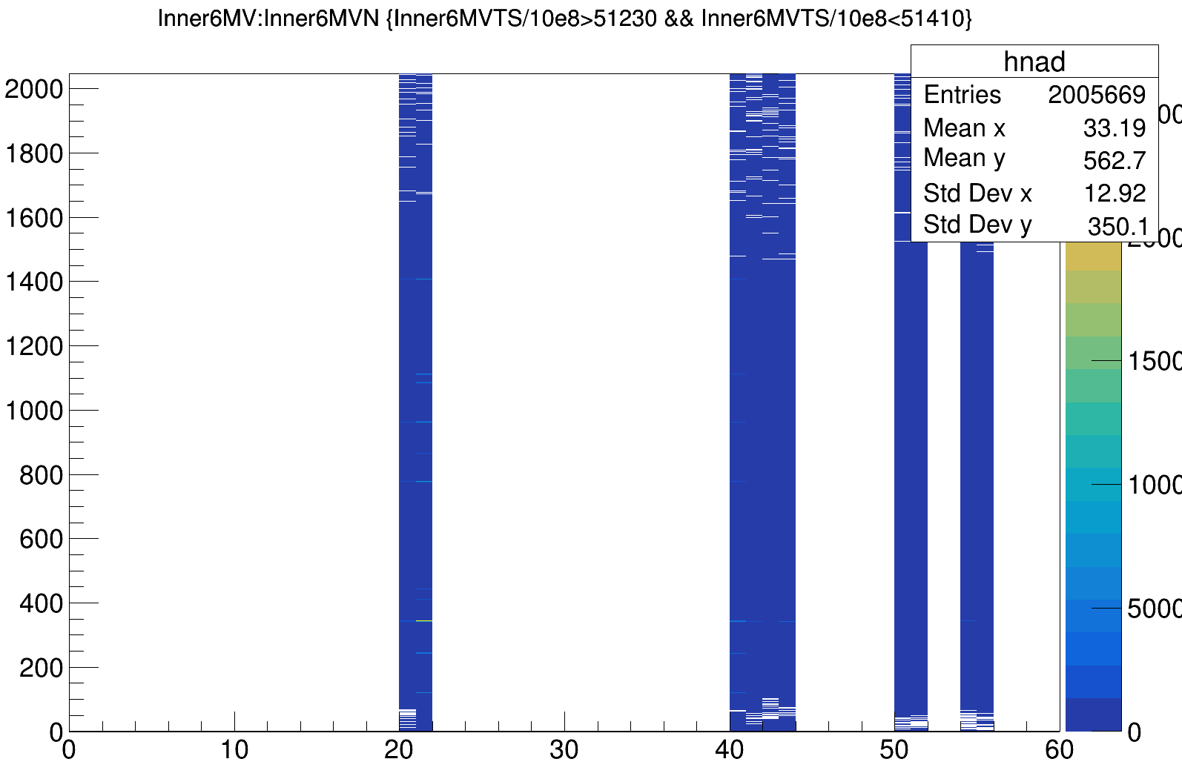
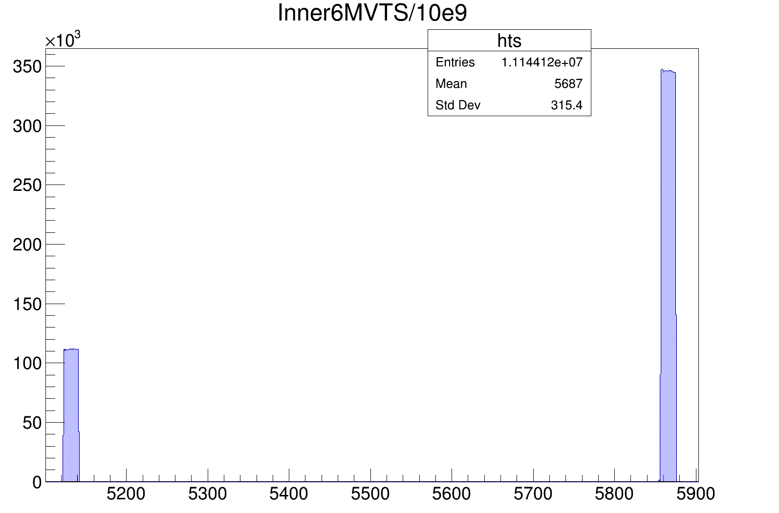
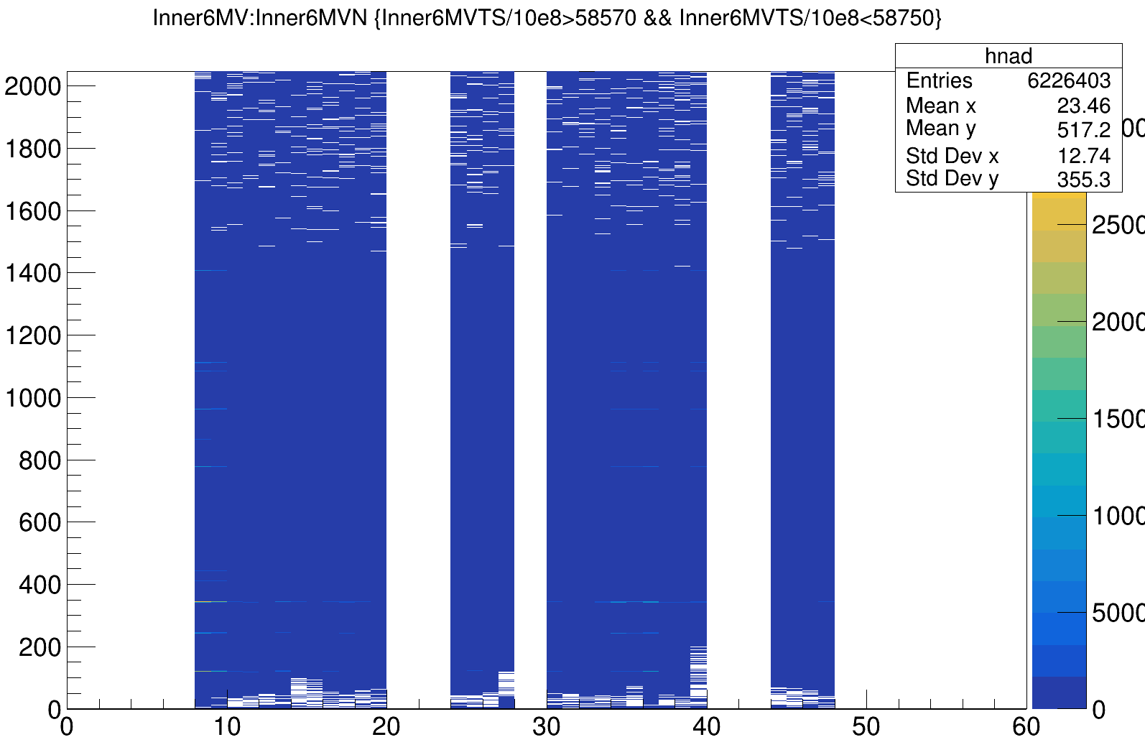
Run425 after e805, Eu source without MUST2 detectors

