Slide 1
F12
F11
F13
F4
F10
F2
F3
F6
F5
F9
F7
F8
Efficiency differences in 90 degree detectors and 135 degree detectors which are side by side (same Phi angle).
The efficiency lost is higher in low energy than high energy. That explains the target holder effect.
Theta Phi Clover
135.000000 -90.000000 !Flange 2
135.000000 90.000000 !Flange 3
135.000000 0.000000 !Flange 4
135.000000 180.000000 !Flange 5
90.000003 90.000000 !Flange 6
90.000003 135.000000 !Flange 7
90.000003 180.000000 !Flange 8
90.000003 -135.000000 !Flange 9
90.000003 -90.000000 !Flange 10
90.000003 -45.000000 !Flange 11
90.000003 0.000000 !Flange 12
90.000003 45.000000 !Flange 13

Slide 2
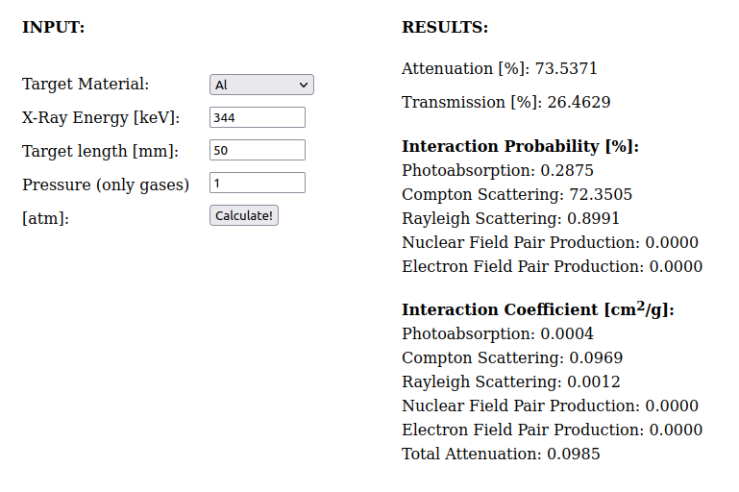
Energy | Al 1cm | 5 cm
121 | 0.65 | 0.12
244 | 0.73 | 0.21
344 | 0.76 | 0.26
778 | 0.82 | 0.39
963 | 0.84 | 0.42
1408 | 0.86 | 0.49

