Slide 1
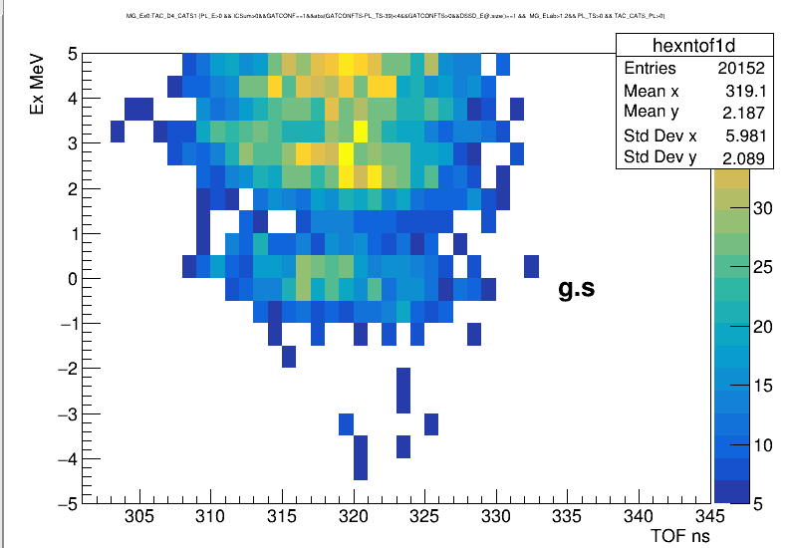

Slide 2
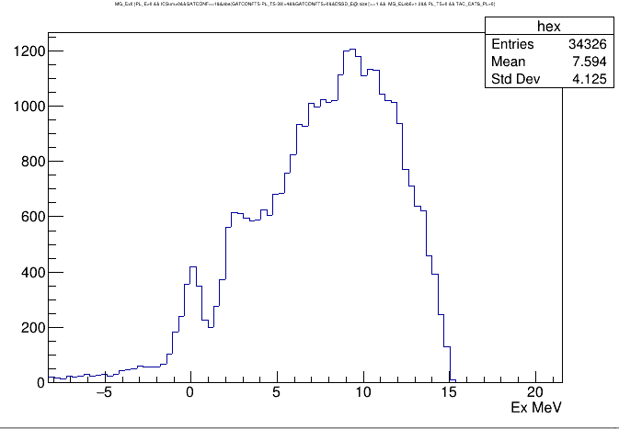
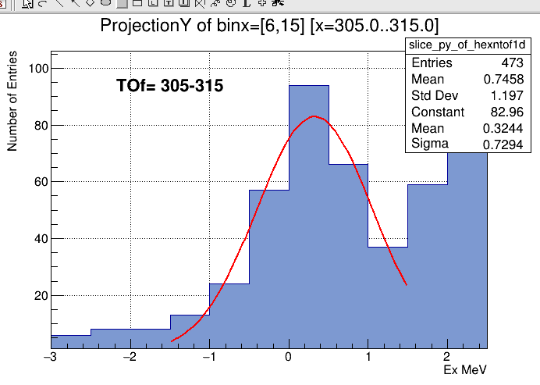
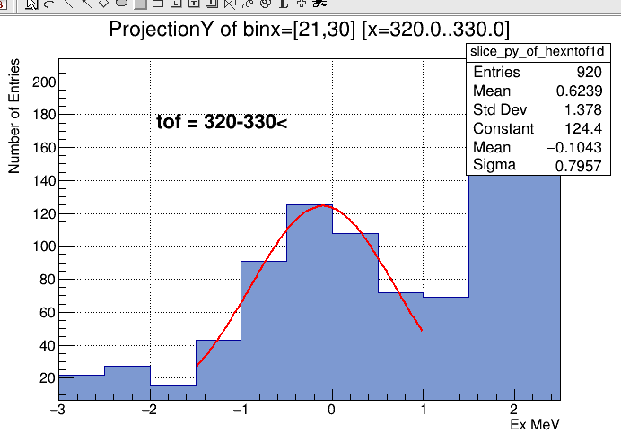
All data
no TOF applied
The mean of the ground state is moving 0.4 MeV from left to right in TOF.
For each 10ns cut sigma is 0.7 MeV

Slide 3
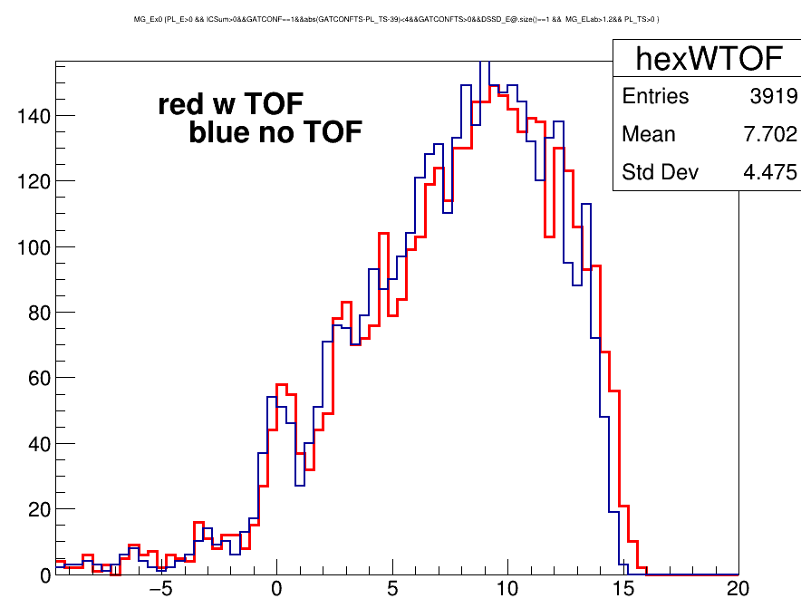
Excitation energy – TOF
TOF = Time D4 to CATS
Sigma 0.8 MeV for gs
No TOF
Sigma 0.98 MeV for gs

